Slide 1
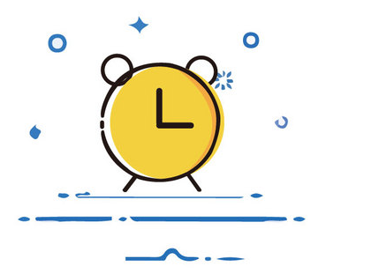

Dates and Time
时间(shí jiān)
Li Xinyu
10月7日

Slide 2
Vocabulary
xiàn zài
现在
now

Slide 3
Vocabulary
shì (r)
事(儿)
matter;affair;
event

Slide 4
Vocabulary
hěn
很
very

Slide 5
Vocabulary
máng
忙
busy

Slide 6
Vocabulary
A:我今天很忙，你呢？
wǒ jīn tiān hěn máng，nǐ ne ？
I am very busy today, How about you?
B:我今天也很忙。
wǒ jīn tiān yě hěn máng 。
I am also very busy today.

Slide 7
Vocabulary
wǎn fàn
晚饭
早饭(zǎo fàn）breakfast
午饭(wǔ fàn) lunch
dinner；supper

Slide 8
Vocabulary
A:你几点吃晚饭？
nǐ jǐ diǎn chī wǎn fàn ？
What time do you have dinner?
B:我六点吃晚饭。
wǒ liù diǎn chī wǎn fàn 。
I have dinner at six

Slide 9
Vocabulary
wèi shén me
为什么
why

Slide 10
Vocabulary
yīn wèi
因为
because

Slide 11
Vocabulary
tóng xué
同学
classmate

Slide 12
Vocabulary
péng you
朋友
friend

Slide 13
Vocabulary
rèn shi
认识
to be acquainted with
to recognize

Slide 14
Affirmative+Negative(A-not-A)Questions
ive
Besides adding the question particle 吗(ma) to a declarative sentence, another common way of forming a question in Chinese is to repeat the verb or adjective in its affirmative and negative form.

Slide 15
Grammar
ive
A:你今天忙不忙？
nǐ jīn tiān máng bu máng ？
Are you busy today?
B:我今天很忙。
wǒ jīn tiān hěn máng.
I am busy today.

Slide 16
Grammar
ive
A:你妈妈喜欢不喜欢吃中国菜？
nǐ mā ma xǐ huan bu xǐ huan chī zhōng guó cài ？
Does your mother like to eat Chinese food or not?
B:我妈妈不喜欢吃中国菜。
wǒ mā ma bù xǐ huan chī zhōng guó cài 。
My mother doesn`t like to eat Chinese food.

Slide 17
Grammar
ive
A:请问，王律师今天有没有事儿？
qǐng wèn，wáng lǜ shī jīn tiān yǒu méi yǒu shìr ？
Excuse me, does Lawyer Wang have anything to do today or not?
B:王律师今天没有事儿。
wáng lǜ shī jīn tiān méi yǒu shìr.
Lawyer Wang is free today.

Slide 18
The adverb 还(hái,also;in addition)
ive
1、白英爱请高文中和王朋，还请李友。
bái yīng ài qǐng gāo wén zhōng hé wáng péng,hái qǐng lǐ yǒu.
Bai Ying`ai is inviting Gao Wenzhong and Wang peng, and Li You,too
2、王朋喜欢吃中国菜，还喜欢吃美国菜。
wáng péng xǐ huān chī zhōng guó cài,hái xǐ huān chī měi guó cài.
Wang Peng likes Chinese food,and American food,too.

Slide 19
还(hái)
ive
也(yě)is usually used for Parallel relationships
还(hái)is mostly used for progressive relationships.

Slide 20
Text
王朋： 白英爱，现在几点？
白英爱：五点三刻。
王朋： 我六点一刻有事儿。
白英爱：你今天很忙，明天忙不忙？
王朋: 我今天很忙，可是明天不忙。
有事儿吗？
白英爱：明天我请你吃晚饭，怎么样？
王朋： 你为什么请我吃饭？
白英爱：因为明天是高文中的生日。
王朋： 是吗？好。还请谁？
白英爱：还请我的同学李友。

Slide 21
Text
王朋 ：那太好了，我认识李友，她也是我的朋友。
明天几点？
白英爱：明天晚上七点半。
王朋 ：好，明天七点半见。

Slide 22
question
ive
1、When is Wang Peng busy?
2、Who else will go to the dinner tomorrow?
3、Does Bai Ying`ai know Li You? How do you know?

Slide 23
ive
Language
Practice

