Slide 1
jiāo tōng
交通
Transportation
LI XIN YU

Slide 2
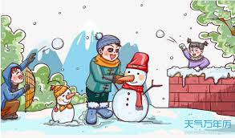
hán jià
寒 假
winter vacation

Slide 3
A：寒假你要做什么？
hán jià nǐ yào zuò shén me ？
What are you going to do during the winter vacation?
B：寒假我要去旅行。
hán jià wǒ yào qù lǚ xíng.
I'm going to travel during the winter vacation.

Slide 4
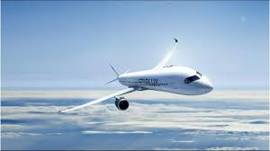
fēi jī
飞 机
airplane

Slide 5
fēi
飞
to fly

Slide 6
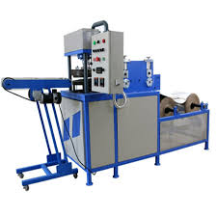
jī
机
machine

Slide 7
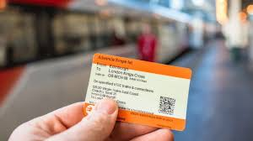
piào
票
ticket

Slide 8
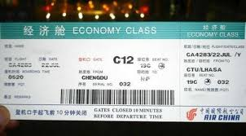
(fēi) jī piào
(飞)机票
air ticket

Slide 9
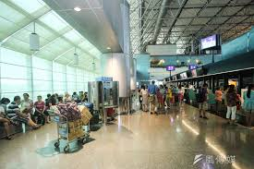
(fēi) jī chǎng
(飞)机场
airport

Slide 10
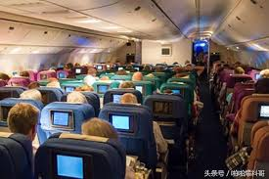
zuò
坐
to travel by

Slide 11
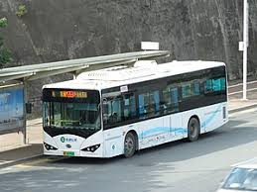
gōng gòng qì chē
公共汽车
bus

Slide 12
gōng gòng
公 共
public

Slide 13
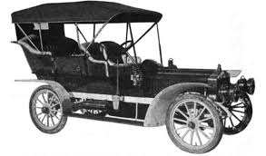
qì chē
汽 车
automobile

Slide 14
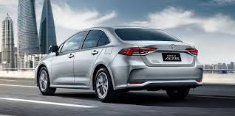
chē
车
vehicle;car

Slide 15
huò zhě
或 者
or

Slide 16
2
或者(huò zhě,or)and 还是(hái shì,or)
While both 或者(huò zhě,or)and 还是(hái shì,or)link up two words or phrases that
indicate different alternatives, the former usually appears in statements, the latter in questions
1.A:你今天晚上做什么？
nǐ jīn tiān wǎn shang zuò shén me ？
What are you going to do tonight?
B:听音乐或者看电影。
tīng yīn yuè huò zhě kàn diàn yǐng.
Listen to music or watch a movie.

Slide 17
2
或者(huò zhě,or)and 还是(hái shì,or)
While both 或者(huò zhě,or)and 还是(hái shì,or)link up two words or phrases that
indicate different alternatives, the former usually appears in statements, the latter in questions
2.A:你周末想看电影还是跳舞？
nǐ zhōu mò xiǎng kàn diàn yǐng hái shi tiào wǔ ？
Would you like to see a movie or go dancing this weekend?
B:看电影或者跳舞都行。
kàn diàn yǐng huò zhě tiào wǔ dōu xíng .
Either seeing a movie or going dancing would be fine with me.

Slide 18
2
或者(huò zhě,or)and 还是(hái shì,or)
While both 或者(huò zhě,or)and 还是(hái shì,or)link up two words or phrases that
indicate different alternatives, the former usually appears in statements, the latter in questions
3.A:你喜欢什么颜色的鞋？黑色的还是咖啡色的？
nǐ xǐ huan shén me yán sè de xié ？hēi sè de hái shi kā fēi sè de ？
What color shoes do you like? Black or brown ones?
B:黑色的或者咖啡色的我都不喜欢，我喜欢白的。
hēi sè de huò zhě kā fēi sè de wǒ dōu bù xǐ huan,wǒ xǐ huan bái de.
I don`t like either black or brown; I like white ones.

Slide 19
2
或者(huò zhě,or)and 还是(hái shì,or)
While both 或者(huò zhě,or)and 还是(hái shì,or)link up two words or phrases that
indicate different alternatives, the former usually appears in statements, the latter in questions
4.明天你去开会或者他去开会都可以。
míng tiān nǐ qù kāi huì huò zhě tā qù kāi huì dōu kě yǐ .
Either you or he may attend tomorrow`s meeting.

Slide 20
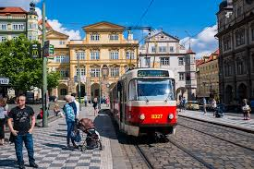
diàn chē
电 车
tram

Slide 21
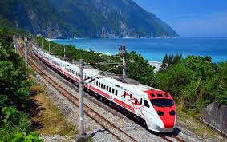
huǒ chē
火 车
train

Slide 22
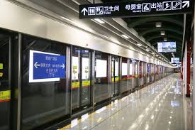
dì tiě
地 铁
subway

Slide 23
zǒu
走
to go by way of; to walk

Slide 24
xiān
先
first

Slide 25
3
先...再...(xiān ...zài ...,first...,then...)
Sometimes 再(zài)indicates a sequence of actions rather than a repetition.先看电影再吃饭(xiān kàn diàn yǐng zài chī fàn,first go to the movie,then eat) means 先看电影以后吃饭(xiān kàn diàn yǐng yǐ hòu chī fàn,eat after seeing the movie).
1.A:你什么时候给妈妈打电话？
nǐ shén me shí hou gěi mā ma dǎ diàn huà ？
When are you going to call Mom ?
B:下课以后再打。
xià kè yǐ hòu zài dǎ.
I`ll call after class.

Slide 26
3
先...再...(xiān ...zài ...,first...,then...)
Sometimes 再(zài)indicates a sequence of actions rather than a repetition.先看电影再吃饭(xiān kàn diàn yǐng zài chī fàn,first go to the movie,then eat) means 先看电影以后吃饭(xiān kàn diàn yǐng yǐ hòu chī fàn,eat after seeing the movie).
2.我想先打球再去图书馆。
wǒ xiǎng xiān dǎ qiú zài qù tú shū guǎn.
I`d like to play ball and then go to the library.

Slide 27
3
先...再...(xiān ...zài ...,first...,then...)
Sometimes 再(zài)indicates a sequence of actions rather than a repetition.先看电影再吃饭(xiān kàn diàn yǐng zài chī fàn,first go to the movie,then eat) means 先看电影以后吃饭(xiān kàn diàn yǐng yǐ hòu chī fàn,eat after seeing the movie).
3.弟弟常常先做功课再上网聊天儿。
dì di cháng cháng xiān zuò gōng kè zài shàng wǎng liáo tiānr.
My little brother often does his homework first and then chats online.

Slide 28
3
先...再...(xiān ...zài ...,first...,then...)
As adverbs,先(xiān)and 再(zài) must come immediately before a verb.They cannot be placed in front of the subject.
4.小王先买东西再吃晚饭。
xiǎo wáng xiān mǎi dōng xi zài chī wǎn fàn.
Little Wang will shop first before having dinner.
4a 先小王买东西再吃晚饭。(X)
xiān xiǎo wáng mǎi dōng xi zài chī wǎn fàn.

Slide 29
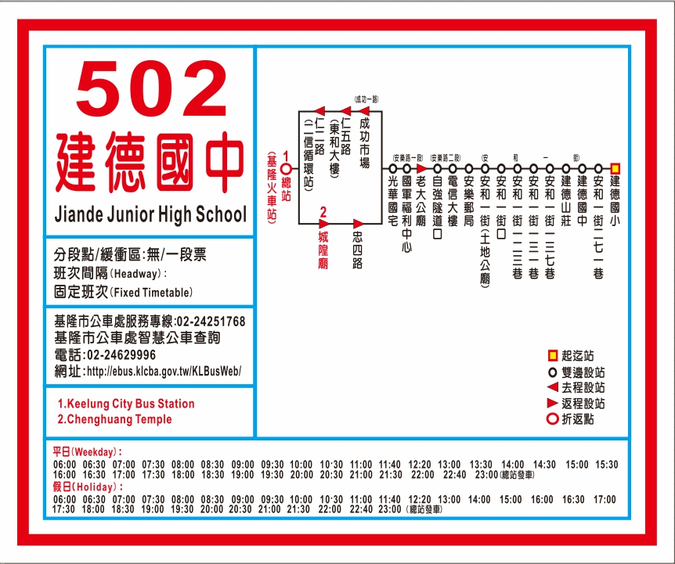
zhàn
站
measure word for stops of bus,train,ect

Slide 30
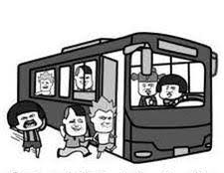
shàng chē
上 车
to get on(a bus,train,ect）

Slide 31
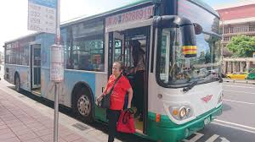
xià chē
下 车
to get off(a bus,train,ect）

Slide 32
rán hòu
然 后
then

Slide 33
lǜ
绿
green

Slide 34
lán
蓝
blue

Slide 35
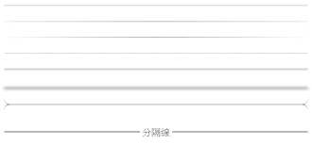
xiàn
线
line

Slide 36
zuì hòu
最 后
final；last

Slide 37
má fan
麻 烦
troublesome

Slide 38
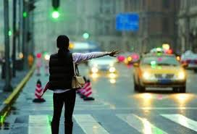
dǎ chē
打 车
to take a taxi

Slide 39
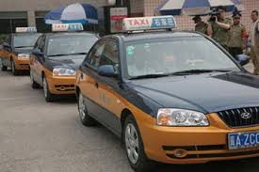
chū zū qì chē
出租汽车
taxi

Slide 40
Taxicabs are called 计程车(jì chéng chē, metered cars) in Taiwan but 出租(汽)车(chū zū[qì]chē) in mainland China. To take a taxi is 打车(dǎ chē)

Slide 41
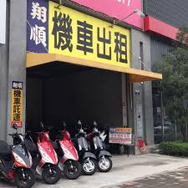
chū zū
出 租
to rent out; to let

Slide 42
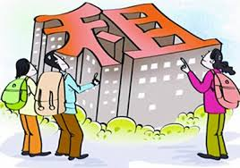
zū
租
to rent

Slide 43
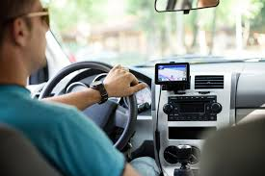
kāi chē
开 车
to drive a car

Slide 44
kāi
开
to drive; to operate

Slide 45
sòng
送
to see off or out; to take(someone somewhere)

Slide 46
1
Topic-Comment Sentences
When a noun or noun phrase has become established as a known element in a conversation, it can occur at the beginning of the sentence as the “topic,” with the rest of the sentence functioning as a “comment” on it. This forms what is known as a “topic-comment sentence.” In such a sentence the object of the verb can be brought forward to serve as the topic of the sentence.
1.A:我昨天买了一枝笔。
wǒ zuó tiān mǎi le yì zhī bǐ.
I bought a pen yesterday.
B:那枝笔你用了吗？
nà zhī bǐ nǐ yòng le ma ？
Have you used that pen?

Slide 47
1
Topic-Comment Sentences
2.A:你知道我的衬衫在哪儿吗？
nǐ zhī dao wǒ de chèn shān zài nǎr ma ？.
Do you know where my shirt is?
B:你的衬衫我给你妈妈了。
nǐ de chèn shān wǒ gěi nǐ mā ma le.
I gave your shirt to your mother.

Slide 48
1
Topic-Comment Sentences
3.A:你有朋友吗？
nǐ yǒu péng you ma ？
Do you have friends ?
B:朋友我有很多，可是都不在这儿。
péng you wǒ yǒu hěn duō ，kě shì dōu bú zài zhèr.
I have many friends, but none of them are here.

Slide 49
1
Topic-Comment Sentences
4.她不想去纽约，可是飞机票她妈妈已经帮她买了。
tā bù xiǎng qù niǔ yuē ，kě shì fēi jī piào tā mā ma yǐ jīng
bāng tā mǎi le.
She does not want to go to New York, but her mother has
already bought the airplane ticket for her.

Slide 50
4
还是...(吧）(hái shì ...ba,had better)
The structure 还是...(吧）(hái shì ...[ba],had better) can be used to signify making a selection after considering two or more options. Sometimes in making such a decision one is forced to give up one`s preference.
1.A:你说，明天看电影还是看球？
nǐ shuō, míng tiān kàn diàn yǐng hái shi kàn qiú ？
What do you think we should watch tomorrow, a movie or a ball game?
B:还是看电影吧。
hái shi kàn diàn yǐng ba .
Let`s see a movie.

Slide 51
4
还是...(吧）(hái shì ...ba,had better)
The structure 还是...(吧）(hái shì ...[ba],had better) can be used to signify making a selection after considering two or more options. Sometimes in making such a decision one is forced to give up one`s preference.
2.A:我的车有问题。怎么办？
wǒ de chē yǒu wèn tí. zěn me bàn ？
There is a problem with my car. What shall we do ?
B:那别去听音乐会了。我们还是在家看电视吧。
nà bié qù tīng yīn yuè huì le. wǒ men hái shi zài jiā kàn diàn shì ba.
Let`s not go to the concert then. We`d better stay home and watch TV.

Slide 52
A:你怎么回家？
nǐ zěn me huí jiā ？
How do you go home?
B:我坐公共汽车回家。
wǒ zuò gōng gòng qì chē huí jiā.
I go home by bus.

Slide 53
1.怎么去(zěn me qù)asks the means of transportation and 怎么走(zěn me zǒu)asks the detailed route or directions
2.Taxicabs are called 计程车(jì chéng chē, metered cars) in Taiwan but 出租(汽)车(chū zū[qì]chē) in mainland China. To take a taxi is 打车(dǎ chē)

Slide 54
A:你怎么去学校？
nǐ zěn me qù xué xiào ？
How do you get to school?
B:我坐电车去学校。
wǒ zuò diàn chē qù xué xiào.
I go to school by tram.

Slide 55
question
1.What was Li You going to do for the winter vacation?
2.Why did Li You abandon her first two choices?
3.How did Li You finally go to the airport?

Slide 56
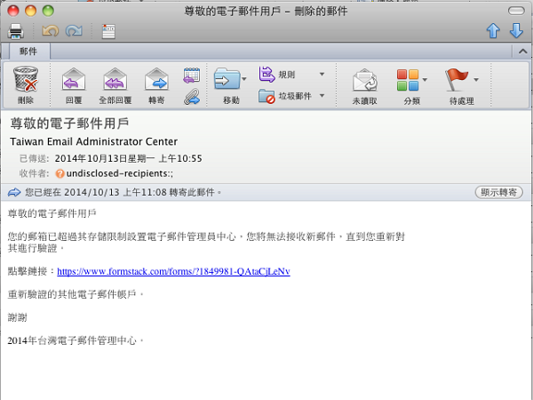
diàn zǐ yóu jiàn
电子邮件
email

Slide 57
The Chinese word for email, 电子邮件(diàn zǐ yóu jiàn), literally means electronic mail. It is sometimes abbreviated as 电邮(diàn yóu).

Slide 58
diàn zǐ
电 子
electron

Slide 59
ràng
让
to allow or cause(somebody to do something)

Slide 60
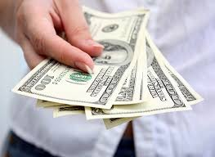
huā
花
to spend

Slide 61
bù hǎo yì sī
不好意思
to feel embarrassed

Slide 62
měi
每
every;each

Slide 63
5
每...都...(měi...dōu...,every)
In a sentence that contains the term 每(měi,every), usually 都(dōu,all)has to be inserted further along in the sentence, immediately in front of the verb.
1.他每天晚上都预习课文。
tā měi tiān wǎn shang dōu yù xí kè wén.
He studies the lessons in advance every night.
2.我每节课都来。
wǒ měi jié kè dōu lái.
I come to every class.

Slide 64
5
每...都...(měi...dōu...,every)
In a sentence that contains the term 每(měi,every), usually 都(dōu,all)has to be inserted further along in the sentence, immediately in front of the verb.
3.这儿每个人我都认识。
zhèr měi ge rén wǒ dōu rèn shi.
I know everyone here.
4.常老师的字每个都好看。
cháng lǎo shī de zì měi ge dōu hǎo kàn.
Every one of Teacher Chang`s characters looks nice.

Slide 65
chéng shì
城 市
city

Slide 66
A：你最喜欢哪座城市？
nǐ zuì xǐ huan nǎ zuò chéng shì ？
Which city is your favorite？
B：我最喜欢_________。
wǒ zuì xǐ huan_________.
My favorite city is________.

Slide 67
tè bié
特 别
especially

Slide 68
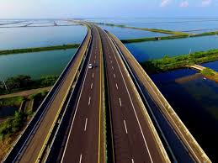
gāo sù gōng lù
高速公路
highway

Slide 69
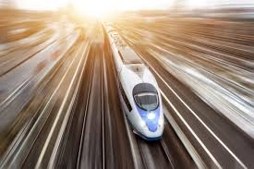
gāo sù
高 速
high speed

Slide 70
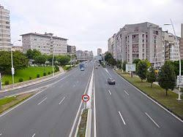
gōng lù
公 路
highway;public road

Slide 71
lù
路
road;path

Slide 72
jǐn zhāng
紧 张
nervous,anxious

Slide 73
zì jǐ
自 己
oneself

Slide 74
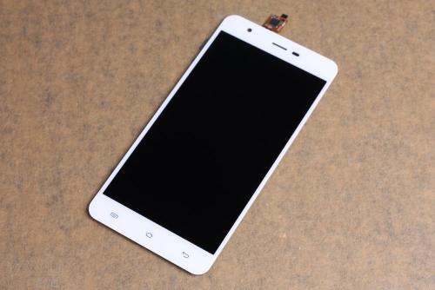
shǒu jī
手 机
cell phone

Slide 75
fā duǎn xìn
发短信
to send a text message;(lit.)to send a short message

Slide 76
xīn nián
新 年
new year

Slide 77
A:你们新年会做什么?
nǐ men xīn nián huì zuò shén me ?
What will you do in the new year?
B:我们新年会吃饭、放烟花，还会逛街。
wǒ men xīn nián huì chī fàn 、fàng yān huā ，hái huì guàng jiē.
We will eat dinner, set off some fireworks and go
shopping in the New Year.

Slide 78
kuài lè
快 乐
happy

Slide 79
bēi shāng
悲 伤
sad

Slide 80
6
要...了(yào...le,soon)
The 要...了(yào...le)structure indicates the imminence of an anticipated action or situation. It also appears in the form of 快要...了(kuài yào...le).
1.新年快要到了，我们给爸爸妈妈写一封信吧。
xīn nián kuài yào dào le, wǒ men gěi bà ba mā ma xiě yì fēng xìn ba .
New Year is around the corner. Let`s write to Mom and Dad.
2.寒假要到了，你要做什么?
hán jià yào dào le ，nǐ yào zuò shén me ?
It`ll be winter break soon. What do you want to do ?

Slide 81
6
要...了(yào...le,soon)
The 要...了(yào...le)structure indicates the imminence of an anticipated action or situation. It also appears in the form of 快要...了(kuài yào...le).
3.电影快要开始了，你买票了吗?
diàn yǐng kuài yào kāi shǐ le, nǐ mǎi piào le ma ?
New Year is around the corner. Let`s write to Mom and Dad.
4.快要考试了，我们大家得准备一下。
kuài yào kǎo shì le, wǒ men dà jiā děi zhǔn bèi yí xià.
The exam is coming. We have to study for it.

Slide 82
question
1.How do you express New Year`s greetings in Chinese?
2.Why did Li You thank Wang Peng?
3.What did Li You do for the past few days?

