Slide 1




Visiting Friends
看朋友
kàn péng you
LI XIN YU

Slide 2

ya
呀
interjectory particle used to soften a question

Slide 3
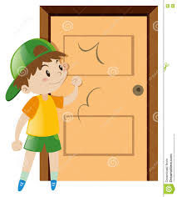
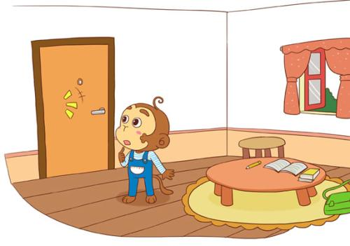
If someone knocks or you hear the doorbell, you can ask "谁呀"（shéi ya? Who is it?)
谁呀？

Slide 4
jìn
进
to enter

Slide 5
lái
qù
来
去
to come
to go

Slide 6
jìn lái
chū qù
进来
出去
to come in
to go out

Slide 7
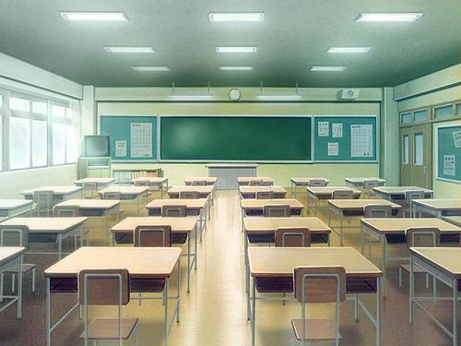

老师走进来。(lǎo shī zǒu jìn lái)
The teacher came in.

Slide 8
老师走出去。(lǎo shī zǒu chū qù )
The teacher went out..

Slide 9
kuài
màn
快
慢
fast,quick;quickly
slow

Slide 10


兔子跑的快。
tù zǐ pǎo de kuài
Rabbit runs fast
乌龟跑的慢。
wū guī pǎo de màn
Tortle runs slowly

Slide 11
jiè shào
介绍
to introduce

Slide 12
yí xià
一下
once；a bit

Slide 13
diǎn(r)
点(儿)
a little, a bit; some

Slide 14
一下(yí xià) and(一)点儿(yì diǎnr) Moderating the Tone of Voice
Following a verb, both 一下(yí xià) and (一)点儿(yì diǎnr) can soften the tone in a question or an imperative sentence, therefore making it more polite. When used in this way, 一下(yí xià) modifies the verb, while (一)点儿(yì diǎnr) modifies the object.

Slide 15
A:你看一下，这是谁的照片？
nǐ kàn yí xià,zhè shì shéi de zhào piàn?
Take a look. Whose photo is this?
B:这是高文中的照片。
zhè shì gāo wén zhōng de zhào piàn 。
This is a photo of Gao Wenzhong.

Slide 16

A:你想吃点儿什么？
nǐ xiǎng chī diǎnr shén me ？
What would you like to eat?
B:我想吃饼干。
wǒ xiǎng chī bǐng gān.
I want to eat cookies.

Slide 17
你进来一下。
nǐ jìn lai yí xià.
Come in for a minute.

Slide 18
你喝一点儿茶吧。
nǐ hē yì diǎnr chá ba.
Have a little tea.

Slide 19


gāo xìng
高兴
happy，pleased
我今天很高兴。
wǒ jīn tiān hěn gāo xìng
I am very happy today.

Slide 20

piào liang
漂亮
pretty
布拉格很漂亮。
bù lā gé hěn piào liang.
Prague is very beautiful.

Slide 21
很(hěn,very)
In Chinese, when an adjective functions as a predicate, it is not preceded by the verb 是(shì,to be). It is usually modified by 很(hěn,very), as seen in (1),(2),(3), and (4),

Slide 22
1、我今天很高兴。
wǒ jīn tiān hěn gāo xìng.
I`m (very) happy today.
2、他妹妹很漂亮。
tā mèi mei hěn piāo liàng.
His younger sister is (very) pretty.

Slide 23
3、那个电影很好。
nà ge diàn yǐng hěn hǎo.
That movie is good.
4、你们大学很大。
nǐ men dà xué hěn dà
Your university is very large.

Slide 24
很(hěn,very)
some other adverbial modifier. However, 很(hěn,very) is not as strong as "very" in English. When forming a question with an adjective as the predicate, 很(hěn,very) is not used, as seen in (5) and (6).

Slide 25
A:你弟弟高吗？
nǐ dì di gāo ma ？
Is your younger brother tall?
B:他很高。
tā hěn gāo.
He is tall.

Slide 26
A:你家大吗？
nǐ jiā dà ma ？
Is your house big?
B:我家不大，很小。
wǒ jiā bú dà,hěn xiǎo.
My house is not big, it`s small.

Slide 27
很(hěn,very)
Chinese adjective without 很(hěn,very) or any sort of modifier before them can often imply comparison or contrast, as seen in (7) and (8) below

Slide 28
A:姐姐漂亮还是妹妹漂亮？
jiě jie piāo liang hái shi mèi mei piào liang ？
Who`s prettier, the older sister or the younger sister?
B:妹妹漂亮。
mèi mei piào liang
The younger sister is prettier.

Slide 29
妹妹的中文好，我的中文不好。
mèi mei de zhōng wén hǎo,wǒ de zhōng wén bù hǎo.
My younger sister`s Chinese is good. My Chinese is not good.

Slide 30
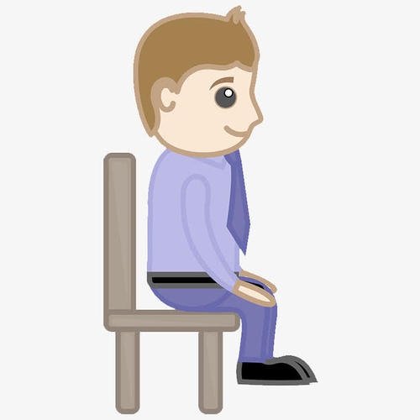
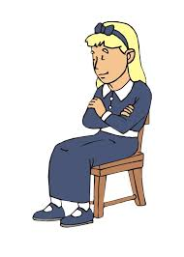
zuò
坐
to sit

Slide 31
zài
在
他坐在椅子上。
(tā zuò zài yǐ zǐ shang)
He is sitting in a chair.
at;in;on

Slide 32
在(zài ,at;in;on)
Combined with a noun, the preposition 在(zài) indicates location. When the phrase is placed before a verb, it indicates the location of the action.

Slide 33
A:我的书在哪儿？
wǒ de shū zài nǎr？
Where is my book?
B:在那儿。
zài nàr.
It`s over there.

Slide 34
A:你在哪儿工作？
nǐ zài nǎr gōng zuò ？
Where do you work?
B:我在这儿工作。
wǒ zài zhèr gōng zuò
I work here.

Slide 35
3、我在这个大学学中文。
wǒ zài zhè ge dà xué xué zhōng wén.
I study Chinese at this university.
4、我不喜欢在家看电影。
wǒ bù xǐ huan zài jiā kàn diàn yǐng.
I don`t like to watch movies at home.

Slide 36
nǎr
哪儿
where
你想去哪儿？
nǐ xiǎng qù nǎr ？
where do you want to go？

Slide 37
哪儿(nǎr,where)
哪儿(nǎr) is a question word meaning "where." Do not confuse it with 那儿(nàr，there). 这儿(zhèr) means" here " in Chinese

Slide 38
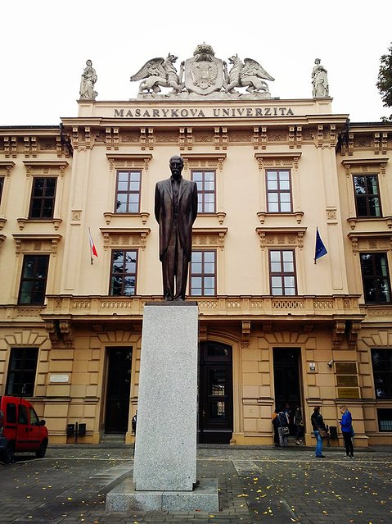
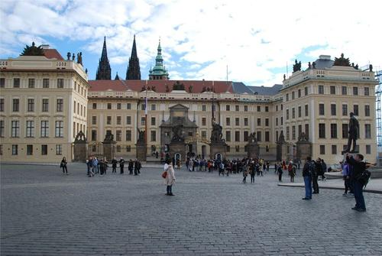
xué xiào
学校
school

Slide 39
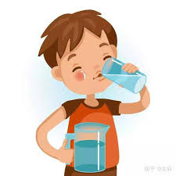
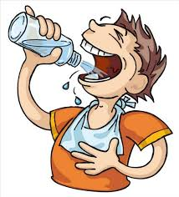
hē
喝
to drink
hē shuǐ
喝 水(Drink water)

Slide 40
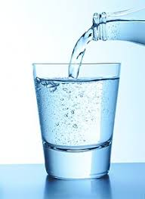


shuǐ
水
water

Slide 41
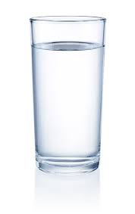
bēi
杯
(measure word for cup and glass)
一杯水
A cup of water
yì bēi shuǐ

Slide 42
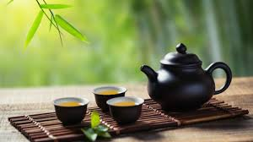
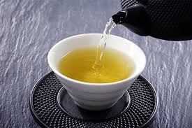
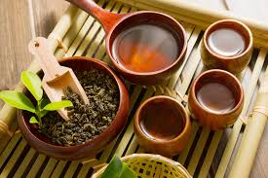
chá
茶
tea

Slide 43



kā fēi
咖啡
coffee

Slide 44
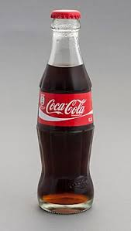
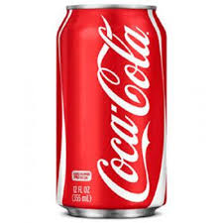
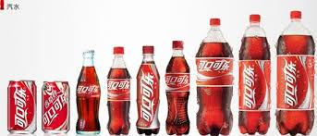
kě lè
可乐
(Coke or Pepsi) cola

Slide 45
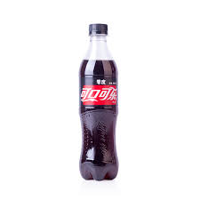
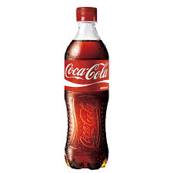
píng
瓶
(measure word for bottle);bottle
一瓶可乐
yì píng kě lè
a bottle of Cola.

Slide 46
水(shuǐ;water)
可乐(kě lè;cola)
咖啡(kā fēi;coffee)
A:你想喝点儿什么？
nǐ xiǎng hē diǎnr shén me ？
What would you like to drink?
B:我想喝茶。
wǒ xiǎng hē chá.
I would like tea.

Slide 47
吧(ba)
吧(ba) is a sentence-final "suggestion" particle, often used at the end of an imperative sentence to soften the tone.

Slide 48
1、你喝咖啡吧。
nǐ hē kā fēi ba.
Why don`t you have some coffee?
2、请进来吧。
Come in, please.
3、我们跳舞吧。
Let`s dance.

Slide 49
yào
要
to want
我要一瓶可乐。
wǒ yào yì píng kě lè.
I want a bottle of Cola.

Slide 50
gěi
给
to give
请给我一杯水，谢谢。
qǐng gěi wǒ yì bēi shuǐ,xiè xie.
please give me a cup of water,thank you.

Slide 51
kě yǐ
可以
can;may
我可以迟交作业吗？
wǒ kě yǐ chí jiāo zuò yè ma ？
Can I hand in my homework late？

Slide 52


duì bu qǐ
对不起
sorry

Slide 53
Text
高文中： 谁呀？
王朋： 是我，王朋，还有李友。
高文中： 请进，请进，快进来！来，我介绍一下，这是我姐姐，高小音。
王朋/李友:小音，你好。认识你很高兴。
高小音： 认识你们我也很高兴。
王朋： 你们家很大，也很漂亮。
高小音： 是吗？请坐，请坐。
王朋： 小音，你在哪儿工作？
高小音： 我在学校工作。你们想喝点儿什么？喝茶还是喝咖啡？
王朋： 我喝茶吧。
李友： 我要一瓶可乐，可以吗？
高小音： 对不起，我们家没有可乐。
李友： 那给我一杯水吧。

Slide 54

Question
1、Why did Li You ask for a glass of water?
2、What did Wang Peng want to drink?
3、How is Gao Wenzhong`s house?

Slide 55

language
practice

