Slide 1
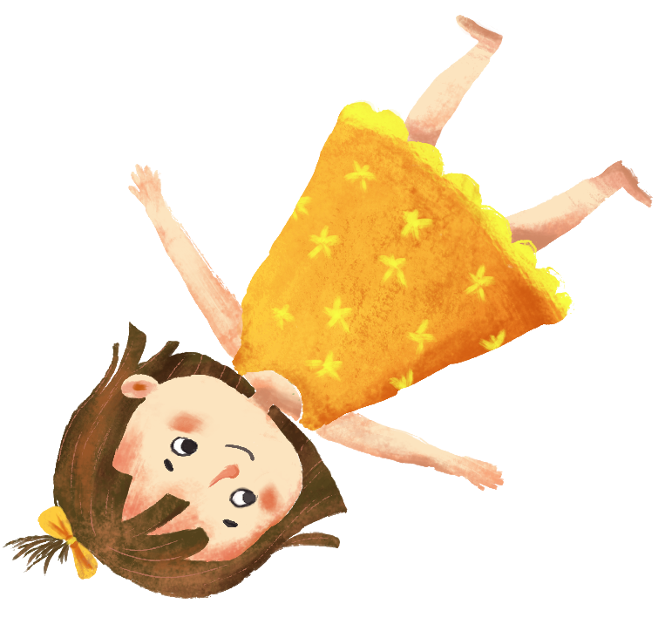
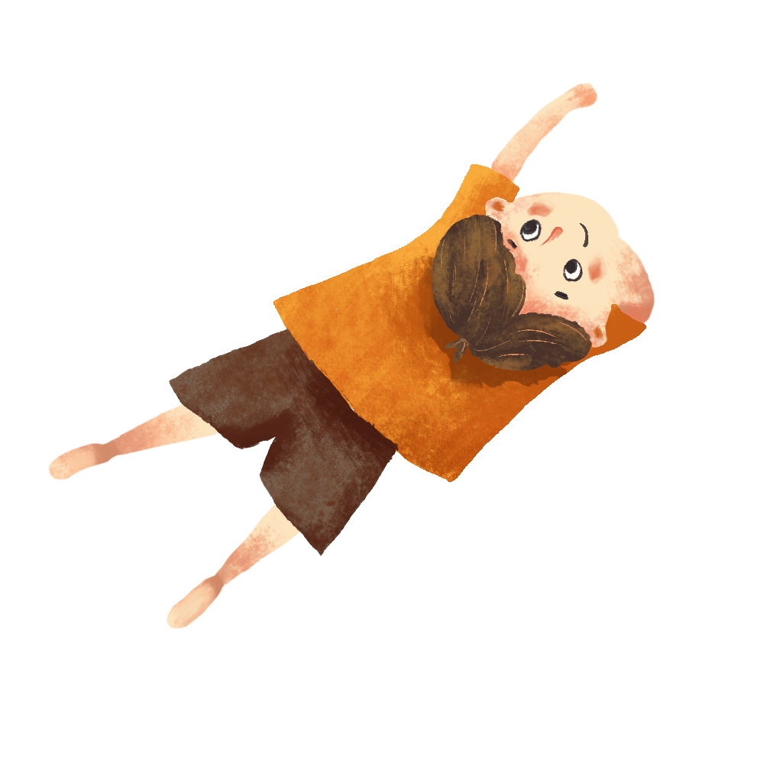
Visiting Friends
看朋友
kàn péng you
LI XIN YU

Slide 2
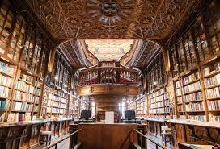
tú shū guǎn
图书馆
library

Slide 3
yì qǐ
一起
together

Slide 4
liáo tiān(r)
聊天(儿）
to chat
他们一起聊天儿、看电视。
tā men yì qǐ liáo tiānr、kàn diàn shì.
They chatted and watched TV together.

Slide 5
liáo
聊
to chat

Slide 6
tiān
天
sky

Slide 7
wán(r)
玩(儿)
to have fun; to play
小王喜欢玩儿泥巴，小李不喜欢。
xiǎo wáng xǐ huan wánr ní ba ，xiǎo lǐ bù xǐ huan 。
Little Wang likes to play with mud, Little Li doesn't like it.

Slide 8
huí
回
to return

Slide 9
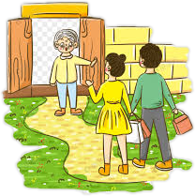
huí jiā
回家
to go home
他们晚上十二点才回家。
tā men wǎn shang shí èr diǎn cái huí jiā.
They did not get home until twelve o`clock.

Slide 10
才(cái ,not until)
The adverb 才(cái ,not until) indicates that the occurrence of an action or situation is later than the speaker may have expected. That lateness is perceived by the speaker, and is not necessarily objective, as seen in (2) and (3). 才(cái) never takes the particle了(le).

Slide 11
1、我请他六点吃晚饭，他六点半才来。
wǒ qǐng tā liù diǎn chī wǎn fàn,tā liù diǎn bàn cái lái.
I invited him out to dinner at six o`clock. He didn`t come till six-thirty.

Slide 12
2、小高常常晚上十二点才回家。
xiǎo gāo cháng cháng wǎn shang shí èr diǎn cái huí jiā.
Little Gao often doesn`t go home until midnight.
3、她晚上很晚才睡觉。
tā wǎn shang hěn wǎn cái shuì jiào 。
She goes to bed very late in the evening.

Slide 13
The particle了(le)
The dynamic particle 了(le) signifies:1) the occurrence or completion of an action or event, or 2) the emergence of a situation. The action, event, or situation usually pertains to the past, but sometimes it can refer to the future. Therefore 了(le)is not a past tense marker, and the use of 了(le) should not be taken as an equivalent to the past tense in English. In this lesson, 了(le) indicates the occurrence or completion of an action or event. It is usually used after a verb. But sometimes it appears after a verb and the object of the verb in interrogative and declarative sentence.

Slide 14
1、今天妈妈喝了三杯水。
jīn tiān mā ma hē le sān bēi shuǐ 。
Mom had three glasses of water today.
(occurrence or completion of an action, in the past)
2、星期一小高请我喝了一瓶可乐。
xīng qī yī xiǎo gāo qǐng wǒ hē le yì píng kě lè 。
On Monday Little Gao bought me a bottle of cola.
(occurrence or completion of an event, in the past)

Slide 15
A：昨天晚上你去打球了吗？
zuó tiān wǎn shang nǐ qù dǎ qiú le ma ？
Yesterday evening did you go play ball?
(occurrence or completion of an event, in the past,
an interrogative sentence)
B：昨天晚上我去打球了。
zuó tiān wǎn shang wǒ qù dǎ qiú le.
Yesterday evening I went to play ball.
(occurrence or completion of an event, in the past)

Slide 16
The particle了(le)
There is often a specific time phrase in a sentence with the dynamic particle 了(le)-----such as 今天(jīn tiān,today) in, 星期一(xīng qī yī,Monday) in (2), or 昨天晚上(zuó tiān wǎn shang,last night) in (3)
When 了(le) is used between the verb and the object, the object is usually preceded by a modifier. The following-------numeral+measure word----is the most common type of modifier for the object:
三杯(sān bēi;three cups/three glasses) in (1)
一瓶(yì píng; one bottle) in (2)

Slide 17
4、明天我吃了晚饭去看电影。
jīn tiān mā ma hē le sān bēi shuǐ 。
Tomorrow I`ll go see a movie after I have eaten dinner.
(occurrence or completion of an action in the first part
of the sentence, in the future)

Slide 18
The particle了(le)
If there are other phrases or sentence following the object of the first clause, then the object does not need a modifier, See example(4) above. This V 了 O+V(O) structure can be used to depict a sequence of two actions, and it doesn`t matter whether the two actions take place in the past or in the future.
明天我吃(V)了晚饭(O)去看(V)电影(O)。
jīn tiān mā ma hē le sān bēi shuǐ 。
Tomorrow I`ll go see a movie after I have eaten dinner.

Slide 19
5、我昨天看了《哈利·波特》，那个电影很好。
wǒ zuó tiān kàn le《hā lì ·bō tè》nà ge diàn yǐng hěn hǎo.
I saw Harry Potter yesterday. That movie was good.
If the object following 了(le) is a proper noun, as "Harry
Potter" in (5) below, it does not need a modifier, either.

Slide 20
To say that an action did not take place in the past, use 没(有)(méi yǒu) instead of 不...了(bù...le) or 没有...了(méi yǒu...le)
6、昨天我没有听音乐。
zuó tiān wǒ méi yǒu tīng yīn yuè 。
I didn`t` listen to music yesterday.
昨天我不听音乐了。(X)
zuó tiān wǒ bù tīng yīn yuè le 。
昨天我没有听音乐了。(X)
zuó tiān wǒ méi yǒu tīng yīn yuè le 。

Slide 21
A:你吃饭了吗？
nǐ chī fàn le ma ？
Did you eat?
B:我没吃。
wǒ méi chī.
No, I didn`t.
A:你吃饭了没有？
nǐ chī fàn le méi yǒu？
Did you eat?
B:我没吃。
wǒ méi chī.
No, I didn`t.

Slide 22
A:你喝了几杯水？
nǐ hē le jǐ bēi shuǐ ？
How many glasses of water did you drink?
B:我喝了一杯水。
wǒ hē le yì bēi shuǐ.
I drank one glass of water.

Slide 23
Text
昨天晚上，王朋和李友去高文中家玩儿。在高文中家，他们认识了高文中的姐姐。她叫高小音，在学校的图书馆工作。她请王朋喝茶，王朋喝了两杯。李友不喝茶，只喝了一杯水。他们一起聊天儿、看电视。王朋和李友晚上十二点才回家。

Slide 24
Question
1、What did Wang Peng and Li You do at Wenzhong`s house?
2、Where does Gao Wenzhong`s older sister work?
3、When did Wang Peng and Li You go home?

Slide 25
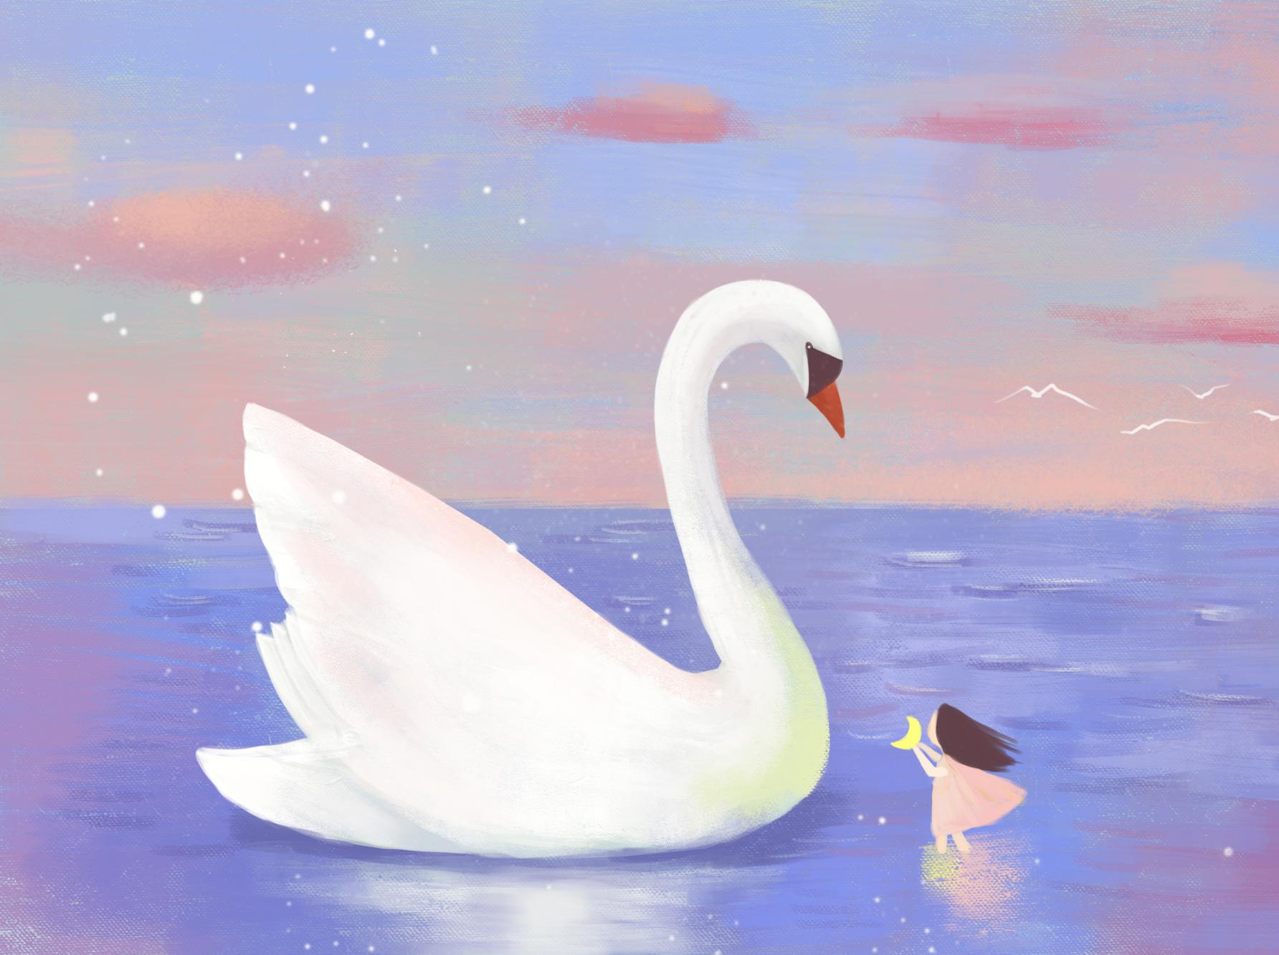
language
practice

