Slide 1

Lesson8
practice

Slide 2

Read the following schedule for Little Wang and answer the questions.(True/False)
8:00 复习第七课生词、语法
9:00 上电脑课
10:00 去常老师的办公室练习发音
14:30 去图书馆看书
16:00 去打球
18:00 去宿舍餐厅吃晚饭
20:15 给小李打电话，跟他一起练习中文
22:30 给爸爸妈妈打电话
24:00 睡觉

Slide 3
Read the following schedule for Little Wang and answer the questions.(True/False)
1、小王今天只有一节课。 （）
2、小王跟小白一起吃午饭。 （）
3、小王上午去找常老师。 （）
4、小王去小李家练习中文 （）
5、小王吃晚饭以前去打球 （）
6、小王去图书馆以后去找常老师 （）
7、小王睡觉以前给爸爸妈妈打电话。（）
8、小王跟小李练习中文以后才吃饭。（）

Slide 4
Read the passage and answer the question.(True/False)
小高以前常常跟朋友一起打球，聊天，看电视，不做功课。可是因为他下星期要考试，所以这个星期他不打球，不看电视，也不找朋友聊天，一个人到图书馆去看书。他很早就起床，很晚才睡觉，所以他上课的时候常常想睡觉。
question
1、小高以前常常跟朋友一边做功课，一边聊天。 （）
2、小高常常跟朋友一起到图书馆去看书。 （）
3、小高觉得上课没有意思，所以他上课的时候常常想睡觉。 （）

Slide 5
Fill in the blanks with the appropriate measure words. Each measure word can only be used once.
1、一____老师
2、一____照片
3、一____电脑
4、一____笔
5、一____咖啡
6、一____可乐
7、一____课
8、一____日记
9、一____信
10、我家有三____人

Slide 6
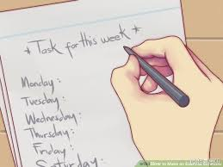

Bai Ying ai is such a capable person. She has many skills, and there is only one thing she is not able to handle.List some of the things that she can do and the only thing she cannot do based on the information given.
Example:
她会写英文

Slide 7
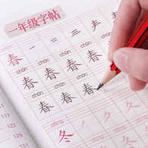
Bai Ying ai is such a capable person. She has many skills, and there is only one thing she is not able to handle.List some of the things that she can do and the only thing she cannot do based on the information given.
1、
______________

Slide 8
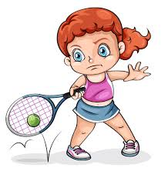
Bai Ying ai is such a capable person. She has many skills, and there is only one thing she is not able to handle.List some of the things that she can do and the only thing she cannot do based on the information given.
2、
______________

Slide 9

Bai Ying ai is such a capable person. She has many skills, and there is only one thing she is not able to handle.List some of the things that she can do and the only thing she cannot do based on the information given.
3、
______________

Slide 10


Bai Ying ai is such a capable person. She has many skills, and there is only one thing she is not able to handle.List some of the things that she can do and the only thing she cannot do based on the information given.
4、
______________

Slide 11

According to our parents and teachers, there are some things that we are not supposed to do at home or in class. Can you think of some of those things with the help of the visuals?
EXAMPLE :老师告诉我，考试的时候，
老师告诉我，考试的时候，不能问问题。
__________

Slide 12
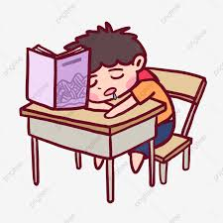
According to our parents and teachers, there are some things that we are not supposed to do at home or in class. Can you think of some of those things with the help of the visuals?
1、老师告诉我，上课的时候，
________________________________________

Slide 13
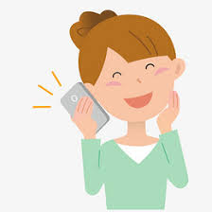
According to our parents and teachers, there are some things that we are not supposed to do at home or in class. Can you think of some of those things with the help of the visuals?
2、老师告诉我，上课的时候，
________________________________________

Slide 14

According to our parents and teachers, there are some things that we are not supposed to do at home or in class. Can you think of some of those things with the help of the visuals?
3、妈妈告诉我，做功课的时候，
________________________________________

Slide 15
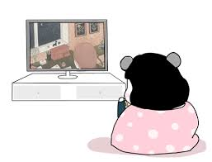
According to our parents and teachers, there are some things that we are not supposed to do at home or in class. Can you think of some of those things with the help of the visuals?
4、妈妈告诉我，吃饭的时候，
________________________________________

