Slide 1

yuē shí jiān
约时间
Making Appointments
LI XIN YU

Slide 2
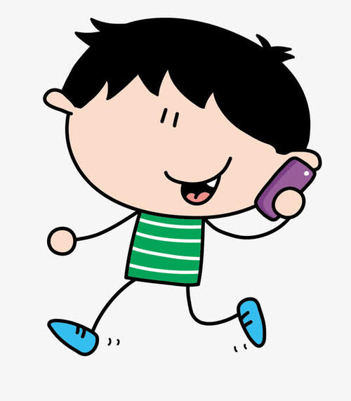
Vocabulary
dǎ diàn huà
打电话
1
to make a phone call

Slide 3

Vocabulary
diàn huà
1
电 话
telephone

Slide 4
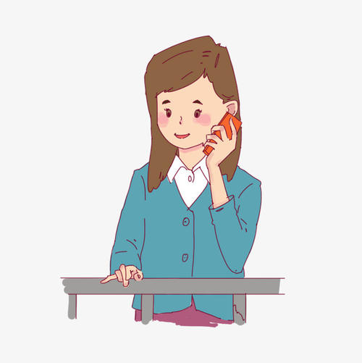
Vocabulary
喂
wéi/wèi
1
喂
(on telephone)Hello!; Hey!

Slide 5
Vocabulary
gěi
1
给
to;for

Slide 6
The Preposition 给（gěi ）
给(gěi) can be a verb or a preposition. In Chinese, prepositions are generally combined with nouns or pronouns to form prepositional phrases, which appear before verbs as adverbials.
1
1.他给我打了一个电话。
tā gěi wǒ dǎ le yí ge diàn huà.
He gave me a call.

Slide 7
The Preposition 给（gěi ）
给(gěi) can be a verb or a preposition. In Chinese, prepositions are generally combined with nouns or pronouns to form prepositional phrases, which appear before verbs as adverbials.
2.他是谁？请你给我们介绍一下。
tā shì shéi ？qǐng nǐ gěi wǒ men jiè shào yí xià.
Who is he? Please introduce us.
3.你有你姐姐的照片吗？给我看一下，行吗？
nǐ yǒu nǐ jiě jie de zhào piàn ma ？gěi wǒ kàn yí xià ，xíng ma ？
Do you have a picture of your older sisiter? Can you let me have a look?
1

Slide 8
Vocabulary
zài
1
在
to be present; to be at (a place)

Slide 9
Vocabulary
jiù
1
就
precisely;exactly

Slide 10
A：喂，请问，常老师在吗？
wéi,qǐng wèn,cháng lǎo shī zài ma ？
Hello, is Teacher Chang there?
B：我就是。您是哪位？
wǒ jiù shì.nín shì nǎ wèi?
This is she. Who is this ,please?
1

Slide 11
Vocabulary
nín
1
您
you(honorific 你)

Slide 12
The personal pronoun 您(nín) is often used to address an older person or someone of a higher social rank. It is common for strangers to address each other with 您 and then switch to 你 as they become more familiar with each other.
1

Slide 13
Vocabulary
nǎ/něi
nǎ yí gè
哪一个？
which one
哪
nǎ yí gè shì zhèng què de ？
哪一个是正确的？
Which one is correct？
1
which

Slide 14
Vocabulary
wèi
A:您是哪位？
nín shì nǎ wèi ？
Who is this,please
B:我是李友。
wǒ shì lǐ yǒu.
This is LiYou
位
1
(polite measure word for people)

Slide 15
Vocabulary
shàng wǔ
1
上 午
morning

Slide 16
Vocabulary
xià wǔ
1
下 午
afternoon

Slide 17
Vocabulary
shí jiān
1
时 间
time

Slide 18
Vocabulary
kòng (r)
1
空(儿)
free time

Slide 19
“To have free time” is 有时间(yǒu shí jiān) or 有空儿(yǒu kōngr),never 有时候(yǒu shí hou, sometimes).
1

Slide 20
几点(jǐ diǎn) is to ask for a specific time, as in “what time is it?” The general question word for “when” is 什么时候(shén me shí hou), not 什么时间(shén me shí jiān)
1

Slide 21
A:您什么时候有空儿？
nín shén me shí hou yǒu kōngr ？
When will you be free?
B:明天四点以后有空儿。
míng tiān sì diǎn yǐ hòu yǒu kōngr
There will be time after 4 o'clock tomorrow.
1

Slide 22

Vocabulary
wèn tí
1
问 题
question；problem

Slide 23
Both 问(wèn) and 请(qǐng) could be “to ask” in English. The verb 问(wèn) means “to inquire” e.g.,我问她一个问题(wǒ wèn tā yí gè wèn tí, I ask her a question). To mean “to invite” or “to request”, say 请(qǐng),e.g.,我请她跳舞(wǒ qǐng tā tiào wǔ, I invite her to dance)
1

Slide 24

Vocabulary
kāi huì
1
开 会
to have a meeting

Slide 25
Vocabulary
kāi
1
开
to open; to hold(a meeting,party,ect.)

Slide 26
Vocabulary
huì
1
会
meeting

Slide 27
Vocabulary
yào
1
要
will,be going to;to want to, to have a desire to

Slide 28
The Modal Verb要(yào,will;be going to)
The modal verb 要(yào) has several meanings. In this lesson, 要(yào) indicates a future action, particularly a scheduled event or an activity that one is committed to. The negative form is expressed by adding 不 and deleting 要(yào)
1
1.下午我们要考试。
xià wǔ wǒ men yào kǎo shì
In the afternoon we are going to have a test.

Slide 29
The Modal Verb要(yào,will;be going to)
2.今天晚上妹妹要去看电影。
jīn tiān wǎn shang mèi mei yào qù kàn diàn yǐng
This evening my younger sister is going to see a movie.
3.A:明天我要去小白家玩儿。你呢？
míng tiān wǒ yào qù xiǎo bái jiā wánr ,nǐ ne ？
Tomorrow I`m going to visit Little Bai.How about you?
B:明天我不去小白家玩儿，我要开会。
míng tiān wǒ bú qù xiǎo bái jiā wánr,wǒ yào kāi huì 。
Tomorrow I`m not going to visit Little Bai. I am going to a meeting.
1

Slide 30
Vocabulary
jié
1
节
(measure word for class periods)

Slide 31
Vocabulary
kè
1
课
class；course；lesson

Slide 32
The measure word for academic courses is 门(mén).
Compare:三门课(sān mén kè,three courses),三节课(sān jié kè,three class periods) and 三课(sān kè,three lessons)
1

Slide 33
A:你一周有几节课？
nǐ yì zhōu yǒu jǐ jié kè ？
How many classes do you have in a week?
B:我一周有九节课。
wǒ yì zhōu yǒu jiǔ jié kè.
I have nine class a week.
1

Slide 34
A:这学期你有几门课？
zhè xué qī nǐ yǒu jǐ mén kè ？
How many courses do you have this semester?
B:这学期我有三门课。
zhè xué qī wǒ yǒu sān mén kè.
I have three courses this semester.
1

Slide 35
Vocabulary
nián jí
1
年 级
grade in school

Slide 36
Vocabulary
kǎo shì
1
考 试
to give or take a test;test

Slide 37
Vocabulary
kǎo
1
考
to give or take a test

Slide 38
Vocabulary
shì
1
试
test;to try; to experiment

Slide 39
Vocabulary
yǐ hòu
1
以 后
after；from now on,later on

Slide 40
In English, we say “after four o`clock” The word “after” appears before the time expression “four o`clock.” The Chinese equivalent is 四点以后(sì diǎn yǐ hòu). Note the difference in word order. Likewise, we say “before Monday.” but 星期一以前(xīng qī yī yǐ qián) in Chinese.
1

Slide 41
Vocabulary
fāng biàn
1
方 便
convenient

Slide 42
Vocabulary
dào
1
到
to go to; to arrive

Slide 43
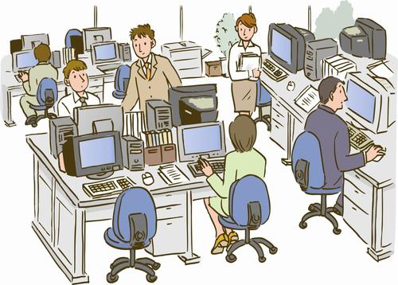
Vocabulary
bàn gōng shì
1
办公室
office

Slide 44
Vocabulary
xíng
1
行
all right;O.K.

Slide 45
Vocabulary
yào shi
1
要 是
if

Slide 46
要是(yào shi,if) is a conjunction to introduce a contingent or hypothetical action or situation. It`s not the “whether if” in English.
1

Slide 47
A:要是您方便，四点半我到您的办公室去，行吗？
yào shi nín fāng biàn,sì diǎn bàn wǒ dào nín de bàn gōng shì qù,xíng ma ？
If it`s convenient for you, I`ll go to your office at four-thirty. Is that all right？
B:四点半，没问题。
sì diǎn bàn,méi wèn tí.
Four-thirty? No problem.
1

Slide 48
没问题(méi wèn tí) here means “no problem.” It is used to assure someone that a promise will be fulfilled or a favor will be done. But when people thank you and say 谢谢(xiè xiè), you cannot respond with 没问题
1

Slide 49
Vocabulary
děng
1
等
to wait; to wait for

Slide 50
Vocabulary
bié
1
别
don`t

Slide 51
Vocabulary
kè qi
1
客 气
polite

Slide 52
The Adverb 别(bié,don`t)
别(bié,don`t) is used to advise someone to refrain or stop someone from doing something. Depending on the context, it can be used to form a polite formula, a gentle reminder, or a serious admonition
1
1.别客气。
bié kè qi
No need to be so polite.
2.你别说。
nǐ bié shuō
Don`t tell/say anything.

Slide 53
The Adverb 别(bié,don`t)
别(bié,don`t) is used to advise someone to refrain or stop someone from doing something. Depending on the context, it can be used to form a polite formula, a gentle reminder, or a serious admonition
1
3.别进来！
bié jìn lai ！
Don`t come in!
4.那个电影没有意思，你别看。
nà ge diàn yǐng méi yǒu yì si ，nǐ bié kàn.
That movie is boring. Don`t go see it.

Slide 54
Text
（李友给常老师打电话）
常老师：喂？
李 友：喂，请问，常老师在吗？
常老师：我就是。您是哪位？
李 友：老师，您好。我是李友。
常老师：李友，有事儿吗？
李 友：老师，今天下午您有时间吗？我想问您几个问题。
常老师：对不起，今天下午我要开会。
1

Slide 55
李 友：明天呢？
常老师：明天上午我有两节课，下午三点要给二年级考试。
李 友：您什么时候有空儿？
常老师：明天四点以后才有空儿。
李 友：要是您方便，四点半我到您的办公室去，行吗？
常老师：四点半，没问题。我在办公室等你。
李 友：谢谢您。
常老师：别客气。
1

Slide 56
Questions
1、Why did Li You call Teacher Chang?
2、Will Teacher Chang be free this afternoon?Why or why not?
3、What will Teacher Chang do at three o`clock tomorrow afternoon?
1

Slide 57

Language Practice

