Slide 1
yuē shí jiān
约时间
Making Appointments
LI XIN YU

Slide 2
Vocabulary
zhōng wén
1
中 文
Chinese language

Slide 3
Vocabulary
wén
1
文
language；script；written language

Slide 4
Vocabulary
bāng
1
帮
to help

Slide 5
Vocabulary
zhǔn bèi
1
准 备
to prepare

Slide 6
Vocabulary
liàn xí
1
练 习
to practice

Slide 7
Vocabulary
shuō
1
说
to say; to speak

Slide 8
Vocabulary
xià ge
下 个
1
next one

Slide 9
Vocabulary
xià
1
下
below;next

Slide 10
Time Expressions
下个星期(xià ge xīng qī) literally means “the week below.” By the same token, 上个星期(shàng ge xīng qī ) literally means “the week above.” The measure word 个 can be omitted: 下个星期=下星期；上个星期=上星期. “Last/next month” is 上个月/下个月(shàng ge yuè/xià ge yuè).However, we don`t say “上月/下月”
To help you remember, envision a calendar. Next week/month is below(下,xià) this week/month; last week/month is above (上,shàng)
this week/month.
1

Slide 11
Time Expressions Involving Month and Week
上上个月 | shàng shàng ge yuè the month before last | 上上(个)星期 | shàng shàng(ge) xīng qī the week before last
上个月 | shàng ge yuè last month | 上(个)星期 | shàng (ge)xīng qī last week
这个月 | zhè ge yuè this month | 这(个)星期 | zhè (ge) xīng qī this week
下个月 | xià ge yuè next month | 下(个)星期 | xià (ge) xīng qī next week
下下个月 | xià xià ge yuè the month after next | 下下(个)星期 | xià xià (ge) xīng qī the week after next
1

Slide 12
一月 yī yuè January | 二月 èr yuè February | 三月 sān yuè March
四月 sì yuè April | 五月 wǔ yuè May | 六月 liù yuè June
七月 qī yuè July | 八月 bā yuè August | 九月 jiǔ yuè September
十月 shí yuè October | 十一月 shí yī yuè November | 十二月 shí èr yuè December
1

Slide 13
Time Expressions
The above expressions with 月(yuè) and 星期(xīng qī) form two parallel serics. “one weeks” is 一个星期(yí ge xīng qī), therefore “one week later” is 一个星期以后(yí ge xīng qī yǐ hòu ). “One month” is 一个月(yí ge yuè), not 一月(yī yuè). “One month later” is 一个月以后(yí ge yuè yǐ hòu)
1

Slide 14
Additional Time Expressions Involving Year and Day
大前天 | dà qián tiān three days ago | 大前年 | dà qián nián three years ago
前天 | qián tiān the day before yesterday | 前年 | qián nián the year before last
昨天 | zuó tiān yesterday | 去年 | qù nián last year
今天 | jīn tiān today | 今年 | jīn nián this year
1

Slide 15
Additional Time Expressions Involving Year and Day
明天 | míng tiān tomorrow | 明年 | míng nián next year
后天 | hòu tiān the day after tomorrow | 后年 | hòu nián the year after next
大后天 | dà hòu tiān three days from today | 大后年 | dà hòu nián three years from now
1
The above expressions with 天(tiān) and 年(nián) form two parallel series except for 昨天(zuó tiān) and 去年(qù nián)

Slide 16
Vocabulary
a
1
啊
(a sentence-final particle of exclamation, interrogation, etc)

Slide 17
Vocabulary
dàn shì
1
但 是
but

Slide 18
Vocabulary
děi
1
得
must; to have to

Slide 19
The Modal Verb得(děi,must)
The Modal Verb得(děi) means “need to “ or “must”.
1.我现在得去开会，没空儿跟你聊天儿。
wǒ xiàn zài dé qù kāi huì,méi kōng ér gēn nǐ liáo tiānr.
I need to go to a meeting right now, and have no time
to chat with you.
2.我有事儿，得去学校。
wǒ yǒu shìr，děi qù xué xiào 。
I`ve some business[to attend to]. I must go to school.
1

Slide 20
The Modal Verb得(děi,must)
The negative form of 得(děi,must) is 不用(bú yòng,need not) or 不必(bú bì, need not). not 不得(bú děi). Therefore, the correct way to say “ You don`t have to go to the library” in Chinese is A, not B:
1
A:你不用去图书馆。 or 你不必去图书馆。
nǐ bú yòng qù tú shū guǎn nǐ bú bì qù tú shū guǎn
B:你不得去图书馆。
nǐ bù děi tú shū guǎn

Slide 21
Vocabulary
gēn
1
跟
with

Slide 22
Vocabulary
jiàn miàn
1
见 面
to meet up;to meet with

Slide 23
Vocabulary
miàn
1
面
face

Slide 24
Vocabulary
huí lái
1
回 来
to come back

Slide 25
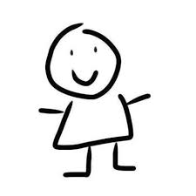
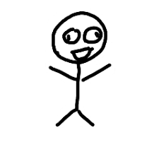
Directional Complements (I)
来/去(lái/qù, to come/go) can serve as a directional complement after such verbs as 进(jìn, to enter) and 回(huí, to return). 来(lái, to come) signifies movement toward the speaker, while 去(qù, to go) signifies movement away from the speaker.
1
来

Slide 26
Directional Complements (I)
来/去(lái/qù, to come/go) can serve as a directional complement after such verbs as 进(jìn, to enter) and 回(huí, to return). 来(lái, to come) signifies movement toward the speaker, while 去(qù, to go) signifies movement away from the speaker.
1
去

Slide 27
Directional Complements (I)
1、[A is at home, speaking on the phone to B, who is away from home]
A:你什么时候回来？
nǐ shén me shí hou huí lai ？
When are you coming back?
B:我六点回去。
wǒ liù diǎn huí qu.
I`m going back at six.
1

Slide 28
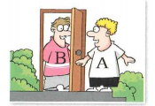
Directional Complements (I)
2、[A is outside, and B is inside. A knocks on the door, and B tells A to come in.]
B:进来。
jìn lai.
Come in
1

Slide 29
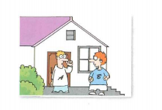
Directional Complements (I)
2、[Both A and B are outside. A tells B to go inside.]
A:进去。
jìn qu.
Go in
1

Slide 30
吧vs吗？
Compare the two particles 吧(ba) and 吗(ma):
1、你是李友吧?
(nǐ shì lǐ yǒu ba?)
You are Li You, aren`t you?
(I think you`re Li You. Am I right?)
2、你是李友吗？
(nǐ shì lǐ yǒu ma?)
Are you Li You？
(I am not quite sure.)
1

Slide 31
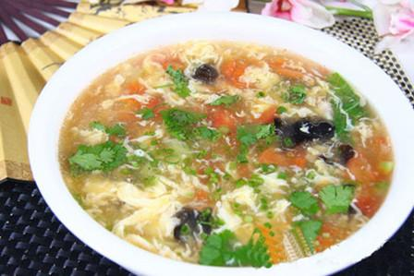
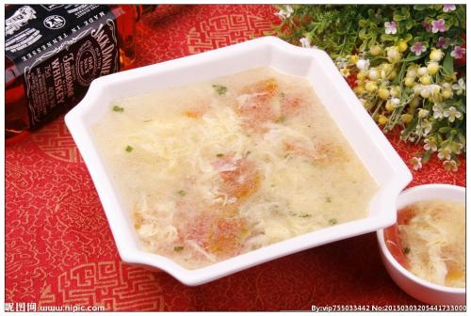
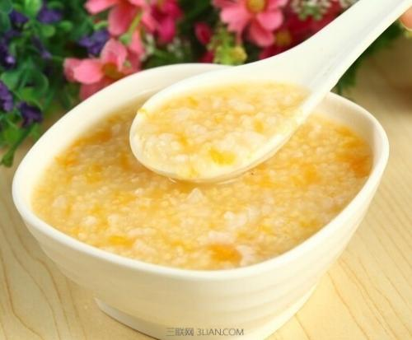
酸辣鸡蛋汤
suān là jī dàn tāng
玉米粳yù mǐ jīng
1
柿茄木须汤
shì qié mù xū tāng

Slide 32
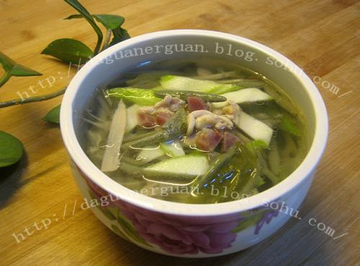
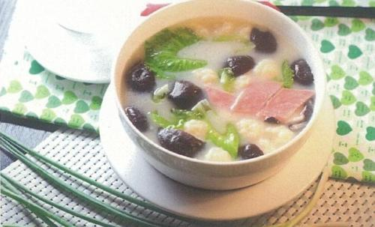
1
凤片纯菜汤
fēng piàn chún cài tāng
清汤三鲜
qīng tāng sān xiān

Slide 33
Text
李友:喂，请问，王朋在吗？
王朋:我就是。你是李友吧？
李友:王朋，我下个星期要考中文，你帮我准备一下，跟我
练习说中文，好吗？
王朋:好啊，但是你得请我喝咖啡。
李友:喝咖啡，没问题。那我什么时候跟你见面？你今天晚上有空儿吗？
王朋：今天晚上白英爱请我吃饭。
李友：是吗？白英爱请你吃饭？
王朋：对。我回来以后给你打电话。
李友：好，我等你的电话。
1

Slide 34
Questions
1、Why did Li You call Wang Peng?
2、What will Wang Peng do tonight?
3、What will Li You do tonight?
1

Slide 35
Language Practice

