Slide 1

mǎi dōng xi
买东西
Shopping
LIXINYU
2019/11/26

Slide 2
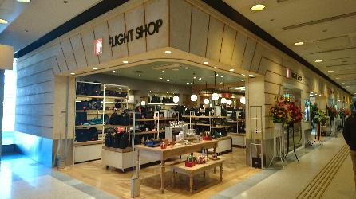
shāng diàn
商 店
store;shop

Slide 3

mǎi
买
to buy

Slide 4

dōng xi
东 西
things;objects

Slide 5
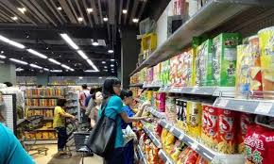
大家去商店买东西。
dà jiā qù shāng diàn mǎi dōng xi.
Everyone goes to the store to buy things.

Slide 6
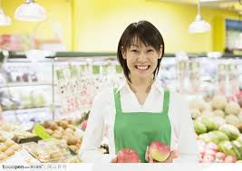
shòu huò yuán
售货员
shop assistant; salesclerk

Slide 7
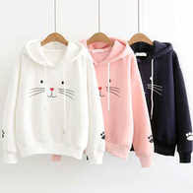
yī fu
衣 服
clothes

Slide 8
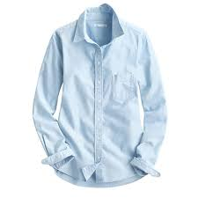
chèn shān
衬 衫
shirt

Slide 9
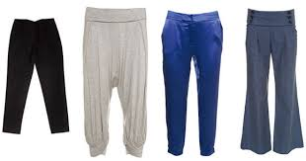
kù zi
裤 子
pants

Slide 10
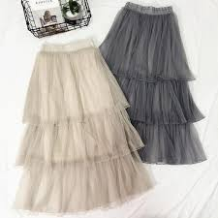
qún zi
裙 子
skirt

Slide 11
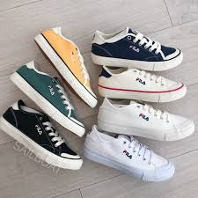
xié
鞋
shoe

Slide 12
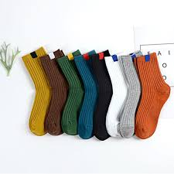
wà zi
袜 子
sock

Slide 13
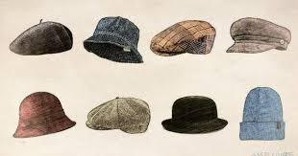
mào zi
帽 子
hat

Slide 14
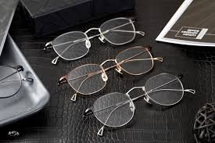
yǎn jìng
眼 镜
glasses

Slide 15
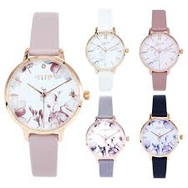
shǒu biǎo
手 表
Watch

Slide 16
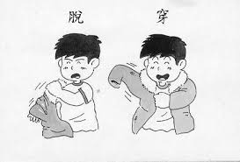
chuān
穿
to wear; to put on

Slide 17
穿(chuān)VS戴(dài)
Note that the verb 穿(chuān) can mean both “to wear” and “to put on.” However, for most accessories, especially those for the upper part of the body, 戴(dài) is used instead of 穿(chuān)

Slide 18
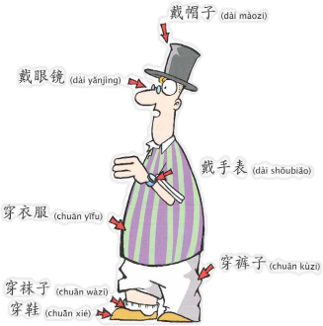
Verb+noun

Slide 19
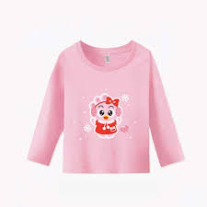
jiàn
件
measure word for shirts,dresses,jackets,coats,ect

Slide 20
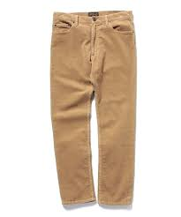
tiáo
条
measure word for pants and long, thin objects

Slide 21
shuāng
双
measure word for a pair

Slide 22
In Chinese, a pair of pants is just one single piece of clothing. Hence 一条裤子(yì tiáo kù zi, literally, a trouser) instead of 一双裤子(yì shuāng kù zi, a pair of trousers)(X)

Slide 23
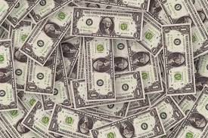
qián
钱
money

Slide 24
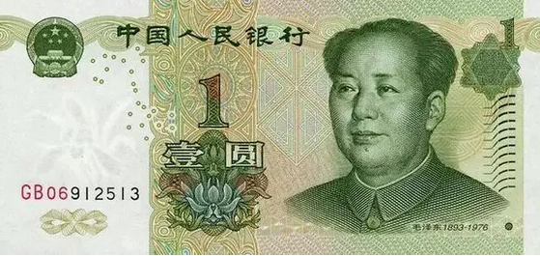
kuài
块
measure word for the basic Chinese monetary unit

Slide 25
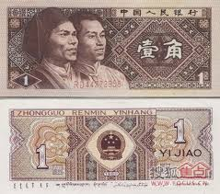
máo
毛
measure word for 1/10 of a kuai, dime[in US money]

Slide 26
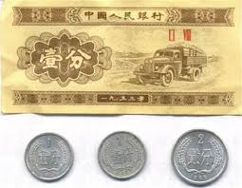
fēn
分
measure word for 1/100 of a kuai, cent

Slide 27
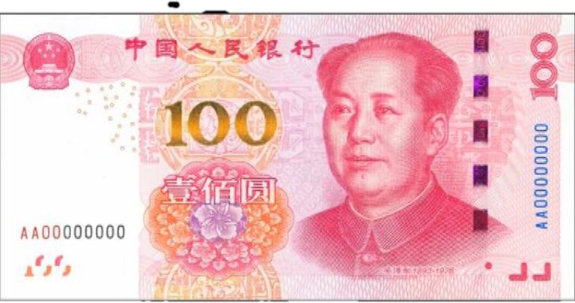
bǎi
百
hundred

Slide 28
Measure Words
一_____人 a person
一_____先生 a gentleman
一_____茶 a cup of tea
一_____可乐 a bottle of cala
一_____笔 a pen

Slide 29
Measure Words
一_____纸 a piece of paper
一_____课 a class period
一_____日记 a diary entry
一_____信 a letter
一_____书 a book

Slide 30
Measure Words
一_____衬衫 a shirt
一_____裤子 a pair of pants
一_____鞋 a pair of shoes
一_____鞋 a shoe(one of a pair)
一_____帽子 a hat

Slide 31
Measure Words
一_____手表 a watch
一_____ 裙子 a skirt
一_____袜子 a pair of socks
一_____袜子 a socks(one of a pair)
一_____眼镜 a pair of glasses

Slide 32
Measure Words
一_____钱 one yuan
一_____钱 1/10 of a yuan
一_____钱 1/100 of a yuan, one cent

Slide 33

yí gòng
一 共
altogether

Slide 34
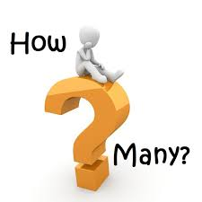
duō shao
多 少
how much/many

Slide 35
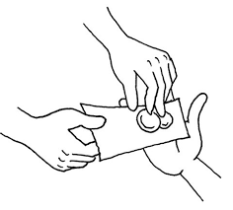
zhǎo (qián)
找(钱)
to give change

Slide 36
Amounts of Money
1.$8.55 八块五毛五(分)(钱）
bā kuài wǔ máo wǔ (fēn)(qián）
2.$15.30 十五块三(毛)(钱)
shí wǔ kuài sān (máo)(qián)
3.$103 一百零三块(钱)
yì bǎi líng sān kuài (qián)

Slide 37
Amounts of Money
4.$100.30 一百块零三毛(钱)
yì bǎi kuài líng sān máo (qián)
5.$100.03 一百块零三分(钱)
yì bǎi kuài líng sān fēn (qián)
To avoid ambiguity,毛（máo）and 分（fēn）cannot be omitted in (4) or (5)

Slide 38
A:这些东西一共多少钱？
zhè xiē dōng xi yí gòng duō shǎo qián ？
How much are these things altogether？
B:一共九十二块三毛七分。
yí gòng jiǔ shí èr kuài sān máo qī fēn.
Ninety-two dollars thirty-seven cents altogether.

Slide 39
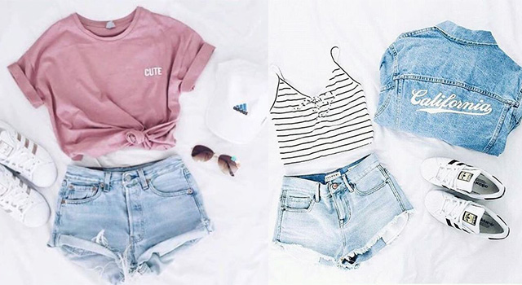
$295.39
$125.87
$43.28
$36.71
$89.53

Slide 40
$301.99
$101.33
$32.21
$68.79
$76.53
$23.13

Slide 41

yán sè
颜 色
color

Slide 42

huáng
黄
yellow

Slide 43

hóng
红
red

Slide 44

hēi
黑
black

Slide 45

kā fēi sè
咖啡色
brown;coffee color

Slide 46


chéng
lǜ
橙
绿
Orange
green

Slide 47


lán
zǐ
蓝
紫
blue
purple

Slide 48
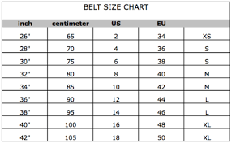
hào
号
size

Slide 49

zhōng
中
medium；middle

Slide 50
小号(xiǎo hào)
中号(zhōng hào)
大号(dà hào）

Slide 51
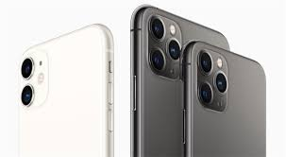
pián yi
便 宜
inexpensive；cheap
$1

Slide 52
The character 便 in 便宜(pián yi, inexpensive) is pronounced “pián” But in 方便(fāng biàn, convenient) the same character is pronounced “” It is not uncommon in Chinese for the same character to be pronounced differently and carry different meanings. Other examples include:乐(yuè/lè)in 音乐(yīn yuè,music),可乐(kě lè ,cola); and 觉(jué/jiào) in 觉得(juéde,to feel) and 睡觉(shuì jiào,to sleep)

Slide 53
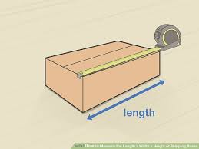
cháng duǎn
长 短
length

Slide 54
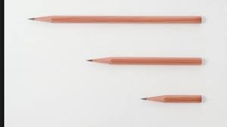
cháng
长
long

Slide 55
duǎn
短
short

Slide 56

hé shì
合 适
suitable

Slide 57
rú guǒ ... de huà
如果...的话
if

Slide 58
1、如果长短合适的话，我就买。
rú guǒ cháng duǎn hé shì de huà ，wǒ jiù mǎi.
If the size is right, I`ll take them.
2、如果我有很多钱的话，我要买很多衣服。
rú guǒ wǒ yǒu hěn duō qián de huà ，wǒ yào mǎi hěn
duō yī fu.
If I have a lot of money, I'll buy a lot of clothes.
3、如果我是你的话，我不会买那条裤子。
rú guǒ wǒ shì nǐ de huà ，wǒ bú huì mǎi nà tiáo kù zi.
If I were you, I would not buy that pair of pants.

Slide 59

shì
试
to try

Slide 60
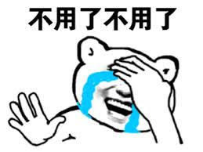
bú yòng
不 用
need not

Slide 61
The Modal Verb 要(yào)
One of the meanings of 要(yào) is “to desire to do something.”
1.明天是周末，你要做什么？
míng tiān shì zhōu mò ，nǐ yào zuò shén me ？
Tomorrow is the weekend. What do you want to do？
2.我要去图书馆看书，你去不去？
wǒ yào qù tú shū guǎn kàn shū ，nǐ qù bu qù ？
I want to go to the library to read. Are you going？

Slide 62
The Modal Verb 要(yào)
One of the meanings of 要(yào) is “to desire to do something.”
3.我要喝可乐，他要喝茶。
wǒ yào hē kě lè ，tā yào hē chá.
I want to drink cola. He wants to drink tea.

Slide 63
The Modal Verb 要(yào)
To negate it, use 不想(bù xiǎng)
4.我不想去图书馆。
wǒ bù xiǎng qù tú shū guǎn.
I don`t feel like going to the library.
For(4), however, some Chinese speakers, particularly in the South, would say:
我不要去图书馆。
wǒ bú yào qù tú shū guǎn.

Slide 64
The Modal Verb 要(yào)
To negate it, use 不想(bù xiǎng)
5.今天我不想做功课。
jīn tiān wǒ bù xiǎng zuò gōng kè 。.
I don`t feel like doing my homework today.
Both modal verbs 想(xiǎng) and 要(yào) can express a desire or an intention, but 要(yào) carries a stronger tone.

Slide 65
多(duō) Used interrogatively
The adverb 多(duō) is often used in a question asking about degree or extent,e.g,
1.你今年多大？
nǐ jīn nián duō dà ？
How old are you this year？
2.你穿多大的衣服？
nǐ chuān duō dà de yī fu ？
What size clothes do you wear？

Slide 66
多(duō) Used interrogatively
The adverb 多(duō) is often used in a question asking about degree or extent,e.g,
3.你弟弟多高？
nǐ dì di duō gāo ？
How tall is your younger brother？
The adjectives that follow 多(duō) are typically those suggesting large extents such as 大(dà，big), 高(gāo,tall;high) and 远(yuǎn,far), rather than those denoting small degrees such as 小(xiǎo, small;little),矮(ǎi, short), and 近(jìn, near).

Slide 67
question
1、What did Li You want to buy？
2、What color did LiYou like？
3、What did Li You like about the pants？

Slide 68

huàn
换
to exchange; to change

Slide 69

yí yàng
一 样
same;alike

Slide 70
跟/和...（不）一样(gēn /hé ...(bù)yí yàng,[not] the same as... )
To express similarity or dissimilarity between objects, persons, or actions, we use the structure 跟/和...(不)一样(gēn /hé ...(bù)yī yàng)
1.你的衬衫跟我的一样。
nǐ de chèn shān gēn wǒ de yí yàng.
Your shirt is the same as mine.
2.贵的衣服和便宜的衣服不一样。
guì de yī fu hé pián yi de yī fu bù yí yàng.
Expensive clothes are different from cheap ones.

Slide 71
跟/和...（不）一样(gēn /hé ...(bù)yí yàng,[not] the same as... )
Following 一样(yí yàng), an adjective can be used:
3.弟弟跟哥哥一样高。
dì di gēn gē ge yí yàng gāo.
The younger brother is as tall as the older one.
4.这个电脑跟那个电脑一样新。
zhè ge diàn nǎo gēn nà ge diàn nǎo yí yàng xīn.
This computer is as new as that one.

Slide 72
跟/和...（不）一样(gēn /hé ...(bù)yí yàng,[not] the same as... )
Following 一样(yí yàng), an adjective can be used:
5.常老师写汉字写得跟王老师(写汉字写得）一样漂亮。
cháng lǎo shī xiě hàn zì xiě de gēn wáng lǎo shī (xiě
hàn zì xiě de )yí yàng piào liang.
Teacher Chang writes Chinese charactes as nicely as
Teacher Wang does.

Slide 73
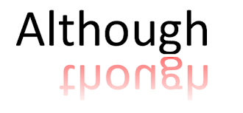
suī rán
虽 然
Although

Slide 74
虽然...，可是/但是...（suī rán ...，kě shì /dàn shì ...
although...yet...）
This pair of conjunctions links the two clauses in a complex sentence. Note, however, that 虽然(suī rán) is often optional.
1.虽然这双鞋很便宜，可是大小不合适。
suī rán zhè shuāng xié hěn pián yi,kě shì dà xiǎo bù hé shì.
Although this pair of shoes is inexpensive, it`s not the right size.

Slide 75
虽然...，可是/但是...（suī rán ...，kě shì /dàn shì ...
although...yet...）
This pair of conjunctions links the two clauses in a complex sentence. Note, however, that 虽然(suī rán) is often optional.
2.这本书很有意思，可是太贵了。
zhè běn shū hěn yǒu yì si ，kě shì tài guì le
This book is very interesting, but it`s too expensive.

Slide 76
虽然...，可是/但是...（suī rán ...，kě shì /dàn shì ...
although...yet...）
Whether or not 虽然(suī rán) is used in the first clause, 可是/但是(kě shì /dàn shì) cannot be omitted in the second. The following sentence is, therefore, incorrect:
2a.虽然这本书很有意思，太贵了。
suī rán zhè běn shū hěn yǒu yì si, tài guì le.

Slide 77
虽然...，可是/但是...（suī rán ...，kě shì /dàn shì ...
although...yet...）
This pair of conjunctions links the two clauses in a complex sentence. Note, however, that 虽然(suī rán) is often optional.
3.中文不容易，但是很有意思。
zhōng wén bù róng yì ，dàn shì hěn yǒu yì si .
Chinese is not easy, but it`s very interesting.

Slide 78
dà xiǎo
大 小
size

Slide 79
这双鞋虽然大小合适，可是颜色不好。
zhè shuāng xié suī rán dà xiǎo hé shì ，kě shì yán sè bù hǎo.
This pair is the right size, but it`s not a good color.

Slide 80

How many several kinds of flowers are there？
zhǒng
种
measure word for kinds, sorts,types

Slide 81
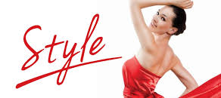
yàng zi
样 子
style

Slide 82

tǐng
挺
very; rather

Slide 83
挺+adj+的(tǐng+adj+de) means “it`s rather adj.” The 的(de) is optional.
挺好的(tǐng hǎo de）it`s rather good

Slide 84
tā
它
It
it

Slide 85
就是它吧(jiù shì tā ba ) is an expression one often uses when making a decision at the end of a process of selection. It roughly means “This is it” or “I`ll take it”

Slide 86
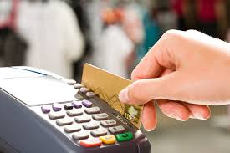
shuā kǎ
刷 卡
to pay with a credit card

Slide 87

shuā
刷
to brush;to swipe

Slide 88

kǎ
卡
card

Slide 89
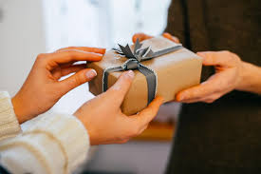
shōu
收
to receive; to accept

Slide 90
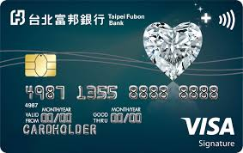
xìn yòng kǎ
信用卡
credit card

Slide 91
A：你们这儿可以刷卡吗？
nǐ men zhèr kě yǐ shuā kǎ ma ？
Can I use my credit card here？
B： 对不起，我们不收信用卡。
duì bu qǐ ，wǒ men bù shōu xìn yòng kǎ.
I`m sorry, we don`t take credit cards.

Slide 92

bú guò
不 过
howerer; but

Slide 93

zài
再
again

Slide 94
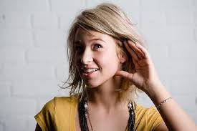
请你再说一次。
qǐng nǐ zài shuō yī cì.
Please say it again.

Slide 95
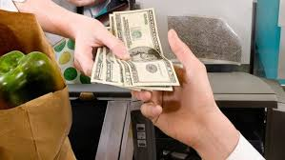
fù
付
to pay

Slide 96
fù qián
付 钱
to pay money

Slide 97
question
1.What color of shoes did Wang Peng finally accept？why？
2.Why did Wang Peng want to return the shoes for a
different pair？
3.Did Wang Peng like the black shoes ？Why or Why not?

