Slide 1
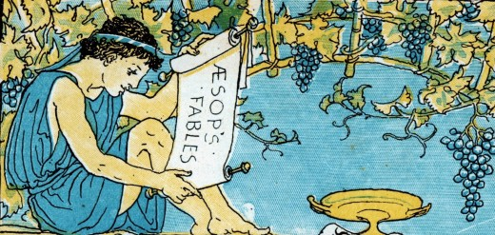
Aesop and Animal Fable
Animals in Antiquity, Week 3

Slide 2
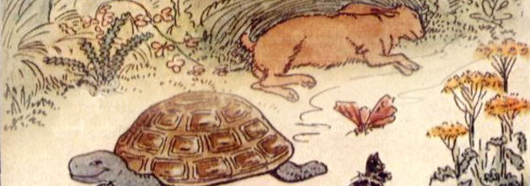
Fables
Anthropomorphic animals
Projetcs human behaviour onto animal protagonist
What differentiates humans from animals?

Slide 3
History of Fable
Starting point for investigating Greek and Roman ideas about animals
Oral tradition (Near East)
According to Greeks: of great antiquity – source of wisdom
All are from later collections (2.ce AD) or sophisticated literary context (Aristophanes, Aristotle, Horace, Phaedrus)
Earliest known collection of Aesopic fables is lost and was compiled by Demetrius of Phaleron in 4th ce. BC

Slide 4
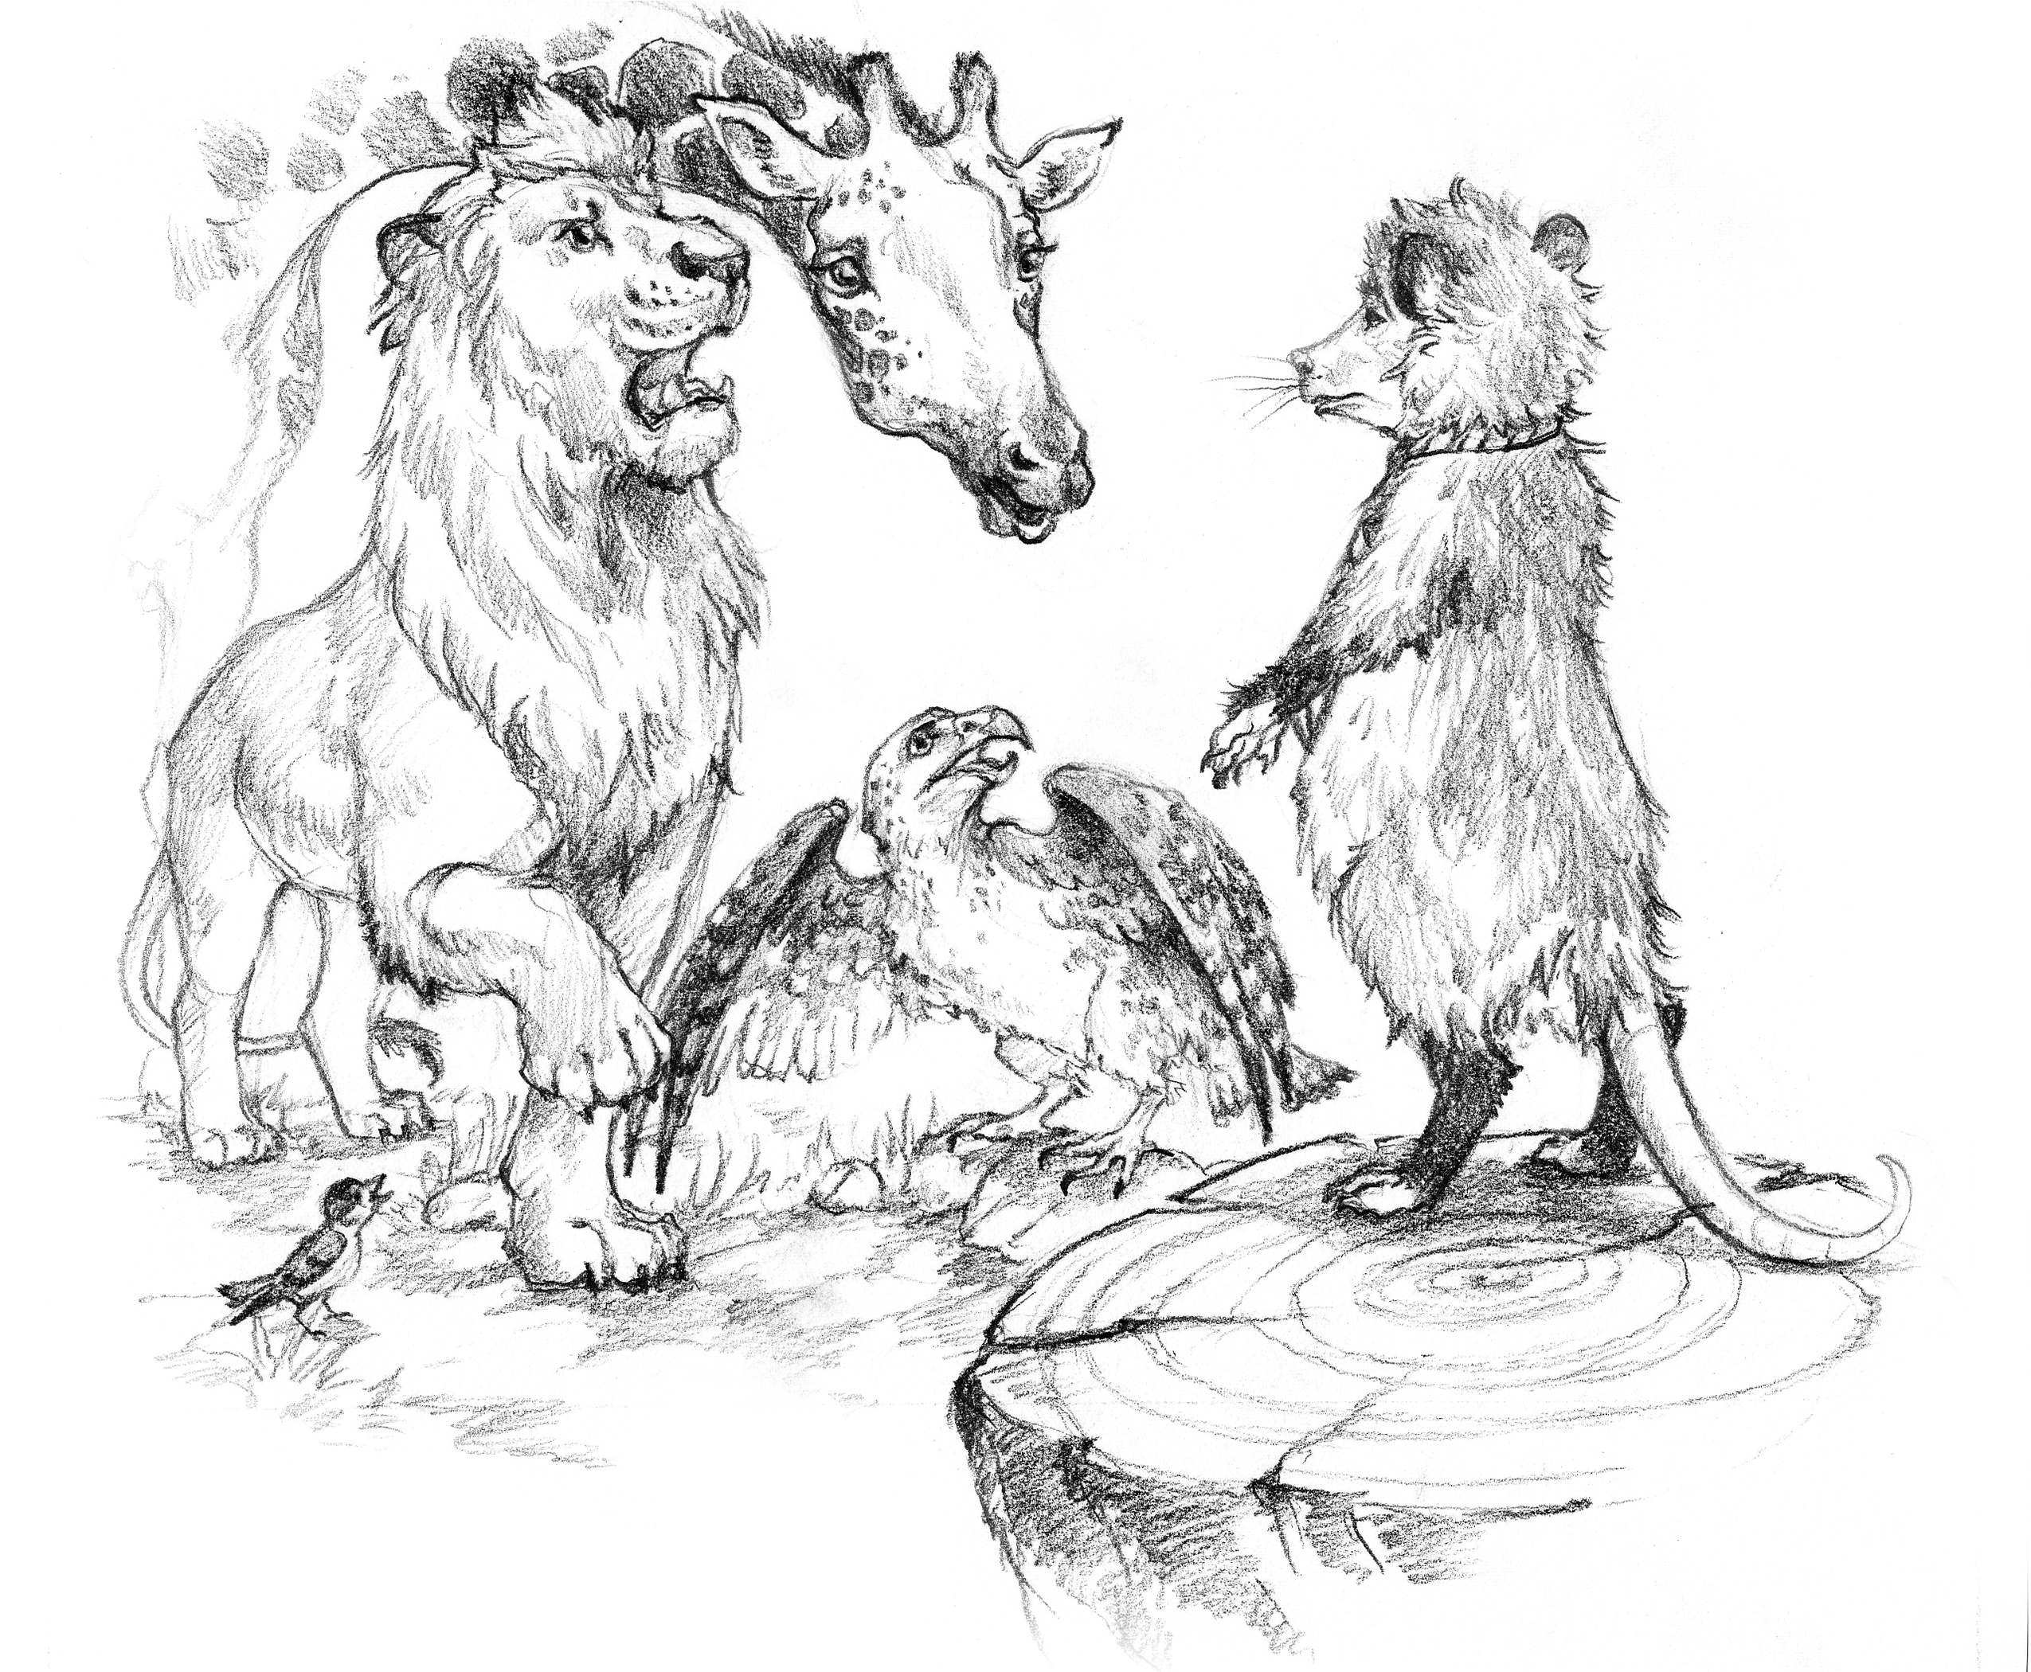
Style
Deliberate simplicity
No artistry – air of archaism and authenticity
Aesop left no writings – prominent as fable-teller – very specific genre

Slide 5
Sources – Categories of Evidence
1) Within various other genres of Greek and Latin literature (from 5th ce. BC)
2) Fable collections (lost Demetrios of Phalerum 4/3rd ce.BC)
3) Life of Aesop (anonymous, probably attached to a collection, fictionalized biography, 2.ce.AD, placing Aesop in 6/5th ce.BC)
4) Allusions and Intertexts (riddle, simile, metaphor, allegory, proverb – especially in Attic comedy, natural history and mock epic)

Slide 6
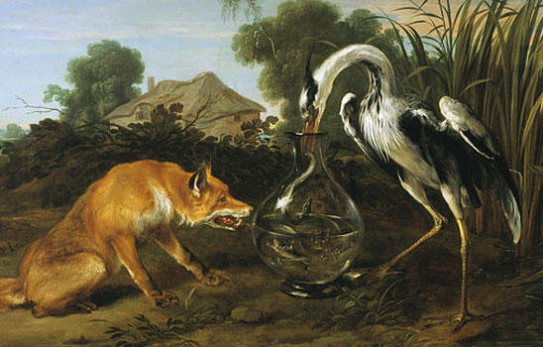
Approaches to Animal Fable
Animals are present in 75% of fables in Collectio Augustana, 65% of Phaedrus, 80% of Babrius
Not all Aesopic fables include animals, „Aesopic“ refers to a manner of telling stories not type of content

Slide 7
What can we consider a fable?
1) Text which is explicitly reffered to as ainos, muthos or logos in Greek or apologus, fabula or fabella in Latin
2) It is ascribed to Aesop or collected under his name
3) It contains certain formulae and/or conventional narrative elements (specific opening and closing formulae, tripartite narrative structure, moral of the story)
Notes:
See also Ben Edwin Perry – Aesopica (1952)

Slide 8
Animals in Fable – Animals speak
Problems with speech – differences between humans and animals
Wolf and the Lamb – futility of speech (Perry 155) - https://www.youtube.com/watch?v=9Ntycz339Bo
Wolf and the Sheep
What are the similarities and differences? Contradiction?

Slide 9
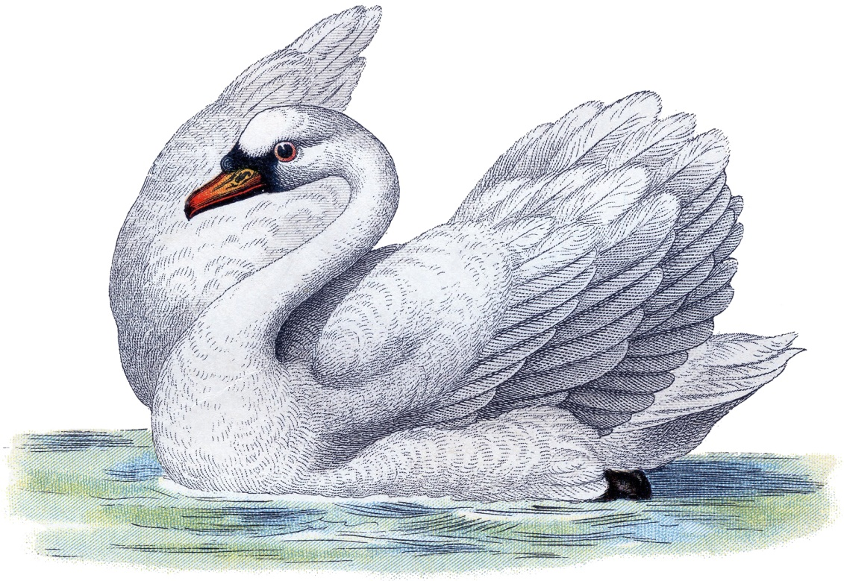
Humans vs. Animal Interaction in Fable
Fisherman and the fish (Perry 11)
The swan and his owner (Perry 233)
Comparison?

Slide 10
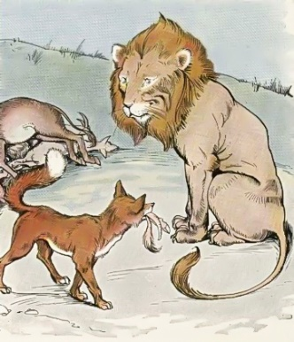
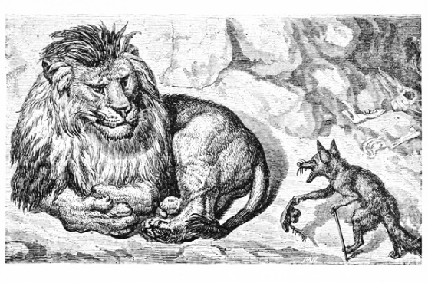
Animal stereotypes
Lion, fox and the stag (Babrius 95) – knowledge of stereotipical traits becomes a theme of a fable – both fox and reader are aware of them

