Slide 1
Aristophanes’s
The Clouds
Oscar
Νεφέλαι
Lucie
Ziqing
Jitka
Marin

Slide 2
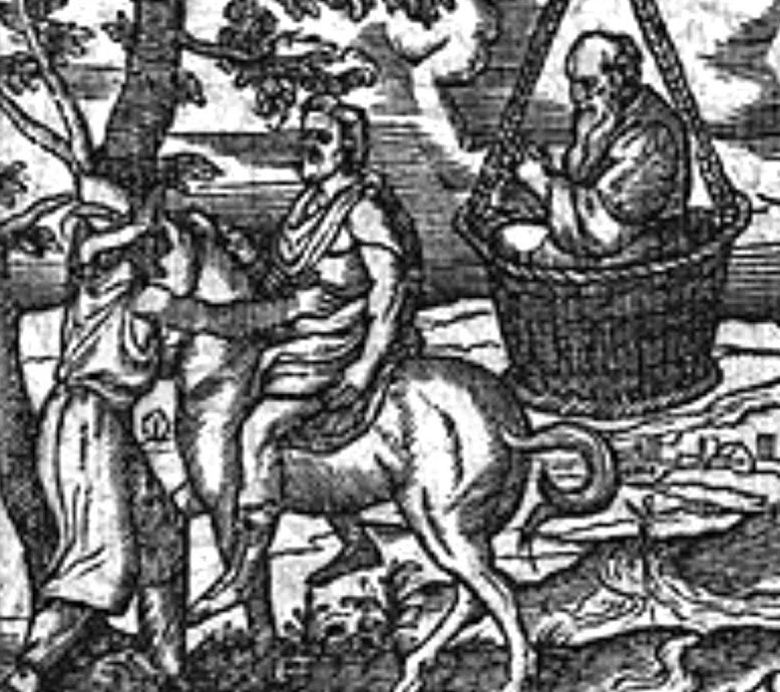
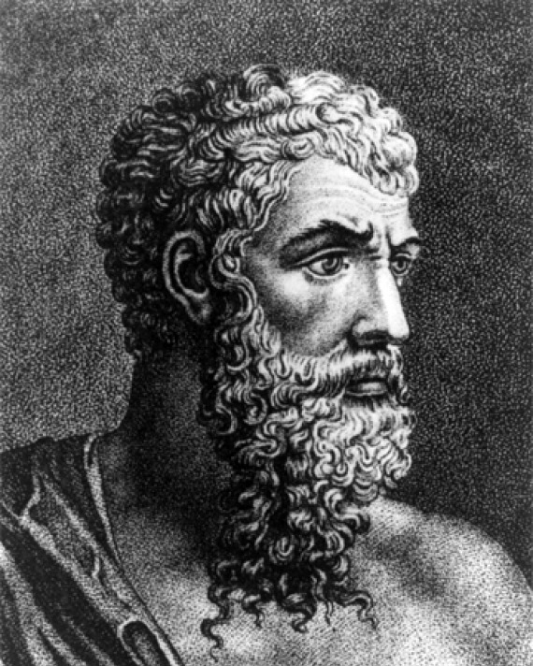
Aristophanes
Born around 446 BC in Athens (Golden Age)
Came from a wealthy family (received an excellent education)
Greatest representative of ancient Greek comedy
Wrote 40 plays out of which 11 survived
The Clouds – 423 BC, revised later (we do not have the original)
The Wasps, The Birds, The Frogs, Lysistrata…
Criticized contemporary politics (imperialist Athens)
Made fun of “modern” education and morals (sophists)
    One of the victims: Socrates
        Purposely (and unfairly) given many of their characteristics
        Plato: The Clouds = slander that contributed to Socrates’s trial and execution (399 BC)

Slide 3
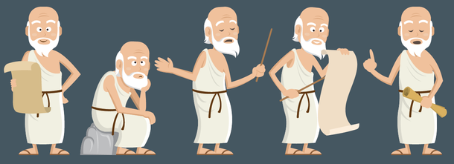
Background
Thematic shift for the work of Aristophanes from Political satire on the Peloponnesian war
Recorded not to be successful in its time – receiving 3rd (last) place
Satire on the intellectual culture of Athens – great thinkers get nothing done – see: play’s ending

Slide 4
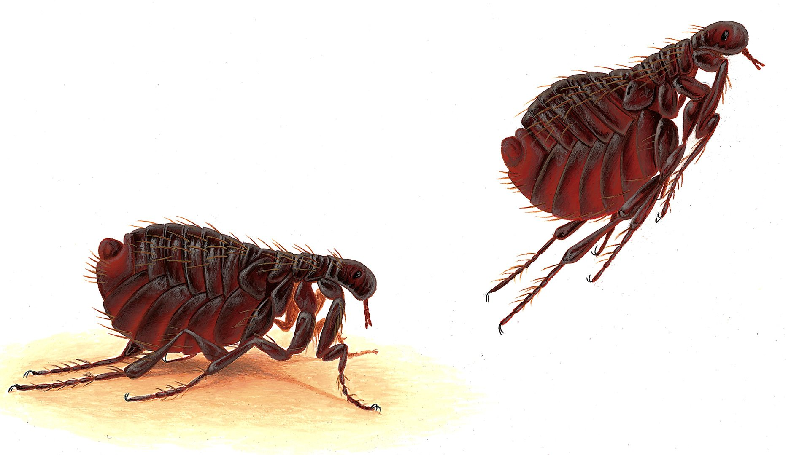


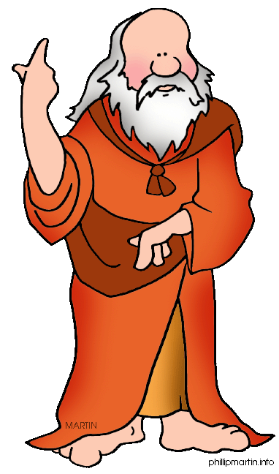
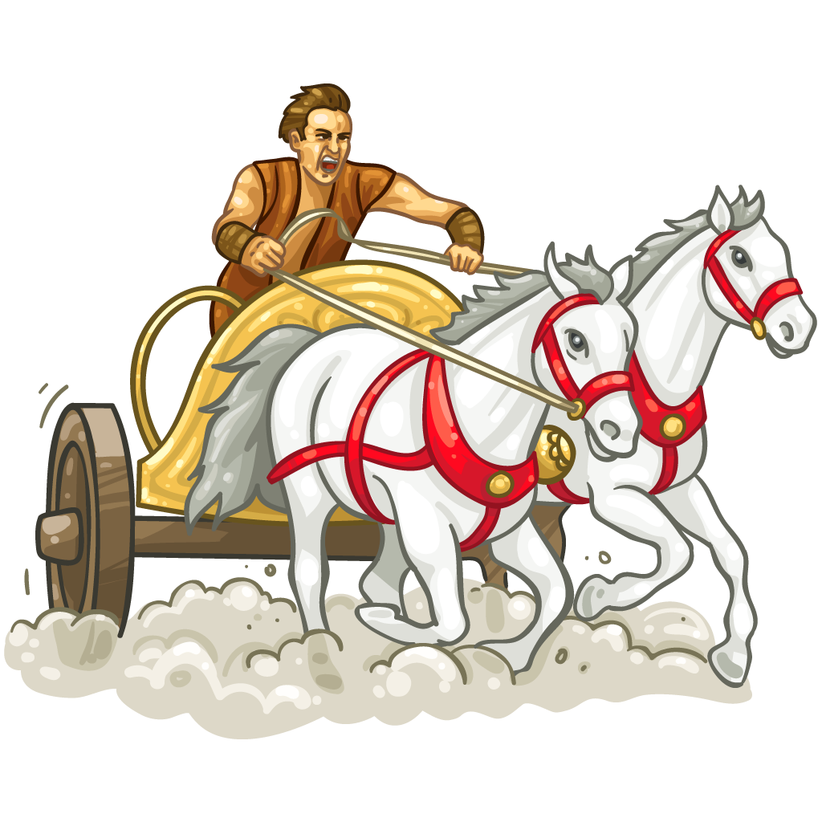
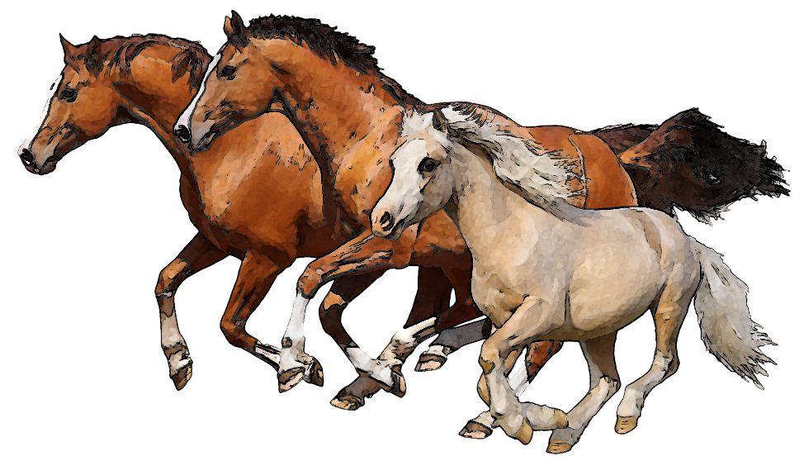
Animals and the plot
Action of the play is driven by P.’s debt on account of horse racing
Lizard that defecates on Socrates
Socrates’s new ideas:
  Measurement of distance jumped by a flea
  Gnat’s buzzing noise made by a hollow, trumpet-shaped hind-quarters as it moves
An overall theme of nature and its positing among the intellectual class: Socrates’s ideas and the chorus as clouds

Slide 5

Intellectual satire, a purely ancient idea?; Does the humour translate?
Basic principle relies on satirising and questioning of those perceived to be powerful and useful to their society – really they are frauds and/or clowns!
      Monty Python’s Life of Brian (1979)
      Marx Brothers’s Duck Soup (1933)
      Stanley Kubrick’s Dr. Strangelove (1964)
Aristophanes even breaks the fourth wall – chorus’s rebuke of the audience:
‘May I secure both victory and renown as certainly as I hold you for adept critics and as I regard this comedy as my best… [W]hich had cost me much trouble, but which I withdrew, unjustly beaten by unskilful rivals. It is you, oh, enlightened public, for whom I have prepared my piece, that I reproach with this. Nevertheless I shall never willingly cease to seek the approval of the discerning. I have not forgotten the day, when men, whom one is happy to have for an audience, received my Virtuous Young Man and my Paederast with so much favour in this very place… My value is so well known, that I take no further pride in it. I do not seek to deceive you, by reproducing the same subjects two or three times; I always invent fresh themes to present before you, themes that have no relation to each other and that are all clever… as for you, who love and applaud my inventions, why, posterity will praise your good taste.’

Slide 6
Intellectual satire, a purely ancient idea?; Does the humour translate?
Perhaps one of the more apparent types of humour for a modern audience is the lewd masturbation joke:
Socrates: Have you got hold of anything? [speaking metaphorically of an idea]
Strepsiades: No, nothing whatsoever.
Socractes: Nothing at all?
Strepsiades: No, nothing except my tool, which I’ve got in my hand!

