Slide 1
Economy and Gastronomy
Animals in Antiquity, Week 2

Slide 2
Ancient diet
Grape, grain, olive
High in fiber, low in cholesterol
Meat eating connected to religious sacrifice (story abour Prometheus – Hesiod, Theogony 535-57)
Consumption of meat – symbol of status

Slide 3
Sacrificial meat
Sacrifice and feasting from Iron Age
In Classical period – fundamental feature of life in Polis (16 city-wide sacrifices/year)
Bone deposit at Corinth – sacrifise would have fed 15 000 spectators for 4-5 days
Mass sacrifices – emerging meat market in Athens (see decree of the deme Skambonidai)
Notes:
Reese (1987: 264); https://www.atticinscriptions.com/inscription/CGRN/19

Slide 4
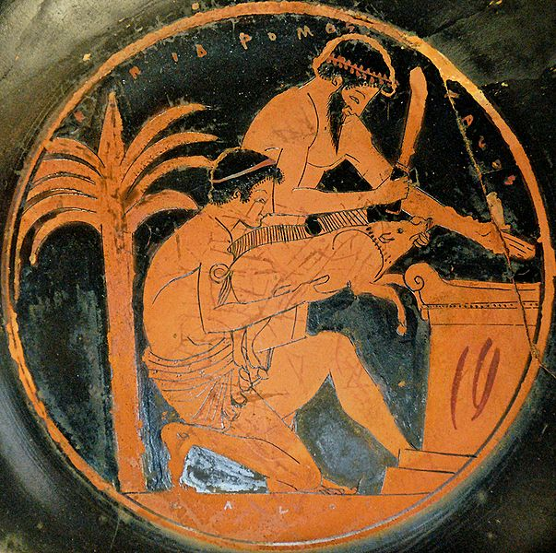
Sacrificial victim vs. commercial commodity
The same official conducts sacrifice and sale: mageiros
After 5th ce. AD the meat trade was less connected to religion
Notes:
Mageiros: https://1historyofgreekfood.wordpress.com/2009/12/04/mageiros-the-sacrifice-the-cuisine/, picture: Epidromos painter, 510 - 500 B.C.

Slide 5
Appetites
Meat consumtion connected also to impious behavior (Homer, Odyssey 12.354-425 – Cattle of the sun)
Appetites of gluttons in comedy (eating meat without sacrifice – carnal appetite)
Golden Age – culinary simplicity – vegetarianism (Empedocles against sacrifice, Pythagoras) – not frequent
Rejection of sacrifice – rejection of religion (ox made from spices, cakes, wheat)

Slide 6
Eating raw flesh – omophagia – ritual destruction of animals
Female followers of Dionysos (inverted pious treatment of meat)

Slide 7
Fish and Gastronomy
Fish – the finest food
No heroic or divine association
Associated with women, boys and seduction
Athenias avid fish-eaters
Romans – rotten fish sauce garum - https://www.youtube.com/watch?v=KLDlUGXJMFY
Piscinarii – Hortensius´ fishponds – retreated from public life to tend to fish

Slide 8
Consumption and Taste
Criticism of excessive consumption
Petronius – Satyricon – Trimalchio´s Feast
Apicius
Roman simplicity
Marcus Antonius´ love for banquets (condemnation by Plutarch) – competitions with Cleopatra
Notes:
https://www.gutenberg.org/files/5219/5219-h/5219-h.htm ; Plutarch – Antony 28

Slide 9
Value Economics
Elite status – owning land and animals
Socially acceptable forms of wealth – from agriculture (Cicero – De officiis 1.151)
„There is nothing more profitable than to take good care of cattle“ Cato, De agricultura 54.5
Columella – De re rustica 8.27 – animals impact all aspects of human life – from food to clothing

Slide 10
Prioritizing animal husbandry over agriculture
Animals – best return of investment – numerous young, grow quickly
Large animals difficult to maintain, but offspring sold for high prices
Smaller animals easy to feed (sheep, goats, pigs)
Big animals – public impression
Producing animals only for those of high status – big investments, big payoff

Slide 11
Animals as symbol of status – horses, cattle
Self-sufficiency, substinance, manpower, resources
Homer – „rich in flocks“/“rich in herds“epithets
Cattle – currency?
Latin word pecunia – from pecus - cattle?

Slide 12
Animals and the market
Sacrificial demand
Athens – state sponsored sacrifices – 6500 cattle, equal number of sheep, goats, pigs, birds, fish
Lesser Panathenaia – 9-12 000kg of meat (7200-9600 portions – fed 30 000 people)
Transport, sale, sacrifice, distribution of meat – boonai „cowboys“ to purchase animals from private sellers

Slide 13
Anyone could sell animals to sanctuary – perfect ones – inspectors
Urban markets – spike at festival times
Smaller public and private sacrifices
Complemented by demand for other animal products – wool, cheese, draught animals
Athens - sheep – high quality wool
Sparta – cattle, horses, sheep – larger herds

Slide 14
Delphi
Sacrifice before consultation – steady demand for animals
Isolated position
Later sacred herds (cattle and racehorces) – pastured on sacred land and sold to pilgrims at sanctuary

Slide 15
Roman markets
Year-round livestock markets in fixed locations in Rome: Forum Boarium (Bovarium), Forum Pecuarium, Forum Suarium
Independent from sacrificial demand
Romans ate more meat (especially cured pork)
Goats primarily for milk

