Slide 1
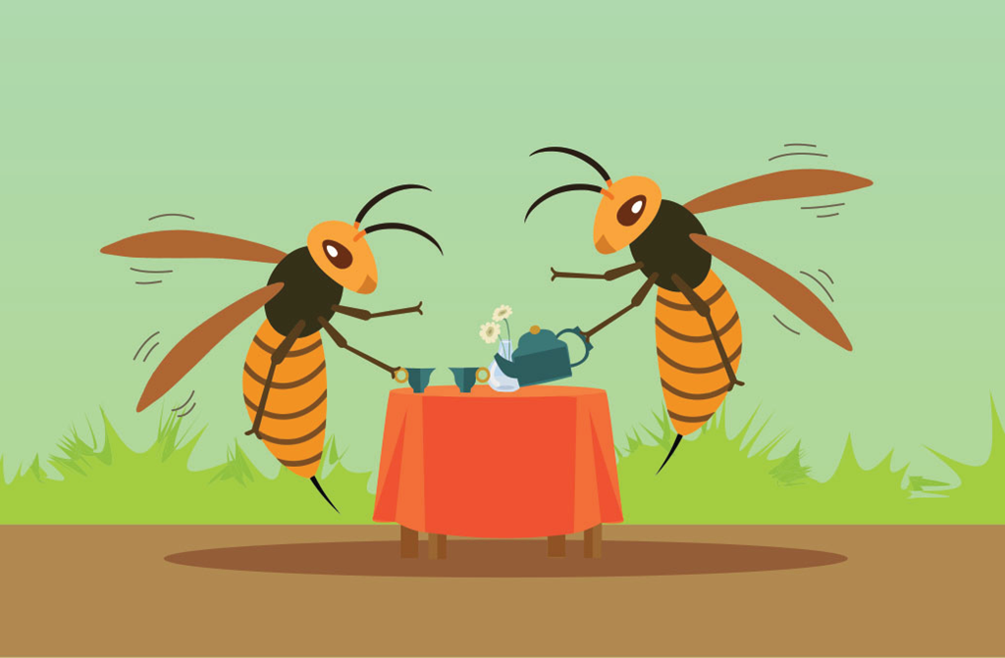
Aristophanes: Wasps
Animals in Antiquity
Isha Dadhwal, Michaela Adámková, Eliška Svobodová, Antonia Seifert
Notes:
Wasps –
Dog #1 (Labes) – 840 – ukradl sicilský sýr, mlčí samozřejmě, ale vlky umí zahánět, nejlepší z nynějších psů a velkým stádům v čele státi dovede, chrání dům
Dog #2 (The Dog) – 895 podal žalobu
Other mentioned animals:
Orel 15
Štítkovec 15
Ovce 35
Tuleň 35
Vepř 35
Krkavec 50
Kohout 100
Škeble 105
Včela/čmelák 105
Kavka 130
Myš 140
Osel 170
Vrabec 210
Bahňák 255
Červ 350
Kočka 360
Želva 430
Šelma 450
Slaneček, kapr, bělice 490
Pták 510
Rejnoci, úhoři 510
Beran, selata 575
Pištec 580
Mouchy 600
Pes 750
Ostrozubec 1035
Velbloud 1035
Labuť 1065
Larva 1115
Zajíc, kanec 1205
Osel 1305
Kobylka 1315
Chrobák 1449
Rak, pavouk, krab 1510

Slide 2
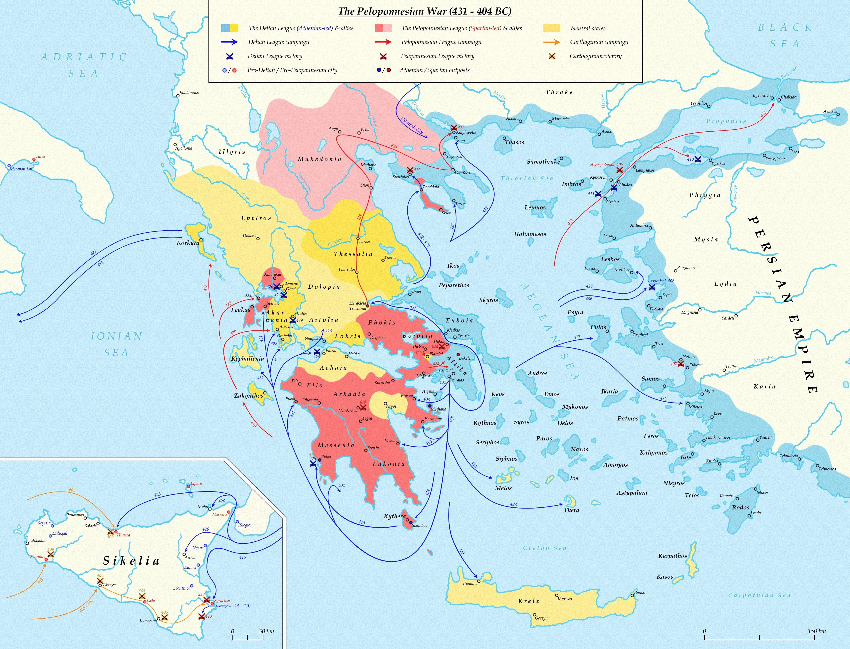
Background:
Amphipolis
431-404: Peloponnesian War
423: One-year truce with Sparta
422: Aristophanes at the Lenaea
422: Truce between Athens and Sparta ends
Scione
and
Mende
Athens
Sparta
➔ Wasps satirizes Athenian jurors and criticizes their staunch devotion to demagogic politicians.
Notes:
TEXT
Five papyri preserve fragments of Wasps
And there are twelve medieval Manuscripts that represent four independent witnesses
In Wasps any two of these witnesses may agree in error against the other two, showing that the medieval transmission of the play was open,
though Venetus Marcianus 474 (XI/XII) preserves more true readings alone than any of the other three
The Play Wasps was produced by Aristophanes himself at the Lenaea of 422 BCE and won the second prize.
Other plays like „Frogs“ have instead been produced by Philonides or Cratinus.
HISTORY
Its historical background derives from the Peloponnesian War (431–404 BCE), which changed the political and social situation most notably.
Wasps satirizes Athenian jurors and criticizes their staunch devotion to demagogic politicians.
As in Knights, the chief demagogue is Cleon – the Athenian leader at that time – , who is again harshly caricatured, this time as a malevolent watchdog.
Cleon had recently recovered from a political eclipse: after the Athenian defeat at Delium in late 424 and the subsequent loss of Amphipolis, public opinion had turned against his aggressive war policies.
and in spring 423 the Athenians voted, against his advice, in favor of a one-year truce with Sparta.
But then Scione and Mende revolted from Athens, provoking a resurgence of anti-Spartan sentiment in Athens and reviving Cleon’s political fortunes
PLAY
In Wasps he is portrayed as planning judicial revenge against Laches, one of the proposers of the truce.
But the focus in Wasps is not so much on Cleon personally as on how he and other demagogues could (allegedly) manipulate the jury courts, a central Athenian institution, for their own purposes: to attack political opponents, shake down the rich, and pocket the money that rightfully belonged to the people.
As in Clouds, the play’s satirical themes are exemplified by a conflict between an uncouth father – here being Lovecleon – and his sophisticated son – here being Loathecleon –, though this time the characterizations are more spacious and the son has a larger role.

Slide 3
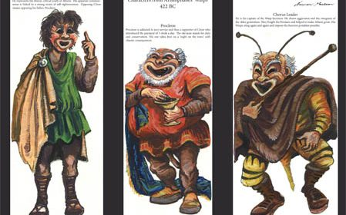
Plot
Two slaves are guarding „a monster“
Philocleon, father of Bdelycleon and a trialophile
„Waspish“ jury comes to collect the judge
Bdelycleon tricks Philocleon with a trial of a dog
First Parabasis: Chorus praises author and chastises audience
P. & B. argue about clothing and a dinner party
Second Parabasis: Chorus jokes about important concurrent figures of Athens (i.e. Cleon)
Household slave describes P‘s appalling behaviour at the party
Chorus speaks of the difficulty of changing habits and commends filial devotion
Notes:
Scene set as house covered in nets with 2 slaves (Xanthias and Sosias) sleeping in front of it alongside of a man sleeping on the roof.
The slaves speak of their dreams and a monster they are guarding, who is revealed to be Philocleon, the father of their master Bdelycleon. They challenge the audience to think what might be the old man‘s ‚illness,‘ eventually revealing he loves judging too much, spending all his time getting all accused convicted.
Philocleon attempts to leave several times, but is stopped each time. Eventually, the chorus of jurors (costumed as wasps) arrives and encourages P. to escape by gnawing his way through the net around the house. The chorus essentially assaults B. and the slaves, swarming like wasps – the conflict ends with Philocleon nearly escaping, but still within his son‘s custody, and both sides agree to settle the issue peacefully, thorugh debate.
The debate focuses on what Philocleon believes to be the best things about his occupation: the flattery of the powerful and rich, the freedom to interpret the law, his pay allowing him authority in his own household. Bdelycleon refutes these points by saying jurors are subjects to those in power and are undervalued in their pay, most money going to men like Cleon.
Chorus is won over, but Philocleon is not ready to give up his old ways – he is offered to play judge in domestic disputes as consolation for not being a city juror. Two dogs are brought for him to judge – one, who looks like Cleon, accuses the other of stealing cheese and not sharing. Multiple eating tools are brought as witnesses, and Bdelycleon speaks for them, eventually also bringing out puppies of the accused to soften the judge‘s verdict. This does not work, but Bdelycleon tricks his father to vote for acquittal anyway. Philocleon is shocked by the outcome of the trial as he is used to convictions and believes this to be his end as told to him in a prophecy. He is lead away by his son and promise of entertainment.
The first parabasis talks of Aristophanes‘ for standing up to monsters like Cleon and chastises the audience for not appreciating his last play (the Clouds) enough. It also praises the older generation and traditions alongside mourning how imperial funds are being taken by unworthy men in power.
P. & B. return to the stage, arguing about the father‘s style of clothing that B. deems unsuitable to the sophisticated dinner party they are to attend and thus P. is forced into fancier dress and is explained what manners and style are expected of him. He also expresses reluktance to drink wine, but is assured that trouble can be avoided through careful and intelligent speech.
The second parabasis shortly touches on the conflict between Cleon and the author, alongside remarks about other local characters that Aristophanes‘ audience would be familiar with.
Household slave arrives and talks how Philocleon has gotten violently drunk, insulted most other guests at the diner party and is assaulting everyone he meets. As P. arrives, obviously drunk, he is criticized by his son and more people with grievances against him arrive. P. tries to talk his way out of the situation, but only causes it to worsen, finally gets dragged into the house by his scandalized son.
Chorus finally remarks on how difficult it is to change a man‘s habits and praises B.‘s filial devotion.

Slide 4

The Animals
Wasps (chorus)
2 Dogs: Labes and The Dog (with their puppies)
Other mentioned animals:
Mammals – Sheep, Donkey, Cow, Pig, Camel, Cat, Mouse, Seal…
Birds – Eagle, Raven, Swan, House sparrow, Jackdaw, Wader,…
Fish – Carp, Herring, Ray, Eel,…
Insect – Fly, Honey bee, Spider, Beetle, Katydid,…
Notes:
Wasps
= chorus of jurors, consisted of of old men, who are costumed as wasps.
Dog #1 (Labes)
- Who looks like Laches, is accused of stealing a piece of Sicilian cheese; he‘s not defending himself in front of the jury
- Bdelycleon defends Labes, that he‘s a good watchdog
Dog #2 (The Dog)
- The Dog is a nickname for Cleon, who was called the watchdog of Athens
- He initiated the case

Slide 5

The Interpretation
Considered one of the greatest comedies regarding Old Comedy ever made
The play is about Cleon, a politician leader of the pro-war faction
The interpretation must have been very funny at the time, but no so much today
Notes:
- nothing
the interpretation was considered very funny to its intended audience because it was making a satirical joke about Cleon, a politician and leader of the pro-war faction at the time in Athens, and so you can see that obviously that was a huge deal. However, you would have to be informed on what exactly is going on at the time, so it would not be funny.
However, what is funny about it is that it shows this man who was probably not very popular back in his day as this crazy old man who instead of being typically being obsessed with women and drinking and gambling, he was crazy obsessed with the law court, which is strange and weird. Another funny part is him just appearing in a cloud of smoke at the court even when there were efforts put to keep him away. And again, relating it back to real life, it’s funny because Cleon was known for manipulating the court for his own personal vandettas at times

