Slide 1
POPULISM AND BREXIT. A UNITED KINGDOM IN CRISIS?

Slide 2
BACKGROUND INFLUENCES
Globalisation/ Collapse of Manufacturing: Movement of Manufacturing and High-Skilled Manual Jobs to cheaper countries
Financial Crisis (2008)- Collapse of Global Financial System. Caused by Excessive risk-taking by banks for profit, destroyed trust in ‘The Establishment’.
Multiculturalism/Migration Crisis: Refugees from Middle East moved into mainland Europe in their millions. Challenges to Social Cohesion, Racism, and Fear across Europe.
Euroscepticism- Britain always a ‘reluctant’ Member of the wider European project.

Slide 3
Right Wing Populism.
Combines Right-Wing Politics with Populism.
Speaks for ‘The Common People’ against an ‘Elite’.
In Right Wing Populism, this elite usually refers to ‘Globalists’, ‘Intellectuals’, and ‘Liberals’. Perceived as against the ‘Nation’.
Heartlands, Mythologising of a glorious ‘Past’ Nation against a changing and immoral ‘

Slide 4
HISTORY
UK Conservative Party divided between Eurosceptics and Europhiles.
Cameron, ‘moderate conservative’, sought to ‘renegotiate’ Britains relationship with the EU but did not return with enough concessions to placate his party.
Prime Minister Cameron (believing he would win) held the referendum in order to United the Party, and to see off the threat of UKIP (Nigel Farage)
At this point, the vast majority of Brits favoured staying in the EU.

Slide 5
Results.
52 % Leave, 48 % Remain.
Male:54-46% Leave. Female 51-49%. To remain.
Over 65 :65% Leave
18-24: 81-19 % Remain

Slide 6
Consequences.
Brits to lose European Citizenship and Right to Free Movement. Europeans lose the right to move to the UK.
Trade and customs barriers erected between the EU and UK. Huge implications for mutual recognition, standards, etc.
Brits to lose protection of European legal system.
Still no deal at this stage- could be further damage.

Slide 7
LEAVE CAMPAIGN.
Two Campaigns: Vote Leave (Official) and Leave.EU (Farage, Unofficial)
Vote Leave focused on the Politer Arguments, leaving Leave.EU to go for a harder, ‘cultural nationalist’ approach to the vote. Vote Leave led by Dominic Cummings, now Chief Strategist to Boris Johnson, and many argue to be the real Prime Minister.

Slide 8
How did Leave Win? What Lessons for Politics
Short, Simple, EMOTIVE slogans. ‘Take Back Control’, encompassed the nationalist, ‘heartlands’ message in the Leave campaign and appealed particularly to elderly voters, particularly those with a view of British Exceptionalism.
Focus on elderly voters, who shared these nationalist sentiments and were MORE LIKELY TO VOTE.
Anti-Elitist, Populist ‘Insurgent’ Message Anti-Knowledge Message. Michael Gove ‘The People have Had enough of Experts’.
This reduced the importance of factual accuracy
British Exceptionalism and references to ‘The Blitz’ and other wartime romance.

Slide 9
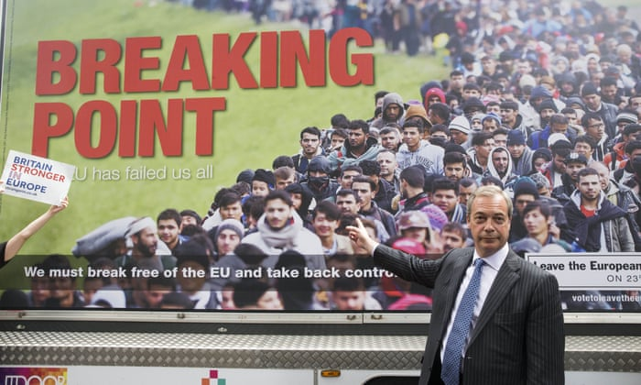

Slide 10
Why Did the Remain Campaign Lose: Aftermath
Excessive focus on facts and figures failed to cut through to voters.
Failure to Articulate a ‘positive’ vision for European Membership.
Seen to represent ‘The Establishment’
Failed to understand the potency of Identity Politics (Common to centre and centre-left Liberal parties in Europe)
Deep problem with the EU more generally?

Slide 11
Implications for the UK Future
Economic Separation of Northern Ireland from United Kingdom: United Ireland.
Scottish Independence: Scotland Voted 62% remain and dragged out of the EU against its will. Huge surge for independence in Scotland.
‘England Alone’. Diplomatic isolation- especially since Trump lost.

Slide 12
Populist ‘nexus’ in Europe
Rise of Populist Leaders across Europe- Orban, Law and Justice Party in Poland.
Movement of the ‘Overton Window’ to the right, previously ‘fringe’ parties like the AFD and VOX becoming mainstreamed.
‘Backwards movement’ for rights in some countries.

Slide 13
Discussion Question: Right Wing Populism in YOUR country.
Right wing Populism in the Brexit referendum involved, at least partially, using identity politics to create an emotive ‘Us vs Them’ mentality between ‘the people’ and ‘outsiders’ (minorities, academics, liberals), who did not share the ‘values’ of the British heartland. Can you identify such populist trends in the politics of your own countries? How do they affect politics in your country?
Populist argument often seeks to devalue facts and reason in favour of emotions and identity. Are human beings naturally driven more by emotion than reason, and can populists be challenged? If so, How?

