Slide 1
FEMINISM IN THE UK AND US: THE PATRIACHY

Slide 2
The Three (Four) Waves of Feminism
First Wave of Feminism: 1850-1960s- Suffragettes. Fought, Protested, and were sometimes Imprisoned or killed in order to attain ‘legal’ equality with men
Second Wave Feminism: ‘The Personal is Political’: Sought to demonstrate and fight the ‘invisible’ structures of patriarchy and racism that existed in society and held women’s equality back.
Third Wave Feminism: Sought to Understand the ‘Layers of Oppression’ for women; incorporating an intersectional analysis of race, class, sexuality, etc.
Fourth Wave Feminism: Delves deeper into the harm caused by Gender Norms and Focusing on ‘Justice’ for women harmed by Gender Norms and abuses of Male Power. Me Too Movement.

Slide 3
WHAT IS THE PATRIARCHY? SECOND WAVE FEMINISM
PATRIARCHY IS AN ‘IDEOLOGY’ in that it constitutes a set of political beliefs about the relationships of people in society.
PATRIARCHY MEANS ‘RULE OF THE FATHER’
General Control of one Collectivity over another, defined by birth (much like racism, etc). Based on a relationship of dominance and subordination.

Slide 4
PATRIARCHY 2: The ‘Construction’ of Femininity and Masculinity.
Patriarchy ‘the most successful ideology ever perpetuated’
Instilled in people from a young age; forms their worldview and paradigm.
Masculinity constructed by the Patriarchy as Dominant, Aggressive, Competent, etc. Image of ‘ideal man’ or ‘real man’, sexually promiscuous Toys magazines, sports, etc. ‘Real Men Don’t Cry’.
‘Femininity’ constructed as Docile, Submissive ‘Pretty’, chaste, etc- Toys, magazines, etc.
Core ‘gender identity’ inculcated in people From a very young age.
Can be perceived in language: ‘Don’t be a pussy’, ‘man up’- language being used to reinforce these ideals.
Genders almost like ‘different cultures’, but none of this is based in biology but historical and cultural factors, and judged through different lenses of worth.

Slide 5
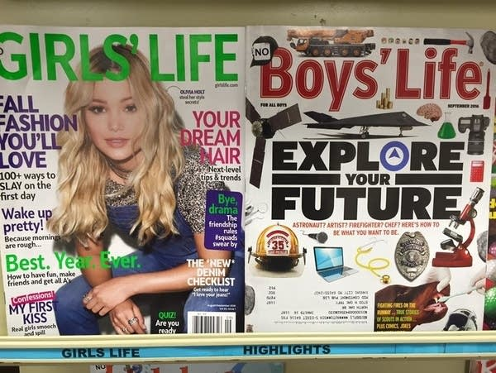

Slide 6
History and Manifestations of Patriarchy.
Religion: God as Male. Indeed, Patriarchy means ‘Rule of the Father’. Adam and Eve tale sees woman created ‘from man’ and embodies an ultimate male-female relationship of dominance and Hierarchy (other religions similar).
Family: Nuclear family with ‘Father Figure’ as Head of Household/Breadwinner. Idea of ‘Father’ and ‘Mother’ Figures with different roles and competences reinforcing male dominance.
Family then socialises young to reproduce these roles in society at a later time.

Slide 7
Manifestations of the Patriarchy in the UK/US.
Education/Employment: Despite advances, huge gaps exist in the earnings of men and women in the United Kingdom and United States. Just under 20%. 5% of women are CEO’s and only 30% of women are parliamentarians. Women massively underrepresented in leadership positions, and therefore power and control.
Education: Huge underreprentations of women in STEM subjects: Broadly as a result of the ‘socialization’ of male and female subjects- Refer to earlier magazine cover!

Slide 8
Sexual Relations and Manifestations of the Patriarchy
‘Slut Shaming’- The idea that women should be judged negatively for an active sexuality and sex life while men are to be praised for the same thing. Has to do with patriarchal viewpoints that men should control womens bodies.
Pornography: Huge amounts (perhaps the majority) or pornography explicitly portrays women as ‘objects’ for mens pleasure and places them in degrading and humiliating positions. This pornography reflects the patriarchal view of women as tools for mens pleasure and male dominance over women.

Slide 9
Bell Hooks: Aint I a woman? White privilege and Feminism
Black women’s struggle ‘distinct’ from white womens due to the mutually destructive combination of patriarchy *and* racism.
Black women neglected from discourse ‘Black’ person in the white feminist movement meant black man and white meant women.
American Women’s movement has not been free of racist socialization. Early feminist movement racist.
White Feminist Movements broadly excluded black women from the struggle for equal rights in the First feminist wave. Voted to exclude them from Women’s Congresses.
Felt their status as ‘ladies’ would be compromised by black women (racist stereotypes)
Main objective of white feminists was to maintain their place in the racial hierarchy and raise themselves in the gender hierarchy
Rather than appealing to a broad sisterhood of equal woman, white feminists still perceived white men as gatekeepers to the ‘capitalist, American dream’, which was distinctly white in every sense.

Slide 10
Bell Hooks 2.
In order for a ‘true’ sisterhood to form, white woman must challenge internal prejudices and racism they have and ‘accept’ the structural racism deep within the white feminist movement. In America, Racial Imperialism was a stronger force than Sexual Imperialism (Trump)
Universities: Primarily white staff in ‘womens studies’ department.
‘Colorblindness’: Acting as if ‘Colour doesn’t matter’ or ‘We’ve moved past that’ ignores the history and structure that still leaves woman of colour facing both the patriarchy and racism. Resistance to racial discussions.

Slide 11
Third/Fourth Wave Femininsm
INTERSECTIONALITY: ‘NOT ALL INEQUALITIES ARE CREATED EQUAL’. Future struggles must accept and make accommodation for the hugely divergent experiences of women premised on their race, class, sexual orientation, assigned sex at birth (Trans) people.
Gender Roles must be considered; not only should ‘constructions of feminity be examined’, but also masculinity: ‘Toxic’ Masculinity must be combatted (Trump).

Slide 12
Discussion Questions
Think about your own countries. How does patriarchy manifest in them, and has there been progress/change over the periods of your life time? How has this change come about?
Is it possible/desirable to remove/desocialize all gender roles from society? How would this be done?
Violent or degrading pornography is often considered to harm male psyche and reinforce toxic patriarchal stereotypes of male/female relationships and sexual relationships. Should this type of pornography be banned/ heavily regulated?

