Slide 1
Capitalism and Socialism in the UK and US.

Slide 2
What is Capitalism?
An economic and political system in which a country's trade and industry are controlled by private owners for profit, rather than by the state.- Oxford English Dictionary.
Major, overridng goal of capitalism is the ‘generation’ of capital, and ultimately profit. This profit is by and large absorbed by ‘corporations’, who exist independently from the state
Accepts the primary agents in society to be those involved in the generation of capital- i.e. corporations, who will become the dominant forces in society.

Slide 3
Capitalism ‘Replaced’ Feudalism
Prior to capitalism, and the dominance of Capital, the UK and most of Europe had been dominated by Feudalism. Feudalism was a system where all land owned by King and Nobles: Others were ‘vassals’ on that land but did not have ownership.
Capitalism ‘overpowered’ feudalism and allowed non-nobles and corporations to attain dominance in society.
Reduced ideas of ‘God-given’ power and the power of ‘Blood’ or Ancestry as providing a right to rule or dominate society.

Slide 4
What Has Capitalism Ever Given Us?

Slide 5
Marx’s Critique of Capitalism 1. Capitalism is amoral and leads to increasing inequalty
As Capitalism’s core goal is profit, it seems humans as ‘units of production’. The key purpose of Capitalism is to attain maximum profit at minimum cost.
In such a system, wealth will inevitably flow towards the top and an increasing degree of what is produced will be possessed by a very small percentage at the top, with the minimum possible given to the wider ‘proletariat’ who produce most.
Capitalism need not ‘start’ so unequal but the ruthless logic of it will inevitably lead to these injustices and inequalities.

Slide 6
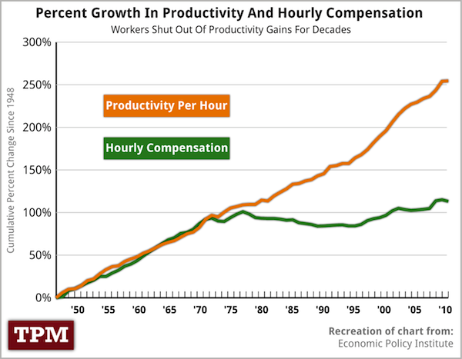
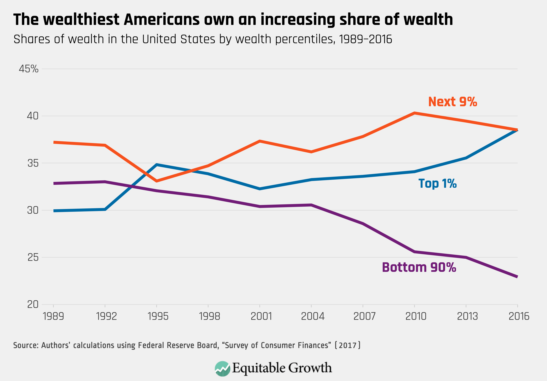

Slide 7
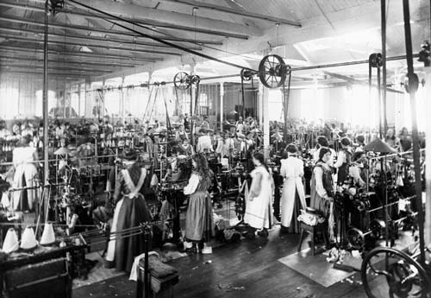
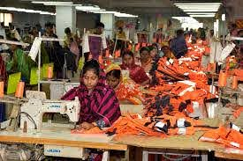

Slide 8
Marx 2: Capitalism ‘Alienates’ People from Labour which harms their ‘Species being’
People’s ‘Species Being’ intends them to be creative and productive and enjoy the fruits of their labour.
Capitalism ‘alienates’ people from their own work by ‘taking’ that labour from them and giving it to someone else to profit from.
Workers are therefore ‘dehumanized’ in the process of their work, unable to lead creating or fulfilling lives.

Slide 9
Capitalism Alienates us from….
Ourselves: When we are engaged in monotonous and repetitive forms of ‘wage slavery’ we are no longer living as ‘humans’ but are alienated from that humanity, with the product of our work becoming something hostile we have to do instead of something creative we cherish.
Others: Competition between people in a capitalist world formed on competition prevents us generating truly meaningful and uncalculating relationships with other people.
We are therefore only truly ‘human’ when we are ‘away’ from work, meaning we spend the vast majority of our lives, at work, unfulfilled from the perspective of our ‘species’ being’.
As everything is purchased with capital which is required to live, we have no choice but to participate in this dehumanizing system
In talking about ‘Species Being’, it appears Marx is referring to mental health and happiness. His argument is that being forced into monotonous and unfulfilling labour against your will will lead to an unhappy and unsatisfied society not fulfilling its potential.

Slide 10
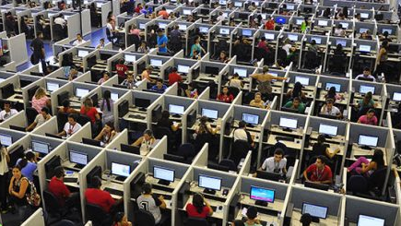

Slide 11
Marx’s Solutions/ Marxian Socialism
Abolition of Private Property
Heavy Graduated Taxation
Means of Production and Credit in the Hands of the State
Heavy Redistribution of Wealth.
Marx’s aim was to redistribute wealth to the extent of providing equality between all citizens.

Slide 12
American Capitalism vs Social Democracy
American Capitalism is premised on the the idea of the ‘American Dream’, that it is the responsibility and duty of the individual to attain wealth through his or her own talents and the States obligation to intervene to create this equality is minimal. Characteristics: Low State Intervention, Weak Welfare State, rejection of ‘redistributionist’ ideas. Fear and Loathing of ‘Socialism’.
European Social Democracy: Premised in a ‘mix’ of socialist and capitalist ideas. Premised on the idea that the state should provide everybody with the ‘basics’ to live a reasonable standard of life and to take advantage of the opportunities provided by the capitalist frame.

Slide 13
The Collapse of the American Dream? Is America an Oligarchy?
Modern United States has often been described as an oligarchy because economic elites control huge elements of the political class and have huge influence over policymakers and policy decisions.
Led to a huge expansion of wealth for the 1% and increasing economic struggles for many others, particularly the young.
Dominance of Private companies even in essential area of healthcare preventing a national health system to being implemented. The Healthcare debate demonstrates just how powerful corporations are in the US
Marxian argument that this represents the ‘Inevitable end stage’ of uncontrolled capitalism.

Slide 14
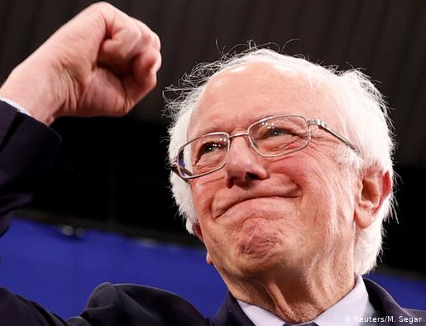
American Socialism

Slide 15
American Socialism
American ‘Socialists’ like Bernie and AOC are not ‘Socialists’ in the Marxist sense.
American Socialists seek to implement ‘European Social Democracy’ in the US: Healthcare, and a strong ‘Welfare State’. To make the US more like the UK and other European states.
Conservativists have thus far managed to demonise these Social Democrats as radical Marxists or to say they want to turn the US into Venezuela- while actually they want to turn the US into Sweden(at worst)!
American Socialism responding to the same problems that Marx identifies, but seeking to solve these problems through strengthening the welfare state and community and compassion rather than through blaming outsiders and nationalism.

Slide 16
Universal Basic Income: A solution to the Marxian Problem?
UBI seeks to pay everyone a monthly sum sufficient to provide housing, food, medicine, and basic amenities.
Most famously propounded by Andrew Yang in his 2020 presidential campaign, in which he proposed giving every adult American 1000 dollars.
Proponents suggest it could resolve the issues Marx raises by changing the power dynamic between corporations and people.
If being didn’t *have* to work to survive, corporations would be forced to provide more fulfilling work, conditions, and pay, creating a more equal society.
Capitalism would therefore cease to ‘alienate’ people and corporations would be forced to treat employees as full human beings rather than units of production

Slide 17
Discussion Questions.
To what Extent should the State be involved in the ‘redistribution of wealth?
Is Marx correct in his assessment of capitalism?
Is Universal Basic Income a viable solution to the problems Marx identifies?

