Slide 1
English Autonomously
Second Introductory Session Autumn 2020
Martina Šindelářová Skupeňová
Notes:
Technické hlášení
Small talk
Představení (improvizovaný rozhovor vedoucí k „priorities“)

Slide 2
ENGLISH AUTONOMOUSLY checking understanding
Finish the sentence:
Autonomous learning is …
In English, I am really good/bad at …
When learning, I feel …
When learning, I would like to …
When learning, I need …
In EA, I can …
Counselling is …
Modules are …
With EA materials, I did ….
Notes:
Složky – ve skupinkách prochází, diskutují, ptají se…
examples???

Slide 3
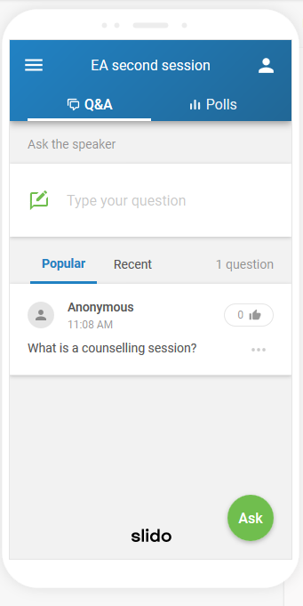
ENGLISH AUTONOMOUSLY slido
slido.com
#EA2
Notes:
Fotka nějakého dobrého kontraktu pro inspiraci…? MŠS, poté erasure
examples???

Slide 4

ENGLISH AUTONOMOUSLY plan for today – 1st part
CONTRACT
COUNSELLINGS
LOG
READINESS
SLIDO
Notes:
Fotka nějakého dobrého kontraktu pro inspiraci…? MŠS, poté erasure
examples???

Slide 5


ENGLISH AUTONOMOUSLY plan for today – 2nd part (7-7.20 pm)
BOOKING
study buddy
1st counselling
module
module
Notes:
Fotka nějakého dobrého kontraktu pro inspiraci…? MŠS, poté erasure
examples???

Slide 6
ENGLISH AUTONOMOUSLY contract/ agreement
Notes:
Fotka nějakého dobrého kontraktu pro inspiraci…? MŠS, poté erasure
examples???

Slide 7
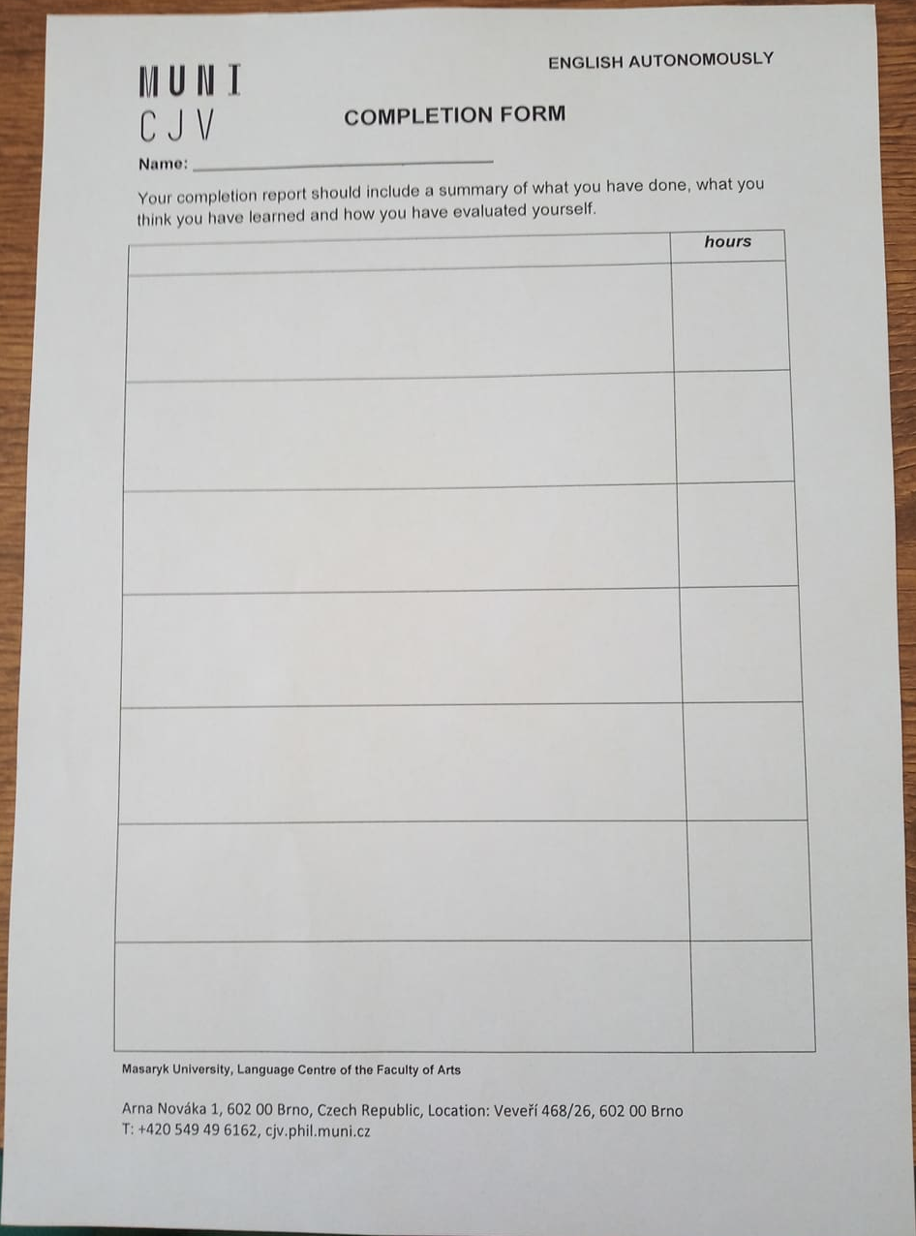
ENGLISH AUTONOMOUSLY contract/ plan/ agreement
Notes:
Připomenout DIY!!!!!!
contact hours – 4,5 with modules plus home preparation – how much?
Odkazy na videopozvánky?

Slide 8
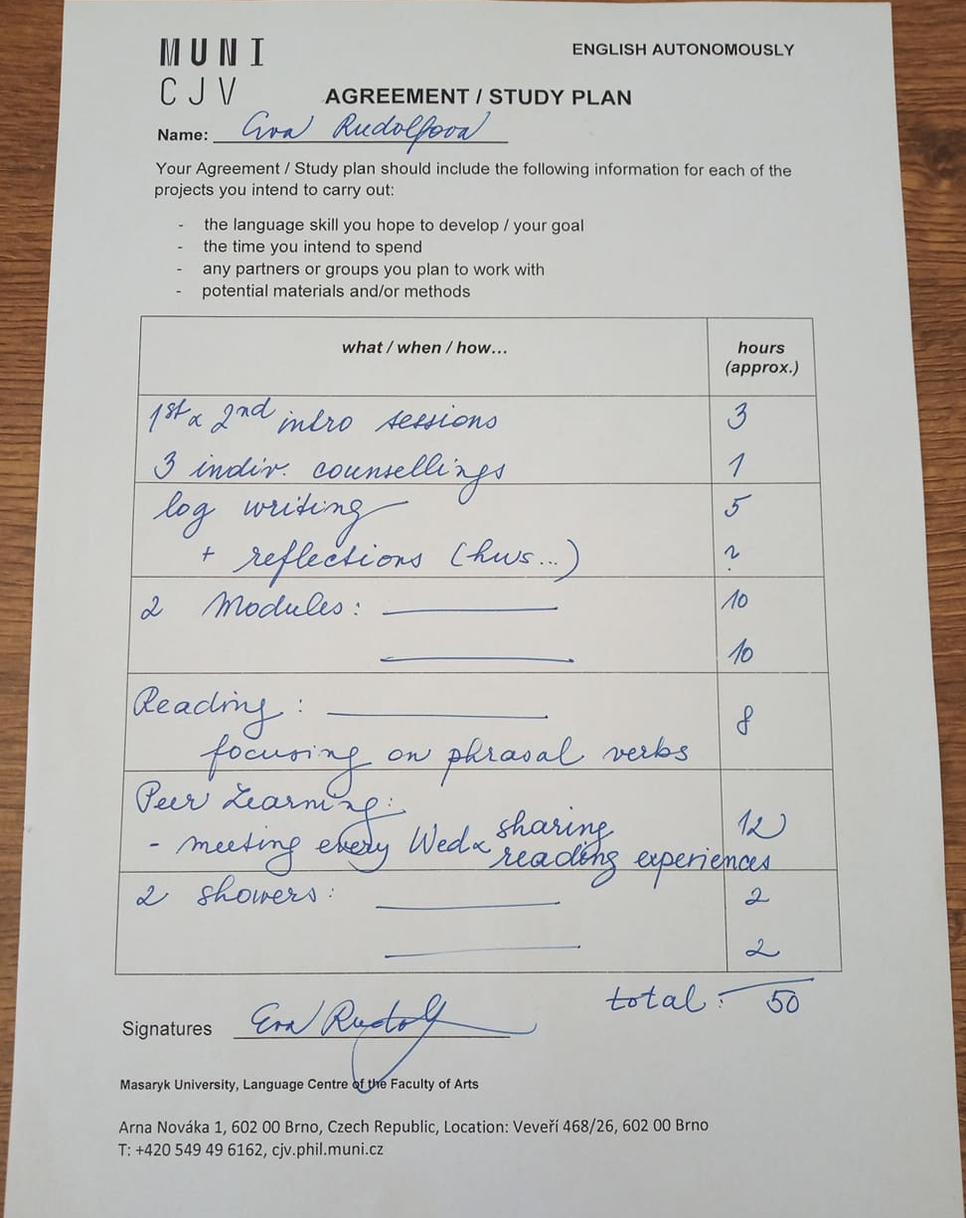
ENGLISH AUTONOMOUSLY contract/ plan/ agreement
Notes:
Struktura kurzu!!!
contact hours – 4,5 with modules plus home preparation – how much?
Odkazy na videopozvánky?

Slide 9
ENGLISH AUTONOMOUSLY metacognition for autonomous learning
planning
monitoring
evaluating
Notes:
MAI – všichni snad mají…

Slide 10
ENGLISH AUTONOMOUSLY counselling sessions
planning
monitoring
evaluating

Slide 11

ENGLISH AUTONOMOUSLY counseling session 1 - planning
Image from https://kimblechartingsolutions.com/2017/06gold-bulls-wantnedd-support-hold/

Slide 12
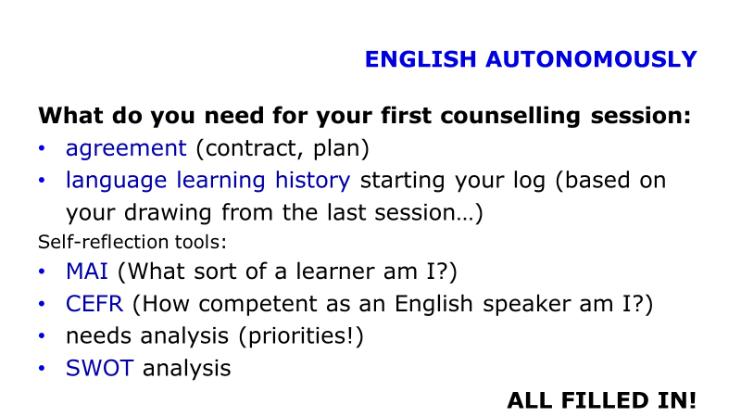
ENGLISH AUTONOMOUSLY getting ready for 1st counselling
TASK:
In pairs talk about your preparation for the 1st counselling session:
What do I want and need to achieve?
Do I know what to bring?
Do I know what to do with each paper and why?
Do I have a plan?

Slide 13

ENGLISH AUTONOMOUSLY counseling session 2 - monitoring
Image from Unsplash.com

Slide 14

ENGLISH AUTONOMOUSLY counseling session 3 - evaluating
Image from Unsplash.com

Slide 15






ENGLISH AUTONOMOUSLY learning diary/ log/ reflective writing
Images from Unsplash.com
Notes:
examples???

Slide 16



ENGLISH AUTONOMOUSLY reflective writing
a guide by University of Hull
a very brief guide by Vancouver Community College

Slide 17
ENGLISH AUTONOMOUSLY log writing
Focus: English learning
Activity: regular
Writing style: use I/we/me
structure your writing (before/during/after; event/learning/what/how/why/next time)

Slide 18
ENGLISH AUTONOMOUSLY log writing
Questions:
What have I learned?
What do I know now that I did not know?
What were my strenghts and weaknesses during the experience? What were the challenges and how did I handle them?
What was useful?
What would I do better next time?
What have I learnt from this?

Slide 19
ENGLISH AUTONOMOUSLY log writing
Form: online log, video log, audio log, hand-written log, portfolio, book...
language learning history (LLH) to start with

Slide 20
ENGLISH AUTONOMOUSLY learning by doing – writing a reflection
Try to reflect on your recent learning experience.

Slide 21
ENGLISH AUTONOMOUSLY log writing
Questions:
What have I learned?
What do I know now that I did not know?
What were my strenghts and weaknesses during the experience? What were the challenges and how did I handle them?
What was useful?
What would I do better next time?
What have I learnt from this?

Slide 22
ENGLISH AUTONOMOUSLY
What do you need for your first counselling session:
agreement (contract, plan)
language learning history starting your log (based on your drawing from the last session…)
Self-reflection tools:
MAI (What sort of a learner am I?)
CEFR (How competent as an English speaker am I?)
needs analysis (priorities!)
SWOT analysis
ALL FILLED IN!

Slide 23
ENGLISH AUTONOMOUSLY
FAIR
BOOKING
study buddy
1st counselling
module
module
Make sure you stay till the end to find out which modules and showers get opened.
Notes:
Fotka nějakého dobrého kontraktu pro inspiraci…? MŠS, poté erasure
examples???

Slide 24
ENGLISH AUTONOMOUSLY modules and showers
Conversation
Public Speaking Module
Listening to Brno Architecture
Academic? Ambitious? Absolute?
Vocabulary Builder
Real-life German – English translations
Fear
Writing Lab
Board Games
Stress Management
Breakfast to learn English from
Let'sTalk Safe Tech
Mindsets
Theatre Night: Frothing Mouths. Hungry Eyes
Sitting Through a Sitcom

Slide 25
ENGLISH AUTONOMOUSLY
Thank you for the second session:)

Slide 26
ENGLISH AUTONOMOUSLY bibliography
Holec, Henri: Autonomy and Foreign Language Learning. Oxford, 1981.
Little, David: Learner autonomy 1: definitions, issues and problems. Dublin, 1991.
Karlsson, Leena, Kjisik, Felicity & Nordlund, Joan: From Here To Autonomy. Helsinki, 1997.
Schraw, Gregory and Dennison, Ryne Sperling: Assessing metacognitive awareness. In: Contemporary Educational Psychology, 19, 460-475.

