Slide 1
English Autonomously
Second Introductory Session Autumn 2020
Eva Rudolfová
Notes:
Technické hlášení
Small talk
Představení (improvizovaný rozhovor vedoucí k „priorities“)

Slide 2
ENGLISH AUTONOMOUSLY checking understanding
Finish the sentence:
Autonomous learning is …
In English, I am really good/bad at …
When learning, I feel …
When learning, I would like to …
When learning, I need …
In EA, I can …
Counselling is …
Modules are …
With EA materials, I did ….
Notes:
pairs
examples???

Slide 3

ENGLISH AUTONOMOUSLY plan for today – 1st part
CONTRACT
COUNSELLINGS
LOG
READINESS
SLIDO
Notes:
examples???

Slide 4
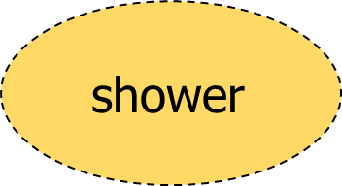

ENGLISH AUTONOMOUSLY check out
BOOKING
study buddy
1st counselling
module
module
Notes:
Fotka nějakého dobrého kontraktu pro inspiraci…? MŠS, poté erasure
examples???

Slide 5
ENGLISH AUTONOMOUSLY contract/ agreement
Notes:
Fotka nějakého dobrého kontraktu pro inspiraci…? MŠS, poté erasure
examples???

Slide 6
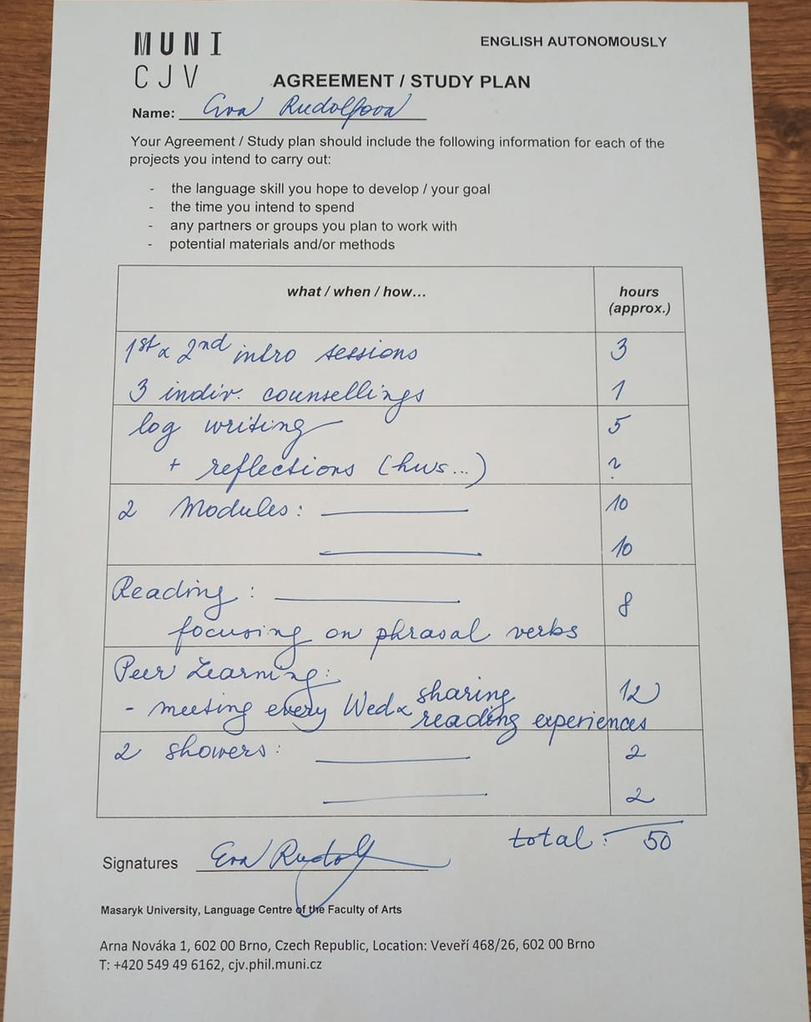
ENGLISH AUTONOMOUSLY contract/ plan/ agreement
Notes:
Struktura kurzu!!!
contact hours – 4,5 with modules plus home preparation – how much?
Odkazy na videopozvánky?

Slide 7
ENGLISH AUTONOMOUSLY metacognition for autonomous learning
planning
monitoring
evaluating
Notes:
MAI – všichni snad mají…

Slide 8
ENGLISH AUTONOMOUSLY counselling sessions
planning
monitoring
evaluating

Slide 9

ENGLISH AUTONOMOUSLY counseling session 1 - planning
Image from https://kimblechartingsolutions.com/2017/06gold-bulls-wantnedd-support-hold/

Slide 10
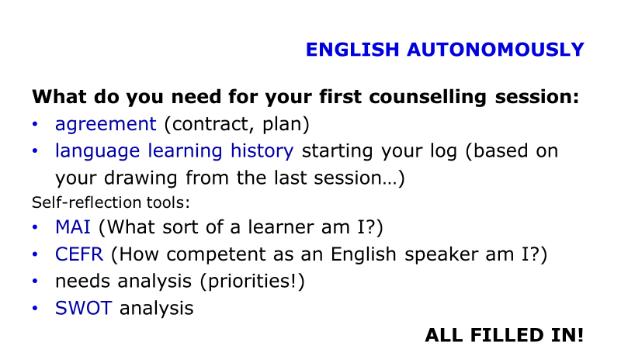
ENGLISH AUTONOMOUSLY getting ready for 1st counselling
TASK:
In pairs talk about your preparation for the 1st counselling session:
What do I want and need to achieve?
Do I know what to bring?
Do I know what to do with each paper and why?
Do I have a plan?

Slide 11

ENGLISH AUTONOMOUSLY counseling session 2 - monitoring
Image from Unsplash.com

Slide 12

ENGLISH AUTONOMOUSLY counseling session 3 - evaluating
Image from Unsplash.com

Slide 13






ENGLISH AUTONOMOUSLY learning diary/ log/ reflective writing
Images from Unsplash.com
Notes:
examples???

Slide 14



ENGLISH AUTONOMOUSLY reflective writing
a guide by University of Hull
a very brief guide by Vancouver Community College

Slide 15
ENGLISH AUTONOMOUSLY log writing
Focus: English learning
Activity: regular
Writing style: use I/we/me
structure your writing (before/during/after; event/learning/what/how/why/next time)

Slide 16
ENGLISH AUTONOMOUSLY log writing
Questions:
What have I learned?
What do I know now that I did not know?
What were my strenghts and weaknesses during the experience? What were the challenges and how did I handle them?
What was useful?
What would I do better next time?
What have I learnt from this?

Slide 17
ENGLISH AUTONOMOUSLY log writing
Form: online log, video log, audio log, hand-written log, portfolio, book...
language learning history (LLH) to start with

Slide 18
ENGLISH AUTONOMOUSLY learning by doing – writing a reflection
Try to reflect on your recent learning experience.

Slide 19
ENGLISH AUTONOMOUSLY log writing
Questions:
What have I learned?
What do I know now that I did not know?
What were my strenghts and weaknesses during the experience? What were the challenges and how did I handle them?
What was useful?
What would I do better next time?
What have I learnt from this?

Slide 20
ENGLISH AUTONOMOUSLY
What do you need for your first counselling session (to be put in the HOMEWORK VAULT/ ODEVZDAVARNA):
agreement (contract, plan)
language learning history starting your log (based on your drawing from the last session…)
Recommended self-reflection tools:
CEFR (How competent as an English speaker am I?)
needs analysis (priorities!)
SWOT analysis
ALL FILLED IN!

Slide 21
ENGLISH AUTONOMOUSLY
Where does our counselling session happen?
In Google Chat (Google serviced need to be allowed on your IS page)
Other questions?

Slide 22
ENGLISH AUTONOMOUSLY
Thank you for being with me for the second session:)

Slide 23
ENGLISH AUTONOMOUSLY bibliography
Holec, Henri: Autonomy and Foreign Language Learning. Oxford, 1981.
Little, David: Learner autonomy 1: definitions, issues and problems. Dublin, 1991.
Karlsson, Leena, Kjisik, Felicity & Nordlund, Joan: From Here To Autonomy. Helsinki, 1997.
Schraw, Gregory and Dennison, Ryne Sperling: Assessing metacognitive awareness. In: Contemporary Educational Psychology, 19, 460-475.

