Slide 1
Abstraktní malířství v USA Color-field painting

Slide 2
Barnett Newman 1905-1970

Slide 3
Command 1946

Slide 4
Genetic moment I 1947

Slide 5
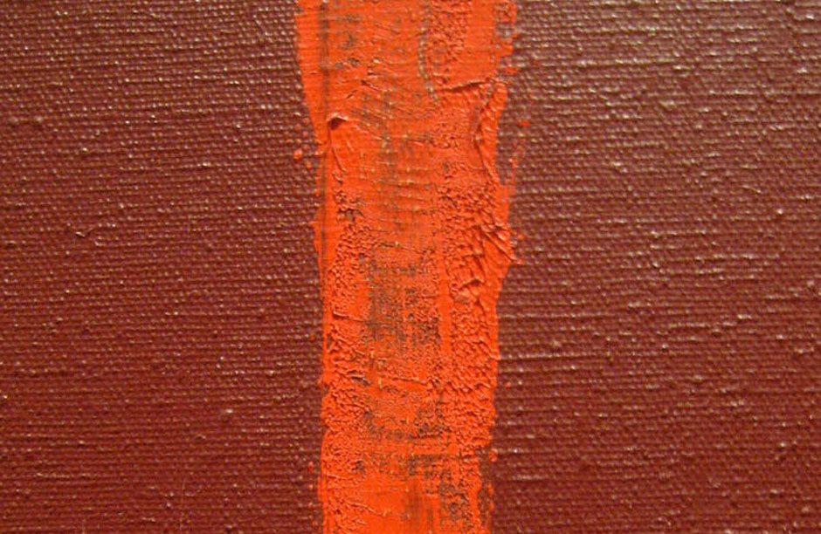
Onement 1, 1948

Slide 6
Concord 1949

Slide 7
Tundra 1950

Slide 8
Adam 1952

Slide 9
Vir Heroicus Sublimis 1950-51

Slide 10
Uriel 1955

Slide 11
Anna´s Light 1968

Slide 12
Stations of the Cross 1965-70

Slide 13
Broken obelisk 1963-67

Slide 14
Mark Rothko 1903-1970

Slide 15
Slow Swirl at the Edge of the Sea 1944

Slide 16
Multiform 1947

Slide 17
No 11, 1949

Slide 18
No 16, 1949

Slide 19
Untitled 1949

Slide 20
No. 24, 1949

Slide 21
No. 6 (Yellow, White, Blue Over Yellow on Gray) 1954

Slide 23
Black blue painting 1968

Slide 24
Black on grey 1970

Slide 26
Rothko´s Chapel, Houston 1971

Slide 27
Clyfford Still 1904-80
PH 143

Slide 28
1936-37 no. 2 1937

Slide 29
1943-J, 1943

Slide 30
PH-233 (Self portrait), 1946

Slide 31
Ph 950, 1950 Ph 252, 1955

Slide 32
Ph 401, 1957

Slide 33
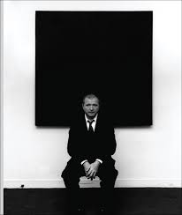
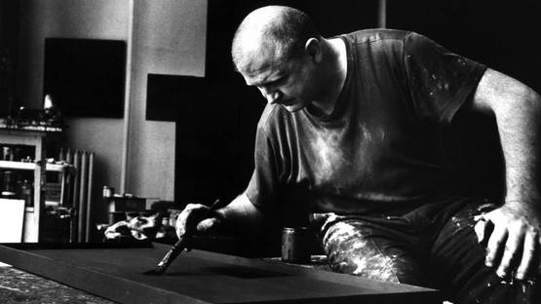
Ad Reinhardt 1913 - 1967

Slide 34
Number 88 (Blue), 1950

Slide 35
Abstract painting 1952

Slide 36
Blue-purple painting 1952

Slide 37
No. 17, 1953

Slide 38
Painting 1959

Slide 39
Abstract painting no. 4, 1961

Slide 40
Abstract painting no. 5, 1962

