Slide 1
Post-painterly abstraction
Hard edge painting

Slide 2
1940
1945
1950
1955
1960
1965
1970
ABSTRACT EXPRESSIONISM
Action painting
Color field painting
Pop art
Post-painterly abstraction
---------
Hard edge
painting
Minimalism

Slide 3
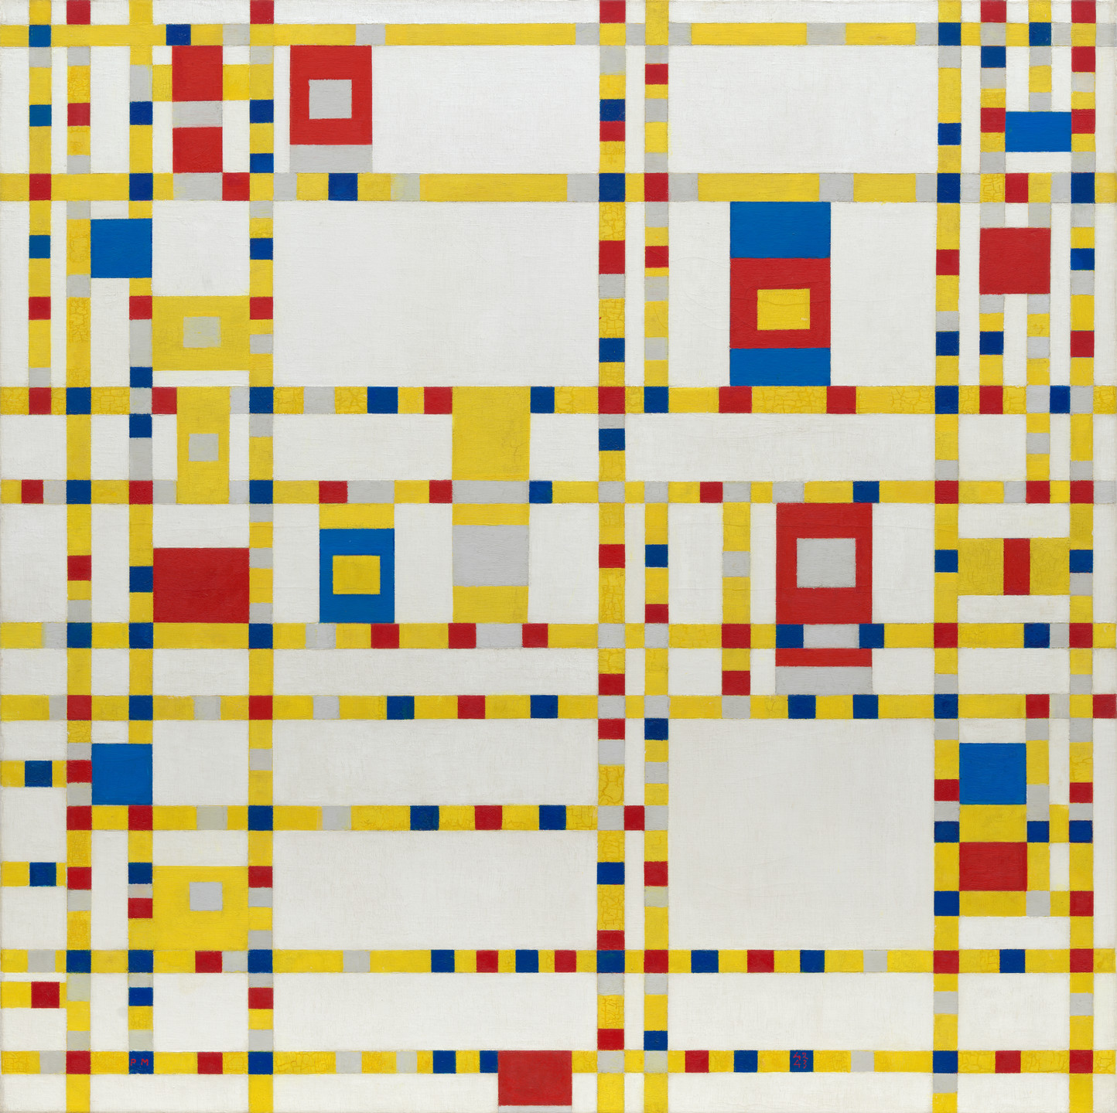
Broadway Boogie woogie, 1942-43

Slide 4
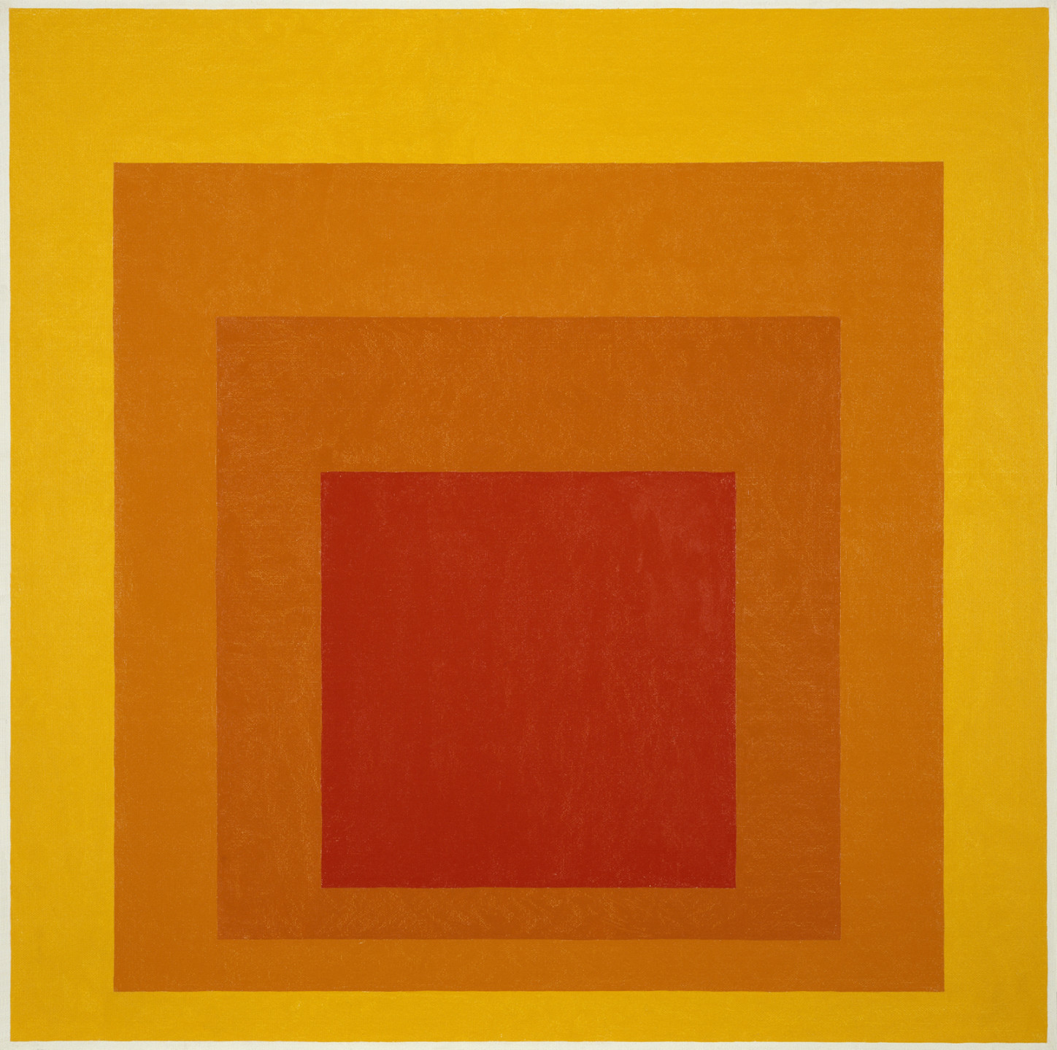
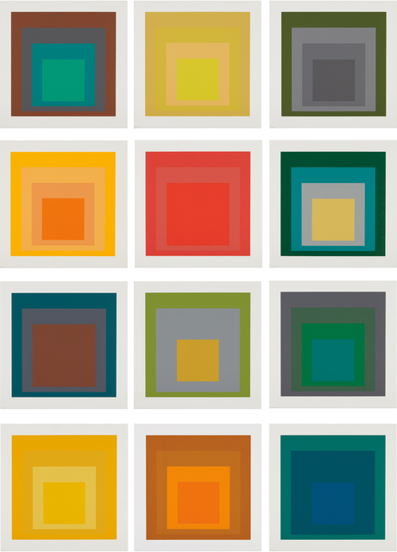
Josef Albers

Slide 5
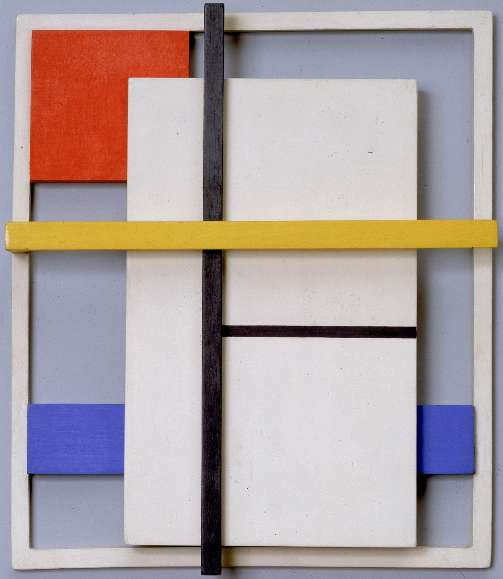
Burgoyne Diller 1906-65
Construction 1938

Slide 6
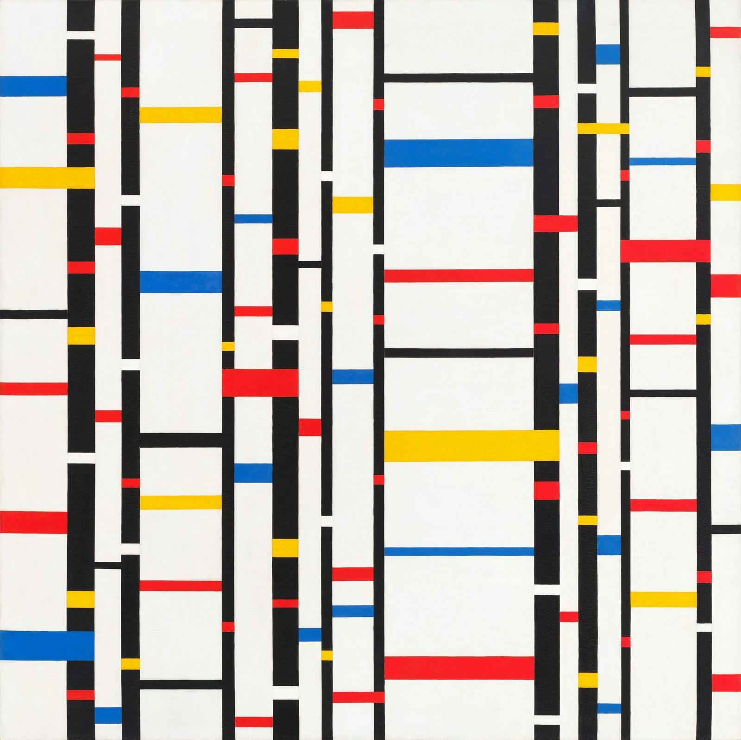
Third theme 1946-48

Slide 7
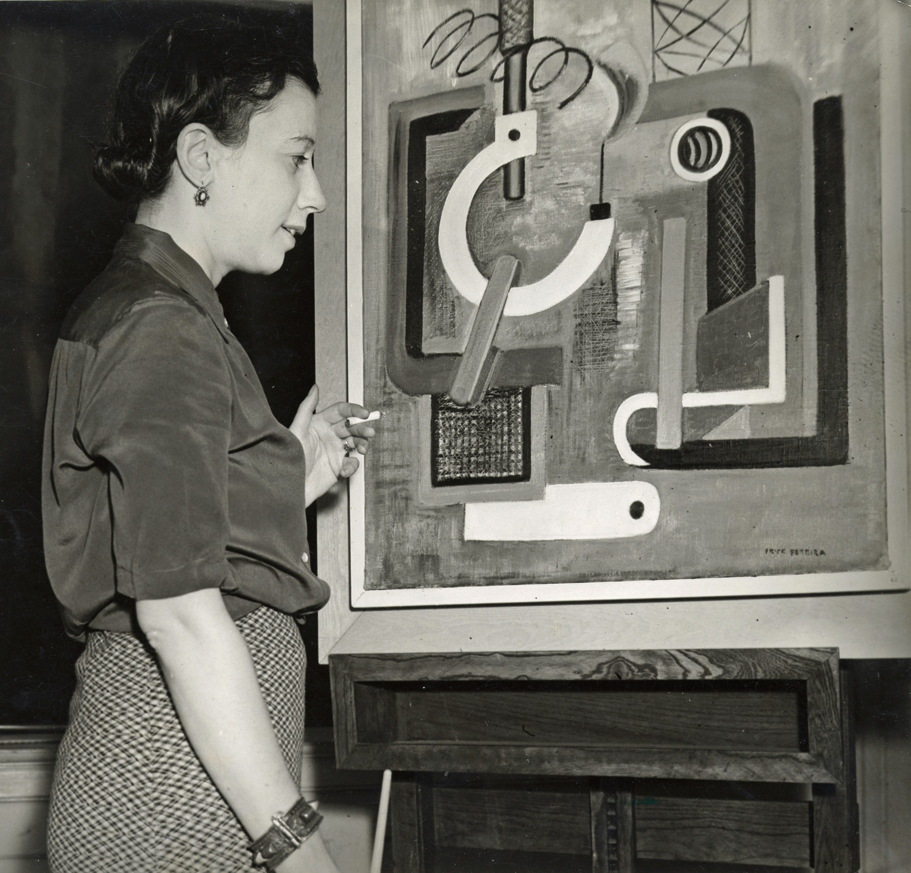
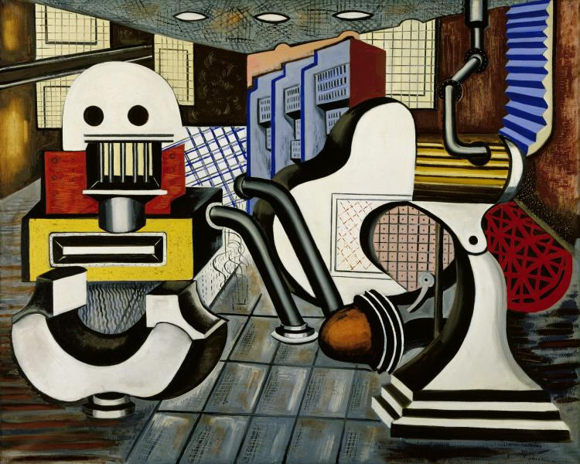
Irene Rice Pereira 1902-1971
Machine composition 2, 1937

Slide 8
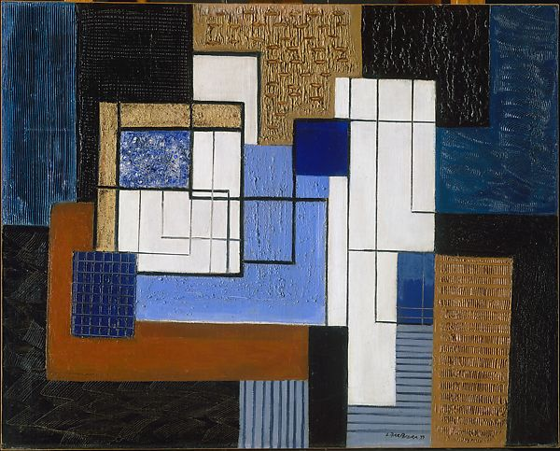
White rectangles, no. 3, 1939

Slide 9
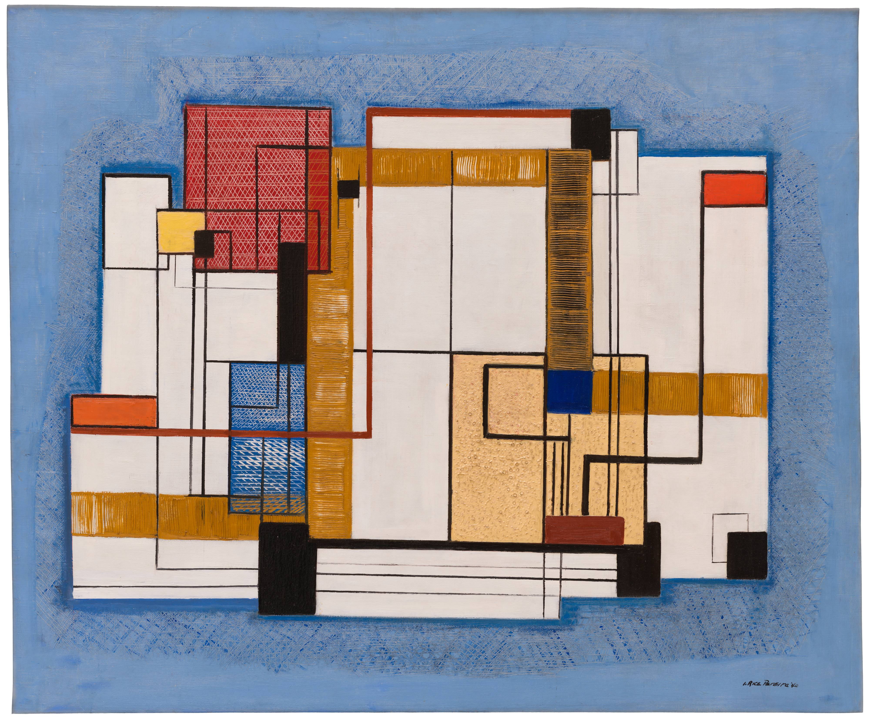
Abstraction 1940

Slide 10
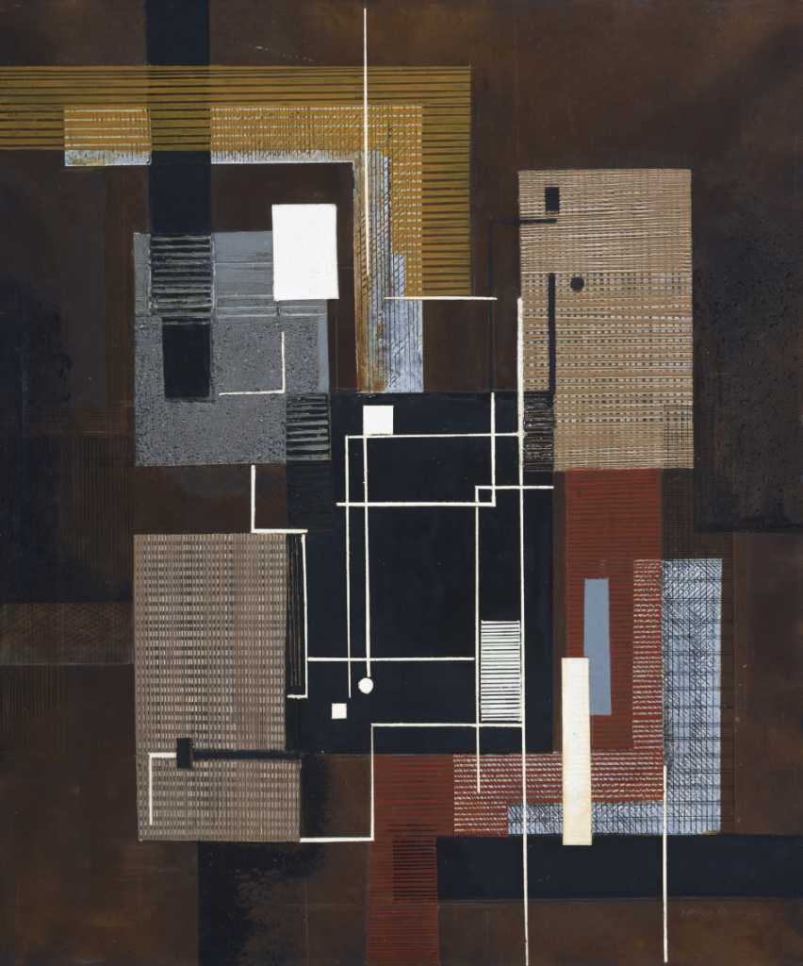
White Lines 1942

Slide 11
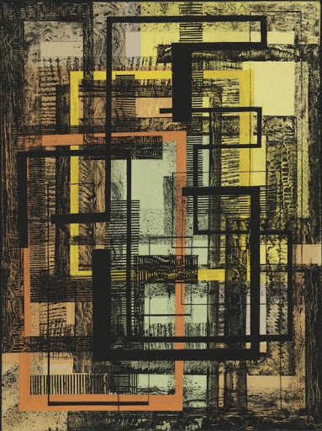
Unfolding Spring 1951

Slide 12
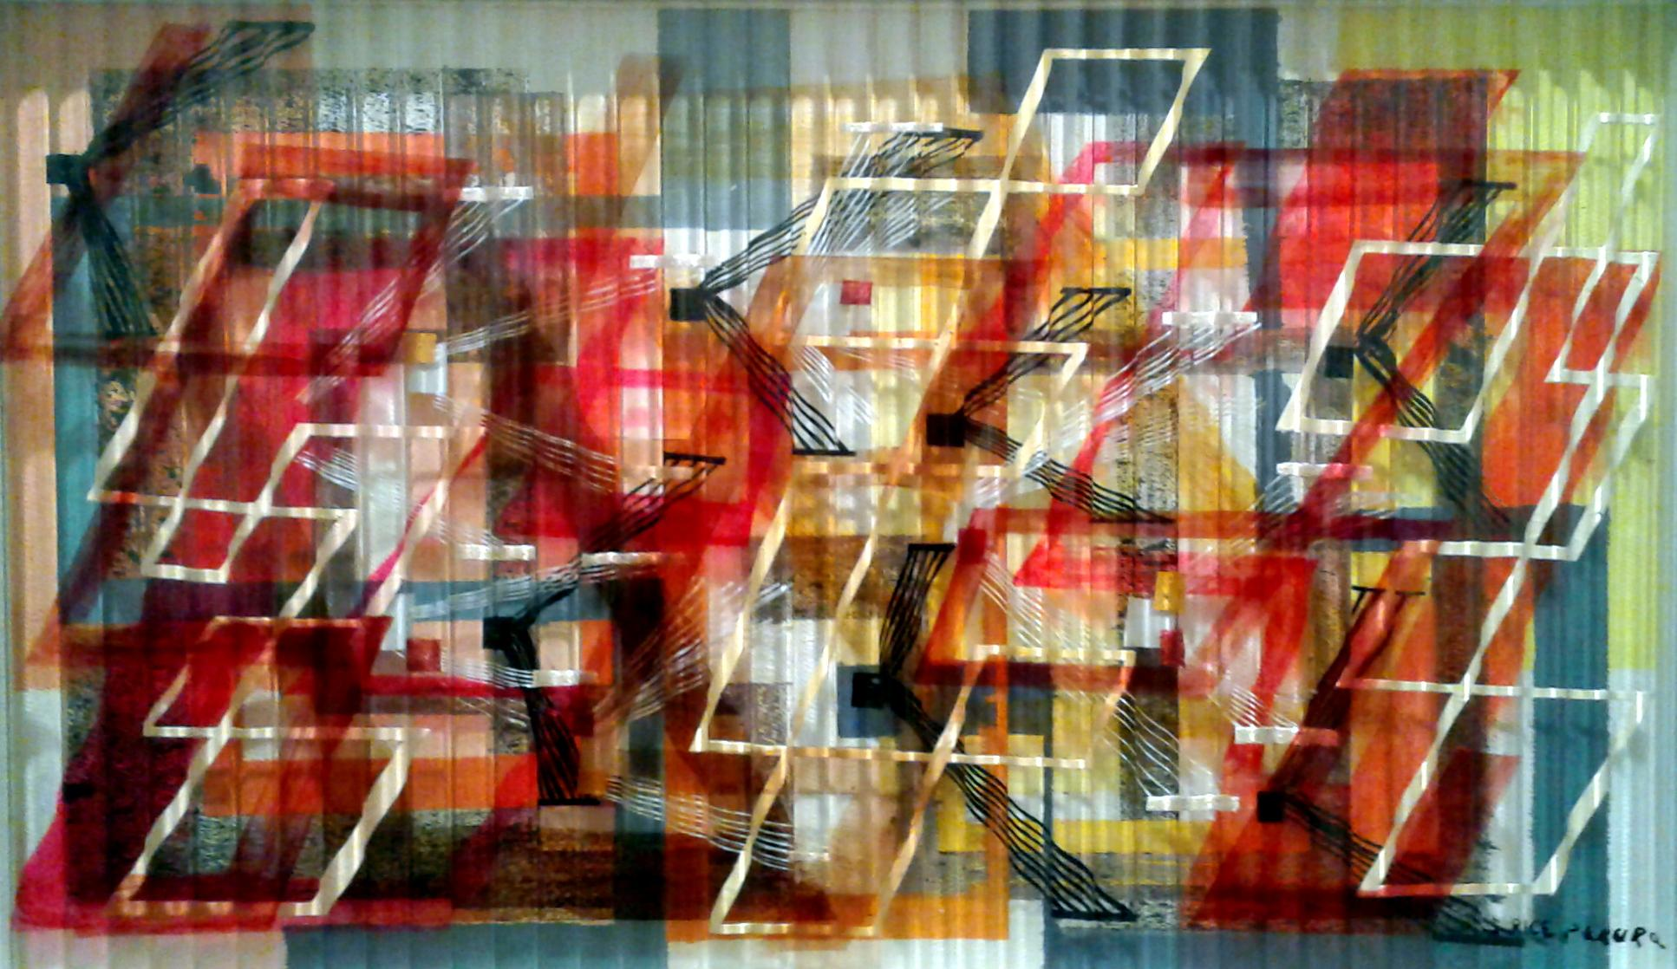
Shooting stars 1952

Slide 13
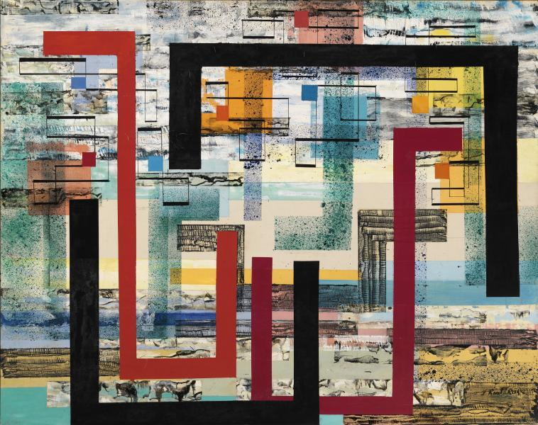
Mecca 1953

Slide 14
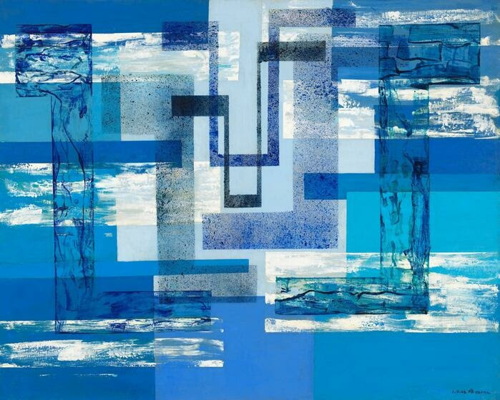
Landscape of the Absolute 1955

Slide 15
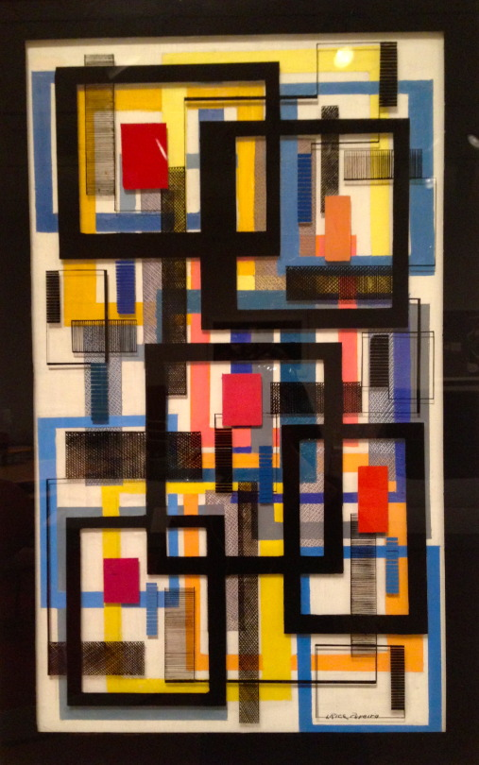
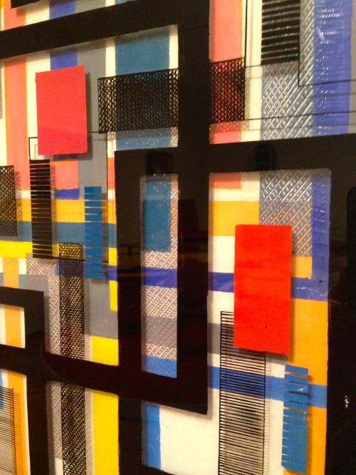

Slide 16
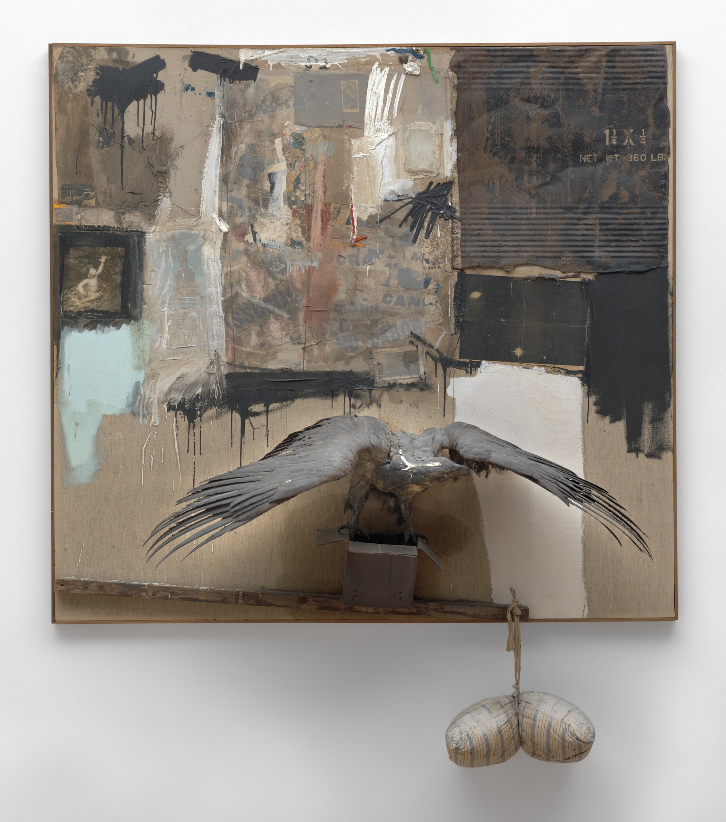
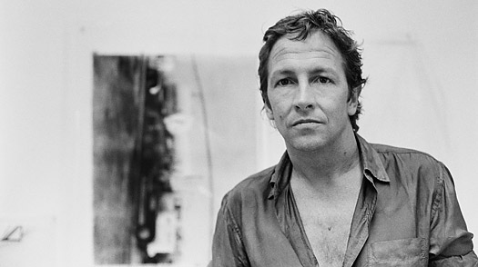
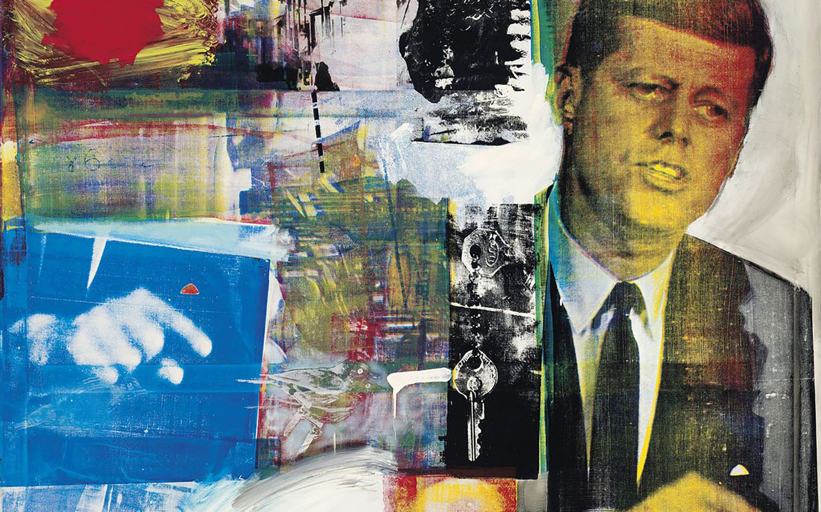
Robert Rauschenberg
Canyon 1959

Slide 17
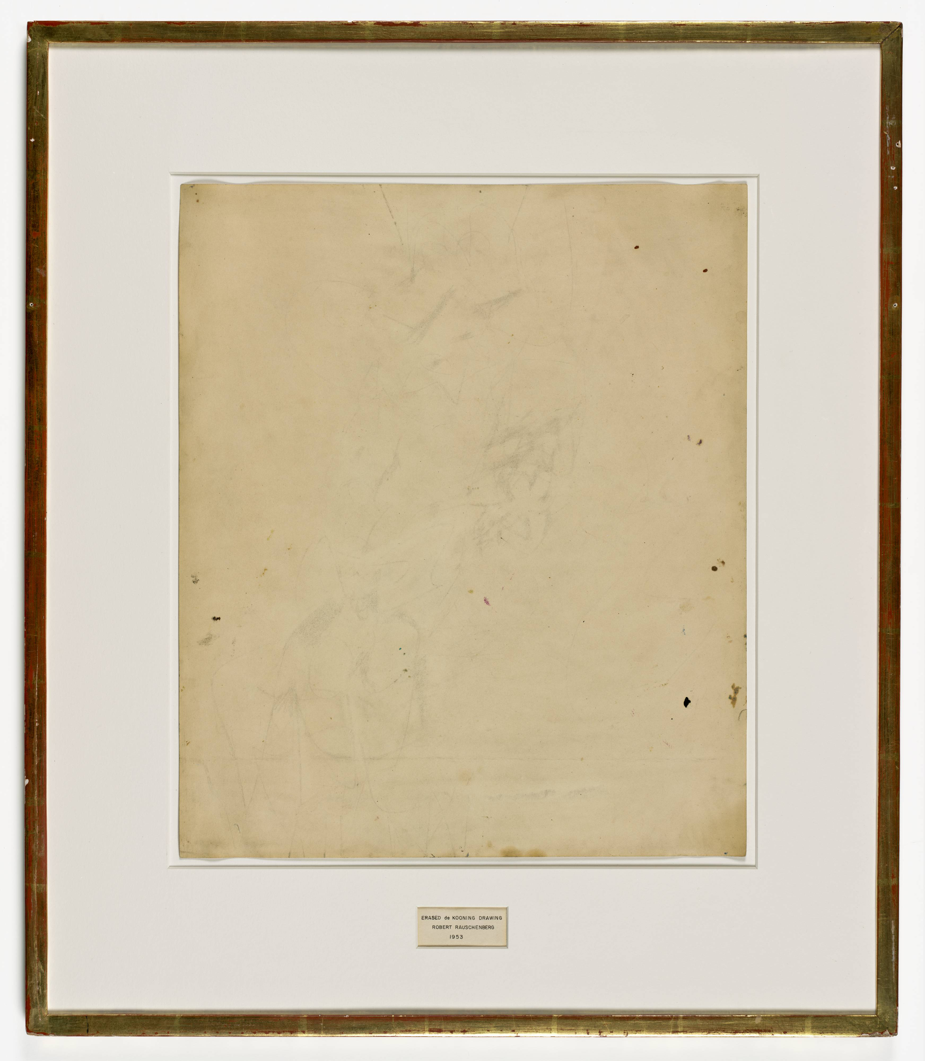
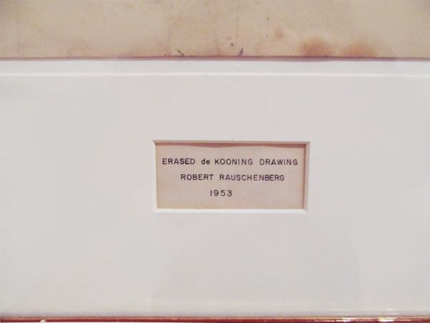

Slide 18
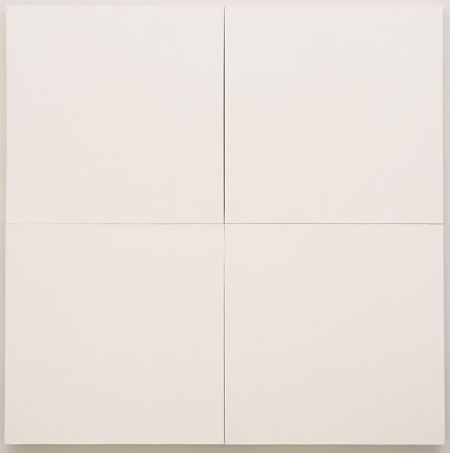
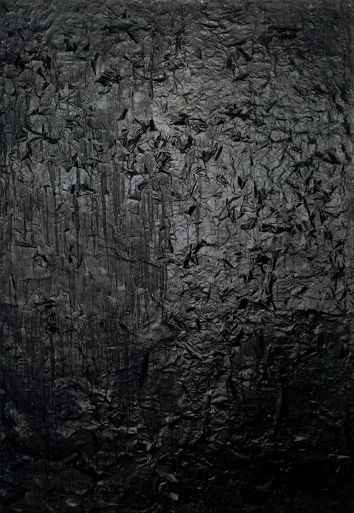
White painting 1951 Untitled (Black painting) ca 1951

Slide 19
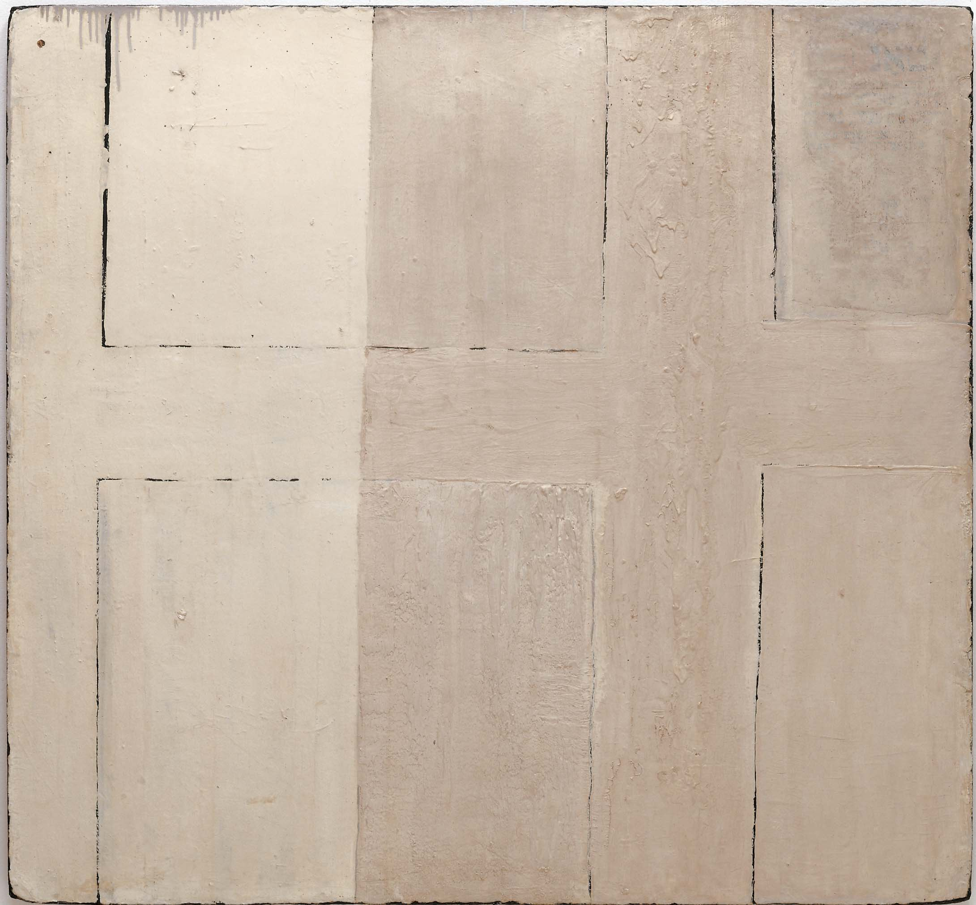
Crucifixion and Reflection ca 1950

Slide 20
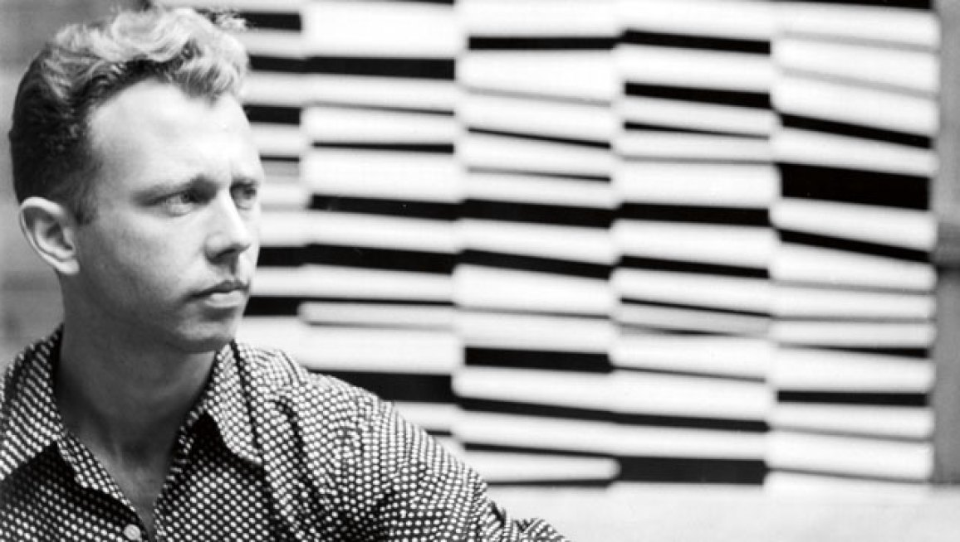
Ellsworth Kelly 1923-2015

Slide 21
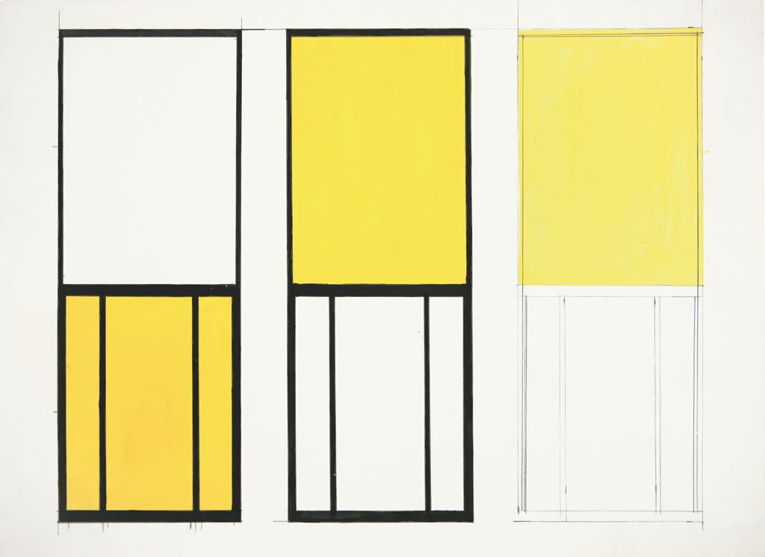
Studies for Window 1949

Slide 22
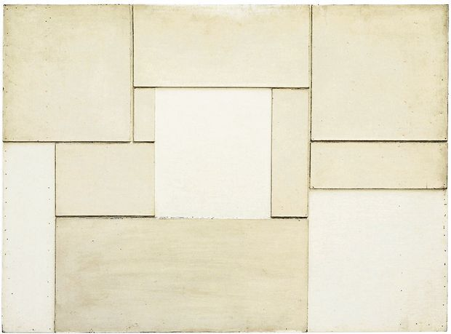
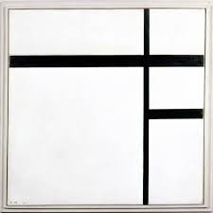
Neuilly 1950

Slide 23
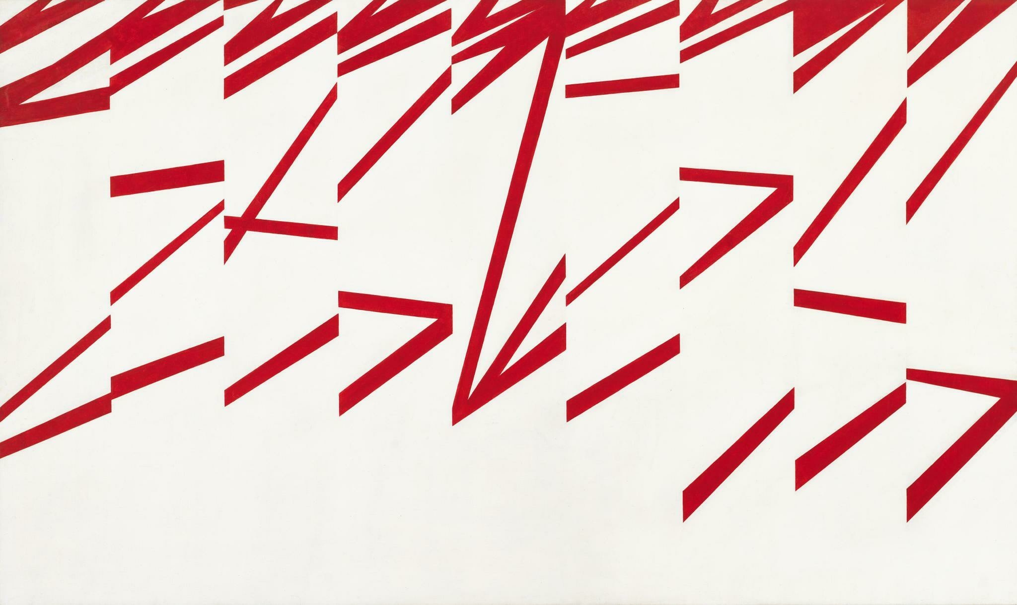
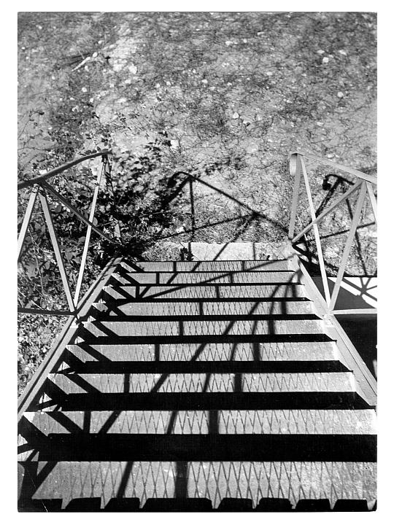
La Combe I 1950 Shadows on Stairs 1950

Slide 24
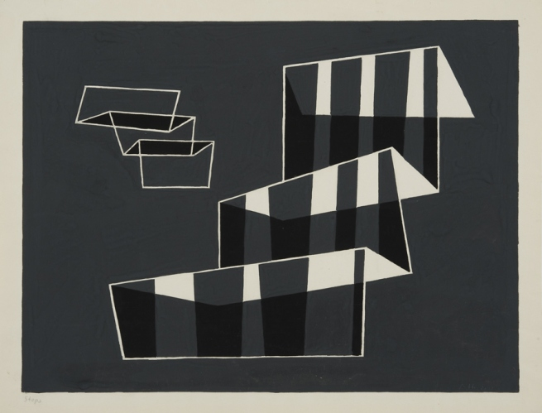
Joseph Albers, Steps 1931

Slide 25
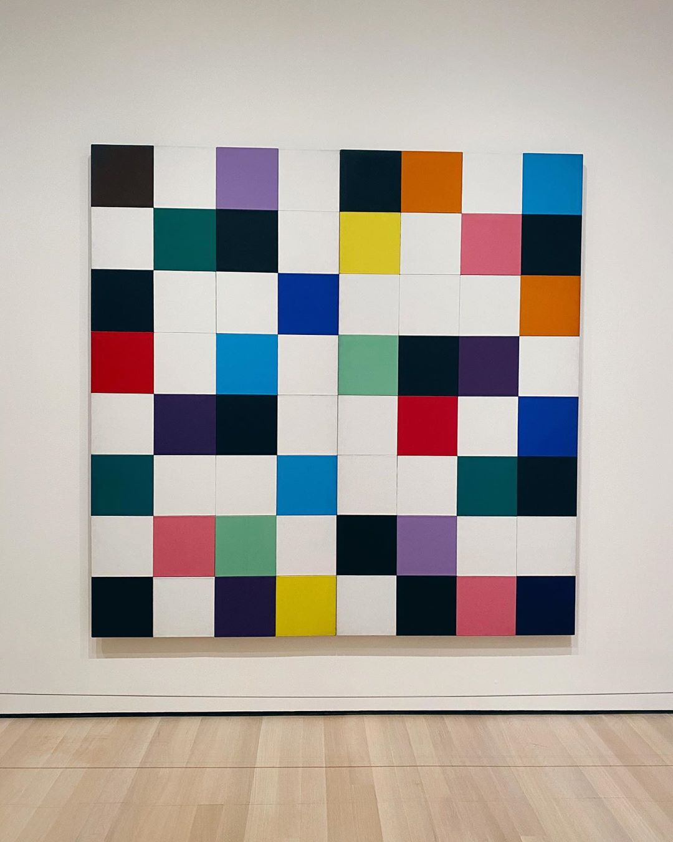
Colors for a large wall 1951

Slide 26
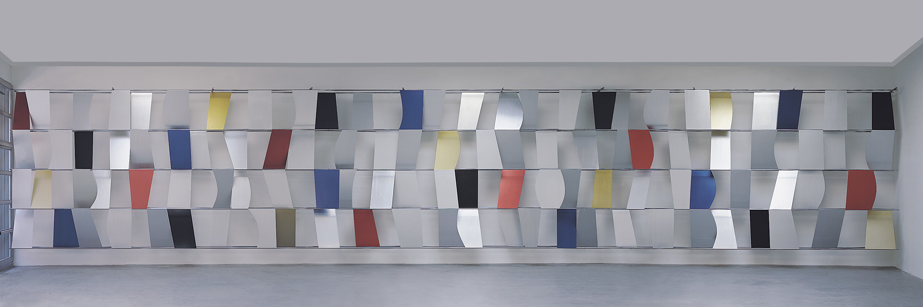
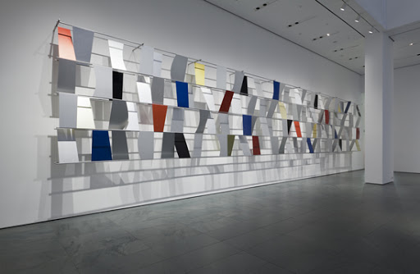
Sculpture for a Large Wall 1956-57

Slide 27
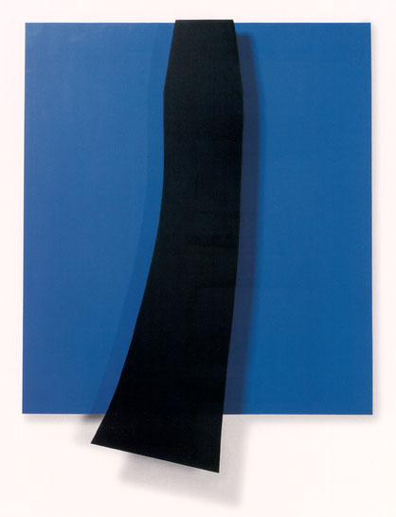
Black over blue 1963

Slide 28
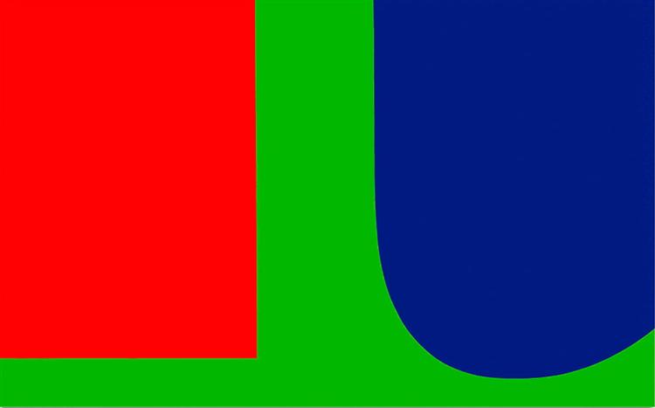
Red Blue Green 1963

Slide 29
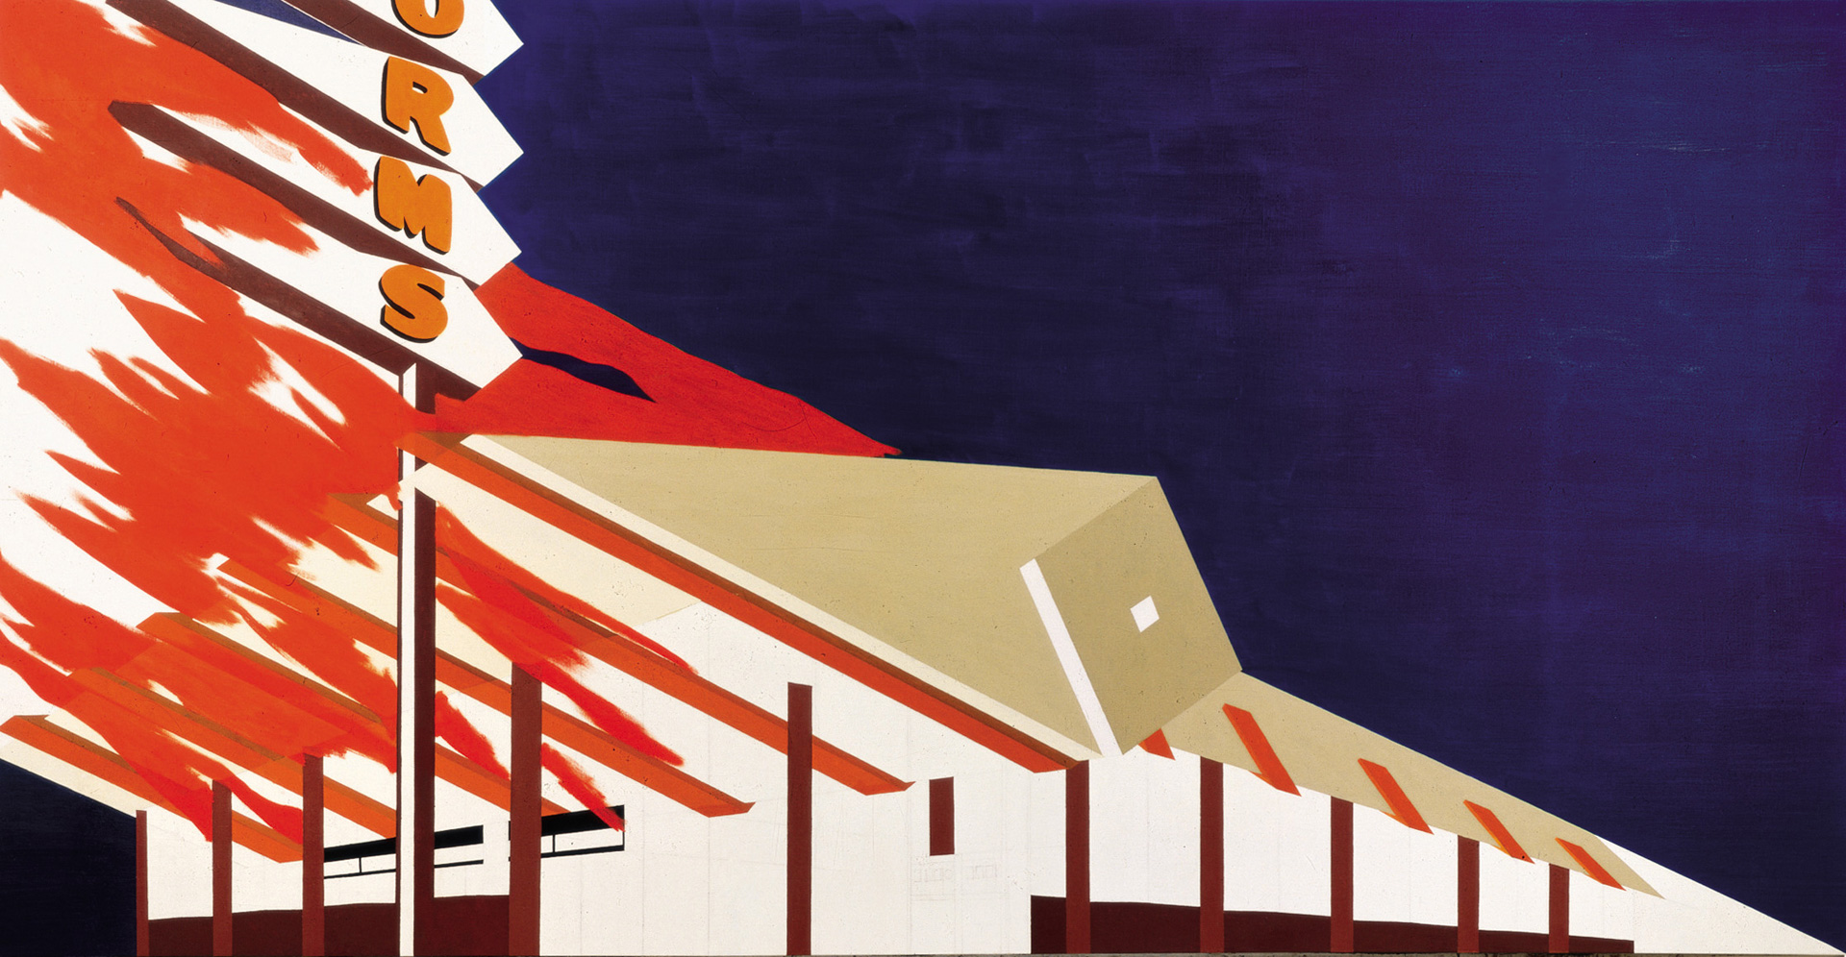
Ed Ruscha, Norms La Cienega, On fire 1964

Slide 30
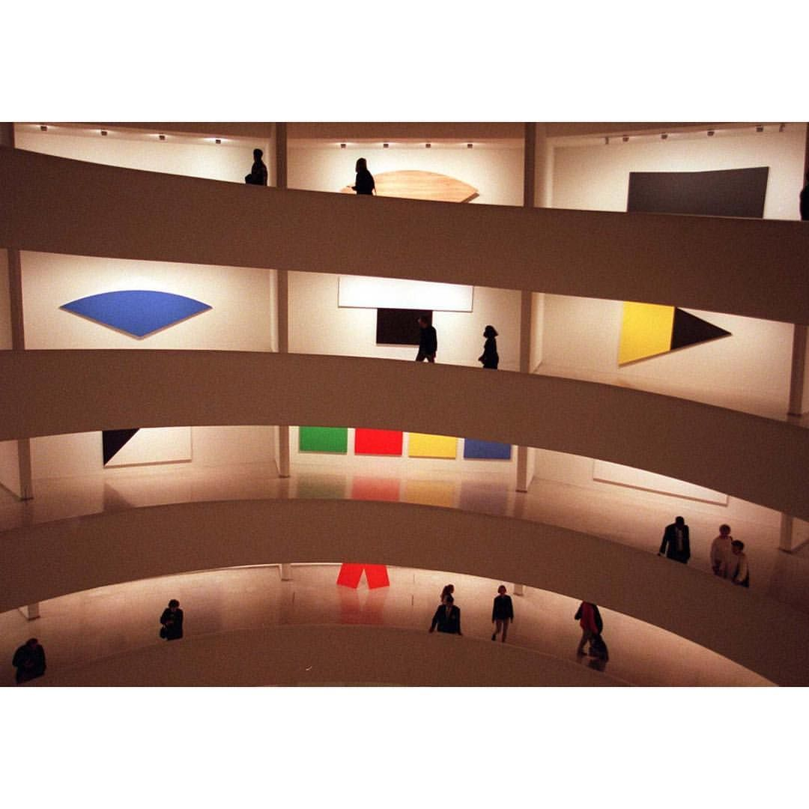
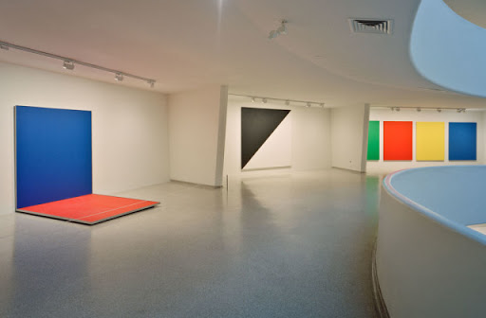

Slide 31
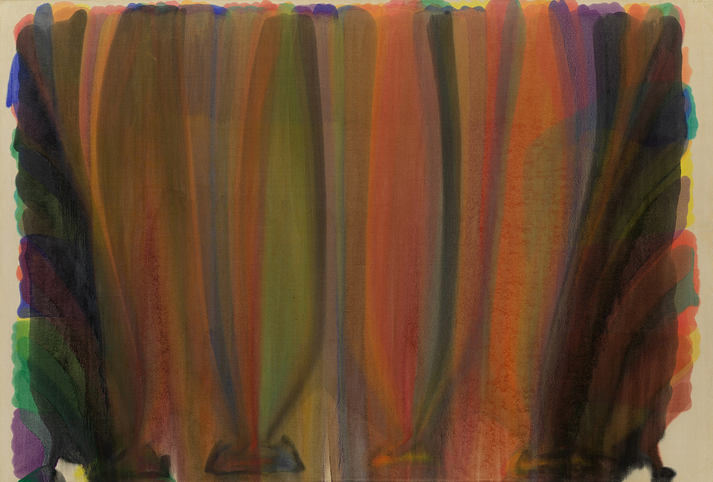
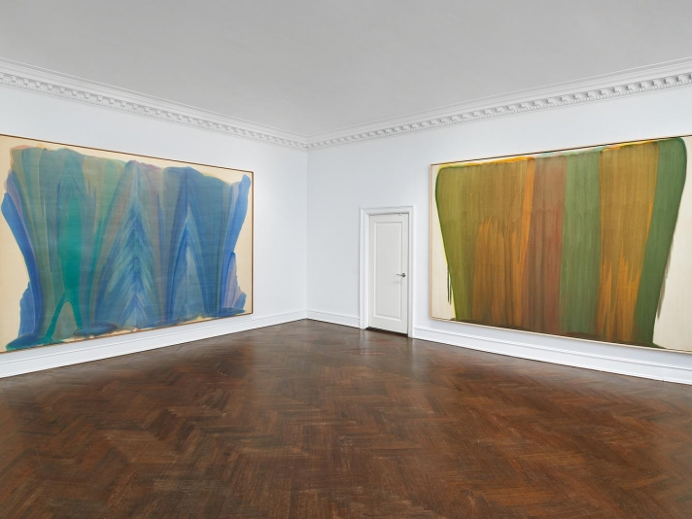
Morris Louis 1912-62
Saraband 1959

Slide 32
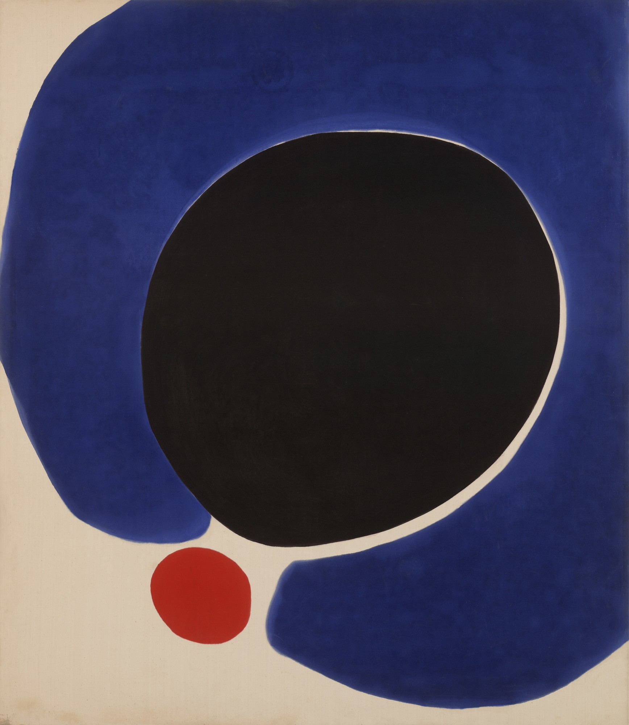
Jules Olitski 1922-2007
Cleopatra Flesh 1962

Slide 33
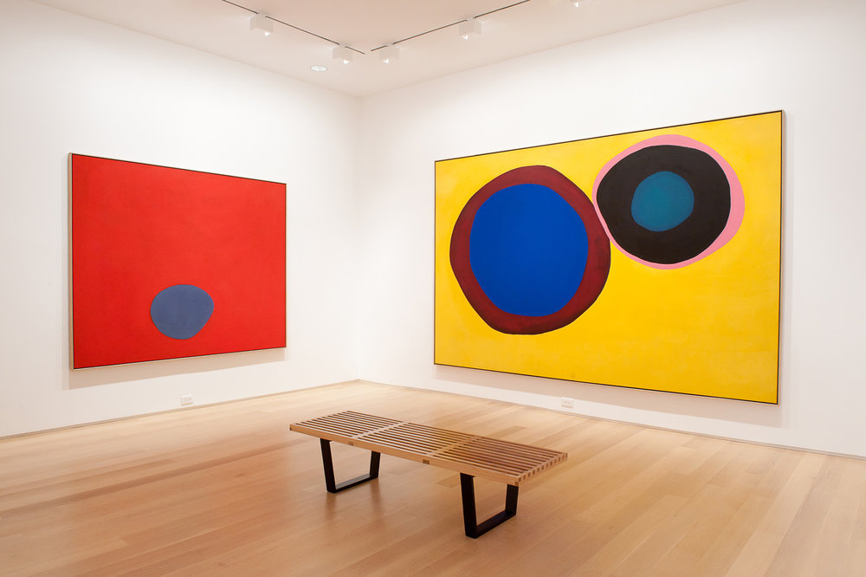

Slide 34
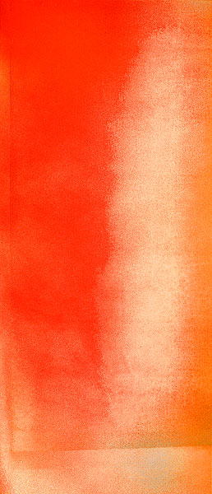
Prince Patutsky command 1966

Slide 35
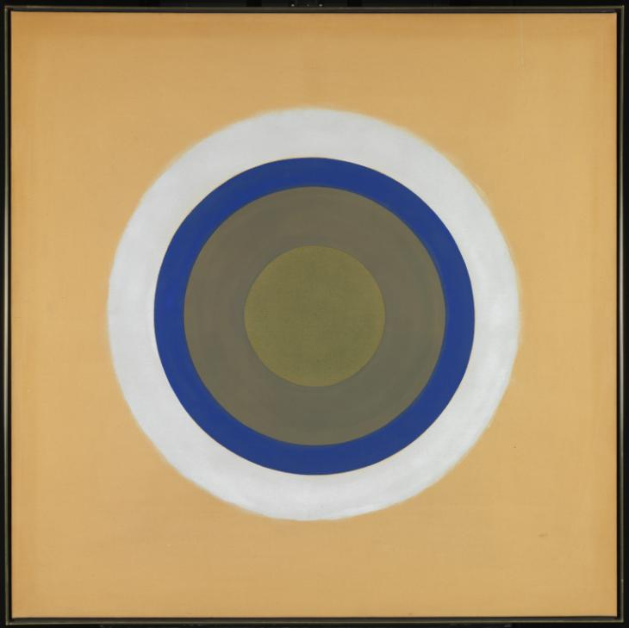
Kenneth Noland 1924-2010
Drought 1962

Slide 36
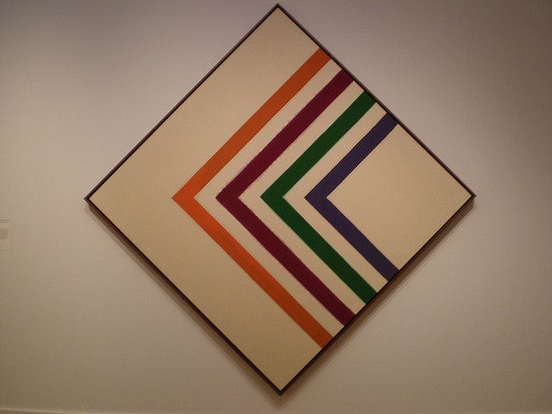
Drive 1965

Slide 37
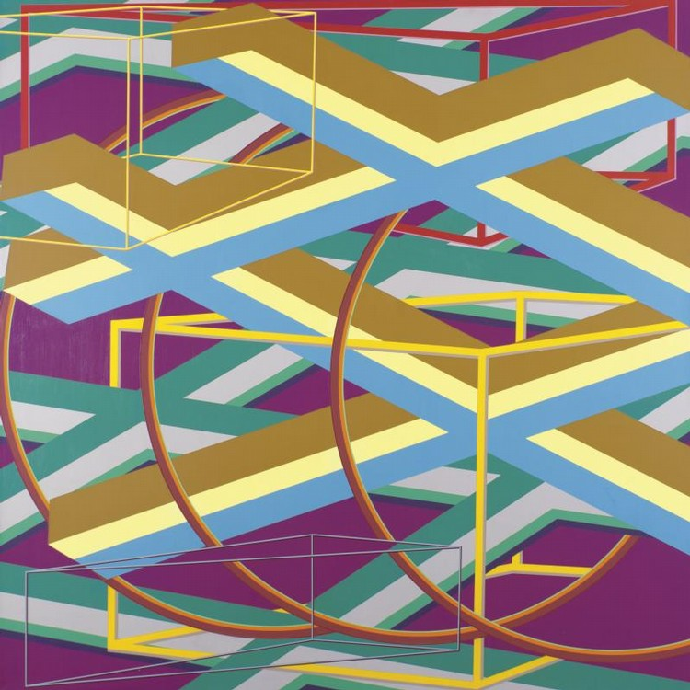
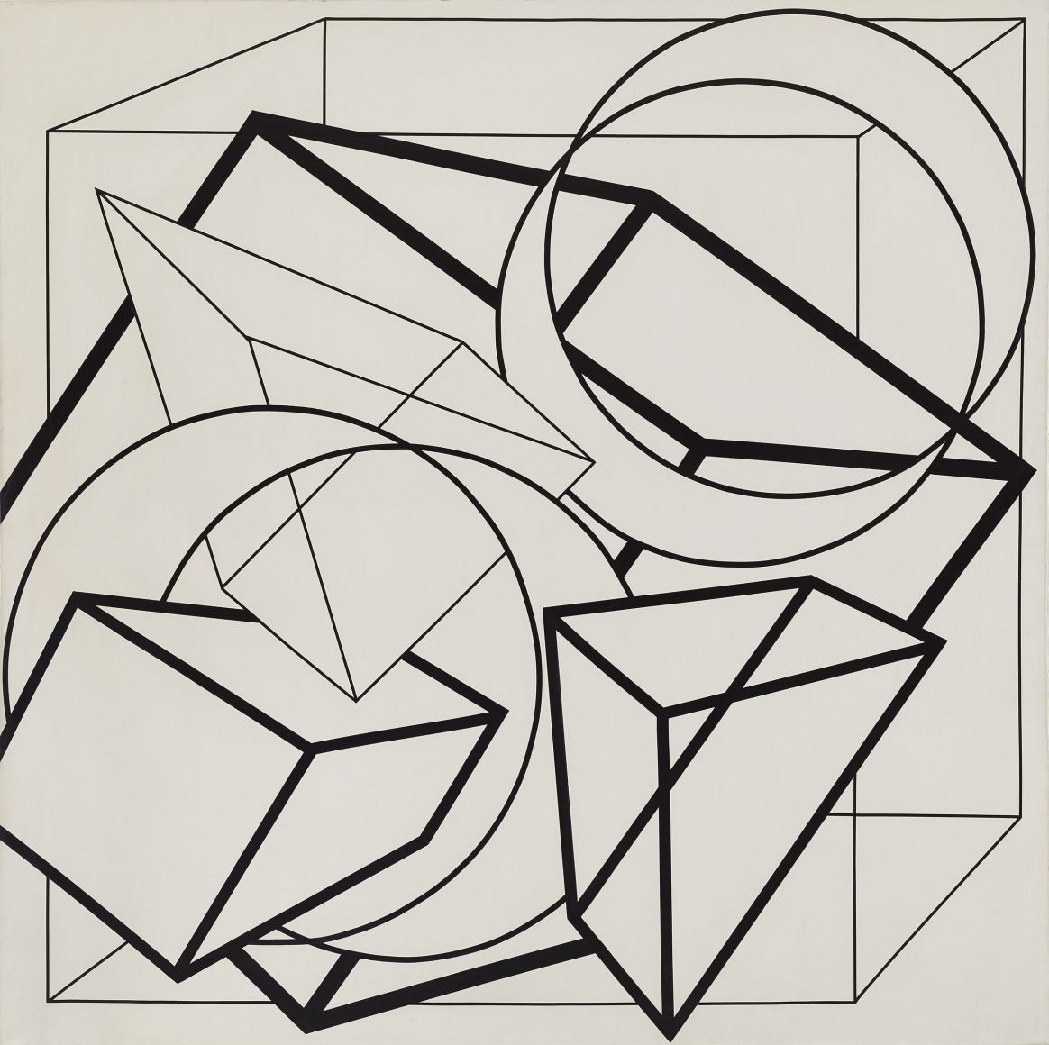
Al Held 1928-2005

Slide 38
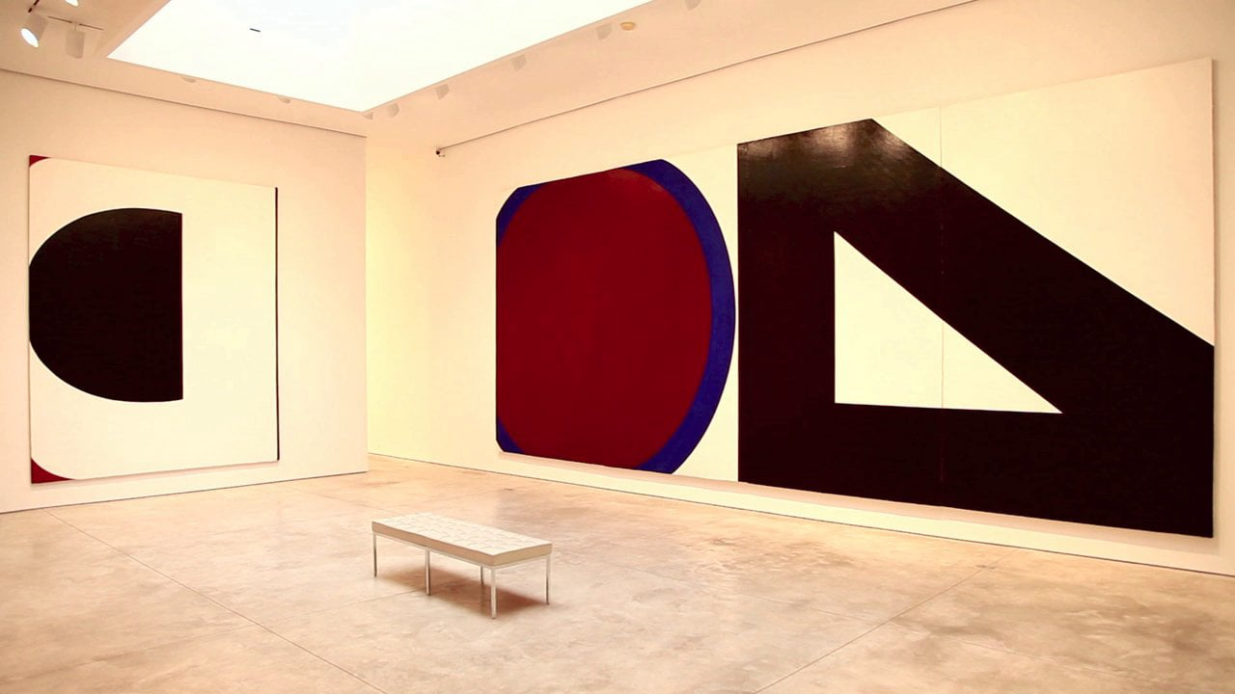
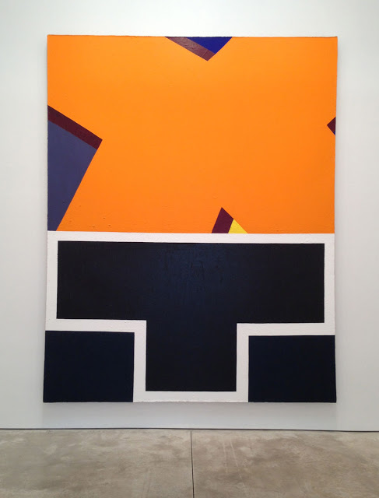
Alphabet paintings 1961-67

Slide 39

North-northwest 1973

Slide 40

Giza gate II 1976

Slide 41


Frank Stella 1936-

Slide 42


Die Fahne Hoch 1959

Slide 43

The Marriage of Reason and Squalor, II. 1959

Slide 44

Gran Cairo 1962

Slide 45

Albers, Hommage to the Square in Wide Light B 1953

Slide 46
217 x 217 cm 46 x 46cm

Slide 47

Itafa II 1964

Slide 48

Rabat 1964

Slide 49

Damascus gate 1969-70

Slide 50

Copper Series 1970

Slide 51

Suchowolla III 1973 (from Polish village series)

Slide 52



Slide 53

Cantahar 1998

Slide 54


Jasper Johns
Jasper Johns, Canvas 1956

Slide 55


Andy Warhol

Slide 56

Crossword 1961

Slide 57


Close Cover before Striking 1962 Orange Car Crash Fourteen Times 1963

Slide 58


Oxidation painting 1978 Rorsach 1984

