Slide 1
The Celts and their languages 1
history, geography and festivals
Lucie Vinšová
Masarykova univerzita 2017

Slide 2
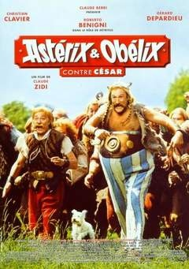
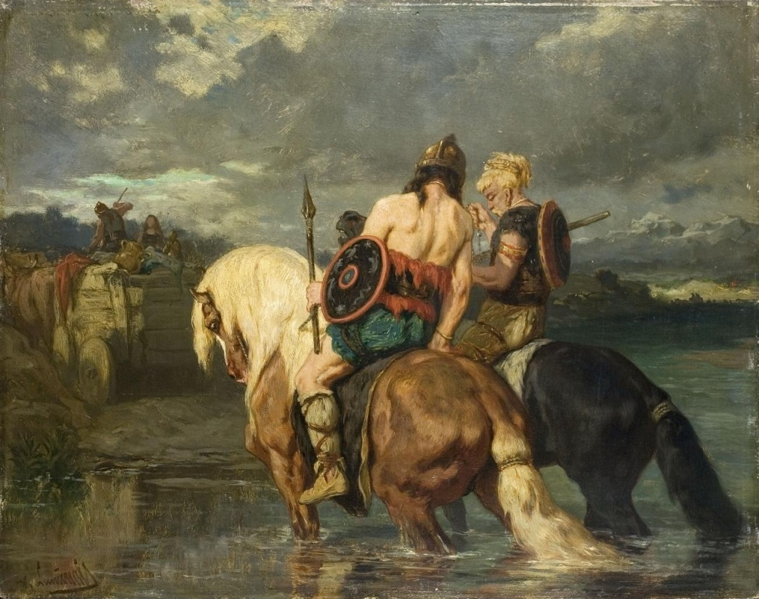
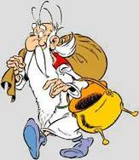
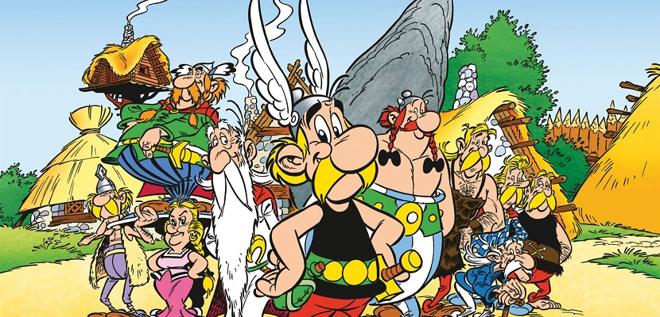
And who are the Celts?
Évariste Vital Luminais (1821 – 1896) paintings of Goths used to be rather popular in France and are a possible role model for the Asterix series.

Slide 3
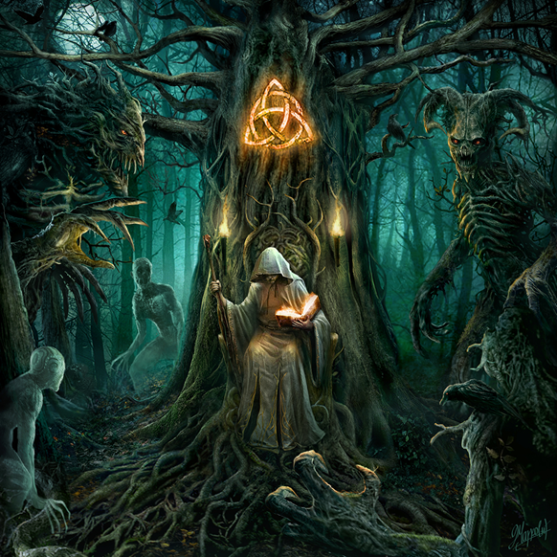
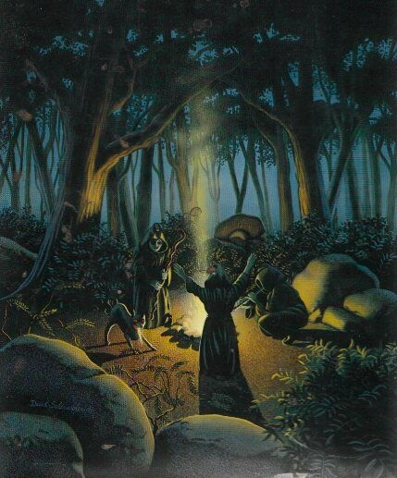

Slide 4
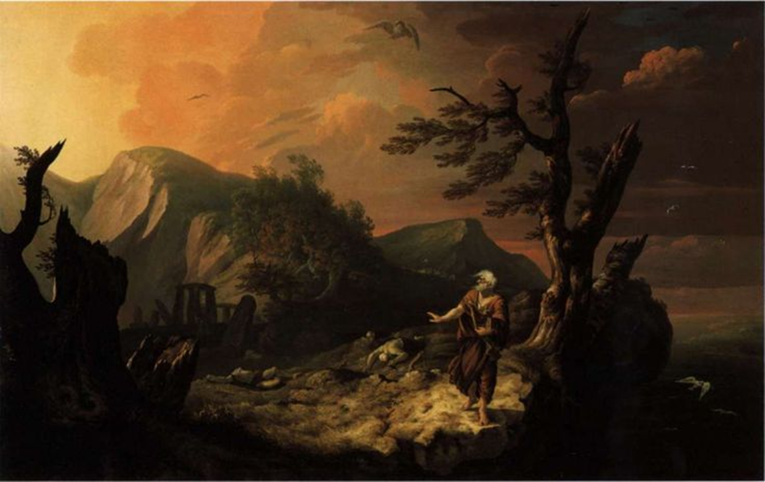
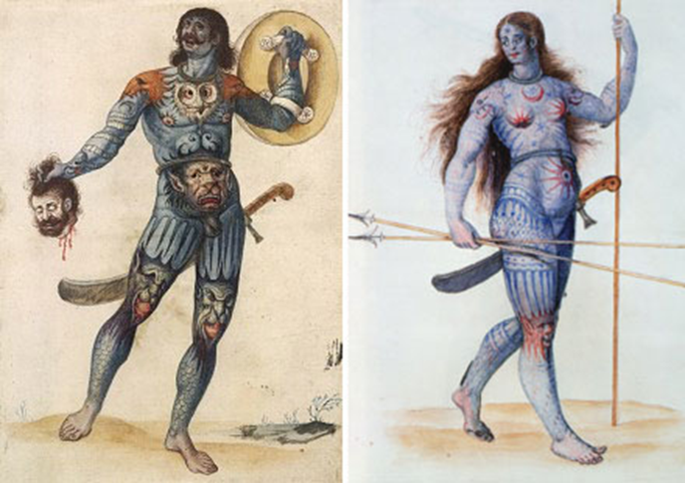
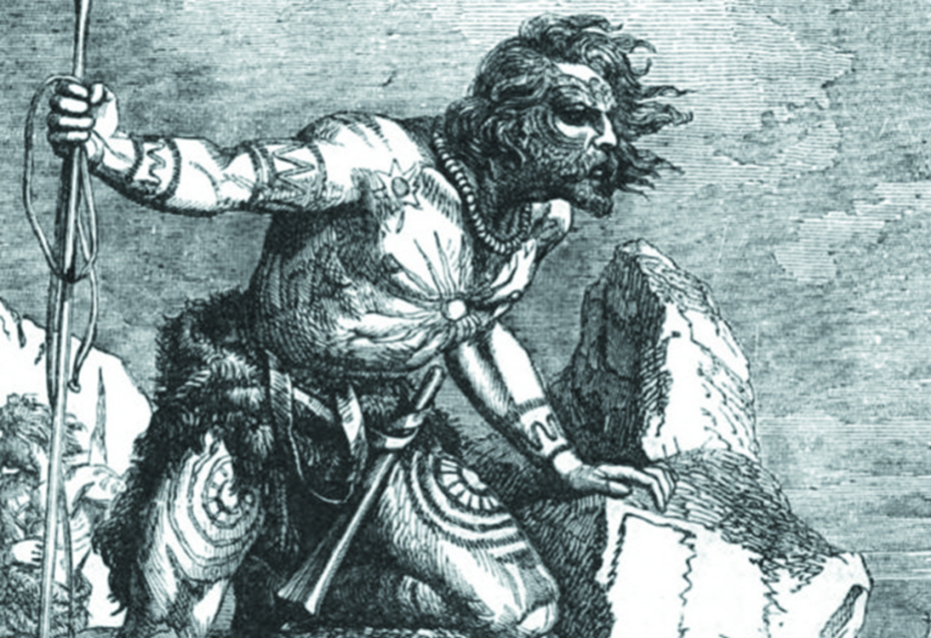

Slide 5
The Celts: an overall name for a large group of Indo-European tribes that populated western, central and eastern Europe throughout the Iron and Medieval ages and spoke Celtic languages.
They can be identified with a particular archeological Hallstatt culture (8. – 5. cent. B. C) (The area between Danube, Rhine and Rhône).
During the La Tène culture era, 5.-1. cent. BC, the Celtic tribes spread into the eastern Europe as well as into the Balkans and Asia Minor.
In the 1. cent. BC, the areas inhabited by the Celtic tribes were considerably diminished due to the Roman colonization and the raids of Germanic tribes.
At the end of the “great European migration period” (6. cent. AD), the Celts were pushed all the way to the British Isles, where the Celtic languages survived until the present day.

Slide 6
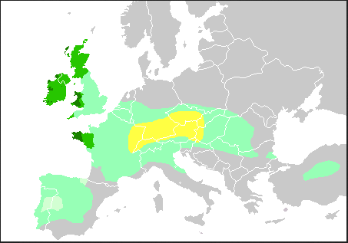
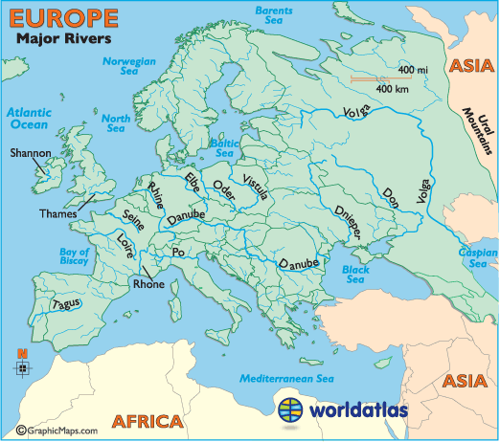

Slide 7
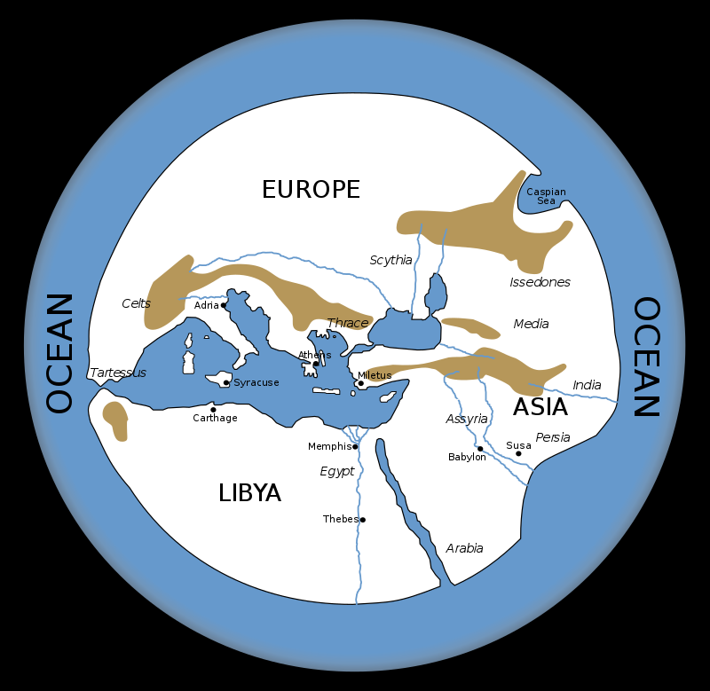
The oldest roots of the Celtic languages can be traced back into the first half of the 2. millennium BC. This rich ethnic group was probably created by a few pre-exiting cultures merging together. The Celts shared a common language, culture and beliefs, but they never created a unified state.
The first time the Celts were mentioned in the classical Greek text was in the 6th cent. BC, in the text called Ora maritima written by Hecateo of Mileto (c. 550 BC – c. 476 BC). He placed the main Celtic settlements into the area of the spring of the river Danube and further west.
From Periodos Ges „Journey around the world“ reconstruction of Hecateu`s map.
Translated from KELTSKÉ JAZYKY, Václav Blažek

Slide 8
The ethnic name Kelto… (Herodotus), Kšltai (Strabo), Celtae (Caesar), KeltŇj (Callimachus), is usually etymologically explained with the ie. root *kelH- “to stick out" (Pokorny 1959, 544), com. lat. celsus “raised, erected, high, noble", so it might have meant “noble" or “people from highlands" (sr. Erhart, Slavia 67,1998, 289-94, who derives the name Čech from the same root). Other possibility is ie. root *kel- “to beat" (Pokorny 1959, 545-47), so the Celts = “warriors".
Ad. KELTSKÉ JAZYKY, Václav Blažek

Slide 9
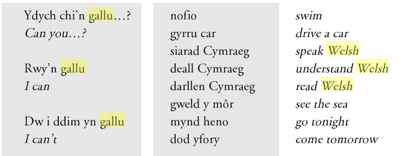
In the first century B.C., J. Caesar noticed that the peoples known to the Romans as the Gauls called themselves Celts. This means that the name Celts was received by all the Celtic tribes of the Roman Gallia.
The lat. Gallus is most probably derived from an ethnic or tribal name and was later accepted by Latin during the period of the Celtic expansion into the Roman empire in the 5th cent. B.C.
The root probably comes from the proto-celtic *galno, and means “power, strength”, ad old Irish gal “courage” and Welsh gallu “to be able to”.

Slide 10
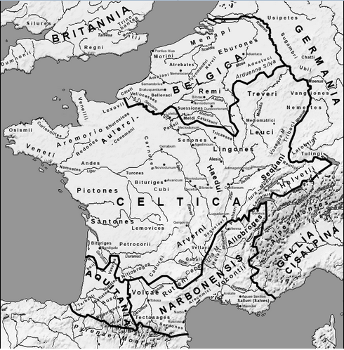
The map of the Gaulish tribes in the 1st century B.C

Slide 11
The Guardian March 18, 2015
…People living in southern and central England today typically share about 40% of their DNA with the French, 11% with the Danes and 9% with the Belgians, the study of more than 2,000 people found. The French contribution was not linked to the Norman invasion of 1066, however, but a previously unknown wave of migration to Britain some time after then end of the last Ice Age nearly 10,000 years ago.
…The Welsh also showed striking differences to the rest of Britain, and scientists concluded that their DNA most closely resembles that of the earliest hunter-gatherers to have arrived when Britain became habitable again after the Ice Age.
Surprisingly, the study showed no genetic basis for a single “Celtic” group, with people living in Scotland, Northern Ireland, Wales and Cornwall being among the most different form each other genetically.
“The Celtic regions one might have expected to be genetically similar, but they’re among the most different in our study,” said Mark Robinson, an archaeologist from the Oxford University Museum of Natural History and a co-author. “It’s stressing their genetic difference, it’s not saying there aren’t cultural similarities.”

Slide 12
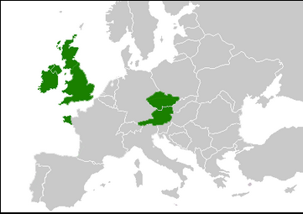
Na základě studia rozšíření jednotlivých mutací genu CFTR (cystic fibrosis transmembrane conductance regulator) způsobujících cystickou fibrosu byly v evropské populaci nalezeny nehomogenity rozšíření jednotlivých mutací tohoto genu, které je možné vysvětlit zastoupením etnicky specifických „genů“ v současné evropské populaci.V tomto kontextu je zajímavé, že relativně vysokou četnost mutace G551D je možné pozorovat pouze v Česku, Rakousku, Británii, Irsku a v Bretani. Na základě těchto faktů citovaní autoři soudí, že uvedené populace vykazují relativně vysokou míru příbuznosti s keltskými předky. Tato příbuznost není tak překvapivá v Irsku, Británii a Bretani, kde jsou keltské kořeny zřejmé. V české kotlině by to však málokdo předpokládal.
Macek Jr. et al. – Population study of the CFTR gene mutations in Bohemia and Moravia: hypothesis on the historical spread of the G551D and F508 mutations in Europe. American Journal of Human Genetics, 1991, 49, Suppl. A 2703
Doc. Dr. Milan Macek, CSc., Dr. Milan Macek ml., Dr. Alice Krebsová, Doc. Dr. V. Vávrová, DrSc. ,Centrum pro diagnostiku a léčbu cystické fibrosy,

Slide 13
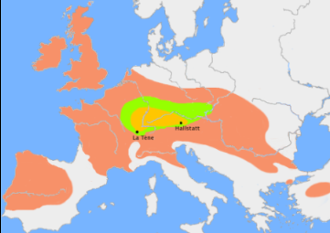
Celtic expansion 5th/4th century BC

Slide 14
The Celtic seasonal festivities
Many customs and beliefs have survived until modern days.
The Celts observed both solstices and equinoxes, but the main attention was put on the agrarian year. The year was divided into two main seasons- summer and winter.
The day started traditionally with dusk on the “previous” day.
The year most probably started with Samhain (the Winter Calends, w. Calan gaeaf) 1st of November (on the night before the Holy Day), even though some theories support the possibility that the Celtic calendar year started on Beltine.
This time was the time of the year, when people were most likely to encounter supernatural powers and beings. The Welsh saying pwca ar bob camfa „a hobgoblin on every stile“ is connected to the time of samhain . In Scotland, people used to carve pumpkins, wear masks and begged for treats. Today, the festival has merged with the All Saints` Day and All Hallow`s Eve. Samhain plays a very important role in the classical Celtic literature (ex. The intoxication of Ulstermen, The dream of Oengus).
Dissolution of the established order and its recreation in a new period of time- regeneration myths and ritual slaying- “The waisting sickness of Cú Chulaind”.

Slide 15
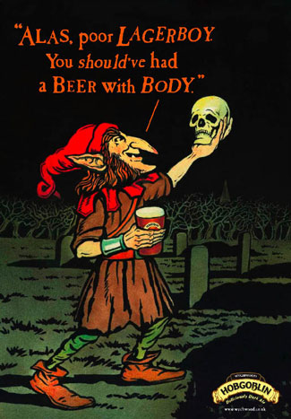
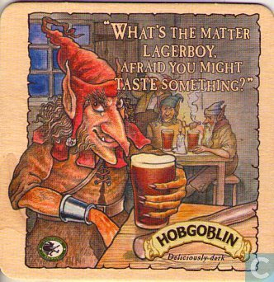
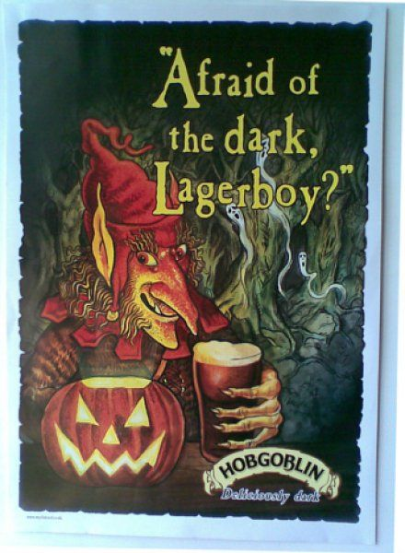
Wychwood Brewery Company, England

Slide 16
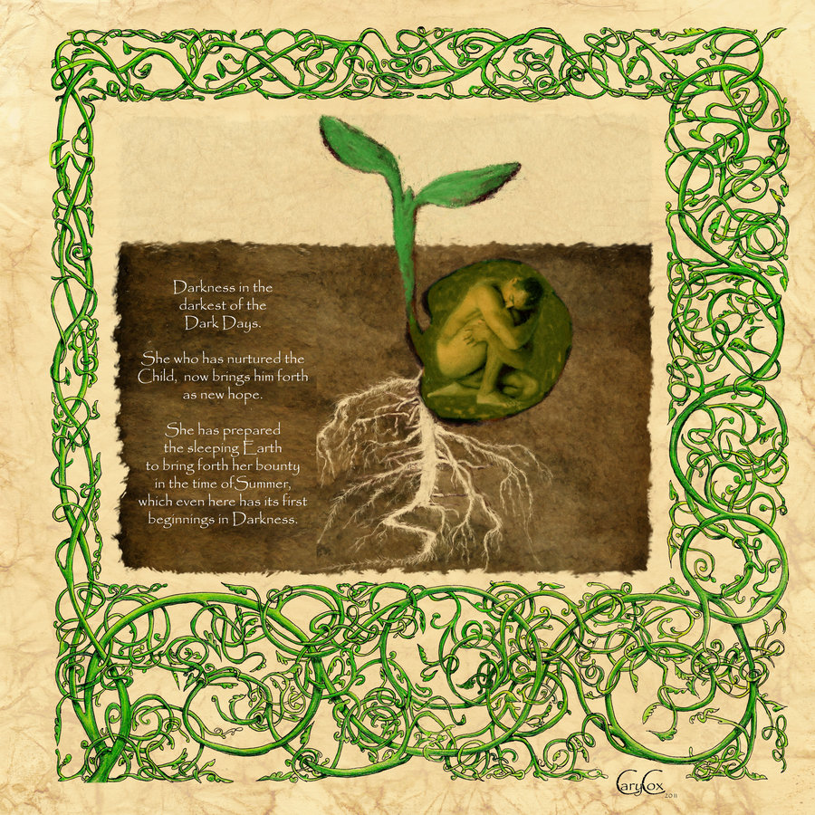
Imbolc: 1st of February, the beginning of spring, the cleansing after winter, the celebration of fertility and noticeable lengthening of daylight. Lambing season. It has become the (Saint Brigid's Day- St. Brigid being one of the most important patron saints of Ireland- originated from an old Celtic goddess Brigit.). In Welsh it is known as Gŵyl Fair y Canhwyllau "Mary's Festival of the Candles", the Welsh name for Candlemas (in Cristianity this corresponds with the Presentation of Jesus at the Temple).

Slide 17
Beltine: the festival started on the night of the 31st April and continued throughout the first day of May. It is also known as the Calends of May, w. Calan Mai. In the Czech Republic this festival is called “the witches”. It marked the beginning of the summer season.
During this festival, the Celts used to make two big fires and led their cattle in between them, in this way the animals should have been cleansed after the winter. On the Island of Man, people used to make big fires on hilltops. People also used to visit sacred wells and springs. Dew collected at the Beltine night or in the morning was believed to have magical properties (it got ladies rid of freckles and wrinkles). The dairy products were the most prone to being cursed on Beltine. The name of the festival comes from the proto-celtic *belo-te(p)niâ and means “bright fire” or “the fire of Bel” (from continental god Belenos) In Edinburgh, Scotland, people traditionally welcome the first sunrays of the Beltine sunrise on the Arthur`s Seat.
The Beltine festival was mentioned many times in the medieval masterpieces of Celtic literature ( The first branch of Mabinogi- the colt of Teyrnon Twrf Liant- ad. Reading sample n.1 ).
Household and farm workers were usually hired for a period from beltine to beltine (medieval law significance- hence the theory that it was the beginning of the Celtic calendar.).

Slide 18
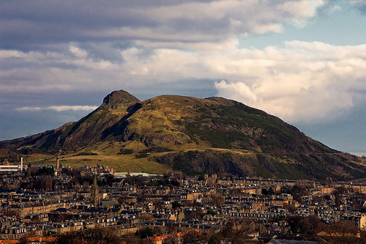
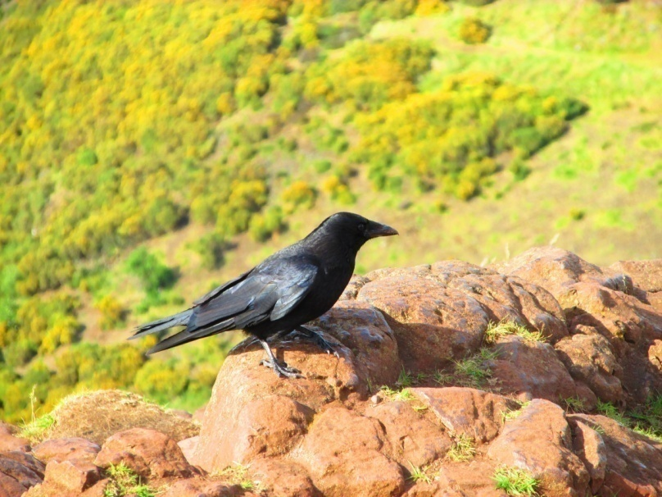
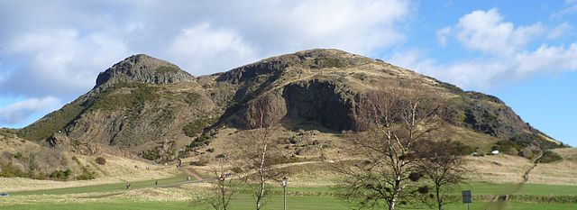

Slide 19
Reading sample: Mabinogi, The First Branch of Mabinogi, Pwyll Pendeuic Dyuet „Pwyll, the lord of Dyfed“.
At that time there was a lord, Teyrnon Twryf Liant, ruling over Gwent-Ys-Coed, and the best man in the world was he. At his house [he had] a mare: and throughout his realm there was neither horse nor mare in his realm as beautiful as she. And she would give birth every night at the Calends of May - yet no-one ever knew what became of her foals.
One night Teyrnon was talking with his wife:
'Wife,' he said 'it is careless of us, letting our mare foal every year without our [ever] getting a single one of them.'
'What can we do about that?' she asked.
'Tonight is the Calends of May,' said he 'The vengeance of God be upon me if I do not find out what misfortune is taking these colts!'
He had the mare brought into the house, and he equipped himself with weapons and began his watch for the night.
As night was falling, the mare gave birth to a large, perfectly-formed foal: standing up on the spot. Teyrnon got up to admire the sturdiness of the foal.

Slide 20
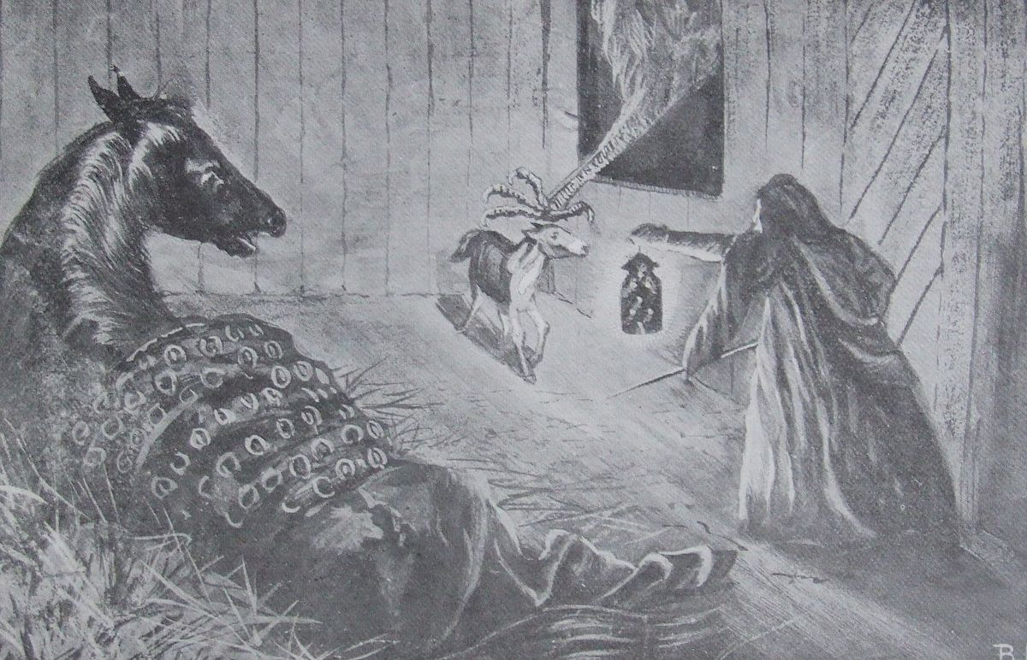
…As he was doing this, he could hear a mighty commotion - and, following this commotion there was an enormous claw [reaching] through the window, seizing the colt by its mane. Teyrnon drew a sword and severed the arm from the elbow down - so that the bulk of the arm, together with the colt, [fell off] inside next to him.
At that he heard a commotion and a scream (at the same time). He went out of the door in the direction of the commotion. He could not identify [the source of] the commotion as the night was so dark. But he kept up its trail and its pursuit.
He remembered that he had left the door open, [so] he returned. And by the door - lo and behold! - a small child in swaddling clothes, wrapped in a sheet of brocaded silk. He picked up the boy, and [noticed] he was strong for his age.

Slide 21
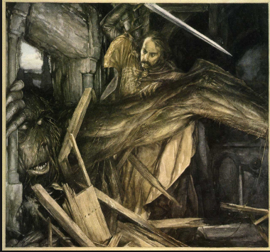
He fastened the door, and made for the chamber where his wife was [sleeping].
'Lady,' he said 'are you asleep?'
'No I'm not, my Lord,' she said 'I was sleeping, and when you came in I woke up.'
'Here is a child for you,' he said 'if you want him. That which you have never had.'
'Lord,' she exclaimed 'what is the story behind this?'
'Well,' said Teyrnon 'it was like this..' And he related the entire account.
'Aye,' said she 'what kind of clothing is the child wearing?'
'Brocaded silk,' he replied.
'He is the son of gentle-folk...' said she.
'Lord,' she continued 'it would be a pleasure and a comfort to me: if it is what you want. I could get the other women on my side, and say that I had been pregnant.'

Slide 22
'I'll go along with you on that, gladly' he replied.
And so it was done. They had the boy baptized, with the baptism that they used to practice in those days. The name he was given was Gwri Golden-Hair - for the hair that was on his head was as yellow as gold.
The child was brought up in the court until he was one year old. And before [the end of] his [first] year he was walking steadily, and was stronger than a three-year old boy of the greatest growth and size. And [after] he had been raised for another year, he was as sturdy as a six-year old boy. Before the end of the fourth year, he was striking deals with the stable lads to be allowed to lead [the horses] down to water.
'Lord,' said Teyrnon's wife to him [one day] 'where is that foal which you saved on the night we got the boy?'
'I put it in the care of the stable boys,' he replied 'and asked them to look after it.'
'Would it not be good, my Lord,' said she 'for you to have it broken in, and given to the boy? For the night we got the boy, the foal was born and saved.'
'I will not go against that,' replied Teyrnon 'and I will let you do the giving of it to him.'
'Lord,' said she 'God re-pay you. I will give it to him.‘
Translated by Will Parker, 2003

Slide 23
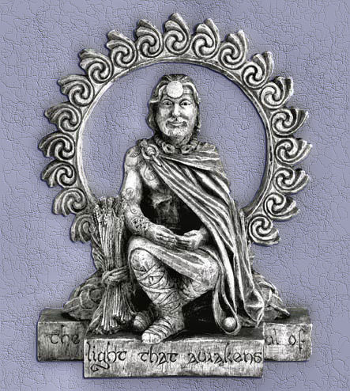
Lughnasad: 1st of August, the celebration of harvest, this season was popular for marriages. Lughnasad has been observed especially in Britain until these days. It`s known as the 'Garland Sunday‘, 'Bilberry Sunday‘ or 'Mountain Sunday' (people welcome the Sun, waiting for the sunrise on mountains, there used to be a goat and cattle market in villages). Ripening of grains and maturing of potatoes. Horse races (Macha) in Ireland, Wales and Cornwall. In old Irish language, Lugnasad was a word combined from the name of the god Lug and násad (gathering).
Lug, the Celtic god of skills and crafts, but also of war, the sky and storms.

Slide 24
