Slide 1

The Celts and their languages 2
Classification of Celtic languages
Lucie Vinšová
Masarykova univerzita 2017

Slide 2

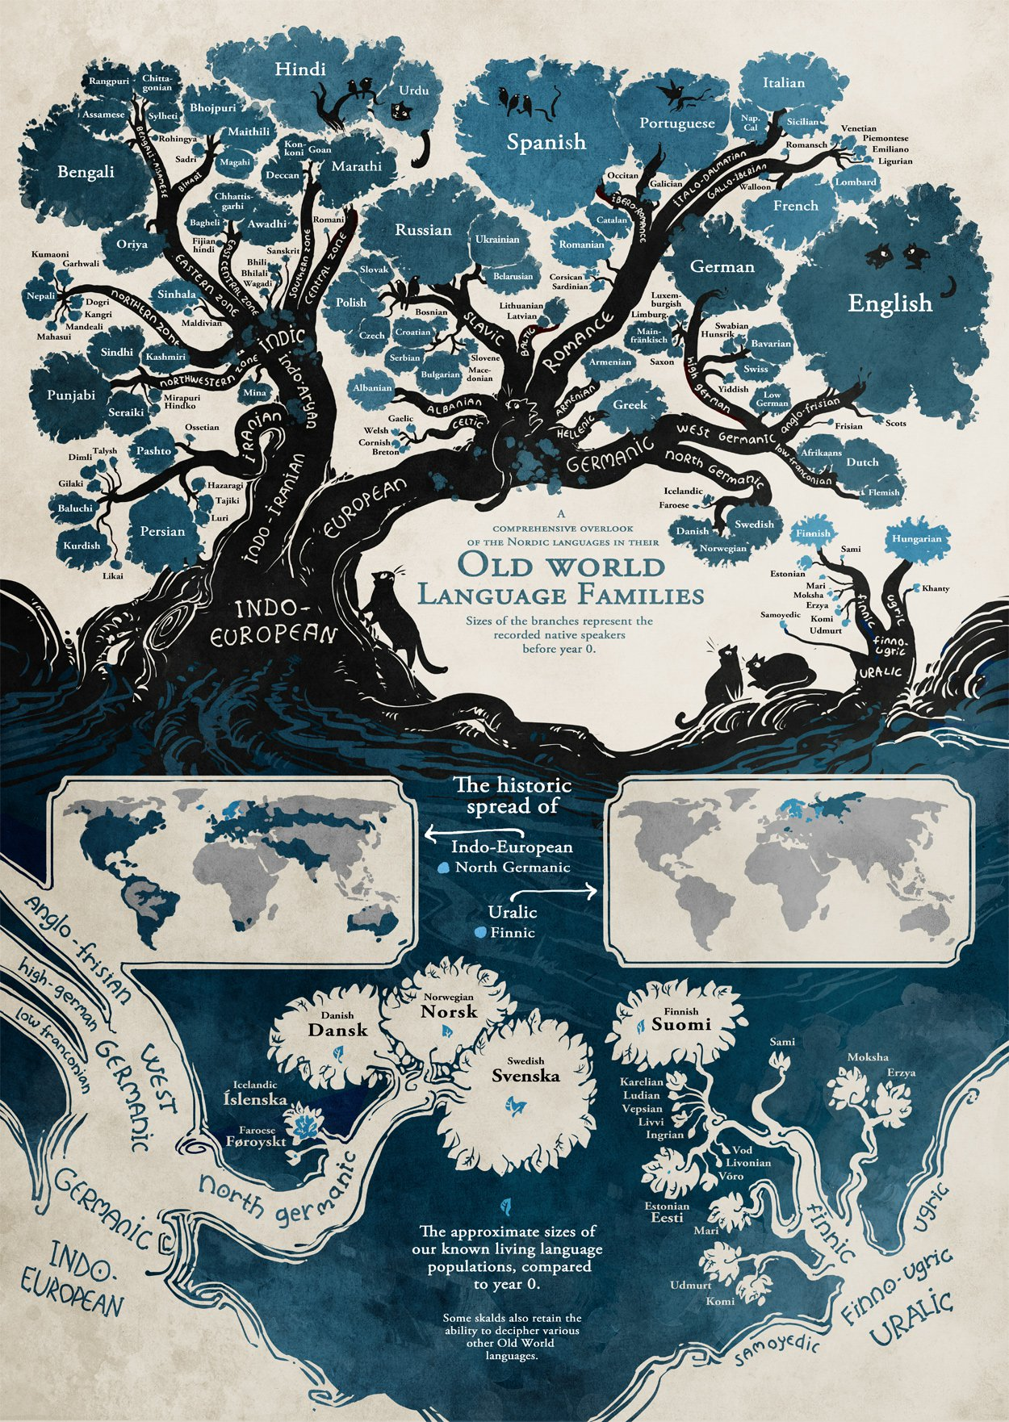

Slide 3
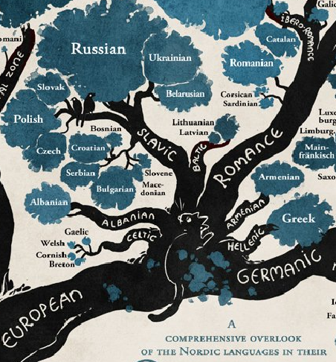

Slide 4
History of the Classification of the Celtic Languages
The Celtic languages hold a special place in the early history of Indo-European linguistics, because they presented the first real challenge to the nascent science.
The demonstration that Irish and its relatives are related to Greek, Latin and Sanskrit was a genuine triumph, for these languages at the first sight seem to be very different.
(Fortson, Indo-European Linguistics, 2010, p. 309)

Slide 5
The relationship between Welsh and Latin and Greek was recognized earlier than the relationship within the family of the Celtic languages (ex. the relationship between Welsh and Irish).
This first comparison was suggested by a Welsh historian Gerald of Wales (lat. Giraldus Cambrensis). In his “Description of Wales” (Descriptio Cambriae) , he managed to compare a few Welsh words with their Latin and Greek equivalents. In a few cases, the words he listed were indeed the words derived from the common Proto-Indo-European language (ex. W. haul "sun": Lat. sōl, Gr. hélios, halein "salt": Lat. sal, Gr. hals, enou “name": Lat. nómen, Gr. ónoma [Ônoma].
During the 16. and 17. centuries, more similarities were recognized between the insular Celtic languages and the continental languages of ancient, medieval and modern Europe (Irish with Greek, Welsh with the classical European languages, Irish with the Germanic languages).
Translated from Keltské jazyky, Václav Blažek.

Slide 6
The fact that the Brythonic and the Goidelic languages represented two main branches of the same language family (the Celtic languages), was first recognized in 1632 by a linguist J. Davis.
In 1707, E. Lhuyd, welsh naturalist, botanist, linguist and antiquary, presented in his masterpiece “Archaeologia Britannica:
an Account of the Languages, Histories and Customs of Great Britain, from Travels through Wales, Cornwall, Bas-Bretagne, Ireland and Scotland” the first attempt of a comparative grammar of the Celtic languages.
The Celtic languages belong amongst so called Centum languages (ad principle division of the Indo-European languages).

Slide 7
In the Avestan language “hundred” was pronounced as [satəm], (therefore Satem languages), ex. OSl. sъto, Lith. šimtas, Latv. simts. The Satem languages include Indian, Baltic, Indo-Iranian, Slavic and other languages.
On the other hand, in old Latin, c was pronounced as [k] . The number “hundred” was then pronounced as [kentum] and for this reason we call these languages Centum languages (ex. Gr. ha katon [heketon], Goth. hund [hund], G. hundert, E. hundred [handrid]. The Centum languages include Germanic, Celtic, Italic and other languages.

Slide 8
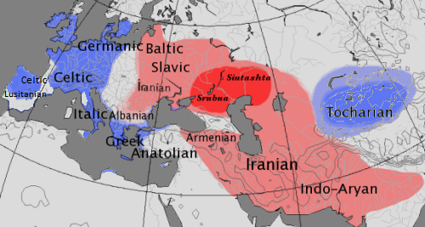
Map showing the approximate extent of the centum (blue) and satem (red) language areas.

Slide 9
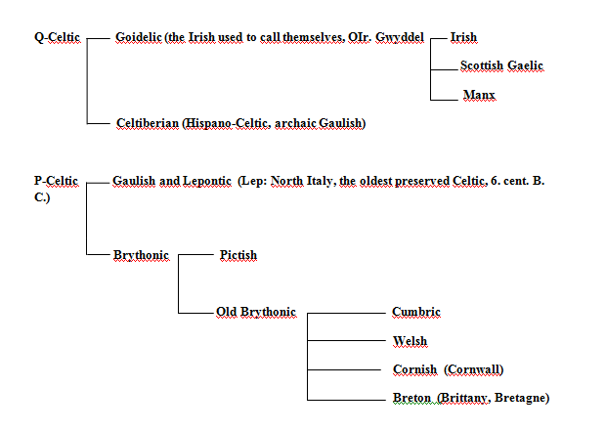

Slide 10
This classification is based on the different development of IE. *kʷ, which was kept amongst the Q-Celtic languages and changed to p amongst the P-Celtic languages. This traditional model of Celtic languages classification is supported by H. Pedersen and K.H. Schmidt.
IE. *kʷ appears in the Celtiberian (Hispano-Celtic) language, as well as in some early dialects of the Gaulish language (where it is taken for an archaic variation) and in the Ogham script (where it is traditionally transcribed as Lat. Q) as /kṷ/, which later develops into /k/ in the Goidelic languages (Irish, Scottish Gaelic, Manx).
On the other hand, in the Gaulish, Lepontic and Brythonic languages, it changes into /p/.
Ex. OGaul. cenn, W. pen(n), "head"; OGaul.. mac(c), W. map, "son".

Slide 11
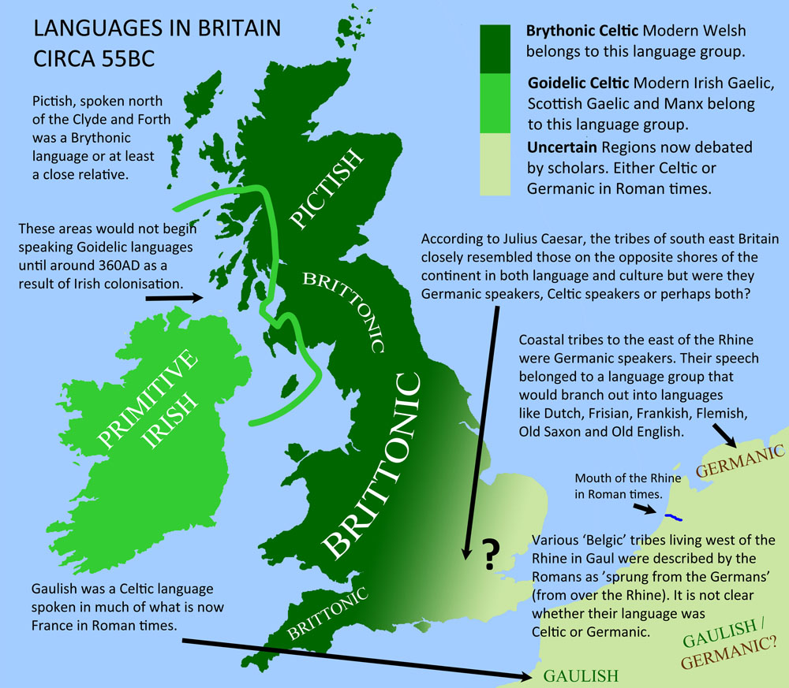
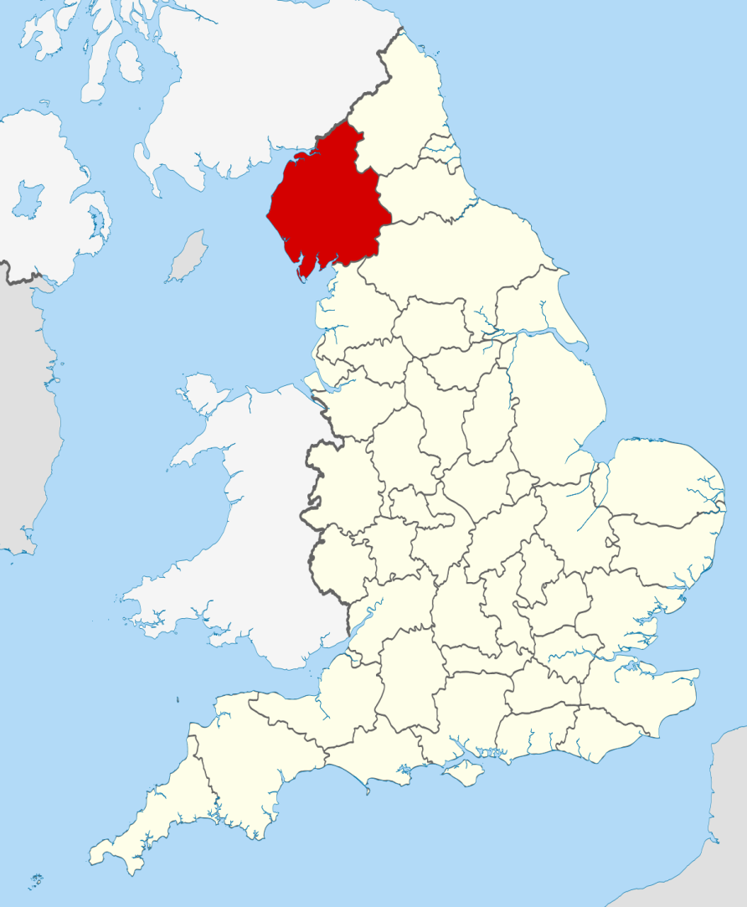
Cumbria

Slide 12
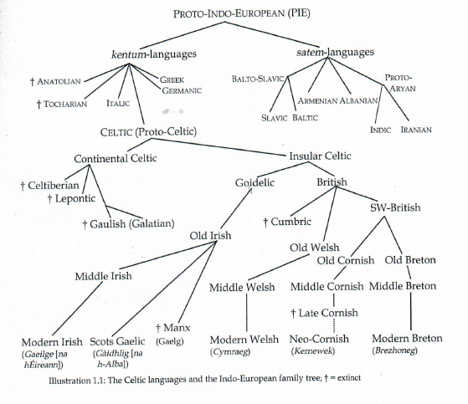

Slide 13
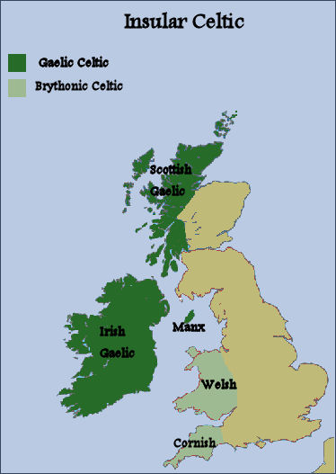
Communities using the Celtic languages today include:
Wales: cca 500 000 speakers (about 20% of population, esp. in North Wales)
Bretagne: about 210 000 speakers
Scotland: about 58 000 speakers
Ireland: only 75 000 speakers, but about one million speaks Irish as L2 in the Republic of Ireland.
Cornwall: only a few hundreds of speakers, new attempts of revival of the language presently continue .
Manx: the last native died in 1974, attempts of a revival, today about 2000 speakers, but only about 100 report that they would use Cornish in everyday conversation.

Slide 14
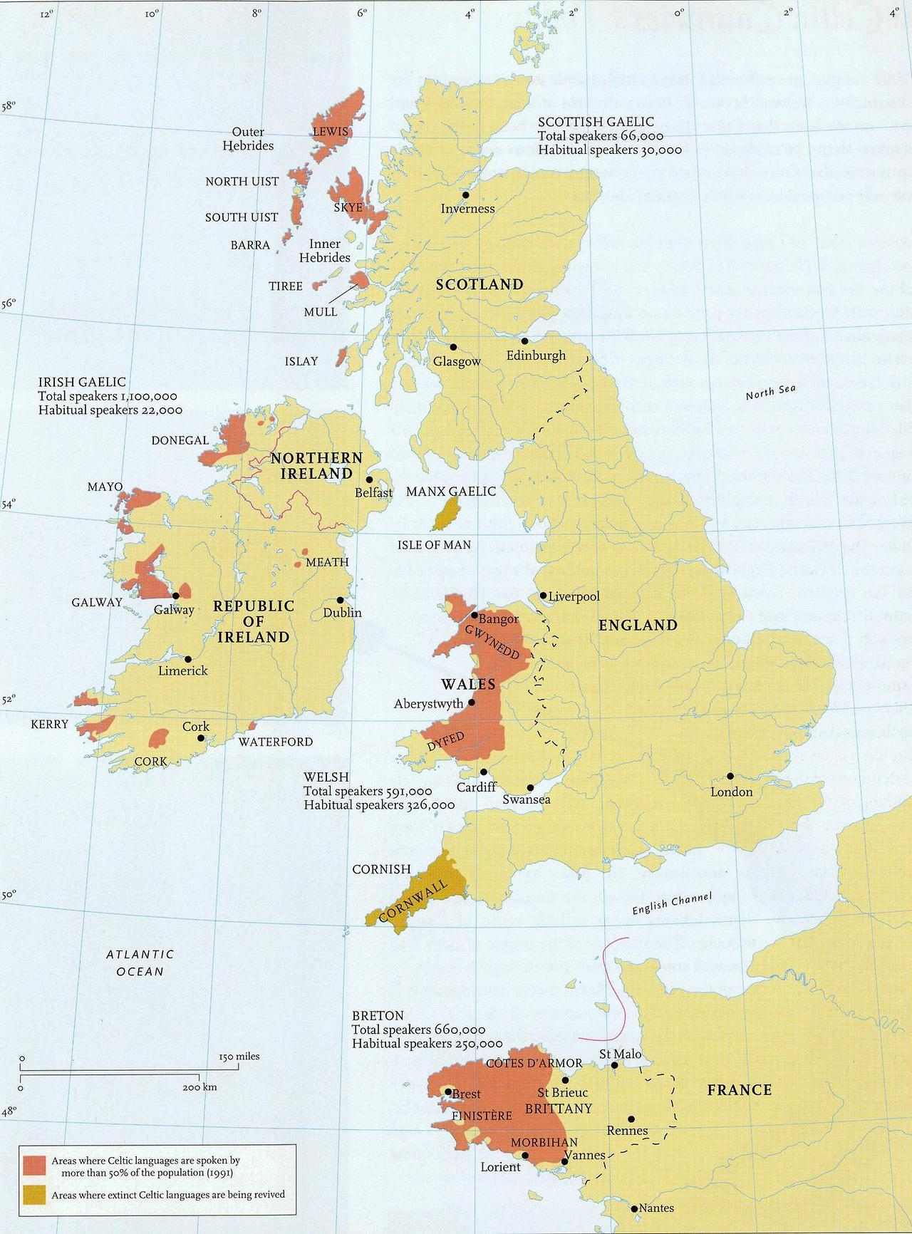
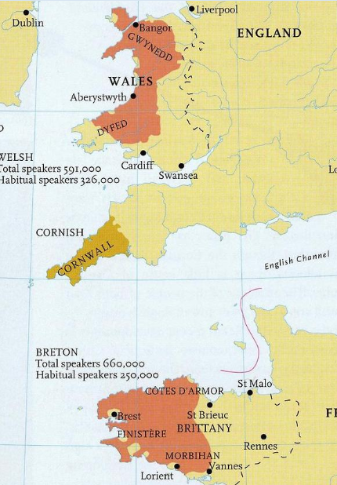
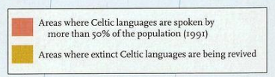

Slide 15
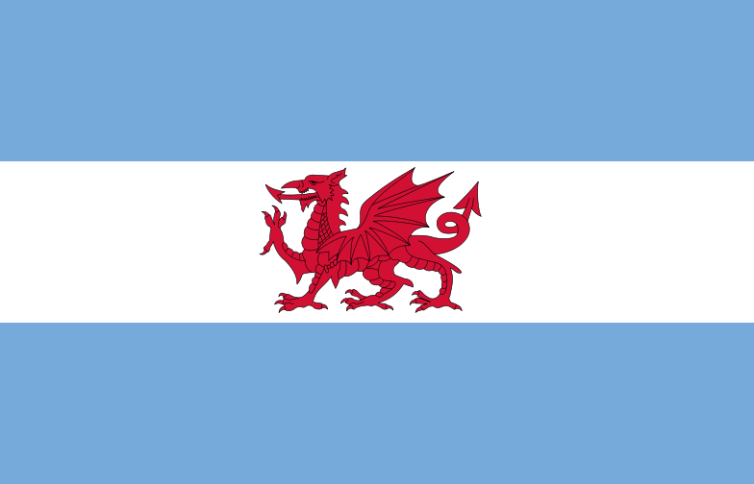
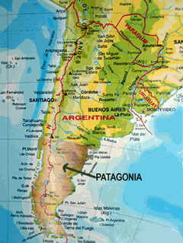
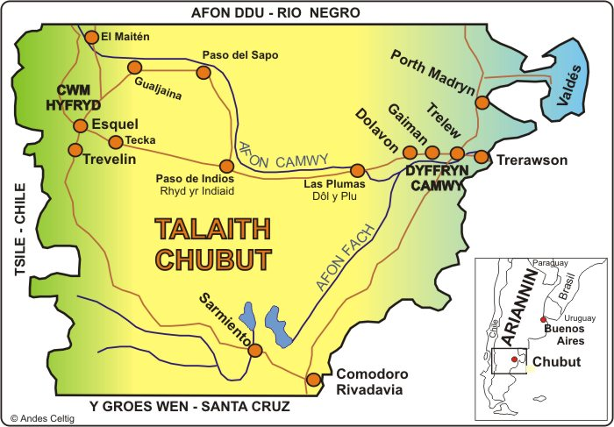
About 1500 descendants of the Welsh colony from the end of the 19th century and the beginning of the 20th century have kept their original Welsh language until the present day. Y Wladfa, W. “ colony” lies in province Chubut in Argentina and includes a few Welsh speaking settlements.

Slide 16
Some typological features of modern Celtic languages
The most distinctive phonological innovation is the loss of Indo-European *p, which occurred initially and medially.
Eg: Gl. éan, W. edn, ader, compare with L. penna, Gr. pterón, E. feather
Celtic languages are regarded as having a few archaic features: the lack of a verb “have” and the differentiation of gender in the numbers 3 and 4 (still surviving in Welsh).
VSO sentence structure in most modern Celtic languages
Scot. Gael: I am at the door. Tha mi aig an dorus.
(Is I at the door.)
Consonant mutations: The Celtic languages mutate some of the initial consonants of some nouns. The number of mutations depends on the language. The Welsh and Breton have three different mutations. The mutations are preserved vestiges of final syllables in prehistoric Celtic.
From Fortson, Indo-European Linguistics, 2010, p. 317 and Donald MacAulay, The Celtic Languages, 2008, p. 6-7.

Slide 17
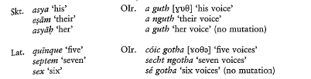
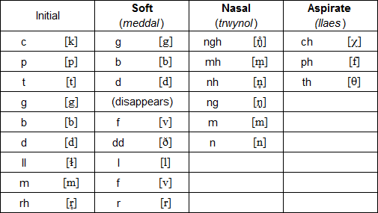
Fortson, Indo-European languages, 2010
Modern Welsh mutations

Slide 18
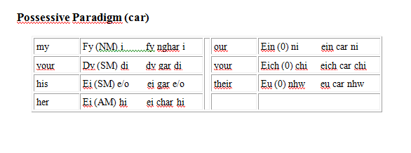

Slide 19
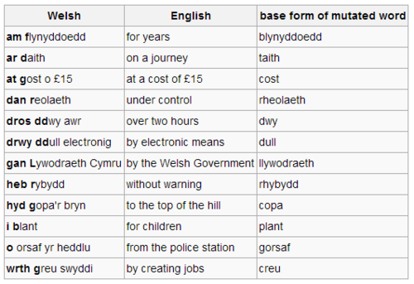

Slide 20
Continental Celtic Languages
Celtic languages were spoken on the European continent until the first half of the first millennium A. D.
Gaulish: the biggest of the Continental European languages was spoken in most of ancient Gaul and also in Northern Italy. Gauls were a huge ethnic group which consisted of a few hundred tribes living in the Western and Central Europe. One of the main tribes even settled (3rd century B. C) in Asia Minor (Galatians). The Gauls are known in the classical history for their raids on Rome in the 4th cent. B. C. They were, however, later assimilated into Roman culture. Most discovered samples of the Gaulish language are written in the Roman and Greek alphabet.
Lepontic language: a language used by the Celtic tribes in the northern part of Italy. It`s not certain whether this language was not merely one of Gaulish dialects. Most of the found inscriptions are grave stones. The texts are written in the North Italian, so-called Lugano alphabet (taken over from the Etruscans). The oldest examples of the Lepontic language are the oldest examples of Celtic languages ever found (6th cent. B. C).

Slide 21
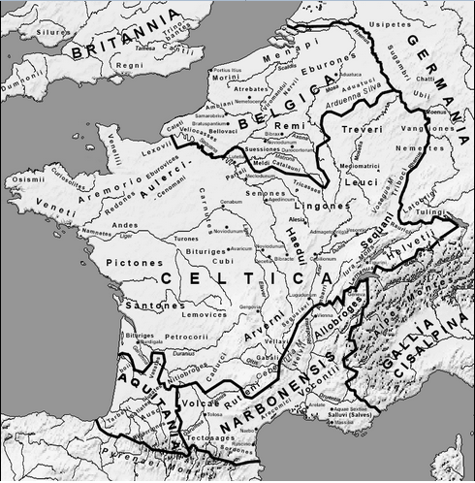

Slide 22
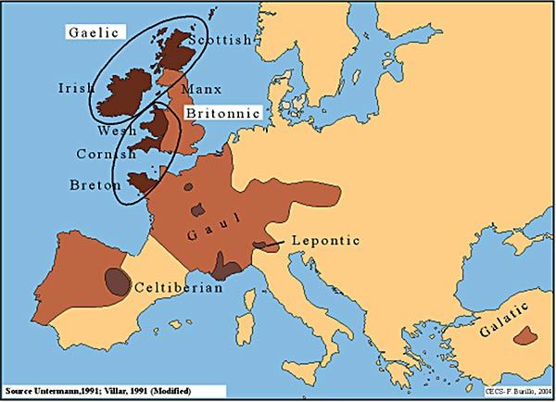

Slide 23
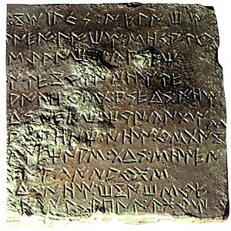
Celtiberian (Hispano-Celtic) language was spoken by the Celtic tribes which migrated in the 1st mil. B. C into the areas of the North-East of Spain. Celtiberian seems to be a very different to Gaulish and Lepontic, phonetically and morphologically. From this we can say that it separated from other Celtic languages at an early stage. Most of the inscriptions are dated into the 2nd and 1st cent. B. C, and are written in the Iberian script.

Slide 24
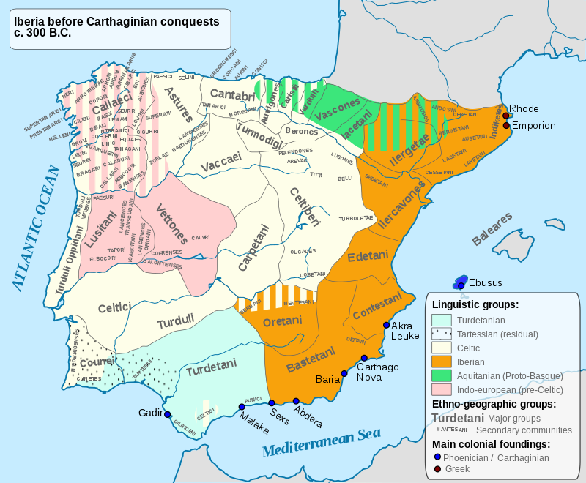

Slide 25
