Slide 1
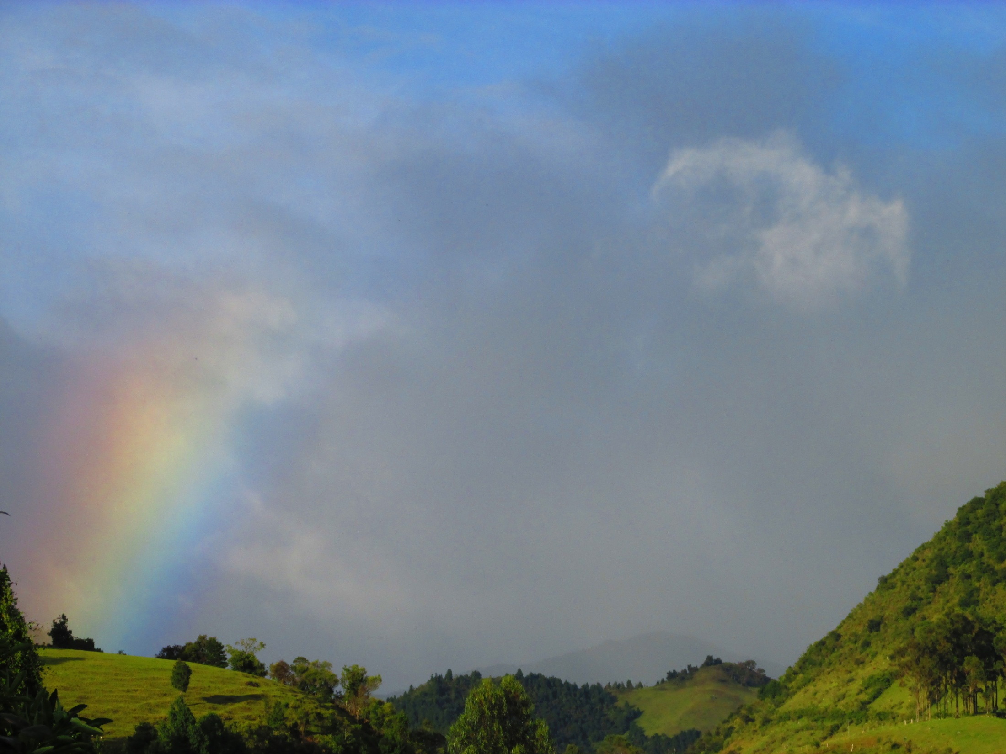
The Creation Myths
of Misak, Nasa and Coconuco tribes
Lucie Vinsova
Masaryk Universtity of Brno

Slide 2

In most Andean cultures, including those in south-east Colombia, the Earth together with the principle of nature is of a female essence. Plants, animals, water and atmospheric phenonema are all Her manifestations, whose eternal task is to establish good relations among themselves and to find harmony and social well-being. This should be directly projected into human communities.
The body of the Mother Earth consists of three parts:
Eeka: all that is above
Kwes kiwe: our world (or This world)- divided into two territories: sacred (wild, not cultivated places, páramos) and not sacred (cultivated lands, villages, fields, pastures etc.)
Kiwe dyihu: all that is below
Sometimes, four Houses are mentioned:
Eeka yat: Space, the House of the Great Spirit, Ksaw Wala (creator: masculine and feminine principle)
Ks`ya`w yat: Space, the House of the Spirits
Kiwe nyhi yet o kwes kiwe: Mother Earth or Our World
Kiwe dyihu yet: The House under the Earth, inhabited by strange, small creatures called tapanos.
(mythology of Páez, Nasa)

Slide 3
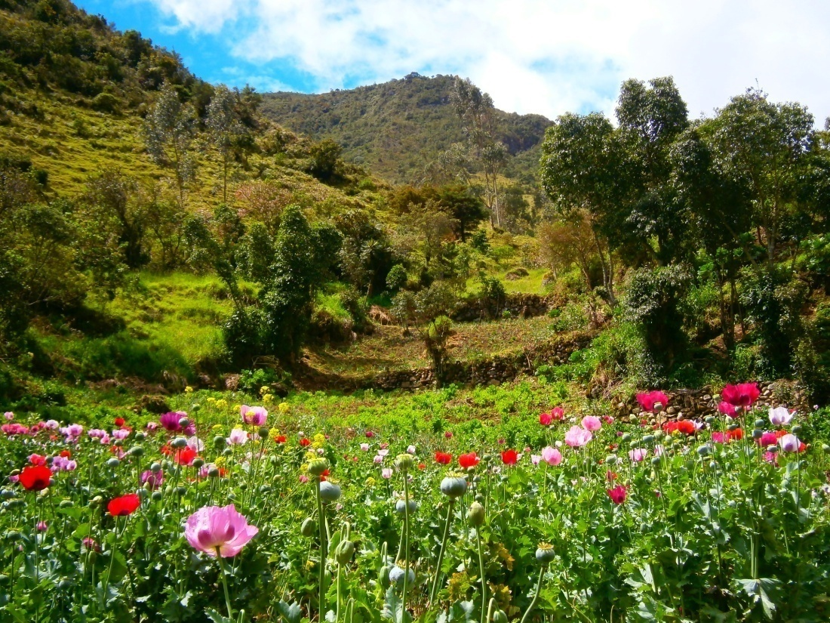
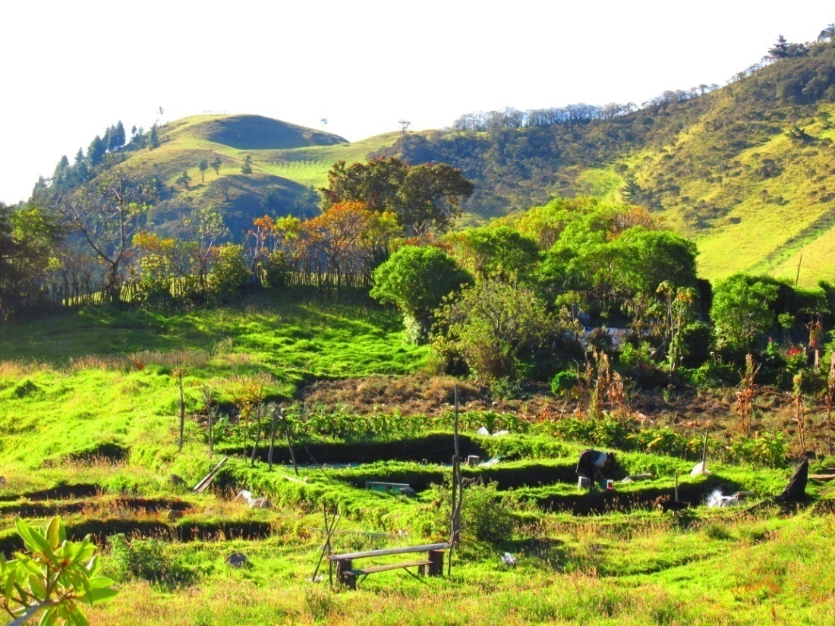
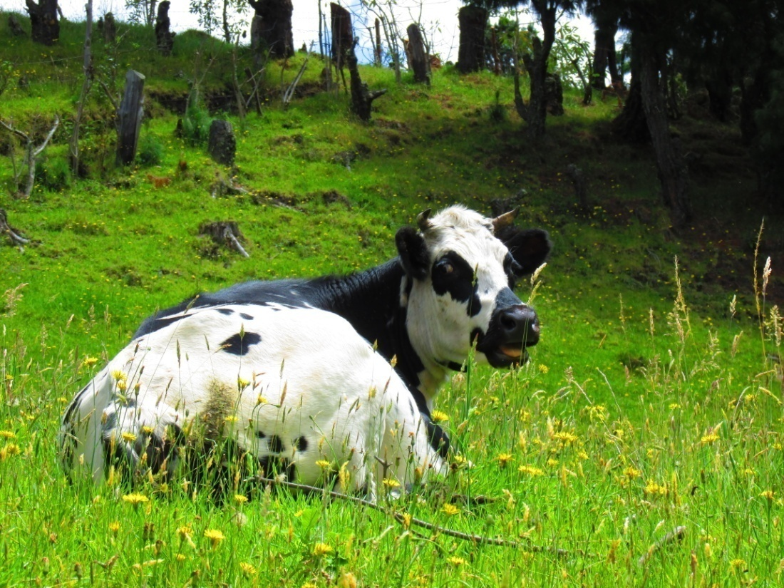
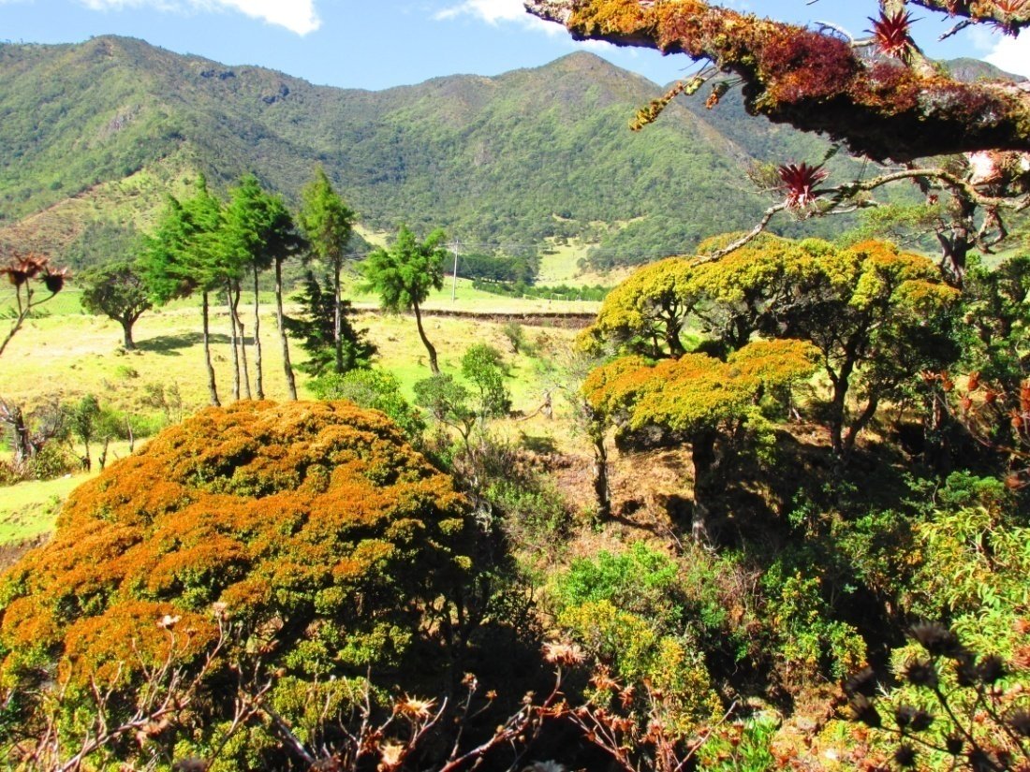

Slide 4
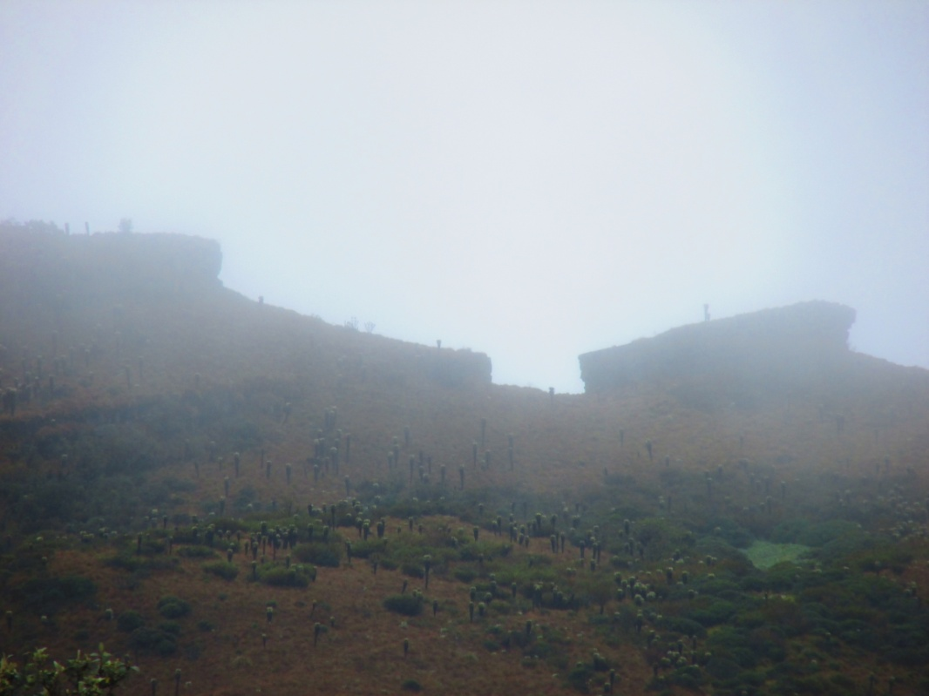
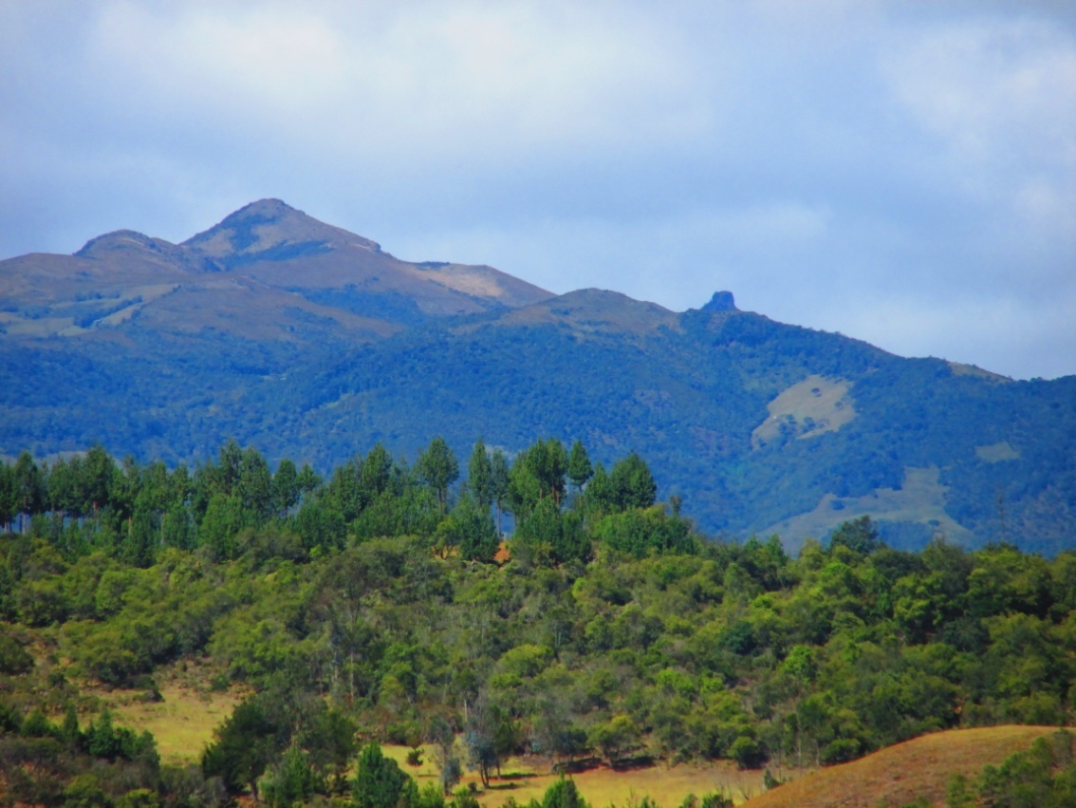
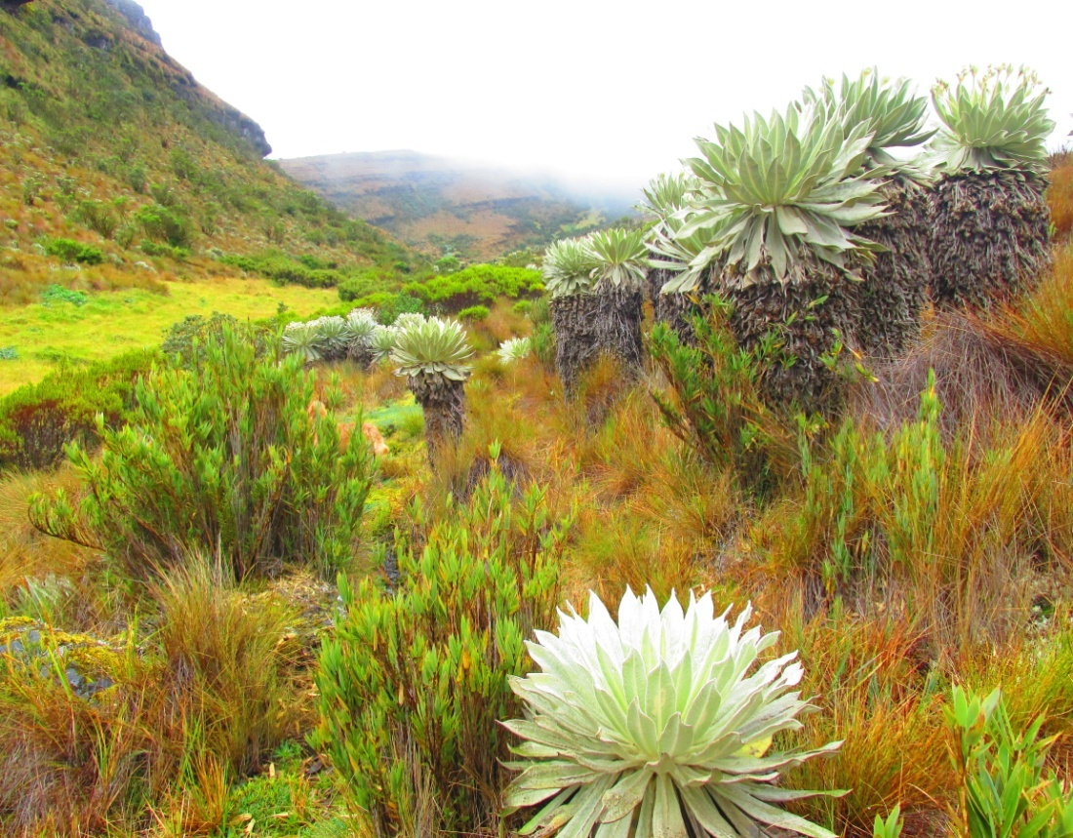
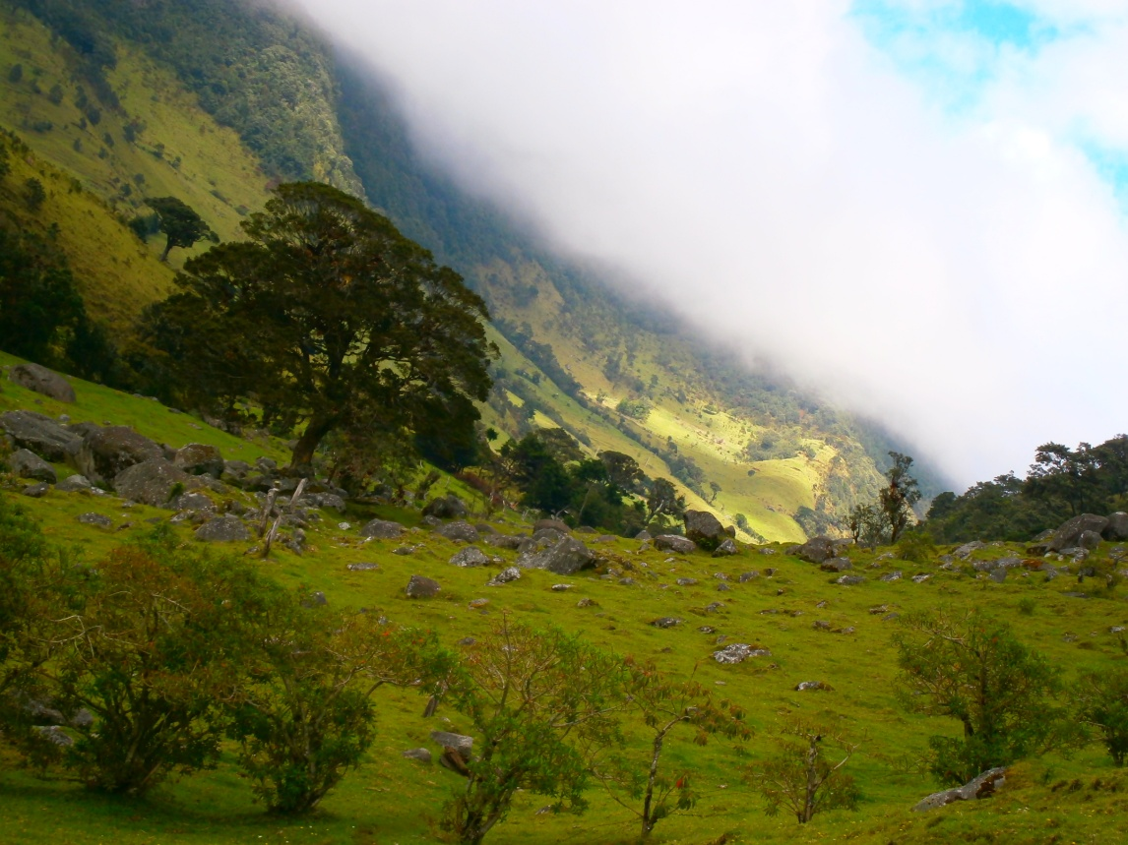

Slide 5
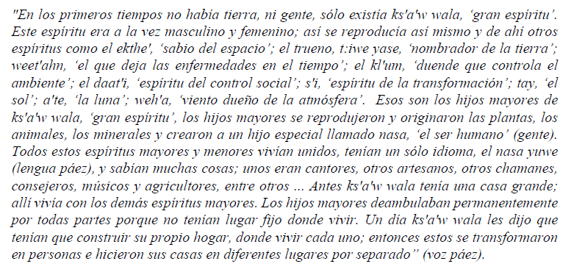
Hugo Portela Guarín, El Pensamiento de las Aguas de las Montañas.

Slide 6
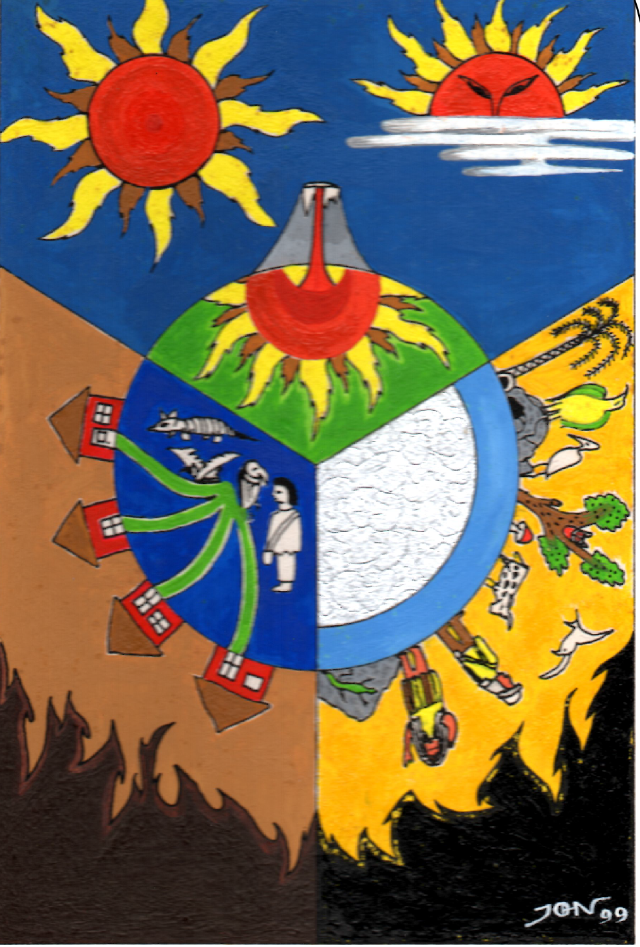
The four realms (Houses) of existence.
Picture by Jhon Ferney López Muñoz

Slide 7
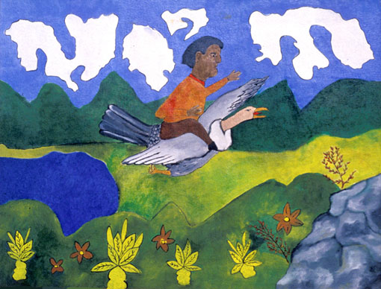
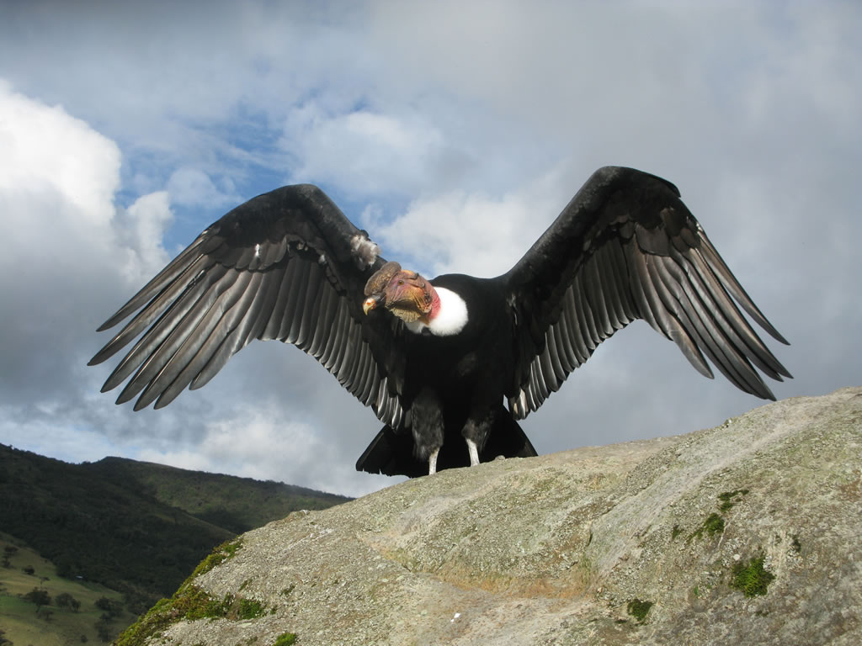
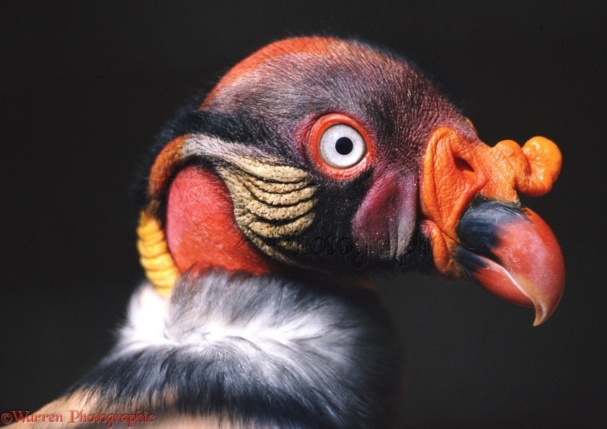
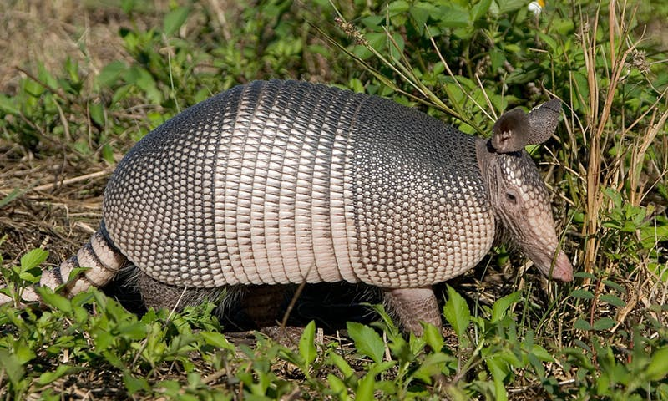
Picture by taita Juan Bautista Ussa Ulluné.
Words for shamans:
Misak: mӨrӨbik; explained in two different ways: mor (to hear), mӨrӨb (to hear with skin, to feel)- The one who feels, hears with skin or mӨrӨbik: the one who works with water.
Nasa: thë`wala: thë` (old) wala (great, big): Great old wise man.
But usually they are called in Spanish médicos.
There are many categories: curanderos, yerbateros etc.

Slide 8
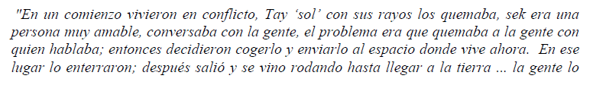
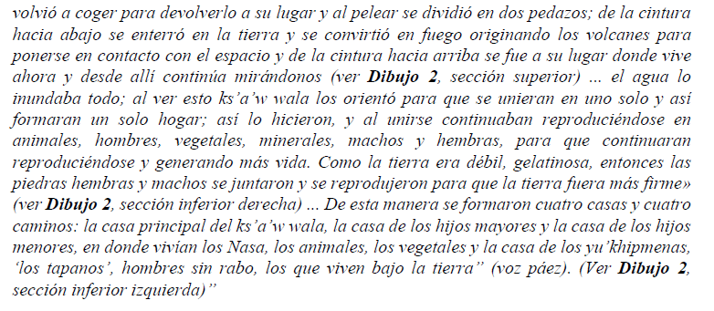
Hugo Portela Guarín, El Pensamiento de las Aguas de las Montañas.

Slide 9
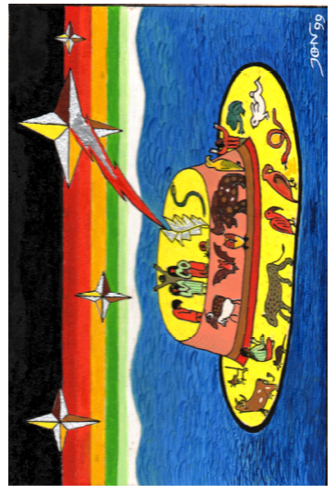
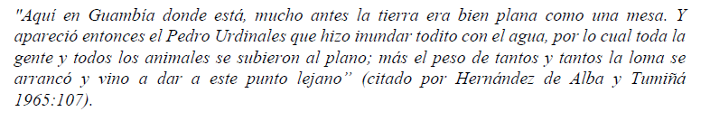
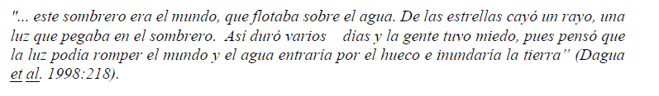
Picture by Jhon Ferney López Muñoz
The world as a hat
Hugo Portela Guarín, El Pensamiento de las Aguas de las Montañas.

Slide 10
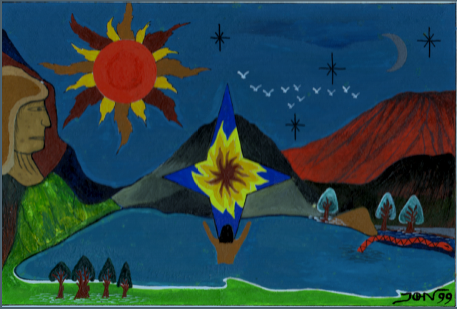
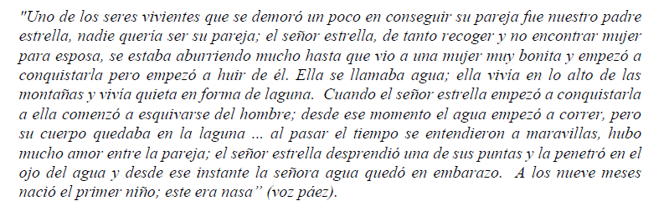
Picture by Jhon Ferney López Muñoz
Hugo Portela Guarín, El Pensamiento de las Aguas de las Montañas.

Slide 11
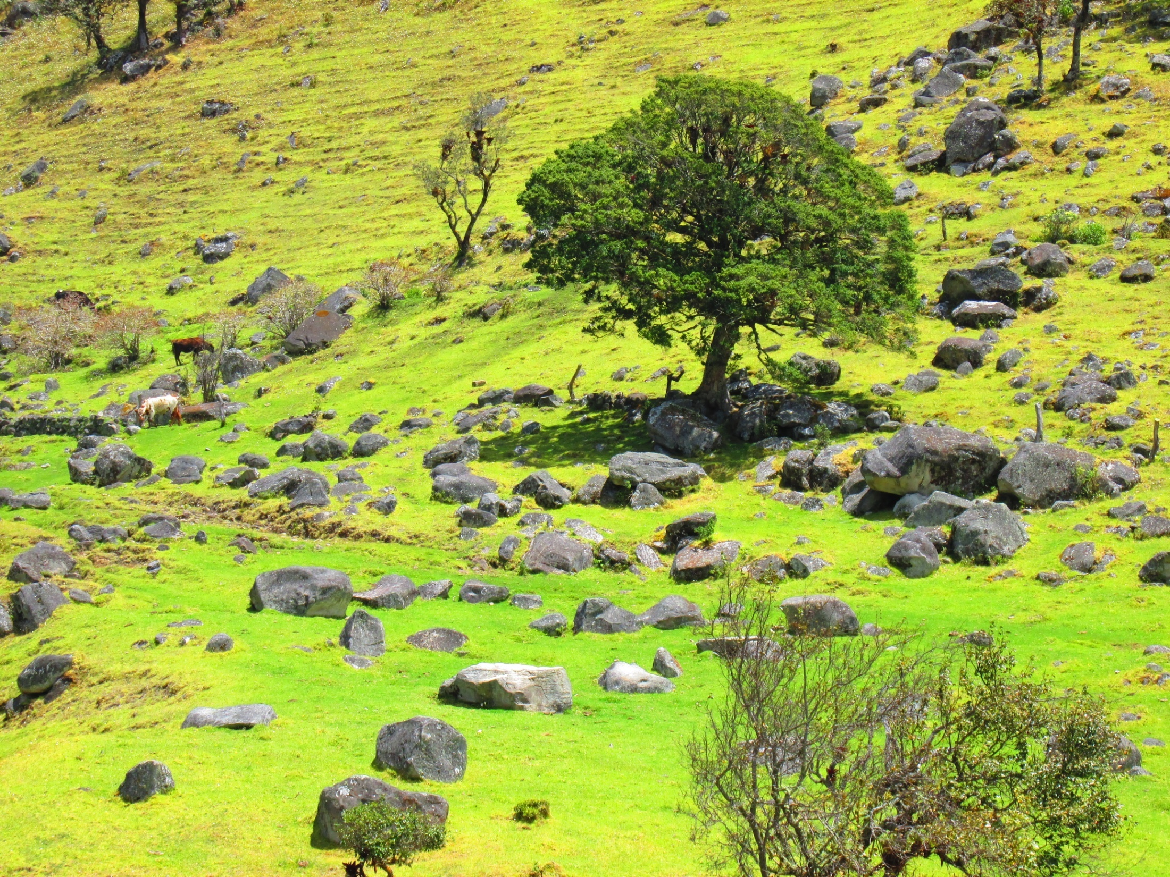
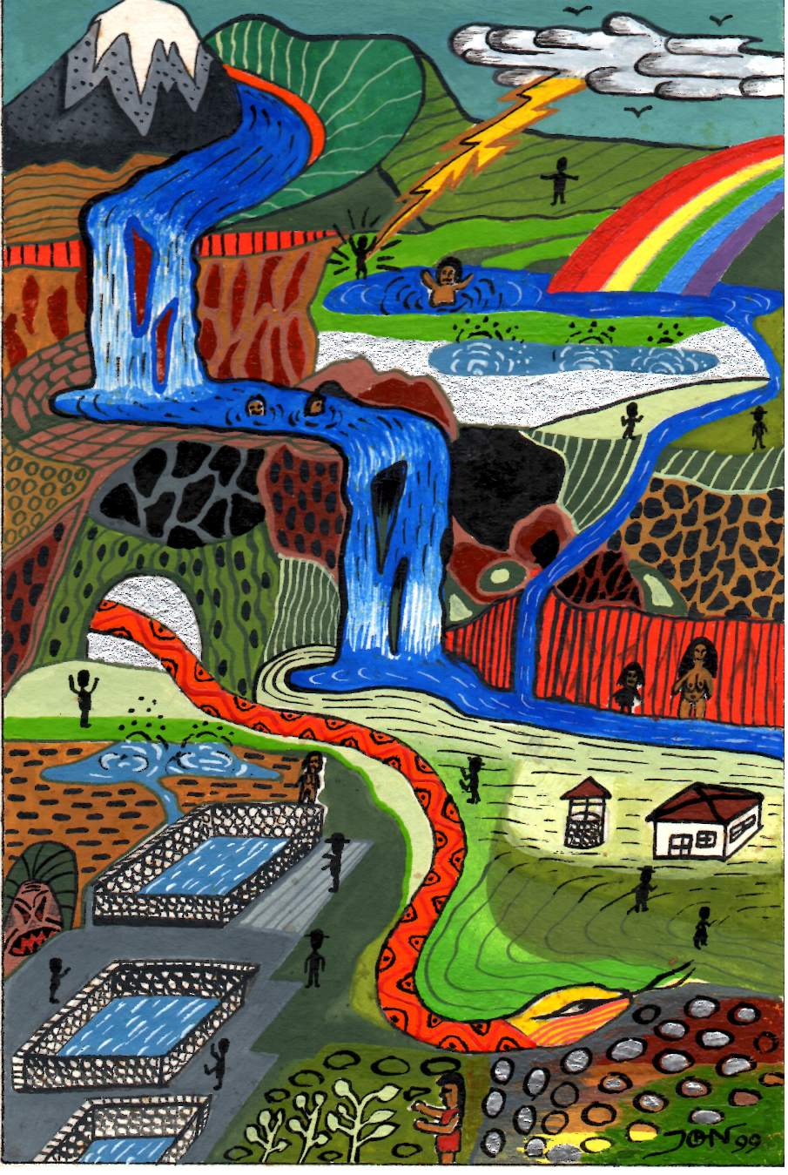
To get a bigger picture

