Slide 1
The Art of Living: birth, myths about saviors, adulthood and the organization of the community
Lucie Vinsova, Masaryk University Brno

Slide 2
Birth
Birth is a very important event for the whole community. Firstly it is said that a Misak has arrived (not that a baby was born, people come and go, they can`t be born and they don`t die (fire for example can die, but not a person).
The essence of birth affects the whole house and contaminates it with papθ, which attracts malevolent spirits. Shaman must arrive to perform the cleansing ceremonies.
Placenta is a very important part of the birth. It is forever connected to the baby and its life. There are different ways of placenta disposal: it is buried by the house and some flowers of very cold essence are planted above it. It is buried underneath the central fire or it is burnt in the central fire.
Together with a baby, a fire-fly is born. There are many different types of fire-flies, the white ones are the ones that accompany people through their lives. The fire-fly turns red if the person gets ill and green ones are the souls of people who have left for Kansrθ. There are also other kinds of fire-flies that can cause illnesses and need to be killed in a special way by a shaman.
Some people also have a soul connected to a tree or a bird, especially shamans.

Slide 3
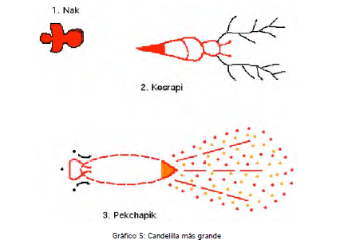

Slide 4
The stories of prodigies
There are many stories of “special” children- prodigies, that became important chieftains and teachers of their communities.
They usually come from inside a mountain after a landslide in a stream of water and mud (or they come floating on another body of water- lake, river etc.). They are swaddled in the most beautiful chumbes or even decorated with gold.
Strange events accompany their childhood and they have strange dietary habits.
The most important examples:
Juan Tama de la estrella
Teresita de la estrella
(similarities with the Serpent story)

Slide 5
THE BIRTH OF LEGENDARY CHIEFTAINS (NASA and MISAK)
Juan Tama de la estrella (Nasa)
Teresita de la estrella (Misak)
The birth of legendary chieftains and teachers (Sat for Nasas and Piuno or Pishau for Misaks - connection to mythological ancestors Pishau).
Their birth comes from the union of water and a celestial body (star). They are said to gestate inside mountains, being fed by a giant puma.
They usually come from the inside of a mountain (underground lakes) after a landslide or a tremor, in a stream of water and mud (or they come floating on another water body- lake, river etc.). They are swaddled in the most beautiful chumbes or are even decorated with gold.
Strange events (falling stars) accompany their arrival and they have strange dietary habits.
They devote their life to the community (important warriors, teachers etc.) and end their lives reentering the water body.
Communities await these prodigies in certain time periods (40 or 60 years). If they don`t appear, they take it as a warning or punishment (earthquake and mud avalanche in northeast Cauca in 1994).

Slide 6
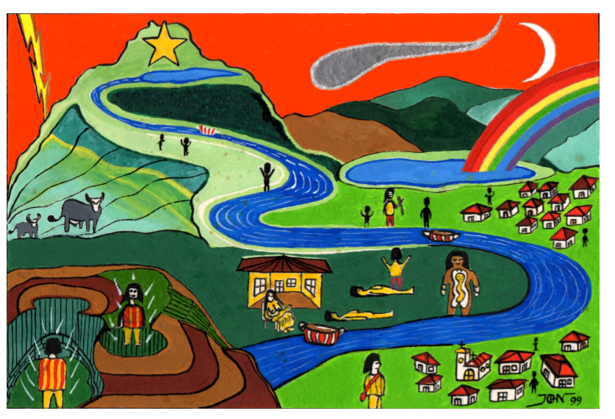
The birth of Juan Tama
Author: Jhon Ferney López Muñoz

Slide 7
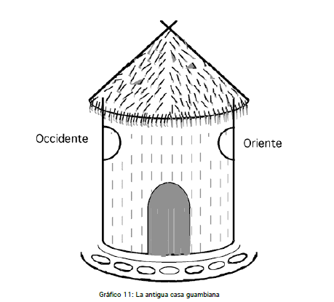
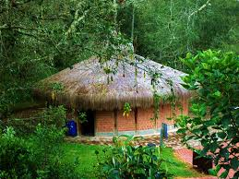
Household
The traditional house served as a clock and a calendar. The house used to be circular with a conical roof with two windows, one towards the east and the other towards the west. These windows are referred to as nθsik llarrarrik- “the eyes of the house”.
As the Sun rays climb the walls of the house it shows the time for performing certain household chores.

Slide 8
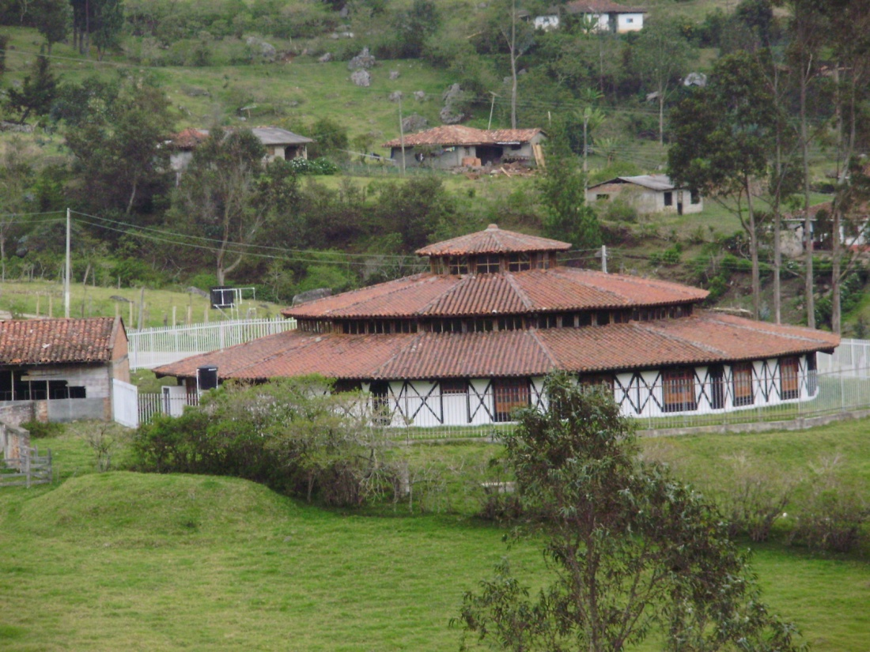
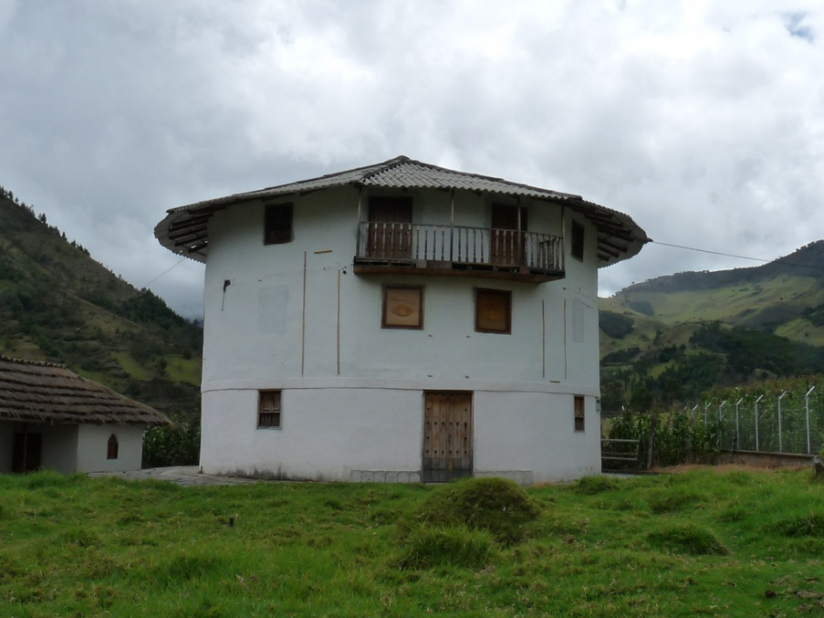
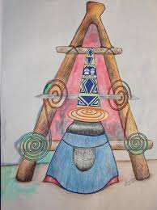
House of traditional medicine
Misak University

Slide 9
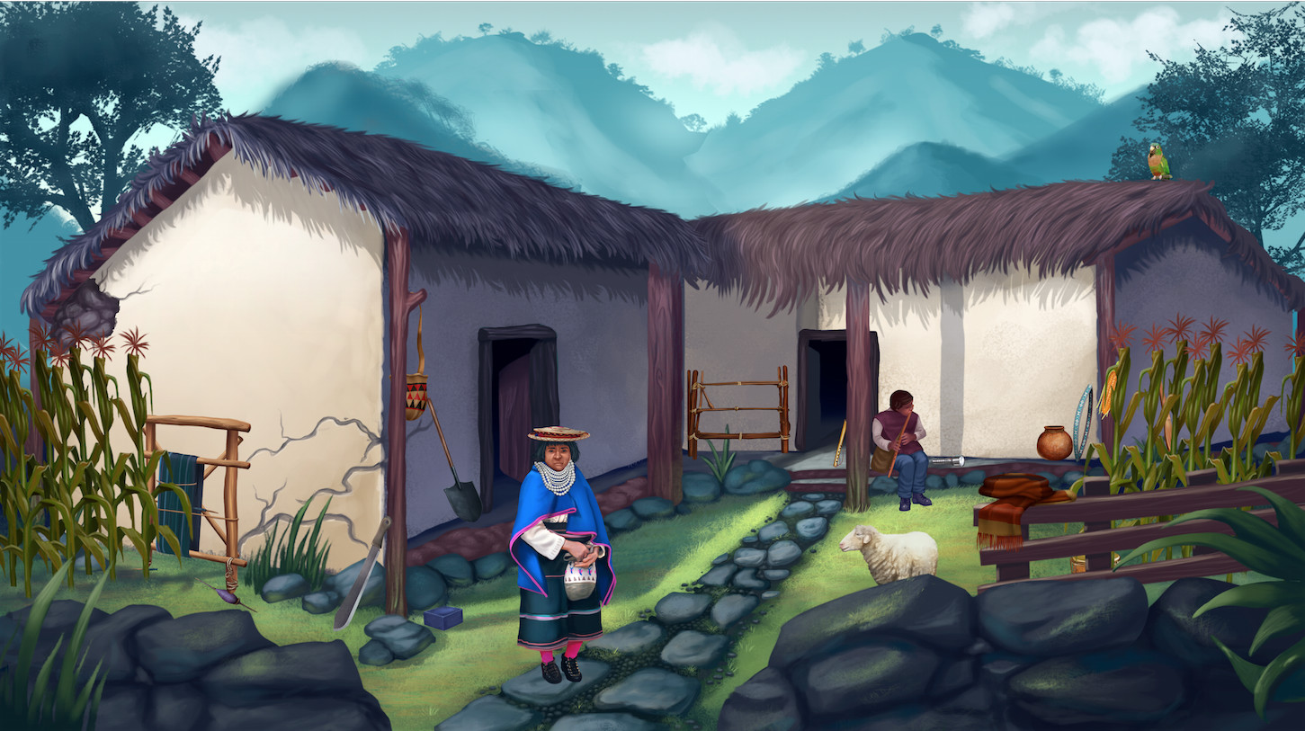
The most important part of the house is its centre- nachak, where the family gathers together to talk, make decisions, tell each other dreams in the morning, and of course to eat. The centre fire, nak, is the element that connects the whole family. Through the fire, the spirits of ancestor can communicate their messages. The central fire is also very important for agricultural rituals. It can never go out completely.

Slide 10
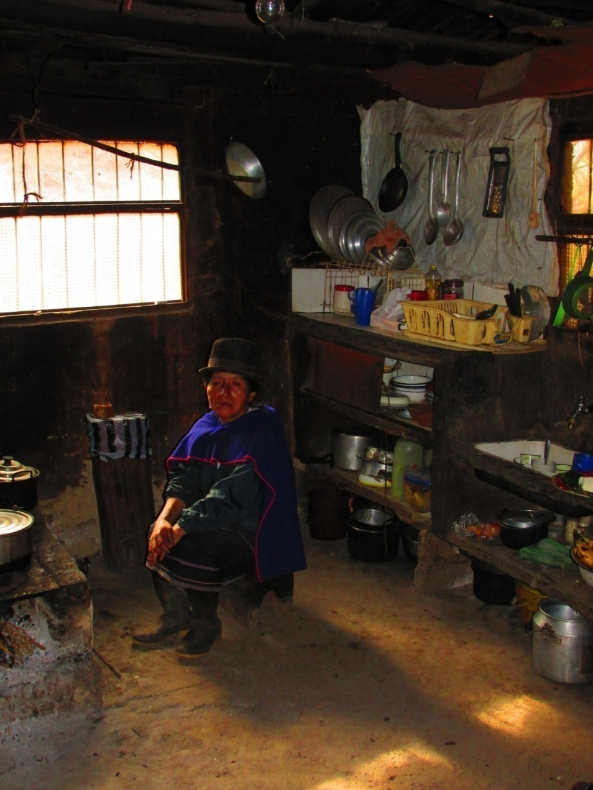
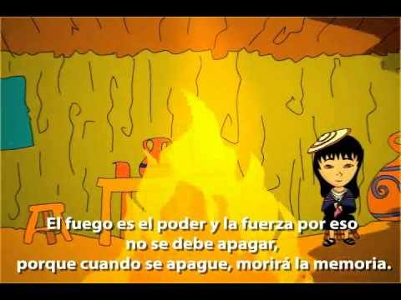
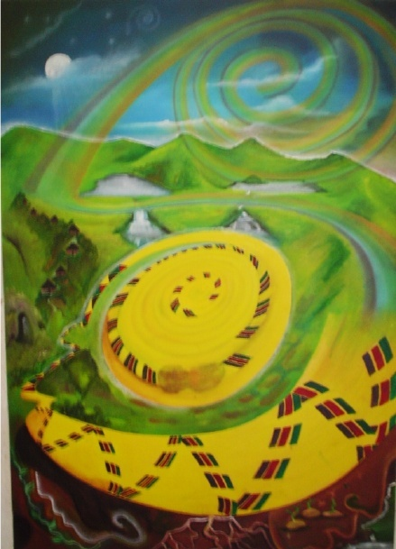

Slide 11
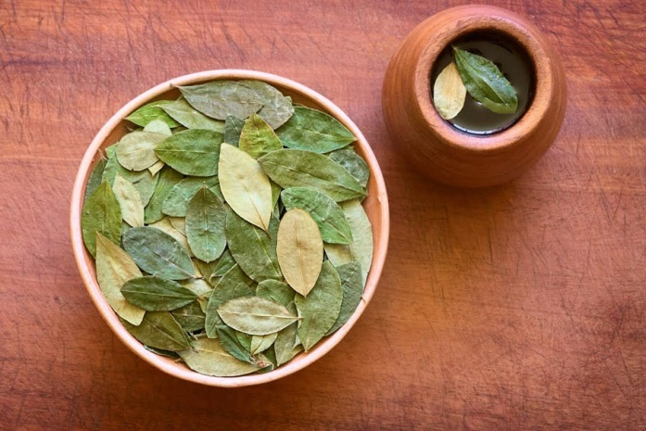
Telling time
Misaks used to tell time according to many natural occurrences:
how the sun rays climb the walls of their house
the shadows of main landmarks (during days and nights- esp. old ladies know the journey of the Moon and can tell time at night too)
animal sound- especially birds and insects
chewing coca
Coca was men`s clock. At the arrival at work, a man would put two measures of coca into his mouth and start chewing. When this wore out, he would chew two more measures. When this was finished, it`s time to have a break and eat. Then he would have two more measures. When this finished, it`s the time to go home. For the journey home, one rather small measure of coca was needed.

Slide 12
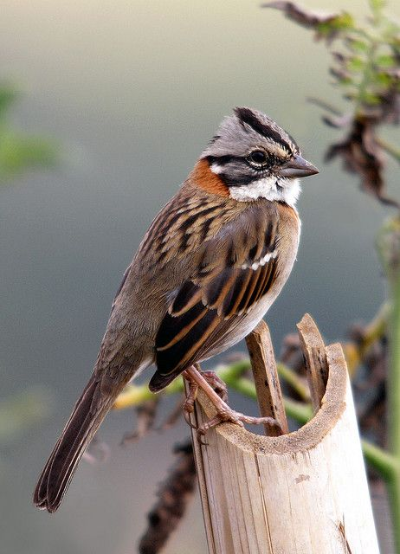
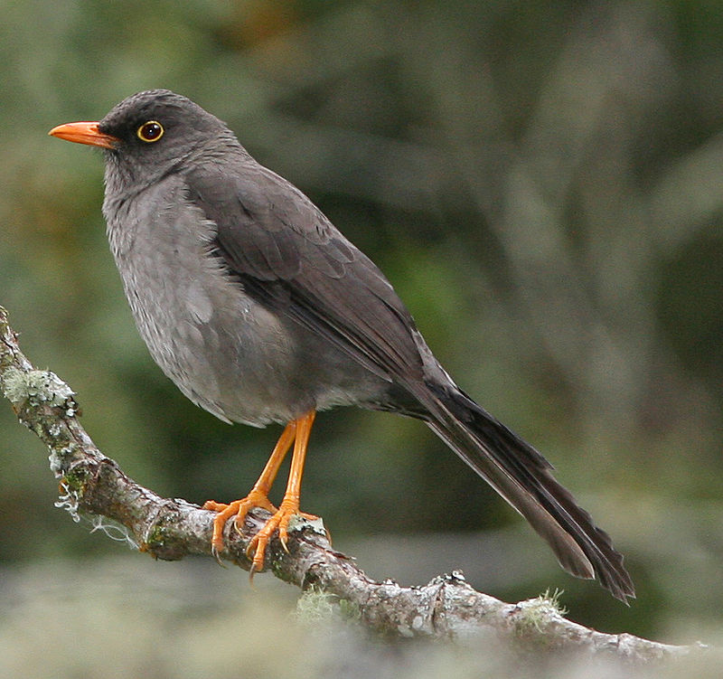
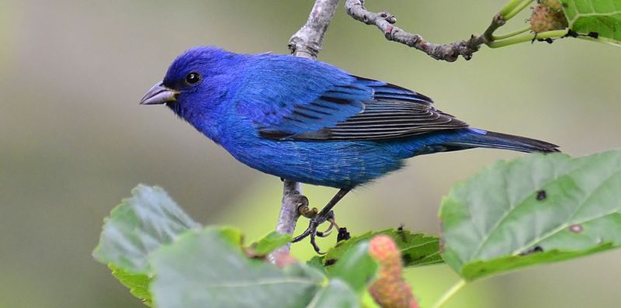
Bird Clock
Usro illi (sparrow) starts singing between five and six in the morning. If it sings at night, it is a bad omen and somebody is going to die.
Poñik (thrush, drozd) always sings at three o`clock in the afternoon. At four it sings again, but a rather sad tune. It is the sign that people should finish work and go home.
Chiñí (azulejos, indigo bunting, papežík indigový) sings once at three o`clock in the afternoon, then twice at three thirty and three times at four. If you continue working and hear it singing five times, you really have to hurry home to return to your house before dusk.

Slide 13
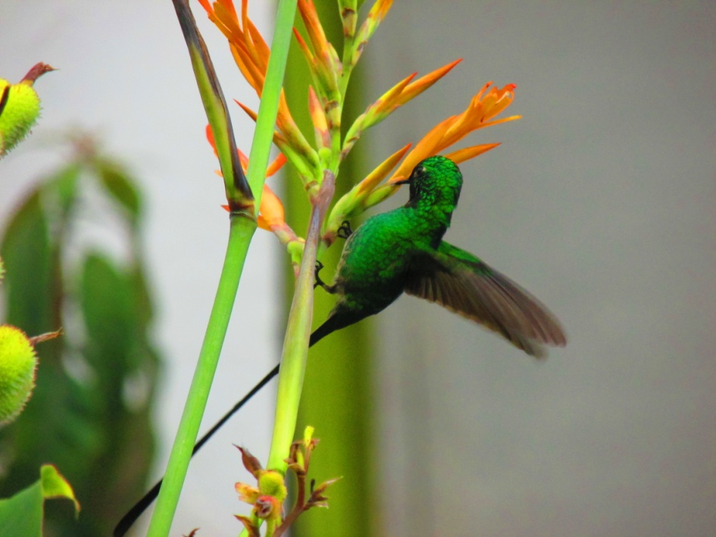
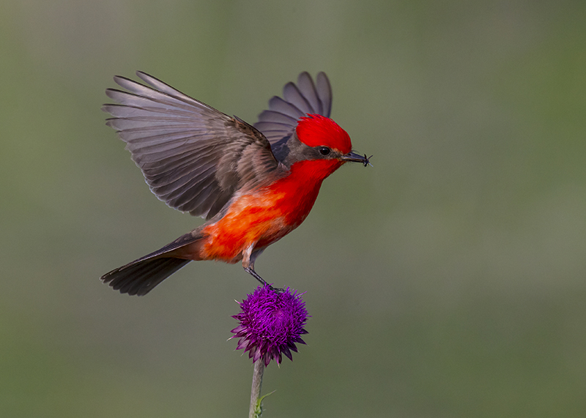
Weather forecast
Alatsi, pájaro brujo (vermilion flycatcher, tyranovac rubínový)
cries when it`s going to rain or when it`s going to be a strong storm. It can also appear when somebody is going to die soon.
Tsatso (humming bird) whistles when it is going to rain or when something bad is going to happen.
Other signs of weather and seasons are given by swallows, moths, cowboy-beetles, ants, cicadas and so on.

Slide 14
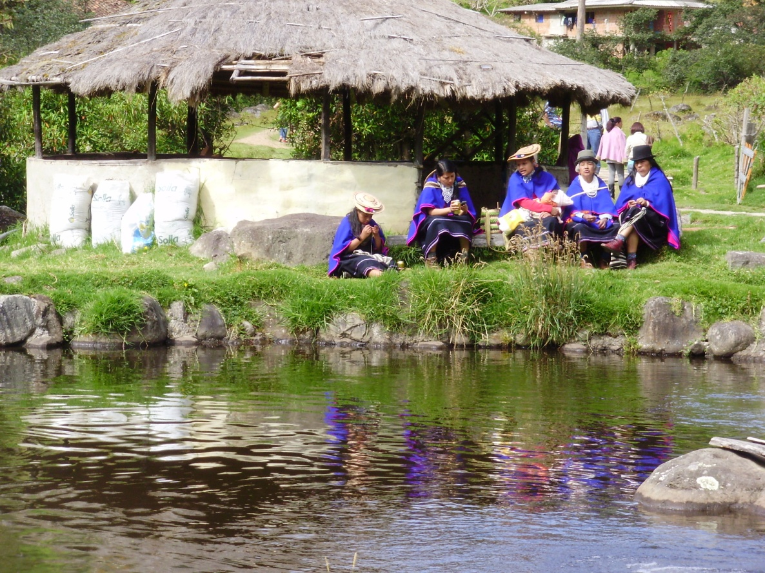
Mingas
Mingas are organized group work projects connected to celebrations- the greatest minga is performed on the day of offerings, when the spirits are coming back from Kansrθ.
Mingas are usually organized in occasion of building a house, preparing fields, harvesting, checking upon the next season`s crop, first menstruation, wedding, baptism etc.

Slide 15
Agriculture
There are big differences between the cold land and the warm land fields- in each altitude different plants are grown. Some families have a piece of land in both climatic zones.
The sowing, the checking upon crops and harvesting are all done in accordance with seasonal rains and the Moon stages.
For example corn grows the highest if it`s planted on the fourth day of the Moon cycle. In general, when the Moon is growing, it is best for the plants.
Certain time after the crops are seeded, there is also a ceremony of checking upon them (especially with potatoes), when shaman digs out a few of the potatoes, checks if they are not being eaten by worms and then blesses the field with herbs and alcohol libations.
There are also festivals of harvest. Especially to celebrate the harvest of corn and potatoes. The biggest corn cob is celebrated as la madre de maíz and is taken home and put above the central fire to assure an abundant corn harvest in the future. It is similar with potatoes. Sometimes, the best corn for sowing is buries under the fire where it can be kept for many years.

Slide 16
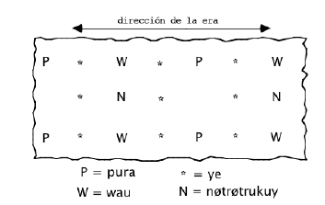
The cultures are always mixed, so the plants can help each other growing and they protect each other against the wind and strong rain.
For example corn and beans are usually grown together. But other plants also thrive while seeded together.
Pura- corn
Wau- celery
Ye- potato
Nθtrθtrukuy- fazole

Slide 17
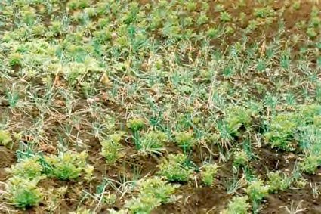
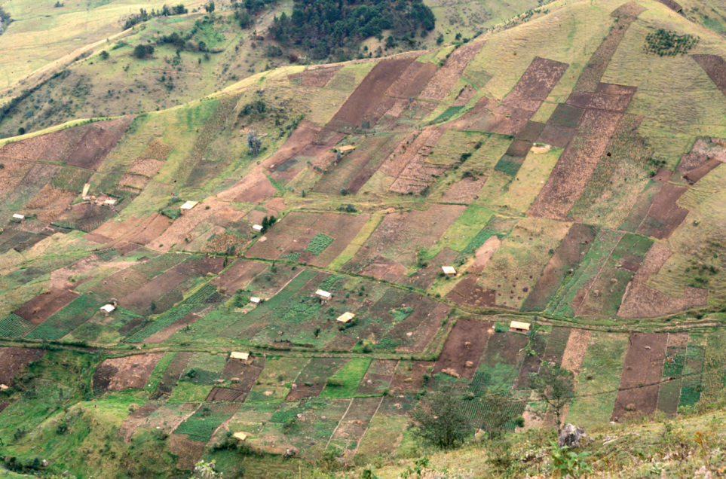
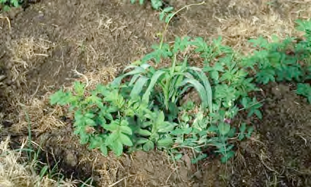
Acompañamiento de cebolla, ajo y papa.
Habitaciones y cultivos en Santiago
Siembra acompañada de maíz, papa, fríjol y alverja

Slide 18
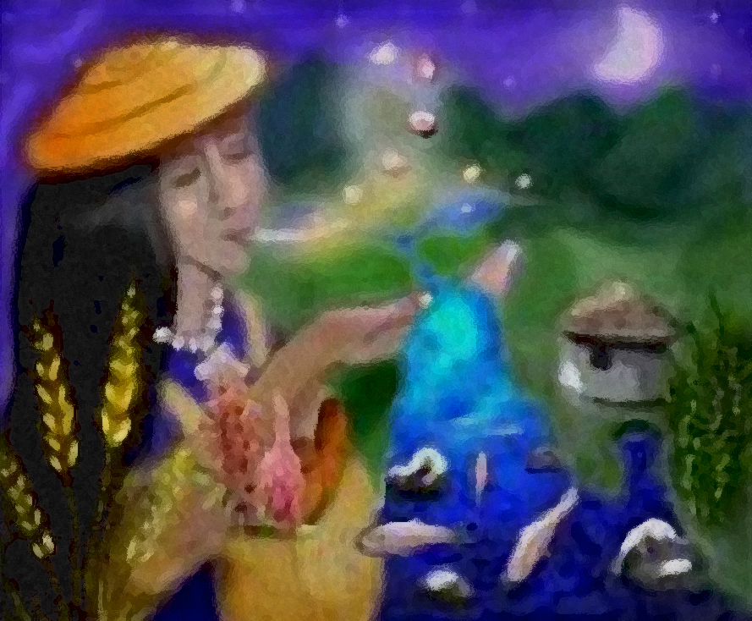
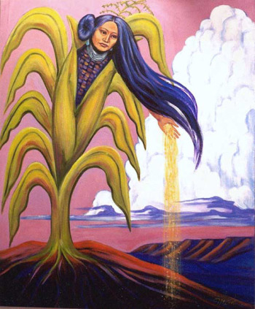
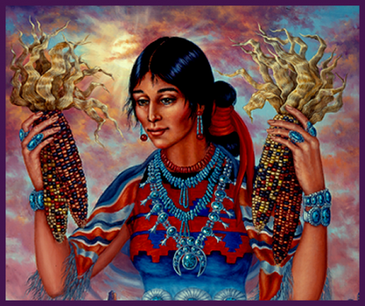

Slide 19
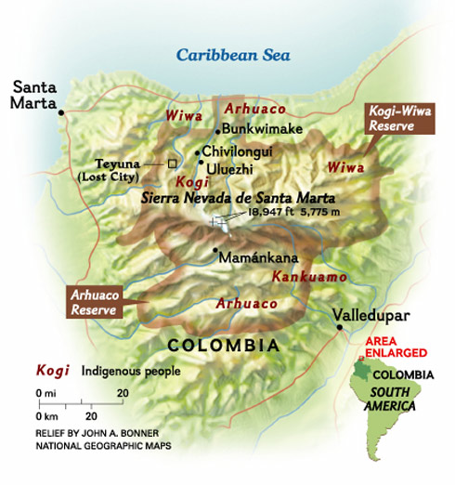
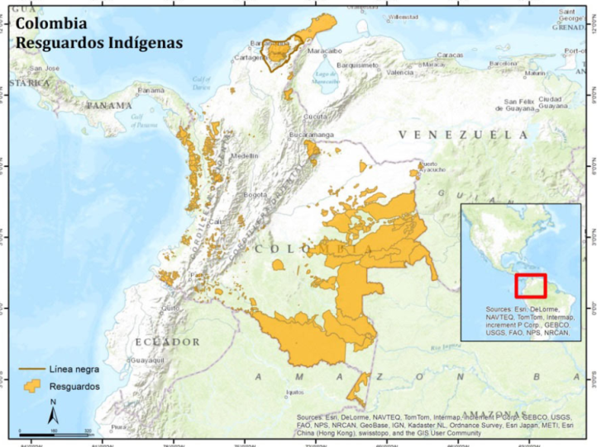
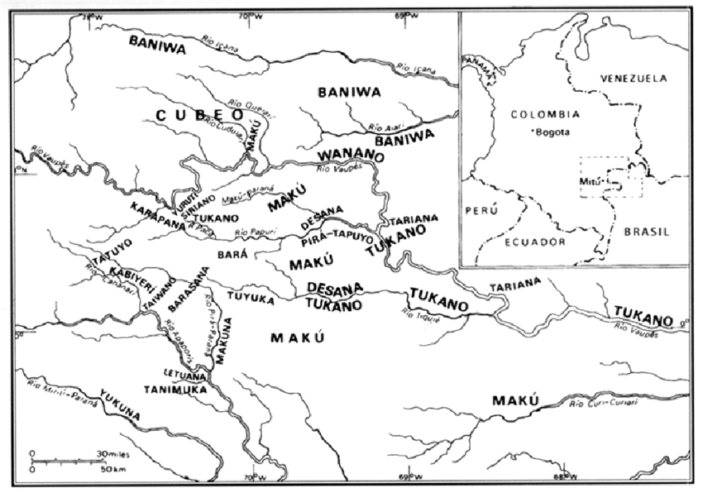
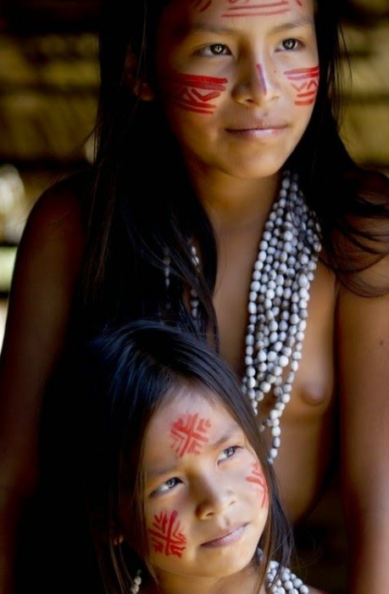
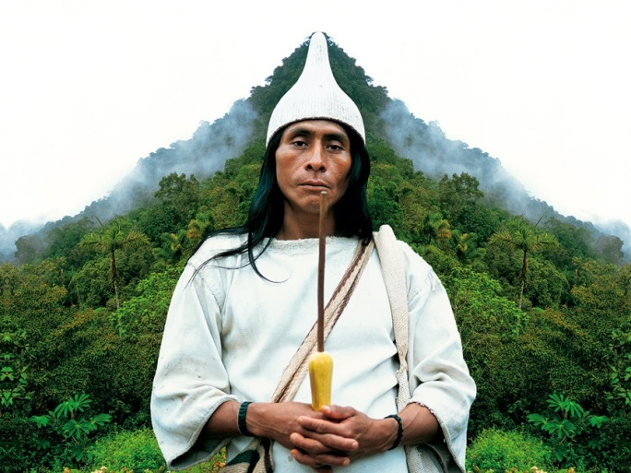
Desana (Tukano family) (mimí-porá “Sons of the Humming Bird”
Kogi (Kággaba) (“jaguar”)
Regions: Magdalena, Cesar, La Guajira
Population: cca. 10 000
Language Kogian (Chibcha family)
Regions: Vaupéz, Brasilian Amazonas (Brasilian-Colombian border)
Population cca: 2 200
Language: Tucano
Gerardo Reichel-Dolmatoff

Slide 21
Desana
Division of male and female roles-
Hunting- of a masculine character, fishing- of a feminine character
These activities cannot be performed on one excursion. The shaman must prepare the participants for them separately.
The hunter carries with him the smell of smoke and blood which the fish loathe (especially anacondas, their representatives).
Mixing these two would actually mean mixing the female and male spheres, equivalent to a forbidden sexual relationship, contrary to the law of exogamy
The hunter cannot bring the dead animal into the maloca. Only women can. The hunting- strictly masculine (fishing into some extend too), cooking and preparing food- feminine. The circuit thus closes. Energy circuit stays closed and self-regenerating. (semen-uterus-baby)
Constellations- Kogi, the Milky Way- Desana, Opossum in Desana and Kogi traditions- reading the fold-tale Dolmatoff n. 24

