Slide 1

Korean class
week 2

Slide 2
index
Review
Batchim
Basic word / sentence / dialogue
Today’s Korean Culture (politeness, dialect)

Slide 3
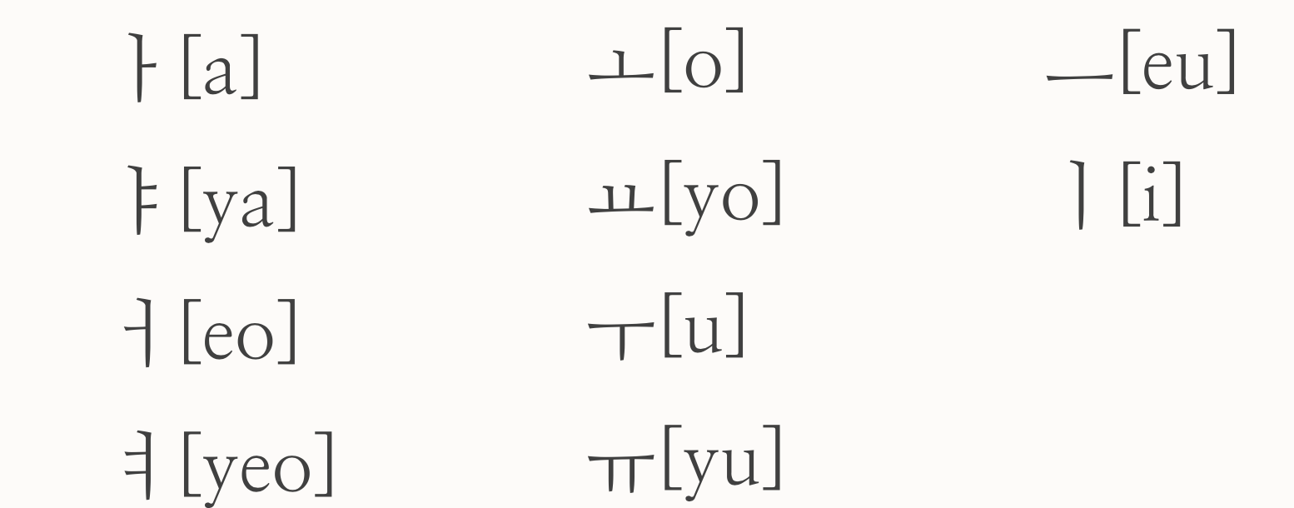
Let’s review !
Basic Vowels

Slide 4
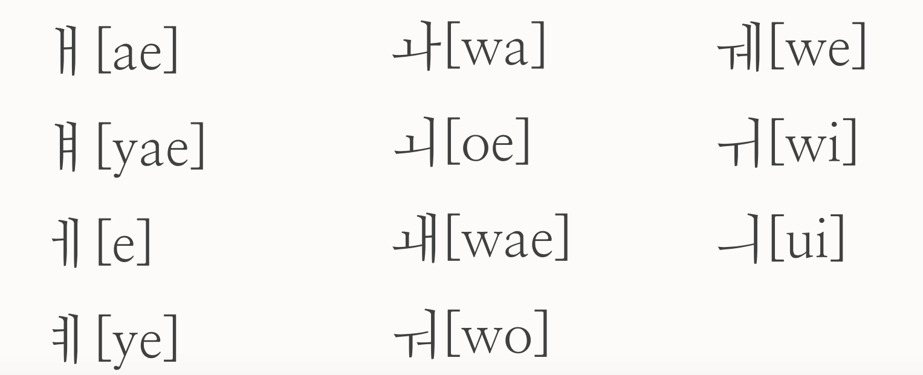
Let’s review!
Combined Vowels

Slide 5
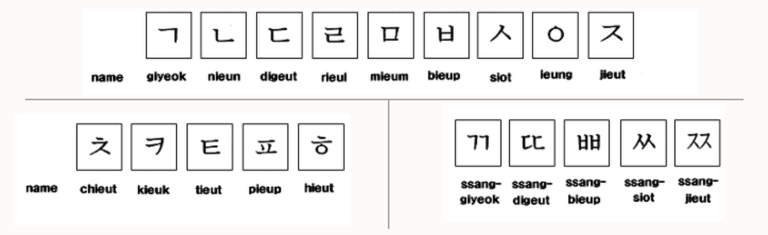
Let’s review!
Consonants

Slide 6
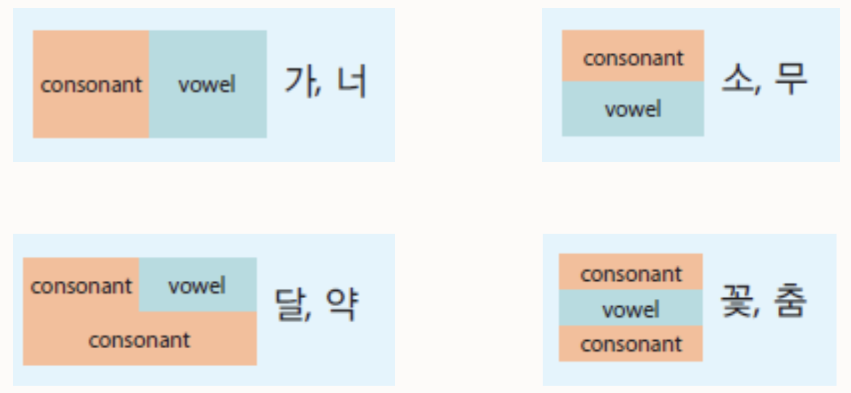
About 받침 (batchim)
- There are 4 types of Korean word
Batchim

Slide 7
Batchim pronounce
Consonant base | Pronunciation | Example
ㄱ,ㅋ,ㄲ | [ㄱ] | 책[책]:Book-{Caeck}, 부엌[부억]:Kitchen-{Bueok}
ㄴ | [ㄴ] | 산[산]:Mountain-{San}
ㄷ,ㅅ,ㅆ,ㅈ,ㅊ,ㅌ,ㅎ | [ㄷ] | 약[약]:Medicine-{Yak}, 낮[낟]:Daytime-{Not}, 꽃[꼳]:Flower-{ggoat}
ㄹ | [ㄹ] | 길[길]:Road-{Gil}
ㅁ | [ㅁ] | 몸[몸]:Body-{Moam}
ㅂ,ㅍ | [ㅂ] | 밥[밥]:Rice-{Bap}, 숲[숩]:Forest-{Soop}
ㅇ | [ㅇ] | 강[강]:River-{Gang}

Slide 8
Regular Sound | Strong Sound | Hard Sound
ㄱ,ㄷ,ㅂ,ㅅ,ㅈ, | ㅋ,ㅌ,ㅍ,ㅊ | ㄲ,ㄸ,ㅃ,ㅆ,ㅉ

Slide 9

Plus
- Can you see the difference between them?
ㅏ, ㅑ, ㅓ, ㅕ
ㅣ, ㅒ, ㅖ
ㅗ, ㅛ, ㅜ, ㅠ, ㅡ
On the right side of consonant
On the down side of consonant

Slide 10


Basic Word – (In Home)
Mom – 엄마{ Eom-ma}
Dad - 아빠{ A-bba}
Older sister – 누나/언니{ Nuna / Eon-ni }
Older brother – 형/오빠{Hyeong / Oppa}
Family – 가족{Gajok}

Slide 11


Basic word – (in school)
Class – 수업 { Su-up}
Assignment – 과제 { Gwa-jae}
Professor – 교수님 { Gyo-su-nim}
Friend – 친구 { Ching-gu}
Bag – 가방 {Ga-bang}

Slide 12
Basic sentence
Hi/Hello
: 안녕하세요 ( An-nyeong-ha-sae-yo)
Bye
:안녕히계세요 ( An-nyeong-hee-gae-sae-yo)

Slide 13
Basic sentence
Thank you
: 감사합니다 (Gam-sa-hap-ni-da)
Sorry
: 미안합니다 ( Mi-an-hap-ni-da)

Slide 14
Basic sentence
What’s your name?
: 이름이 뭐예요? ( i-reum-i-mo-ye-yo)
My name is ~
: 내 이름은 ~ 이에요 ( Nae-i-reum-eun ~ i-ye-yo)

Slide 15
Basic sentence
Nice to meet you
: 만나서 반가워요 (man-na-seo-bang-ga-wo-yo)

Slide 16
Basic sentence
Where are you from?
: 어디에서 왔어요? ( eo-di-ae-seo-what-seo-yo?)
I’m from ~
: ~에서 왔어요 ( ~ ae-seo-what-seo-yo)

Slide 17
Basic sentence
Are you Czech?
: 당신은 체코사람인가요? (dang-sin-eun-chae-ko-sa-ram-in-ga-yo?)
Yes / No
:네 / 아니요 ( nae / a-ni-yo)

Slide 18
Plus
Let’s learn name of country !
Korea – 한국 (Han-guk)
Czech – 체코 (Chae-ko)
Germany – 독일(Dok-il)

Slide 19

Russia – 러시아(Leo-si-a)
Spain – 스페인(Seu-pae-in)
Slovakia – 슬로바키아(Seul-lo-ba-ki-a)
France – 프랑스(Peu-rang-seu)

Slide 20
Basic sentence
What is this?
:이게 뭐예요? ( i-gae-mo-yae-yo?
This is ~
:이건 ~ 예요 ( i-geon ~ yae-yo)

Slide 21
Basic grammar
It
: 이거 ( i-geo)
This
:그거 (geu-geo)
That
:저거 (jeo-geo)
These are typical demonstrative pronouns

Slide 22
Dialogue
Eun ju - Hi, Nice to meet you
: 안녕하세요, 만나서 반가워요
(an-nyeong-ha-sae-yo, man-na-seo-ban-ga-wo-yo)
Thomas - Me too, What’s your name?
:저도요, 이름이 뭐예요? (jed-do-yo, i-reum-i-meo-yae-yo?)

Slide 23
dialogue
Eun ju - My name is Eun ju. And you?
:제 이름은 은주예요. 당신은요?
(jae-i-reum-eun-eunju-yae-yo. Dang-sin-eun-yo?)
Thomas – I am Thomas. Where are you from?
: 저는 토마스예요. 어디에서 왔어요?
(jeo-neun-to-ma-seu-yae-yo. Eo-di-ae-seo-what-e-yo?)

Slide 24
Dialogue
Eun ju- I am from Korea. Are you Czech?
: 저는 한국에서 왔어요. 당신은 체코사람인가요?
(jeo-neun-han-guk-ae-seo-what-eo-yo. Dang-sin-eun-chae-ko-sa-ram-in-ga-yo)
Thomas- No, I am from Germany.
:아니요, 저는 독일에서 왔어요.
(a-ni-yo, jeo-neun-dok-il-ae-seo-what-a-yo)

Slide 25
Dialogue
Yejin – What is this?
: 이건 뭐예요? ( i-gun-mo-yae-yo?)
Derik- It is my phone.
: 이건 나의 핸드폰이에요. ( i-gun-na-eu-hand-phone-i-yae-yo)

Slide 26
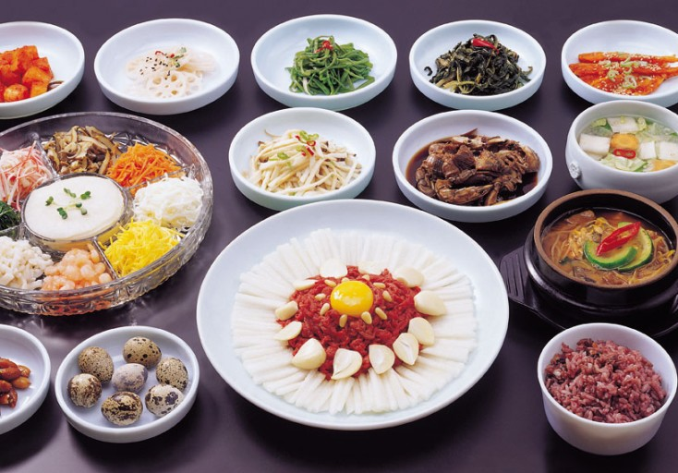
Today’s Korean culture - politeness
Dinning etiquette
1. Don’t eat until adult start eating.
2. Spoon is left side, chopsticks are right side.
3. When you before eat, should say ”잘 먹겠습니다.” – {jal-meok-gae-seup-ni-da}
4. When you finish eat, should say ＂잘 먹었습니다.” – {jal-meok-eot-seup-ni-da}
5. Don't make the sound of the spoon and the bowl collide.
6. Don’t make the sound of chewing food.

Slide 27
Today’s korean culture – dialects
Watch this video first !!
https://youtu.be/cCchIPz_pBs

Slide 28
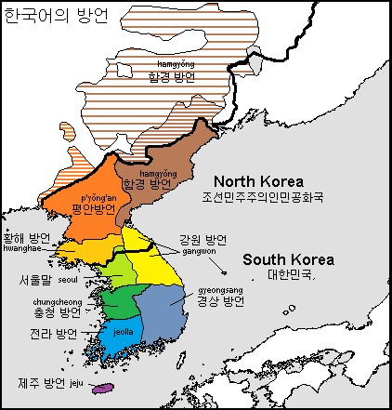
Today’s korean culture - dialects
As shown in the picture, each divided region has a dialect.
Reason : Because local settled populations developed peculiarities in speech + the weather, lifestyle, and culture are different in each region.
The language you are learning is the standard language, “Seoul”.

Slide 29

Thank you

