Slide 1
Philippine English
Pinoy

Slide 2
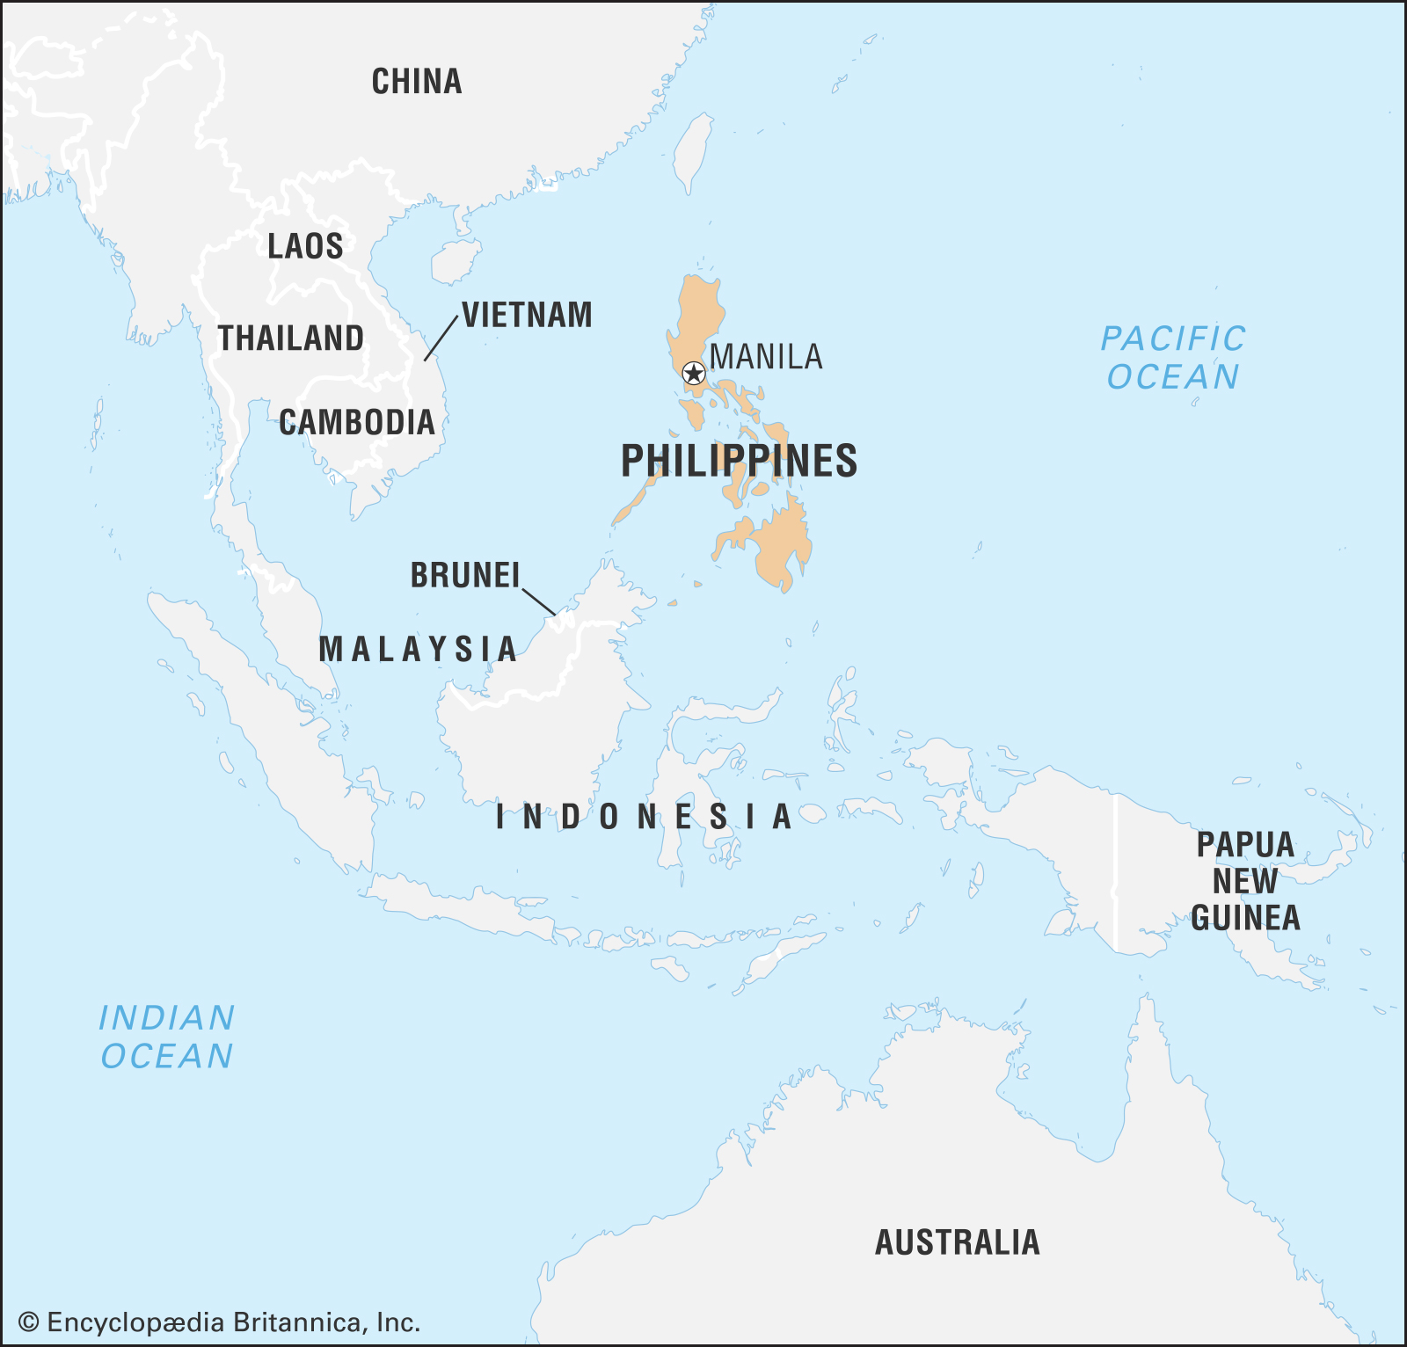
Republika ng Pilipinas
110 million people
more than 175
languages and
dialects
English / Filipino

Slide 3
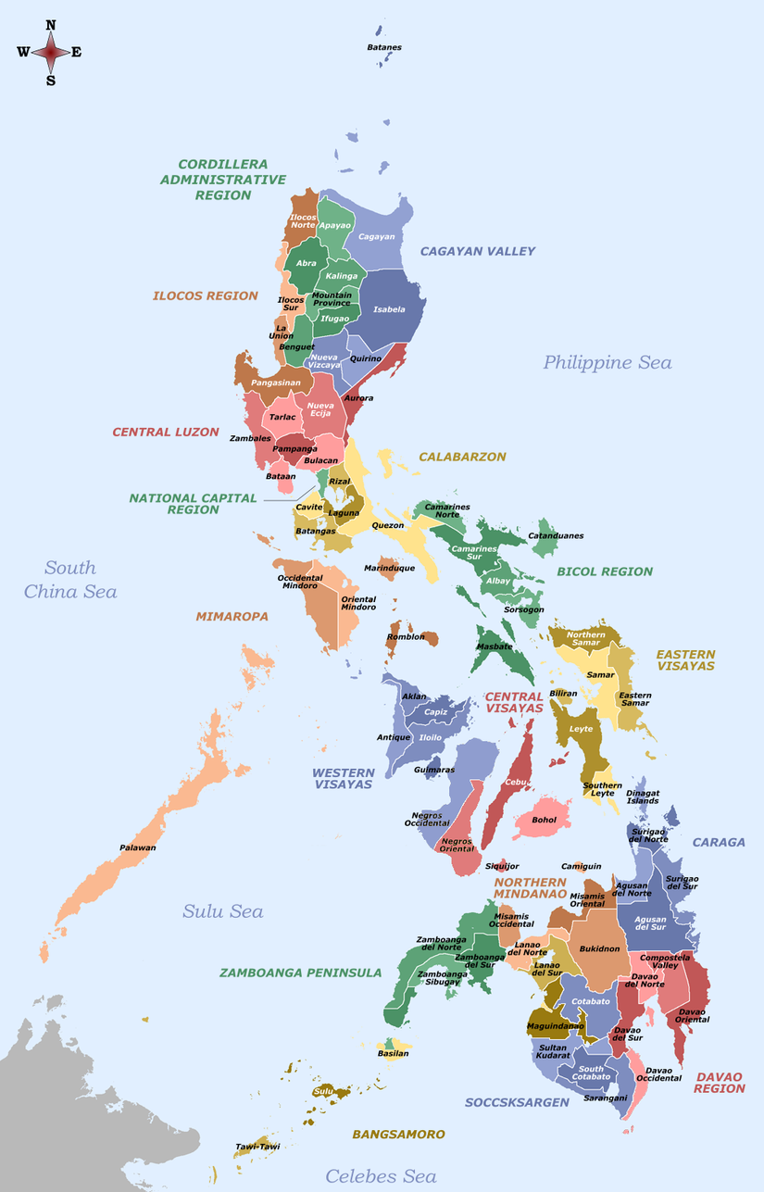
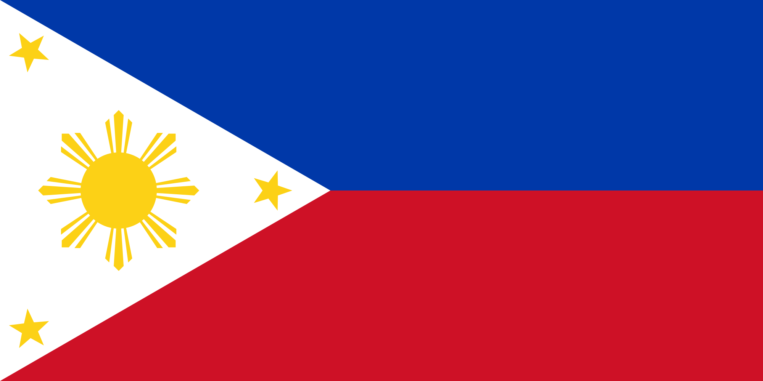
Philippine English
related to American English
one of the two official languages
code-switching to Taglish (Tagalog/English)

Slide 4
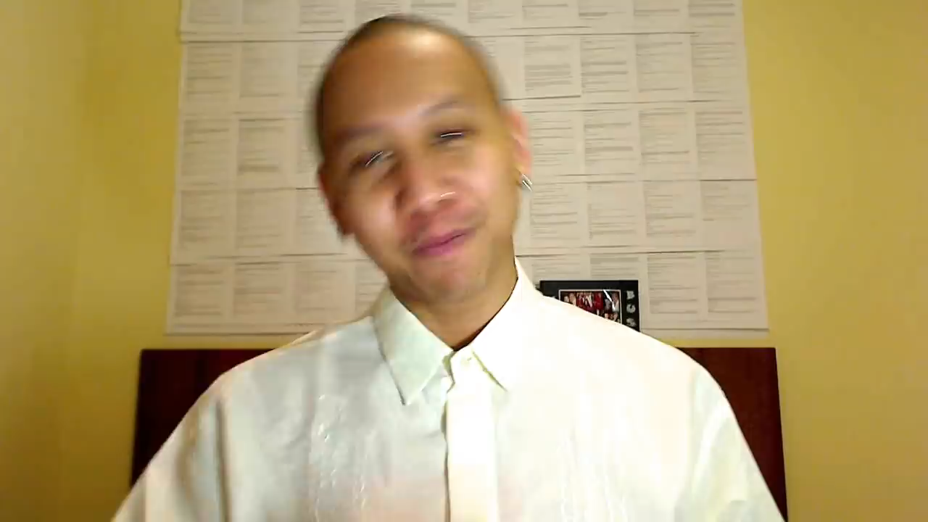
Pinoy accent

Slide 5
Consonants
rhoticity
fricatives /f/and /v/ approximated into the stop consonants [p] and [b]
Th-stopping
Yod-coalescence (the [dj], [tj] and [sj] clusters becomes into [dʒ], [tʃ] and [ʃ])
fricative [ʒ] may be devoiced into [ʃ], or affricated into [dʒ]
/z/ phoneme devoiced into /s/
"dark l" ([ɫ]) merged into "light" /l/

Slide 6
Vowels
⟨a, e, i, o, u⟩ generally pronounced [a, ɛ, i, o, u]
schwa /ə/— absent.
approximations of the schwa: words that end in -le that succeeds a consonant generally pronounced with an [ɛl]
/ɪ/ pronounced as a diphthong /eɪ/
rhotic vowels /ər/ and /ɜːr/ may be pronounced as an [ɛr]
⟨a⟩ pronunciations /æ, ʌ, ɑ/ pronounced as central vowels [ä] and [ɐ]
/ɪ/ phoneme may be merged or replaced by the longer /i/
/ɒ/ may be pronounced as an [o] (color) or an [ɐ] (not)

Slide 7
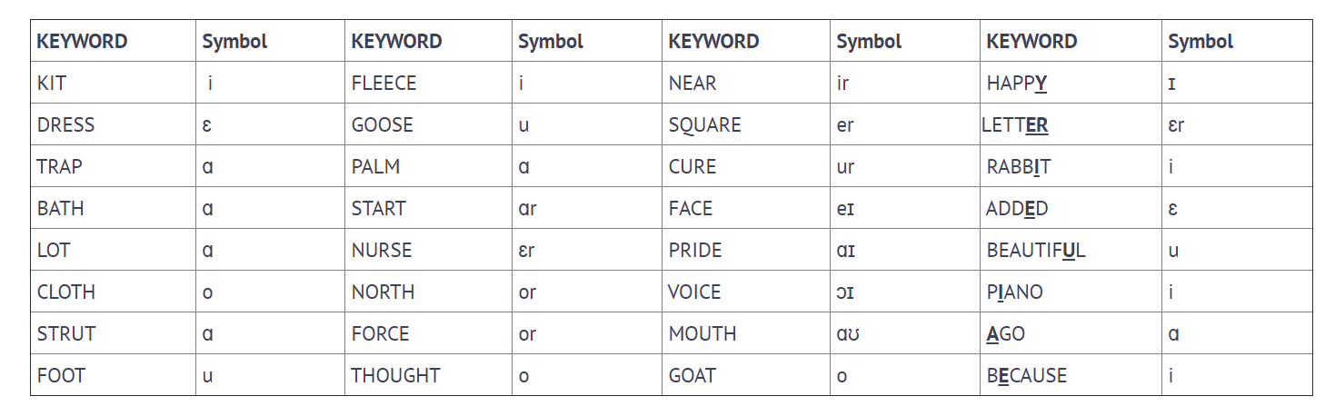
OED model

Slide 8

Filipino English Stereotype

Slide 9

Filipinos in the Czech Republic

Slide 10
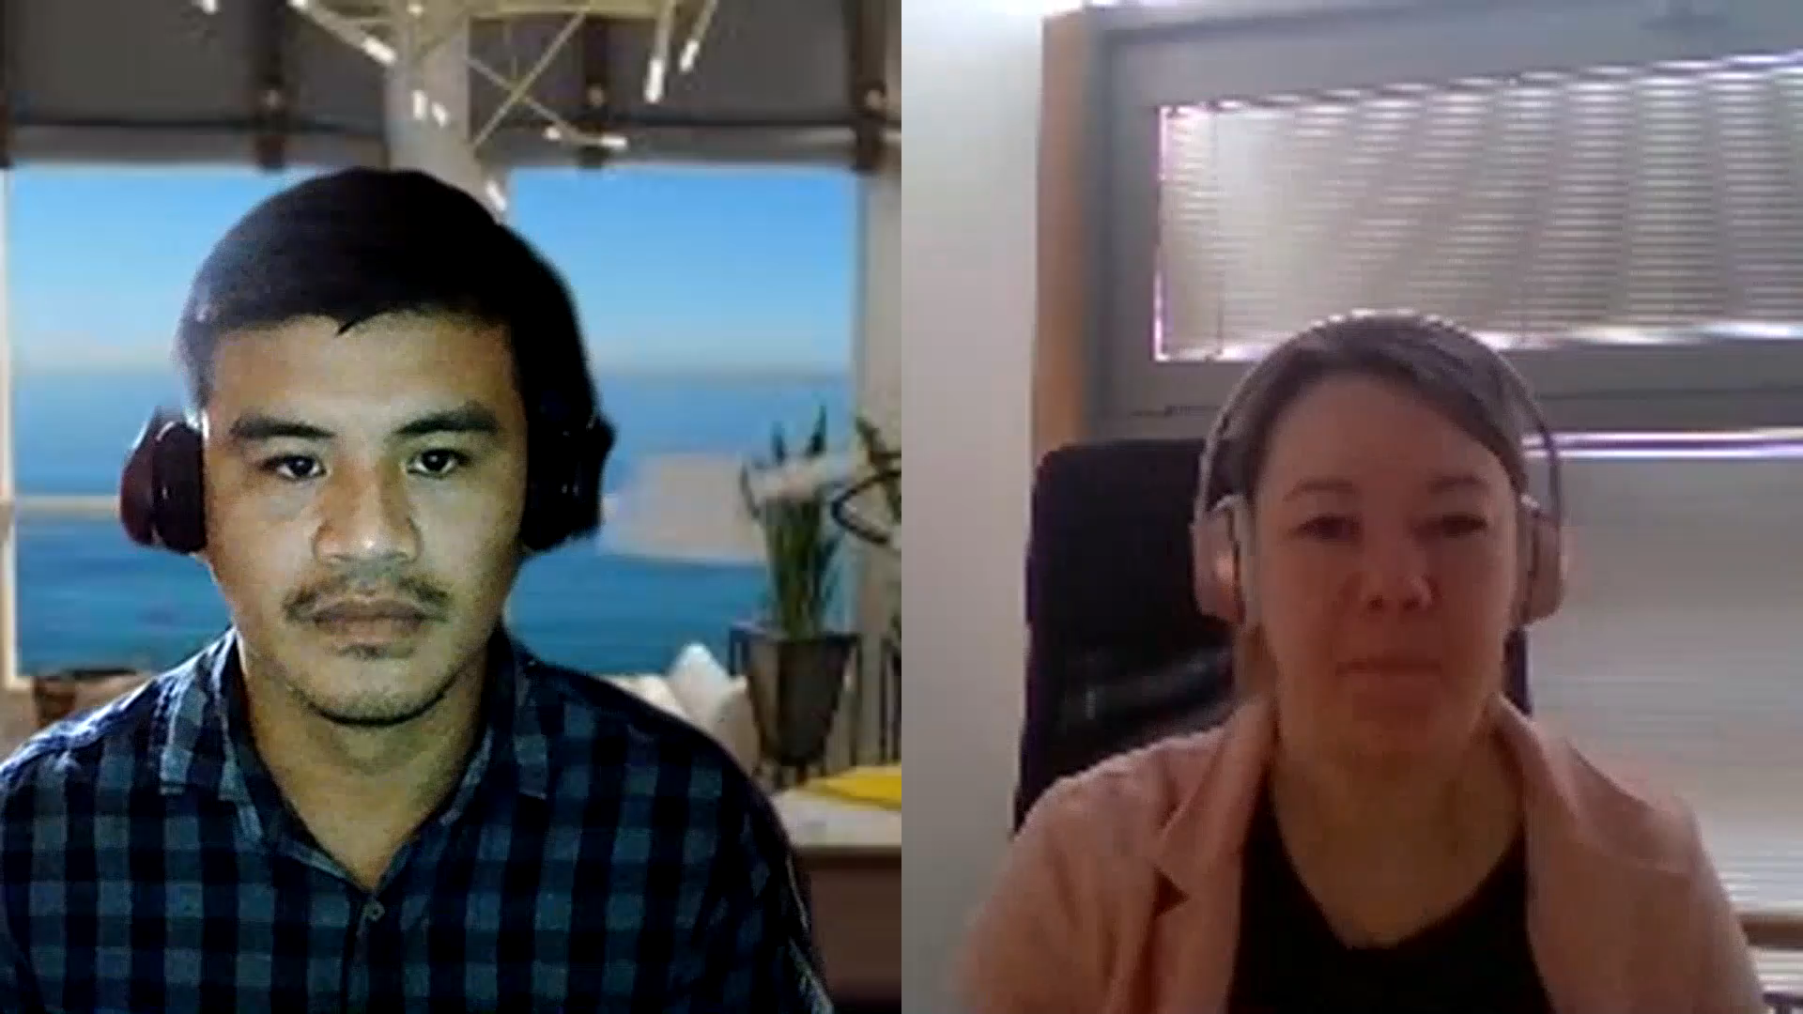
Filipinos in the Czech Republic

Slide 11
Links
https://public.oed.com/how-to-use-the-oed/key-to-pronunciation/pronunciations-for-world-englishes/key-to-pronunciation-philippine-english/
https://public.oed.com/how-to-use-the-oed/key-to-pronunciation/pronunciations-for-world-englishes/pronunciation-model-philippine-english/
https://www.youtube.com/watch?v=M0lKXfyJh-I
https://www.youtube.com/watch?v=3BBtS1ir4tA
https://www.grapecare.cz/

