Slide 1

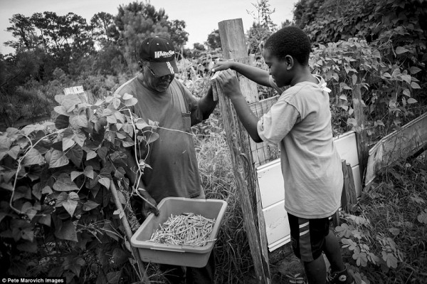
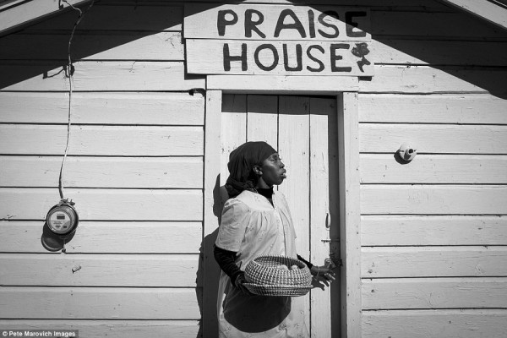
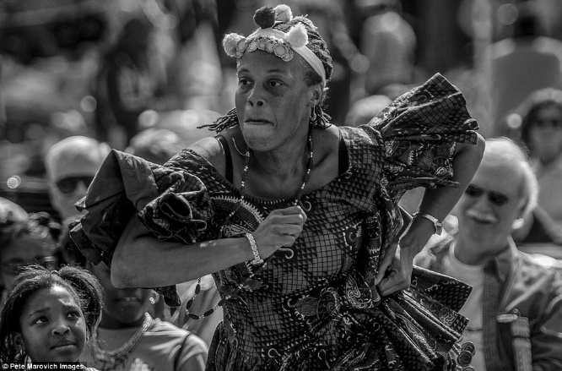
GULLAH
Pronunciation Varieties of American English
Katarína Gábryšová

Slide 2
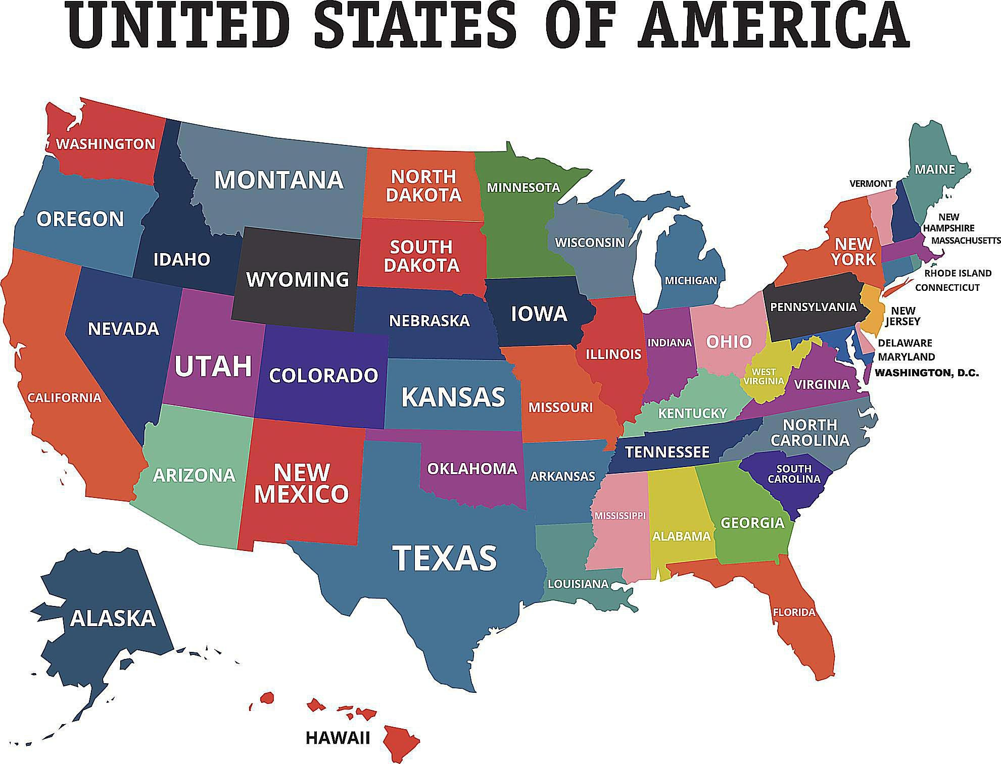
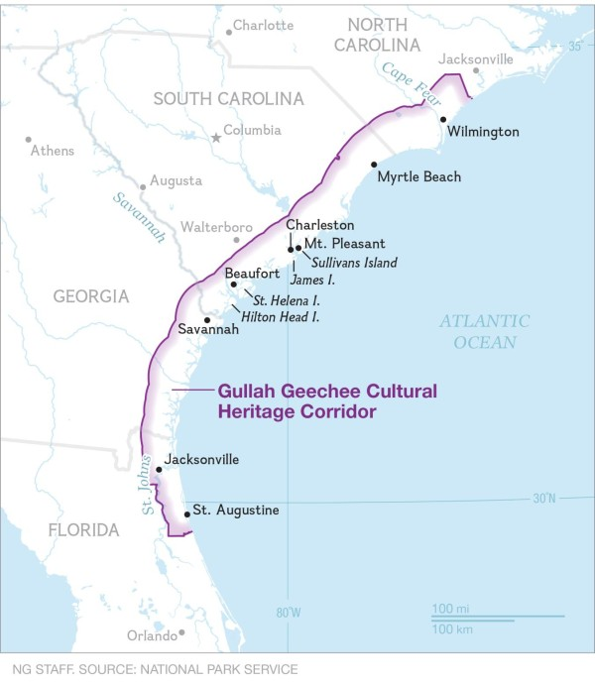

Slide 3


Cultural Background
descendants of Central and West Africans
enslaved together on the isolated sea and barrier islands that span what is now designated as the Gullah Geechee Cultural Heritage Corridor
an intense interaction among Africans from different language groups in settings where enslaved Africans and their descendants formed the majority
they developed the creole Gullah Geechee language as a means of communicating with each other
able to preserve many African practices in their language, arts, crafts and cuisine

Slide 4
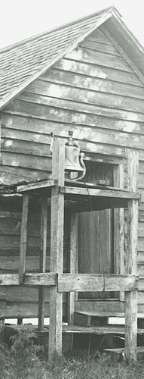
SPIRITUAL EXPRESSION
Religion and spirituality have a sustaining role in Gullah family and community life
Enslaved Africans were exposed to Christian religious practices in a number of ways and incorporated elements that were meaningful to them into their African rooted system of beliefs
  belief in a God, community above individuality, respect for elders, kinship bonds and ancestors; respect for nature, and honoring the continuity of life and the afterlife.
regular religious services on the plantation with compulsory attendance or separate services for blacks with black preachers
Plantations frequently had a praise house or small structure where slaves could meet for religious services, but these also had significance in maintaining community cohesion, social structure and conflict resolution.

Slide 5
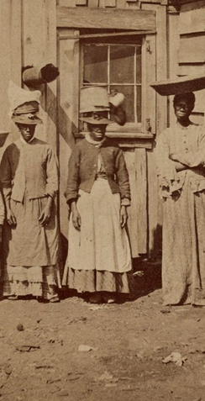
ARTS, CRAFTS AND MUSIC
​Arts and crafts - cast nets for fishing, basket weaving for agriculture and textile arts for clothing and warmth.
  passed down by enslaved Africans brought to the southeastern shores of the United States
  younger generations have lost interest
  African textile traditions combined with European quilting methods - a creole art form emerged
the African art of basket making was significant as a traditionally passed down handicraft practiced by both men and women using similar materials from their homeland.
baskets were sold to non-Gullah Geechee people and were a source of additional income.
African songs are the foundation for what may be referred to as Gullah music. Deeply rooted in music traditions brought to the Americas by enslaved Africans, the music evolved out of the conditions of slavery that characterized their lives. The influence and evolution of musical forms that arose out of Gullah music can be heard in many musical genres such as spirituals and gospel music, ragtime, rhythm and blues, soul, hip hop and jazz.

Slide 6
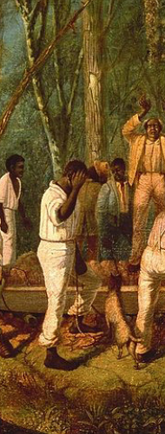
language
a unique creole language spoken along the Sea Islands and adjacent coastal areas of South Carolina and Georgia
The residents in Georgia are typically referred to as “Geechee“
began as a simplified form of communication among people of different languages including European slave traders, slave owners and diverse African ethnic groups
The vocabulary and grammatical roots come from European and African languages
Gullah Geechee language is the only distinctly African creole language in the United States and has influenced traditional Southern vocabulary and speech patterns
Gullah closely resembles nonstandard Bahamian English in both grammar and intonation.

Slide 7
Gullah english creole
Ain ain‘t
Uh I
Gwine going to
Dey they
De the
Dis this
Dem tem
Fada father
Ooman woman
Mi nauna me and you
E she, he, it, his, her
Oomah you
Da that, the, you
Duh it is
Biddi bird
Tittuh sister
Day clean dawn
Krak teet talk
We we, us
Universal negator – ain (He ain go come – he won‘t come)
Multiple negatives (She ain go nowheh. – She isn‘t going anywhere.)
Gender and case distinctions in the pronominal system are made only partially(she refers to females, but he is not gender-specific)

Slide 8
Joso – witchcraft - comes from „njoso“ – forest spirit
Gafa – evil spirit – comes from ngafa – devil
Wanga – charm – comes from an-wanka – swear or fetish
Bento – coffin – comes from and-bento – bier
Buckrah – white man
Nyam – eat
Swonguh – proud
Benne – sesame seed
African derived gullah words

Slide 9
guess the sentence
E da me fada.
He is my father.
Da God work.
It is God‘s work.
Who ya da?
Who are you?

Slide 10
Carolyn White - The Visitor
<Carolyn White is speaking to an audience which participates with numerous “Um hums”>
C. White: Now all the story that I tell, are use, you know, black and white in the story and I ain’t use’em for no harm for nobody. It just for entertainment today. Ok? So now I’m gonna tell [????] story.
You know down in Charleston [????] come down there for visit and go around. Well back in the olden days this old black man been ‘a work down on Broad Street.
‘Cause you know during that time, time [????] and in order to get a good job, you had to go downtown, maybe to Broad Street and do a little work. And just like how these brick [????], downtown in Charleston you find dem cobblestones. And if you ain’t been know where you g’wine den because the street sign wouldn’t up in the air, it was down-down in the stone. So buckra come to town. <To a member of the audience> You know, come here sweetheart. Buckra come to town, you know who the buckra is? No, he say he pass. Well I can tell you right now, you is the buckra. The old slave term for white man is what? Buckra. So well the buckra come to Charleston ‘cause he was a tourist. So he went downtown and he saw the old man workin’, mindin’ his business. So he walked up
to the old black man, said, “Look a’here.” And said, “Can you tell me where’s the Battery?”
Old black man said, “Battery?” Said, “I here dem chilren’ got battery in dem car.” He said, “But I ain’t got none and I ain’t know where dat dis.”
Well, tourist didn’t give up. Look at the old black man, said, “Look a’here. Can you tell me where’s the Custom House?”
Old black man said, “Custom House?” Say, “I ain’t got nothing but a board house on James Island.” Say, “I don’t know where dat dis neither. I don’t know.”
Well you must remember in the olden days, the old people teach their chilren to keep their mouth shut, you see. But the tourist still didn’t give up. He said to him, “Look a’here.” He said, “Do you know where’s the jail house?”
Old black man said, “Jail house?” Said, “Look a’here let me tell you one thing.” Say, “I ain’t never been there. I ain’t try for go there. So I ain’t have a’ no [we] there. Idon’t know.”
<Audience starts to clap>
Well, don’t clap yet, ‘cause that ain’t the end of the story. So when the [????] tourist look at him say, “Look a’here.” Say, “You don’t know nothing eh?”
Old black man look at him, say, “I know one thing. I ain’t lost.”
<Audience laughs and applauds>
https://knowitall.org/audio/visitor-carolyn-white-digital-traditions

Slide 11
SOURCES
https://bglh-marketplace.com/2015/09/americas-oldest-culture-directly-descended-from-west-africa-is-in-danger-of-extinction/
https://www.gullahgeecheecorridor.org/thegullahgeechee/
https://www.britannica.com/topic/Gullah-language
https://www.youtube.com/watch?v=5WZMrSj3pkU

