Slide 1
Week 10
Exoticism and Gender in Opera and Operetta

Slide 2
Exoticism and Gender
The exotic “Other”=often associated with the feminine or effeminate or effeminizing or queer
Western “Self”: associated with heteronormative, patriarchal masculinity
Handel’s Giulio Cesare (Cleopatra and Tolomeo)
Saint-Saëns’s Samson et Dalilah
Borodin’s Prince Igor (Konchakovna)
Britten’s Death in Venice (Aschenbach’s desire for Tadzio)

Slide 3
Bizet’s Carmen
Carmen=Spanish “Gypsy” Woman
“Gypsies”=internal “Other”
How is Carmen exotic?
Habanera (#9): a “Gypsy” song?
Melody: from a collection of Spanish art songs; rhythm: Afro-Cuban
Seguidilla (#16): Spanish triple-meter dance + exotic elements: instrumentation, Phrygian twists
Dance Song (#26)
Only introspective song: B section of the ”Card” Trio (#34, 3:00)

Slide 4
The Spanish (“Us”) Characters in Carmen
Micaëla’s aria (#36, 1:00)
Don José vs. Carmen Motives in the scene following the Habanera (#10)
Don José: duet with Micaëla (#12)
The Murder of Carmen: #42 (4:00)

Slide 5
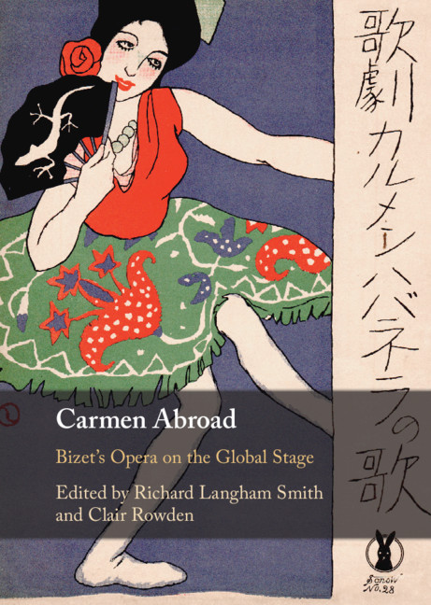
Carmen Reception in Prague
German Theater (Estates Theater, later Neues deutsches Theater): 1880
Czech Theater (National Theater): 1884—first foreign opera to be produced at the NT
German reception: Carmen=progressive, Wagnerian, proto-veristic opera=basically a German opera, the Germans understand it better than the French
Czech reception: too cosmopolitan, regressive, commercial, immoral, sexual

