Slide 1
Week 7
Music and Czech Nationalism
Can Music Be Inherently Czech (or German, or Russian)?

Slide 2
In Search of Czechness in Music
Michael Beckerman, 1986 article in 19th-Century Music
Czechness + Russianness + Germanness: cannot be defined precisely/objectively
It is not IN THE MUSIC ITSELF but rather IS PERCEIVED/CONSTRUCTED by the audience
P. 73: “Czechness” itself comes about when in the minds of composers and audiences, the Czech nation, in its many manifestations, becomes the subtextual program for musical works, and as such, it is that which animates the musical style

Slide 3
Symbolic Markers of Czechness in Music
Libuše, 1871–72 (for the coronation of Franz Joseph as the King of Bohemia, 1881, first opening of the National Theater)
Explicit programmatic/nationalistic elements (symphonic poems, dances, opera)—2:31:00
References to historical styles and works (Hussite chorale)—2:26:00
Folk-likeness—1:26:30
Synthesis of various “mainstream” and “peripheral” traditions (Wagnerian + folksy music)—overture
Referencing the styles of earlier national composers (Smetana)

Slide 4
Complexities of Musical Nationalism:
The Brandenburgers in Bohemia, 1866
Smetana’s first opera (written already in 1863)
Seen as nationalistic + ethnic + inherently Czech + anti-German + anti-Habsburg + anti-Austrian + victory of the Czechs over the Germans
13th-Century Bohemia: invasion of Brandenburger mercenaries
Czech peasants vs. Brandenburgers
Act II, Scene 1: peasant chorale, 58:30
Act II, Scene 1: the Brandenburgers, 1:04:00

Slide 5
The Politics of The Brandenburgers
Weak libretto that does not present a clear distinction between the Czechs and Germans
Confuses Smetana—one of his lesser works
Rather than a simple nationalist propaganda (or a weak work)—the opera reflect the complexity of Bohemian population and politics in the early 1860s

Slide 6
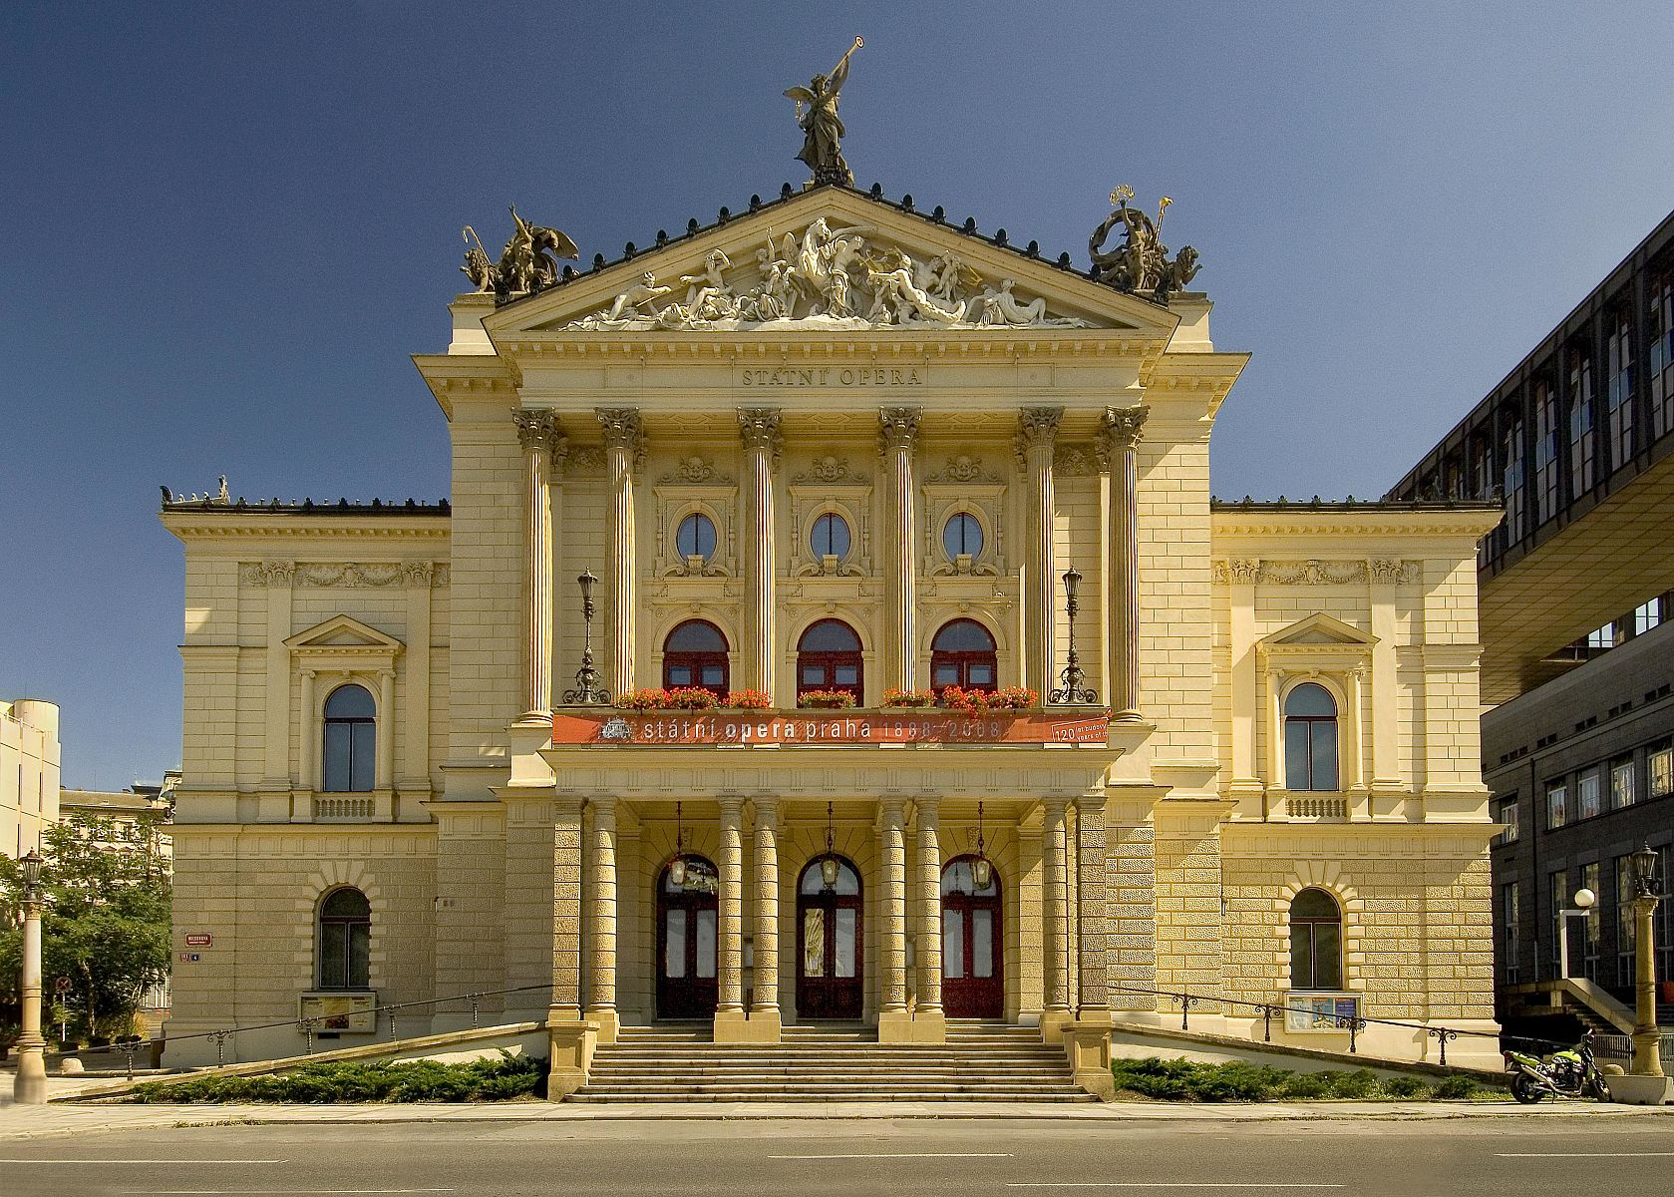
The Brandenburgers at the former
Neues deutsches Theater turned into the Theater of the Fifth of May (now State Opera)
September 4, 1945
Czechs vs. Germans (Nazis)
Bohemian Germans=expelled
Anti-Occupation Opera
Late September 1968

Slide 7
The Politics of The Brandenburgers
1860s: FLUID CONCEPT OF NATIONAL IDENTITY
Multiple “Czech” Groups—not a unified ethnicity:
Peasants—no folk-like music (instead historicizing chorales)
Prague rabble (lůza)—receives the folk-like music (28:00) + not very patriotic
Possibly a commentary on the Old Czech Party—and their leader František Ladislav Rieger (who thought that Czech opera should be based on folk music and not too cosmopolitan or Wagnerian)
Prague’s Burghers: based on historical figure (Václav Vladivoj Tomek’s History of Prague, 1855)
Slavicized names (though historically German)—Wolfram=Volfram OLBRAMOVIČ + 3 daughters (Christina + Elizabeth + Katharina=Ludiše, Vlčanka, Děčana)
Tausendmark=the anti-hero—Czech or German-Bohemian?
Most famous aria: Act 3—1:42:00
Tausendmark judged by a Brandenburger: 1:41:00

Slide 8
The “Germans” in The Brandenburgers
The Brandenburgers=the Prussians (1866—Austro-Prussian War)?
The Brandenburgers vs. the Germans
Early 1860s: no unified Germany: Prussians vs. Saxons vs. German-Bohemians
An Anti-Austrian Opera
Early 1860s: political situation in Bohemia—Austroslavism—hoping for acknowledging Bohemian state rights

