Slide 1
Cantonese I
Week 4

Slide 2
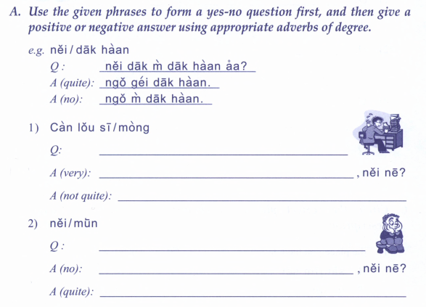
忙 busy
悶 bored

Slide 3
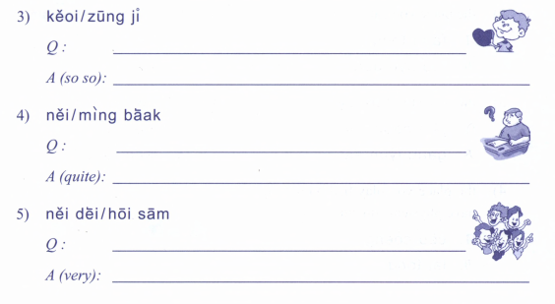
鍾意 like
明白 understand

Slide 4
Numbers

Slide 5
What is your phone numer? 你電話幾多號？nei5 din6 waa2 gei2 do1 hou6?
My phone number is 我嘅電話係XXXXX ngo5 ge3 din6 waa2 hai6 XXXXX

Slide 7
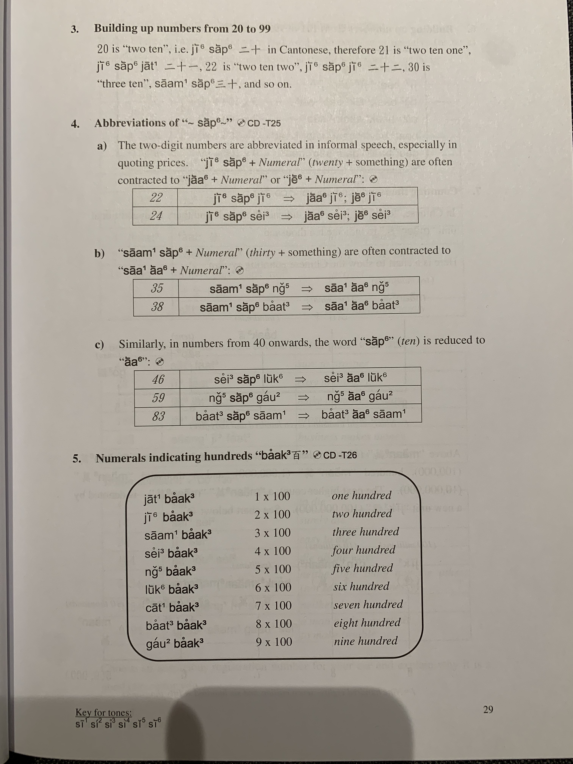
22 -> 2+10+2
34 -> 3+10+4
49 -> 4+10+9

Slide 8
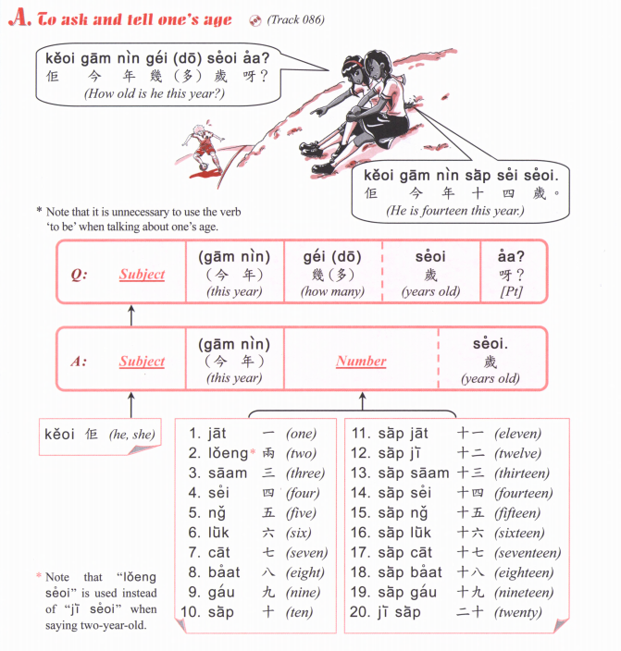

Slide 11
94,669

Slide 12
25
39
42
11
54
89
67
71
601
566
913
384
104
220
477
852
7601
9566
6913
5384
8104
1220
2477
3852

Slide 14
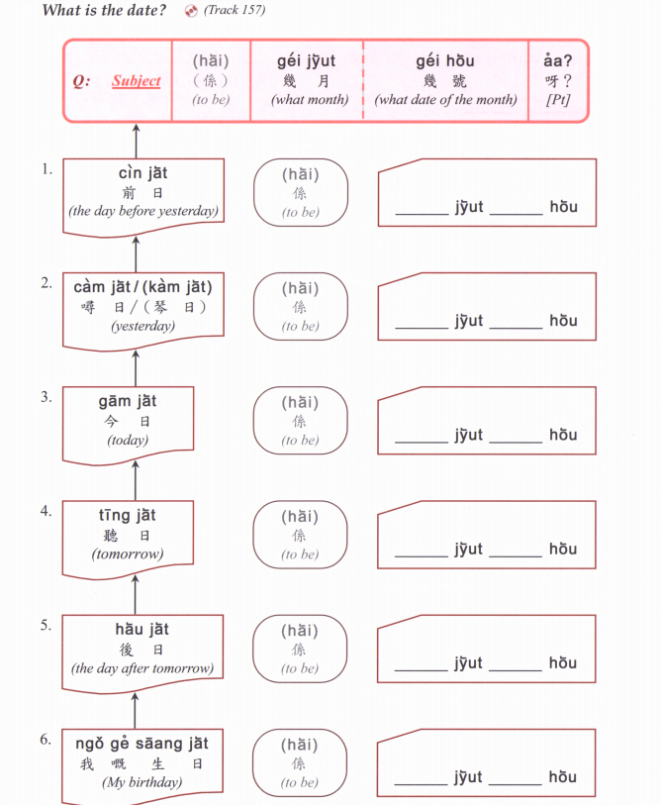

Slide 15
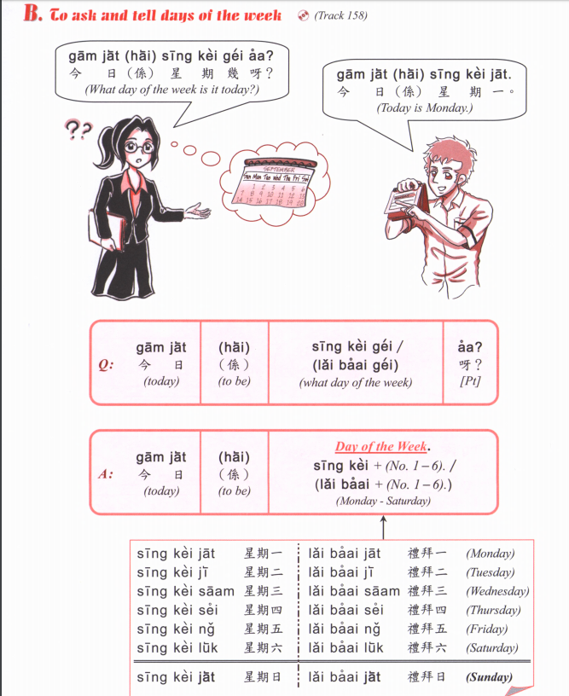

Slide 16
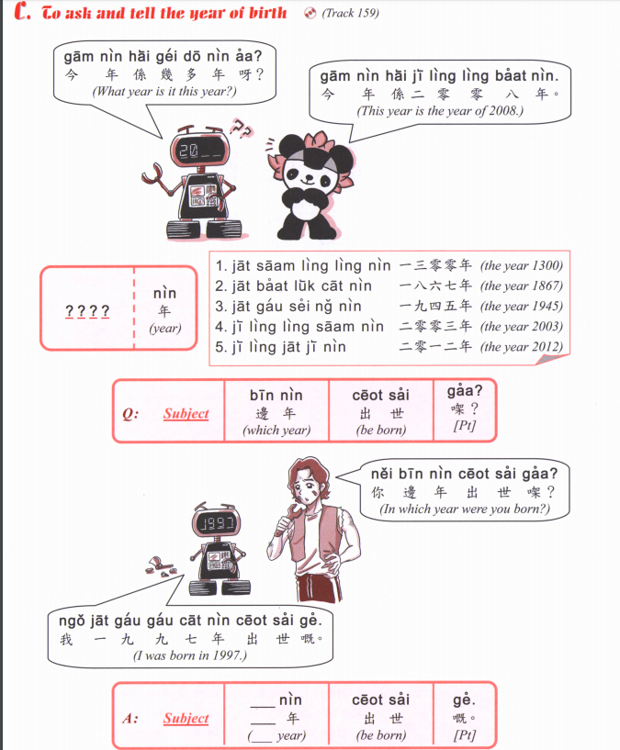

Slide 17
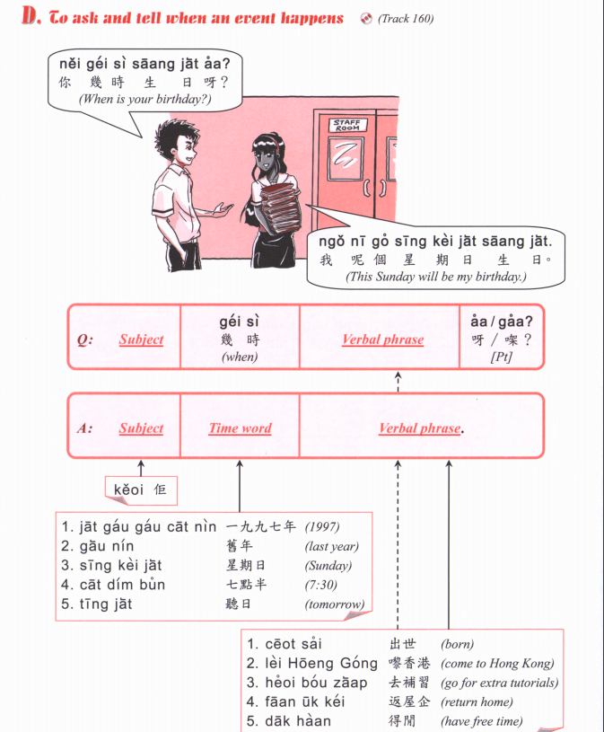
OR
邊年 bin1 nin4
Which year

Slide 18
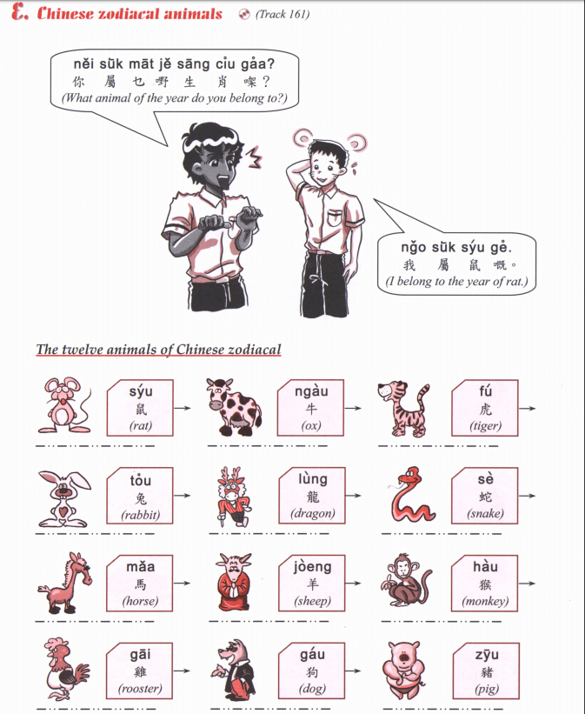

Slide 20
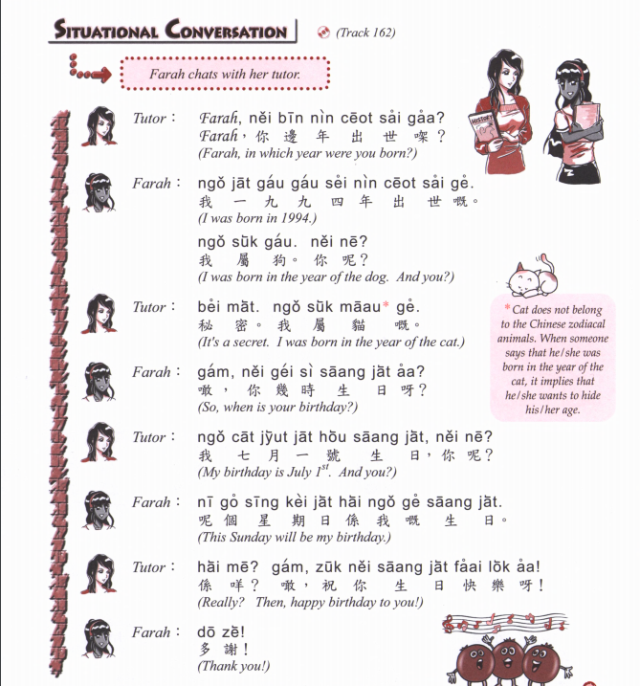

Slide 21
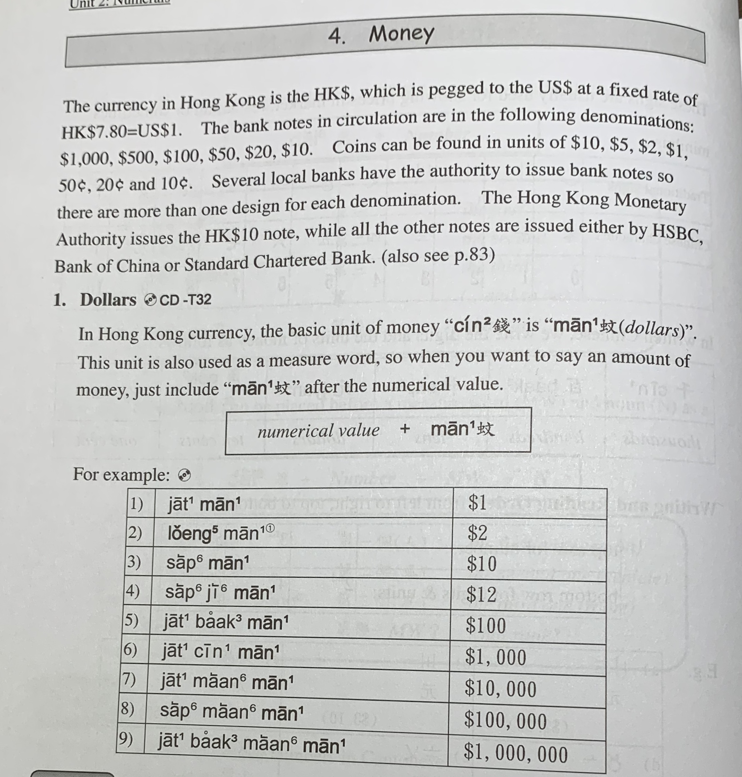

Slide 22
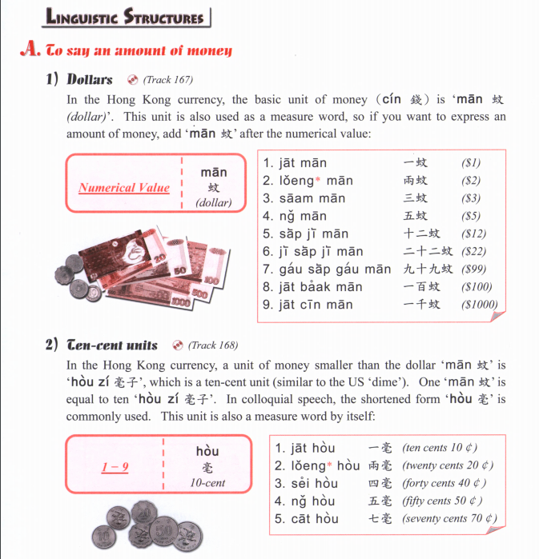

Slide 23
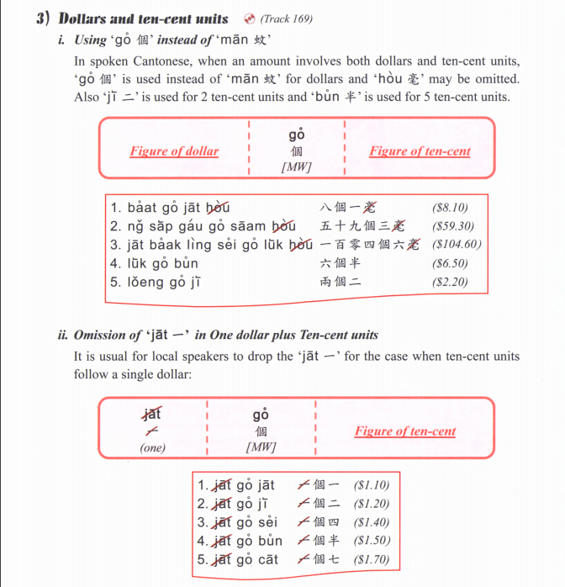

Slide 25
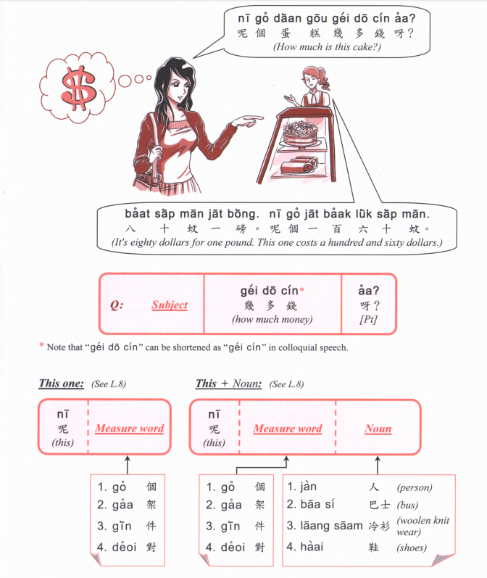

Slide 26
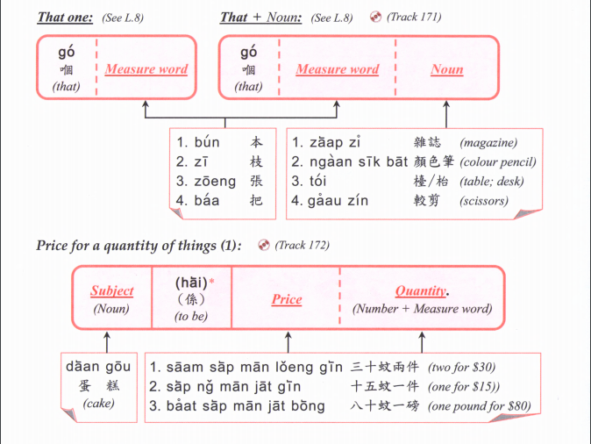

Slide 27
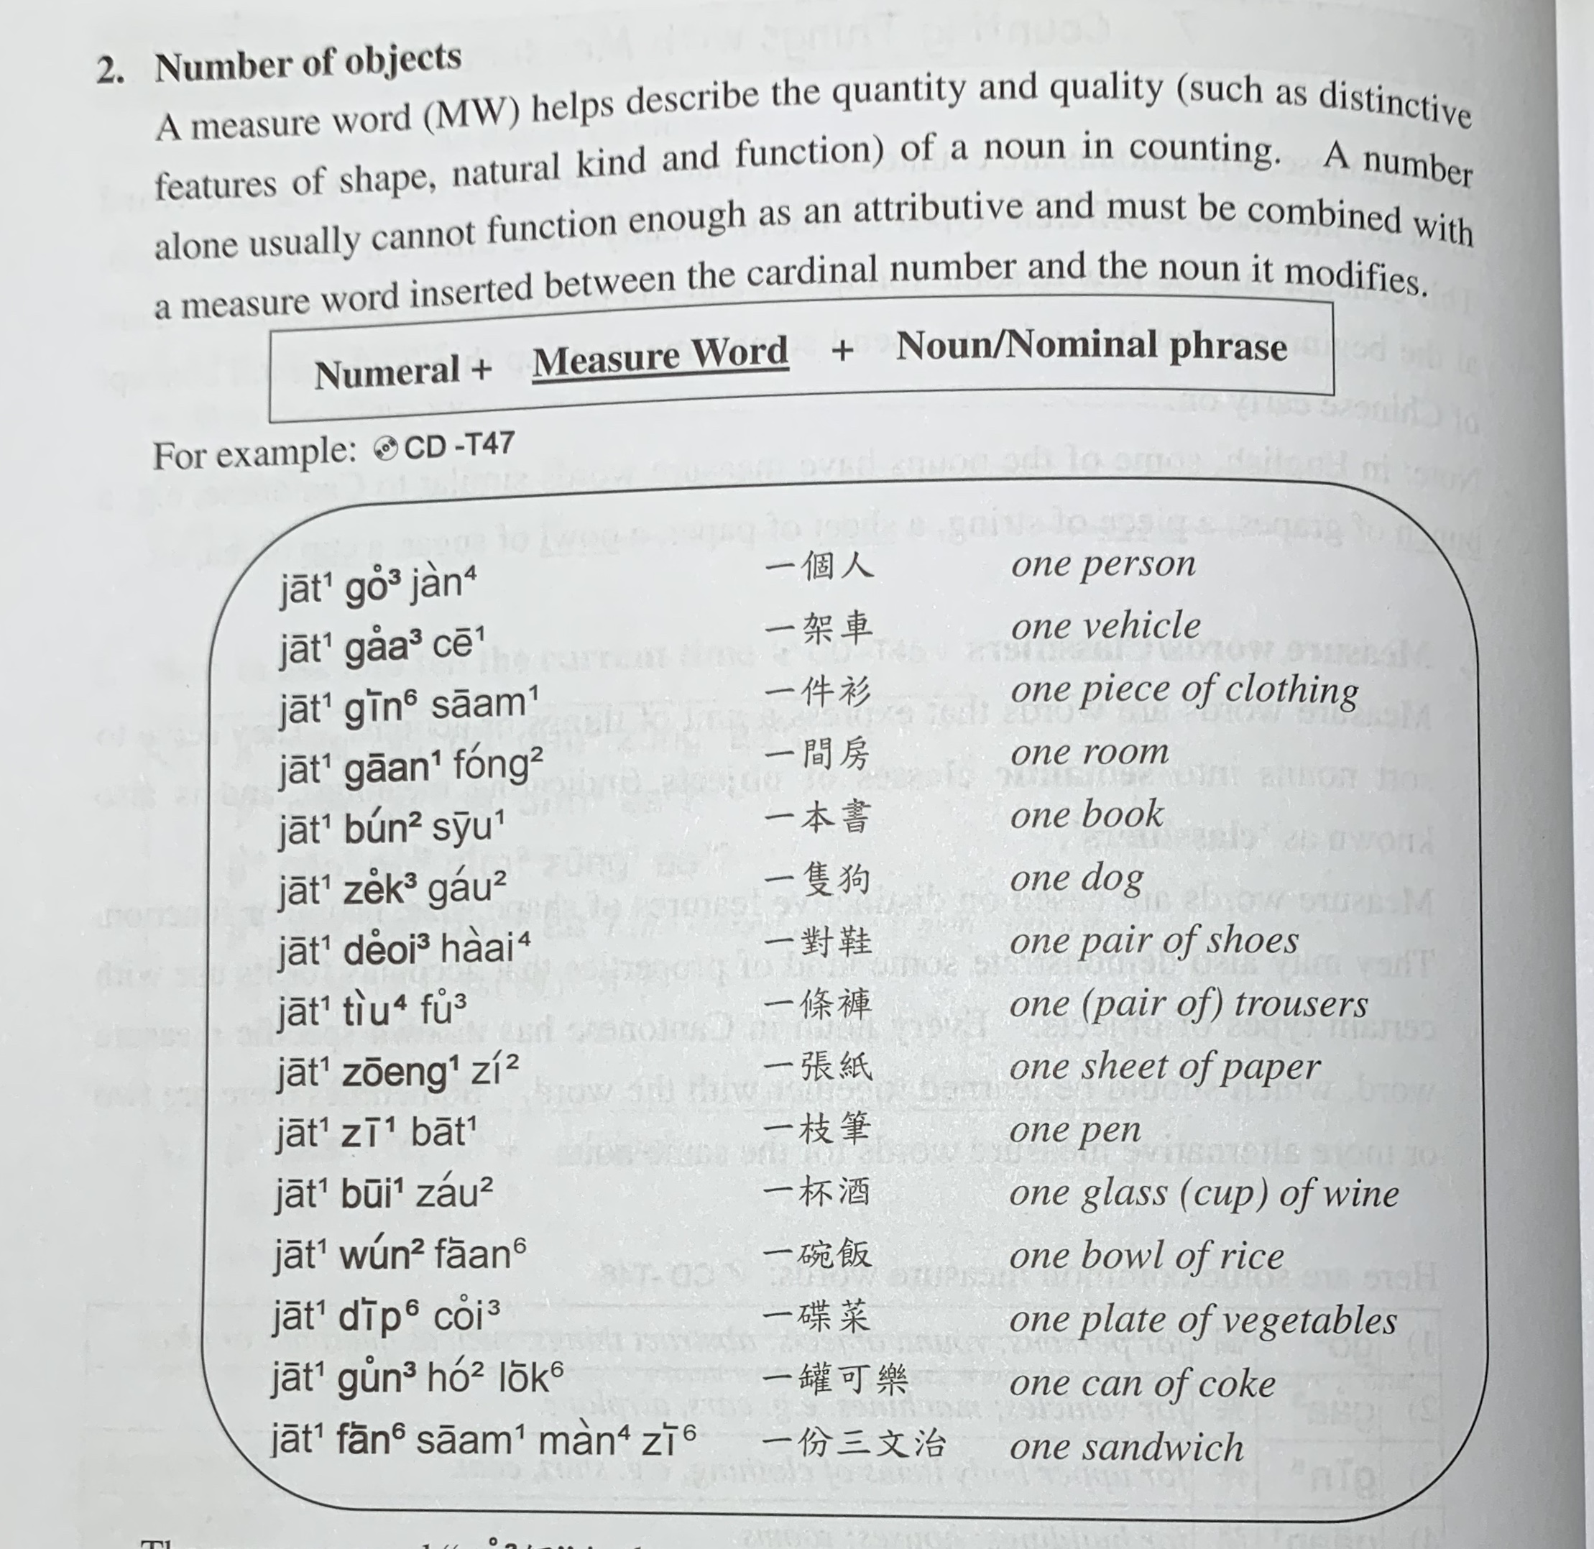

Slide 28
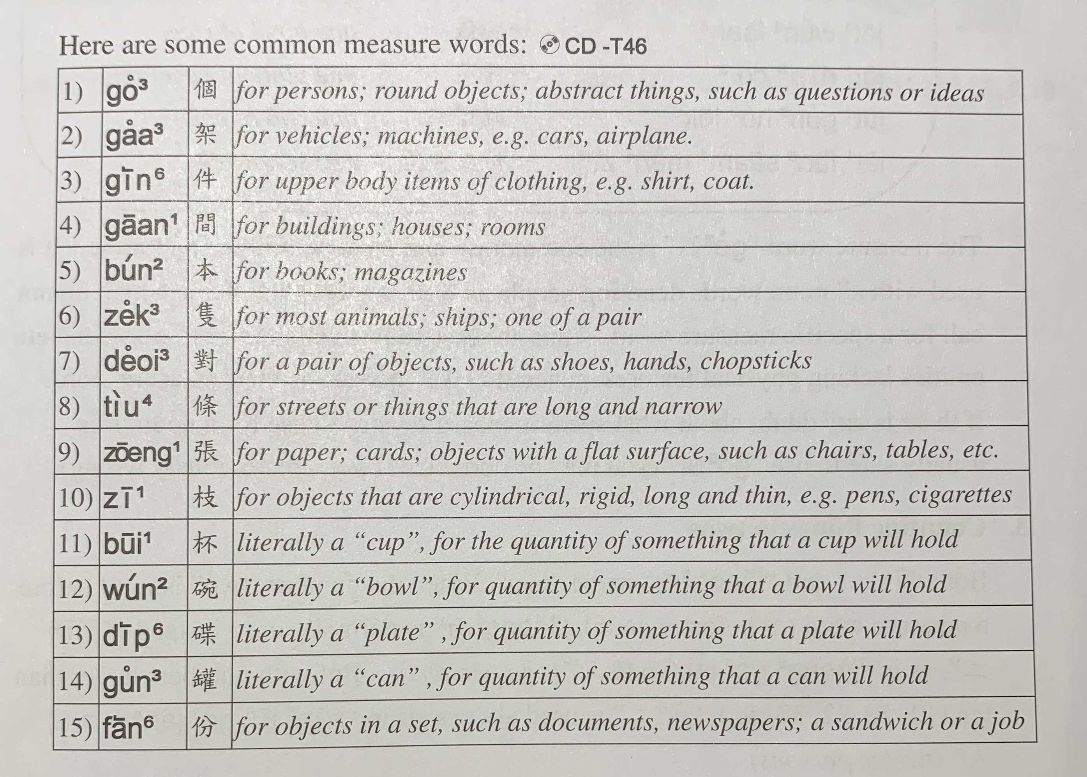

Slide 29
optional

Slide 30
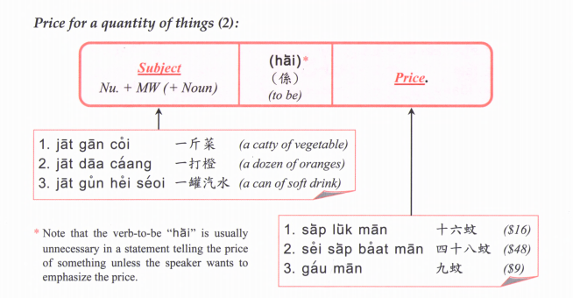
optional
Quantity +

Slide 31
Price for a quantity of things (3):
Subject + quantity + Price
Banana one $2

Slide 33
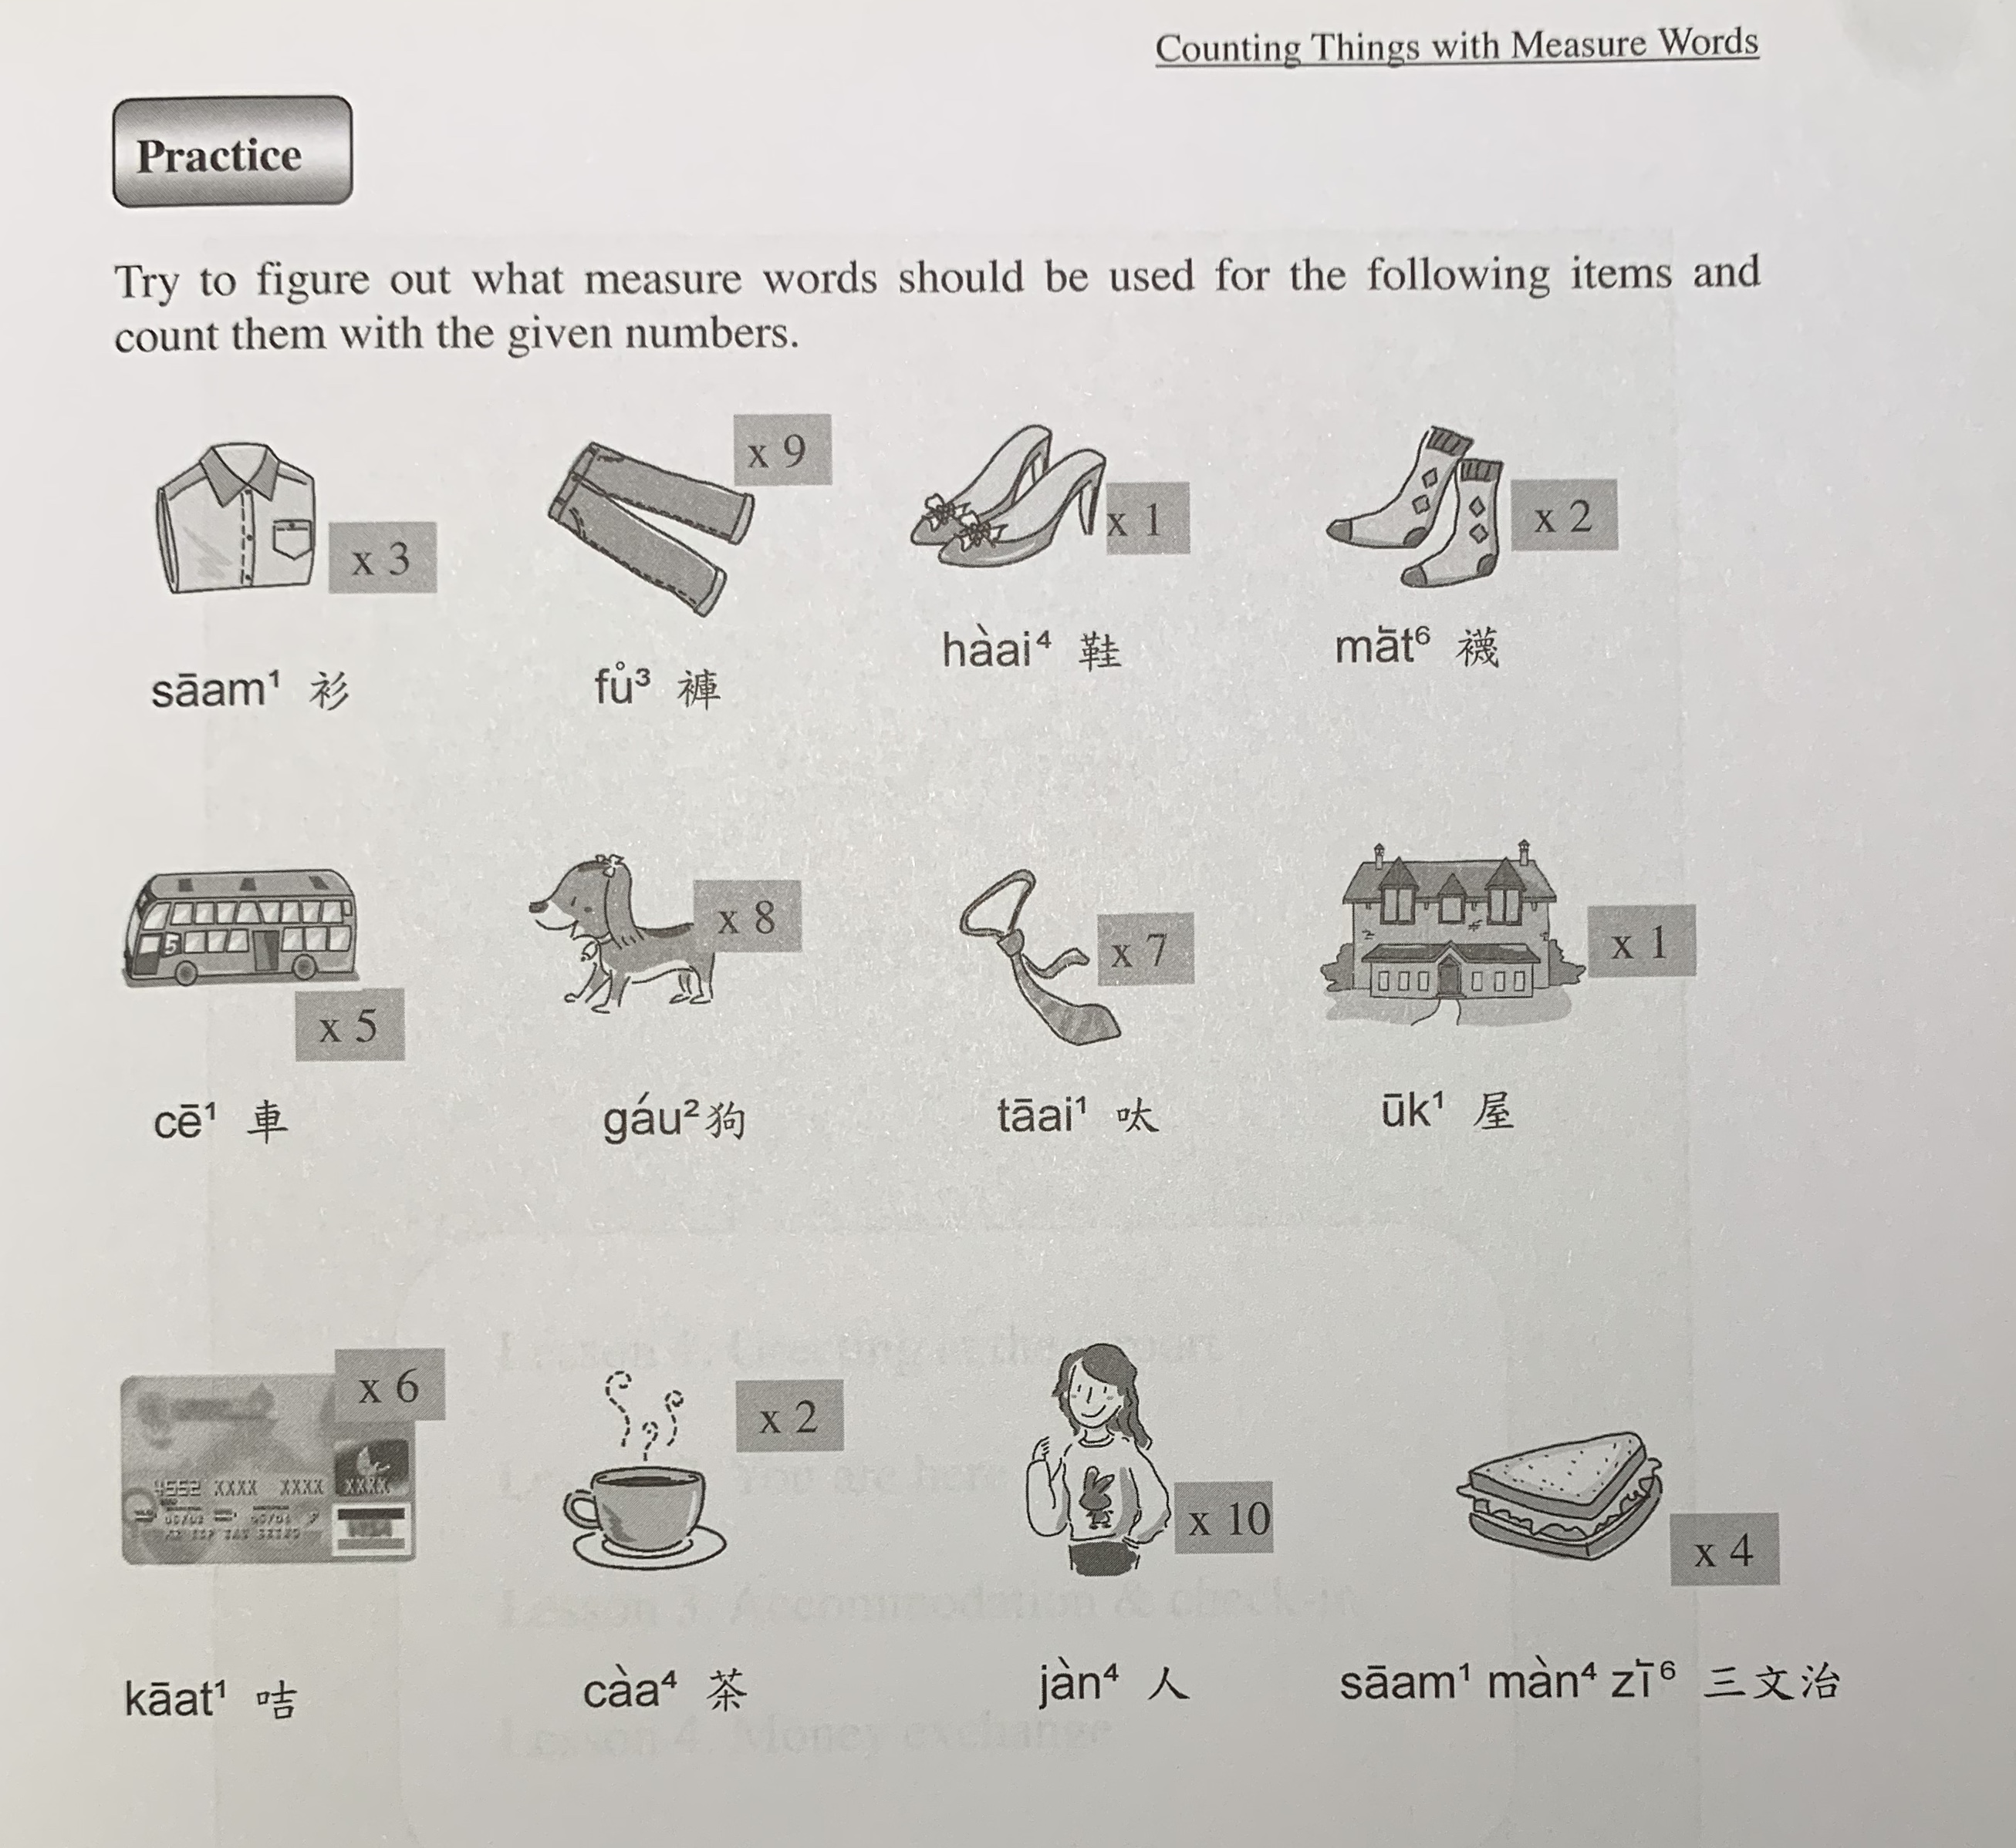

Slide 34
$1423
$540.8
$63.2
$160
tiu4
gin6
deoi3
deoi3
$345.4
$6345
$899.9
$3,700,000
zek3
tiu4
gaan1
gaa3
$26.9
$45
$57
bui1
go3
fan6
zoeng1

Slide 35
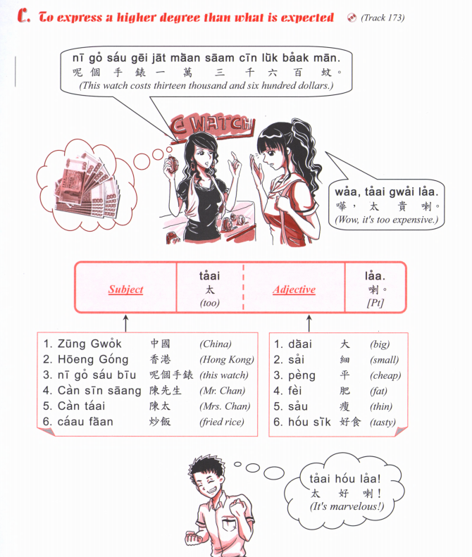
zek3
隻

Slide 36
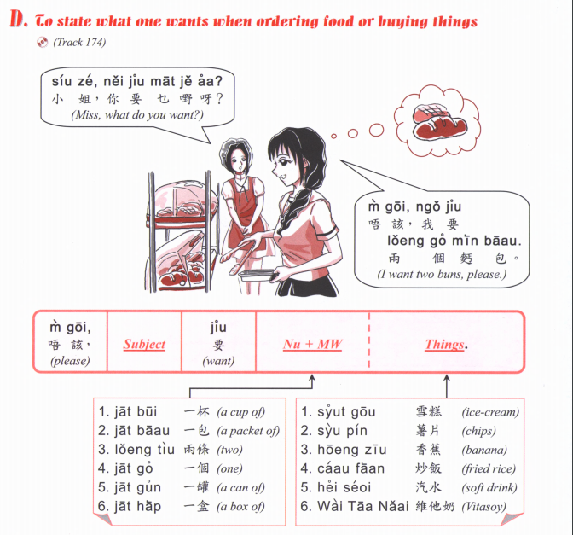

Slide 37
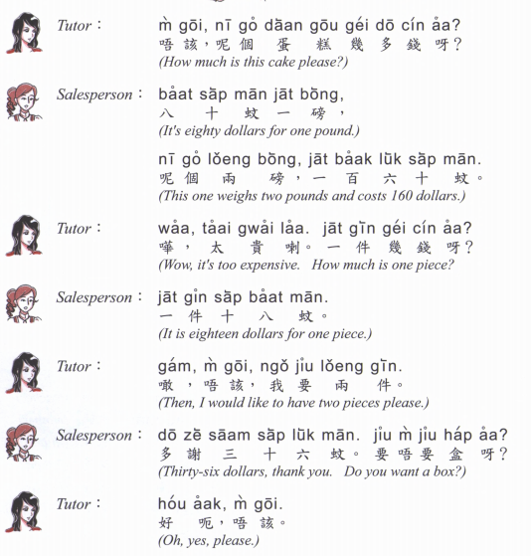

Slide 38
三文治
saam¹ man⁴ zi⁶
漢堡包
hon3 bou2 baau1
壽司
sau6 si1
daan⁶ gou¹
Cake
熱狗
Jit6 gau2
牛扒
Ngau4 paa2
冬甩
dung1 lat1
薯條
Syu4 tiu2
沙律
saa¹ leot²
咖啡
gaa³ fe¹
意粉
Ji3 fan2

Slide 39
Caa4 caan1 teng1
蛋撻
Daan6 taat1
西多士
Sai1 do1 si2
奶茶
Naai5 caa4
菠蘿油
Bo1 lo4 yau4

Slide 40
炒飯
Caau2 faan6
Fried rice
魚蛋粉
Jyu4 daan2 fan2
Fishball noodles
炒河/炒麵
Caau2 ho2/ caau2 min6
Fried flat noodles/ noodles

