Slide 1
Cantonese I
Week 6

Slide 2
鍾意 | To like | zung1 ji3 | m4 zung1 ji3
識 | To know (a skill, a person | sik1 | m4 sik1
知 | To know (information, news) | zi1 | m4 zi1
去 | To go | heoi3 | m4 heoi3
有 | To have | jau5 | Mou5 (冇)
要 | To want | jiu3 | M4 jiu3
講 | To speak | gong2 | M4 gong2
做 | To do | zou6 | M4 zou6

Slide 3
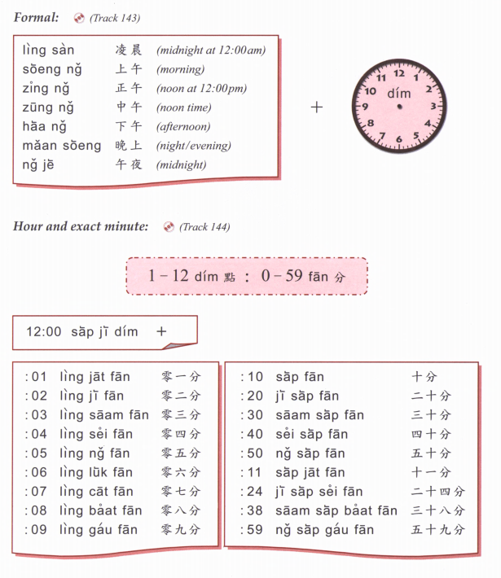

Slide 4
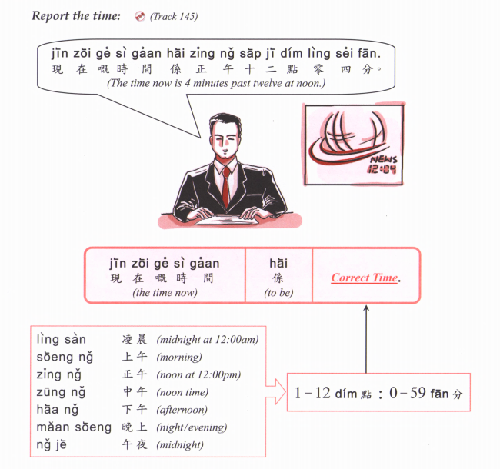

Slide 5
Zou2 caan1 | 早餐 | Breakfast
Zung1 ng5 faan6 | 中午飯 | Lunch
Haa6 ng5 caa4 | 下午茶 | Afternoon tea
Maan5 faan6 | 晚飯 | Dinner
sik6
食
To eat

Slide 7
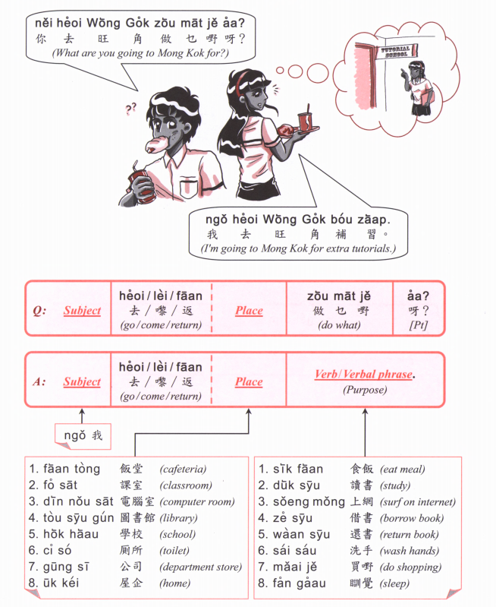

Slide 8
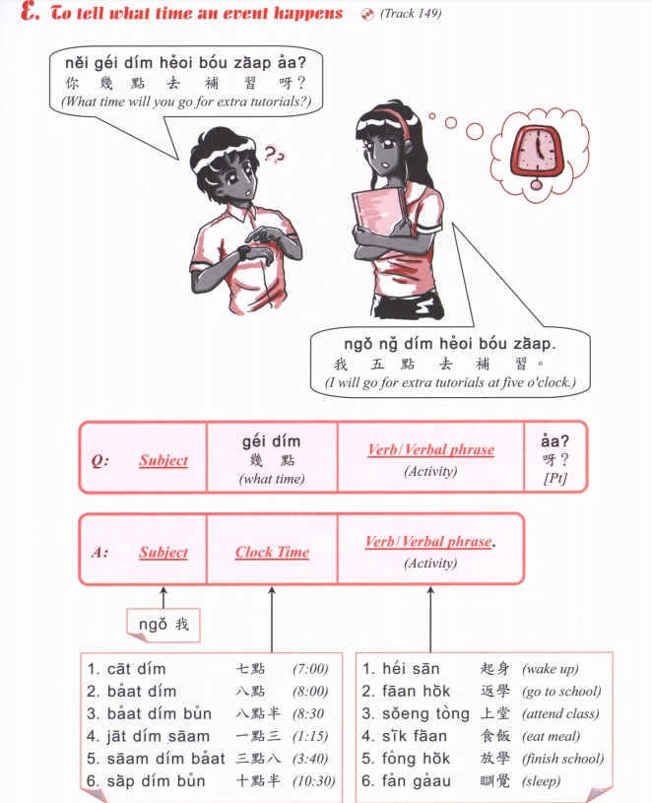

Slide 9
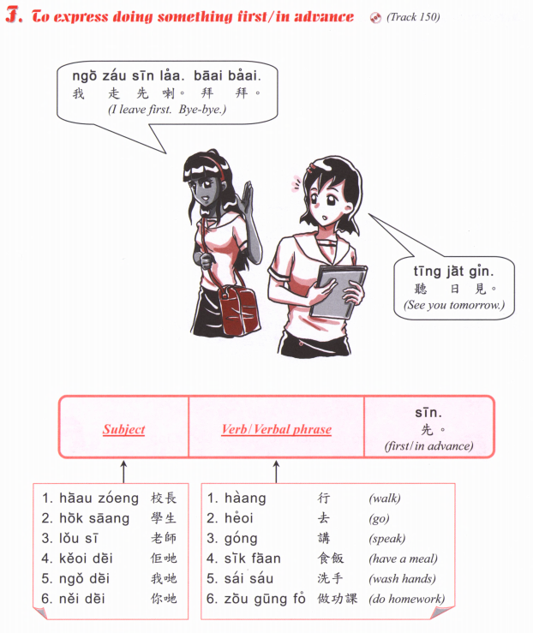

Slide 10
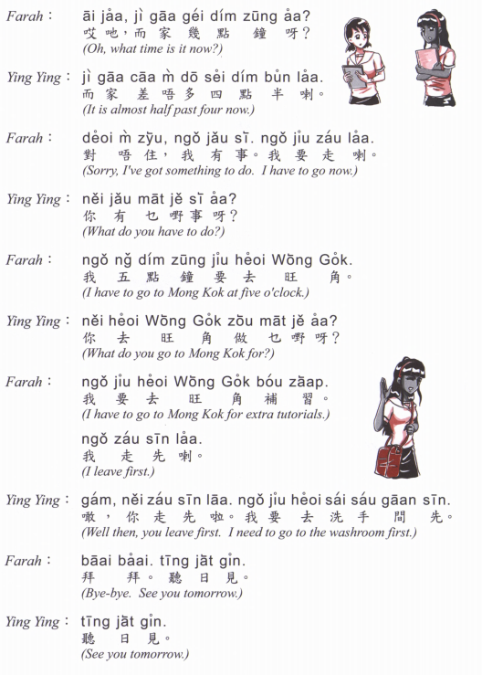

Slide 11
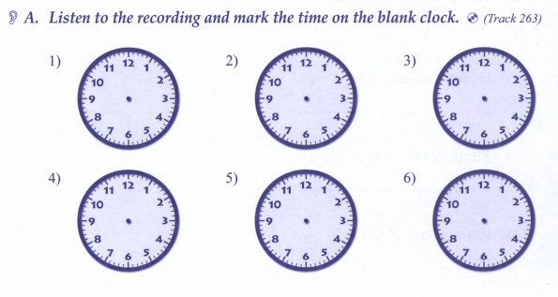

Slide 12
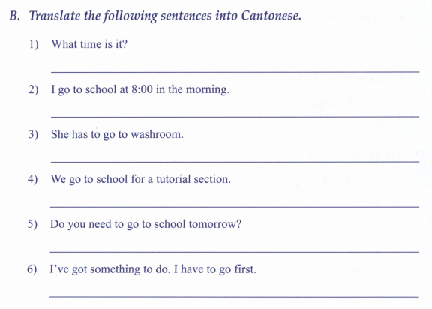

Slide 13
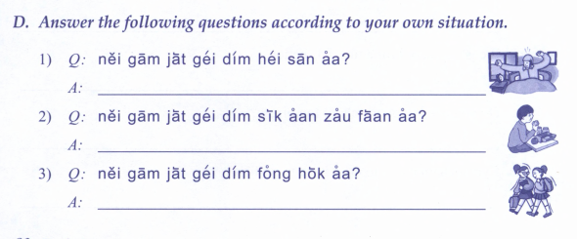
4) What time do you sleep?
5) What time do you go to school?
6) What time do you have dinner?
7) What time do you have breakfast?

Slide 14
I like to ride bicycle.
My hobby is listening to music.
I go home at 8pm

Slide 15
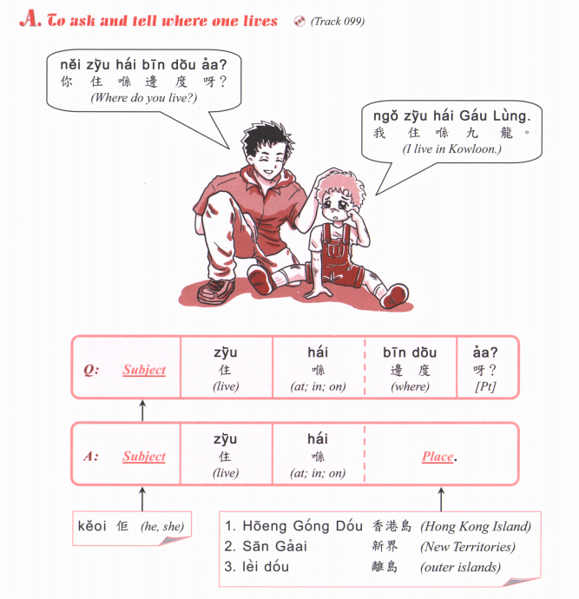

Slide 16
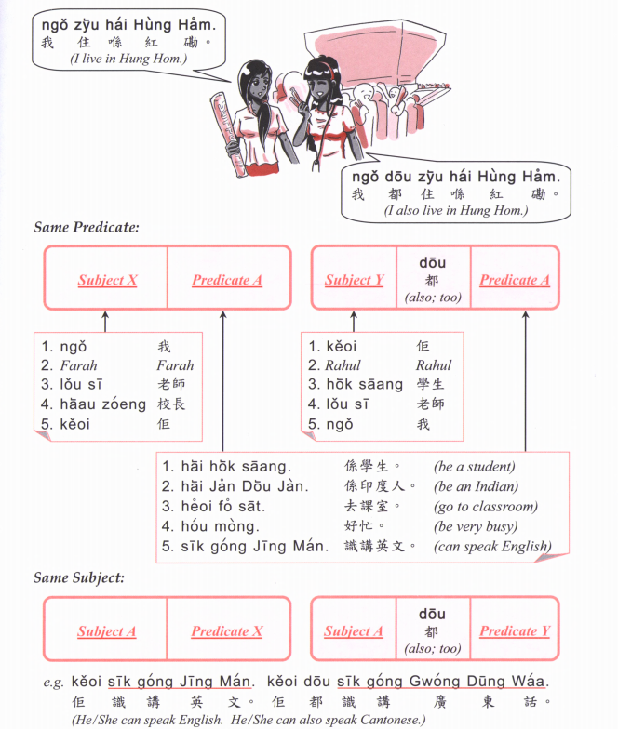

Slide 17
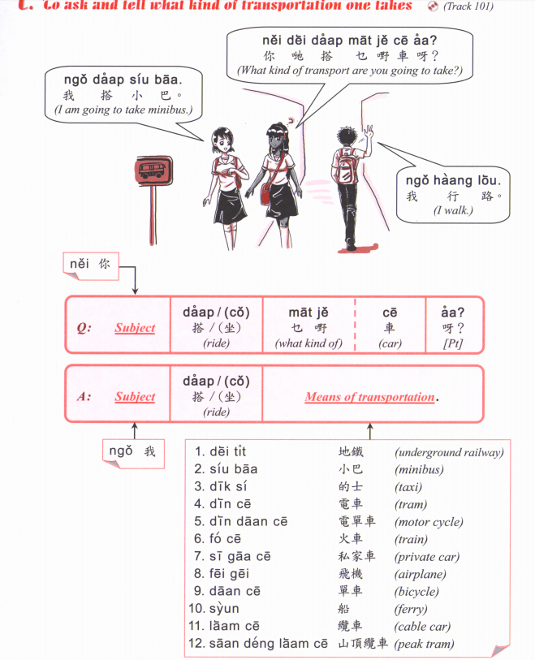

Slide 18
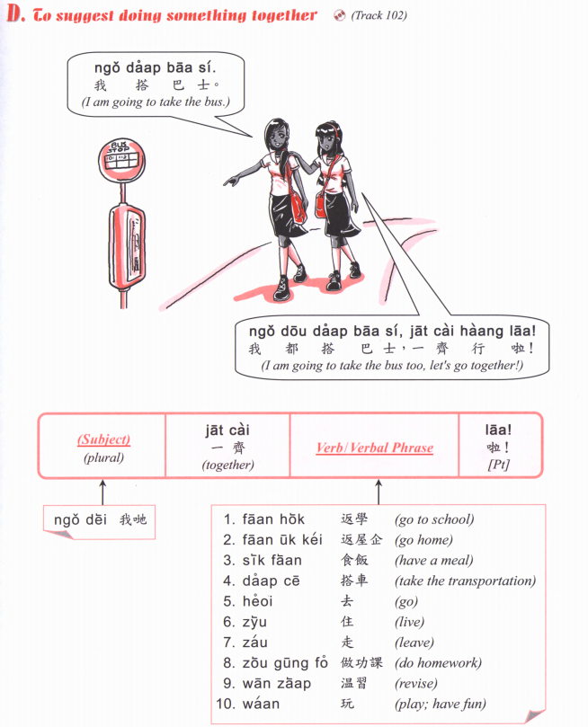

Slide 19
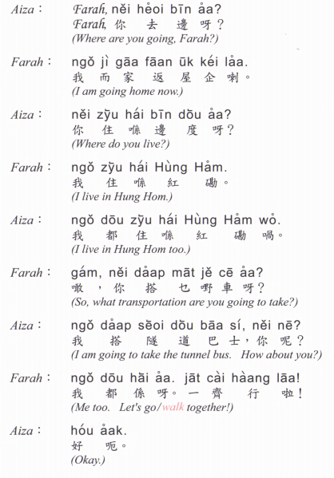

Slide 20
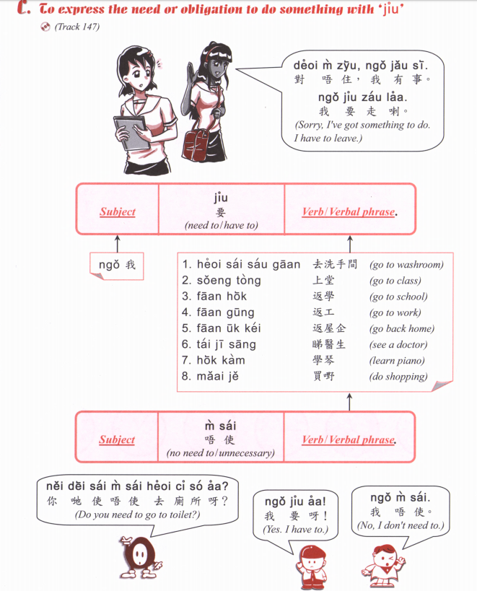

Slide 21
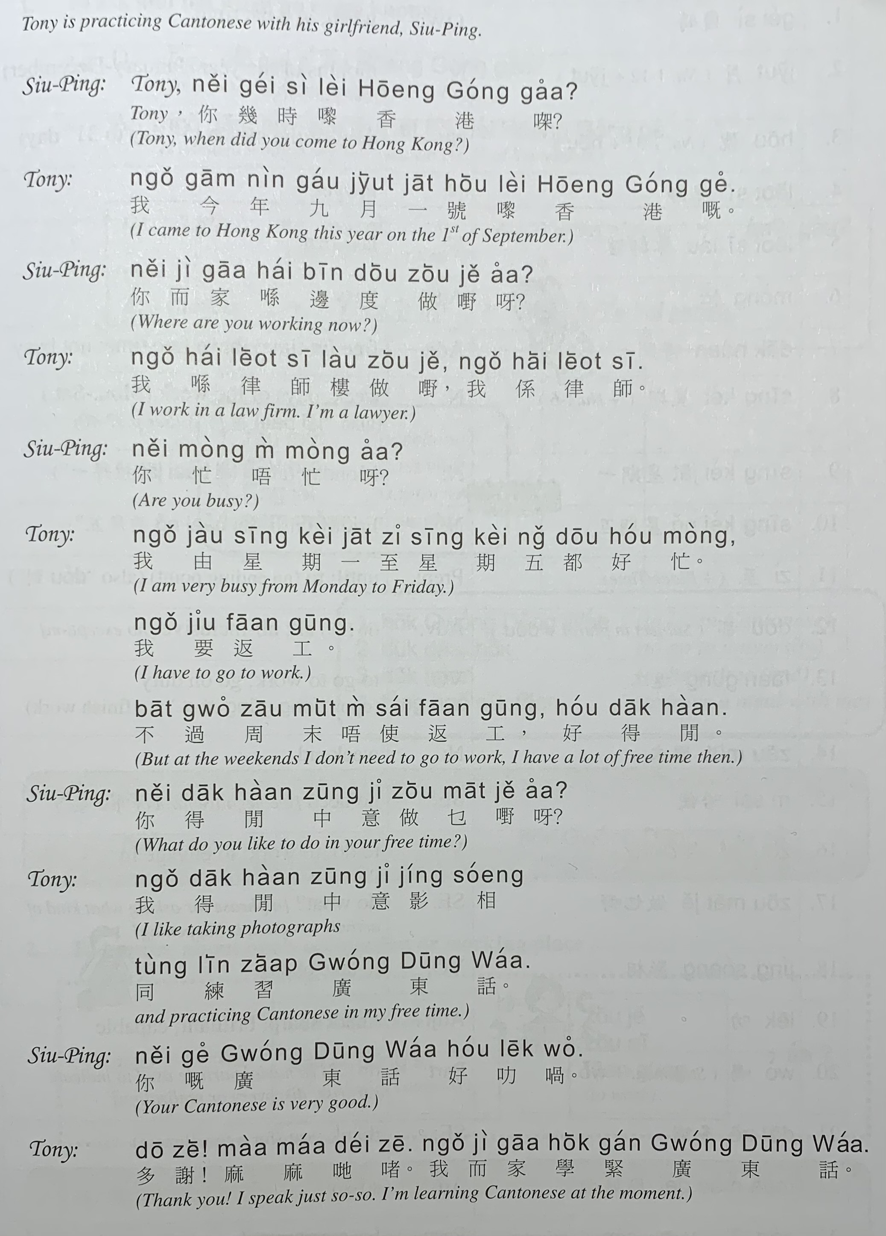

Slide 22
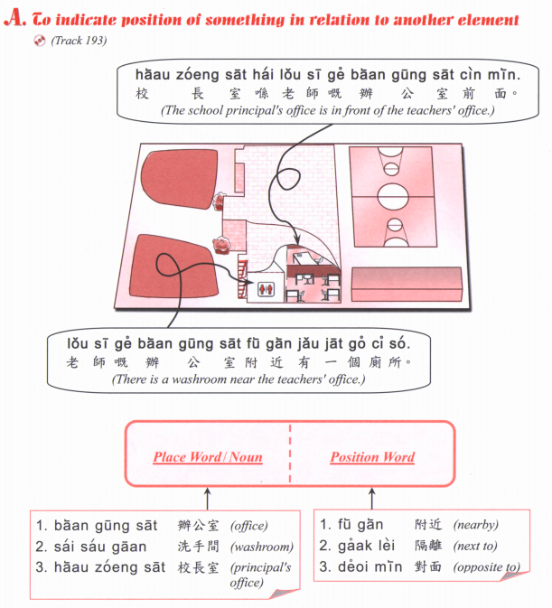

Slide 24
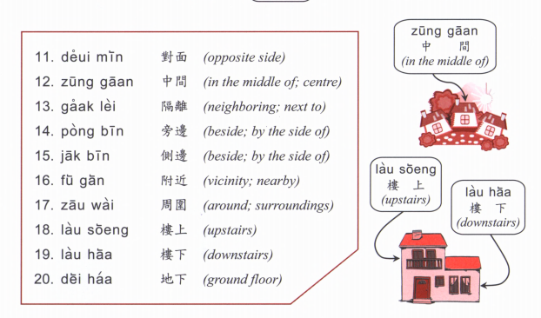

Slide 25
Where is (place)? (Place) + hai2 bin1 dou6 aa3? 喺邊度呀？
Hok6 haau6
Tou4 syu1 gun2
Ting4 ce1 coeng4
wan6 dung6 coeng4
Yi1 jyun2
Fei1 faat3 pou3
Soeng1 coeng4
Zau2 baa1
Ciu1 kap1 si5 coeng4
ngan4 hong4
Joek6 fong4
Caan1 teng1
Answer： (Place) hai2 (Place B) (position word)

Slide 26
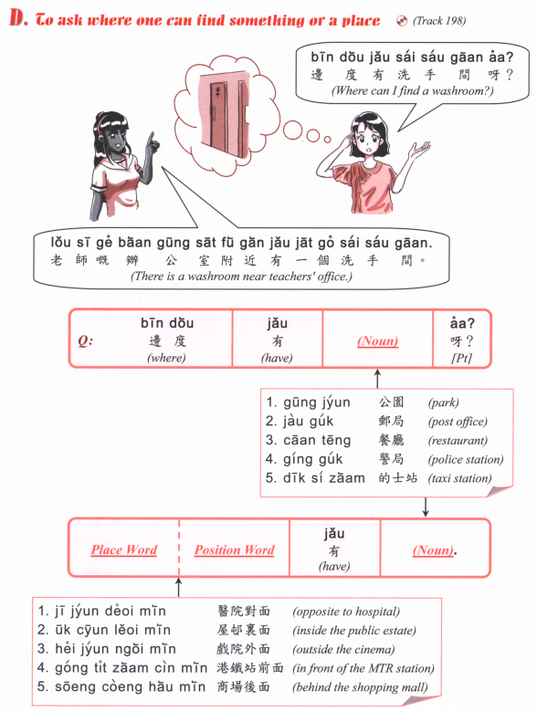

Slide 27
Hok6 haau6
Tou4 syu1 gun2
Ting4 ce1 coeng4
wan6 dung6 coeng4
Yi1 jyun2
Fei1 faat3 pou3
Soeng1 coeng4
Zau2 baa1
Ciu1 kap1 si5 coeng4
ngan4 hong4
Joek6 fong4
Caan1 teng1

