Slide 1
Cantonese I
Week 9

Slide 3
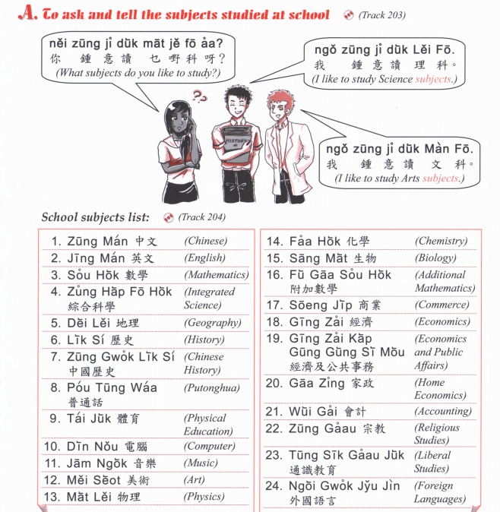
Chinese Studies
中文研究
zung1 man4 jin4 gau3

Slide 4
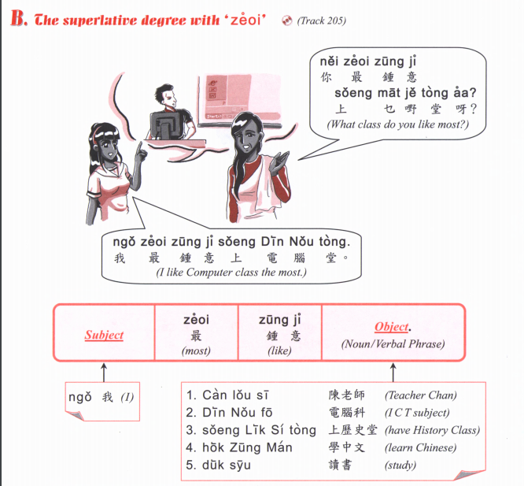

Slide 5
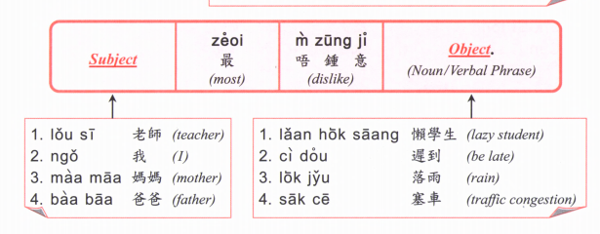

Slide 6
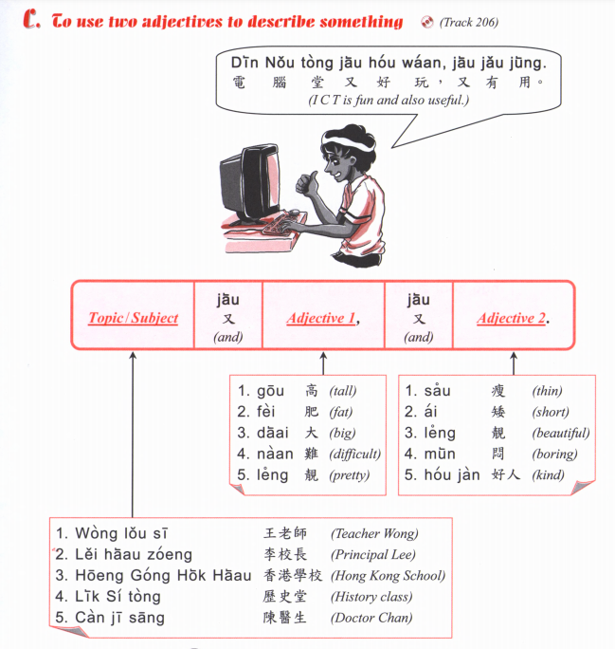

Slide 7
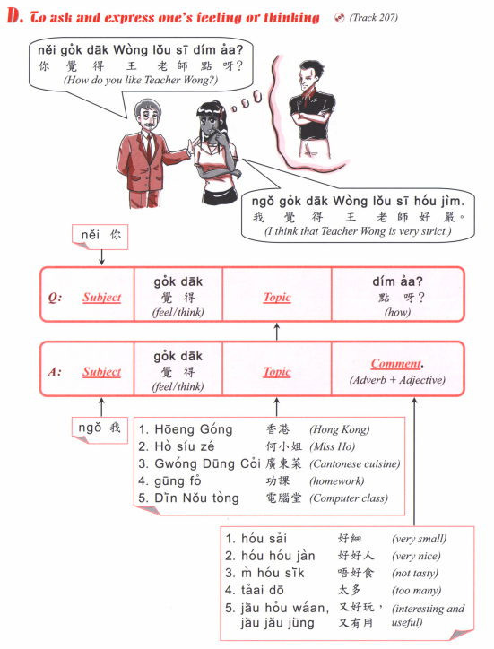

Slide 8
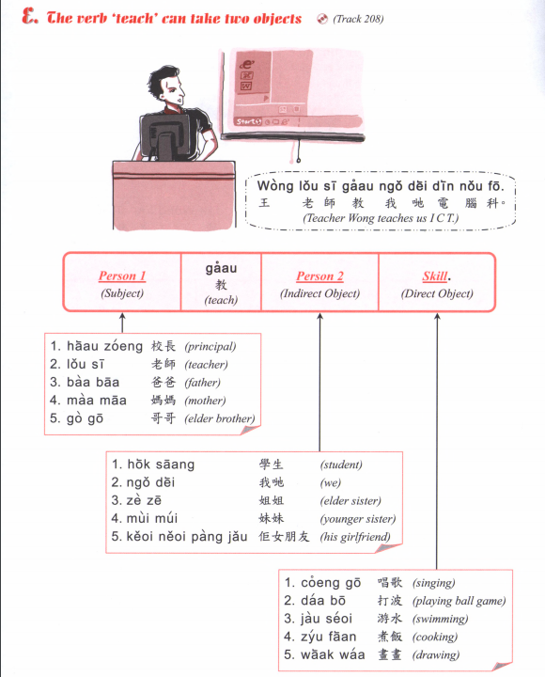

Slide 9
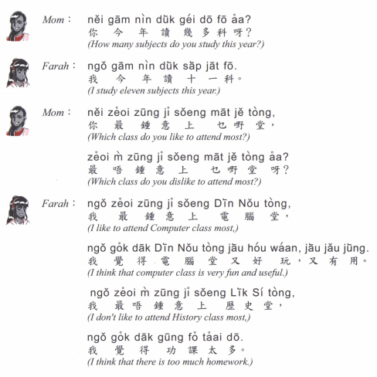
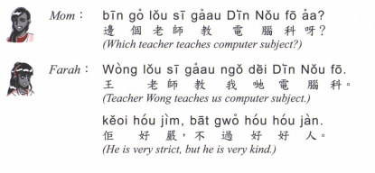

Slide 10
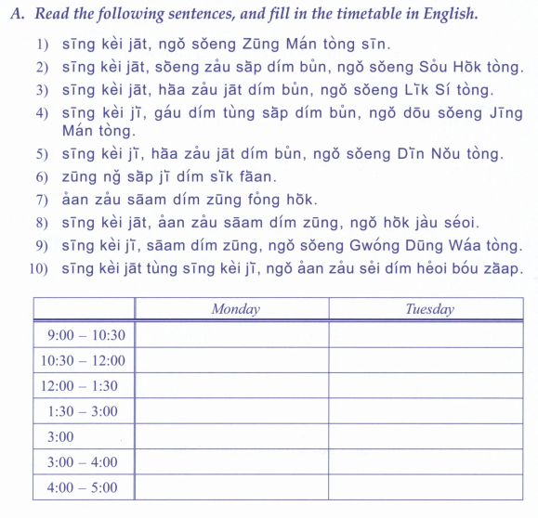

Slide 12
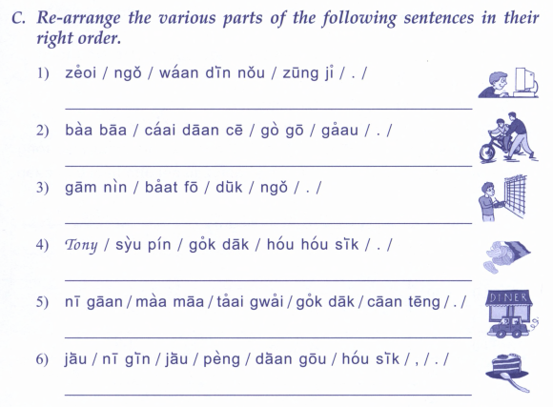

Slide 13
邊個 | Who | Bin1 go6
咩 / 乜嘢 | what | Me1 / Mat1 je5
邊度 | Where | Bin1 dou6
幾多 | How many/ much | Gei2 do1
幾時 | When | Gei2 si4
點解 | Why | dim2 gaai2
因為 | Because | jan1 wai6
鍾意 | To like | zung1 ji3 | m4 zung1 ji3
識 | To know (a skill, a person | sik1 | m4 sik1
知 | To know (information, news) | zi1 | m4 zi1
明白 /明 | To understand | ming5 baak6 / ming5 | M4 ming5 baak6 / M4 ming5
去 | To go | heoi3 | m4 heoi3
有 | To have | jau5 | Mou5 (冇)
要 | To want (object) / have to (do something) | jiu3 | M4 jiu3 (for object)/ M4 sai2 (for action)
想 | To want (to do something) | soeng2 | M4 soeng2
講 | To speak | gong2 | M4 gong2
做 | To do | zou6 | M4 zou6
覺得 | To think (feeling/opinion) | Gok3 dak1 | M4 gok3 dak1
溫習 | To revise | Wan1 zaap6 | M4 wan1 zaap6

Slide 14
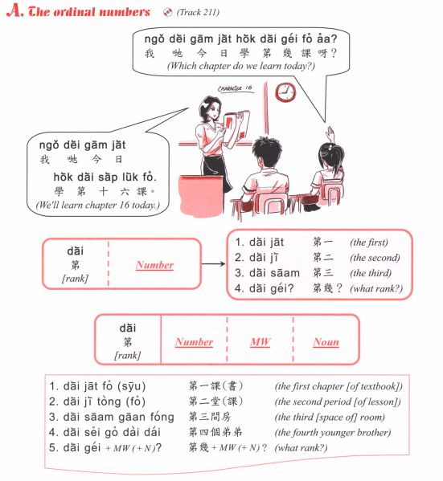

Slide 16
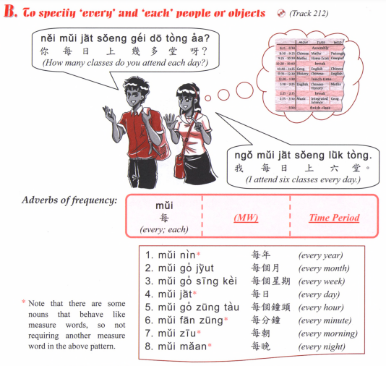

Slide 17
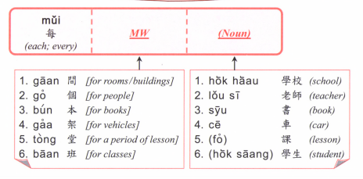

Slide 18
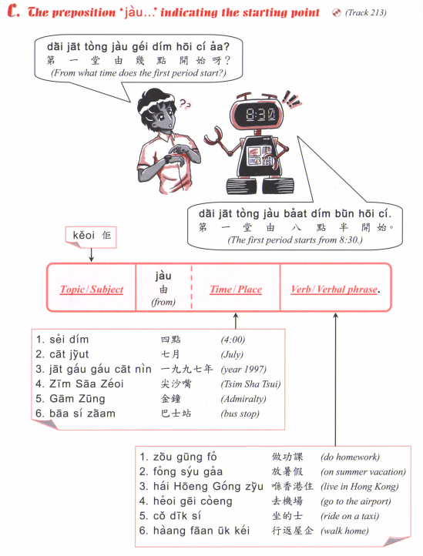

Slide 19
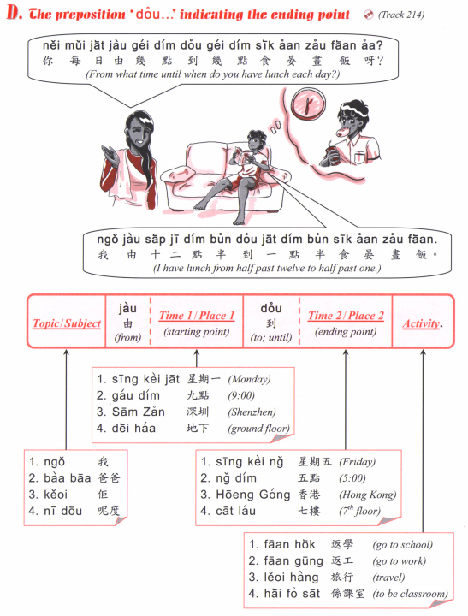

Slide 20
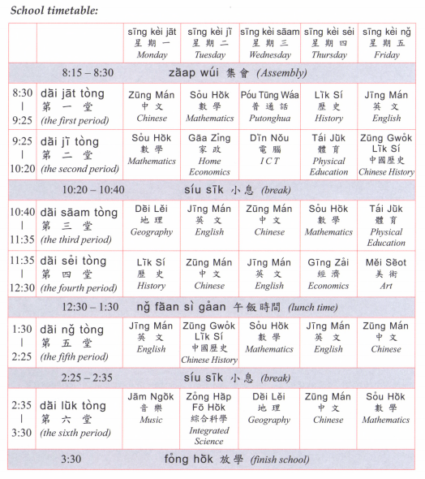

Slide 21
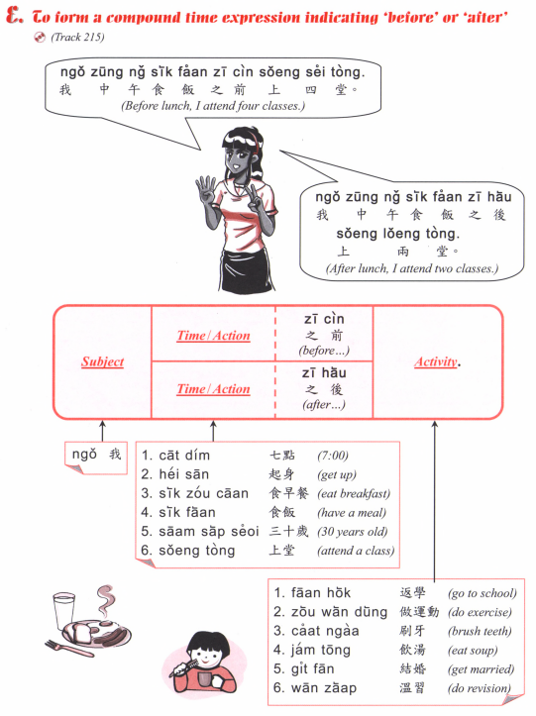

Slide 22
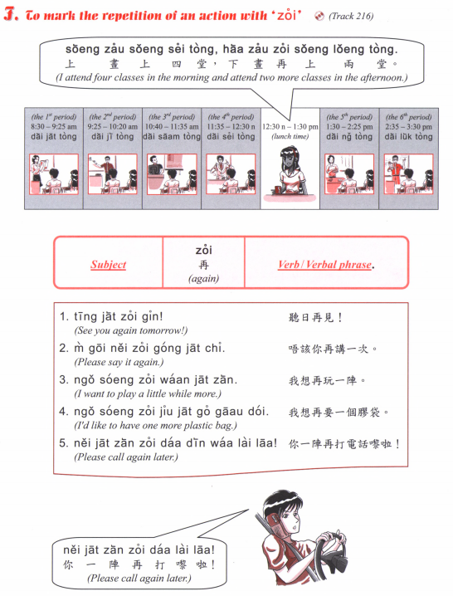

Slide 23
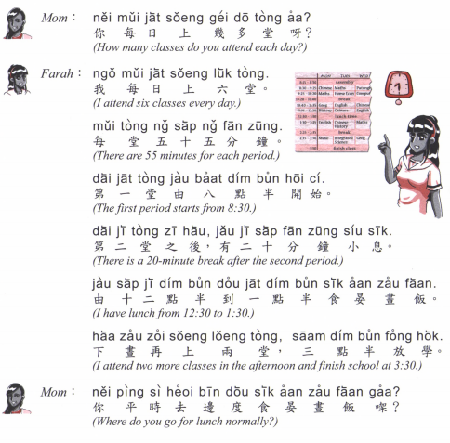
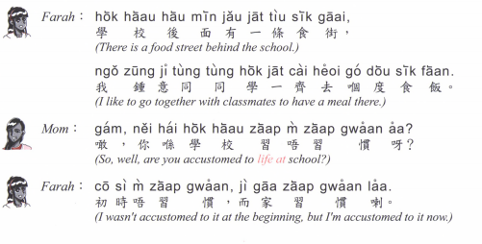

Slide 24
Tell us how you spend a typical week
For example:
From Monday to Friday wake up at ….. Go to school from … to …
Finish school at …
After school I go to [some activity] at …
Saturday…
Sunday…

Slide 26
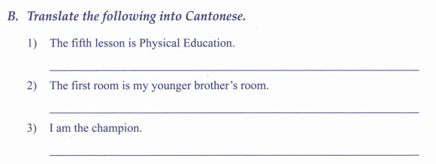
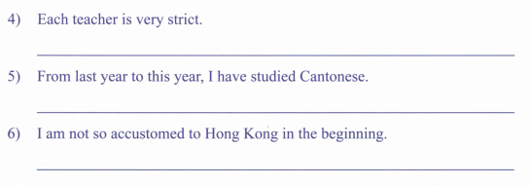
舊年
Gau6 nin2

Slide 27
