Slide 1
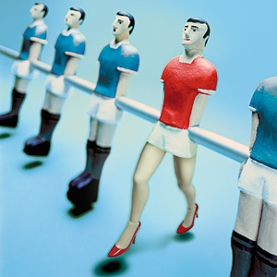

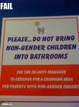
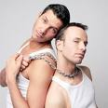

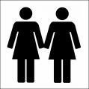
Issues
Gender and Sexuality

Slide 2

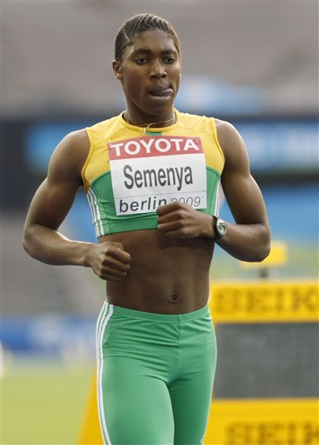
Introduction
Gender
  (Film) Stereotypes
Gender and Advertising
Sexuality
The future of Gender and Sexuality
Round-up

Slide 3
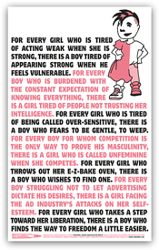
Definitions
Warning!!!!!! Do not view films if you are offended by items of a sexual nature!
Definitions
  Sex
  Gender
  Sexuality
Are we all happy with what we are?

Slide 4
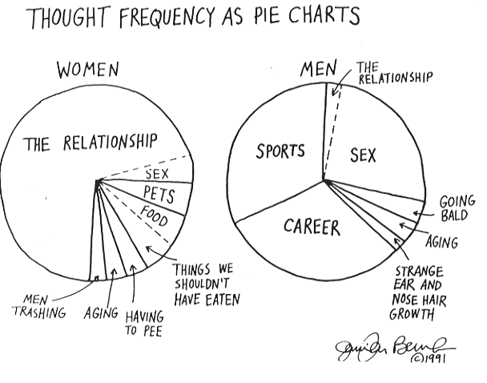

Slide 5
Gender Identity
Binary or pluralist genders?
Who defines our gender identity?
  Film on performance artist discussing gender
Gendered Socialisation (Film) (Film2) and Language (Link to EU)

Slide 6
Things
(without Meaning)
Skirt
Signifiers
Shirt
Jeans
Pondan/ Ah Kwah
T-Shirt
Girl
Guy
Boy
Man
Make-Up
Feminine
Masculine
Sissy
Woman
Nurturing
Handsome
Shopping
Androgen
Estrogen
Strong
Sports
Testes
Activities
Work
Home
Gentle
Ovaries
Petite
Architecture
Breasts
Dispositions
Muscles
Tall
Engineering
Arts
Aggressive
Bodies

Slide 7
A Gendered Structure of Meaning
A
Two Gender
System:
Binary
Oppositions
Guy
Woman
Man
Girl
Boy
Gentle
Masculine
Feminine
Nurturing
Aggressive
T-Shirt
Make-Up
Dress
Jeans
Sari
Shirt
Skirt
Testes
Estrogen
Ovaries
Strong
Androgen
Breasts
Muscles
Pretty
Petite
Tall
Handsome
Arts
Sports
Shopping
Engineering
Home
3rd Gender ?
Work

Slide 8
A Different Gendered Structure of Meaning
A Three Gender
System
Girl
Boy
Nurturing
Guy
Man
Woman
Gentle
Masculine
Skirt
Feminine
Aggressive
Breasts
Sports
Androgen
Estrogen
T-Shirt
Dress
Jeans
Engineering
Pretty
Ovaries
Work
Shirt
Shopping
Strong
Petite
Arts
Handsome
Home
Tall
Muscles
3rd Gender ?
Testes
Make-Up
Feminine
Sissy
Dress

Slide 9
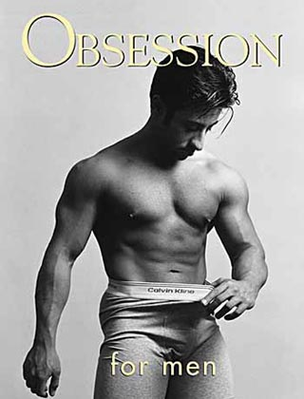
Advertising and Gender
Reinforcing stereotypes
The Male Gaze
Changing times?
  (Film)
You can investigate more here
http://genderads.com/

Slide 10
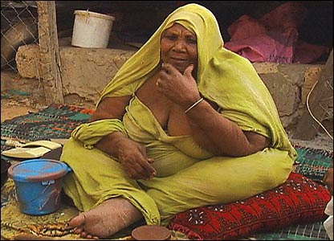
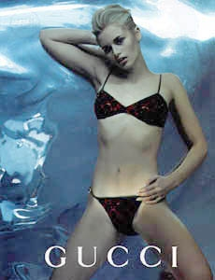
Differing Images of Beauty
Obesity = Beauty
Correlation between Body Image and Status
If little food is available, being overweight implies wealth and thus high social status.
If lots of food is availably being thin could show discipline, leisure time to exercise and high social status.
Anorexia = Beauty

Slide 11
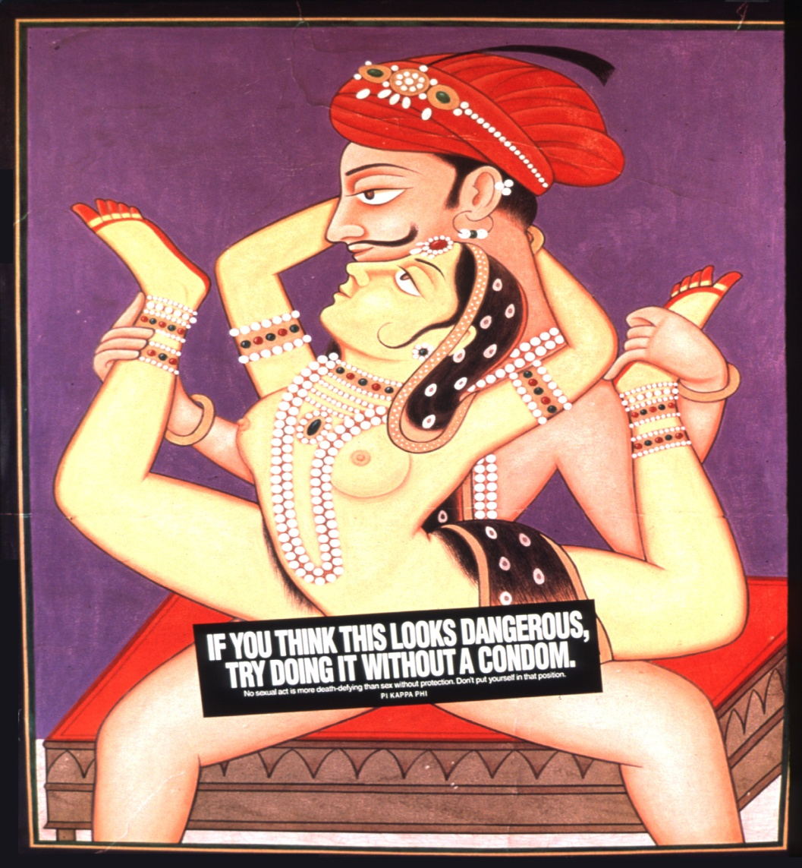
Advertising and Sex
Sex Sells
  Deconstruct this film
De-mystification of the body
Acceptance of sex as ‘normal’

Slide 12
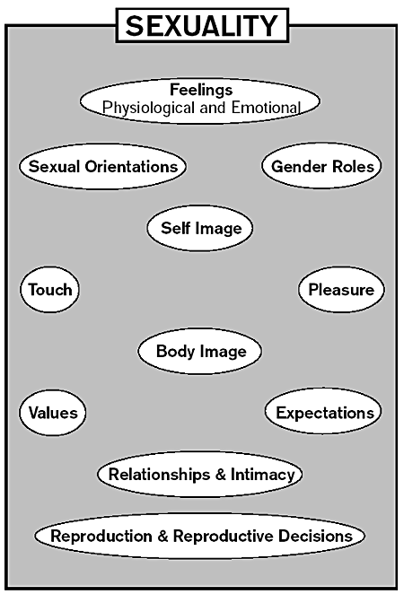
Sexuality
How do we construct it ?
How do we define it?
How can we make ourselves more sexy? (Film)
Is a Post Modern view of Sexuality possible?
Do you agree?

Slide 13
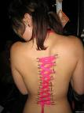
The Future of Gender and Sexuality
Pluralism , homogenisation or retrenchment?
Technological changes
  Gene Manipulation
  Body Augmentation
  Cybersex (Film)
  AI Sex (Film)
  Teledildonics (Film)

Slide 14
Further Reading
EU Briefinghttp://ec.europa.eu/justice/gender-equality/files/womenonboards/wob-factsheet_2015-01_en.pdf
Verge, T., & Lombardo, E. (2015). The differential approach to gender quotas in Spain: regulated politics and self-regulated corporate boards. http://cadmus.eui.eu/bitstream/handle/1814/35807/LAW_2015_24.pdf?sequence=1
Gascoigne, C., Parry, E., & Buchanan, D. (2015). Extreme work, gendered work? How extreme jobs and the discourse of ‘personal choice’ perpetuate gender inequality. Organization, 22(4), 457-475. Online at http://org.sagepub.com/content/22/4/457.full.pdf+html
Stamm, M. (2015). Gay Marriage Laws in Europe Compared to the United States. http://scholarworks.wmich.edu/cgi/viewcontent.cgi?article=3543&context=honors_theses
Woik, E. (2015). Hook Up Culture: Changing the Structure of Future Relationships?.
http://cornerstone.lib.mnsu.edu/etds/433/

Slide 15
