Slide 1
Tactical media, activism, hacktivism, and surveillance
Umění nových médií

Slide 2
Tactical media – teoretické texty
Geert Lovink - The ABC of Tactical Media.
https://www.nettime.org/Lists-Archives/nettime-l-9705/msg00096.html
Leah A. Lievrouw. Oppositional and Activist New Media: Remediation, Reconfiguration, Participation.
http://citeseerx.ist.psu.edu/viewdoc/download?doi=10.1.1.95.3793&rep=rep1&type=pdf
Dvě základní umělecké strategie:
Culture jamming
Alternative computing

Slide 3

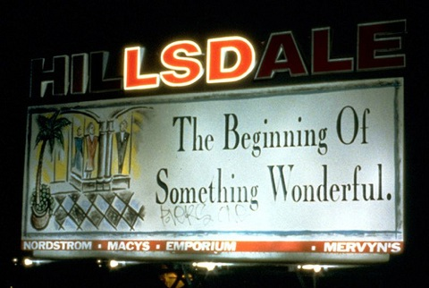
Billboard Liberation Front (1977)

Slide 4
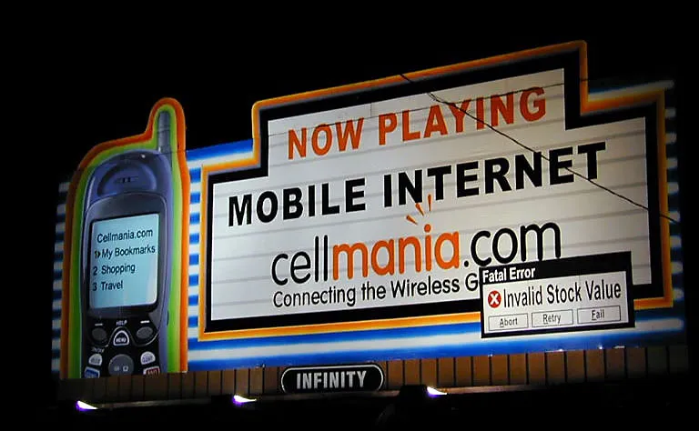

Slide 5
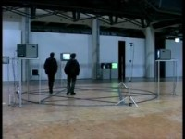
Peter Weibel : Observation of the Observation: Uncertainty (1973)
The Endless Sandwich (1969) - https://archive.org/details/1972PeterWeibelTVSandwickOk

Slide 6

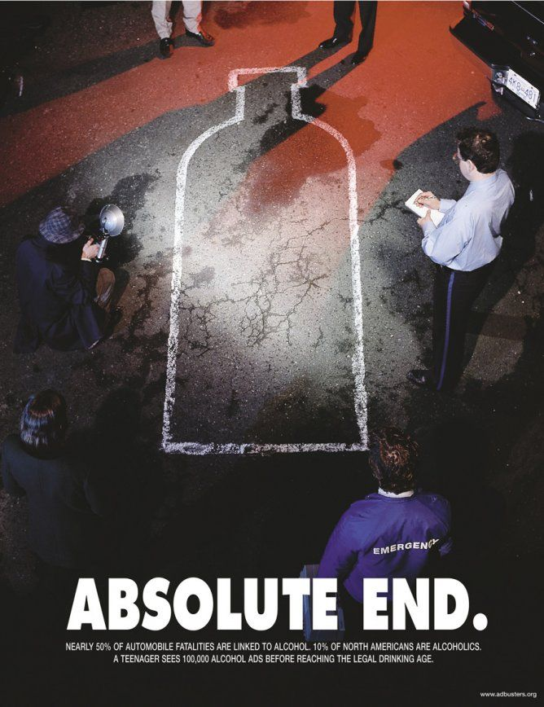

Adbusters (1989)
https://barnbrook.net/work/adbusters-buy-nothing-day/

Slide 7
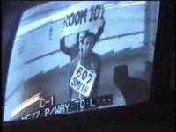
Surveillance Camera Players (1996)

Slide 8
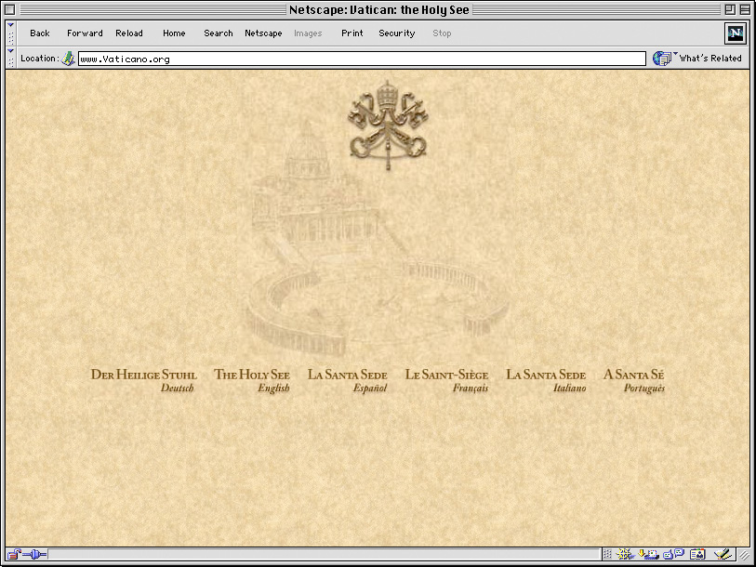
0100101110101101.ORG (Eva a Franco Mattes) –
Vaticano.org (1998)
http://0100101110101101.org/files/vaticano.org/

Slide 9
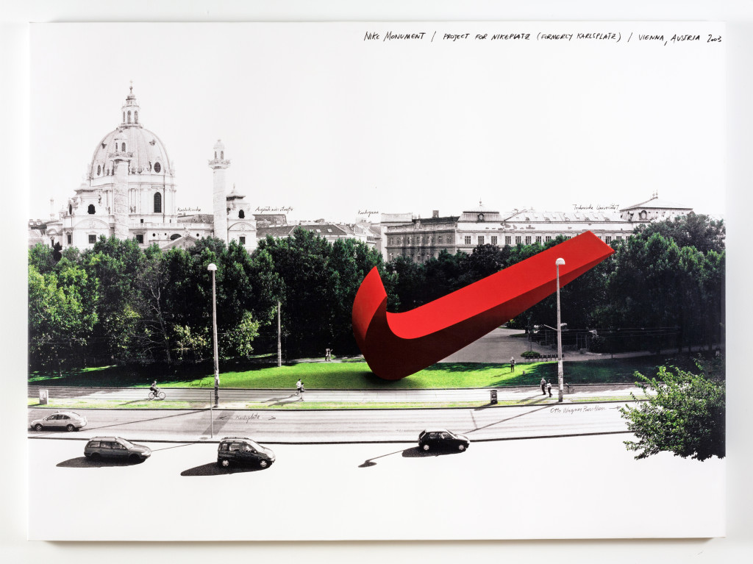
0100101110101101.ORG (Eva a Franco Mattes) –
Nike Ground (2003)
https://0100101110101101.org/nike-ground/

Slide 10
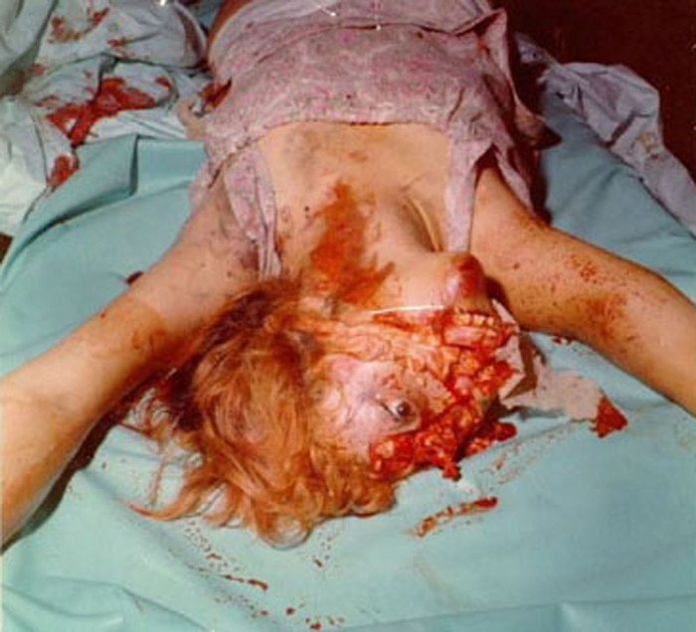
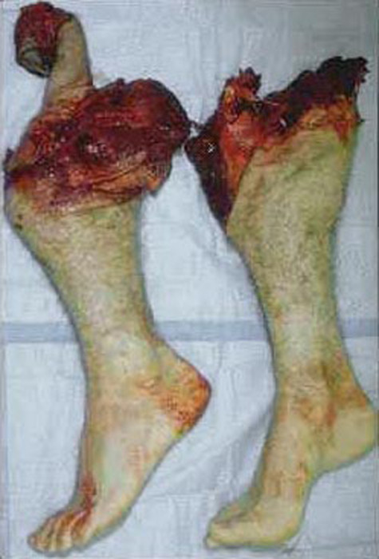
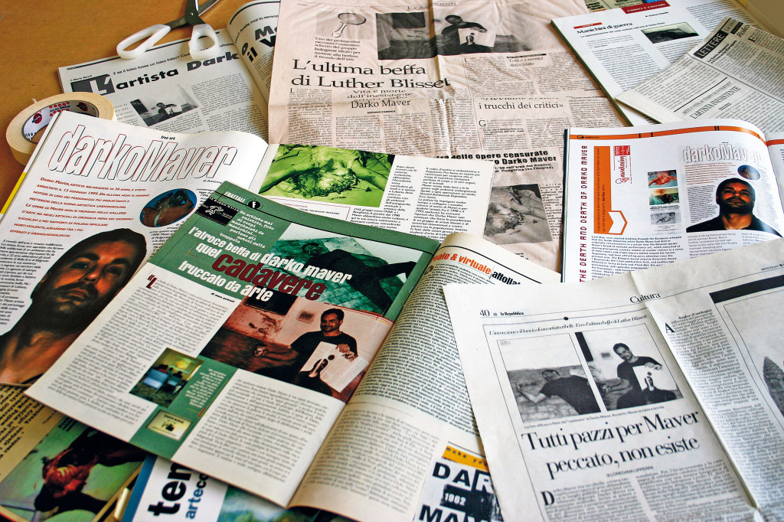
Darko Maver (1998-99)

Slide 11
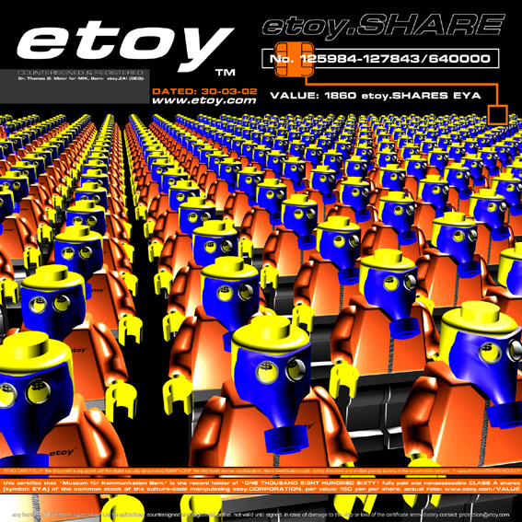
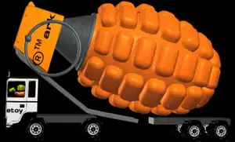
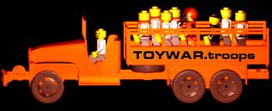
Etoy.Corporation: Toywar (1999 – 2000)
http://www.etoy.com/projects/toywar/

Slide 12


Korporátní parodie – Yes Man

Slide 13
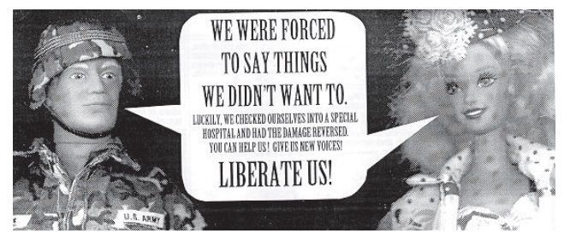
®Tmark
http://www.gwbush.com/
https://archive.org/details/BarbieLiberationOrganisation

Slide 14
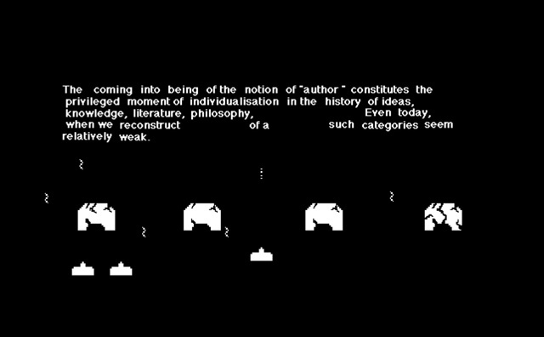
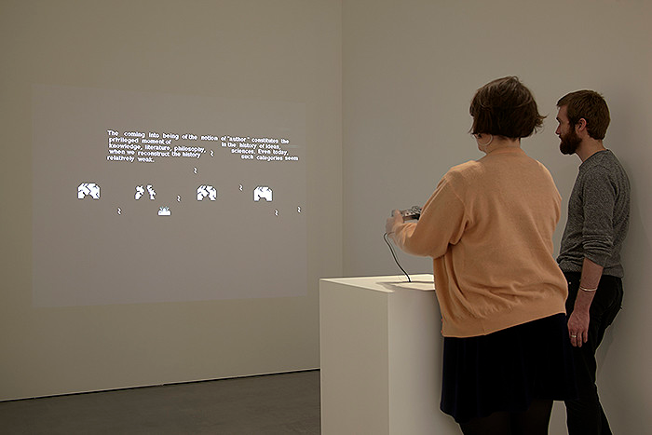
Jon Thomson a Alison Craighead - Trigger Happy (1998)
http://triggerhappy.org/

Slide 15

Antimafia (2002)
http://epidemic.ws/antimafia/download.php

Slide 16
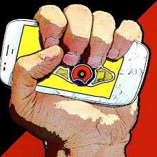
Send Protest (2016) – Constantin Ciervo
https://www.sendprotest.com/videogallery.html

Slide 17
Vladimír Turner
Povinná výbava (2011) - https://www.trendhunter.com/trends/vladimir-turner
Galerie ve Streetartu (2012) – http://sgnlr.com/works/outside/gallery-in-street-art-2012-prague/#
Free The Beast (2016) - http://sgnlr.com/works/outside/free-the-beast-2016-bishkek/
Guestlist (2020) - https://dafilms.cz/film/12629-guestlist

