Slide 1

Korean class
week4

Slide 2
index
Postpositional Particles
Negative expression
Past expression
Basic Word
Dialogue
Korea’s Culture

Slide 3
Postpositional Particles - Topic marking
은 [eun] / 는 [neun]
The main role of topic marking particles is letting the other people know what you are talking about or going to talk about, and topic marking particles are attached after nouns.
Words ending with a consonant + -은
Words ending with a vowel + -는

Slide 4
Example
가방 [ga-bang] + 은 [eun]
=bag
나 [na] + 는 [neun]
= I
이거 [i-geo] + 는 [neun]
= This
저는 학생이에요. [ jeo-neun hak-saeng-i-e-yo] = I am a student.
= I

Slide 5
Postposition Particles – subject making
이[i] / 가[ga]
The role of subject marking particles is relatively simple compared to that of role of topic marking particles.
Words ending with a consonant + -이
Words ending with a vowel + -가

Slide 6
Example
가방 [ga-bang] + 이 [i]
=bag
학교 [hak-gyo] + 가 [ga]
=school
내 [nae] + 가 [ga]
= I
선물이 왔다. [ seon-mul-i-what-da] = A gift is came
=gift

Slide 7
Negative expression
There are mainly two ways to make negative sentence
1. Adding 안 [an] before a verb
2. Using the negative verb ending, 지 않다 [ ji an-ta]

Slide 8
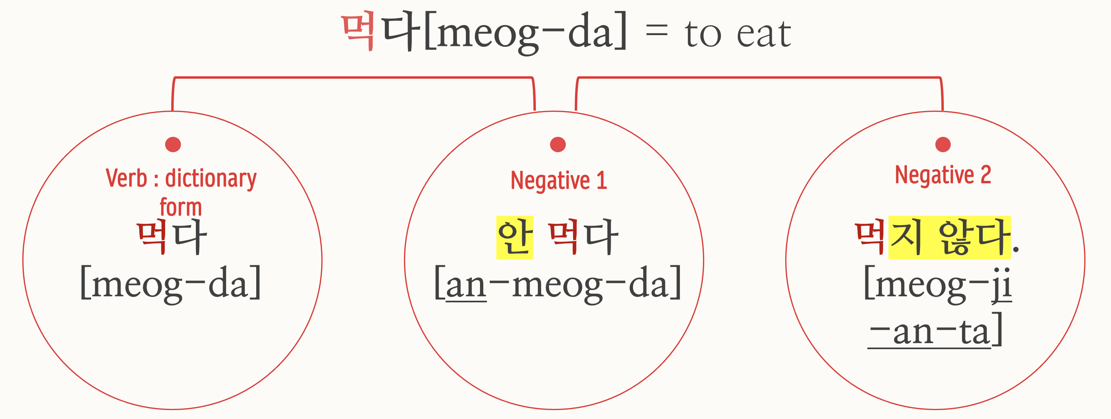
Example - verb

Slide 9
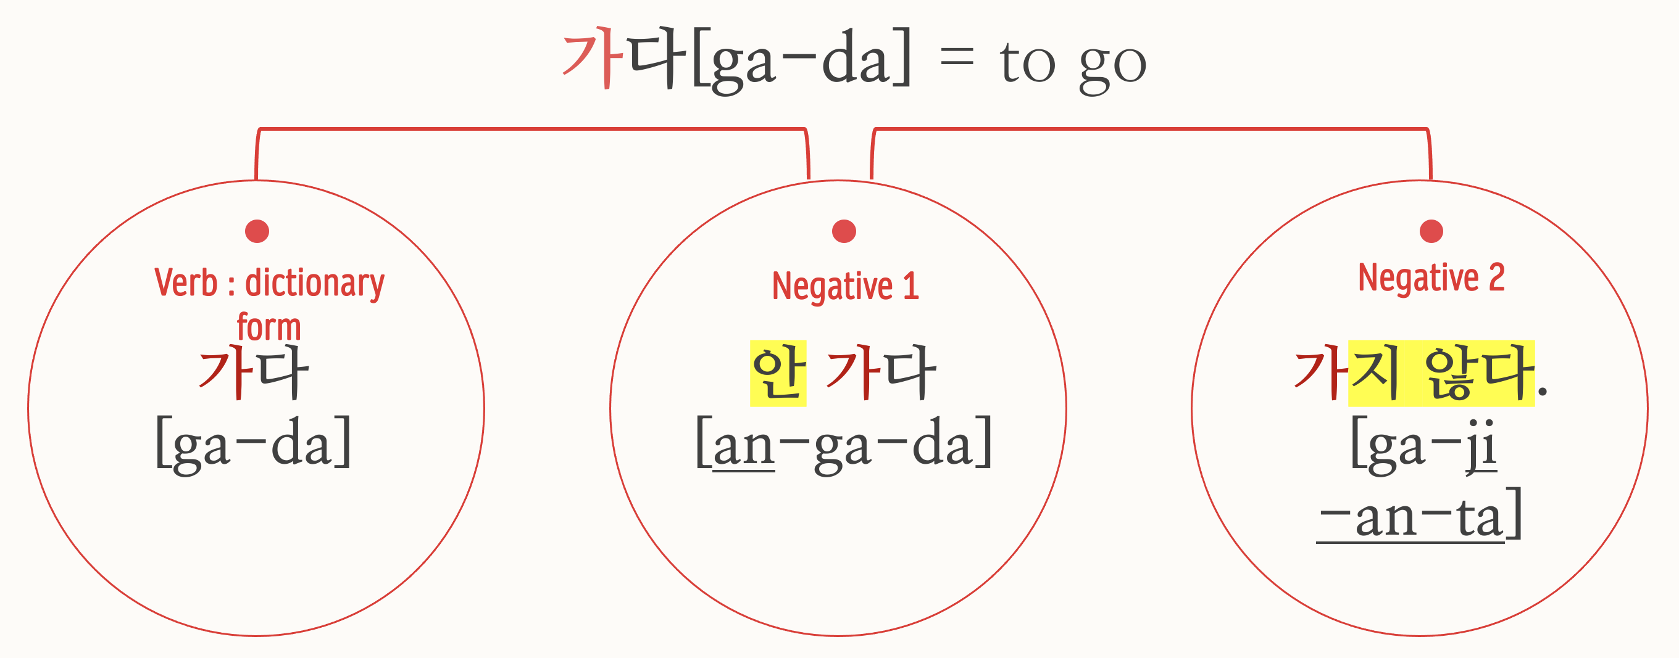

Slide 10
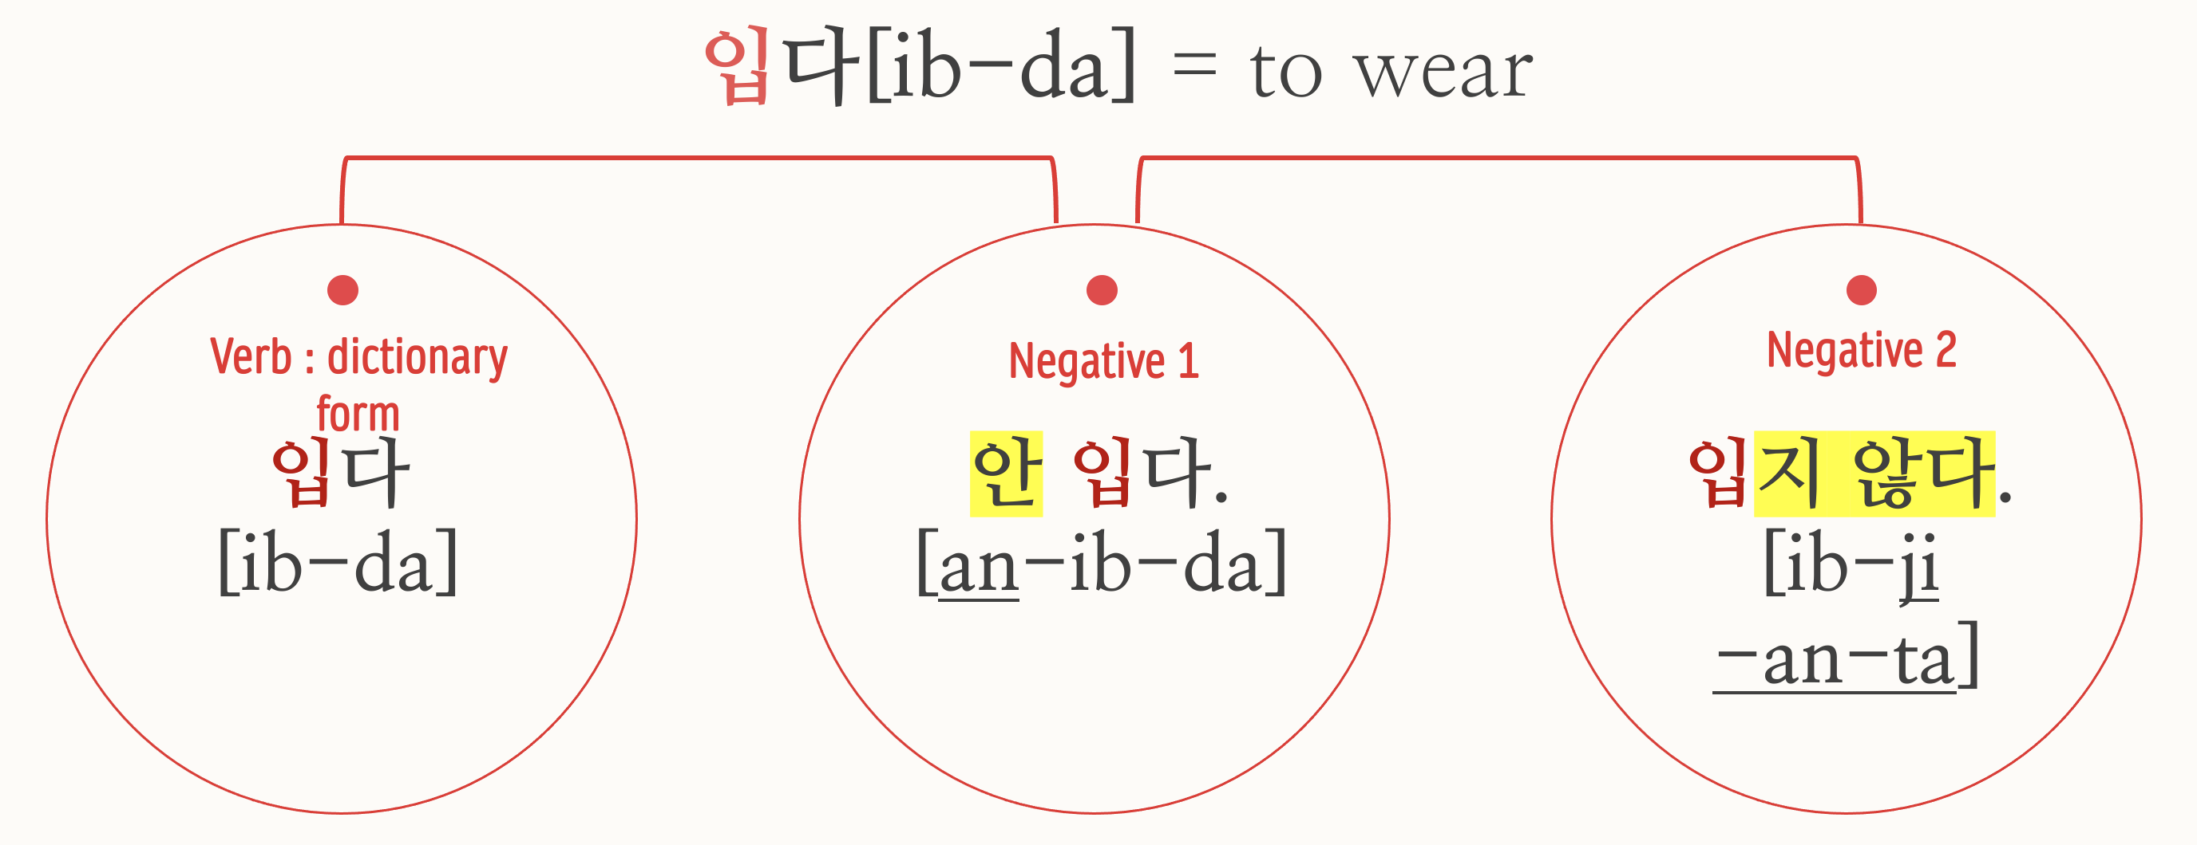

Slide 11
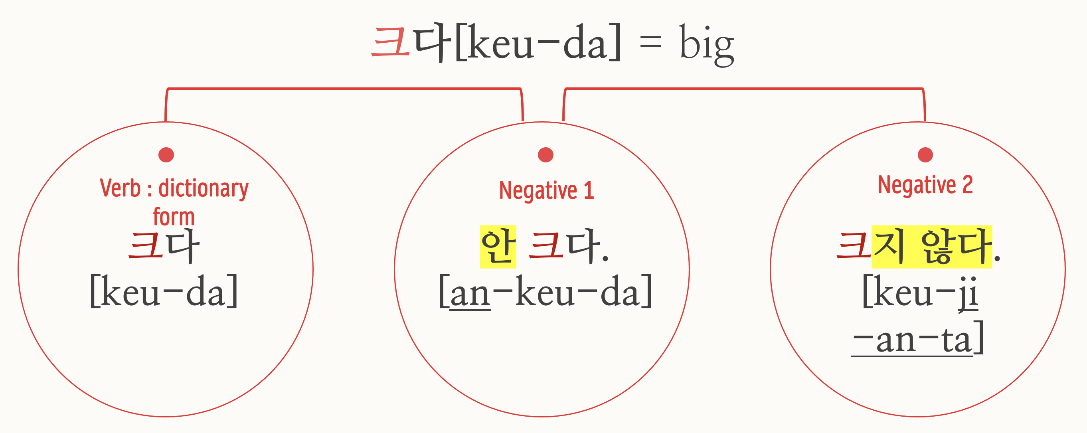
Example - adjective

Slide 12
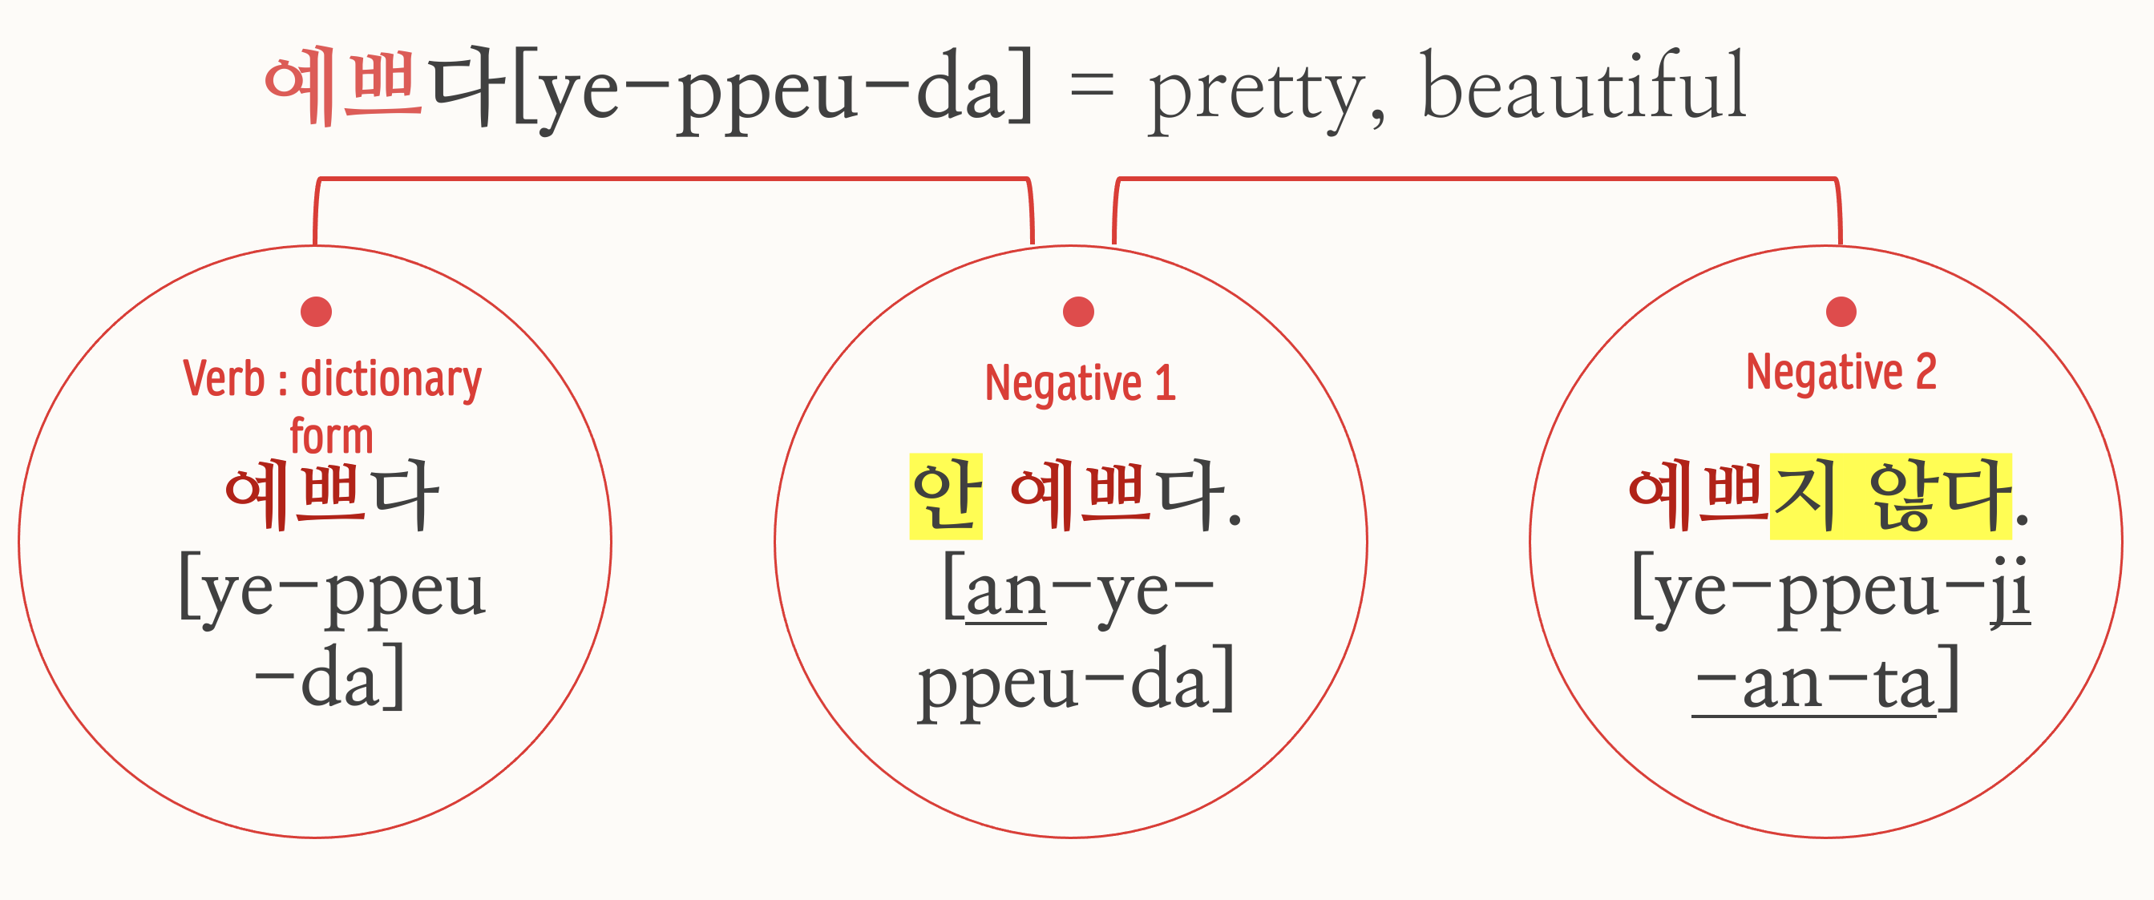

Slide 13
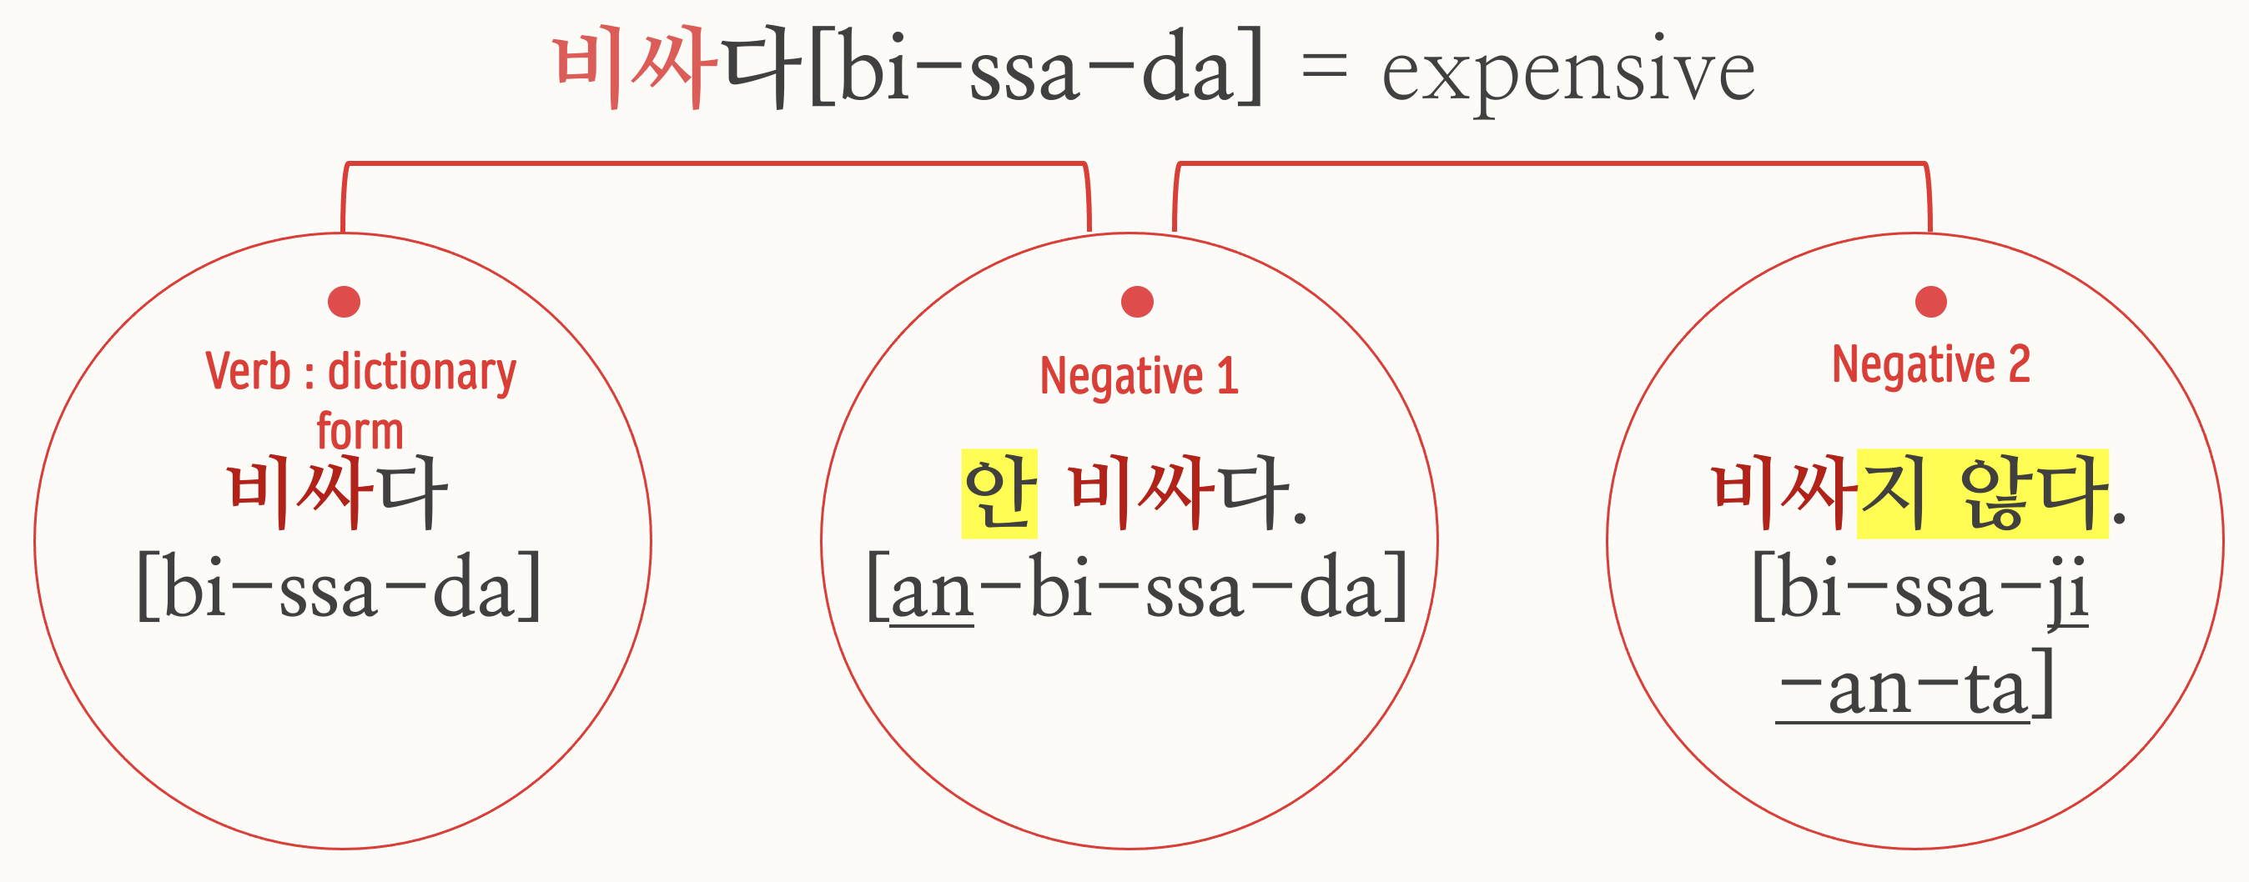

Slide 14
Dialogue – using negative expression
A: 아파요? [a-pa-yo?] = Does it hurt?
B: 안 아파요. [an a-pa-yo] = It doesn’t hurt.
A: 안 아파요? 진짜 안 아파요?
[an a-pa-yo? jin-jja an a-pa-yo?]
= It doesn’t hurt? It really doesn’t hurt?
B: 안 아파요. [an a-pa-yo] = It doesn’t hurt.

Slide 15
Dialogue – using negative expression
A: 안 먹어요? [an meo-geo-yo?] = You are not going to eat?
B: 안 먹어요! [an meo-geo-yo!] = I’m not eating!
A: 정말 안 먹어요? 맛있어요!
[ jeong-mal an meo-geo-yo? ma-si-sseo-yo]
= You are really not going to eat? It’s delicious.
B: 안 먹어요. 배 안 고파요.
[an meo-geo-yo. bae an go-pa-yo]
= I’m not eating. I’m not hungry.

Slide 16
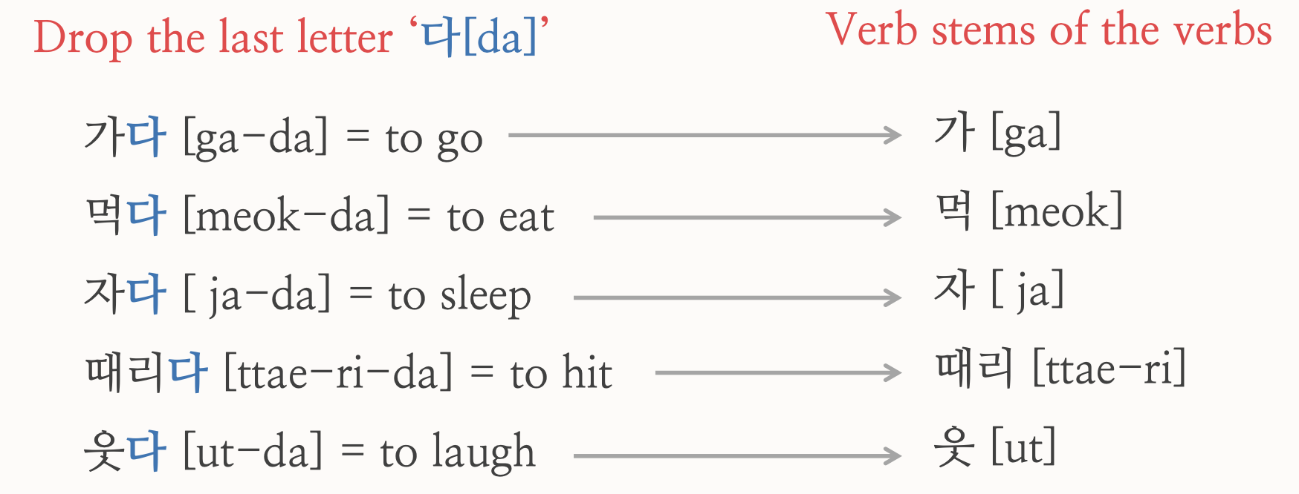
Past expression
Present sentence

Slide 17
Past expression
1. Verb stems ending with vowels ᅩ [o] or ᅡ [a] + 았어요 [ass-eo-yo]
2. Verb stems ending with vowels OTHER THAN ᅩ or ᅡ + 었어요 [eoss-eo-yo]
3. Verb stem 하 + 였어요 [yeoss-eo-yo]

Slide 18
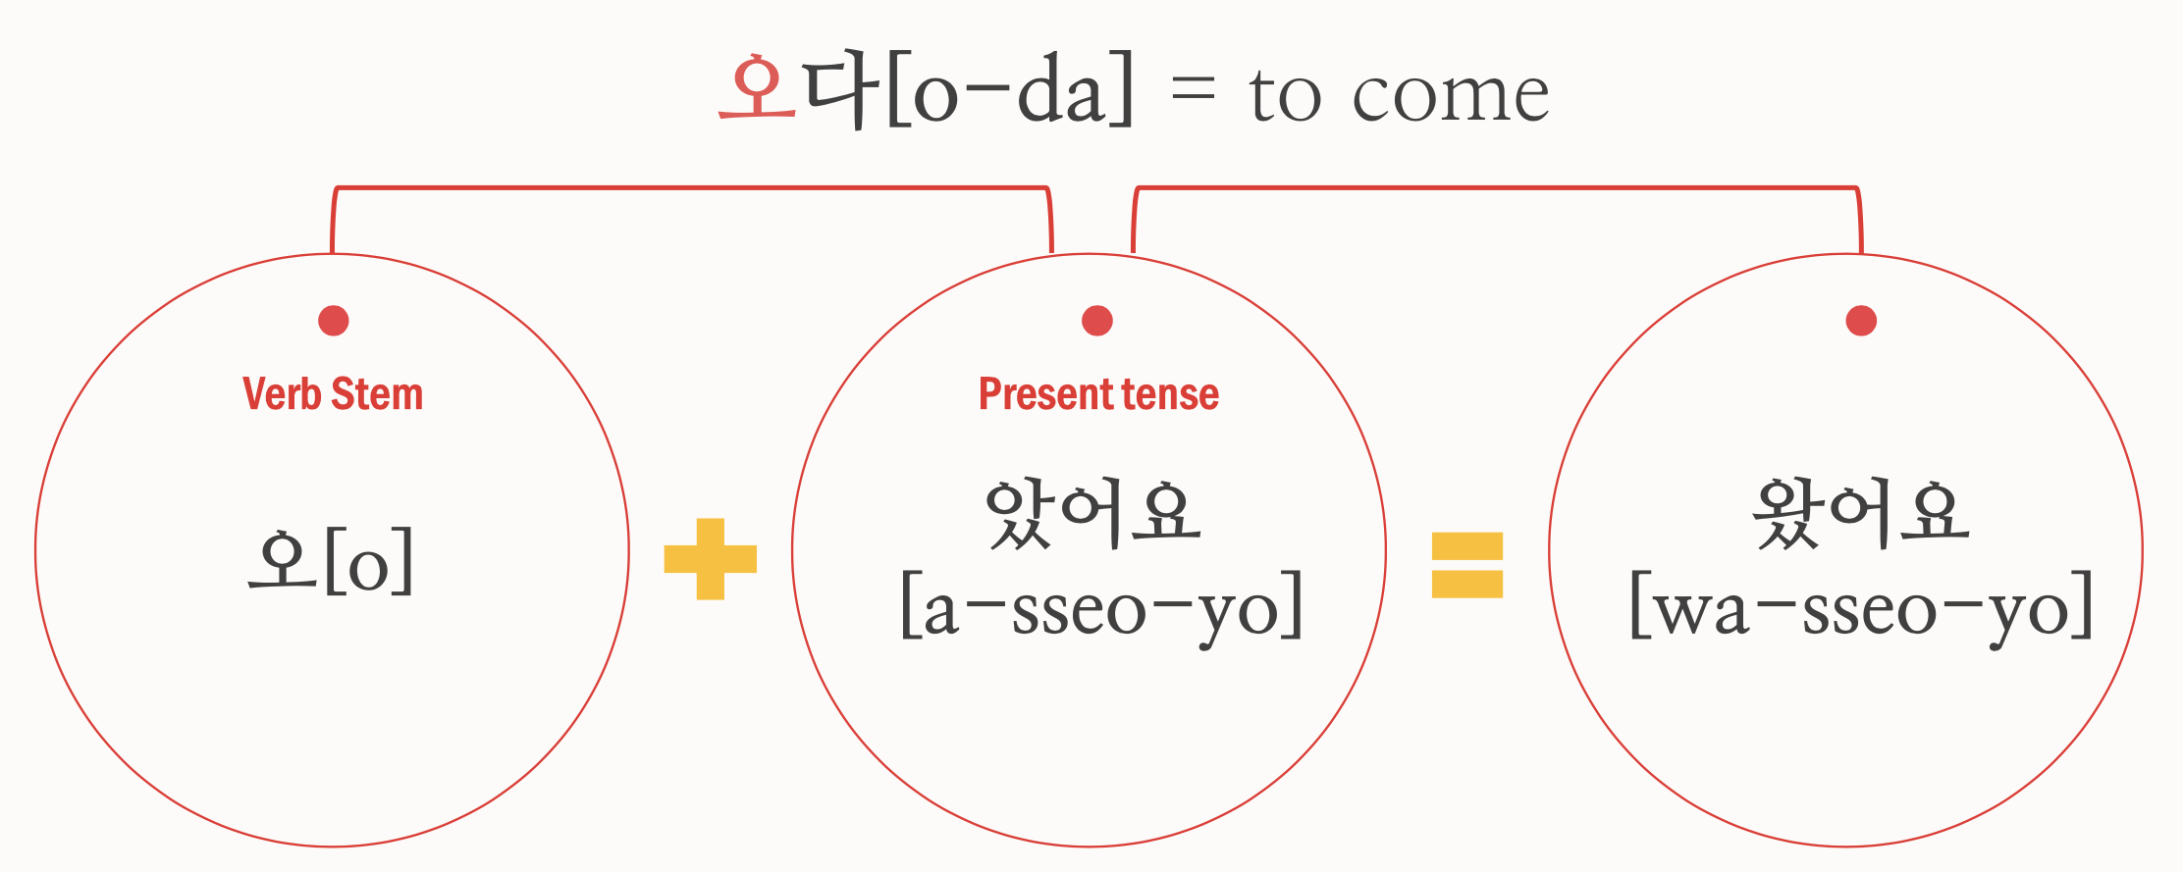
Example
Past tense

Slide 19
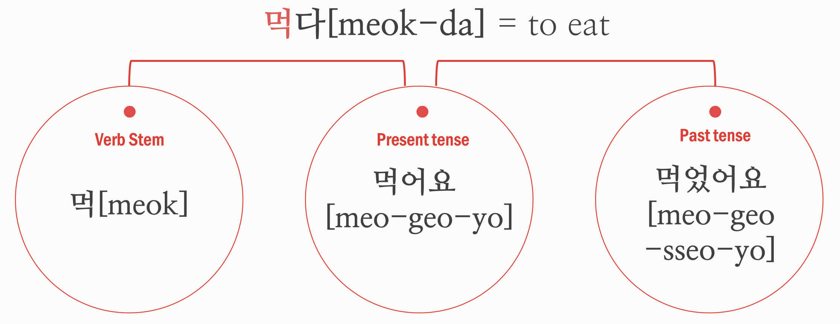

Slide 20
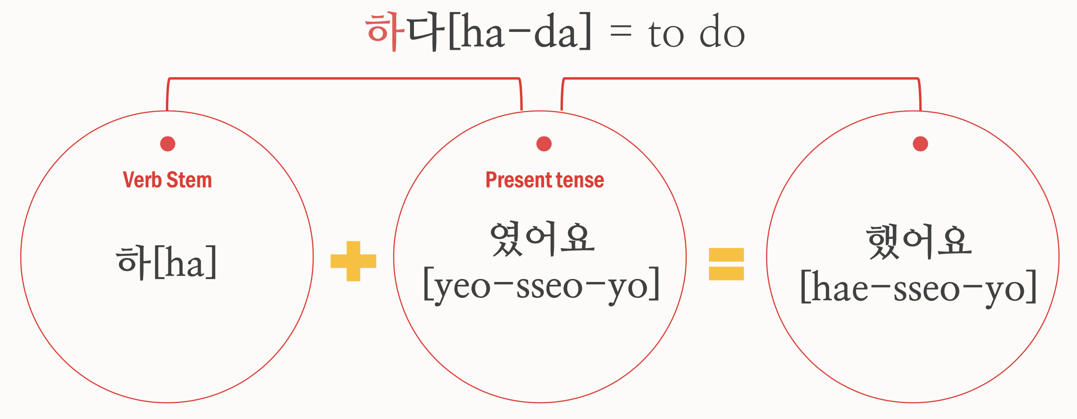
Past tense

Slide 21
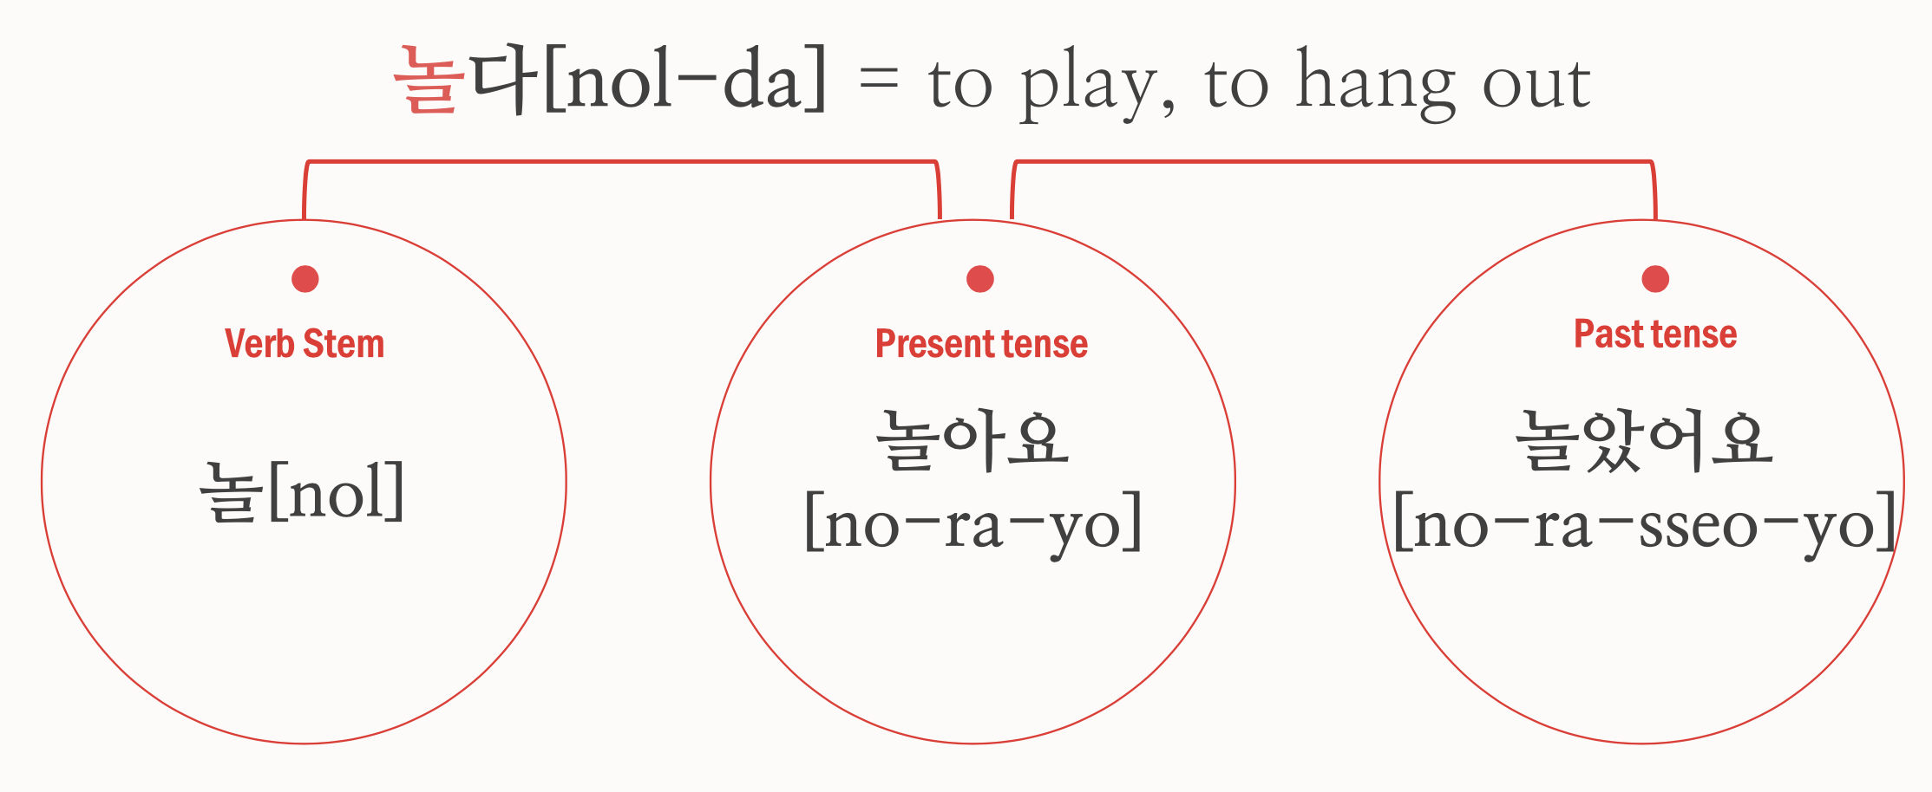

Slide 22
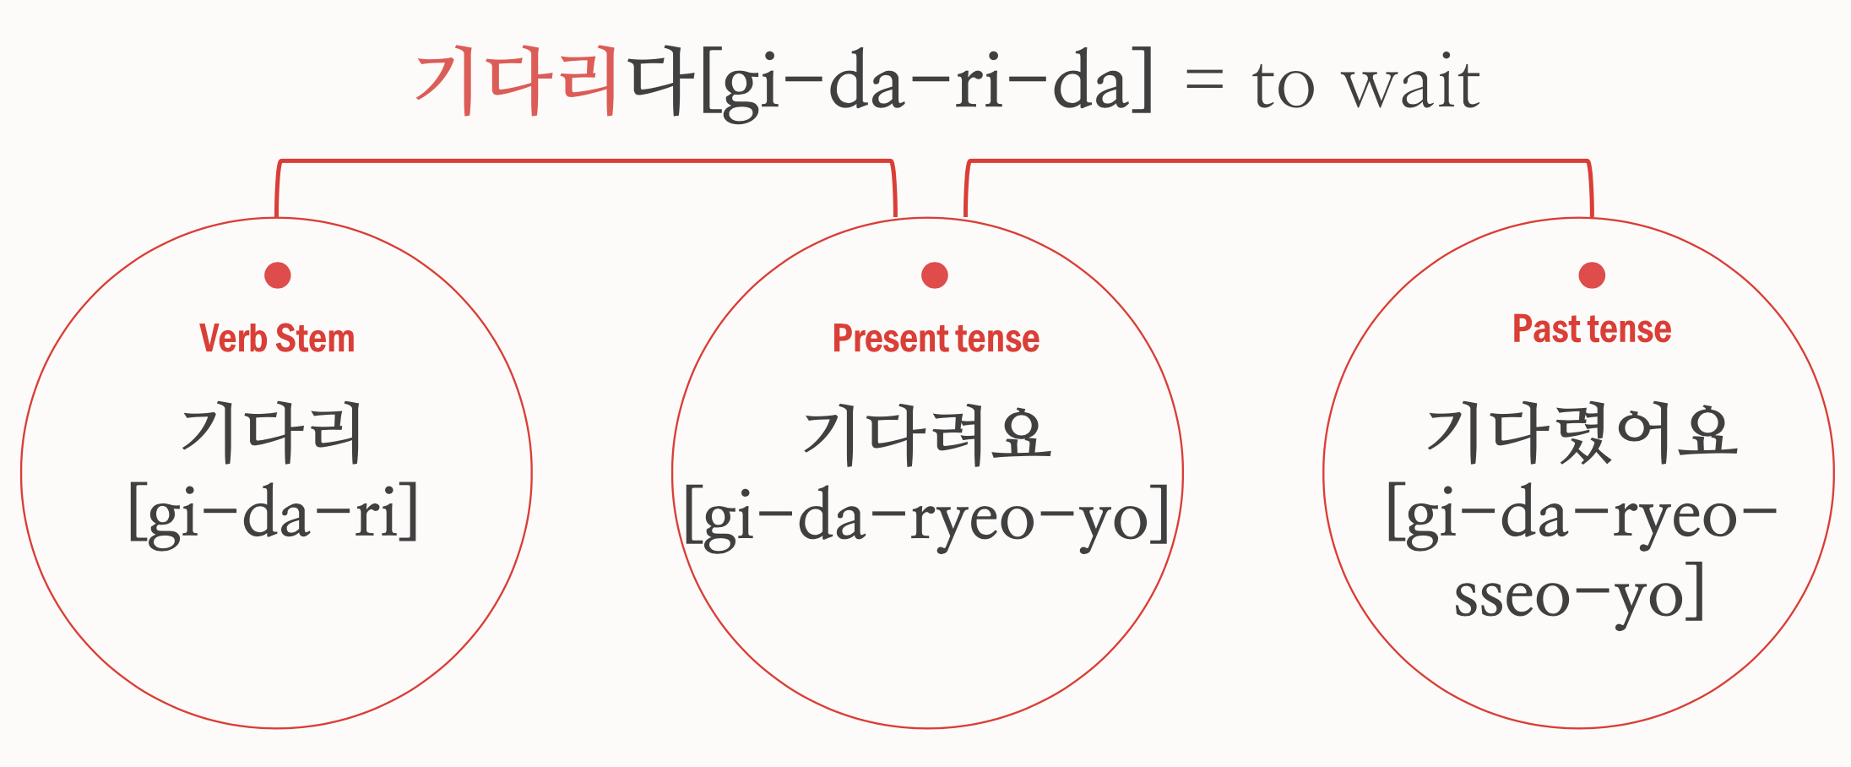

Slide 23
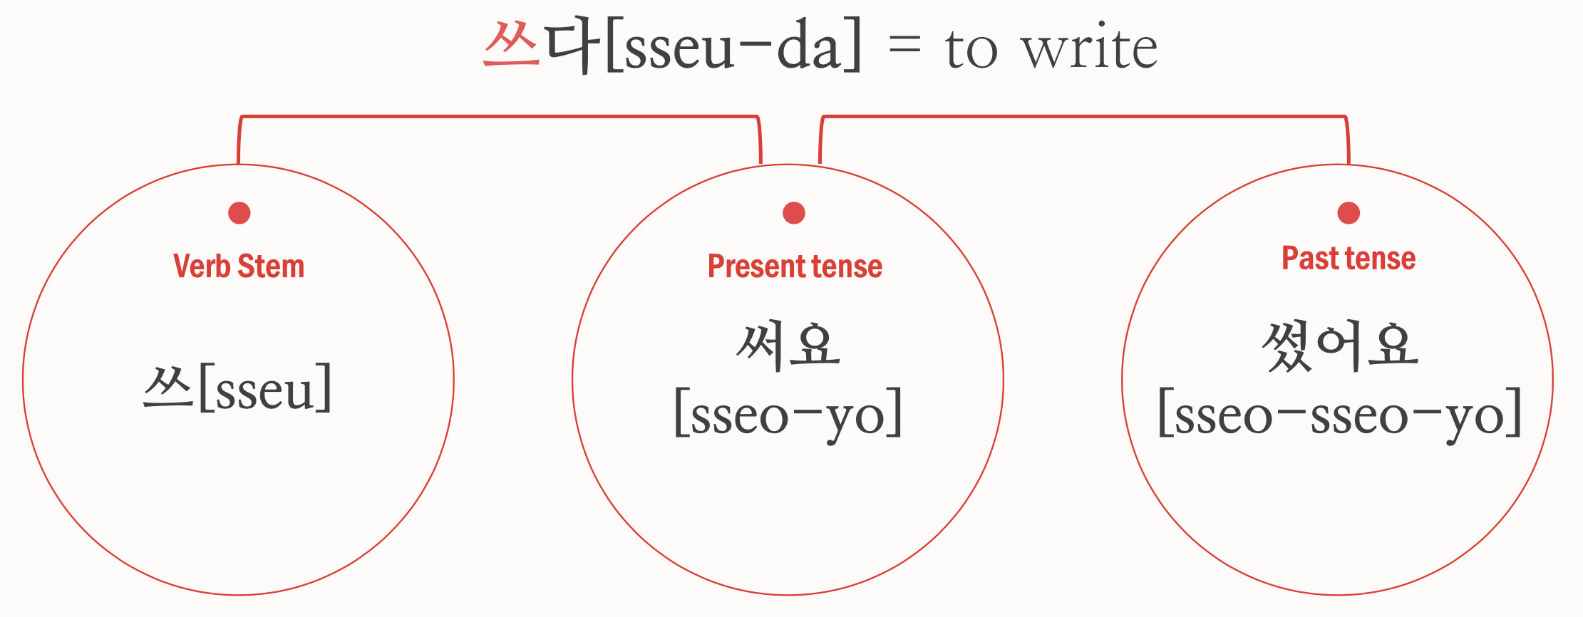

Slide 24
Basic word - Noun
Love = 사랑 [sa-rang]
Movie = 영화 [young-hwa]
Cooking = 요리 [yo-ri]
Today = 오늘 [o-neul]
Tomorrow = 내일 [nae-il]
Yesterday = 어제 [eo-jae]

Slide 25
Basic word - verb
Do not know = 모른다 [mo-reun-da]
Study = 공부하다[gong-bu-ha-da]
Exercise = 운동하다 [un-dong-ha-da]
Sing = 노래하다 [no-rae-ha-da]
Laugh = 웃다 [ut-da]
Cry = 울다 [ul- da]

Slide 26
dialogue
Sana : What did you do last weekend?
=지난 주말에 뭐했어?
[ji-nan ju-mal-e mwo-haet-eo?]
Jin : I watched a movie with my friend.
= 나 친구랑 영화봤어.
[na chin-gu-rang young-hwa-bwat-eo]

Slide 27
dialogue
Sana : What’s the title of movie?
= 영화 제목이 뭐야?
[young-hwa jae-mok-I mwo-ya?]
Jin : Parasite! Have you watched this movie?
= 기생충! 너 이 영화 봤어?
[gi-saeng-chung! Neo I young-hwa bwat-eo?]

Slide 28
dialogue
Sana : No, I haven't seen it yet.
=아니, 아직 안 봤어.
[a-ni, a-jig an bwat-eo]
Jin : Really? It’s really fun.
=정말? 그거 정말 재미있어.
[jeong-mal? Geu-geo jung-mal jae-mi-iss-eo]

Slide 29
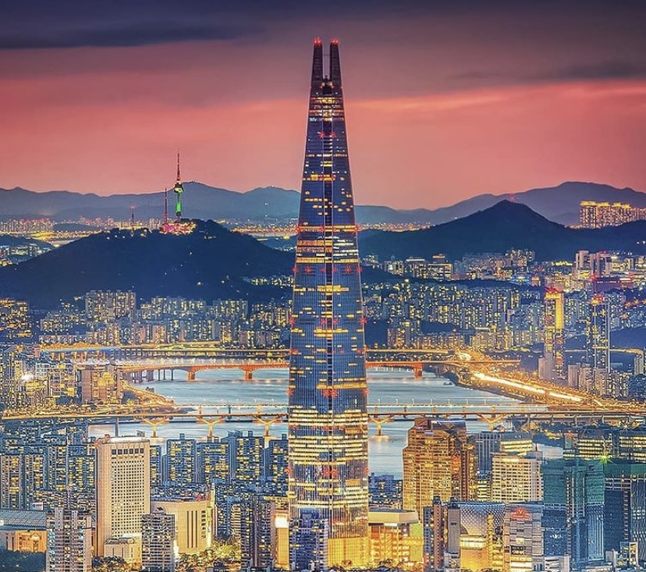
Korea’s culture
- Characteristics of Korean/Korea that Koreans say

Slide 30
1. A title for others
In English, “you” is used to call other people regardless of age or status, but there are several types of titles in Korea.
 | Older people | Younger people
woman | 언니 [eon-ni] 누나 [nu-na] | 여동생 [yeo-dong-saeng]
man | 형 [hyung] 오빠 [o-bba] | 남동생 [nam-dong-saeng]

Slide 31
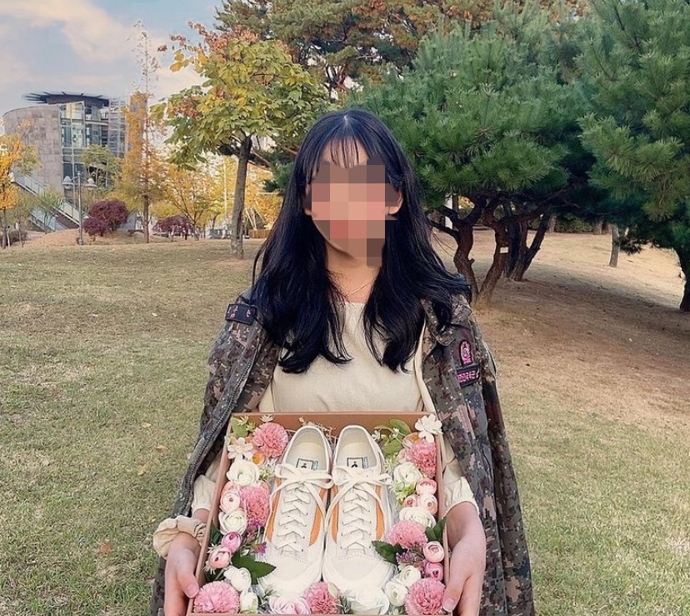
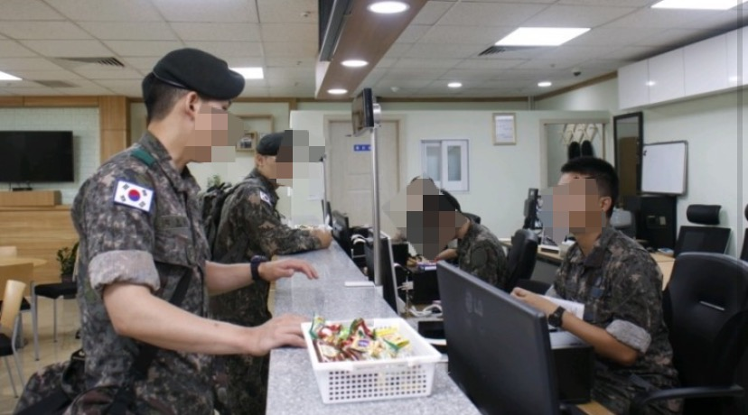
2. duty of military service
Korea is a divided country.
Most men in South Korea have to go to the military when they turn 18.
곰신 [ gom-sin]
Have to spend one year and eight months in the military.

Slide 32
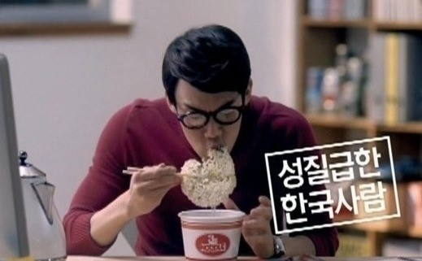
3. hanguk-saram Bbal-li BBAl-li!!
(Korean fast fast!!)
Not everyone is like that, but when compared to people from other countries, we are quick in temper.
When go abroad, feel stuffy with the country's work and the speed of Wi-Fi.
Get up before the bus stops, pick up their card and get ready to get off.
The airplane door hasn't even opened, but they already get up, pack their luggage, and line up in the aisle.
The noodles of cup noodles are not cooked, but eating

Slide 33
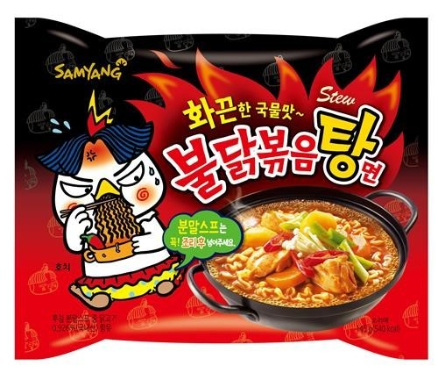
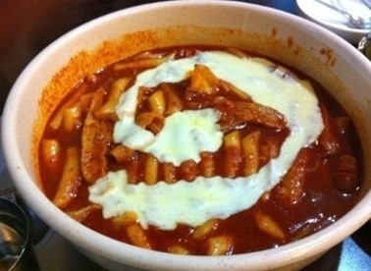
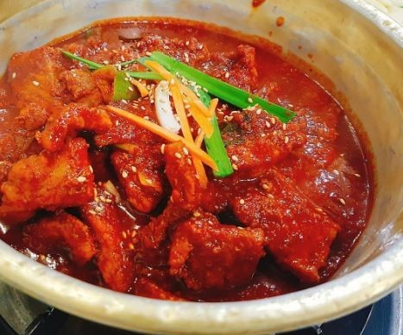
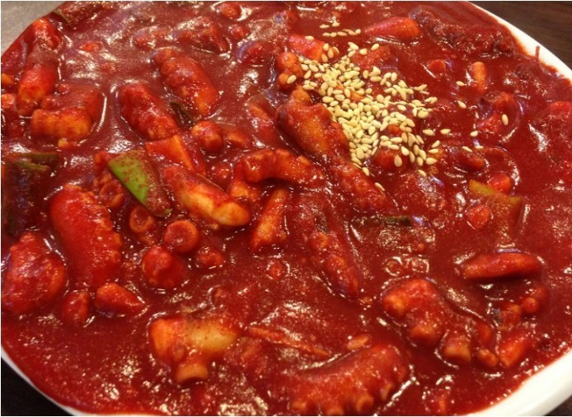
4. Enthusiasm for spicy food.
Almost all Korean food is red.
Garlic and pepper are essential when making food.
New and powerful spicy foods are released every year.
When return from travel(abroad) , always look for spicy food first.

Slide 34
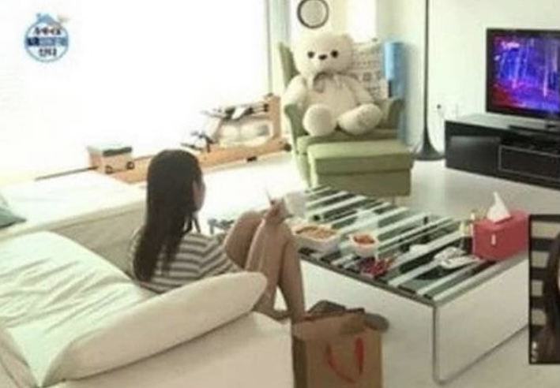
5. Do not sit on the sofa
Many people do not sit on the sofa even if they have a sofa, but sit on the floor with their backs on the sofa.

Slide 35
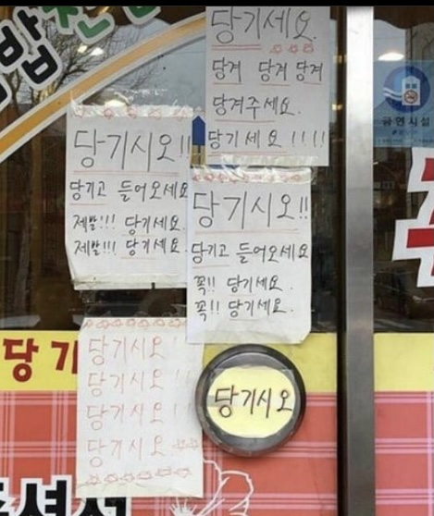
6.Push the door
Even if there is a 'Pull' on the door, push the door open.

Slide 36
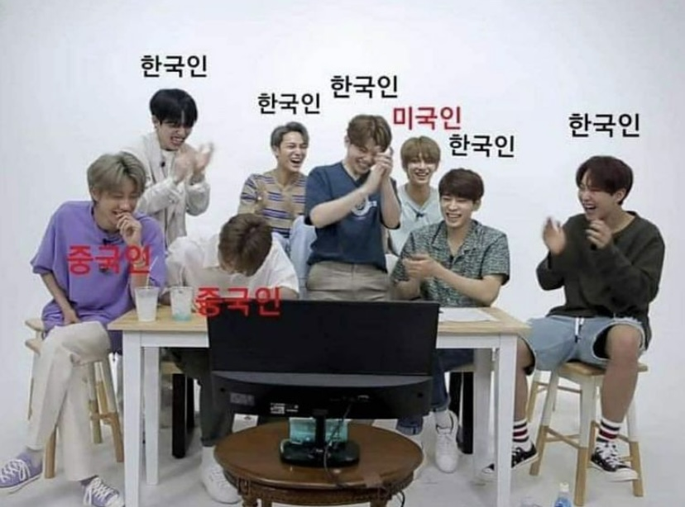
7. Applause when laughing
When laugh, people clap and laugh.
Red = foreign
Black = Korean

Slide 37

Thank you

