Slide 1
Korean class
Week 1

Slide 2
Index
Introduce
About Korea
About Hangeul
Vowels / Consonants
Today’s K-pop

Slide 3
Introduction
Ye-eun Kim
Born in Seoul, Live in Gyeong-gi.
Student of Sungshin Women’s University
Exchange student in Masaryk university
Studying in Faculty of Education

Slide 4
Introduction
Yeri Kim
Born in Seoul, Living in Seoul
Student of Sungshin Women’s University
Exchange student in Masaryk university
Studying in Faculty of Sports

Slide 5
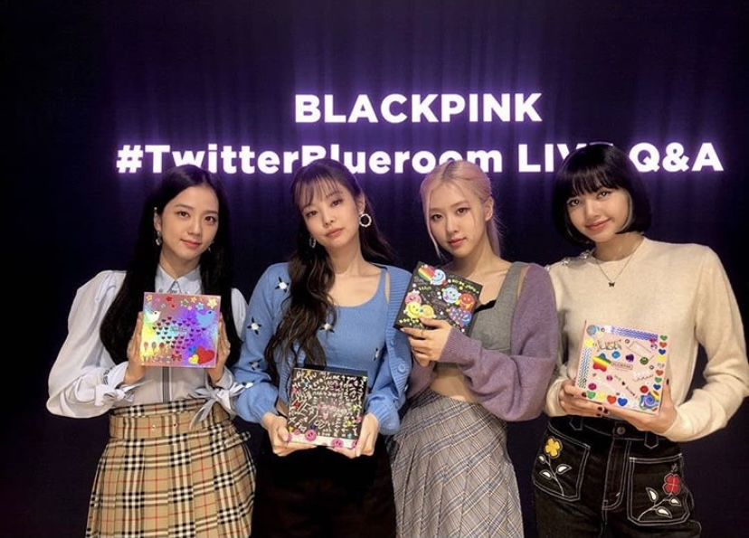
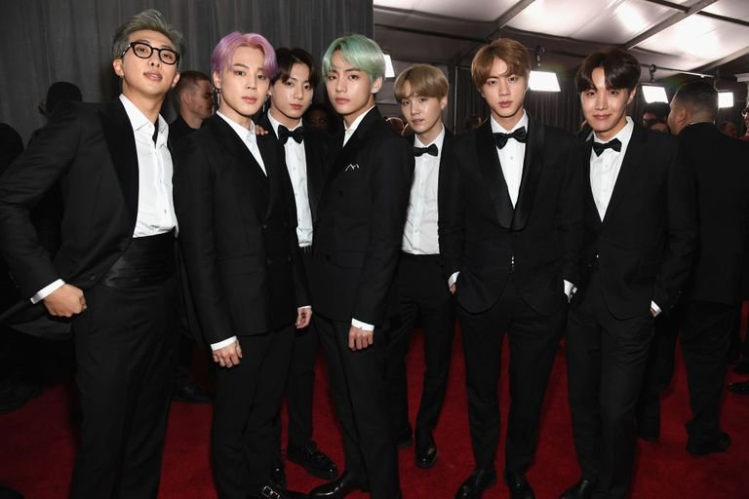
About korea

Slide 6
About korea
Feel the rhythm of Korea
https://www.youtube.com/playlist?list=PL_Lkw4Jwe-heWkDNPYtx3QSYpEXGvEdWb

Slide 7
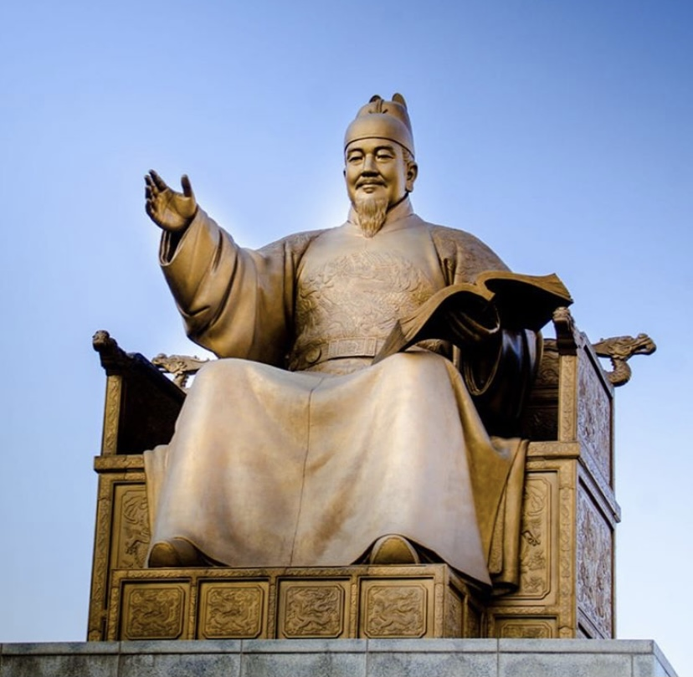
About hangeul
King Sejong created with many scholars
He made it for the whole nation
Cultural heritage

Slide 8
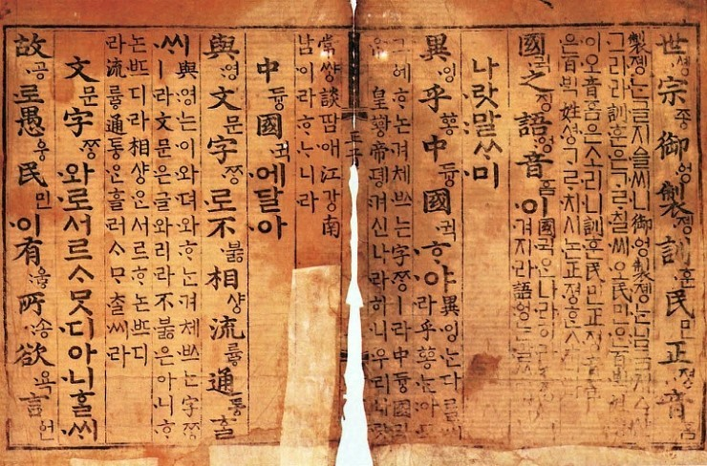
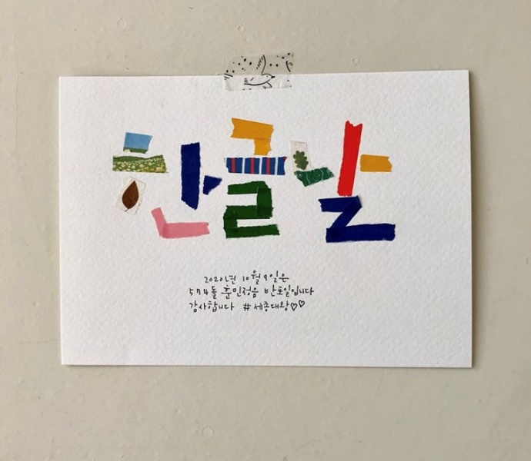
About Hangeul
훈민정음(Hunminjeongeum)
-A book containing the principles of Hangeul
한글날(Hangeul Proclamation Day)
-October 9 every year

Slide 9
About hangeul
Watch video!
https://youtu.be/2aDPpssj0h0

Slide 10
About hangeul

Slide 11
Consonants [자음:ja eum]

Slide 12
Consonants [자음:ja eum]
Let’s learn how to write and make sounds of consonants

Slide 13
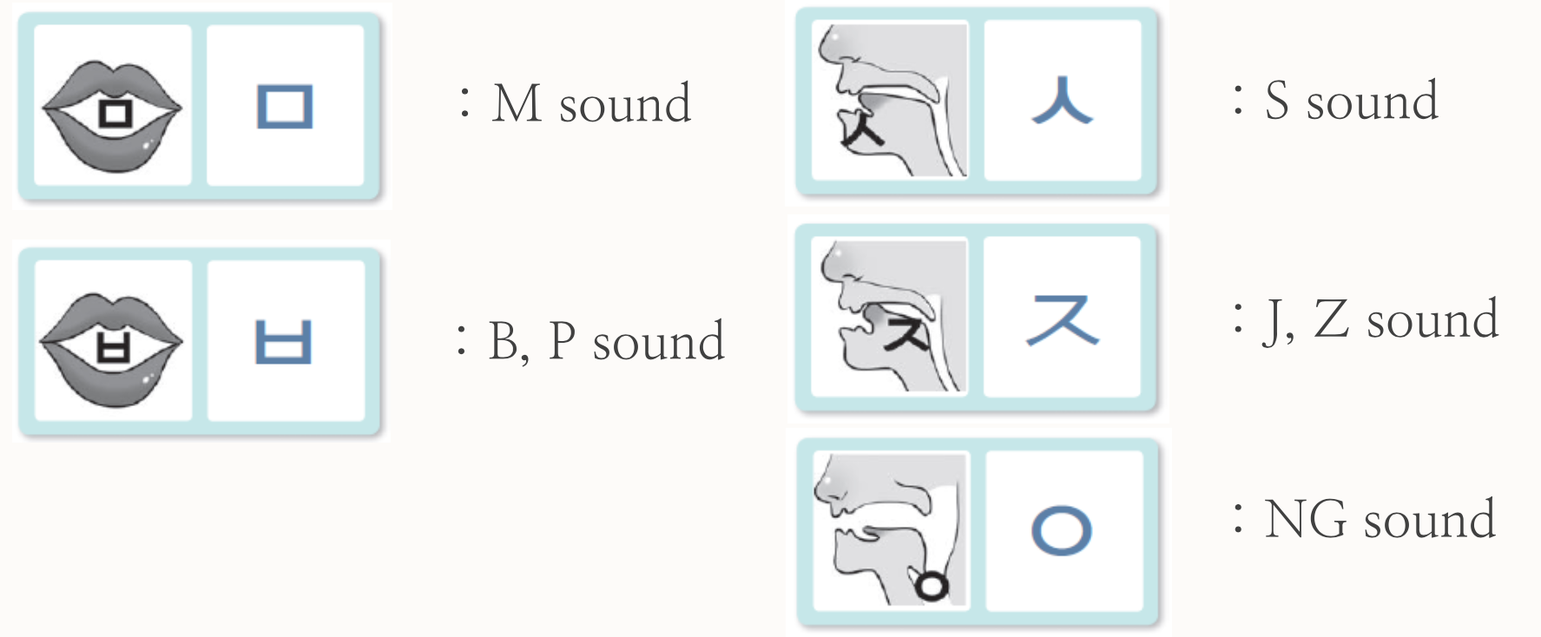
Consonants [자음:ja eum]
Let’s learn how to write and make sounds of consonants

Slide 14
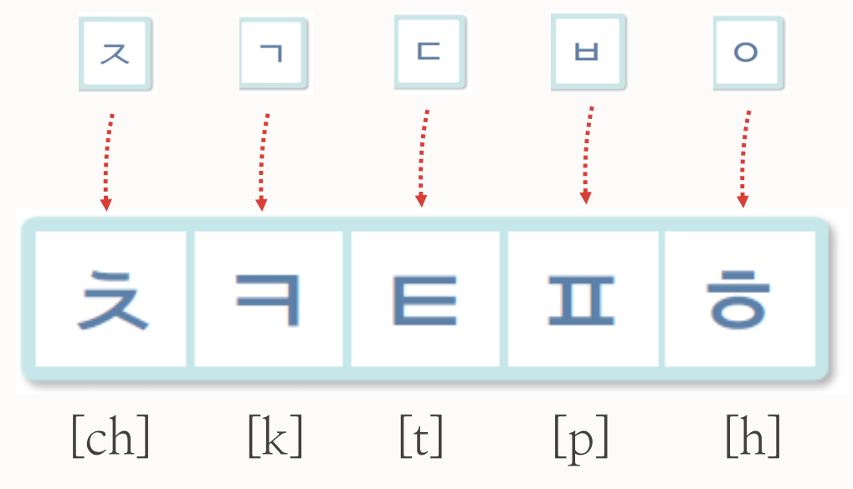
Consonants [자음:ja eum]
Let’s learn how to write and make sounds of consonants
These consonants let out a lor of air when pronounced

Slide 15
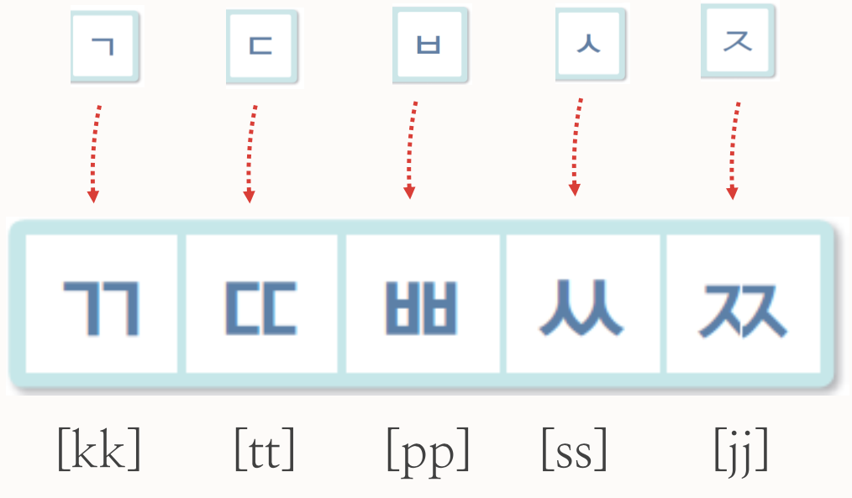
Consonants [자음:ja eum]
Let’s learn how to write and make sounds of 쌍자음 [ssang:jaeum]
These consonants let out no air when pronounced

Slide 16
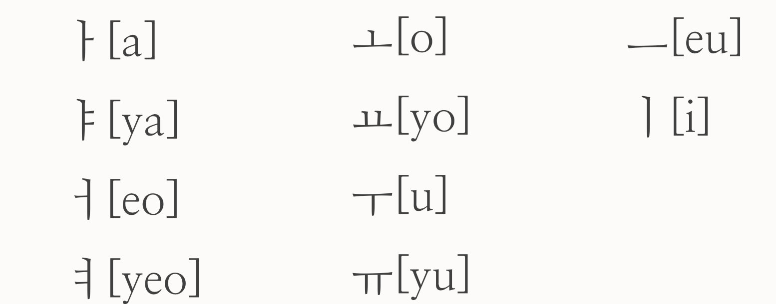
Vowels [모음:mo eum]
Basic vowels

Slide 17
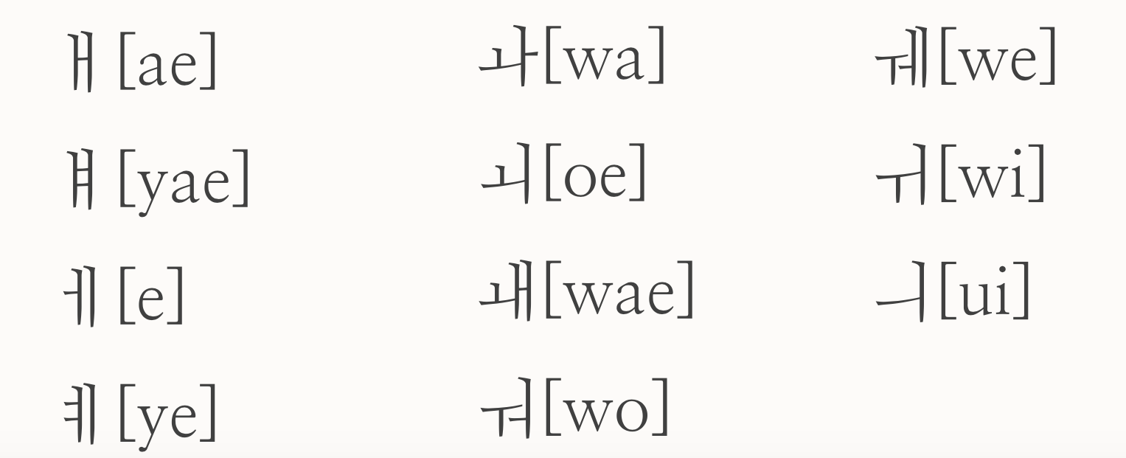
Vowels [모음:mo eum]
Combined Vowels

Slide 18
Combined vowels
ㅐ [ae] =ㅏ+ㅣ ㅘ [wa] =ㅗ+ㅏ ㅞ [we] =ㅜ+ㅔ
ㅒ [yae] =ㅑ+ㅣ ㅚ [oe] =ㅗ+ㅣ ㅟ [wi] =ㅜ+ㅣ
ㅔ [e] = ㅓ+ㅣ ㅙ [wae] =ㅗ+ㅐ ㅢ [ui] =ㅡ+ㅣ
ㅖ [ye] =ㅕ+ㅣ ㅝ [wo] =ㅜ+ㅓ

Slide 19
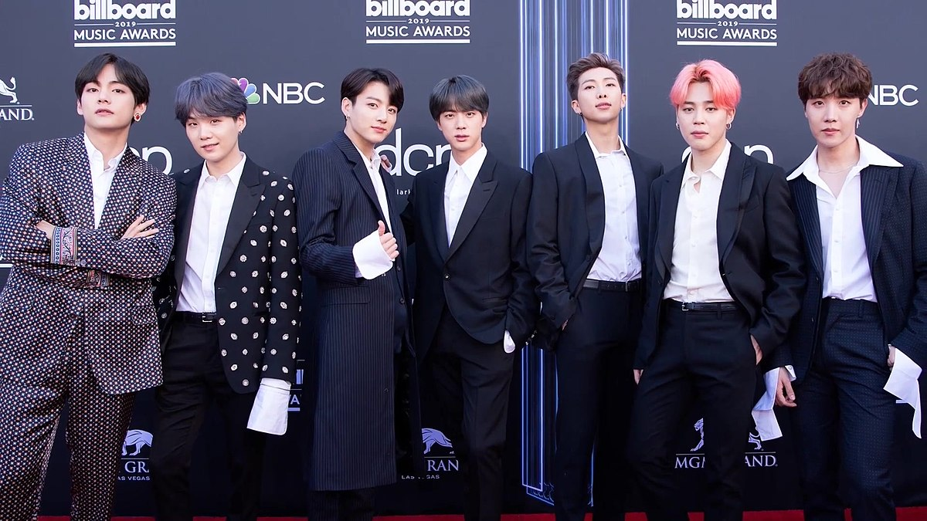
Today’s k-pop
Let’s watch video!
https://www.youtube.com/watch?v=4TrCcG2yUSA
permission to dance - BTS

Slide 20
Thank you

