Slide 1

KPOP CLASS
2019.11.25 + 2021.01.09.+2021.11.24.
Copyrightⓒ. Saebyeol Yu. All Rights Reserved.

Slide 2
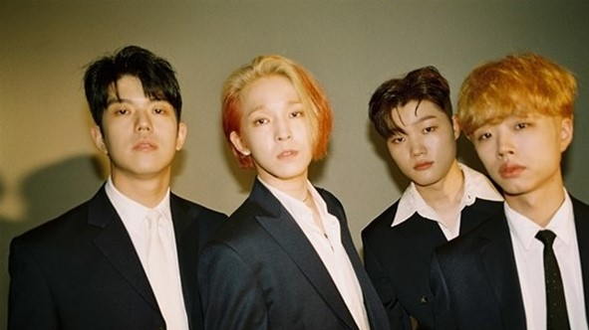
SOUTHCLUB
Debut: 05.26.2017
Members: Nam Taehyun / Kang Minjun
Jeong Hoemin / Lee donggeun
https://www.youtube.com/watch?v=351ntdB-Fto

Slide 3
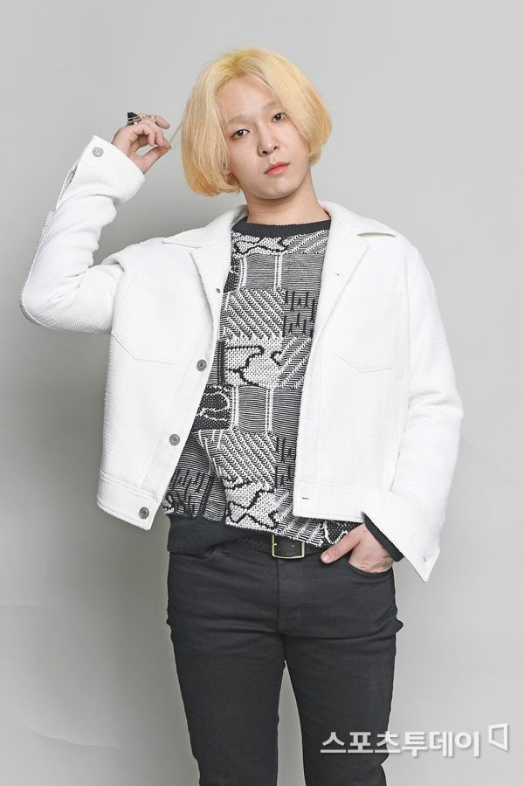
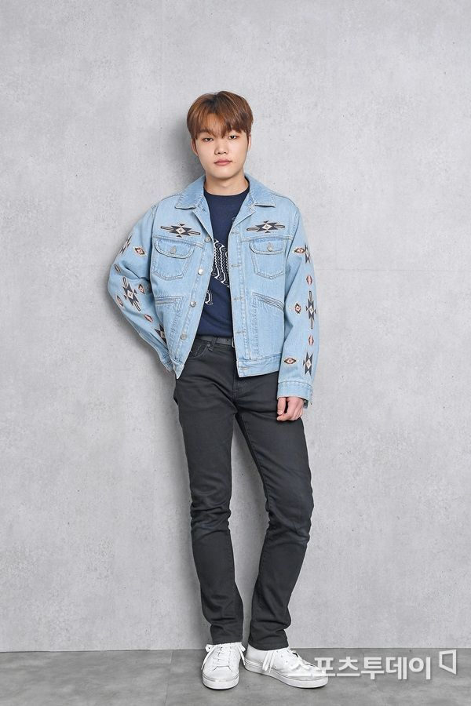
Kang Minjun
Nam Tae Hyun
Group: Southclub
Position: Vocalist, composer, lyricist, guitarist
Birth: 05.10.1994
Physical: 180cm, 63kg
Position: Guitarist
Birth: 178cm, 65kg
복면가왕
https://www.youtube.com/watch?v=2axWpcz399I
셀프 영상
https://www.youtube.com/watch?v=-87JOFZPP14

Slide 4
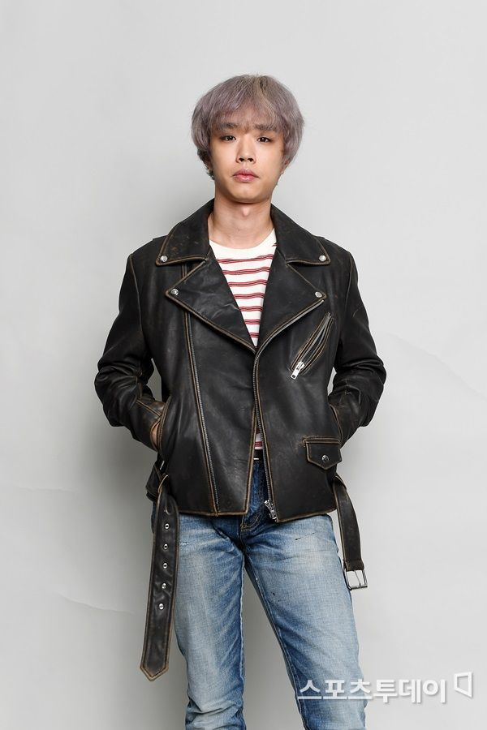
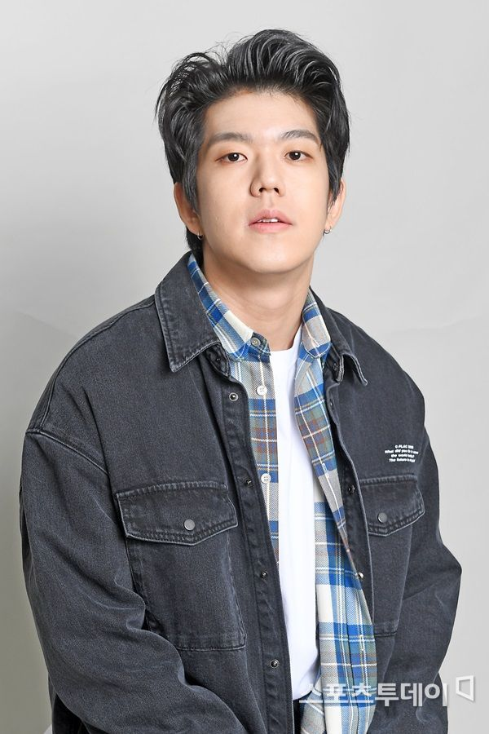
Jung hoe min
Lee dong geun
Position: Base
Birth: 12.21.1993
Position: drummer
Birth: 02.12.1997
Physical: 183cm,
70kg

Slide 5
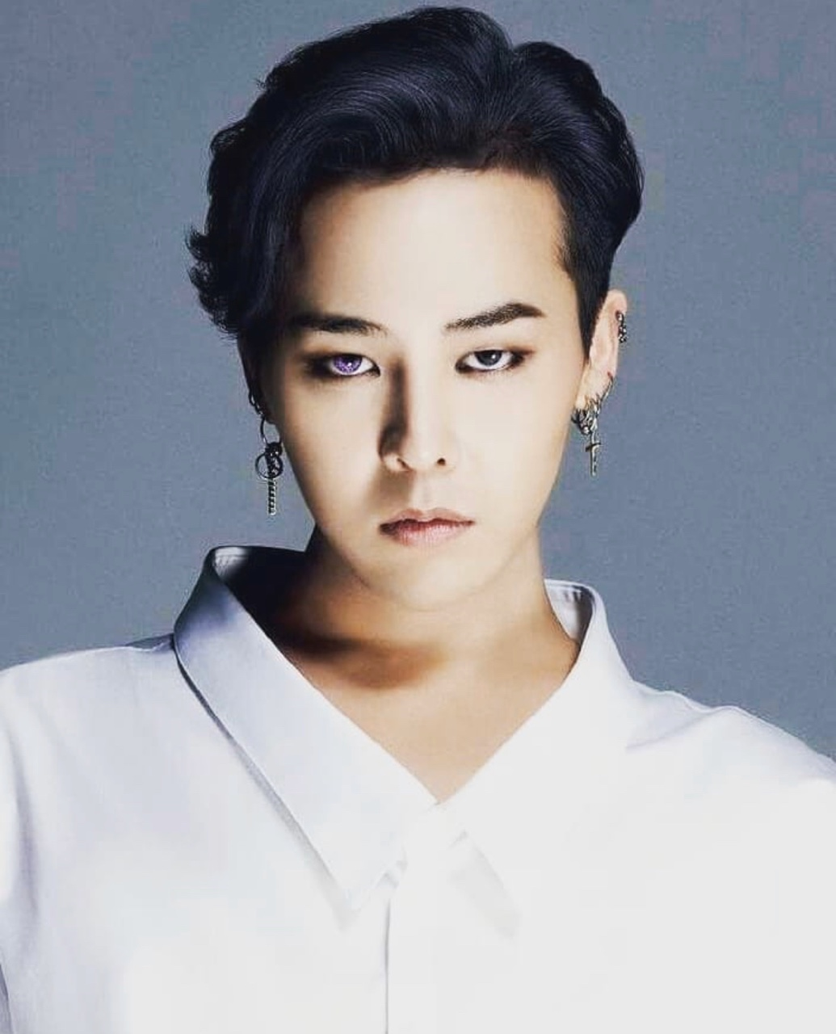
G-Dragon
Original name: Kwon Jiyong
Group: BIGBANG
Debut: 08.19.2006
Position: Leader, Main Rapper, Composer, Lyricist
Entertainment:YG
Birth: 08.18.1988

Slide 6
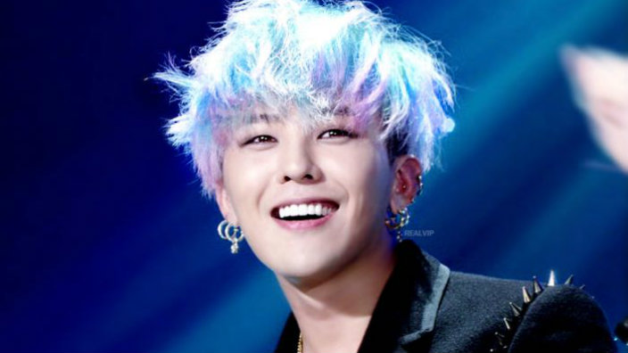
G-DRAGON
Compose,
write the lyrics
Most of BIGBANG best songs
: Lie, Last Farewell, BANGBANGBANG, Loser, Fantastic baby, BLUE, I don’t know
SOLO:
Heartbreaker,
High High
Oh Yeah
Crayon
COUP D’ETAT
Untitled

Slide 7

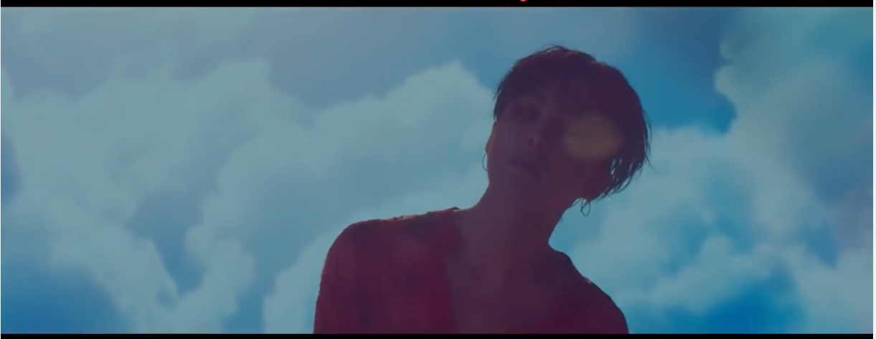
무제 Untitled
https://www.youtube.com/watch?v=IQ8Cmsd4c8E

Slide 8
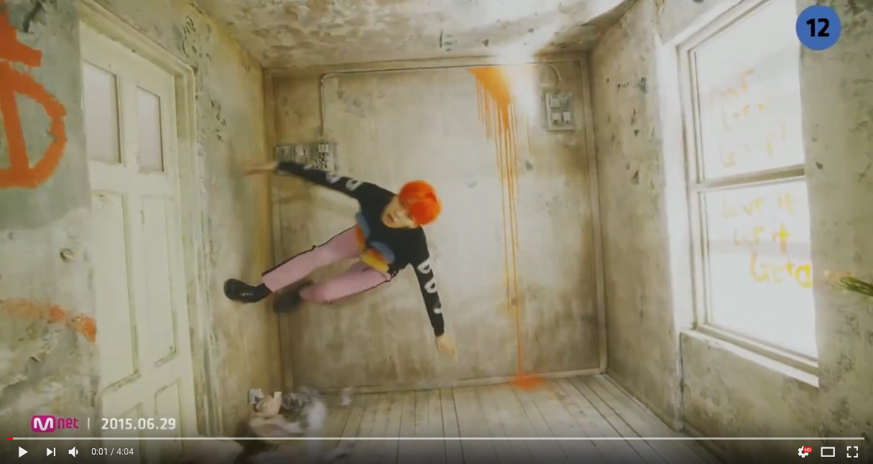
맨정신 sober
https://www.youtube.com/watch?v=AvJ40aW0-zM

Slide 9
Awards
Prime Minister's Award at the 7th Korea Popular Culture and Arts Award
Mnet Asian Music Awards-Singer of the Year
Mnet Asian Music Awards NISSAN JUKE Best Music Video
Mnet Asian Music Awards Best Dance Performance Male Solo
Mnet Asian Music Awards-Male Singer Award

Slide 10

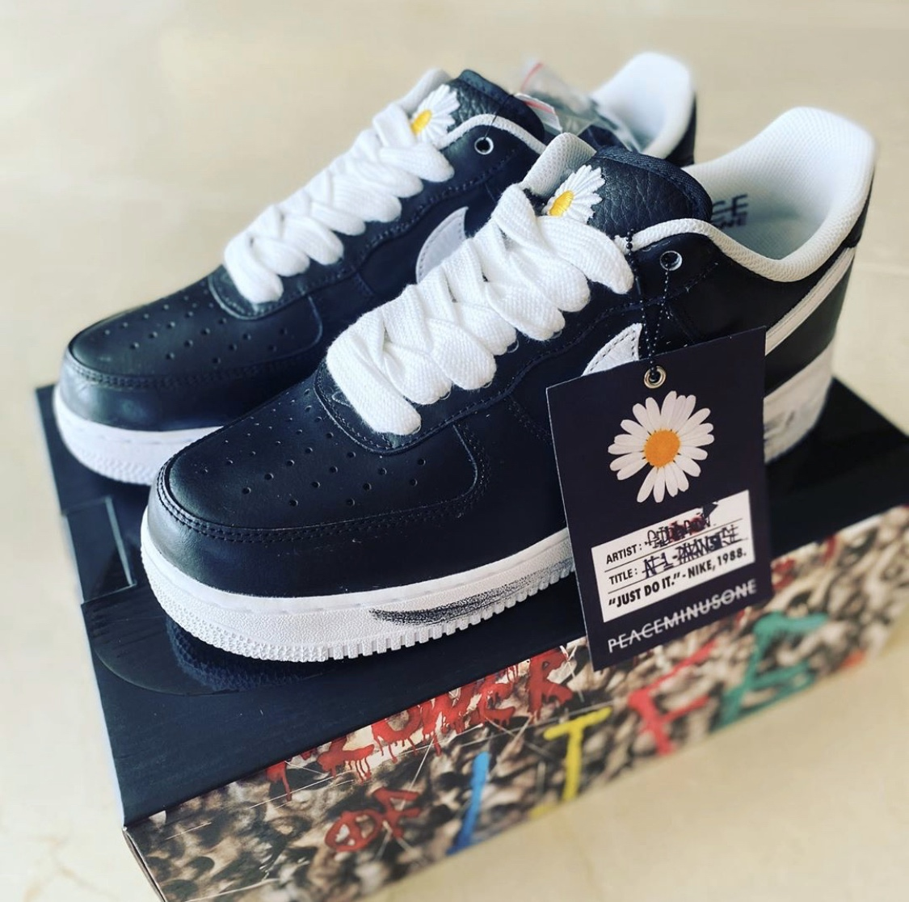
Fashion show 조세호
https://www.youtube.com/watch?v=Wo0Fvyy-POU

Slide 11

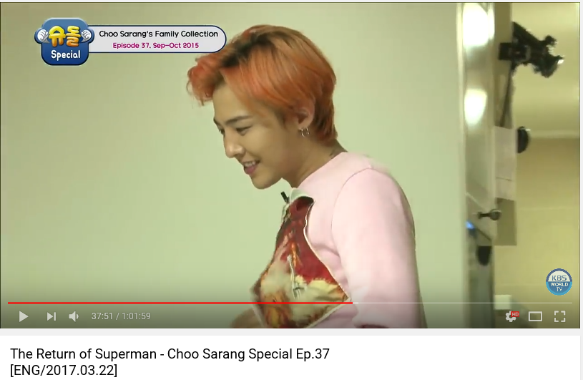
슈퍼맨이 돌아왔다 사랑이 29:41
https://www.youtube.com/watch?v=urcP504U5wk

Slide 12
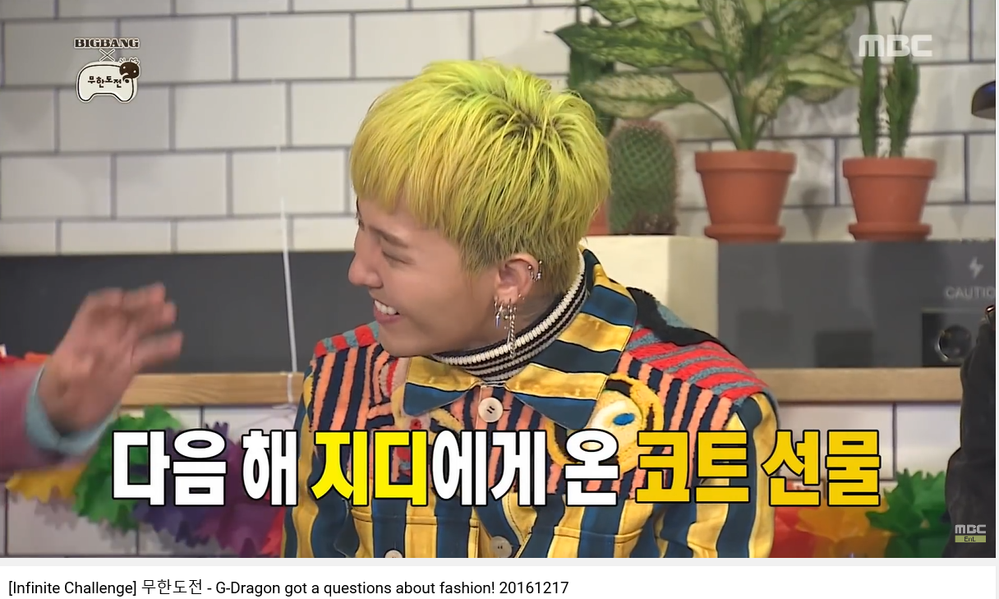
무한도전
https://www.youtube.com/watch?v=ywJpttrQdA8

Slide 13
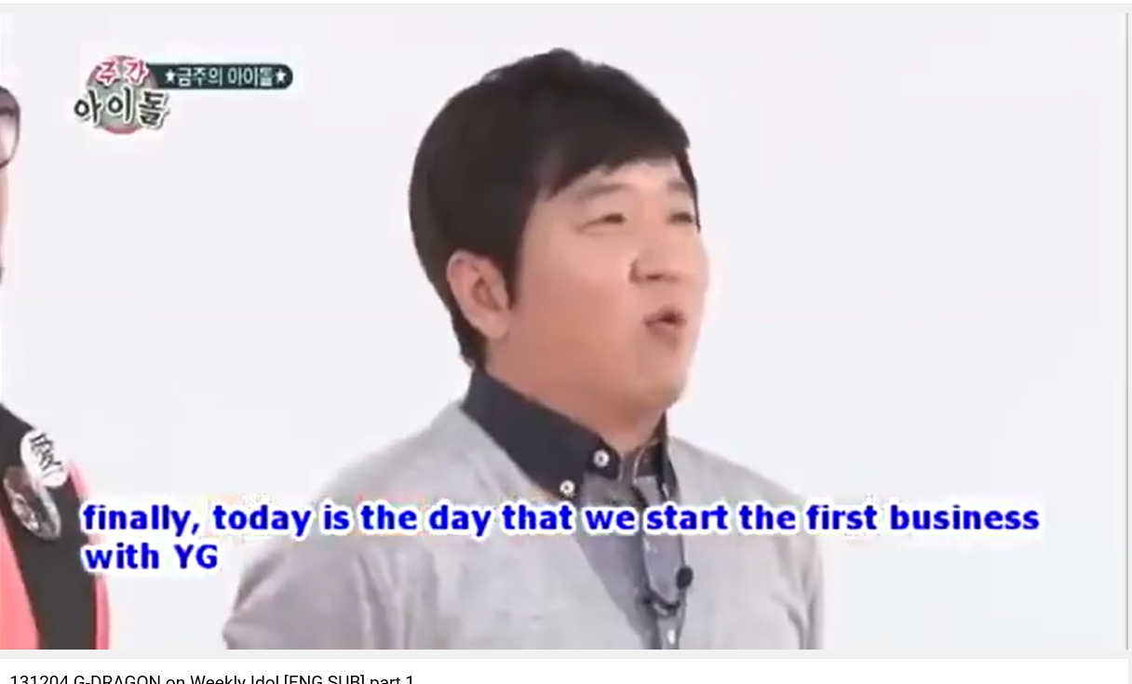
주간아이돌
https://www.youtube.com/watch?v=Zl9GvQ0qrT0

Slide 14
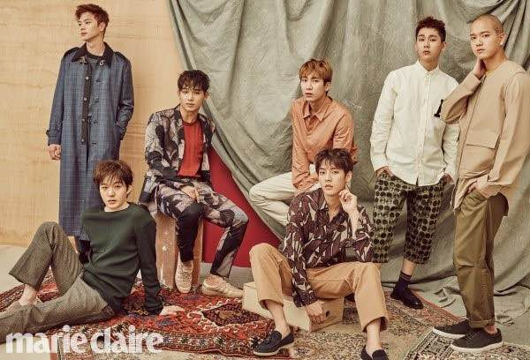
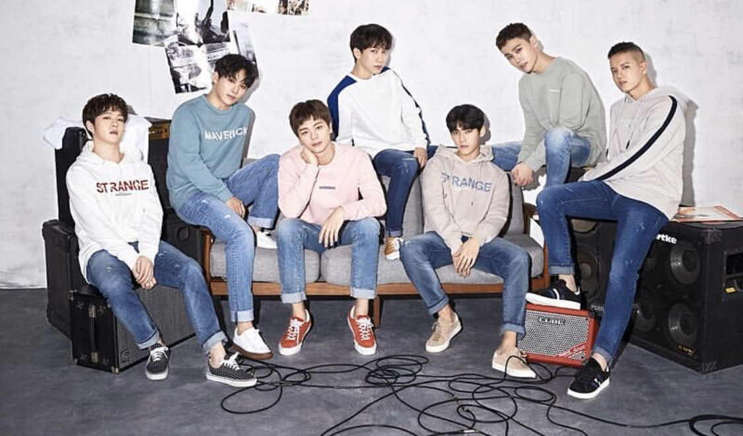
BTOB
Born TO Beat
Debut: 21.03.2012
Fandom: Melody
Famous songs:
I can’t live without you
Miss you
Beautiful but sick
MOVIE

Slide 15
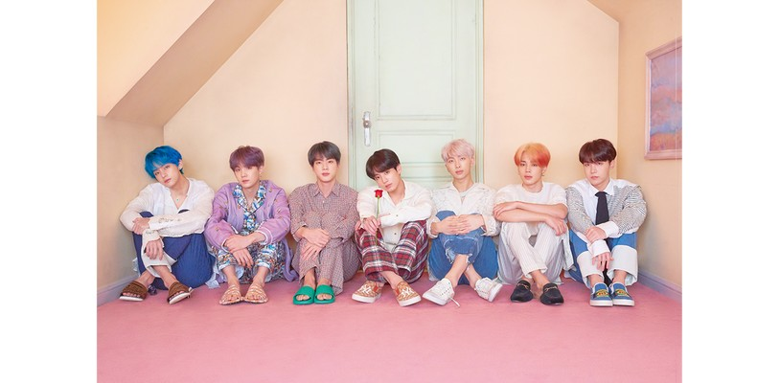
BTS

