Slide 1
The Story of Hare and Turtle :
The Hare Went to the Sea

Slide 2
Index
The Story of Hare and Turtle
The Pansori Version
The Modernized Version

Slide 3
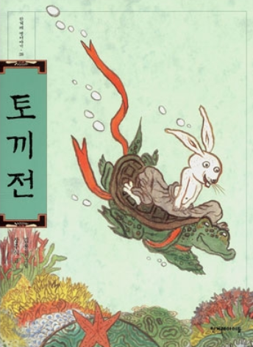
The Story of Hare and Turtle
토끼전
토끼 = Rabbit, Hare
전 = Old story
Fable with turtle and rabbit

Slide 4
Let’s Read

Slide 5
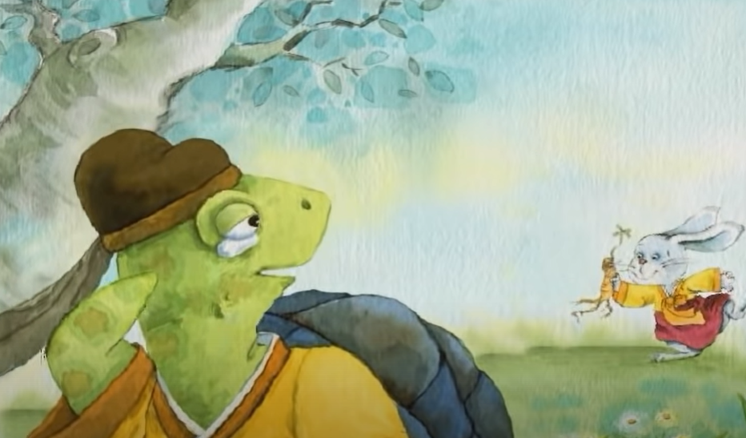
The Story of Hare and Turtle
In this story, the story ends …
The rabbit brings a wild ginseng to the turtle.

Slide 6


The Story of Hare and Turtle
There exists various endings such as …
The turtle failed to get a medicine
and the king passed away.

Slide 7
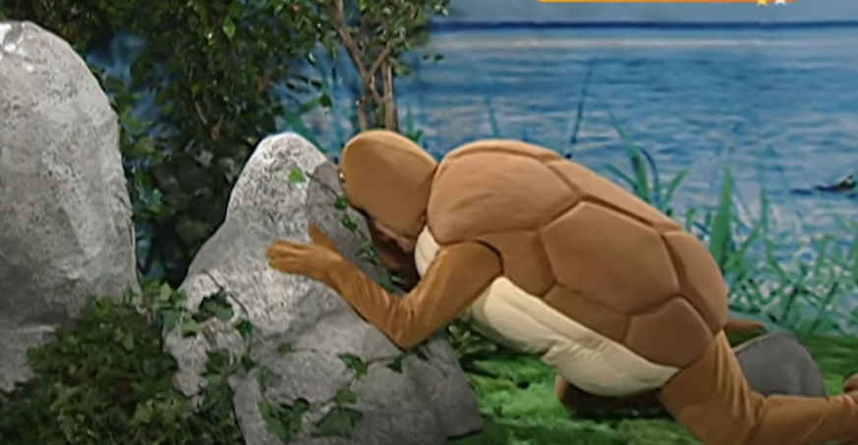
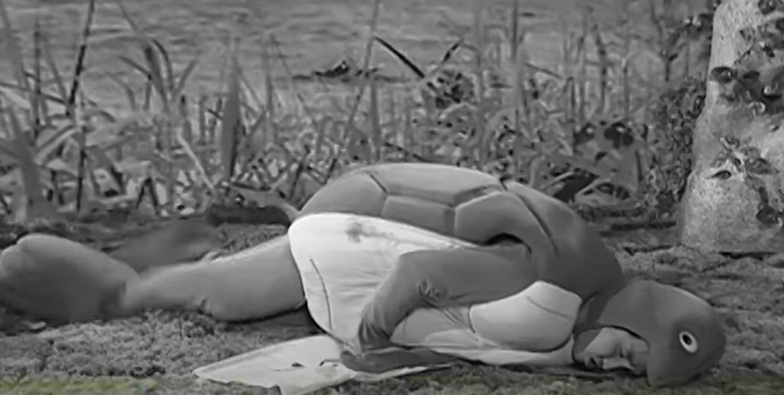
The Story of Hare and Turtle
There exists various endings such as …
The turtle crushed his own head
to the stone and died.

Slide 8
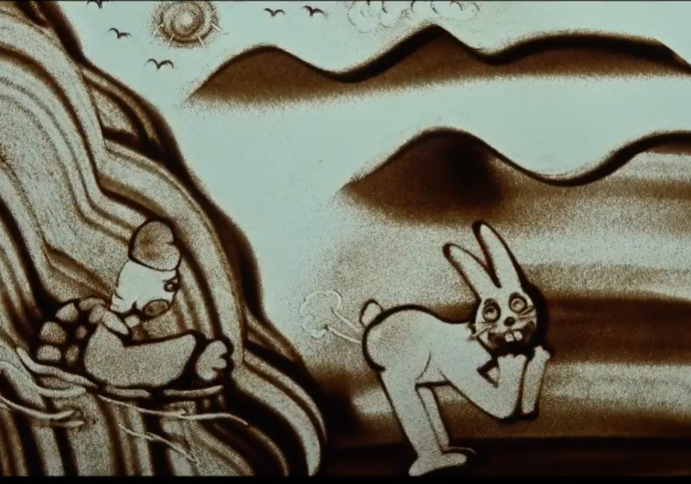
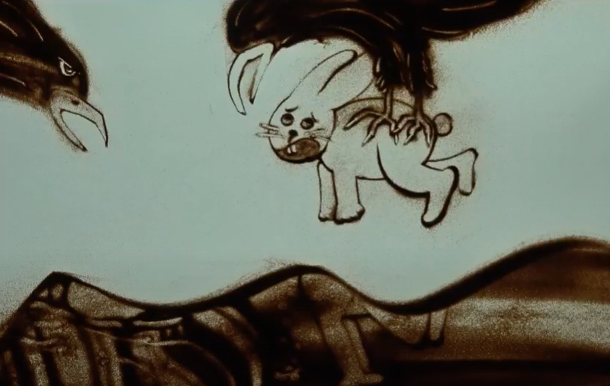
The Story of Hare and Turtle
There exists various endings such as …
The Hare was so happy to run away that she couldn’t notice the eagle approaching and got caught.

Slide 9
Historical Backgrounds
An old folk tale (mouth-to-mouth) :
The first document to include ‘The Story of Hare and Turtle’ was 삼국사기 (Sam gook sagi), which was published in 1145.

Slide 10
Historical Backgrounds
Pansori-based novel :
The story was widely spread in the late Joseon Dynasty(18-19C), through the form of Pansori, then recorded in letters.

Slide 11
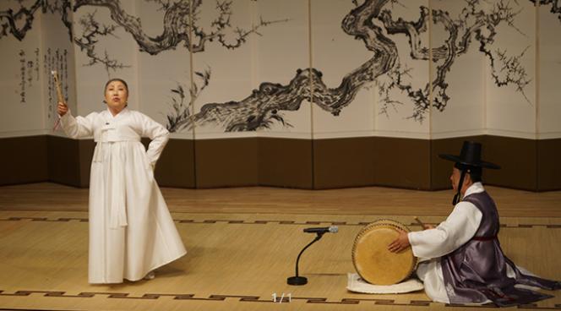
What is 판소리 (Pansori) ?
판 = place where people gather together and enjoy performance
소리 = generally means ‘sound’, can be used to indicate korean traditional vocal music

Slide 12
판소리
(Pansori)
is Korean traditional music genre,
Which presents story in the form of singing

Slide 13
About 판소리 (Pansori)
Consists of 창(Singing a song) and 아니리(Telling stories).
Perfomed by one 소리꾼(Story Teller) and one 고수(Drummer).

Slide 14

Pansori Version of the Story
Generally Pansori has its title ending with –가,
Which means ‘song’
The title for Pansori Version of 토끼전 (The Story of Hare and Turtles) is 수궁가

Slide 15
Let’s Listen
https://youtu.be/j4FmROgbjuI?t=60

Slide 16
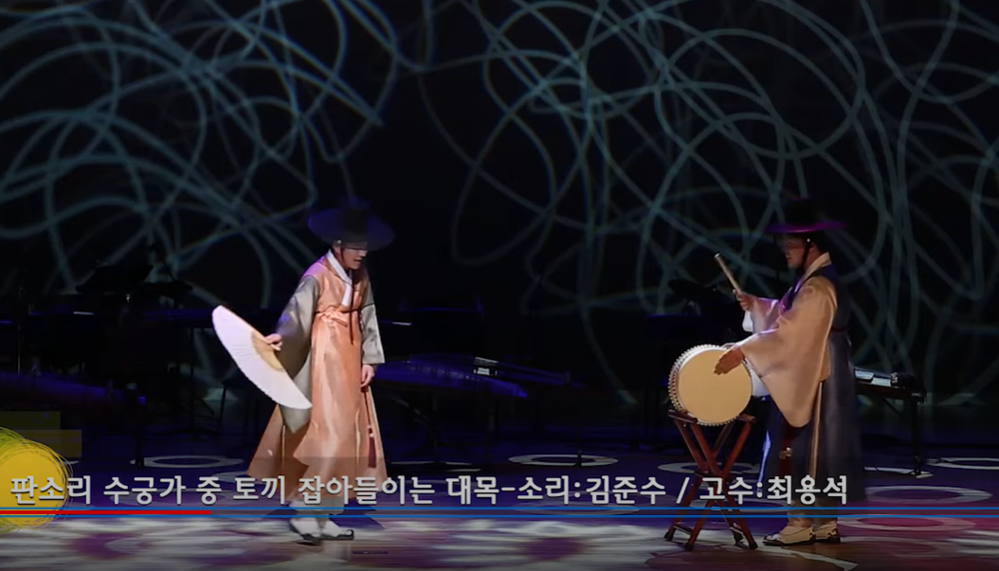
판소리 수궁가 (Pansori Sugungga)
The scene is about when the rabbit was caught by other marine palace soldiers
소리꾼(Storyteller) doing 창(Singing a song) and 아니리(Telling stories), 고수(drummer) also participating

Slide 17
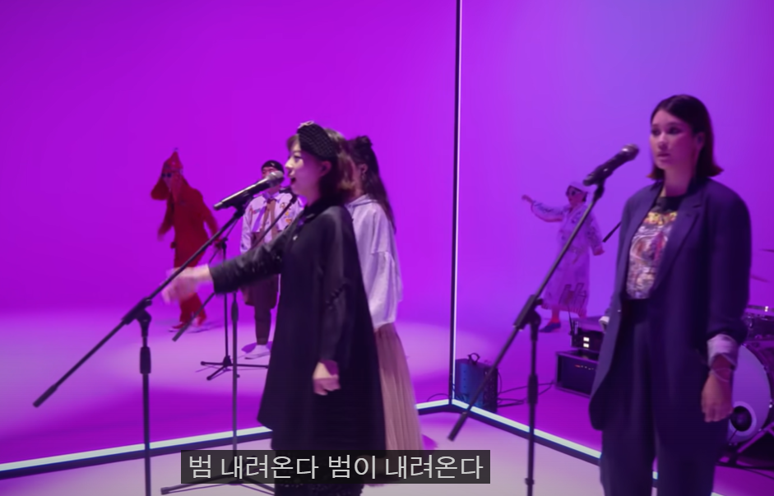
Modernized Pansori
An attempt to fuse Pansori and contemporary music.
Band Inalchi’s song made a hit : 범 내려온다 (Tiger Comes Down) from Pansori Sugungga

Slide 18
Let’s Listen
https://youtu.be/B_X7n0AaLqA

Slide 19
Thank You

