Slide 1
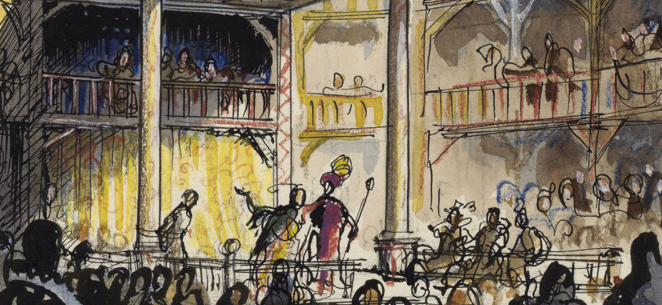
Elizabethan Theatre
Filip Krajník Masaryk University

Slide 2
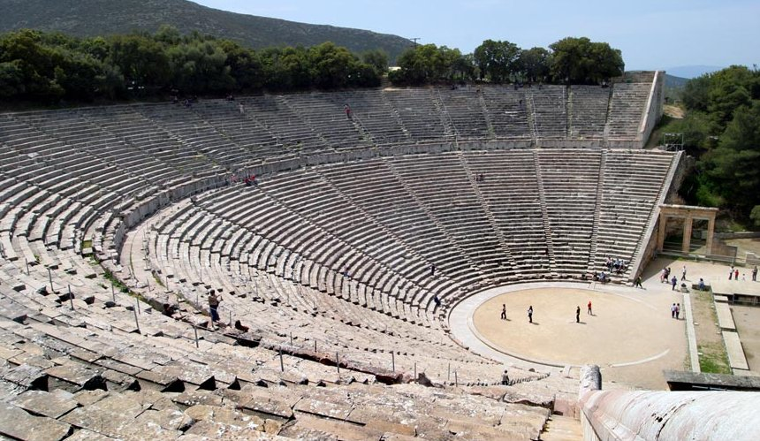
Birth of Drama in Europe
Ancient Greece (6th cent. BC)

Slide 3
Greek Drama
Tragedy
- Aeschilus, Sophocles, Eurepides
Comedy
- Aristophanes
Satyric play
- Sophocles, Eurepides
Aristotle’s Poetics (Περὶ ποιητικῆς, 335 BC)
– first treatise on dramatic (and literary) theory

Slide 4
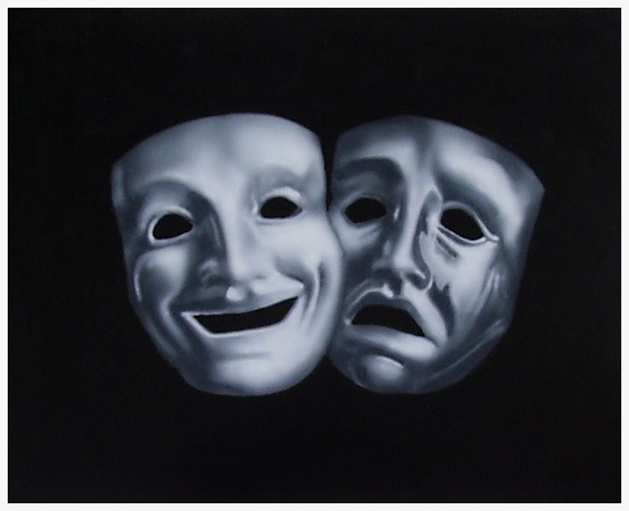
Roman Drama
Tragedy
- Seneca (4 BC-AD 65)
Comedy
- Plautus (254-184 BC)

Slide 5
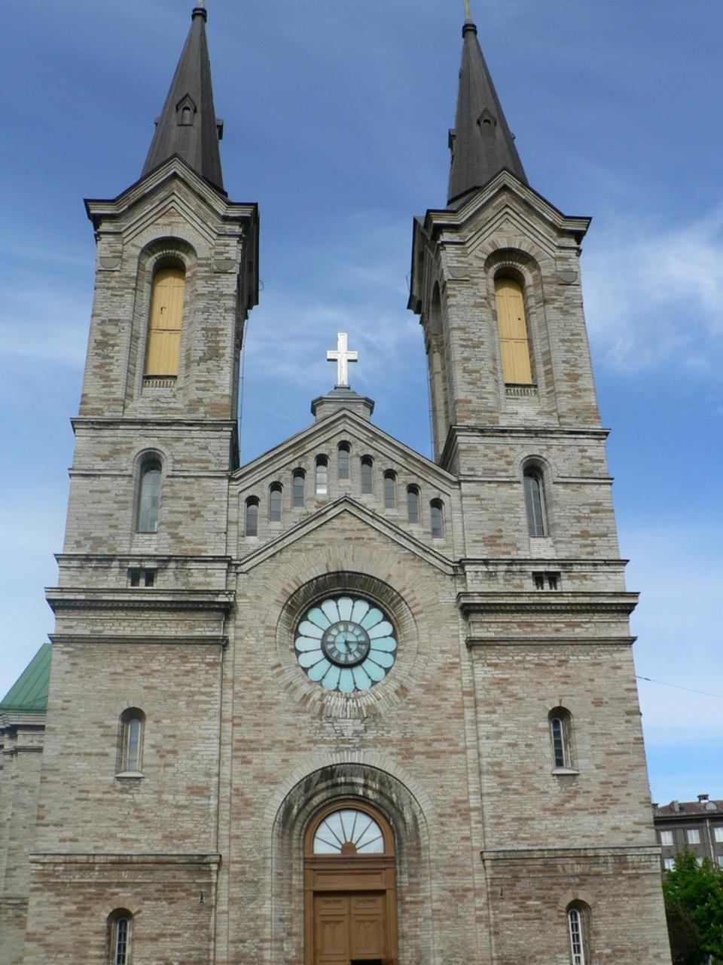
Medieval Theatre (9th cent. AD)
Celebration of principal Christian feasts
Biblical material – re-enacting popular stories of Christian myth

Slide 6
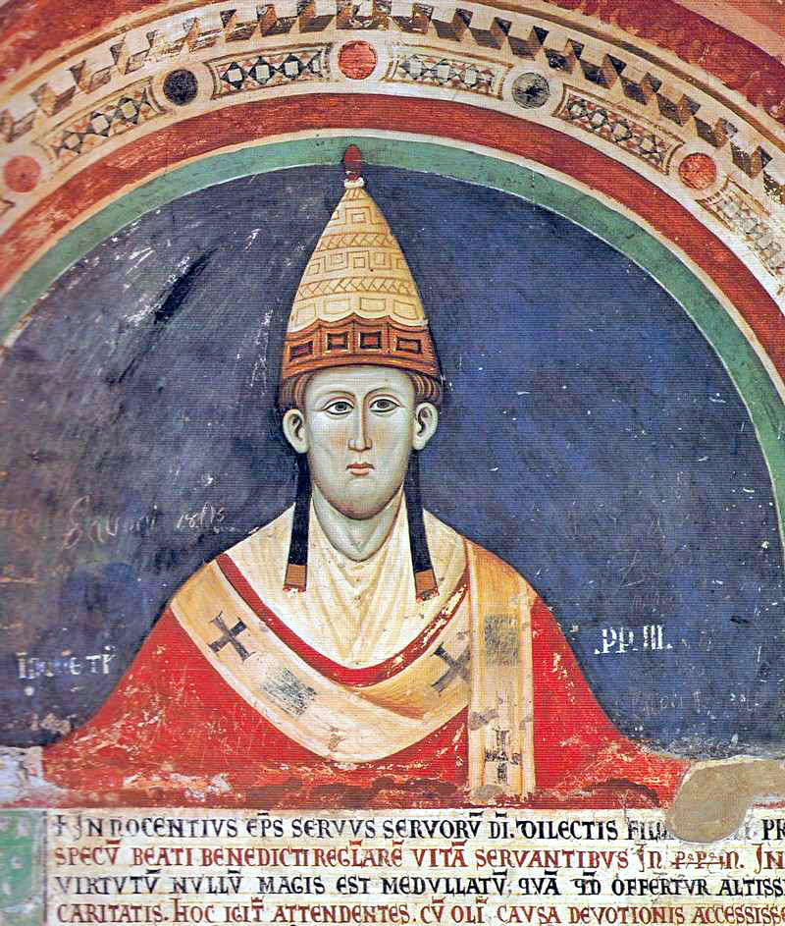
Medieval Theatre
Innocent III (1198–1216)

Slide 7
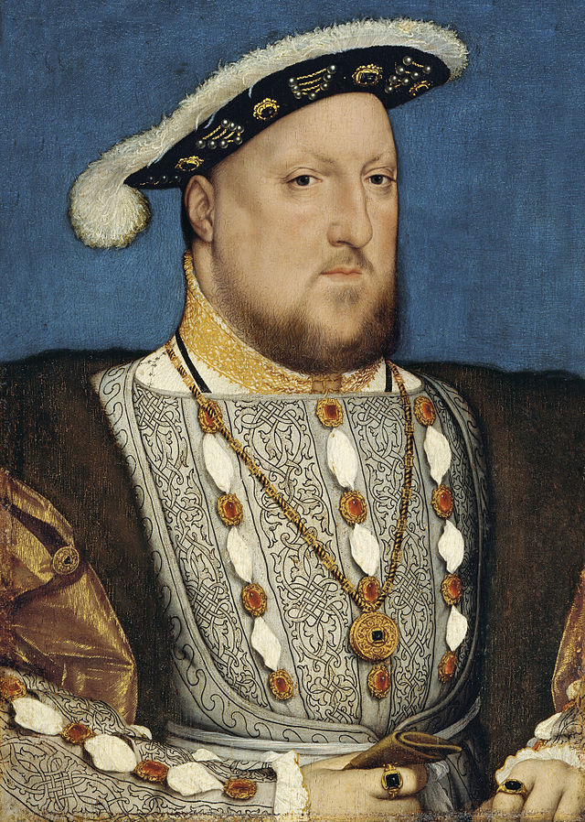
Early-Modern English Theatre
Henry VIII (1509–1547)

Slide 8
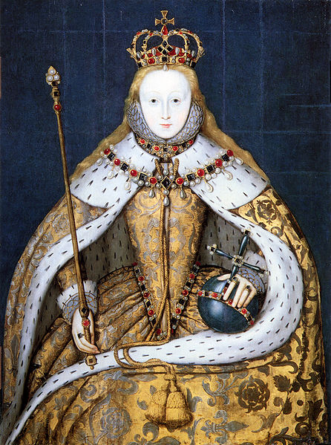
“Elizabethan” Theatre
Elizabeth I (1558–1603)

Slide 9
“Elizabethan” Theatre
The Vagabonds Act of 1572:
… all fencers, bear-wards, common players of interludes, and minstrels wandering abroad (other than players of interludes belonging to any baron of this realm, or any other honourable personage of greater degree to be authorised to play, under the hand or seal of arms of such baron or personage) shall be taken, adjudged, and deemed as rogues-vagabonds…

Slide 10
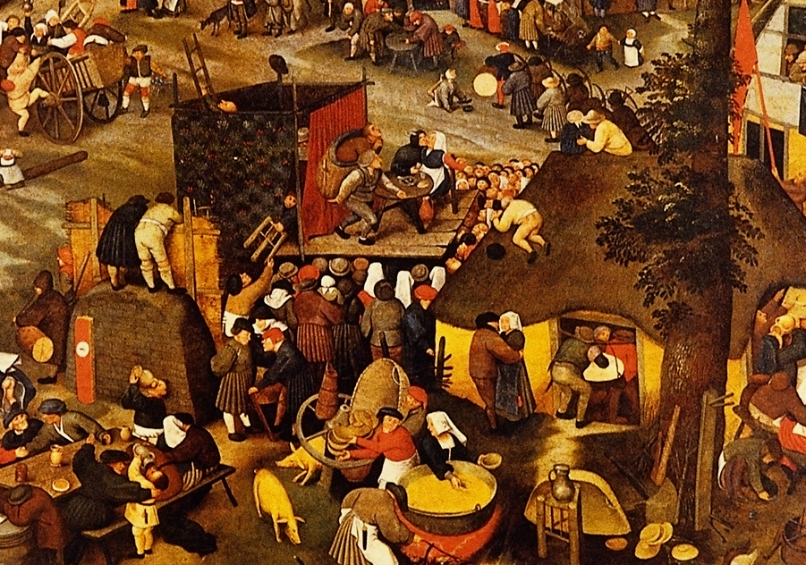
Medieval Theatre
A Village Fair (Pieter Breugel the Younger, 1632)

Slide 11
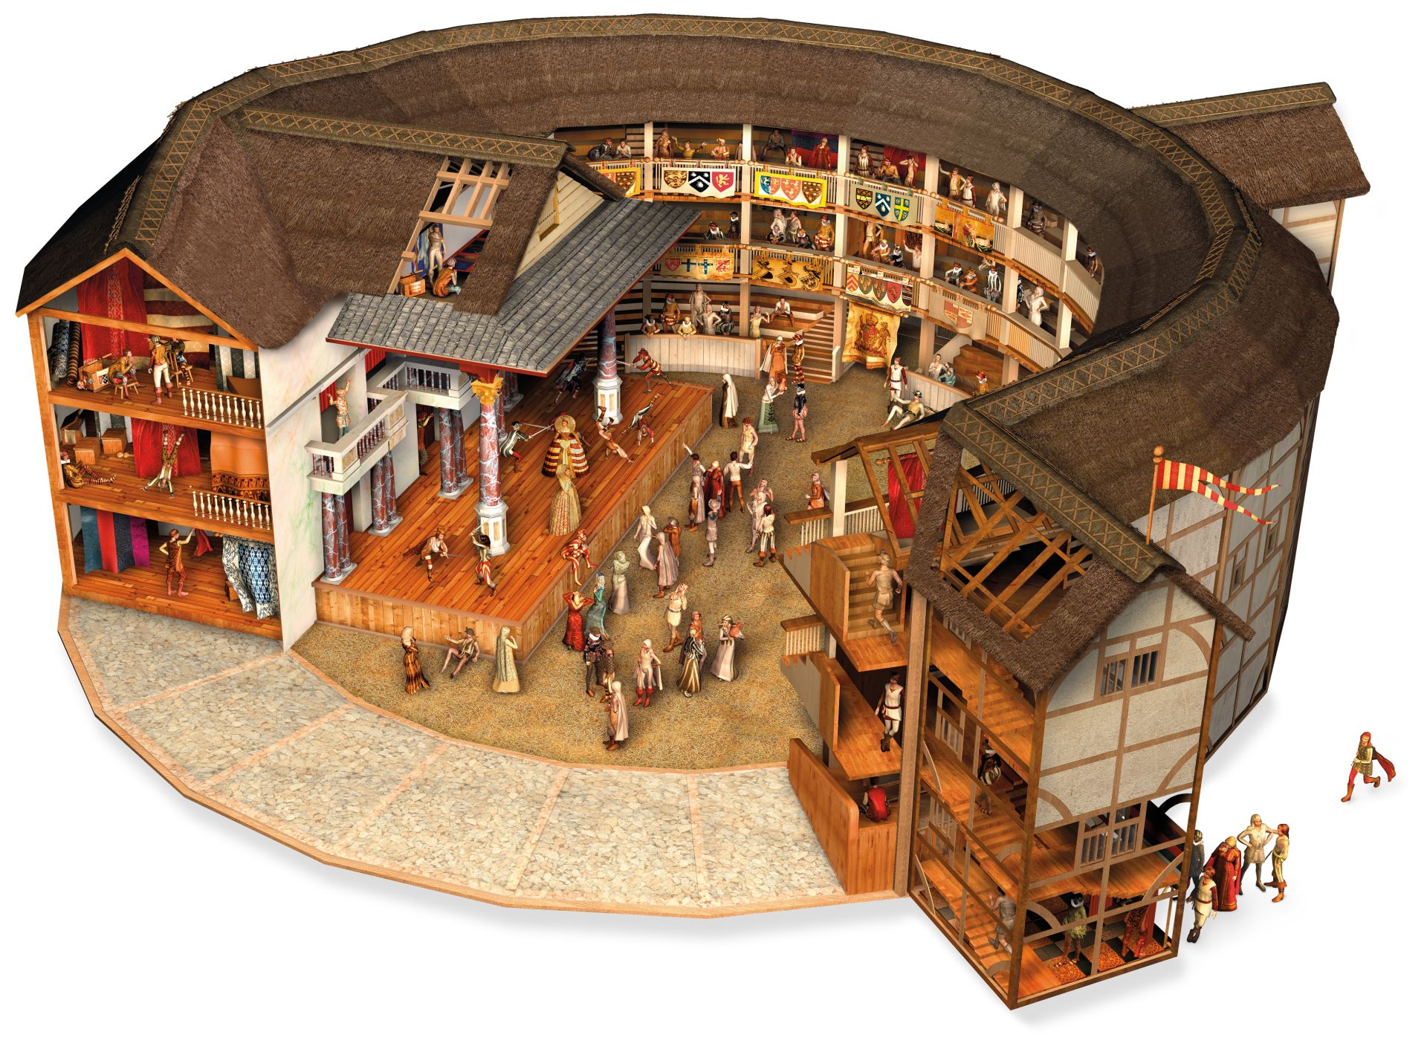
Early-Modern Playhouses
Globe Theatre (1599–1613, 1614–1642)

Slide 12
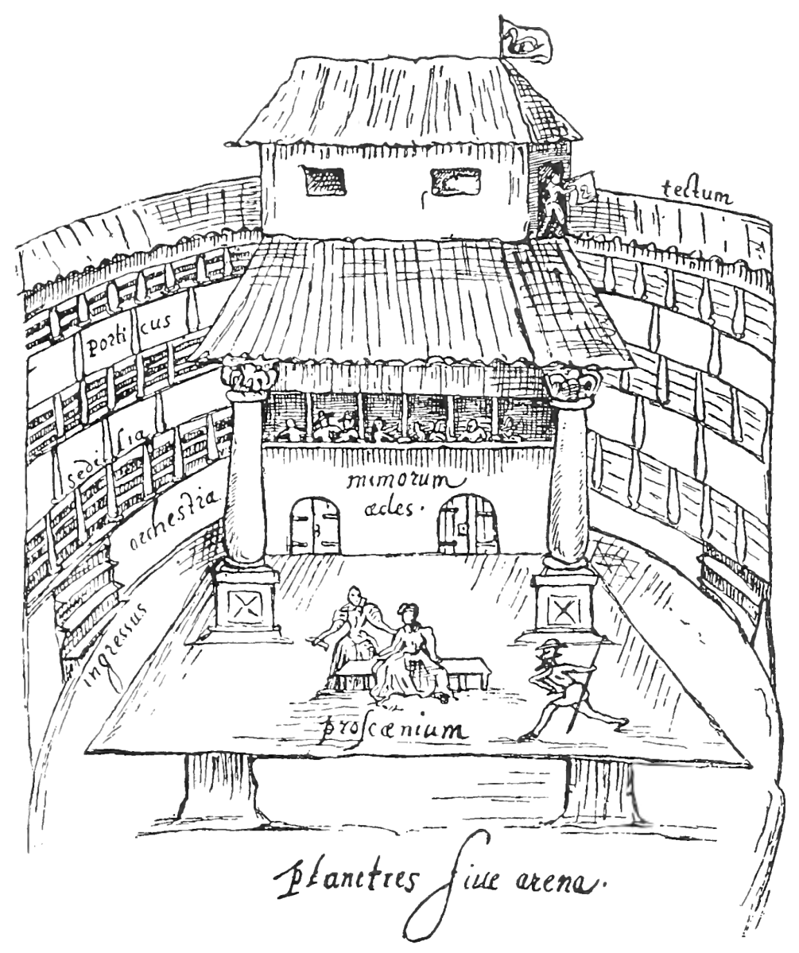
Early-Modern Playhouses
Swan Theatre (Johannes de Witt , 1596)

Slide 13
Early-Modern Playhouses
From A Midsummer Night’s Dream:
Quince. Pat, pat; and here’s a marvellous convenient place for our rehearsal. This green plot shall be our stage, this hawthorn-brake our tiring-house; and we will do it in action as we will do it before the duke.
(Act 3, Scene 1)

Slide 14
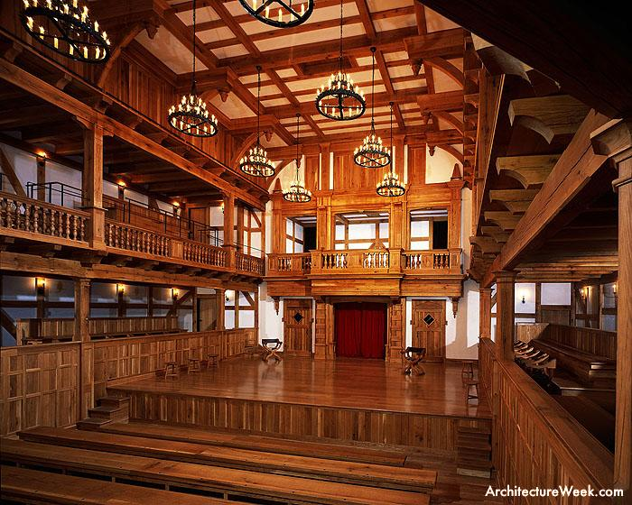
Early-Modern Playhouses
Blackfriars Theatre, a reconstruction (1608–1642)

Slide 15
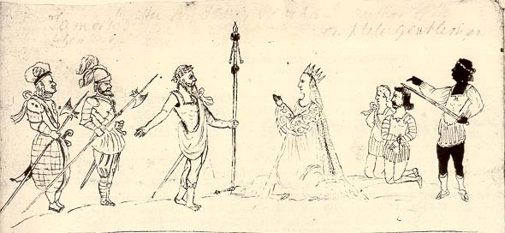
Early-Modern Costumes
A scene from Titus Andronicus (ca 1594)

Slide 16
Early-Modern Acting Companies
Lord Chamberlain’s Men/King’s Men (1594–1642):
ca 8 core actors (26 in total by 1623)
ca 8 hired men (minor parts)
4–6 boys (apprenctices)
musicians
Hamlet. He that plays the king shall be welcome; his majesty shall have tribute of me; the adventurous knight shall use his foil and target; the lover shall not sigh gratis; the humourous man shall end his part in peace; the clown shall make those laugh whose lungs are tickled o’ the sere; and the lady shall say her mind freely, or the blank verse shall halt for’t.
(Hamlet, Act 2, Scene 2)

Slide 17
Early-Modern Character-Types

Slide 18
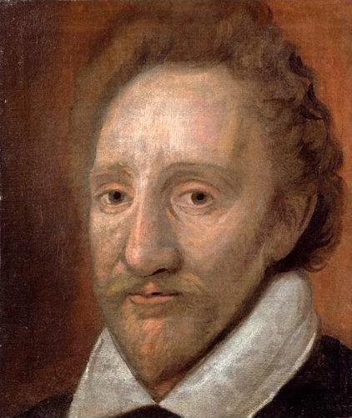
Early-Modern Actors
Richard Burbage (1568–1619)

Slide 19
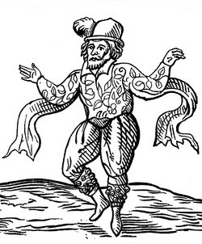
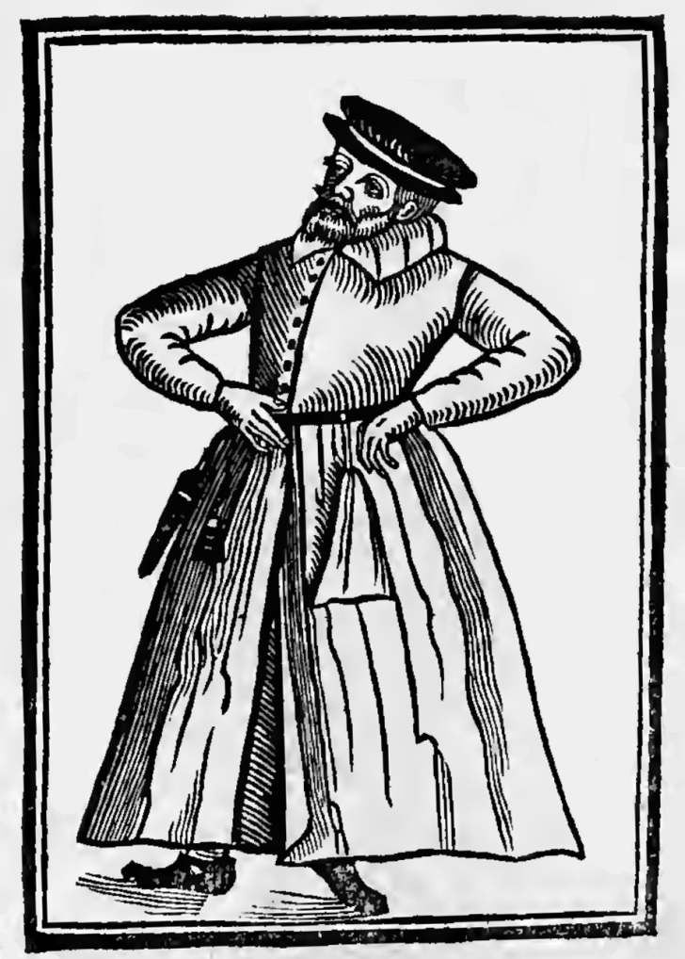
Early-Modern Actors
Will Kemp (1560?–1603?)
Robert Armin (1568?–1615)

Slide 20
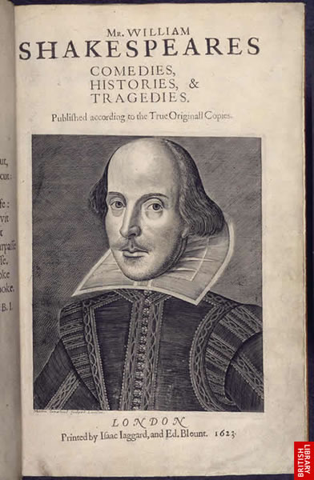
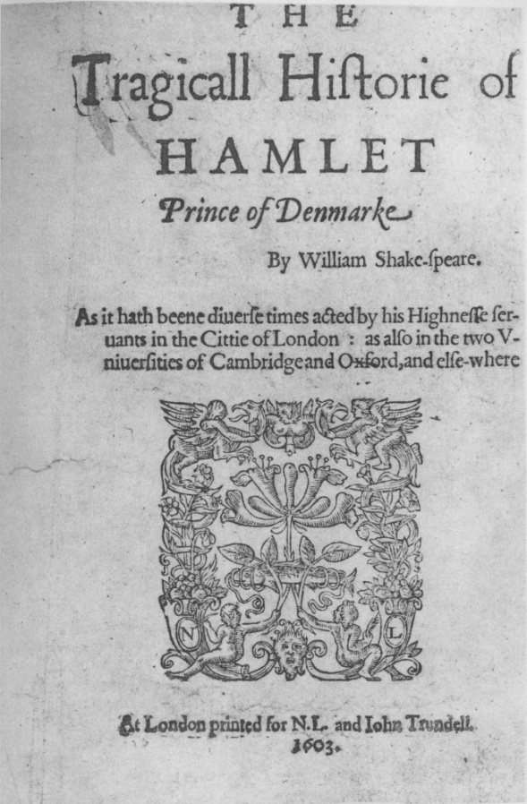
Shakespeare in Print
Shakespeare’s F1 (c. 30x38 cm) Q1 of Hamlet (c. 24x30 cm)

Slide 21
Hamlet: Quartos vs. Folio
Hamlet (1603, “First Quarto”)
Hamlet (1604/5, “Second Quarto”)
Hamlet (1623, “First Folio”)

Slide 22
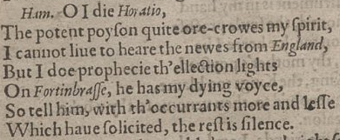
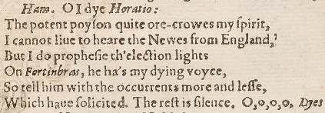
Hamlet: Quartos vs. Folio
Hamlet (1604/5, “Second Quarto”)
Hamlet (1623, “First Folio”)

Slide 23
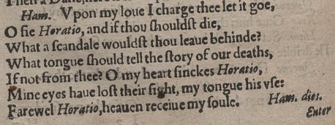
Hamlet: Quartos vs. Folio
Hamlet (1604/5, “Second Quarto”)
Hamlet (1603, “First Quarto”)

Slide 24
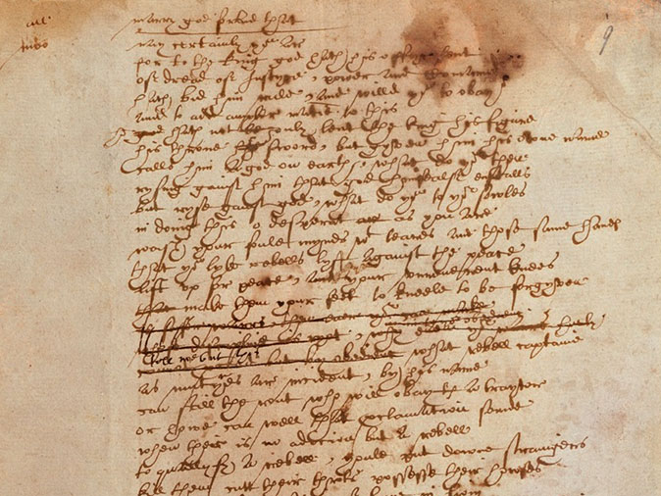
Shakespeare’s Manuscript
“Hand D” in Sir Thomas More

Slide 25
“Elizabethan” Genres
From Hamlet:
Polonius. The best actors in the world, either for tragedy, comedy, history, pastoral, pastoral-comical, historical-pastoral, tragical-historical, tragical-comical-historical-pastoral, scene individable, or poem unlimited: Seneca cannot be too heavy, nor Plautus too light. For the law of writ and the liberty, these are the only men.
(Act 2, Scene 2)

Slide 26
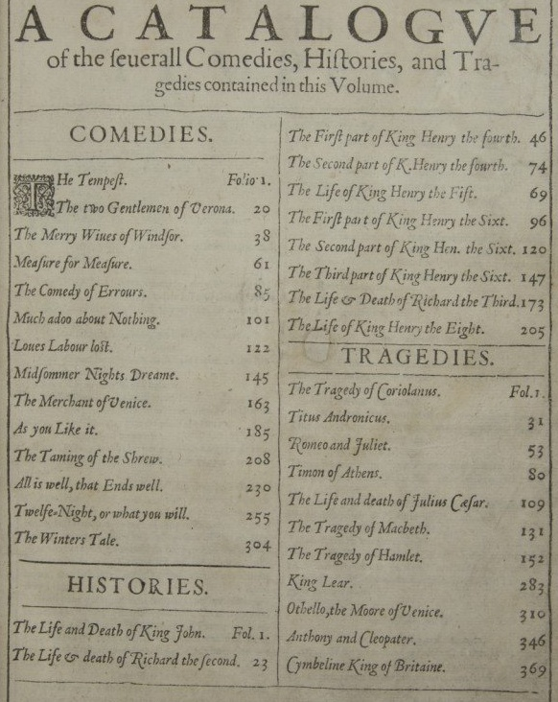
“Elizabethan” Genres

Slide 27
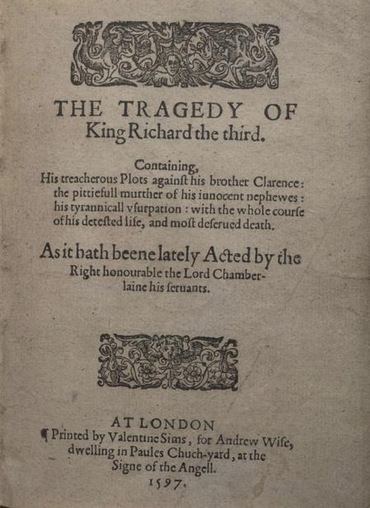
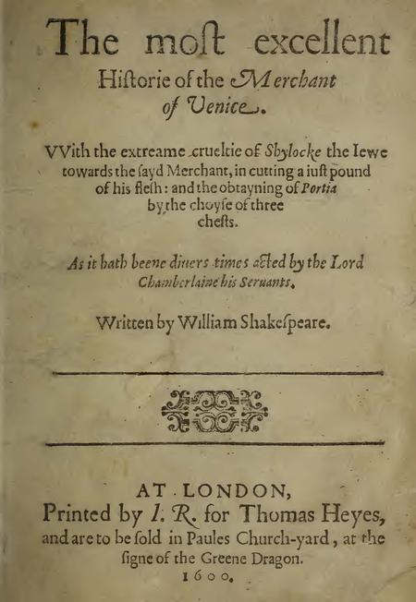
“Elizabethan” Genres

Slide 28
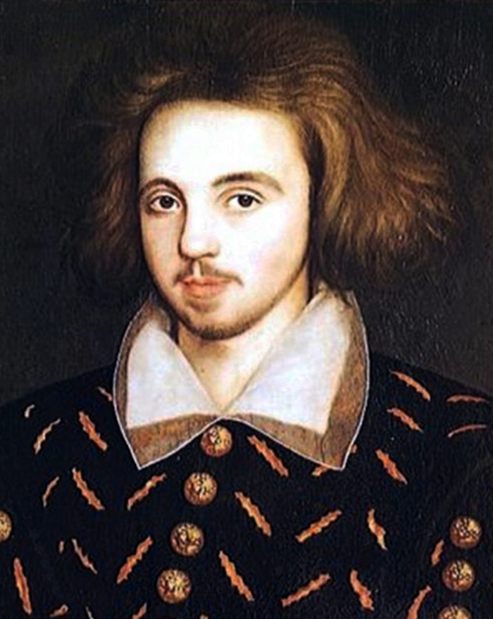
Early-Modern English Playwrights
Christopher Marlowe (1564–1593)

Slide 29
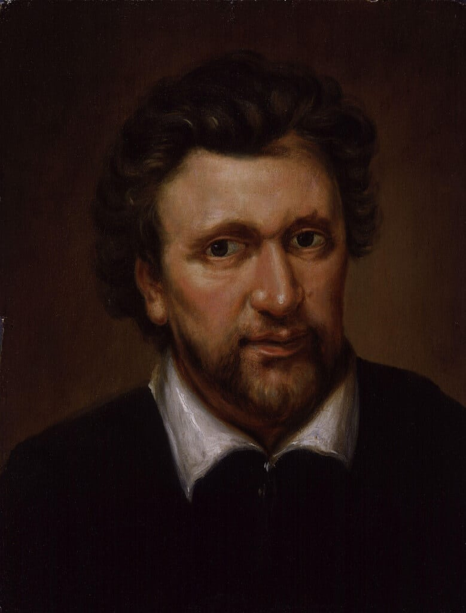
Early-Modern English Playwrights
Ben Jonson (1572–1637)

Slide 30
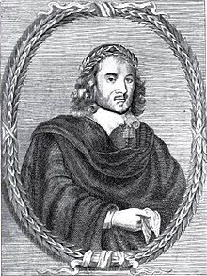
Early-Modern English Playwrights
Thomas Middleton (1580–1657)

Slide 31
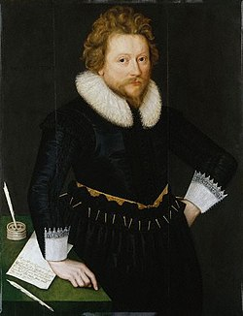
Early-Modern English Playwrights
John Fletcher (1579–1625)

Slide 32
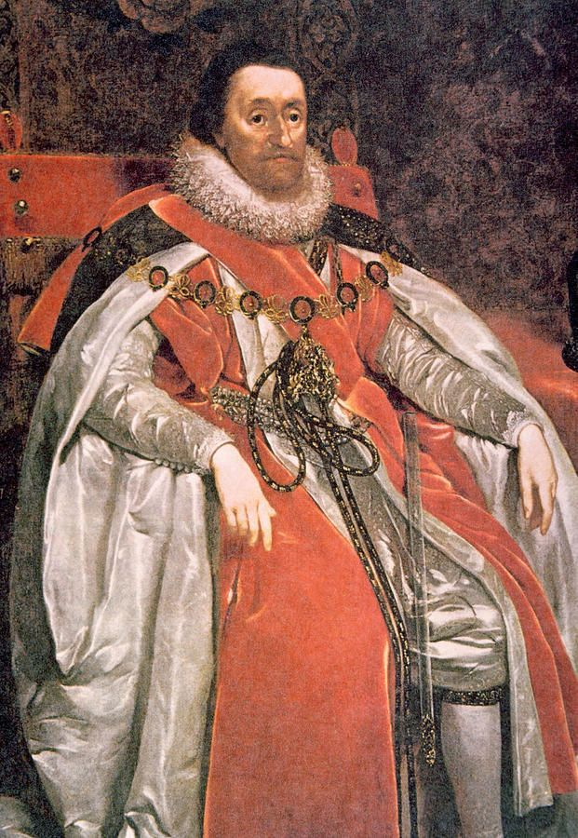
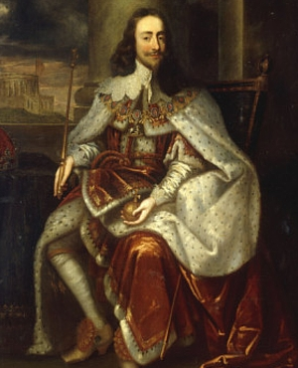
“Jacobean” and “Caroline” Theatre
James I (1603–1625)
Charles I (1625–1649)

Slide 33
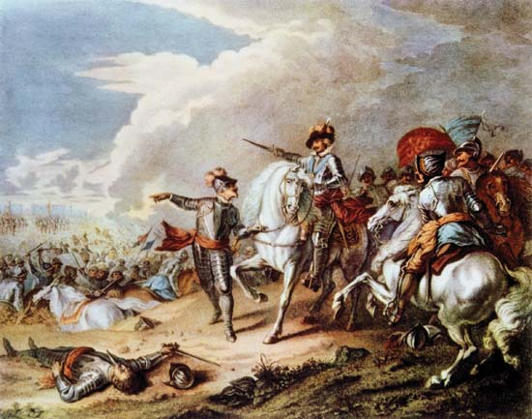
The End of Early-Modern English Theatre
September 2nd, 1642 – an edict closing all the public and private theatres “to appease and avert the wrath of God”

