Slide 1
AMERICAN VOICES
Based on Wolfram and ward

Slide 2
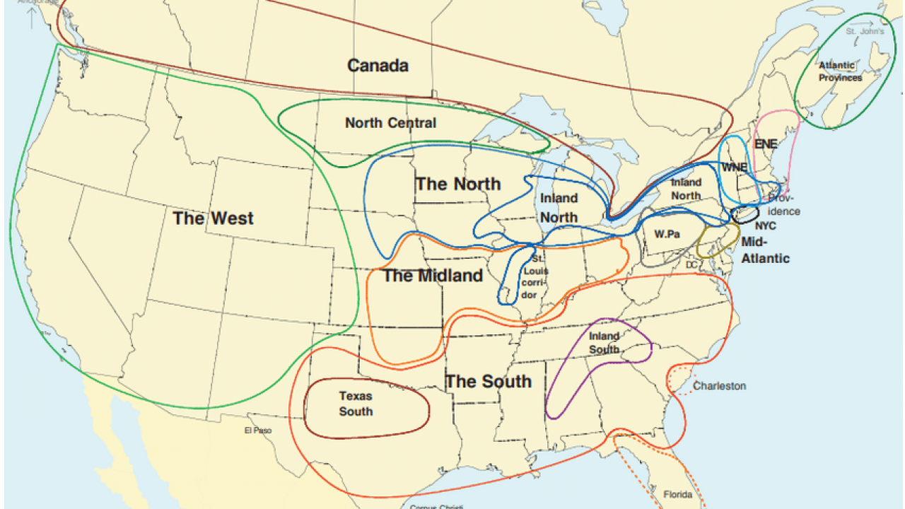

Slide 3
Stereotypes and perceptions
Often unaccurate and unflattering but useful.

Slide 4
A perceptions quiz:
Guess which accents are being so perceived:
Yakking with the yankees New England; to speak in a lengthy, boring way
Beantown babble Boston, ma
Mainely english lobster
Ny tawk
More than just yada yada yada sociocultural dialect
Steeltown speak pittsburgh, pa
Expressions of brotherly love philadelphia, pa

Slide 5
A perceptions quiz:
Guess which accents are being so perceived:
Fading future for forhoodled english pennsylvania dutch (=german)
Maple leaf rap ppp tpscrpt 53
From cod to cool newfoundland, canada
Words of the windy city chicago, il
Talking in the buckeye state ohio
Saying ya to the yoopers michigan‘s upper peninsula
The potato state ppp tpscpt 52 kentucky

Slide 6
A perceptions quiz:
Guess which accents are being so perceived:
Bridging the great divide aave
Doing the charleston south carolina
The lone star state (of speech) PPP tpscrpt 51 texas
Talkin‘ with mi gente sociocultural dialect chicano english
Speaking the big easy new orleans, la
Stirring the linguistic gumbo sociocultural dialect called cajun based on french

Slide 7
A perceptions quiz:
Guess which accents are being so perceived:
Getting real in the golden state california
Desert dialect utah
Dialects in the mist portland, or
Arizona‘s not-so-standard english

Slide 8
Traditional dialects X CHANGING TRENDS
Factors affecting these changes:
- immigration
- language contact within the US
- transportation and communication networks
- changes in social structure
- changes in cultural values
Important dialect changes are initiated in the suburbs, often by young speakers
Dialect endangerment: a distinctive variety spoken by relatively small numbers of people is overwhelmed by mainstream dialects
Traditional dialect divisions:
- Reflect differences established in Colonial America
- Major dialect boundaries are still persistent
Current changes in vowel pronunciation :
- Northern cities (Chicago, Detroit, etc.): caught – cot, lock – lack, tack – tech; they sound alike
- Southern cities: red – raid, fish – feesh; sound alike

Slide 9
SOUTHERN DIALECT
Southern American English (SAE) is the most widely recognized regional dialect of American English, but is also most negatively evaluated → negative stereotypes and linguistic discrimination
exaggerated portrayals in movies (Gone with the Wind)
features:
- y‘all, fixin‘ (meaning intending)
- using more modals for politeness (I might could leave work early today, might should oughta)
- merging vowels: pen – pin, ten – tin
- „Southern Shift“: the vowel in way, stayed sounds like the one in father
the diffusion of these features is most likely caused by the urbanization process; migration to towns → contact among formerly local dialects → the spreading of dialects

Slide 10
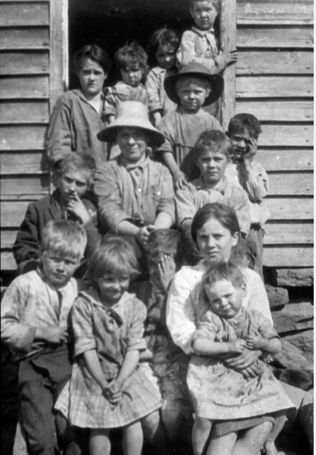
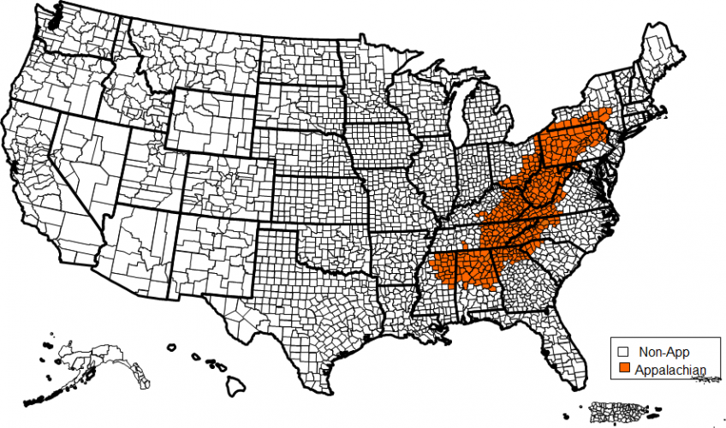
APPALACHIAN ENGLISH
Southern American English (SAE) is the most widely recognized regional dialect of American English, but is also most negatively evaluated → negative stereotypes and linguistic discrimination
exaggerated portrayals in movies (Gone with the Wind)
features:
- y‘all, fixin‘ (meaning intending)
- using more modals for politeness (I might could leave work early today, might should oughta)
- merging vowels: pen – pin, ten – tin
- „Southern Shift“: the vowel in way, stayed sounds like the one in father
the diffusion of these features is most likely caused by the urbanization process; migration to towns → contact among formerly local dialects → the spreading of dialects

Slide 11
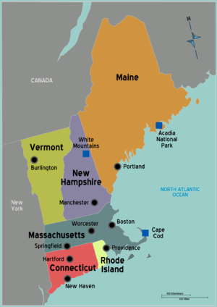
YAKKING WITH THE YANKEES (NEW ENGLAND)
Specific vocabulary relating to nautical terms or gastronomy (hamburg - ground beef, tonic - carbonated drink)
Pronunciation:
- Dropping of post-vocalic r (cah for car, bahn for barn, Woosta for Worcester)
- distinction between for x four, horse x hoarse
- Vermont: cow pronounced like kyou, kite like koit ; glottal stop
- many differences among the states and ages
Traditional dialects remain in rural areas and areas with many local people; however, due to immigration, some of the traditional features are disappearing

Slide 12

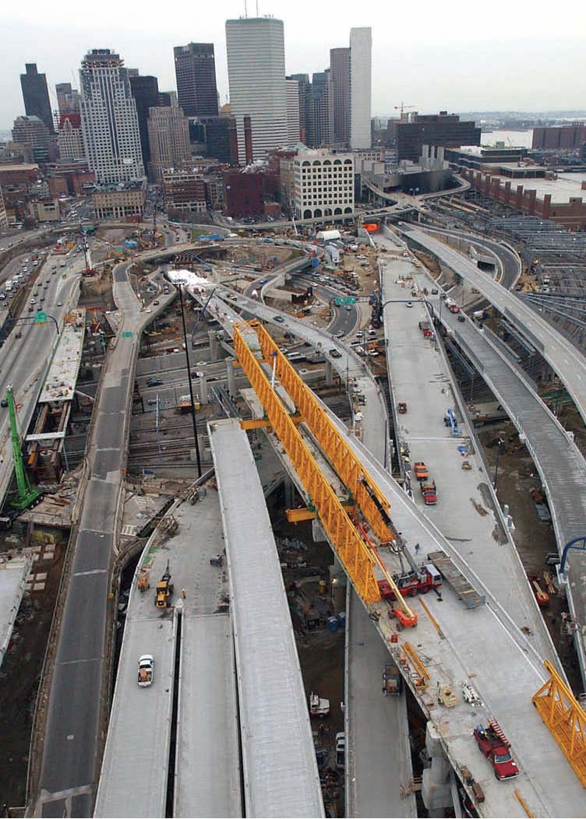
Beantown babble (boston, ma)
Boston accent represented in Good Will Hunting
Pronunciation:
- non-rhotic (Pahk the cah ) but they use the intrusive r (the idear of it)
- broadened and lowered vowels (bahthroom)
- merging of cot – caught
Distinctive vocabulary (That‘s wicked pissa! = very good, bubbler – water fountain, So don‘t I – So do I)
First group of settlers – English Puritans, later many immigrants
Dialect variation among ethnic groups (Jewish people – more rhotic, Italians – non-rhotic
The Big Dig (a notoriously slow construction project in Boston)

Slide 13
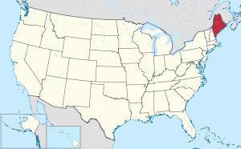
Mainely english (maine)
Word plays – Maine included in business names, etc. (Project Mainestay, Mainely Audio, Maine-iacs)
Due to historical reasons, many people still speak French; French strongly influenced English (French sentence structures, pronunciation, vocabulary…)
Pronunciation:
- Mostly non-rhotic, but the r is replaced with a vowel sound → sounds like the words (door, frontier, etc.) have an extra syllable, sometimes spelled as ah (lobstah, bumpah)
- the –ing (sleeping, running) may be pronounced as n instead of ng
- unstressed syllables in the middle of a word tend to be dropped (prob‘ly, Sad‘dy for Saturday)
- merging of cod-caught
Vocabulary: junk of wood – piece of wood, cunnin‘ – cute, foolishness – something annoying or stupid

Slide 14

NEW YORK TAWK (NY)
New Yorkers tend to be quite conscious of their accent, sometimes trying to limit it or get rid of the features which would give it away (especially the r sound)
NY accent is used by many classes, generations and ethnic groups
A center of pop culture and rap → spreading of terms like da bomb and others
Non-rhoticity is, however, only viewed negatively when combined with other features
- the vowel sound aw in all, coffee, caught, saw; no difference between shore-sure
a lot of ‚Yiddishisms‘ in vocabulary – schlep (to travel or carry something an annoying distance) etc.
Franklin Roosevelt: Americans „have nothing to fear [fee-uh] but fear itself“

Slide 15

More than just yada yada yada (jewish english)
Group membership, a strong sense of community → reinforce shared dialect features
Two main varieties of Jewish English – Sephardim and Ashkenazim
Immigration waves: 1600s and late 1800s/early 1900s → brought Yiddish/Hebrew to America → these later combined with English
Vocabulary: kosher, bagel, kibitz, mensch, yarmulka
Yiddish words integrated into English through the usage of suffixes – shlepn (to drag, carry) → shleps, shlepped, shlepping; beatnik (Slavic -nik)
Vocabulary: names for holidays and celebrations, religious terms (bar mitzvah, kippah/yarmulka….)
Pronunciation:
- most closely associated with NYC
- pitch raising, strong hissing of s, hard g in –ing endings, intrusive r
- loudness, exaggerated intonation and gesture, fast rate of speech (all derived from Yiddish)
„Yiddish Movement“: a syntactic feature used to convey sarcasm – moving adjectives, adverbs or nouns to the beginning of the sentence and stressing it: Smart, he isn‘t.
Howard Stern

Slide 16
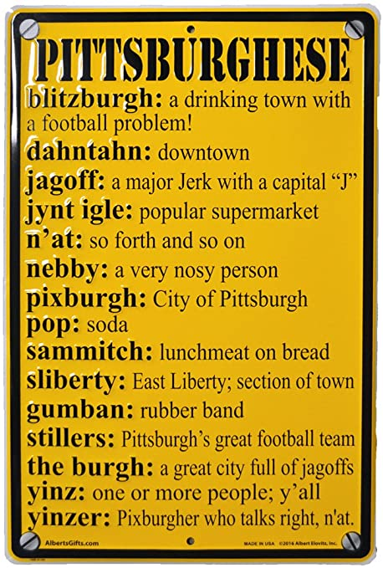
Steel town speak (pittsburgh, pennsylvania)
„Pittsburghese“
yinz (you), nebby (nosy), dahntahn (downtown), n‘at (and that)
many words used in this area are Scots-Irish (diamond – town square, yinz), as well as expressions like the car needs washed, the customers want seated
pronunciation:
- same vowel in steel and still, meal and mill, pull and pool – „mergers“
- pronouncing down as dahn, house as hahs

Slide 17
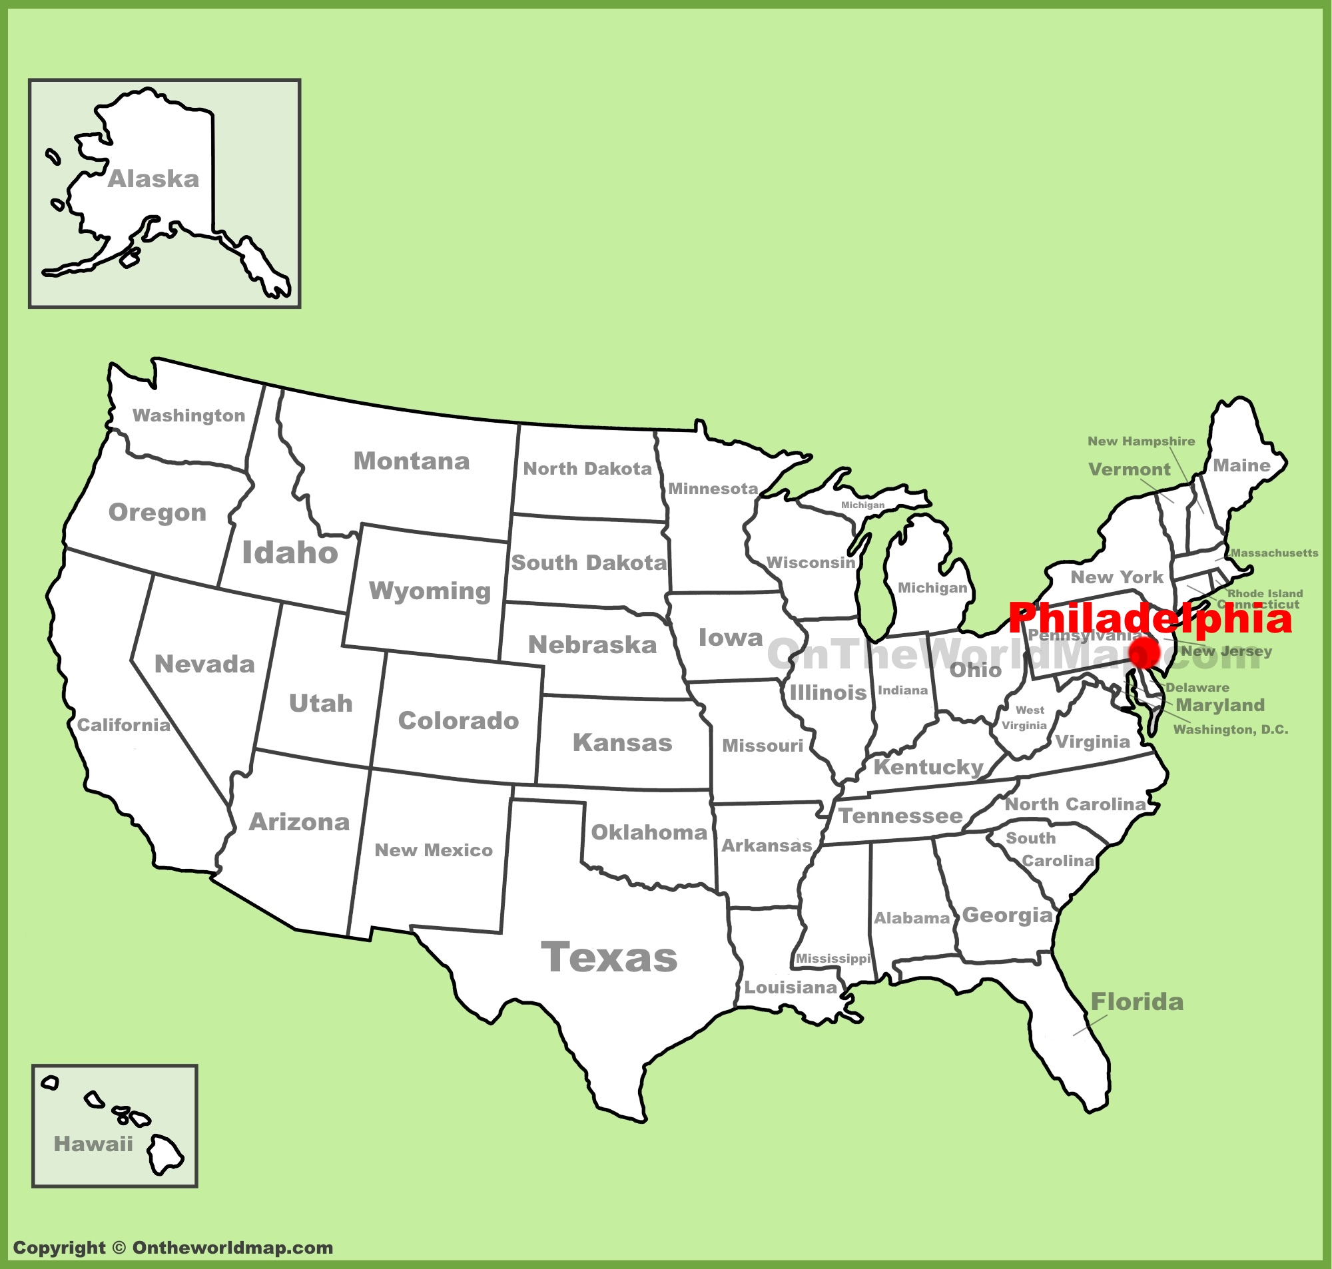
expressions of brotherly love (Philadelphia, pennsylvania)
pronunciation:
- might sound quite similar to NY dialect
- th pronounced like d
- the loss of initial h- (yuge, yumid)
- glottal stop for medial t (sum‘n – something, nut‘n – nothing)
- distinctively raised vowels in cawfee, dawg,
- ruyt (right), luyf (life)
grammar
- second person plural pronoun youse / yuz: Aur youse goin‘? (Are you going?)
- use of anymore to mean „currently“: Things are so expensive anymore.

Slide 18

maple leaf rap (canada)
language mix because of large numbers of immigrants
- DA immigrants: dialect/accent immigrants, speaking languages intelligible to the home population
- SL immigrants: second-language immigrants, their language is unintelligible to the natives
- a strong literacy gap between the two, as SL immigrants are usually not fluent and proficient in their second-language
pronunciation:
- Canadian Raising: about the house sounds like aboot the hoose
- same vowel in Don and Dawn, the sun shone rhymes with gone
- rhoticity
generally quite similar to North American English

Slide 19
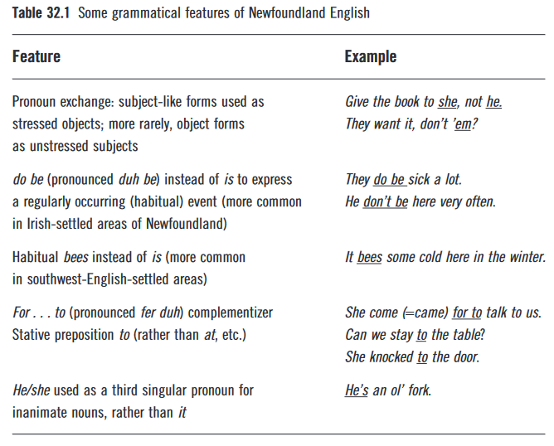
from cod to cool (newfoundland, canada)
very distinctive speech variety because of the geographical isolation and lack of migration
linguistic heritage brough by English / Irish people who settled there
pronunciation:
- low vowels (cat, trap, start, park) sound very broad, John sounds like Jan
- no distinction between vowels in beer, bear, bare, or lure and lore
- features from Irish English: vowels in mug or tough are pronounced with lip-rounding
- side and time pronounced like soid and toim
- unrounding of oi and or: toy sounds like tie and north like narth
- initial h sometimes not pronounced: home pronounced ome
grammar:
- they runs, we wants – the –s suffix is used for all persons

Slide 20
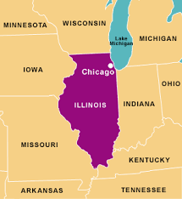
words of the windy city (chicago, illinois)
English in Chicago has always been spoken by native speakers of English and non-native ones with their specific accents
Chicago English Nowadays:
- Upper Midwest American English
- African American English
pronunciation:
- ‚messy‘ vowels and vowel shifts; many different pronunciations of the same vowel
Interesting observation: it seems that if a speech sound is changing, women will lead the way; class differences are likewise significant
Vocabulary: gangway (walkway between two buildings), prairie (empty city lot that may have stray dogs), parkway (grass that separates the sidewalk in front of a house from the street)

Slide 21

Talking in the buckeye state (ohio)
Three distinct dialectal parts – Northern, Midland, overlap with Appalachian speech
Mixed ways of speaking because of historical reasons, immigration and geography
Influence of German
Pronunciation:
- merging cot and caught, Don and dawn (not in Northern Ohio)
- fill and feel, sale and sell sound almost the same
- in Northern Ohio, there is a specific „nasal“ sound caused by vowel raising
- bad and cat are pronounced more like bed and ket
Specific grammar differences:
- He‘s not to home, sick at the stomach, He done it, I seen him – more common in Southern Ohio
- features of Appalachian English (see slide 10)
LeBron James, a famous basketball player born in Ohio

Slide 22

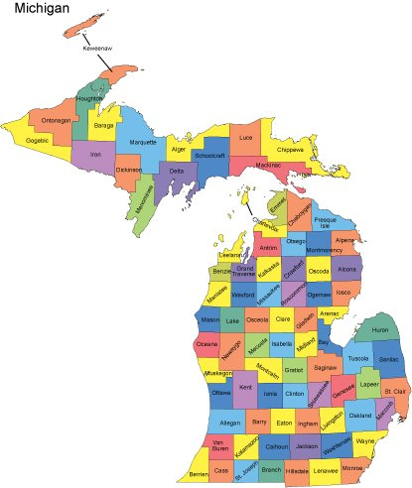
Saying ya to the yoopers (michigan‘s upper peninsula)
Upper Peninsula = Yoopers (from the abbreviation UP), Lower Peninsula = trolls (they live under the Mackinaw Bridge)
Keweenaw Peninsula:
- in the past, there were many Finnish people → great influence on the English dialect of the western Upper Peninsula
UP features:
- using d and t instead of th in words like these, them, the (influenced by Finnish)
- saying in‘ for ing in words such as goin‘, washin‘
- phrases like The car needs washing (need + present participle)
- plural 2nd person pronoun yous(e)
- tag hey in phrases like You‘re coming to dinner, hey
Vocabulary affected by Finnish, original Ojibwa inhabitants and EU immigration
Keweenaw Peninsula

Slide 23
Bridging the great divide – african american english
African slaves – not sharing a common language and culture (strategy of slave traders) x other immigrants
denied access to education → a unique linguistic identity
the position of AAE – “a personal choice”, the Ebonics controversy in Oakland – categorized as a language outside English, genetic inferiority
reduction of final consonant clusters
Post-vocalic r absence
Phonological inversion
He been sad – unstressed – a temporary past event, stressed – a past event stretching to the present
African American are not a linguistically homogeneous group:
Videos
Chicago Blaccent – https://www.youtube.com/watch?v=SlV3qCzM5uQ
  Southern + Midwestern accent → the result of desegregation (https://www.chicagomag.com/city-life/the-blaccent-that-defines-chicago/)
DIFFERENT “HOOD” ACCENTS – https://www.youtube.com/watch?v=YMS70m-OzXo&t=100s

Slide 24
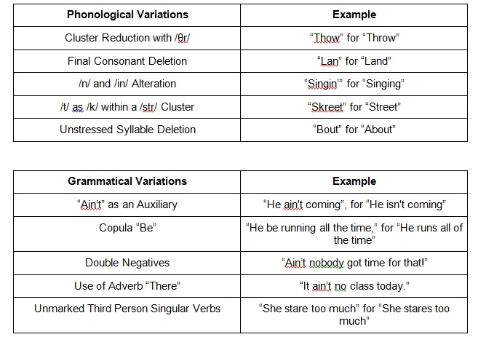
Bridging the great divide – african american english

Slide 25
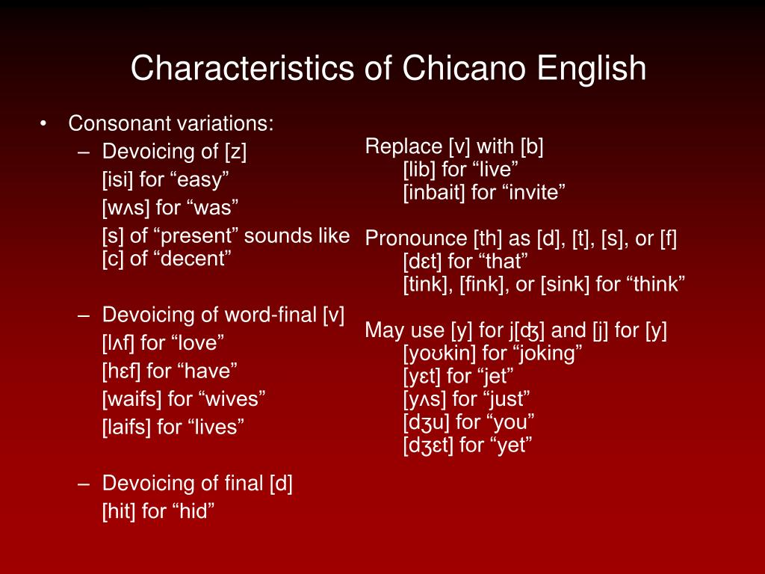
Talkin‘ with mi gente (chicano english)
Southwest (California, Texas…)
product of a bilingual setting – English and Spanish
Chicano English is not “learner English” – many speakers of Chicano English don’t speak Spanish
usage of Spanish lexical items – not code-switching (Spanglish)
the a sound in pasta, saw → more like the Spanish a
going and talking – a higher vowel as in sí in Spanish (possible influence on Valley Girl English)

Slide 26
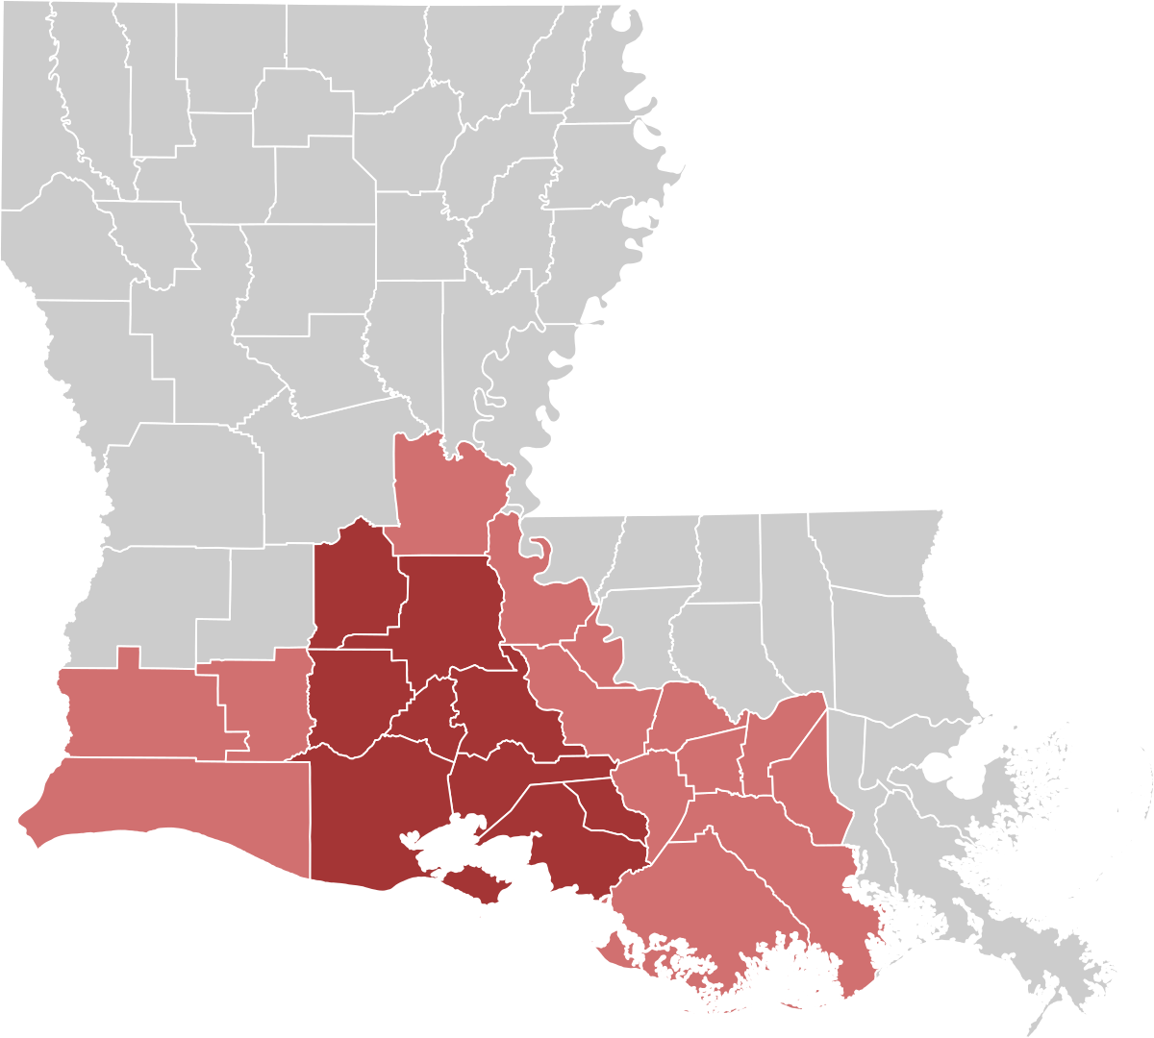
Stirring the Linguistic Gumbo – Cajun English (louisiana)
Cajuns (The Acadians) – descendants of French settlers from Acadia (Canada, Nova Scotia)
preservation of some elements of French from mid-1700s (religious isolation)
affected by Native American tribes, German and Irish immigrants, African and Caribbean slaves, and the Spanish speaking Isleños from the Canary Islands.
five distinctive features: vowel pronunciation, stress change, the lack of the th phonemes, non-aspiration of p, t and k and lexical difference (x Southern Drawl)
diphthongs change to monophthongs (high, tie → ah; tape → ee glide)
the syllable-final/phrase-final stress
the replacement of the th sounds with a t or a d sound
p, t, k without aspiration – pat sounds like bat

Slide 27
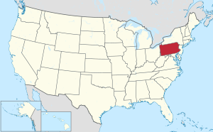
Fading Future for Ferhoodled English – Pennsylvania German
The Pennsylvania Dutch – transformed from Deitsch (not Dutch, but German descendants)
the Plain and the Fancy – Amish and Mennonites x Lutherans, members of the Reformed Church
Pennsylvania German invaded by the outside influence, also mainly spoken in the Plain communities
the Dutchy accent
  j → ch – jars, juice are pronounced as chars, chuice
  th → s – with, thing pronounced as wiss, sing
  v → w – visit, available pronounced as wisit, awailable
  butter, nothing and until → bawter, nawthing and ontil
house, mountain, and down → haase, maantain, and daan

Slide 28
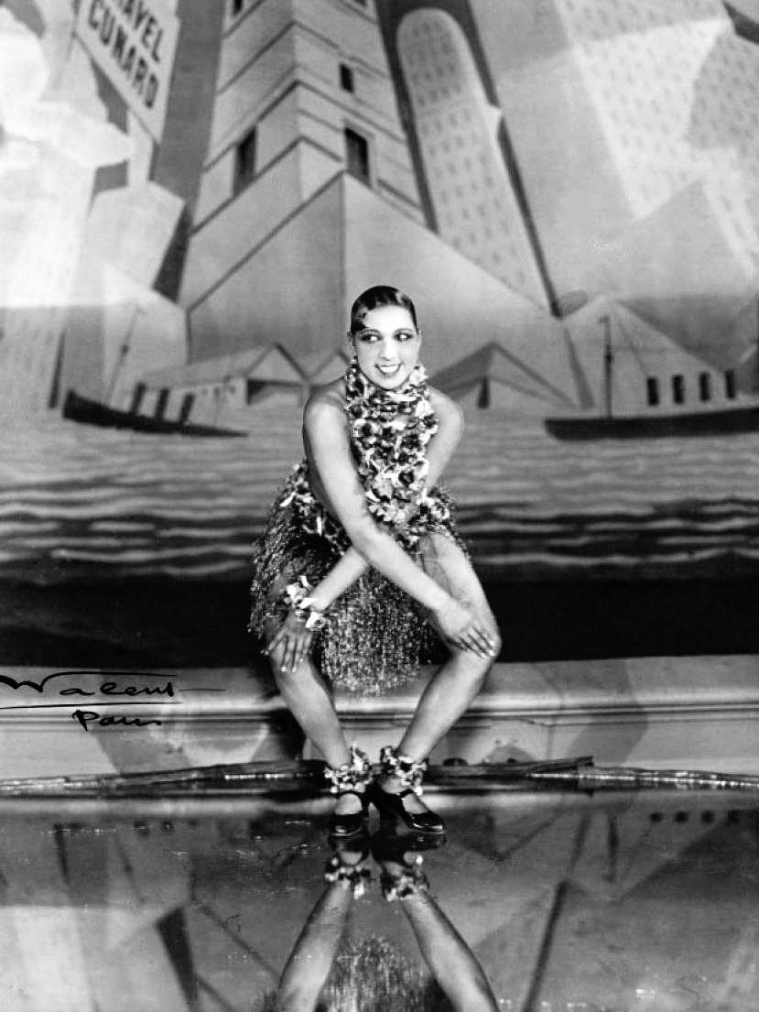
Doing the Charleston (South Carolina)
The first permanent English community established near present-day Charleston (1670); import of African slaves
an important hub of commerce and culture → devastated after the Civil War
Charleston accent x Gullah → influential
day and gate → monophthongs or ingliding vowels:
  the second element is pronounced with the tongue in neutral, central position
  Charleston – the tongue is closer to the roof of the mouth, not unlike in the vowels in bee and boo
  → gee-uh and gee-yuht
softened sound of k and g – car and garden → kyah and gyahden
vowels beginning with the tongue in a higher position (about or abroad) – like and rice → lake and race
a lack of distinction between certain vowels before r – ear pronounced as air, hear as hair and beer as bear
book, put, and look → pronounced with the vowel of buck

Slide 29
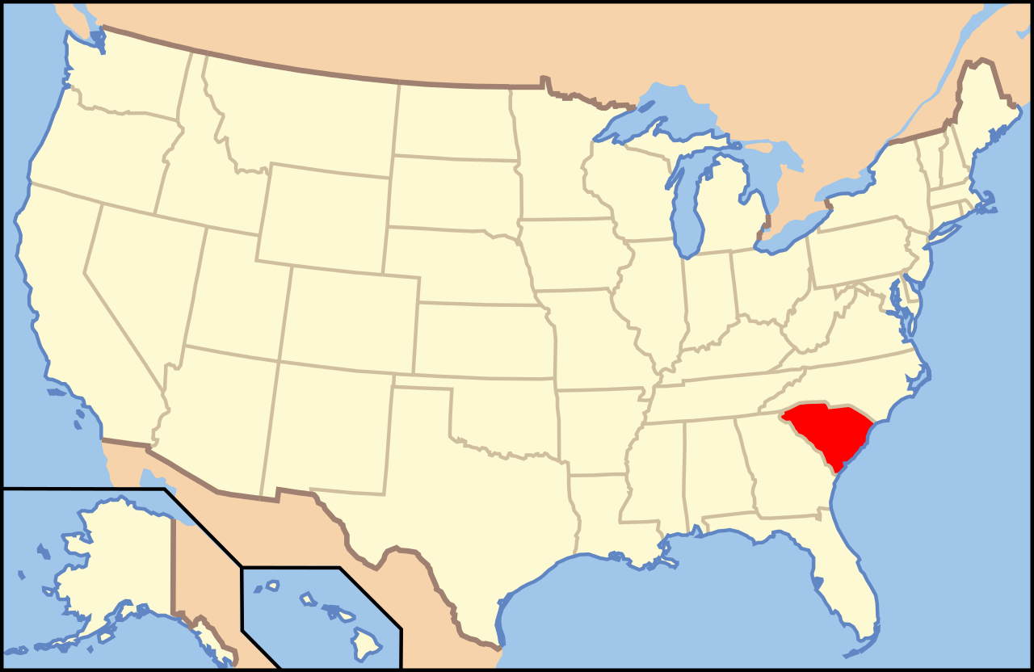
Doing the Charleston (South Carolina)
migration, racial division → change
the unglided and ingliding vowels, the raised initial part (rice, like) → mostly gone
the lack of distinction between the vowels in beer and bear → remains
words such as as two, do, and boot – pronounced with the tongue moving to the front of the mouth, – two → tee-oo (the South, California)
so, go and bone the first element of the vowel is pronounced with the tongue in central – bone → bay-own (the South, Philadelphia)
merger of the vowels in words such as cot and caught and Don and dawn (North American English in general), merger between pinIpen, sinned/send (the South)
→ not very Southern, perceived as Northerners or even Californians

Slide 30
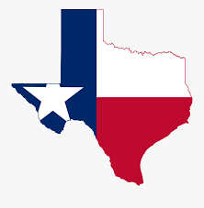
The Lone Star State of Speech (texas)
English – the second language of the state – the Texas Revolution → mixing of the South Midland and Southern dialect – constricted postvocalic r in words like forty and intrusive r in words like warsh x non-rhoticity (forty, four)
the pen/pin merger
the loss of the offglide of i in words like ride and right → rahd and raht
an emerging rural–urban linguistic split → the characteristic features disappearing in the city
new developing features: the caught/cot merger, tense/lax vowel pairs merger (pool/pull)
migration from the Lower South (Louisiana, Mississippi, Alabama, Georgia, and South Carolina) and the Upper South (Tennessee, Kentucky, and North Carolina); European migration (Germans, Czechs, Poles); steady influx of Mexicans → maintaining the role of Spanish

Slide 31

Speaking the Big Easy (New Orleans, LA)
New Orleans (a Spanish colony) – mainly French-speaking at the time of the Louisiana Purchase in 1803 → English, AAVE, immigrants from Germany, Ireland, Italy
different from Cajun dialect
non-rhotic – charmer → chaw-muh, autistic and artistic are homophones
ɔː (as in awful) merges with ah sound → John and lawn rhyme
boil, oil, oysters, and toilet → berl, earl, ersters, and turlet
the word stress on the first syllable – adult, cement, insurance, and umbrella
https://www.youtube.com/watch?v=5Da2iw59ErU – Dat Talk: New Orleans Accents (especially 2:01 – 2:21)

Slide 32

Getting Real in the Golden State (California)
California – a new state → not long enough to develop the kind of dialect depth that is apparent in the East Coast and the Midwest
  White population – Valley Girl and Surfer Dude
  Latino population – Chicano English
  African American population – AAVE
cot/caught merger
the forward movement of the back vowels – dude or spoon sounds a little like the word you, or the vowel in pure or cute; but and cut → bet and ket
the vowel of black → block, the vowel of bet → bat, the vowel of bit → bet
Japanese Americans – internment camps, destroyed communities – no distinctive features
Valley Girl Accent with Emilia Clarke (starts around 2:10) – https://www.youtube.com/watch?v=mIBg-w6TNLE

Slide 33
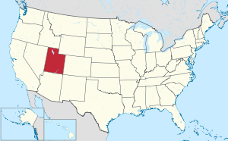

Desert Dialect – Utah
changing vowels after l
  milk → melk, pillow → pellow (ɪ → ɛ)
  steel mill → still mill (iː → ɪ), house for sale → house for sell (eɪ → ɛ)
  pool, fool → pull, full (uː → ʊ)
  → changes in its vowel system analogous to those occurring in the United States South
card/cord merger → or pronounced as ar; Spanish Fork → Fark
pronunciation of the diphthong in words like time and bye – What tahm is it?
Southern pronunciation, but Northern lexicon → tracking the movement of LDS Church (founded in New York → Missouri, Illinois → Utah)
Brendon Urie, Pan!c at the Disco

Slide 34
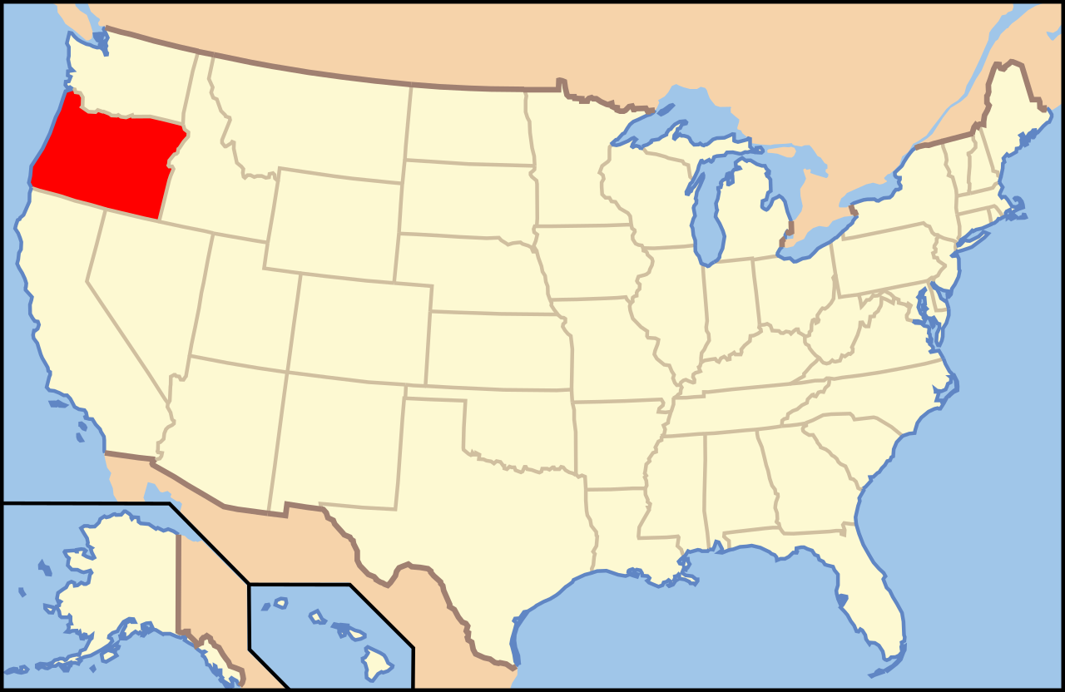
Dialects in the Mist – Portland, ORegon
still largely undefined → distinctive features are still forming
cot/caught merger (merged low back vowel) → backing does not happen before nasal consonants (a higher vowel) – Anne → Ian
bag, tag and gag → y-like glide instead of the open front vowel; beg → bake (bag)
back vowel fronting – used to categorize dialects → boot, book, and boat (North American dialects) → bi-wt, bi-yt (still in progress)
“up-speak” – the use of a rising question intonation on a declarative sentence

Slide 35
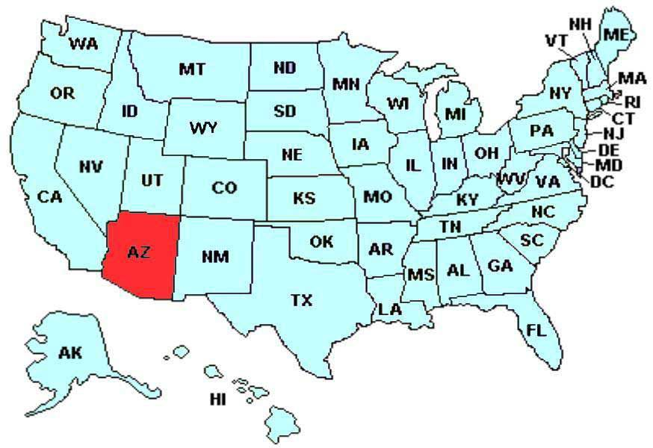
Arizona’s not so Standard English
calling their English standard, bland and boring
strong Mexican Spanish influence (Casa Grande, Table Mesa, canyon, ranch)
1800s – migration from the Southern and Midwestern states, mid-1900s industrial boom, migrants from California
Contemporary Urban Dialect
  back-vowel fronting
  caught/cot merger
  higher vowel after nasal consonants (Anne → Ian)
  filled/field merger
The Rancher Accent
  not merging
  my/fine → mah/fahn
  sometimes vowels in unstressed syllables may be lost completely – every day → ever’ day
The -s of verbs with other verb forms – you’s for you’ve, we’s gots.
double negative (We didn’t have none, ain’t)
decline of agriculture → moving closer to Californian dialect, becoming less like their Oklahoma predecessors
possible Mexican Spanish and Chicano influence

Slide 36
Extra Video:
50 People Show Us Their States' Accents | Culturally Speaking | Condé Nast Traveler - https://www.youtube.com/watch?v=UcxByX6rh24

