Slide 1
Academic skills
Week Eight, 10. 11. 2022
Analysis Refresher Seminar II
Dr. Šárka Gmiterková

Slide 2
Agenda
Structure
Discussing your approaches to reading scholarship and going through your resumés
Targeted Learning Outcome
Identifying effective ways of reading academic output

Slide 3
On reading scholarship
Do you enjoy reading academic output?
What do you like about it and what is there NOT to like?
What is your favorite academic piece to date?
How frequently do you read such pieces?
How do you find what to read? (do you actively search for this kind of content you would like to read?)

Slide 4
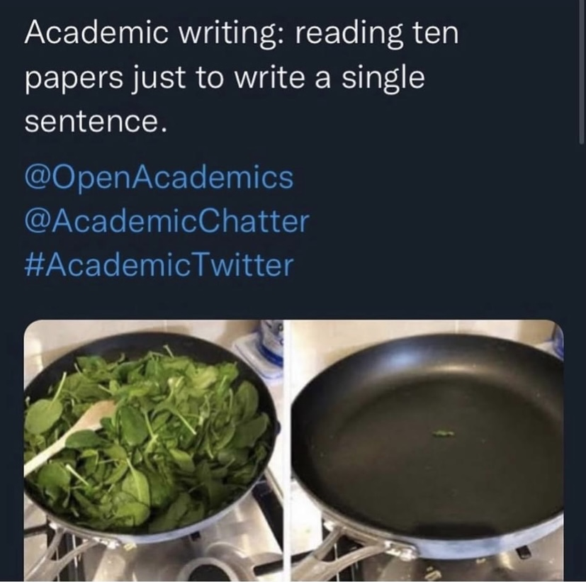
Academic reading and writing can a lot of times look like this…

Slide 5
Note on reading
Academic output is not the most exciting thing to read, however it is necessary for our own relevant academic output. Therefore we should be able to approach it in an organized, systematic way.
In order to navigate ourselves in our area of interest for (future) research, we have to be acquinted with knowledge and key arguments existing in the field.
Your first year of university studies is a good time to do a lot of reading; ideally three to five pieces of scholarship a week (chapter/papers/articles); combining both your obligatory reading for courses/seminars on weekly/biweekly basis with an active research of your own in the areas of your interest.
Look through reading lists of the courses similar to your research interests (either topically or methodologically); check bibliography lists at the end of academic books, chapters and articles; search through various electronical databases.

Slide 6
Kevin Esch: Actorly transformation
How did you find this article topic/language/argumentation/examples wise?
How did you approach writting the resumé? Take me step by step through your process.
- - - - - - - - - - - - - - - - - - - - - - - - - - - - - - - - - - - - - - - - - - - - - - - - - - - - - - - - - - - - - - - - - - - - -
My resumé:
This article argues, that current preference for parts employing drastic changes to performer‘s body is not just a result of a society obsessed with weight loss and body policy. There is a wider historical background stemming from Method acting in the 1950s and its associations with insurgence and counterculture. The effect of „actorly transformation“ helps to keep the Method heritage alive, while stripping it from risks and dangers associated with the lifestyle accompanying it and substituting it with the accent on discipline and control.
Important topics and perspectives:
The physical aspect of acting and performance, including industrial perspective and value making (Oscars and legacy)
not analysing performances per se, but the discourse surrounding certain valued performances (both contemporary and in the past), using magazine profiles, biographies and interviews
Dated 2006, but this issue persists till year 2022 (more critical voices X awarded performances, such as Joker)

Slide 7
Take-aways
There is no exhausting and final resumé of every text we have read.
However, we have to make note of every scholarship piece we have read and might/will need in the future.
Make a note/resumé (one paragraph) out of every chapter/paper/article you read. From which perspective each item approaches the topic? What arguments does it present? Which primary and secondary materials are used? Are there any examples you would like to use for the sake of your own argument?
Key arguments should be compressed into two or three sentences. If needed, note down specific examples or case studies; sometimes a topic for which a similar perspective might be fitting
Use your own words! Paraphrase the key arguments, do not just copy and paste (with the exception when you know, you are going to quote the sentence directly).

Slide 8
Next time
Date: 24. 11., since 17. 11. is a national holiday
Instructor: Richard
Topic: Project Execution Seminar II: Organization
Outcome:Argument-driven paragraphs and evidence-based sections
Prepare: Think about how to break down your paper into 3-4 sections.

