Slide 1
DSBcB49 Starověká ekumena - antické zprávy o Asii a Africe
Egypt
πλεῖστα θωμάσια ἔχει ἢ ἡ ἄλλη πᾶσα χώρη καὶ ἔργα λόγου μέζω παρέχεται

Slide 2
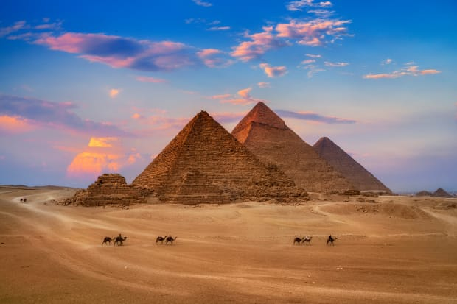
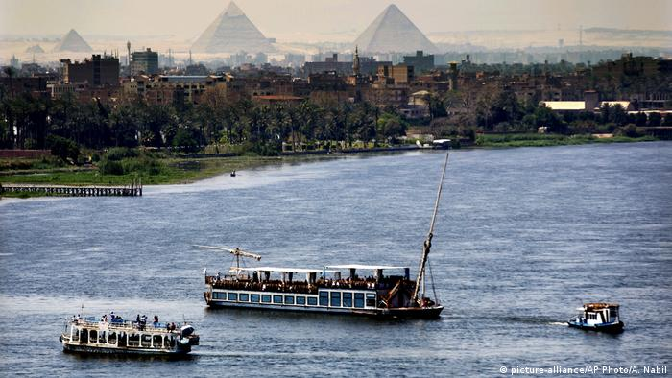
Etymologie
Aigyptos (Αἴγυπτος) – z egyptského slova pro Memfis (Hikuptah)
Aegyptus
Nil (Νεῖλος, Nilus) – také bůh řeky v řecké mytologii (Hapi)
Mytologie – Aigyptos – syn Béla, potomek Ió

Slide 3
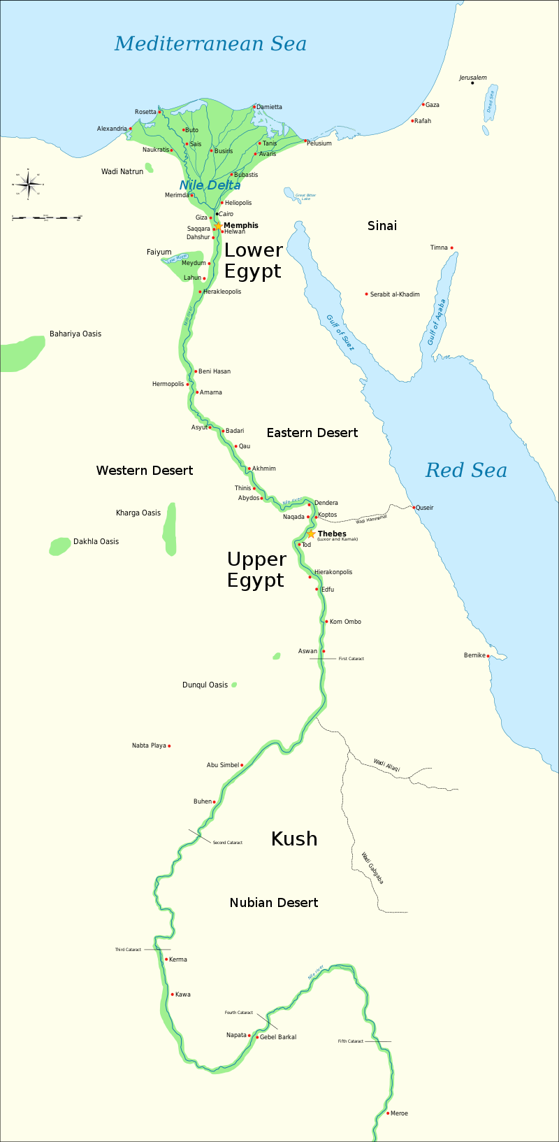
Egypt - dějiny
Na řece Nilu
Horní/Dolní Egypt – sjednocení cca 3150 pnl, Ménés, Narmer
Faraon, vezír, dělení na nomy
Fáze – predynastická doba, Memfis, mastaby
Stará říše – cca 2700–2200 pnl, pyramidy, sfinga
Rozpad na nomy – 1. přechodné období, cca 2200–2050 pnl
Sjednocení – Střední říše – 2050–1700 pnl, Iktavej
Vpád Hyksósů – 2. přechodné období, cca 1700–1550 pnl
Vyhnání Hyksósů – Nová říše, 1550–1050 pnl, Théby, rozšíření do Levanty

Slide 4
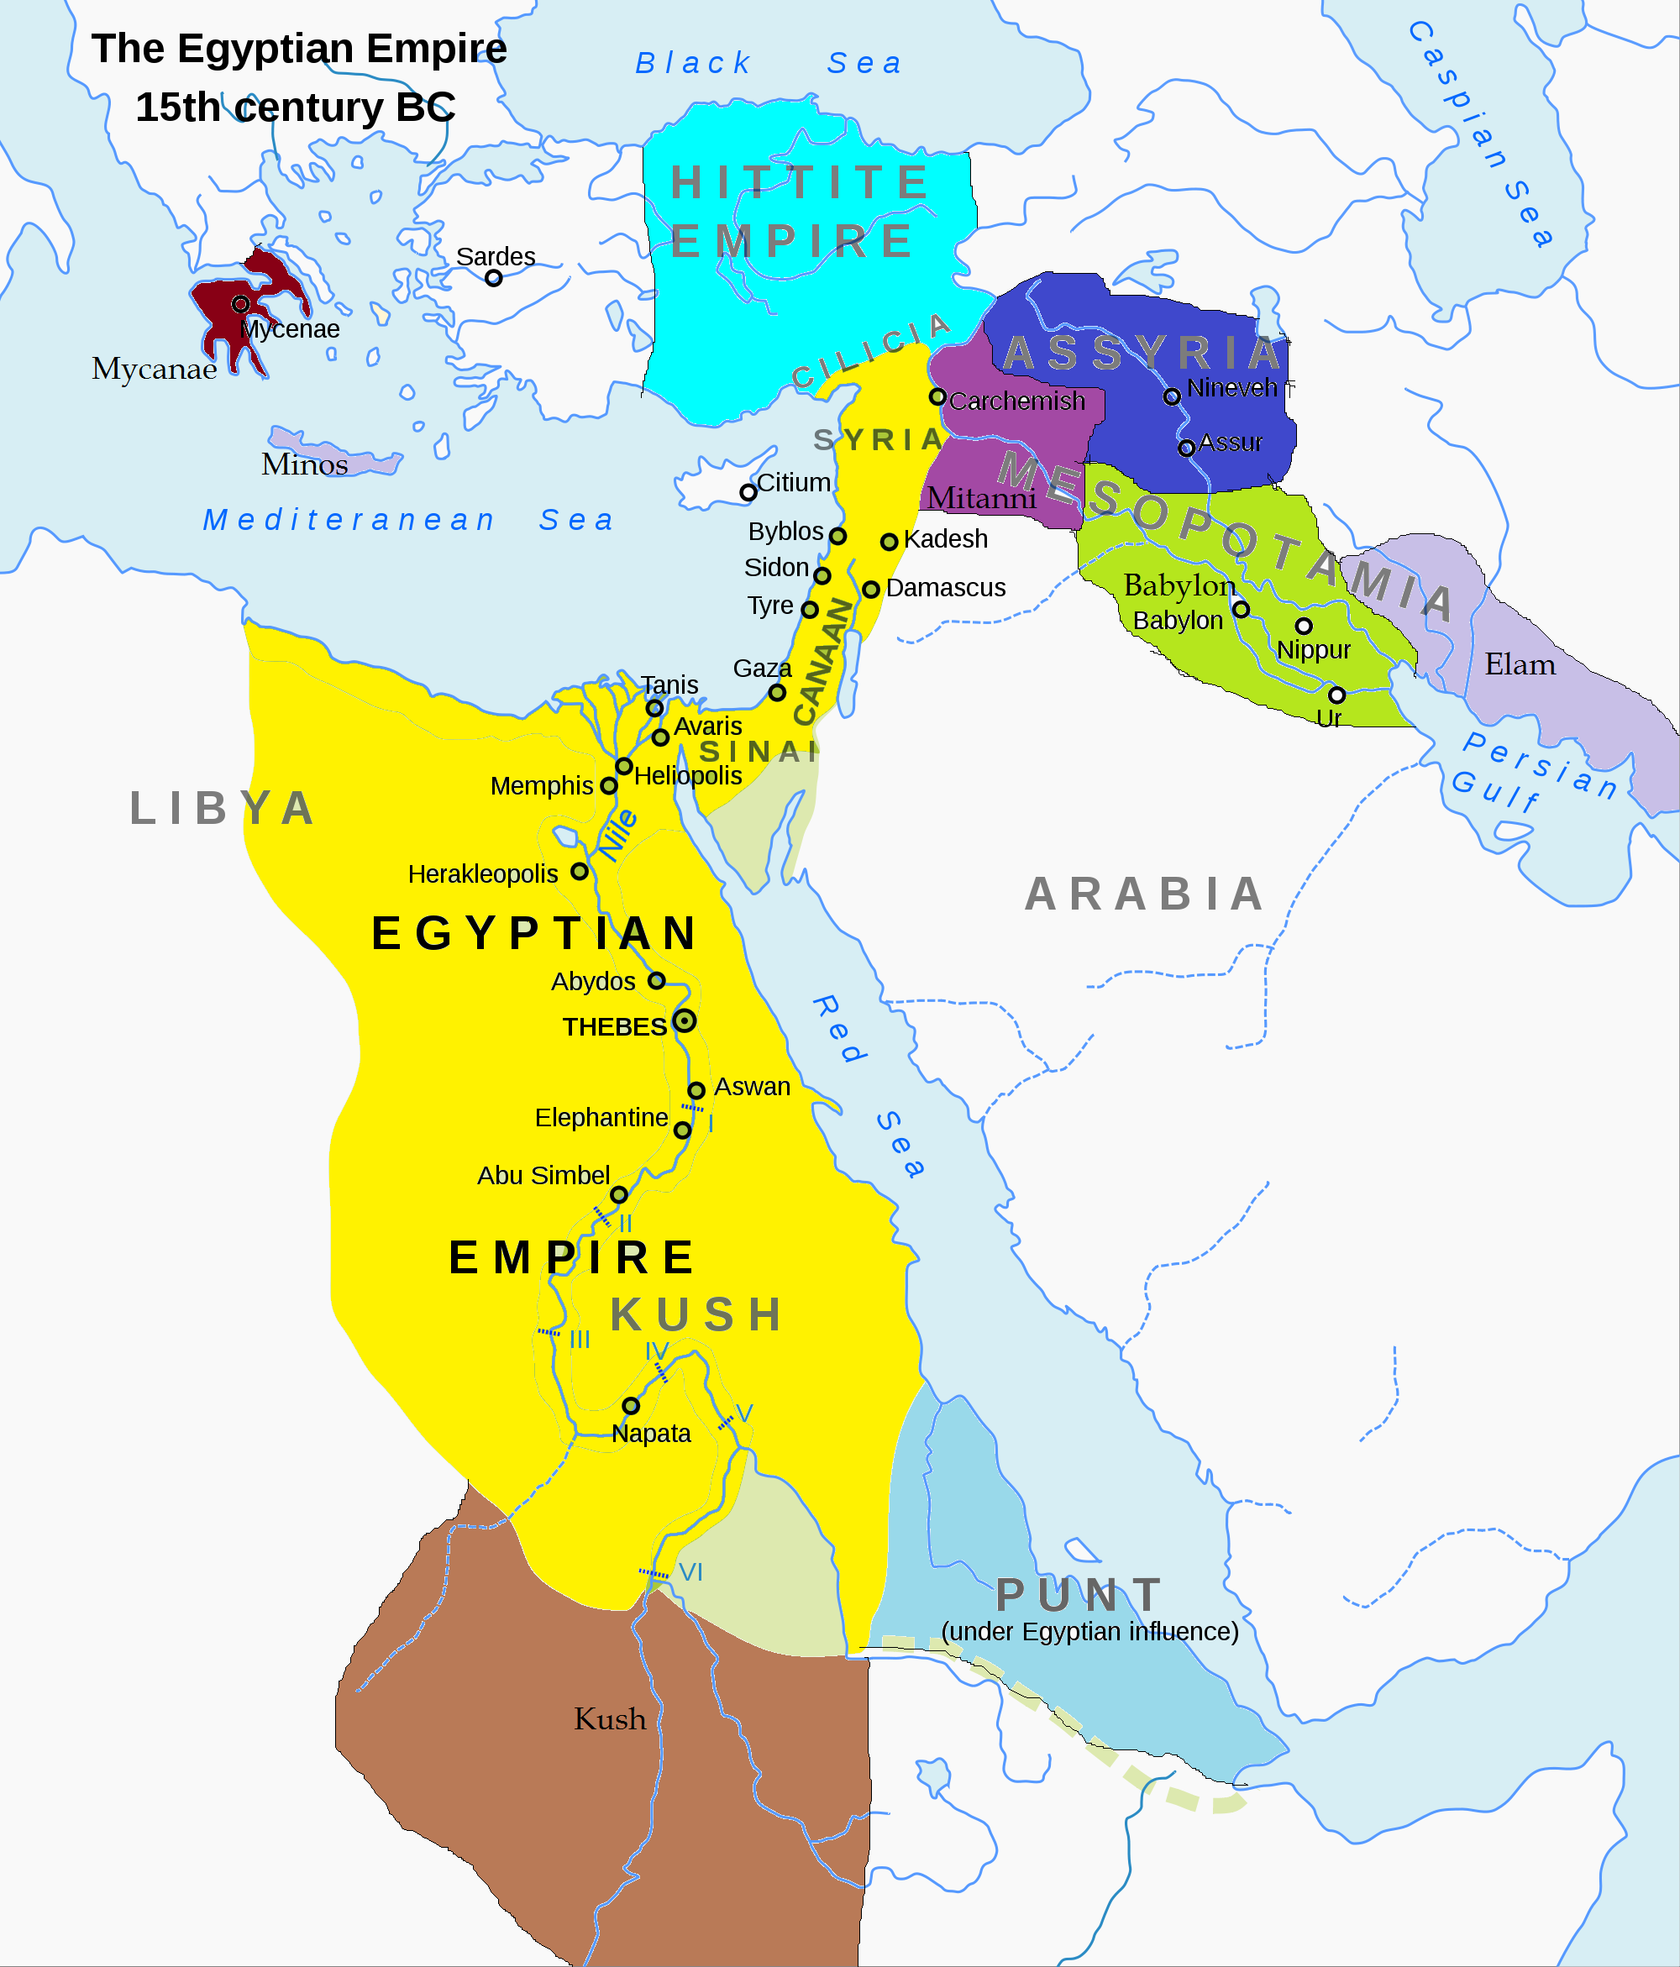
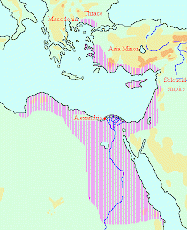
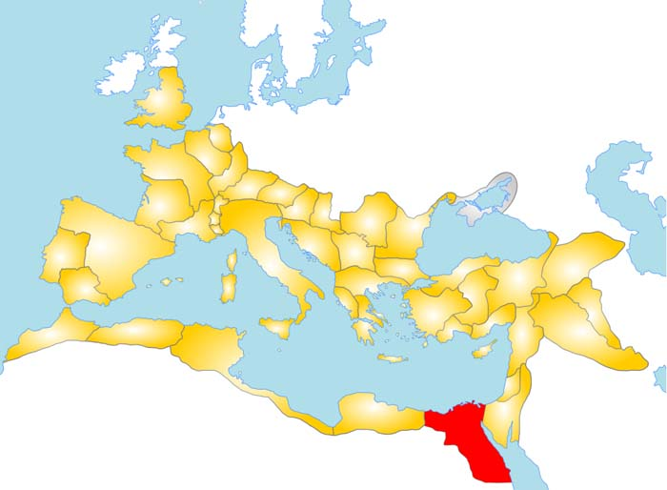
Egypt - dějiny
Mořské národy, cizí dynastie
3. přechodné období – 1050–650 pnl, libyjská, kúšitská dynastie, dobytí Assyřany
Saitská dynastie (26.) – „renesance“, Sais – 650–525 pnl
Dobytí Peršany
Časté vzpoury (i účast Řeků), nové dynastie
Alexander 332 pnl
Ptolemaiovská dynastie 323–30 pnl
Římský Egypt 30pnl–641 nl, provincie
32 dynastií (30 – Manetho)

Slide 5
Egypt a Řecko
Mytologie
Danaos x Aigyptos
Héraklés
Helena a Meneláos (včetně alternativní verze únosu – Hdt. 2.112–120), Próteus
Údajně kolonizace – Bélos (Mesopotamie), Danaos (Argos), Židé, Kolchiďané, Athény, Makedonie– D.S. 1.28–29

Slide 6
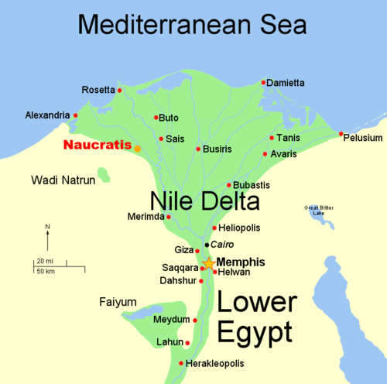
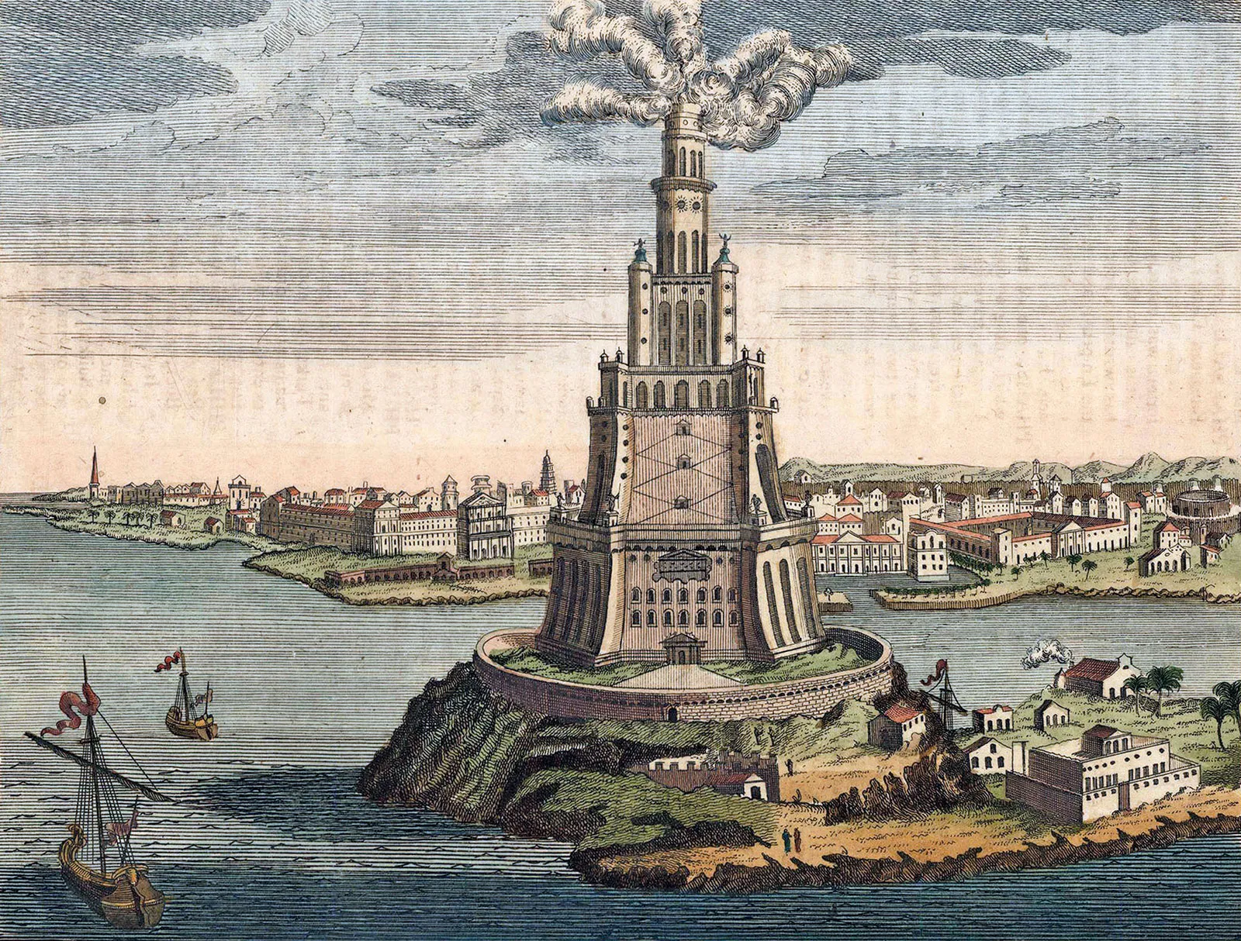
Egypt a Řecko
Naukratis – obchodní stanice, město
7. stol. pnl
Psammétichos I., Amásis II. – Řekové se mohou usadit ve městě
Papyrus, obilí, len ↔ stříbro, dřevo
Alexandrie – 331 pnl, hlavní město Ptolemaiovské říše
Architekt – Deinokratés z Rhodu
Ptolemais

Slide 7
Egypt a Řecko
Častá účast řeckých žoldnéřů v Egyptě – pomoc při povstání
Pol. 5. stol. pnl (460–455 pnl) – Inaros (200 lodí z Athén)
Přelom 5./4. stol. pnl – Amyrtaios (spojenectví se Spartou)
Achoris (spojenectví s Athénami)
4. stol. pnl (358 pnl) – Nektanebos II. (Agésiláos II.)
332 pnl – Alexandr dobývá Egypt
Správce Egypta – Ptolemaios

Slide 8
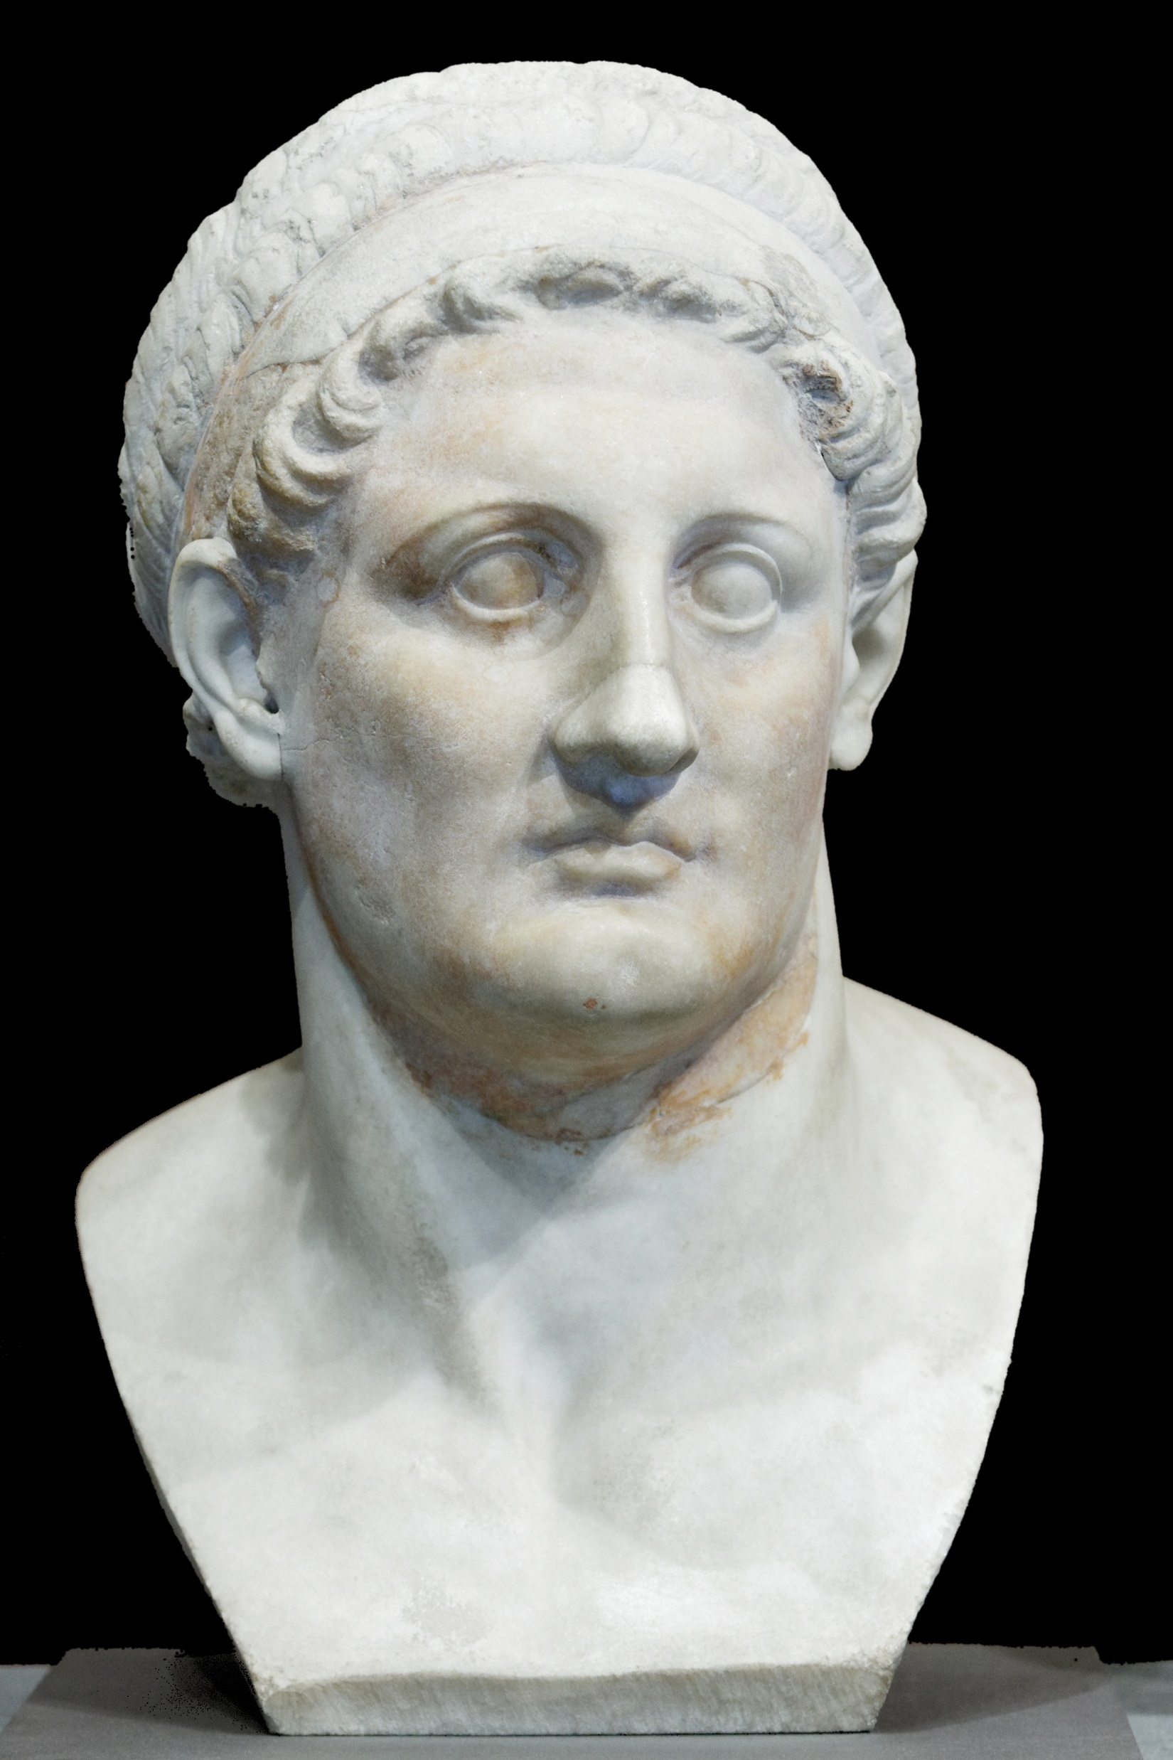
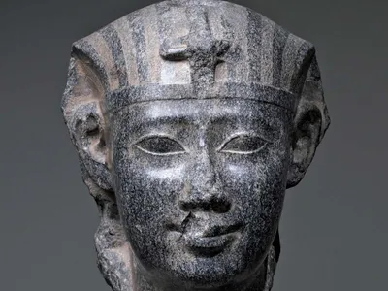
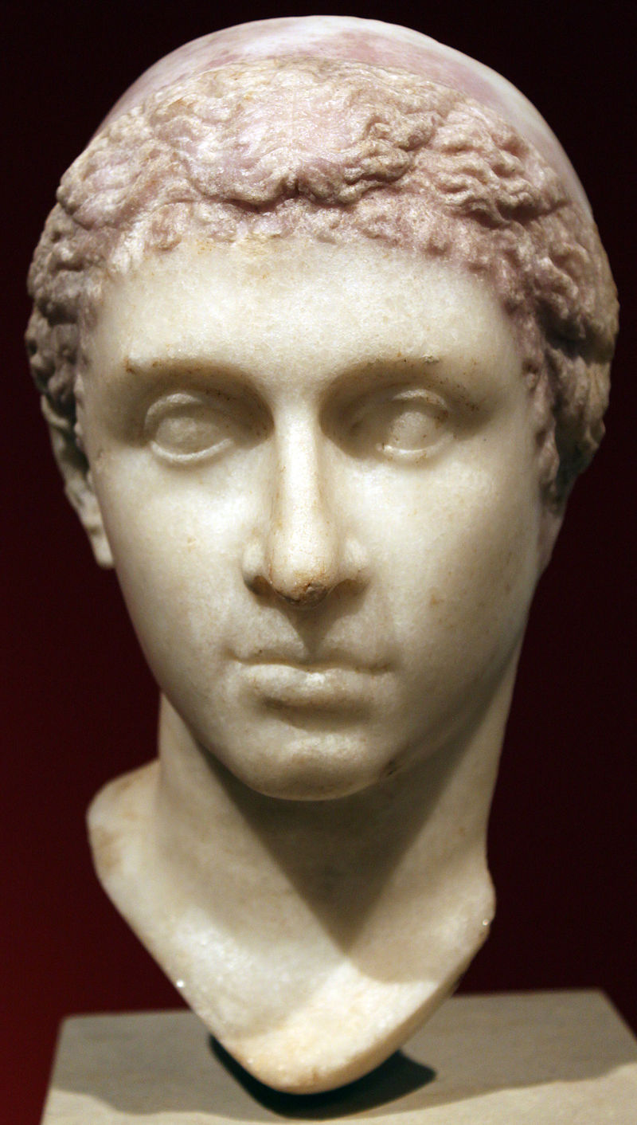
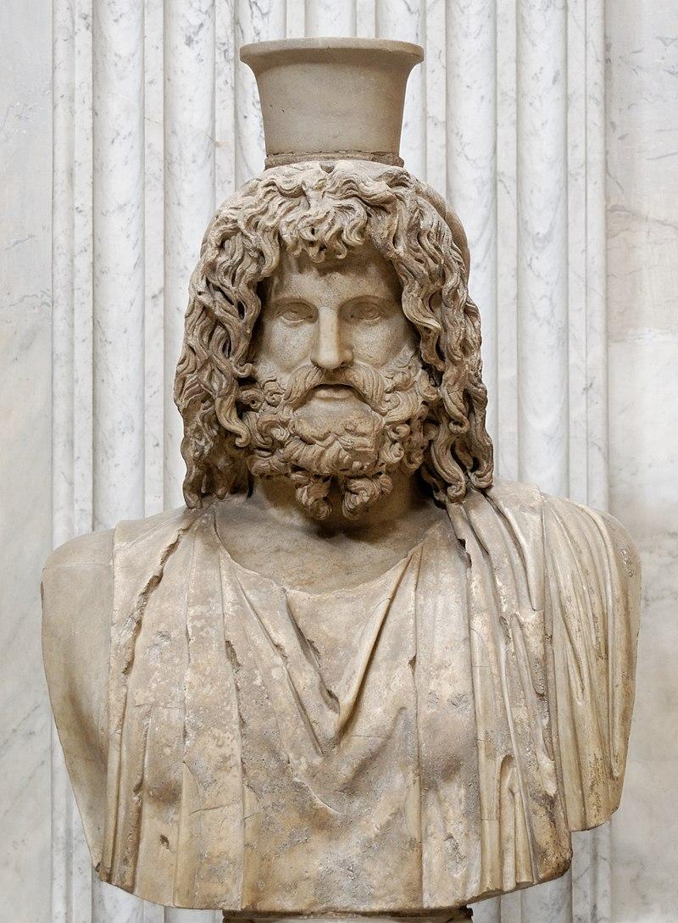
Egypt a Řecko
Ptolemaiovský Egypt
323–30 pnl
Alexandrie
Hellénismus
Řecká/makedonská vládnoucí vrstva
Stylizace vládců do faraonů x navenek Řekové
Múseios, Knihovna v Alexandrii
Podpora egyptského náboženství
Synkretismus – Sarápis
Trilingvní nápisy
Rostoucí vliv Říma

Slide 9
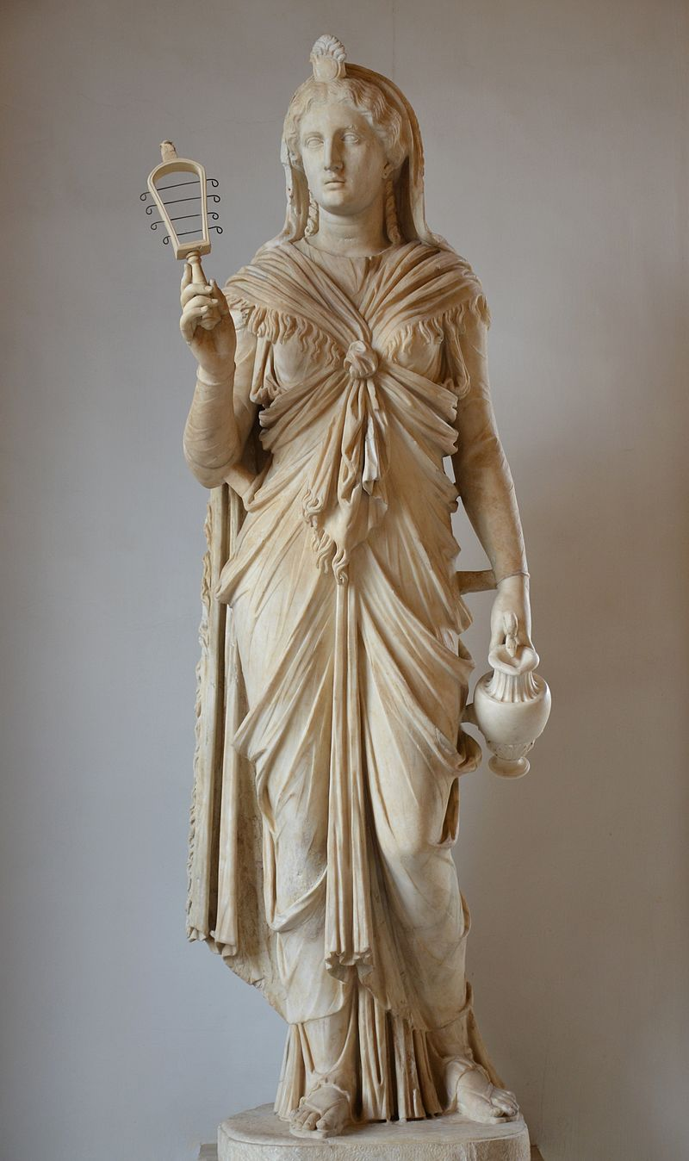
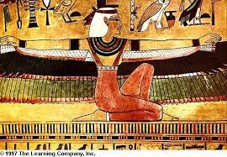
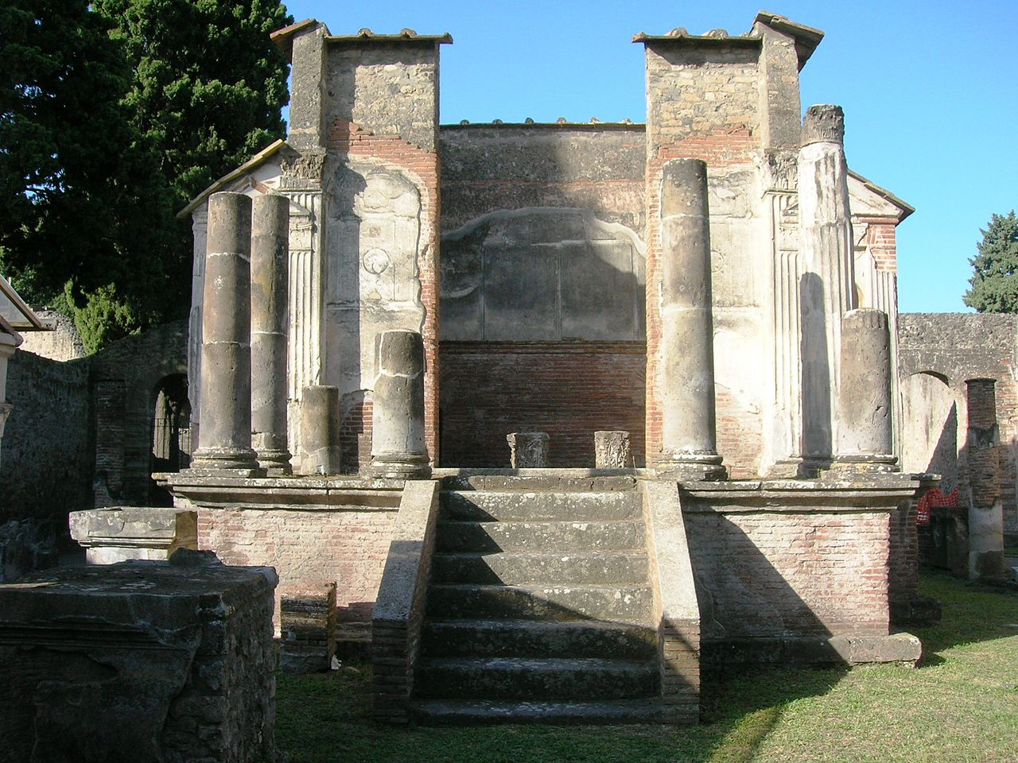
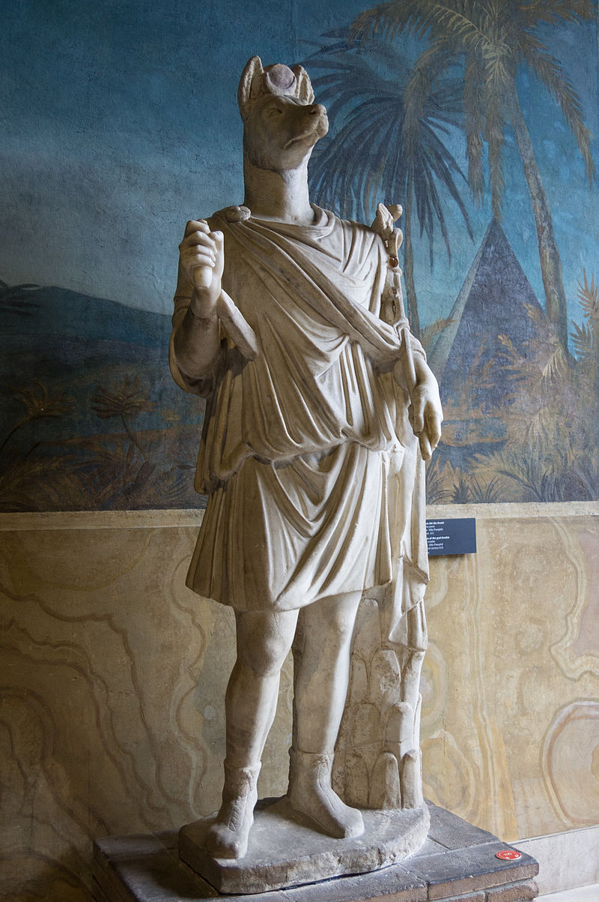
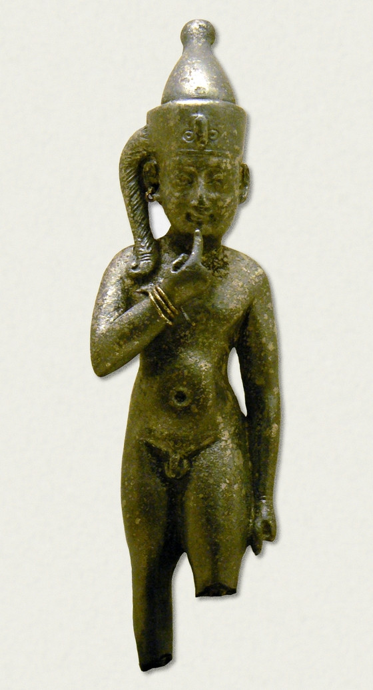
Egypt a Řecko/Řím
Šíření kultu Ísidy (+Osíris)
Sarápis
Harpokratés
Hermanúbis
Mystéria

Slide 10
Autoři
Hekataios z Mílétu
Hérodotos – 2. kniha Dějin
Hellaníkos z Lesbu – Aigyptiaka
Hekataios z Abdér – Aigyptiaka
Eudoxos z Knidu – o náboženství
Strabón – 17. kniha Geógrafiky
Diodóros – 1. kniha Knihovny
Plútarchos – O Ísidě a Osíridovi
Manethó – Aigyptiaka – 3 části, dělení do dynastií, oprava Hérodota (?)

Slide 11
Dějiny Egypta podle Řeků
Nejstarší lidé světa (dle Egypťanů)
Hdt. 2.2
Οἱ δέ Αἰγύπτιοι, πρὶν μὲν ἢ Ψαμμήτιχον σφέων βασιλεῦσαι, ἐνόμιζον ἑωυτοὺς πρώτους γενέσθαι πάντων ἀνθρώπων·
D.S. 1.10
φασὶ τοίνυν Αἰγύπτιοι κατὰ τὴν ἐξ ἀρχῆς τῶν ὅλων γένεσιν πρώτους ἀνθρώπους γενέσθαι κατὰ τὴν Αἴγυπτον διά τε τὴν εὐκρασίαν τῆς χώρας καὶ διὰ τὴν φύσιν τοῦ Νείλου.
Now before Psammetichus became king of Egypt,​ the Egyptians deemed themselves to be the oldest nation on earth.
Now the Egyptians have an account like this: When in the beginning the universe came into being, men first came into existence in Egypt, both because of the favourable climate of the land and because of the nature of the Nile.

Slide 12
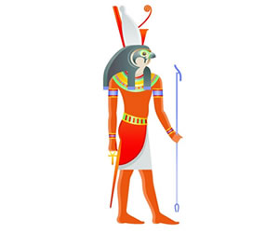
Vláda bohů
D.S. 1.42
μυθολογοῦσι δ᾽ αὐτῶν τινες τὸ μὲν πρῶτον ἄρξαι τῆς Αἰγύπτου θεοὺς καὶ ἥρωας ἔτη βραχὺ λείποντα τῶν μυρίων καὶ ὀκτακισχιλίων, καὶ θεῶν ἔσχατον βασιλεῦσαι τὸν Ἴσιδος Ὧρον: ὑπ᾽ ἀνθρώπων δὲ τὴν χώραν βεβασιλεῦσθαί φασιν ἀπὸ Μοίριδος ἔτη βραχὺ λείποντα τῶν πεντακισχιλίων μέχρι τῆς ἑκατοστῆς καὶ ὀγδοηκοστῆς ὀλυμπιάδος, καθ᾽ ἣν ἡμεῖς μὲν παρεβάλομεν εἰς Αἴγυπτον, ἐβασίλευε δὲ Πτολεμαῖος ὁ νέος Διόνυσος χρηματίζων.
Hdt. 2.144
Some of them give the story that at first gods and heroes ruled Egypt for a little less than eighteen thousand years, the last of the gods to rule being Horus, the son of Isis; and mortals have been kings over their country, they say, for a little less than five thousand years down to the One Hundred and Eightieth Olympiad, the time when we visited Egypt and the king was Ptolemy, who took the name of The New Dionysus. …

Slide 13
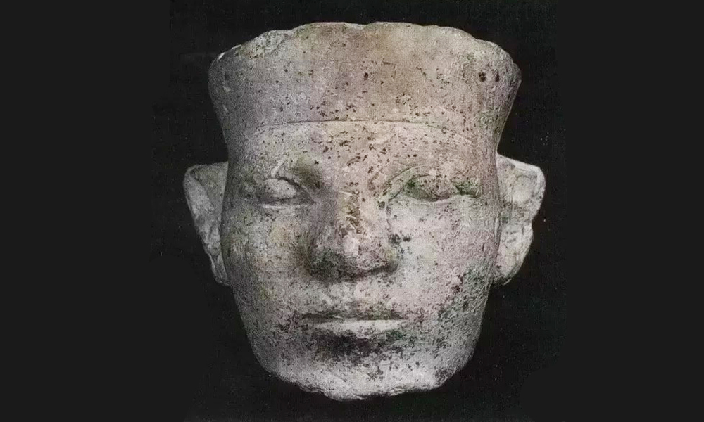
První králové
Hdt. 2.99
Μῖνα τὸν πρῶτον βασιλεύσαντα Αἰγύπτου οἱ ἱρέες ἔλεγον τοῦτο μὲν ἀπογεφυρῶσαι τὴν Μέμφιν.
D.S. 1.45
μετὰ τοὺς θεοὺς τοίνυν πρῶτόν φασι βασιλεῦσαι τῆς Αἰγύπτου Μηνᾶν, καὶ καταδεῖξαι τοῖς λαοῖς θεούς τε σέβεσθαι καὶ θυσίας ἐπιτελεῖν, πρὸς δὲ τούτοις παρατίθεσθαι τραπέζας καὶ κλίνας καὶ στρωμνῇ πολυτελεῖ χρῆσθαι, καὶ τὸ σύνολον τρυφὴν καὶ πολυτελῆ βίον εἰσηγήσασθαι.
The priests told me that Min was the first king of Egypt, and that first he separated Memphis from the Nile by a dam.
After the gods the first king of Egypt, according to the priests, was Menas, who taught the people to worship gods and offer sacrifices, and also to supply themselves with tables and couches and to use costly bedding, and, in a word, introduced luxury and an extravagant manner of life.
Chybí zmínka o sjednocení Egypta

Slide 14
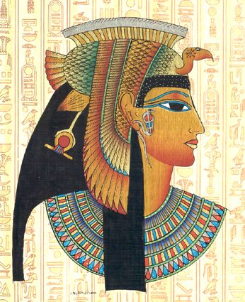
První králové
Hdt. 2.100
Μετὰ δὲ τοῦτον κατέλεγον οἱ ἱρέες ἐκ βύβλου ἄλλων βασιλέων τριηκοσίων καὶ τριήκοντα οὐνόματα. ἐν τοσαύτῃσι δὲ γενεῇσι ἀνθρώπων ὀκτωκαίδεκα μὲν Αἰθίοπες ἦσαν, μία δὲ γυνὴ ἐπιχωρίη, οἱ δὲ ἄλλοι ἄνδρες Αἰγύπτιοι.
=D.S. 1.44–45
After him came three hundred and thirty kings, whose names the priests recited from a papyrus roll.​ In all these many generations there were eighteen Ethiopian kings, and one queen, native to the country; the rest were all Egyptian men.

Slide 15
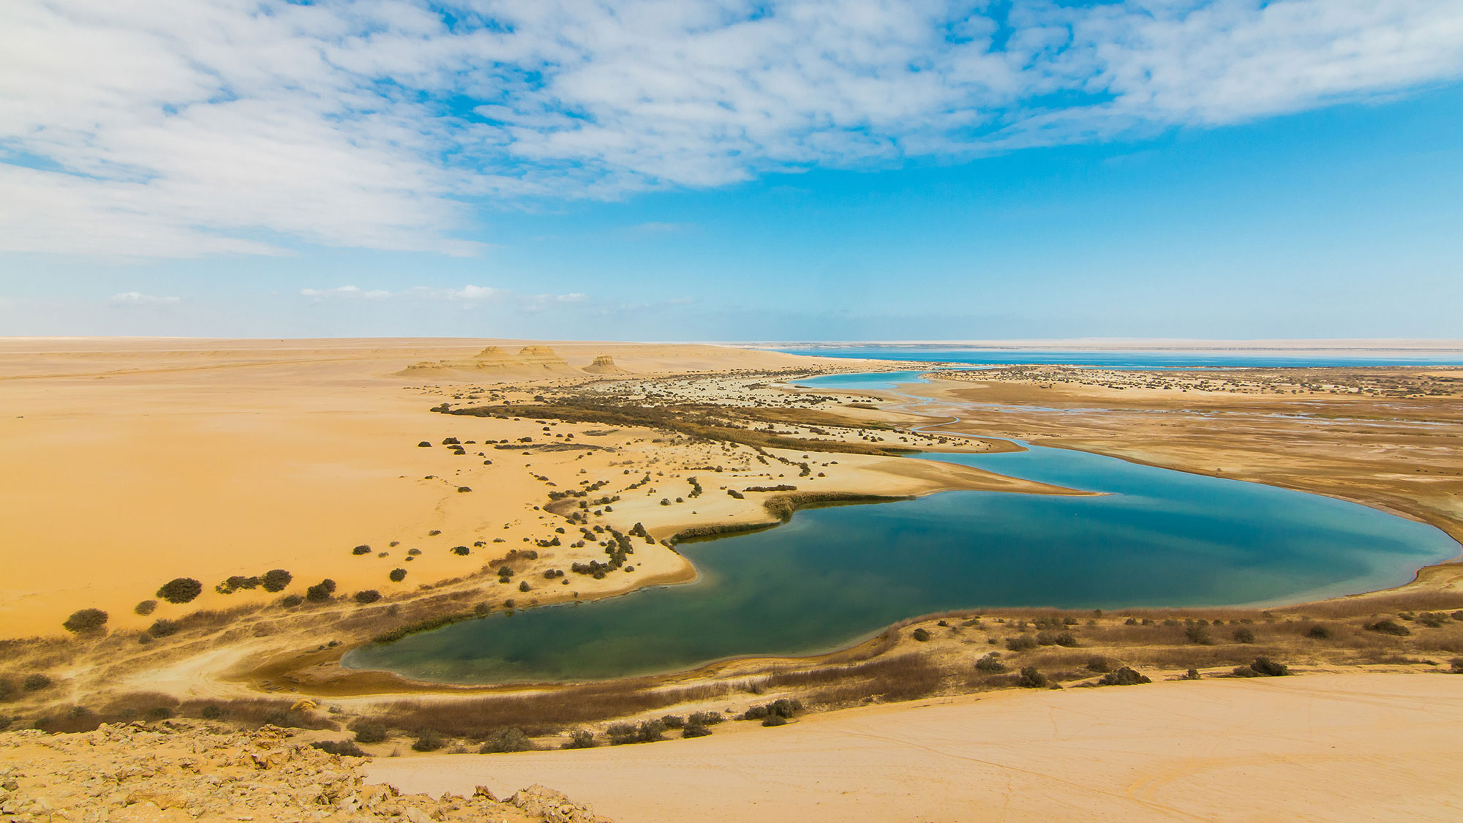
První králové
Hdt. 1.101
Τῶν δὲ ἄλλων βασιλέων οὐ γὰρ ἔλεγον οὐδεμίαν ἔργων ἀπόδεξιν καὶ οὐδὲν εἶναι λαμπρότητος, πλὴν ἑνὸς τοῦ ἐσχάτου αὐτῶν Μοίριος· τοῦτον δὲ ἀποδέξασθαι μνημόσυνα τοῦ Ἡφαίστου τὰ πρὸς βορέην ἄνεμον τετραμμένα προπύλαια, λίμνην τε ὀρύξαι, τῆς ἡ περίοδος ὅσων ἐστὶ σταδίων ὕστερον δηλώσω, πυραμίδας τε ἐν αὐτῇ οἰκοδομῆσαι, τῶν τοῦ μεγάθεος πέρι ὁμοῦ αὐτῇ τῇ λίμνῃ ἐπιμνήσομαι· τοῦτον μὲν τοσαῦτα ἀποδέξασθαι, τῶν δὲ ἄλλων οὐδένα οὐδέν.
But of the other kings they related no achievement or deed of great note, save of Moeris, who was the last of them. This Moeris was remembered as having built the northern forecourt of the temple of Hephaestus, and dug a lake, of as many furlongs in circuit as I shall later show; and built there pyramids also, the size of which I will mention when I speak of the lake. All this was Moeris' work, they said; of none of the rest had they anything to record.
Popis jezera 2.149

Slide 16
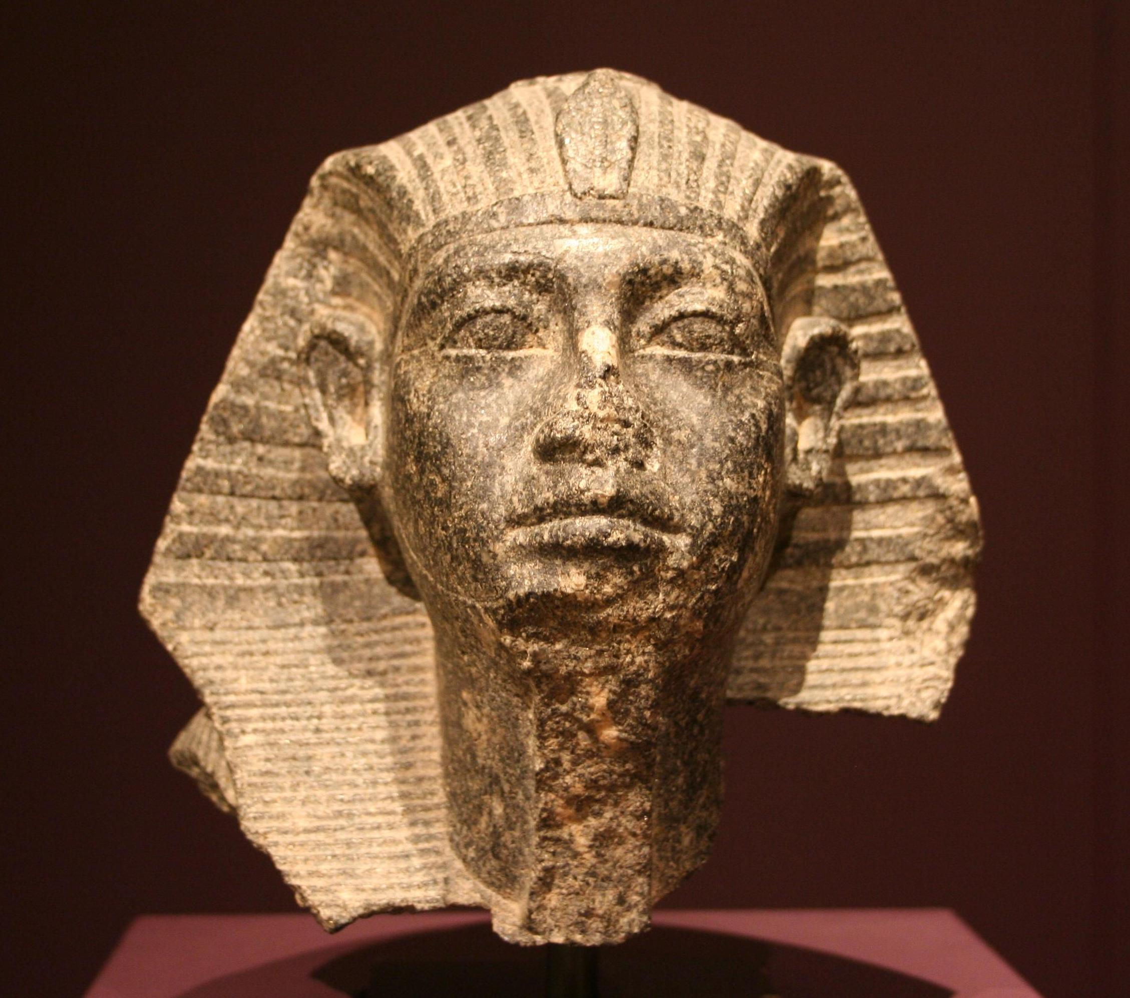
První králové
Sesóstris
Hdt. 2.102–110
τούτοισι μὲν στήλας ἐνίστη ἐς τὰς χώρας διὰ γραμμάτων λεγούσας τό τε ἑωυτοῦ οὔνομα καὶ τῆς πάτρης,
… διὰ τῶν στηθέων γράμματα ἱρὰ Αἰγύπτια διήκει ἐγκεκολαμμένα, λέγοντα τάδε· " Ἐγὼ τήνδε τὴν χώρην ὤμοισι τοῖσι ἐμοῖσι ἐκτησάμην.„
D.S. 1.53–58 (Sesoósis)
Dobyvatel
Tažení do celého světa
Dobytí Asie, části Evropy
Stavba kanálů, rozdělení půdy, daně
Senvosret III.
he set up pillars in their land whereon the inscription showed his own name and his country's, and how he had overcome them with his own power
there is carven a writing in the Egyptian sacred character, saying: "I myself won this land with the might of my shoulders.

Slide 17
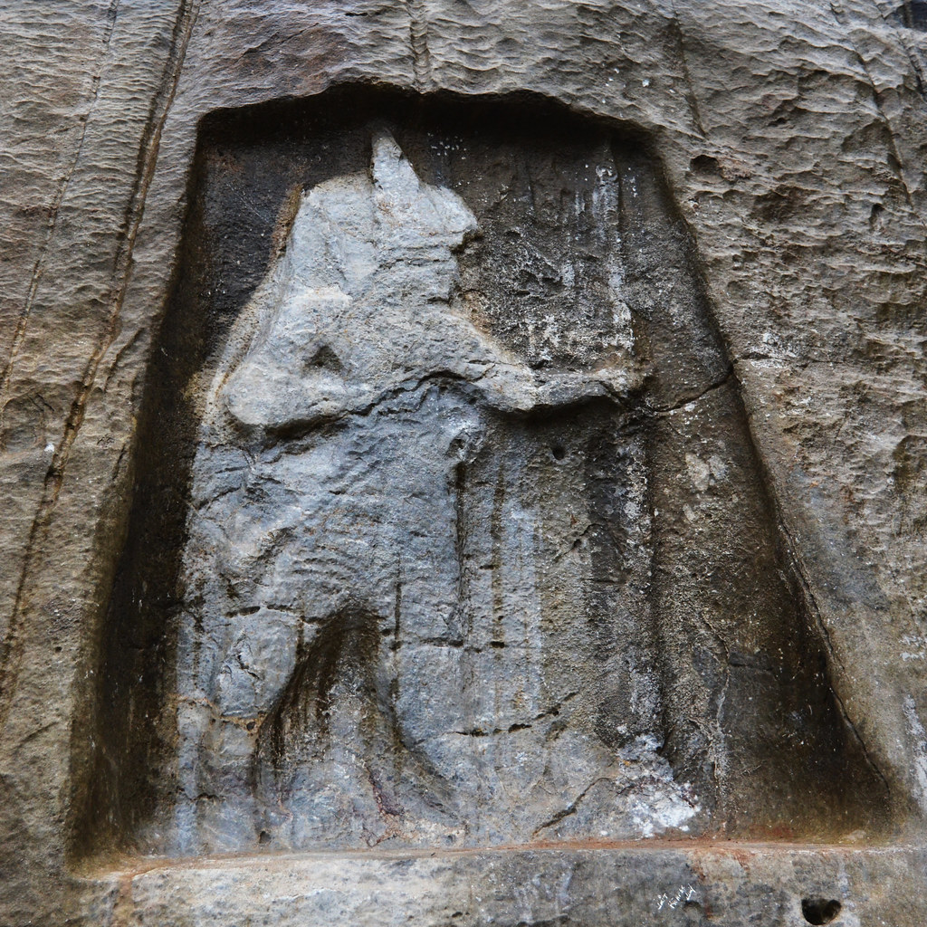
Sesóstris
Reliéf v Karabelu

Slide 18
První králové - historky
Hdt. 2.111 – Ferón
Hdt. 2.112–120 – Próteos – Helena a Meneláos
Hdt. 2.121–122 – Rhampsinitos – extrémně bohatý (D.S. 1.62 - Remfis)

Slide 19
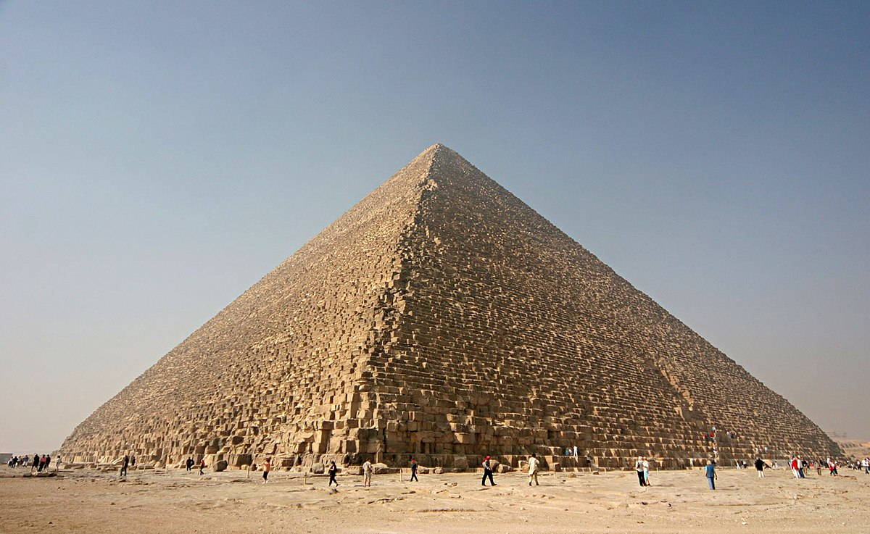
Stavitelé pyramid
Hdt. 2.124–126
Cheops (Chufu)
μετὰ δὲ τοῦτον βασιλεύσαντα σφέων Χέοπα ἐς πᾶσαν κακότητα ἐλάσαι. κατακληίσαντα γάρ μιν πάντα τὰ ἱρὰ πρῶτα μὲν σφέας θυσιέων τουτέων ἀπέρξαι, μετὰ δὲ ἐργάζεσθαι ἑωυτῷ κελεύειν πάντας Αἰγυπτίους.
τὰς ἐποιέετο θῆκας ἑωυτῷ ἐν νήσῳ, … τῇ δὲ πυραμίδι αὐτῇ χρόνον γενέσθαι εἴκοσι ἔτεα ποιευμένῃ·
but Cheops, who was the next king, brought the people to utter misery. For first he shut up all the temples, so that none could sacrifice there; and next, he compelled all the Egyptians to work for him,
these the king meant to be burial-places for himself, and encompassed them with water, bringing in a channel from the Nile. The pyramid itself was twenty years in the making.

Slide 20
Stavitelé pyramid
Cheops
Hdt. 2.126
Ἐς τοῦτο δὲ ἐλθεῖν Χέοπα κακότητος ὥστε χρημάτων δεόμενον τὴν θυγατέρα τὴν ἑωυτοῦ κατίσαντα ἐπ’ οἰκήματος προστάξαι πρήσσεσθαι ἀργύριον ὁκόσον δή τι· οὐ γὰρ δὴ τοῦτό γε ἔλεγον. τὴν δὲ τά τε ὑπὸ τοῦ πατρὸς ταχθέντα πρήσσεσθαι, ἰδίῃ δὲ καὶ αὐτὴν διανοηθῆναι μνημήιον καταλιπέσθαι, καὶ τοῦ ἐσιόντος πρὸς αὐτὴν ἑκάστου δέεσθαι ὅκως ἂν αὐτῇ ἕνα λίθον ἐν τοῖσι ἔργοισι δωρέοιτο. ἐκ τούτων δὲ τῶν λίθων ἔφασαν τὴν πυραμίδα οἰκοδομηθῆναι τὴν ἐν μέσῳ τῶν τριῶν ἑστηκυῖαν, ἔμπροσθε τῆς μεγάλης πυραμίδος, τῆς ἐστὶ τὸ κῶλον ἕκαστον ὅλου καὶ ἡμίσεος πλέθρου.
And so evil a man was Cheops that for lack of money he made his own daughter to sit in a chamber and exact payment (how much, I know not; for they did not tell me this). She, they say, doing her father's bidding, was minded to leave some memorial of her own, and demanded of everyone who sought intercourse with her that he should give one stone to set in her work; and of these stones was built the pyramid that stands midmost of the three, over against the great pyramid; each side of it measures one hundred and fifty feet.

Slide 21
D.S. 1.63.5 (Chemmis)
πᾶσα δὲ στερεοῦ λίθου κατεσκεύασται, τὴν μὲν ἐργασίαν ἔχοντος δυσχερῆ, τὴν δὲ διαμονὴν αἰώνιον: οὐκ ἐλαττόνων γὰρ ἢ χιλίων ἐτῶν, ὥς φασι, διεληλυθότων εἰς τὸν καθ᾽ ἡμᾶς βίον, ὡς δὲ ἔνιοι γράφουσι, πλειόνων ἢ τρισχιλίων καὶ τετρακοσίων, διαμένουσι μέχρι τοῦ νῦν οἱ λίθοι τὴν ἐξ ἀρχῆς σύνθεσιν καὶ τὴν ὅλην κατασκευὴν ἄσηπτον διαφυλάττοντες.
The entire construction is of hard stone, which is difficult to work but lasts for ever; for though no fewer than a thousand years have elapsed, as they say, to our lifetime, or, as some writers have it, more than three thousand four hundred, the stones remain to this day still preserving their original position and the entire structure undecayed.

Slide 22
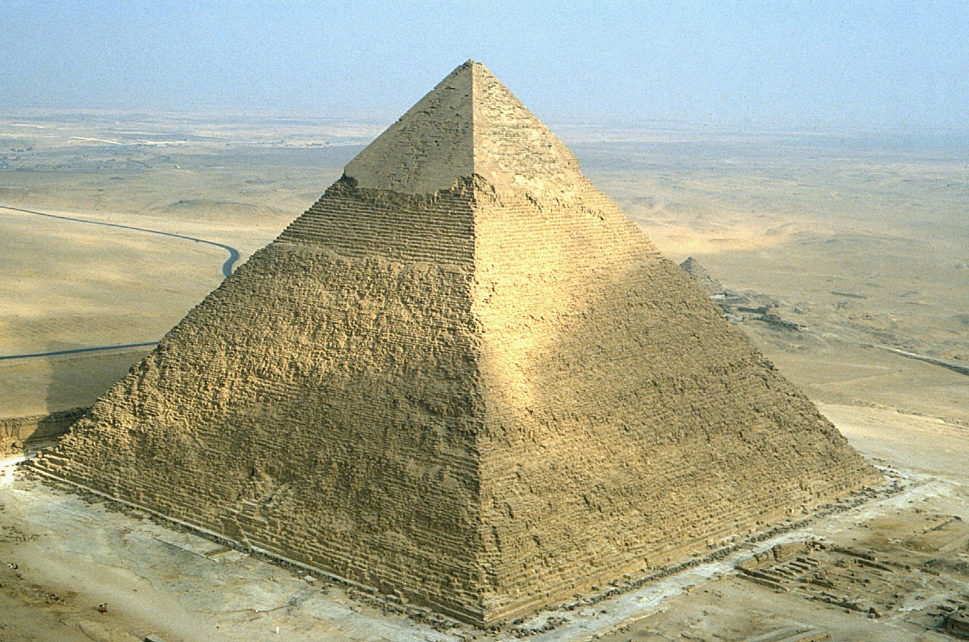
Stavitelé pyramid
Chefrén (Chafra)
Hdt. 2.127
Χεφρῆνα· καὶ τοῦτον δὲ τῷ αὐτῷ τρόπῳ διαχρᾶσθαι τῷ ἑτέρῳ τά τε ἄλλα καὶ πυραμίδα ποιῆσαι,
Chephren also built a pyramid, of a less size than his brother's.

Slide 23
Stavitelé pyramid
D.S. 1.64 (Hdt. 2.128)
τῶν δὲ βασιλέων τῶν κατασκευασάντων αὐτὰς ἑαυτοῖς τάφους συνέβη μηδέτερον αὐτῶν ταῖς πυραμίσιν ἐνταφῆναι: τὰ γὰρ πλήθη διά τε ταλαιπωρίαν τὴν ἐν τοῖς ἔργοις καὶ διὰ τὸ τούτους τοὺς βασιλεῖς ὠμὰ καὶ βίαια πολλὰ πρᾶξαι δι᾽ ὀργῆς εἶχε τοὺς αἰτίους, καὶ τὰ σώματα ἠπείλει διασπάσειν καὶ μεθ᾽ ὕβρεως ἐκρίψειν ἐκ τῶν τάφων:
And though the two kings built the pyramids to serve as their tombs, in the event neither of them was buried in them; 5 for the multitudes, because of the hardships which they had endured in the building of them and the many cruel and violent acts of these kings, were filled with anger against those who had caused their sufferings and openly threatened to tear their bodies asunder and cast them in despite out of the tombs.

Slide 24
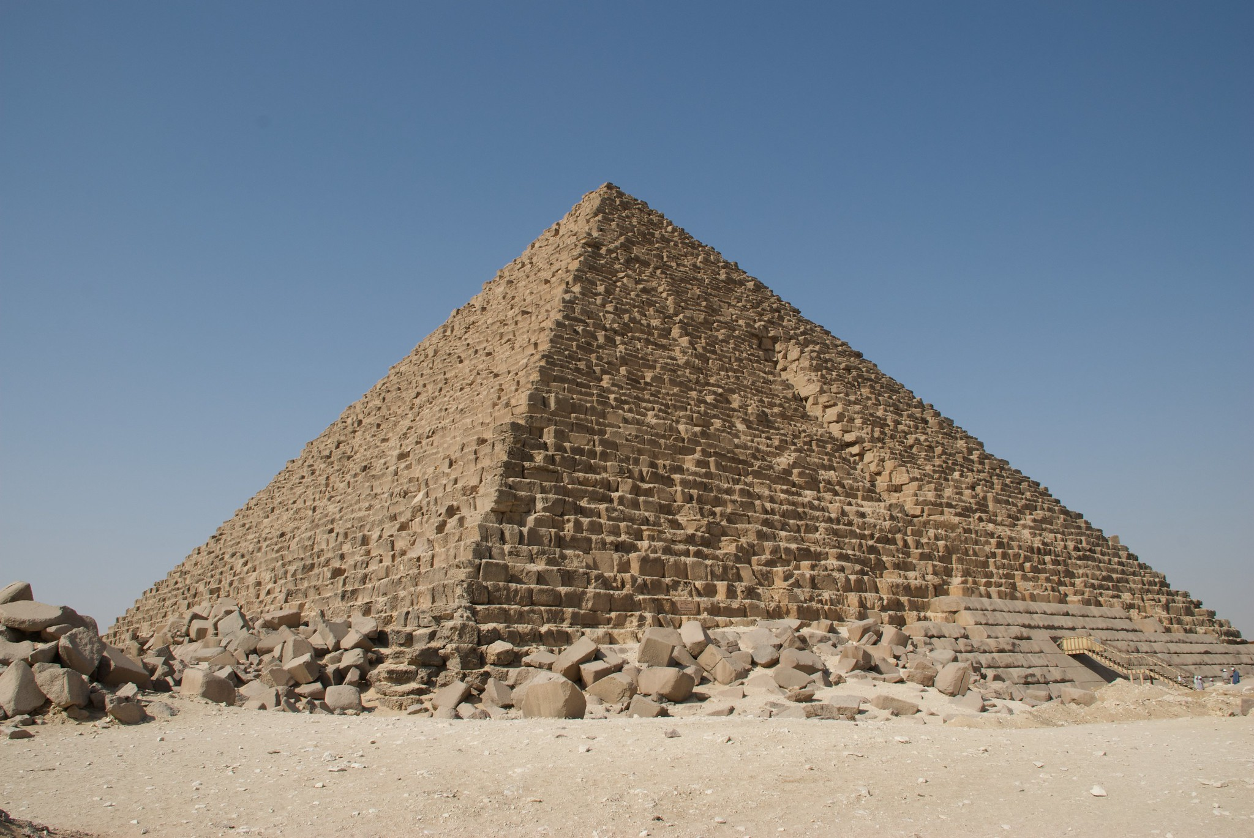
Stavitelé pyramid
Mykerínos (Menkaure)
Hdt. 2.129–134
Πυραμίδα δὲ οὗτος ἀπελίπετο πολλὸν ἐλάσσω τοῦ πατρὸς
This king too left a pyramid, but far smaller than his father‘s
Pohřeb dcery, zabil ji sám/neštěstí, socha krávy v Saïs

Slide 25
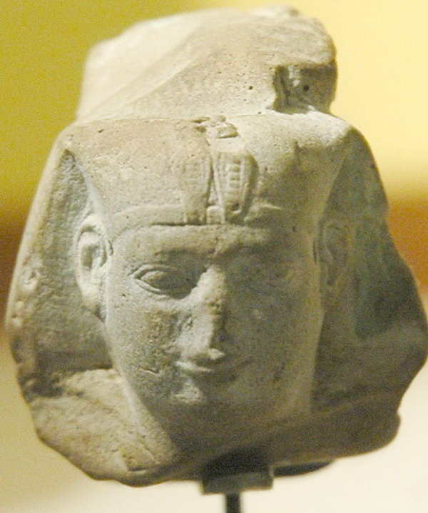
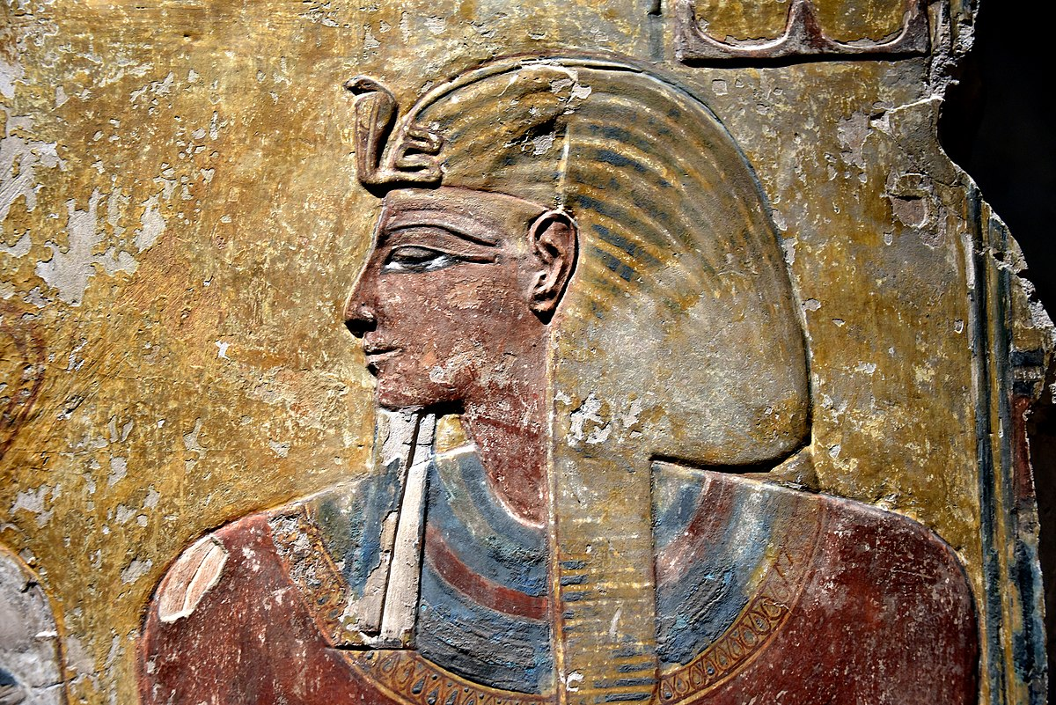
Další králové
Hdt. 2.137–139 Sabakos – z Aithiopie (Šabako)
Hdt. 2.141 – Sethos (Šebitku) – boje s Assyřany
Hdt. 2.142 – chronologie, délka vlády
Ἐς μὲν τοσόνδε τοῦ λόγου Αἰγύπτιοί τε καὶ οἱ ἱρέες ἔλεγον, ἀποδεικνύντες ἀπὸ τοῦ πρώτου βασιλέος ἐς τοῦ Ἡφαίστου τὸν ἱρέα τοῦτον τὸν τελευταῖον βασιλεύσαντα μίαν τε καὶ τεσσεράκοντα καὶ τριηκοσίας γενεὰς ἀνθρώπων γενομένας, καὶ ἐν ταύτῃσι ἀρχιερέας καὶ βασιλέας ἑκατέρους τοσούτους γενομένους. καίτοι τριηκόσιαι μὲν ἀνδρῶν γενεαὶ δυνέαται μύρια ἔτεα· γενεαὶ γὰρ τρεῖς ἀνδρῶν ἑκατὸν ἔτεα ἐστί· μιῆς δὲ καὶ τεσσεράκοντα ἔτι τῶν ἐπιλοίπων γενεέων, αἳ ἐπῆσαν τῇσι τριηκοσίῃσι, ἐστὶ τεσσεράκοντα καὶ τριηκόσια καὶ χίλια ἔτεα. οὕτω ἐν μυρίοισί τε ἔτεσι καὶ χιλίοισι καὶ τριηκοσίοισί τε καὶ τεσσεράκοντα ἔλεγον θεὸν ἀνθρωποειδέα οὐδένα γενέσθαι· οὐ μέντοι οὐδὲ πρότερον οὐδὲ ὕστερον ἐν τοῖσι ὑπολοίποισι Αἰγύπτου βασιλεῦσι γενομένοισι ἔλεγον οὐδὲν τοιοῦτο.
Thus far went the record given me by the Egyptians and their priests; and they showed me that the time from the first king to that priest of Hephaestus, who was the last, covered three hundred and forty‑one generations of men, and that in this time such also had been the number of their kings, and of their high priests. Now three hundred generations make up ten thousand years, three generations being equal to a century. And over and above the three hundred the remaining forty‑one cover thirteen hundred and forty years. Thus the whole sum is eleven thousand three hundred and forty years; in all which time (they said) they had had no king who was a god in human form, nor had there been any such thing either before or after those years among the rest of the kings of Egypt.

Slide 26
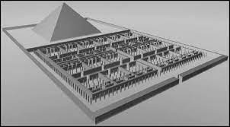
Labyrint
Hdt. 2.148
δόξαν δέ σφι ἐποιήσαντο λαβύρινθον, ὀλίγον ὑπὲρ τῆς λίμνης τῆς Μοίριος κατὰ Κροκοδείλων καλεομένην πόλιν μάλιστά κῃ κείμενον·
ἦσαν μέν νυν καὶ αἱ πυραμίδες λόγου μέζονες, καὶ πολλῶν ἐκάστη αὐτέων Ἑλληνικῶν ἔργων καὶ μεγάλων ἀνταξίη, ὁ δὲ δὴ λαβύρινθος καὶ τὰς πυραμίδας ὑπερβάλλει·
having so resolved they made a labyrinth,​ a little way beyond the lake Moeris and near the place called the City of Crocodiles
Though the pyramids were greater than words can tell, and each one of them a match for many great monuments built by Greeks, this maze surpasses even the pyramids.

Slide 27
Pozdější králové – Saitská dynastie
Již správná chronologie
Psammétichos (Psamtik I.)
Hdt. 2.151–157
Pomoc Řeků
Nekós (Nechó) – Hdt. 2.158–159
Stavba kanálu do Rudého moře
Psammis (Psamtik II.) – Hdt. 2.160
Apriés – Hdt. 2.161
Tažení do Libye
Amasis – Hdt. 2.162–163, 169
Hdt. 2.172–182

Slide 28
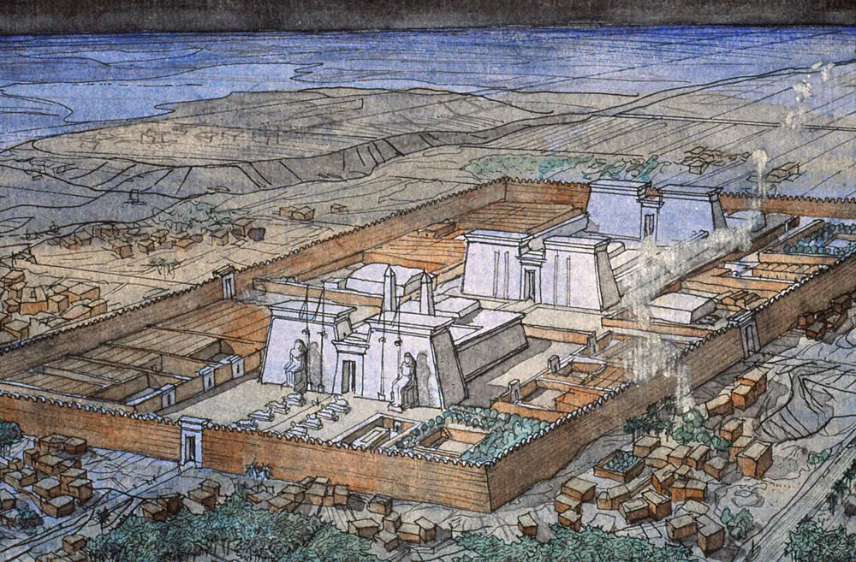
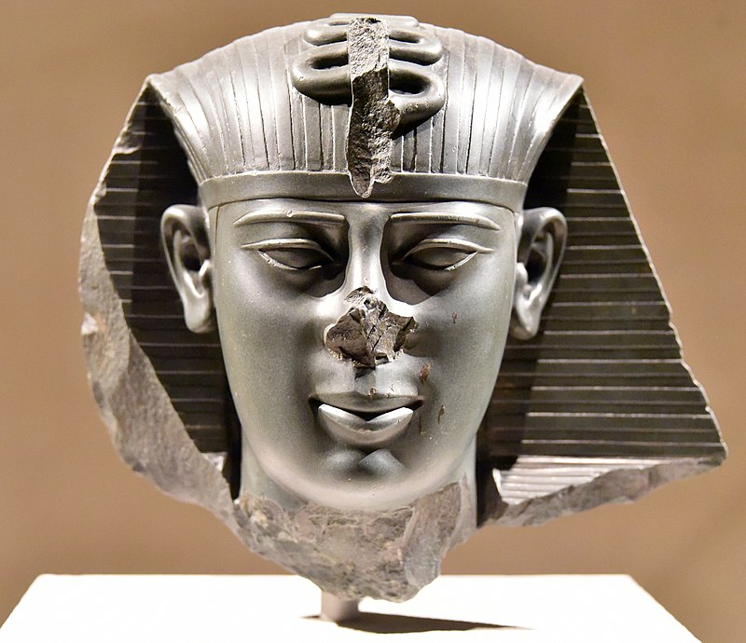
Saitská dynastie
Amasis II.
Ἀπρίεω δὲ ὧδε καταραιρημένου ἐβασίλευσε Ἄμασις, νόμου μὲν Σαΐτεω ἐών, ἐκ τῆς δὲ ἦν πόλιος, οὔνομά οἱ ἐστὶ Σιούφ. τὰ μὲν δὴ πρῶτα κατώνοντο τὸν Ἄμασιν Αἰγύπτιοι καὶ ἐν οὐδεμιῇ μοίρῃ μεγάλῃ ἦγον ἅτε δὴ δημότην τὸ πρὶν ἐόντα καὶ οἰκίης οὐκ ἐπιφανέος· μετὰ δὲ σοφίῃ αὐτοὺς ὁ Ἄμασις, οὐκ ἀγνωμοσύνῃ προσηγάγετο.
Apries being thus deposed, Amasis became king; he was of a town called Siuph in the province of Sais. Now at first he was contemned and held in but little regard by the Egyptians, as having been but a common man and of no high family: but presently he won them to him by being cunning and not arrogant.

Slide 29
Saitská dynastie
Amasis
Ἐπ’ Ἀμάσιος δὲ βασιλέος λέγεται Αἴγυπτος μάλιστα δὴ τότε εὐδαιμονῆσαι καὶ τὰ ἀπὸ τοῦ ποταμοῦ τῇ χώρῃ γινόμενα καὶ τὰ ἀπὸ τῆς χώρης τοῖσι ἀνθρώποισι, καὶ πόλις ἐν αὐτῇ γενέσθαι τὰς ἁπάσας τότε δισμυρίας τὰς οἰκεομένας. νόμον τε Αἰγυπτίοισι τόνδε Ἄμασις ἐστὶ ὁ καταστήσας, ἀποδεικνύναι ἔτεος ἑκάστου τῷ νομάρχῃ πάντα τινὰ Αἰγυπτίων ὅθεν βιοῦται· μὴ δὲ ποιεῦντα ταῦτα μηδὲ ἀποφαίνοντα δικαίην ζόην ἰθύνεσθαι θανάτῳ. Σόλων δὲ ὁ Ἀθηναῖος λαβὼν ἐξ Αἰγύπτου τοῦτον τὸν νόμον Ἀθηναίοισι ἔθετο· τῷ ἐκεῖνοι ἐς αἰεὶ χρέωνται ἐόντι ἀμώμῳ νόμῳ.
It is said that in the reign of Amasis Egypt attained to its greatest prosperity, in respect of what the river did for the land and the land for its people: and that the whole sum of inhabited cities in the country was twenty thousand. It was Amasis also who made the law that every Egyptian should yearly declare his means of livelihood to the ruler of his province, and, failing so to do or to prove that he had a just way of life, be punished with death. Solon the Athenian got this law from Egypt and established it among his people; may they ever keep it! for it is a perfect law

Slide 30
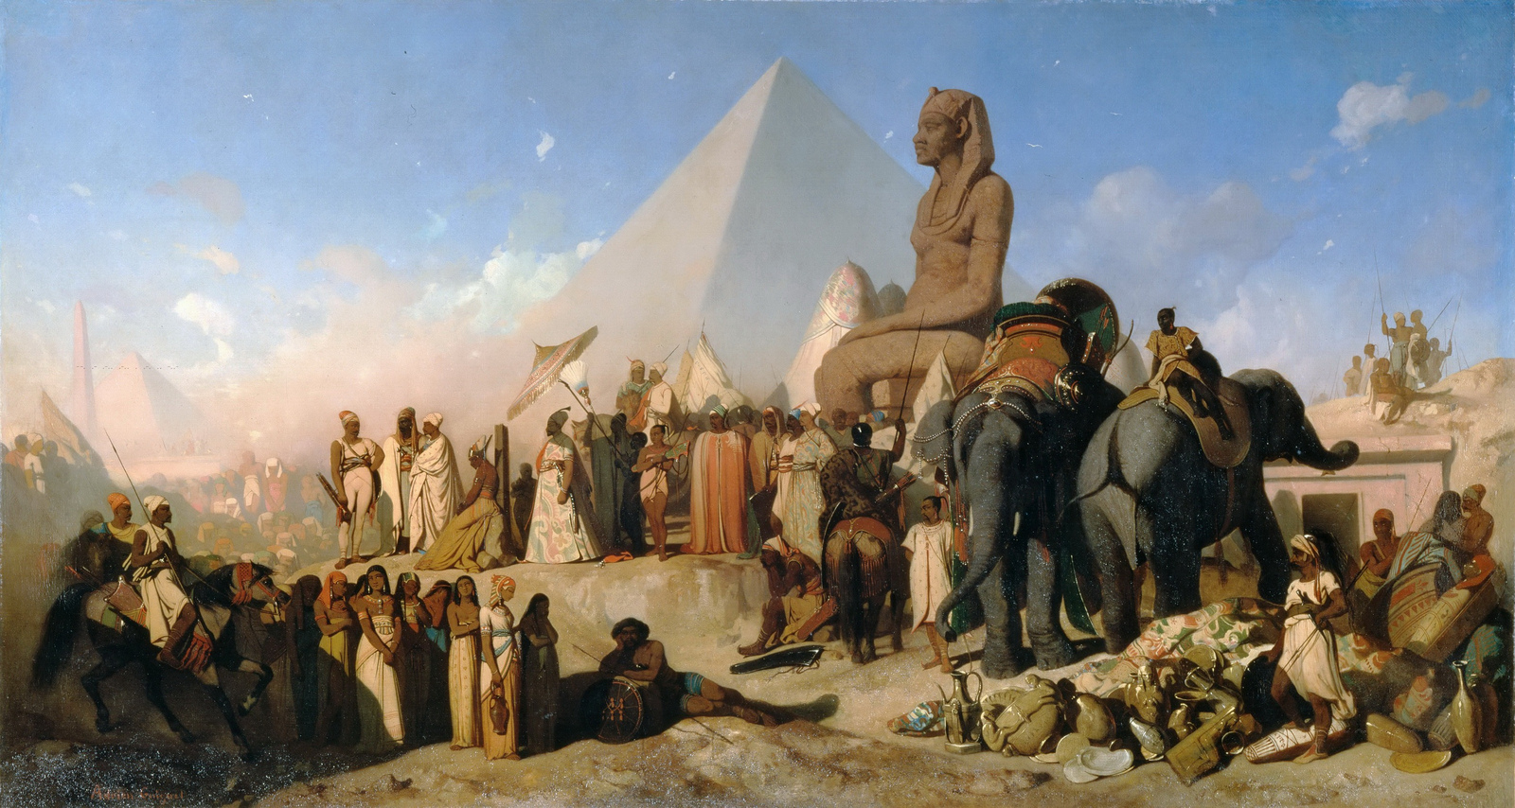
Dobytí Peršany
Amasis (570–525 pnl), Psamménitos (Psamtik III.)
X Kambýses II.
Bitva u Pelúsia Hdt. 3.10

Slide 31
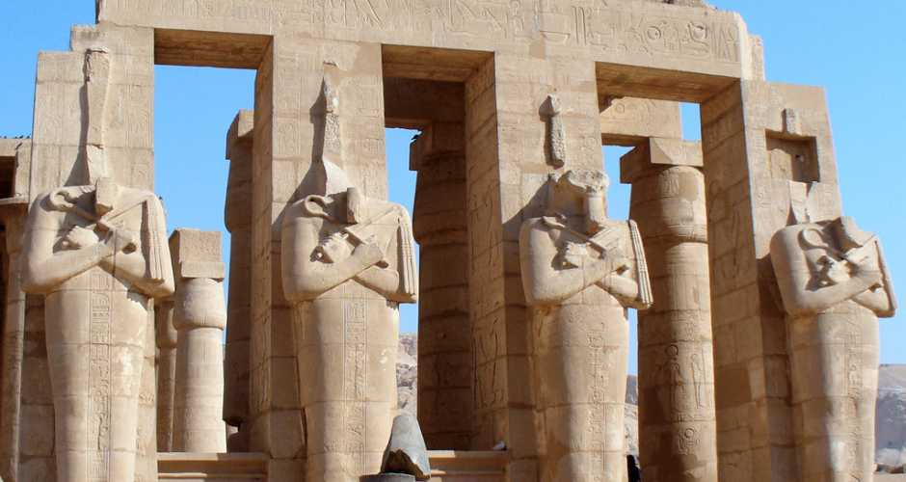
Mimo Hérodota
Osymandyás (Ramesse II.)
D.S. 1.47–49
ἀπὸ γὰρ τῶν πρώτων τάφων, ἐν οἷς παραδέδοται τὰς παλλακίδας τοῦ Διὸς τεθάφθαι, δέκα σταδίων φησὶν ὑπάρξαι βασιλέως μνῆμα τοῦ προσαγορευθέντος Ὀσυμανδύου.
ἐπιγεγράφθαι δ᾽ ἐπ᾽ αὐτοῦ ‘βασιλεὺς βασιλέων Ὀσυμανδύας εἰμί. εἰ δέ τις εἰδέναι βούλεται πηλίκος εἰμὶ καὶ ποῦ κεῖμαι, νικάτω τι τῶν ἐμῶν ἔργων.’
Ten stades from the first tombs, he says, in which, according to tradition, are buried the concubines of Zeus, stands a monument of the king known as Osymandyas.
The inscription upon it runs: "King of Kings am I, Osymandyas. If anyone would know how great I am and where I lie, let him surpass one of my works.

Slide 32
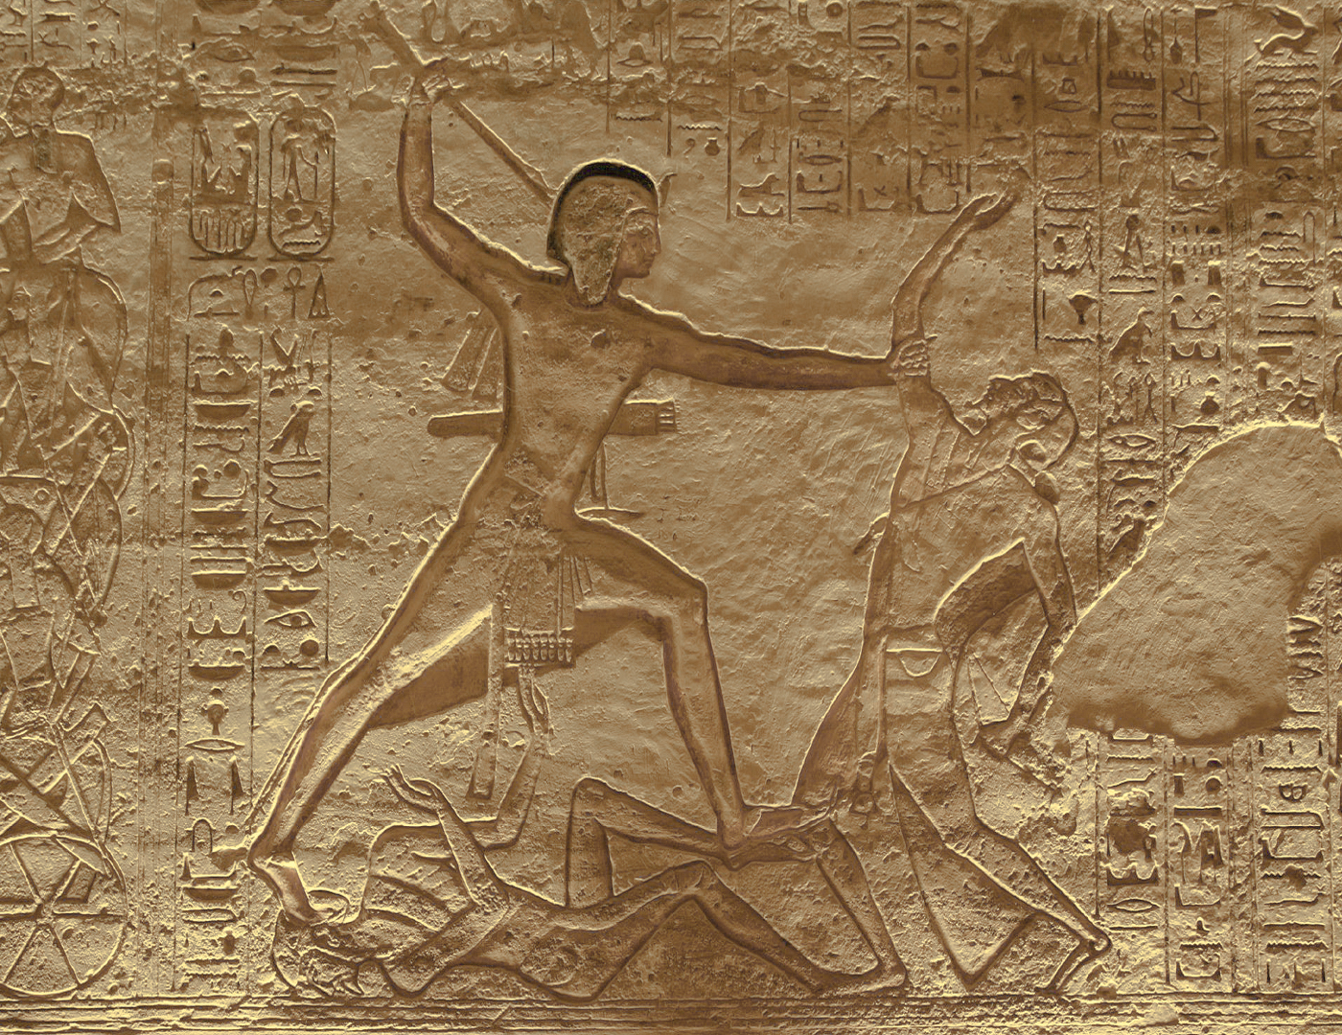
Mimo Hérodota
Ramesse II.
D.S. 1.47
μετὰ δὲ τὸν πυλῶνα περίστυλον εἶναι τοῦ προτέρου ἀξιολογώτερον, ἐν ᾧ γλυφὰς ὑπάρχειν παντοίας δηλούσας τὸν πόλεμον τὸν γενόμενον αὐτῷ πρὸς τοὺς ἐν τοῖς Βάκτροις ἀποστάντας: ἐφ᾽ οὓς ἐστρατεῦσθαι πεζῶν μὲν τετταράκοντα μυριάσιν, ἱππεῦσι δὲ δισμυρίοις, εἰς τέτταρα μέρη διῃρημένης τῆς πάσης στρατιᾶς, ὧν ἁπάντων υἱοὺς τοῦ βασιλέως ἐσχηκέναι τὴν ἡγεμονίαν.
Beyond the pylon, he says, there is a peristyle more remarkable than the former one; in it there are all manner of reliefs depicting the war which the king waged against those Bactrians who had revolted; against these he had made a campaign with four hundred thousand foot-soldiers and twenty thousand cavalry, the whole army having been divided into four divisions, all of which were under the command of sons of the king.

Slide 33
Alexandr a Egypt
Pseudo-Kallisthenés
Romance o Alexandrovi
1.1–12
Poslední egyptský faraon, Nektanebó II., otcem Alexandra

Slide 34
Egypt - dějiny
Hérodotos i Diodóros – důraz na stavitelskou činnost králů
Příběhy k vládě králů
Špatná chronologie (D.S. 1.50)
Dobré záznamy k Saitské dynastii

Slide 35
Manetho
Chronologicky
Kronika
Linie bohů
The first man (or god) in Egypt is Hephaestus,​ who is also renowned among the Egyptians as the discoverer of fire. His son, Helios (the Sun), was succeeded by Sôsis; then follow, in turn, Cronos, Osiris, Typhon, brother of Osiris, and lastly Orus, son of Osiris and Isis.
Seznamy vládců, 30 dynastií, délka vlády, občas události z vlády
Čerpal z oficiálních seznamů vládců
Flavius Josephus – Contra Apionem
Plútarchos – O Ísidě a Osíridovi

Slide 36
Náboženství
Egypt – místo zrození bohů
Hdt. 2.43–63
Plu. De Iside
D.S. 1.11–20
D.S. 1.9.6
Ἐπεὶ δὲ κατὰ τὴν Αἴγυπτον θεῶν τε γενέσεις ὑπάρξαι μυθολογοῦνται, αἵ τε τῶν ἄστρων ἀρχαιόταται παρατηρήσεις εὑρῆσθαι λέγονται, πρὸς δὲ τούτοις πράξεις ἀξιόλογοι καὶ πολλαὶ μεγάλων ἀνδρῶν ἱστοροῦνται …
And since Egypt is the country where mythology places the origin of the gods, where the earliest observations of the stars are said to have been made, and where, furthermore, many noteworthy deeds of great men are recorded,

Slide 37
Náboženství
Interpretatio graeca
Osíris – Dionýsos
Ísis – Démétér/Afrodíté
Ammón – Zeus
Ptah – Héfaistos
Ápis – Epafos
Set – Týfón
Hórus – Apollón
Anúbis/Osíris – Hádés
Ra – Hélios
Thoth/Anúbis – Hermés
Hathor - Afrodíté

Slide 38
Interpretatio graeca
D.S. 1.25
Καθόλου δὲ πολλή τίς ἐστι διαφωνία περὶ τούτων τῶν θεῶν. Τὴν αὐτὴν γὰρ οἱ μὲν Ἶσιν, οἱ δὲ Δήμητραν, οἱ δὲ Θεσμοφόρον, οἱ δὲ Σελήνην, οἱ δὲ Ἥραν, οἱ δὲ πάσαις ταῖς προσηγορίαις ὀνομάζουσι. Τὸν δὲ Ὄσιριν οἱ μὲν Σάραπιν, οἱ δὲ Διόνυσον, οἱ δὲ Πλούτωνα, οἱ δὲ Ἄμμωνα, τινὲς δὲ Δία, πολλοὶ δὲ Πᾶνα τὸν αὐτὸν νενομίκασι· λέγουσι δέ τινες Σάραπιν εἶναι τὸν παρὰ τοῖς Ἕλλησι Πλούτωνα ὀνομαζόμενον.
In general, there is great disagreement over these gods. For the same goddess is called by some Isis, by others Demeter, by others Thesmophorus, by others Selenê, by others Hera, while still others apply to her all these names. 2 Osiris has been given the name Sarapis by some, Dionysus by others, Pluto by others, Ammon by others, Zeus by some, and many have considered Pan to be the same god; and some say that Sarapis is the god whom the Greeks call Pluto.

Slide 39
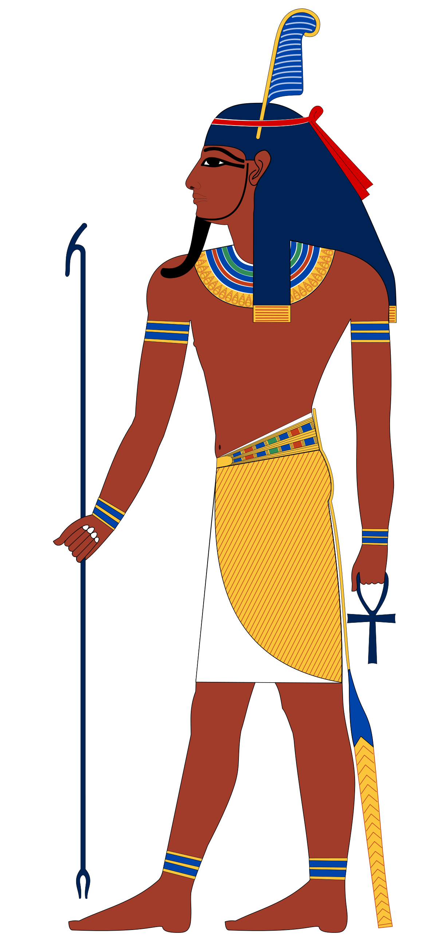
Náboženství
Řečtí bohové (mimo jiné) pocházejí z Egypta
Např. Héraklés (Šu) Hdt. 2.43
καὶ μὴν ὅτι γε οὐ παρ’ Ἑλλήνων ἔλαβον τὸ οὔνομα Αἰγύπτιοι τοῦ Ἡρακλέος, ἀλλὰ Ἕλληνες μᾶλλον παρ’ Αἰγυπτίων καὶ Ἑλλήνων οὗτοι οἱ θέμενοι τῷ Ἀμφιτρύωνος γόνῳ τοὔνομα Ἡρακλέα, πολλά μοι καὶ ἄλλα τεκμήρια ἐστὶ τοῦτο οὕτω ἔχειν, ἐν δὲ καὶ τόδε, ὅτι τε τοῦ Ἡρακλέος τούτου οἱ γονέες ἀμφότεροι ἦσαν Ἀμφιτρύων καὶ Ἀλκμήνη γεγονότες τὸ ἀνέκαθεν ἀπ’ Αἰγύπτου
I have indeed many proofs that the name of Heracles did not come from Hellas to Egypt, but from Egypt to Hellas (and in Hellas to those Greeks who gave the name Heracles to the son of Amphitryon); and this is the chief among them — that Amphitryon and Alcmene, the parents of this Heracles, were both by descent Egyptian;​

Slide 40
Náboženství
Např. Dionýsos Hdt. 2.48–49
Např. věštírny Hdt. 2.54
ἔφασαν οἱ ἱρέες τοῦ Θηβαιέος Διὸς δύο γυναῖκας ἱρείας ἐκ Θηβέων ἐξαχθῆναι ὑπὸ Φοινίκων, καὶ τὴν μὲν αὐτέων πυθέσθαι ἐς Λιβύην πρηθεῖσαν τὴν δὲ ἐς τοὺς Ἕλληνας· ταύτας δὲ τὰς γυναῖκας εἶναι τὰς ἱδρυσαμένας τὰ μαντήια πρώτας ἐν τοῖσι εἰρημένοισι ἔθνεσι.
The priests of Zeus of Thebes told me that two priestesses had been carried away by from Thebes by Phoenicians; one of them (so, they said, they had learnt) was taken away and sold in Libya, and the other in Hellas; these women, they said, were the first founders of places of divination in the countries aforesaid.

Slide 41
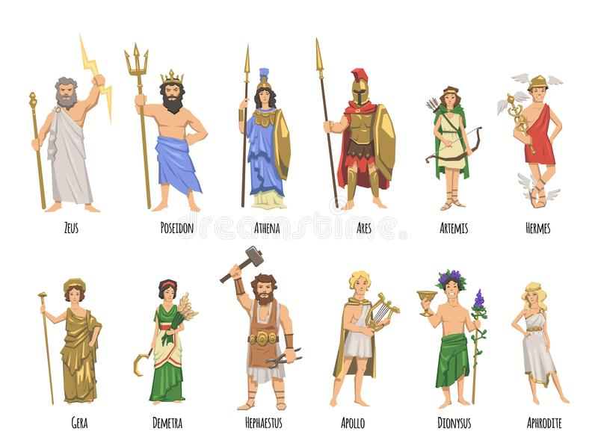
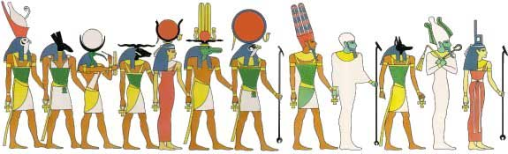
Náboženství
Hdt. 2.50
Σχεδὸν δὲ καὶ πάντων τὰ οὐνόματα τῶν θεῶν ἐξ Αἰγύπτου ἐλήλυθε ἐς τὴν Ἑλλάδα. διότι μὲν γὰρ ἐκ τῶν βαρβάρων ἥκει, πυνθανόμενος οὕτω εὑρίσκω ἐόν· δοκέω δ’ ὦν μάλιστα ἀπ’ Αἰγύπτου ἀπῖχθαι.
Nejzbožnější z lidí – 2.37
Θεοσεβέες δὲ περισσῶς ἐόντες μάλιστα πάντων ἀνθρώπων νόμοισι τοιοῖσιδε χρέωνται.
Indeed, wellnigh all the names of the gods came to Hellas from Egypt. For I am assured by inquiry that they have come from foreign parts, and I believe that they came chiefly from Egypt.
They are beyond measure religious, more than any other nation

Slide 42
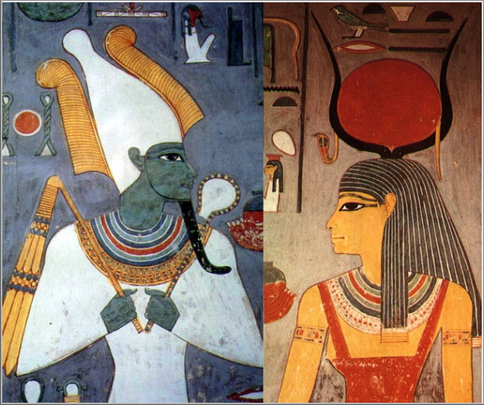
Náboženství
Ísis a Osíris
D.S. 1.11
Μεθερμηνευομένων γὰρ τούτων εἰς τὸν Ἑλληνικὸν τῆς διαλέκτου τρόπον εἶναι τὸν μὲν Ὄσιριν πολυόφθαλμον, … Τῶν δὲ παρ´ Ἕλλησι παλαιῶν μυθολόγων τινὲς τὸν Ὄσιριν Διόνυσον προσονομάζουσι καὶ Σείριον παρωνύμως·… Τὴν δὲ Ἶσιν μεθερμηνευομένην εἶναι παλαιάν, τεθειμένης τῆς προσηγορίας ἀπὸ τῆς ἀιδίου καὶ παλαιᾶς γενέσεως. Κέρατα δ´ αὐτῇ ἐπιτιθέασιν ἀπό τε τῆς ὄψεως ἣν ἔχουσα φαίνεται καθ´ ὃν ἂν χρόνον ὑπάρχῃ μηνοειδής, καὶ ἀπὸ τῆς καθιερωμένης αὐτῇ βοὸς παρ´ Αἰγυπτίοις.
For when the names are translated into Greek Osiris means "many-eyed, … And of the ancient Greek writers of mythology some give to Osiris the name Dionysus or, with a slight change in form, Sirius. …As for Isis, when translated the word means "ancient," the name having been given her because her birth was from everlasting and ancient. And they put horns on her head both because of the appearance which she has to the eye when the moon is crescent-shaped, and because among the Egyptians a cow is held sacred to her.

Slide 43
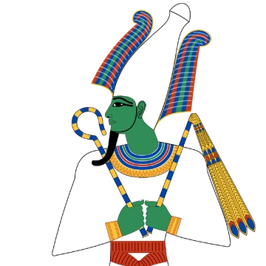
Osíris
D.S. 1.17
Τὸν δὲ Ὄσιριν λέγουσιν, ὥσπερ εὐεργετικὸν ὄντα καὶ φιλόδοξον, στρατόπεδον μέγα συστήσασθαι, διανοούμενον ἐπελθεῖν ἅπασαν τὴν οἰκουμένην καὶ διδάξαι τὸ γένος τῶν ἀνθρώπων τήν τε τῆς ἀμπέλου φυτείαν καὶ τὸν σπόρον τοῦ τε πυρίνου καὶ κριθίνου καρποῦ·
Of Osiris they say that, being of a beneficent turn of mind, and eager for glory, he gathered together a great army, with the intention of visiting all the inhabited earth and teaching the race of men how to cultivate the vine and sow wheat and barley

Slide 44
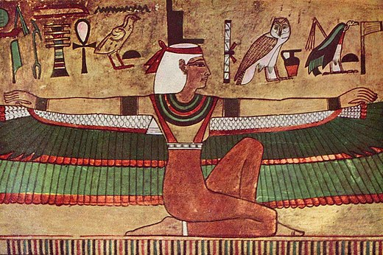
Osíris a Ísis
D.S. 1.21
Φασὶ γὰρ νομίμως βασιλεύοντα τῆς Αἰγύπτου τὸν Ὄσιριν ὑπὸ Τυφῶνος ἀναιρεθῆναι τἀδελφοῦ, βιαίου καὶ ἀσεβοῦς ὄντος· ὃν διελόντα τὸ σῶμα τοῦ φονευθέντος εἰς ἓξ καὶ εἴκοσι μέρη δοῦναι τῶν συνεπιθεμένων ἑκάστῳ μερίδα, βουλόμενον πάντας μετασχεῖν τοῦ μύσους, καὶ διὰ τούτου νομίζοντα συναγωνιστὰς ἕξειν καὶ φύλακας τῆς βασιλείας βεβαίους. Τὴν δὲ Ἶσιν ἀδελφὴν οὖσαν Ὀσίριδος καὶ γυναῖκα μετελθεῖν τὸν φόνον, συναγωνιζομένου τοῦ παιδὸς αὐτῆς Ὥρου· ἀνελοῦσαν δὲ τὸν Τυφῶνα καὶ τοὺς συμπράξαντας βασιλεῦσαι τῆς Αἰγύπτου.
This is the story as they give it: When Osiris was ruling over Egypt as its lawful king, he was murdered by his brother Typhon, a violent and impious man; Typhon then divided the body of the slain man into twenty-six pieces​ and gave one portion to each of the band of murderers, since he wanted all of them to share in the pollution and felt that in this way he would have in them steadfast supporters and defenders of his rule. 3 But Isis, the sister and wife of Osiris, avenged his murder with the aid of her son Horus, and after slaying Typhon and his accomplices became queen over Egypt.

Slide 45
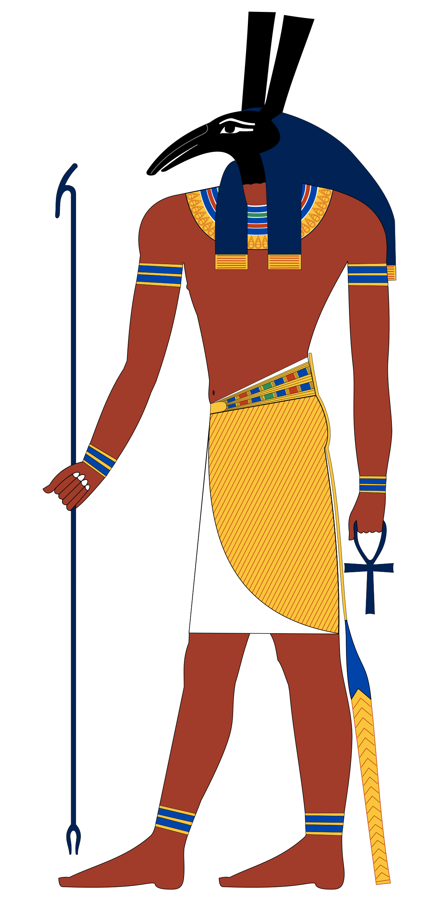
Osíris, Ísis, Hórus, Týfón
Plu. De Iside. 12–19
During his absence the tradition is that Typhon attempted nothing revolutionary because Isis, who was in control, was vigilant and alert; but when he returned home Typhon contrived a treacherous plot against him and formed a group of conspirators seventy-two in number.
As it happened, they had seen it, and they told her the mouth of the river through which the friends of Typhon had launched the coffin into the sea.
Recognizing the body he divided it into fourteen parts​ and scattered them, each in a different place.
Of the parts of Osiris's body the only one which Isis did not find was the male member,
Later, as they relate, Osiris came to Horus from the other world and exercised and trained him for the battle. After a time Osiris asked Horus what he held to be the most noble of all things. When Horus replied, "To avenge one's father and mother for evil done to them,"

Slide 46
Náboženství - hellénismus
D.S. 1.18
Τῷ δ´ οὖν Ὀσίριδι συνεστρατεῦσθαι δύο λέγουσιν υἱοὺς Ἄνουβίν τε καὶ Μακεδόνα, διαφέροντας ἀνδρείᾳ. Ἀμφοτέρους δὲ χρήσασθαι τοῖς ἐπισημοτάτοις ὅπλοις ἀπό τινων ζῴων οὐκ ἀνοικείων τῇ περὶ αὐτοὺς εὐτολμίᾳ· τὸν μὲν γὰρ Ἄνουβιν περιθέσθαι κυνῆν, τὸν δὲ Μακεδόνα λύκου προτομήν· ἀφ´ ἧς αἰτίας καὶ τὰ ζῷα ταῦτα τιμηθῆναι παρὰ τοῖς Αἰγυπτίοις.
Now Osiris was accompanied on his campaign, as the Egyptian account goes, by his two sons Anubis and Macedon, who were distinguished for their valour. Both of them carried the most notable accoutrements of war, taken from certain animals whose character was not unlike the boldness of the men, Anubis wearing a dog's skin and Macedon the fore-parts of a wolf; and it is for this reason that these animals are held in honour among the Egyptians.

Slide 47
Náboženství - hellénismus
D.S. 1.20
Καὶ κατὰ μὲν τὴν Θρᾴκην Λυκοῦργον τὸν βασιλέα τῶν βαρβάρων ἐναντιούμενον τοῖς ὑπ´ αὐτοῦ πραττομένοις ἀποκτεῖναι, Μάρωνα δὲ γηραιὸν ἤδη καθεστῶτα καταλιπεῖν ἐπιμελητὴν τῶν ἐν ταύτῃ τῇ χώρᾳ φυτευομένων, καὶ κτίστην αὐτὸν ποιῆσαι τῆς ἐπωνύμου πόλεως, ἣν ὀνομάσαι Μαρώνειαν. Καὶ Μακεδόνα μὲν τὸν υἱὸν ἀπολιπεῖν βασιλέα τῆς ἀπ´ ἐκείνου προσαγορευθείσης Μακεδονίας, Τριπτολέμῳ δ´ ἐπιτρέψαι τὰς κατὰ τὴν Ἀττικὴν γεωργίας.
In Thrace he slew Lycurgus, the king of the barbarians, who opposed his undertaking, and Maron, who was now old, he left there to supervise the culture of the plants which he introduced into that land and caused him to found a city to bear his name, which he called Maroneia. 3 Macedon his son, moreover, he left as king of Macedonia, which was named after him, while to Triptolemus he assigned the care of agriculture in Attica.

Slide 48
Kult zvířat (Hdt. 2.65–76; D.S. 1.83–89)
D.S. 1.83
Περὶ δὲ τῶν ἀφιερωμένων ζῴων κατ´ Αἴγυπτον εἰκότως φαίνεται πολλοῖς παράδοξον τὸ γινόμενον καὶ ζητήσεως ἄξιον. Σέβονται γὰρ ἔνια τῶν ζῴων Αἰγύπτιοι καθ´ ὑπερβολὴν οὐ ζῶντα μόνον, ἀλλὰ καὶ τελευτήσαντα, οἷον αἰλούρους καὶ τοὺς ἰχνεύμονας καὶ κύνας, ἔτι δ´ ἱέρακας καὶ τὰς καλουμένας παρ´ αὐτοῖς ἴβεις, πρὸς δὲ τούτοις τούς τε λύκους καὶ τοὺς κροκοδείλους καὶ ἕτερα τοιαῦτα πλείω, περὶ ὧν τὰς αἰτίας ἀποδιδόναι πειρασόμεθα, βραχέα πρότερον ὑπὲρ αὐτῶν διελθόντες.
As regards the consecration of animals in Egypt, the practice naturally appears to many to be extraordinary and worthy of investigation. For the Egyptian venerate certain animals exceedingly, not only during their lifetime but even after their death, such as cats,​ ichneumons and dogs, and, again, hawks and the birds which they call "ibis," as well as wolves and crocodiles and a number of other animals of that kind, and the reasons for such worship we shall undertake to set forth, after we have first spoken briefly about the animals themselves.

Slide 49
Kult zvířat
D.S. 1.85.5
Ὅταν δ´ ἀποθάνῃ τι τῶν εἰρημένων, σινδόνι κατακαλύψαντες καὶ μετ´ οἰμωγῆς τὰ στήθη καταπληξάμενοι φέρουσιν εἰς τὰς ταριχείας· ἔπειτα θεραπευθέντων αὐτῶν κεδρίᾳ καὶ τοῖς δυναμένοις εὐωδίαν παρέχεσθαι καὶ πολυχρόνιον τοῦ σώματος τήρησιν θάπτουσιν ἐν ἱεραῖς θήκαις.
When one of these animals dies, they wrap it in fine linen and then, wailing and beating their breasts, carry it off to be embalmed; and after it has been treated with cedar oil and such spices as have the quality of imparting a pleasant odour and of preserving the body for a long time,​ they lay it away in a consecrated tomb.

Slide 50
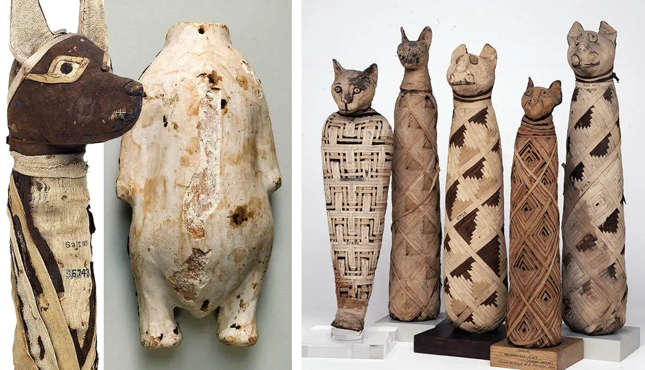
Kult zvířat
Hdt. 2.65
τὸ δ’ ἄν τις τῶν θηρίων τούτων ἀποκτείνῃ, ἢν μὲν ἑκών, θάνατος ἡ ζημίη, ἢ ν δὲ ἀέκων, ἀποτίνει ζημίην τὴν ἂν οἱ ἱρέες τάξωνται. ὃς δ’ ἂν ἶβιν ἢ ἴρηκα ἀποκτείνῃ, ἢν τε ἑκὼν ἢν τε ἀέκων, τεθνάναι ἀνάγκη.
D.S. 1.83
Οὕτω δ´ ἐν ταῖς τῶν ὄχλων ψυχαῖς ἐντέτηκεν ἡ πρὸς τὰ ζῷα ταῦτα δεισιδαιμονία …
Whoever kills one of these creatures with intention is punished with death; if he kill by mischance he pays whatever penalty the priests appoint. Whoever kills an ibis or a hawk, with intention or without, must die for it.
Kočka a ibis
So deeply implanted also in the hearts of the common people is their superstitious regard for these animals ….

Slide 51
Kult zvířat
D.S. 1.83
ἀποκτείναντος Ῥωμαίου τινὸς αἴλουρον, καὶ τοῦ πλήθους συνδραμόντος ἐπὶ τὴν οἰκίαν τοῦ πράξαντος, οὔθ´ οἱ πεμφθέντες ὑπὸ τοῦ βασιλέως ἄρχοντες ἐπὶ τὴν παραίτησιν οὔθ´ ὁ κοινὸς ἀπὸ τῆς Ῥώμης φόβος ἴσχυσεν ἐξελέσθαι τῆς τιμωρίας τὸν ἄνθρωπον, καίπερ ἀκουσίως τοῦτο πεπραχότα·
when one of the Romans killed a cat and the multitude rushed in a crowd to his house, neither the officials sent by the king to beg the man off nor the fear of Rome which all the people felt were enough to save the man from punishment, even though his act had been an accident.

Slide 52
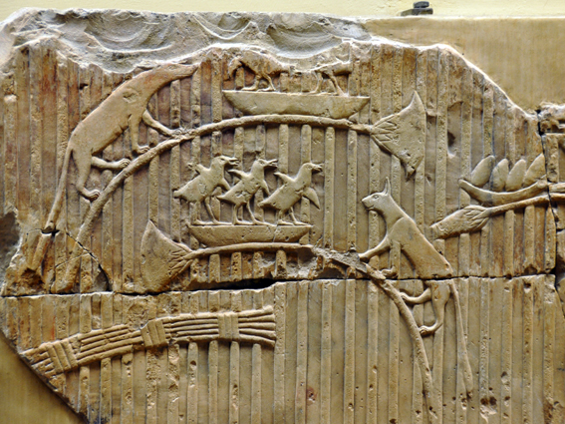
Kult zvířat
Hdt. 2.66
πυρκαϊῆς δὲ γενομένης θεῖα πρήγματα καταλαμβάνει τοὺς αἰελούρους· οἱ μὲν γὰρ Αἰγύπτιοι διαστάντες φυλακὰς ἔχουσι τῶν αἰελούρων, ἀμελήσαντες σβεννύναι τὸ καιόμενον, οἱ δὲ αἰέλουροι διαδύνοντες καὶ ὑπερθρώσκοντες τοὺς ἀνθρώπους ἐσάλλονται ἐς τὸ πῦρ. ταῦτα δὲ γινόμενα πένθεα μεγάλα τοὺς Αἰγυπτίους καταλαμβάνει. ἐν ὁτέοισι δ’ ἂν οἰκίοισι αἰέλουρος ἀποθανῇ ἀπὸ τοῦ αὐτομάτου, οἱ ἐνοικέοντες πάντες ξυρῶνται τὰς ὀφρύας μούνας, παρ’ ὁτέοισι δ’ ἂν κύων, πᾶν τὸ σῶμα καὶ τὴν κεφαλήν.
And when a fire breaks out very strange things happen to the cats. The Egyptians stand round in a broken line, thinking more of the cats than of quenching the burning; but the cats slip through or leap over the men and spring into the fire. When this happens, there is great mourning in Egypt. Dwellers in a house where a cat has died a natural death shave their eyebrows and no more; where a dog has so died, the head and the whole body are shaven.

Slide 53
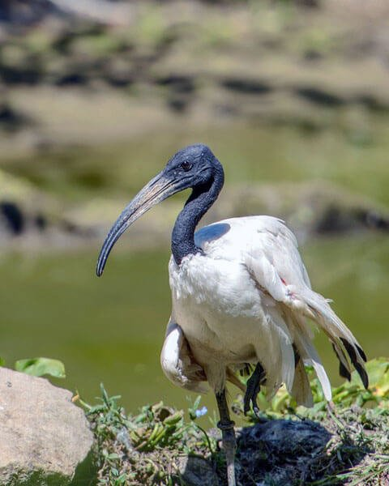
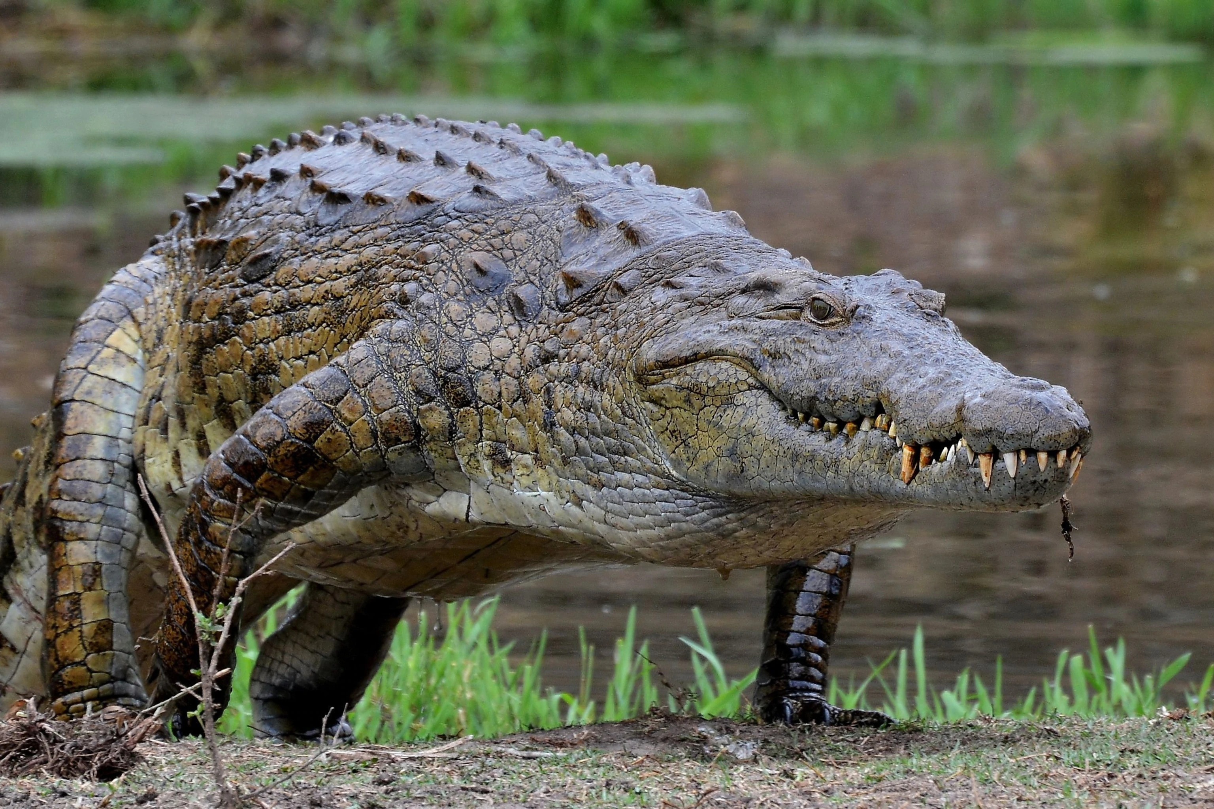
Kult zvířat
Kočky – Hdt. 2.66–67
Krokodýl – Hdt. 2.68–70
Někde uctíván, jinde ne (dokonce i jako potrava), egyptský výraz champsai
Hroch – Hdt. 2.71
Οἱ δὲ ἵπποι οἱ ποτάμιοι νόμῳ μὲν τῷ Παπρημίτῃ ἱροί εἰσι, τοῖσι δὲ ἄλλοισι Αἰγυπτίοισι οὐκ ἱροί. φύσιν δὲ παρέχονται ἰδέης τοιήνδε· τετράπουν ἐστί, δίχηλον, ὁπλαὶ βοός, σιμόν, λοφιὴν ἔχον ἵππου, χαυλιόδοντας φαῖνον, οὐρὴν ἵππου καὶ φωνήν, μέγαθος ὅσον τε βοῦς ὁ μέγιστος· τὸ δέρμα δ’ αὐτοῦ οὕτω δή τι παχύ ἐστι ὥστε αὔου γενομένου ξυστὰ ποιέεσθαι ἀκόντια ἐξ αὐτοῦ.
River horses are sacred in the province of Papremis, but not elsewhere in Egypt. For their outward form, they are four-footed, with cloven hoofs like oxen; their noses are blunt; they are maned like horses, with tusks showing, and have a horse's tail and a horse's neigh; their bigness is that of the biggest oxen. Their hide is so thick that when it is dried spearshafts are made of it.
Vydry – Hdt. 2.72
Hadi – Hdt. 2.74
Okřídlení ještěři – Hdt. 2.75 – Arábie
Ibis – Hdt. 2.76

Slide 54
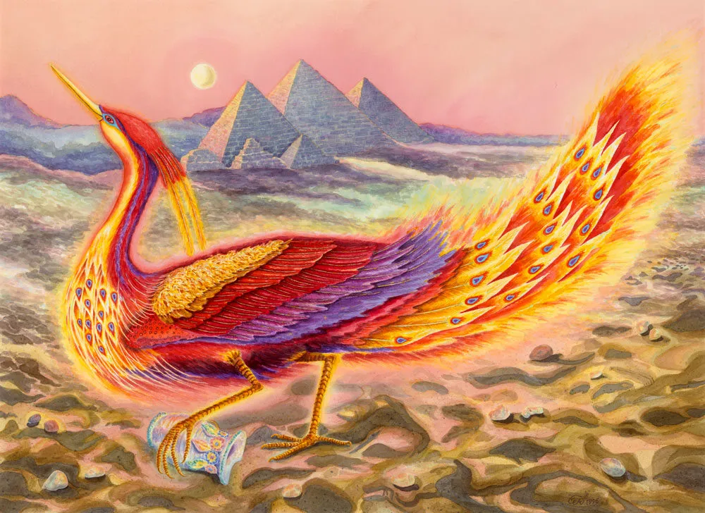
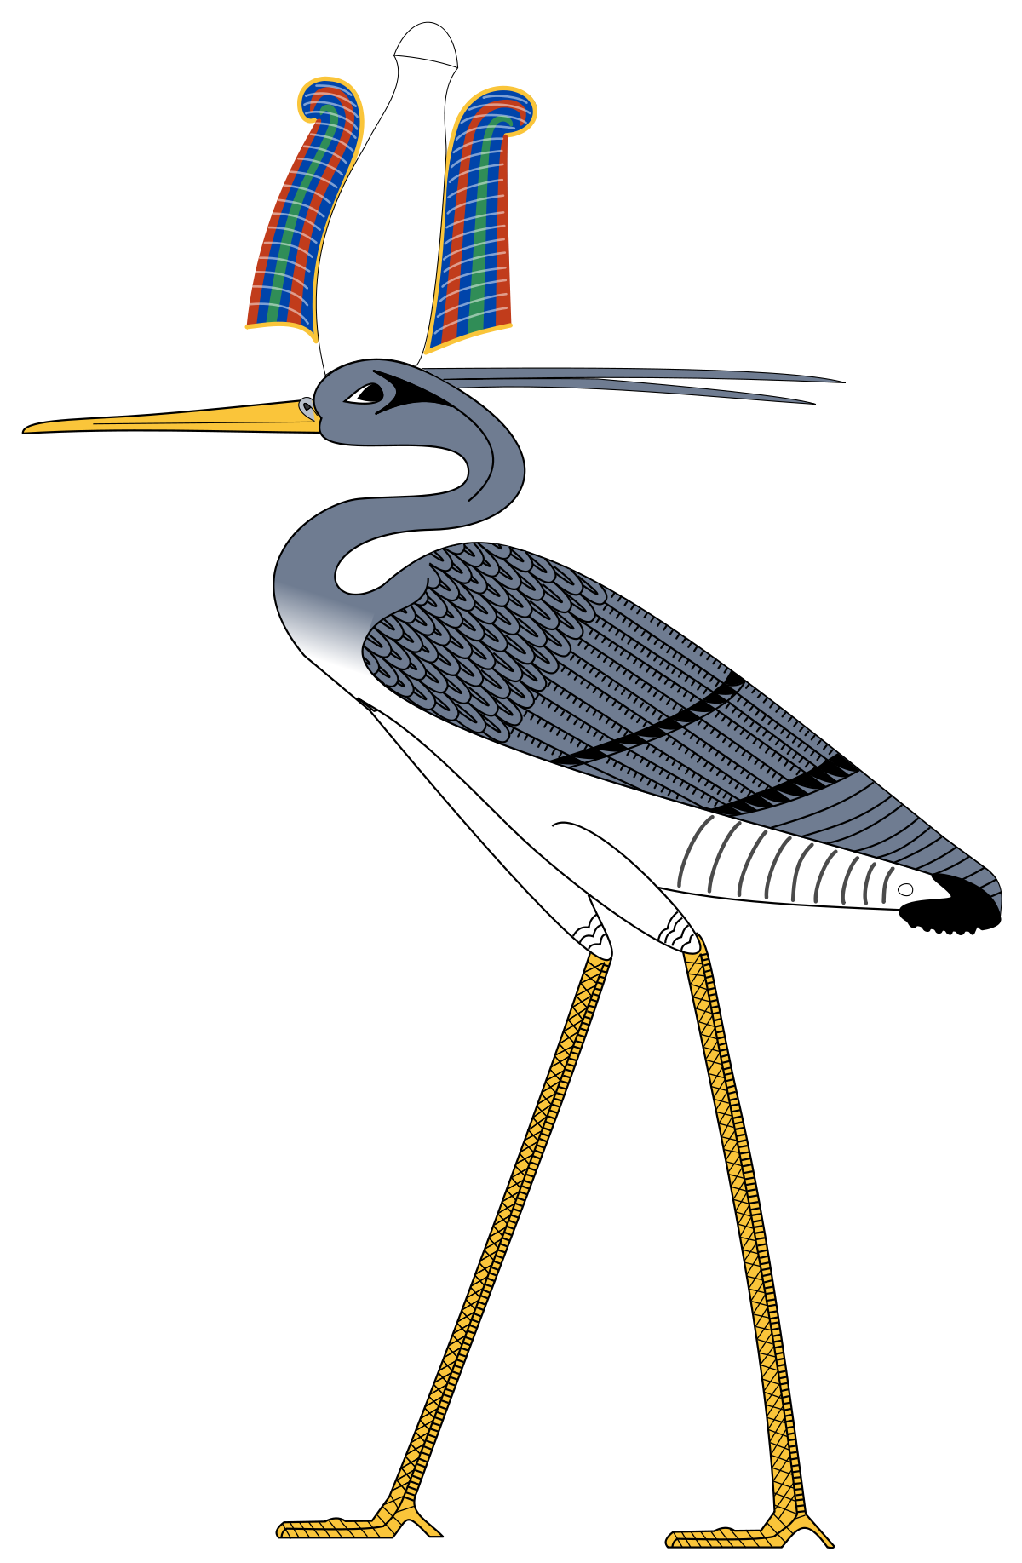
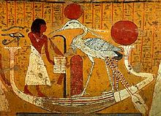
Kult zvířat
Hdt. 2.73
Ἔστι δὲ καὶ ἄλλος ὄρνις ἱρός, τῷ οὔνομα φοῖνιξ. ἐγὼ μέν μιν οὐκ εἶδον εἰ μὴ ὅσον γραφῇ· καὶ γὰρ δὴ καὶ σπάνιος ἐπιφοιτᾷ σφι, δι’ ἐτέων, ὡς Ἡλιοπολῖται λέγουσι, πεντακοσίων· φοιτᾶν δὲ τότε φασὶ ἐπεὰν οἱ ἀποθανῇ ὁ πατήρ. ἔστι δέ, εἰ τῇ γραφῇ παρόμοιος, τοσόσδε καὶ τοιόσδε· τὰ μὲν αὐτοῦ χρυσόκομα τῶν πτερῶν τὰ δὲ ἐρυθρᾷ ἐς τὰ μάλιστα· αἰετῷ περιήγησιν ὁμοιότατος καὶ τὸ μέγαθος. τοῦτον δὲ λέγουσι μηχανᾶσθαι τάδε, ἐμοὶ μὲν οὐ πιστὰ λέγοντες· …
Another bird also is sacred; it is called the phoenix. I myself have never seen it, but only pictures of it; for the bird comes but seldom into Egypt, once in five hundred years, as the people of Heliopolis say. It is said that the phoenix comes when his father dies. If the picture truly shows his size and appearance, his plumage is partly golden but mostly red. He is most like an eagle in shape and bigness. The Egyptians tell a tale of this bird's devices which I do not believe.
Benu (?)

Slide 55
Kult zvířat - příběhy
Once, they say, when the inhabitants of Egypt were being hard pressed by a famine, many in their need laid hands upon their fellows, yet not a single man was even accused of having partaken of the sacred animals.
And if they happen to be making a military expedition in another country, they ransom the captive cats and hawks and bring them back to Egypt,
it happened that the Apis in Memphis died of old age; and the man who was charged with the care of him spent on his burial not only the whole of the very large sum which had been provided for the animal's maintenance, but also borrowed in addition fifty talents​ of silver from Ptolemy.
D.S. 1.84
Λιμῷ γάρ ποτε πιεζομένων τῶν κατ´ Αἴγυπτόν φασι πολλοὺς ἀλλήλων μὲν ἅψασθαι διὰ τὴν ἔνδειαν, τῶν δ´ ἀφιερωμένων ζῴων τὸ παράπαν μηδ´ αἰτίαν σχεῖν μηδένα προσενηνέχθαι.
Κἂν ἐν ἄλλῃ χώρᾳ που στρατευόμενοι τύχωσι, λυτρούμενοι τοὺς αἰλούρους καὶ τοὺς ἱέρακας κατάγουσιν εἰς Αἴγυπτον
ἔτυχεν ἐν Μέμφει τελευτήσας ὁ Ἆπις γήρᾳ· ὁ δὲ τὴν ἐπιμέλειαν ἔχων αὐτοῦ τήν τε ἡτοιμασμένην χορηγίαν, οὖσαν πάνυ πολλήν, εἰς ταφὴν ἅπασαν ἐδαπάνησε καὶ παρὰ τοῦ Πτολεμαίου πεντήκοντα ἀργυρίου τάλαντα προσεδανείσατο.

Slide 56
Kult zvířat - důvody
D.S. 1.86–87 (Plu. De Iside. 379e–382c)
Φασὶ γὰρ τοὺς ἐξ ἀρχῆς γενομένους θεούς, ὀλίγους ὄντας καὶ κατισχυομένους ὑπὸ τοῦ πλήθους καὶ τῆς ἀνομίας τῶν γηγενῶν ἀνθρώπων, ὁμοιωθῆναί τισι ζῴοις …
Φασὶν οὖν κατασκευάσαντας εἰκόνας τῶν ζῴων ἃ νῦν τιμῶσι, καὶ πήξαντας ἐπὶ σαυνίων, φορεῖν τοὺς ἡγεμόνας,
They say, namely, that the gods who came into existence in the beginning, being few in number and overpowered by the multitude and the lawlessness of earth-born men,​ took on the forms of certain animals
Consequently, they say, the commanders fashioned figures of the animals which they now worship and carried them fixed on lances

Slide 57
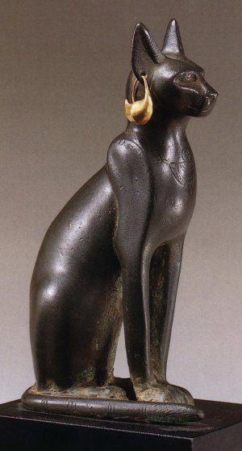
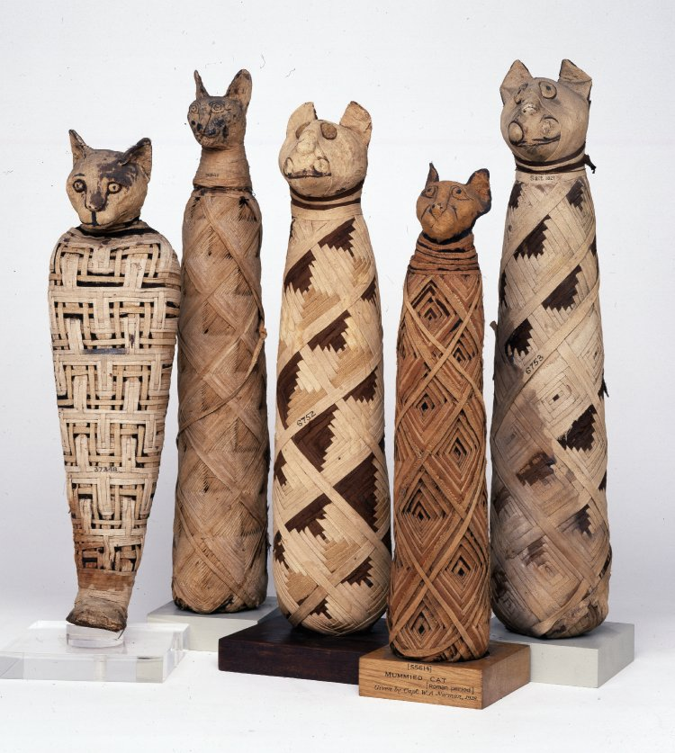
Kult zvířat
τρίτην δ´ αἰτίαν φέρουσι τῆς ἀμφισβητήσεως τῶν ζῴων τὴν χρείαν, ἣν ἕκαστον αὐτῶν προσφέρεται πρὸς τὴν ὠφέλειαν τοῦ κοινοῦ βίου καὶ τῶν ἀνθρώπων.
The third cause which they adduce in connection with the dispute in question is the service which each one of these animals renders for the benefit of community life and of mankind.

Slide 58

Mumifikace
They mourn and bury the dead as I will show. … When this is done, they take the dead body to be embalmed. … The bearers, having agreed in a price, go their ways, and the workmen, left behind in their place, embalm the body. … These make a hollow wooden figure like a man, in which they enclose the corpse, shut it up, and preserve it safe in a coffin-chamber, placed erect against a wall.
Hdt. 2.85–90
Θρῆνοι δὲ καὶ ταφαί σφεων εἰσὶ αἵδε … ἐπεὰν δὲ ταῦτα ποιήσωσι, οὕτω ἐς τὴν ταρίχευσιν κομίζουσι. … οἳ μὲν δὴ ἐκποδὼν μισθῷ ὁμολογήσαντες ἀπαλλάσσονται, οἳ δὲ ὑπολειπόμενοι ἐν οἰκήμασι ὧδε τὰ σπουδαιότατα ταριχεύουσι. … οἱ προσήκοντες ποιεῦνται ξύλινον τύπον ἀνθρωποειδέα, ποιησάμενοι δὲ ἐσεργνῦσι τὸν νεκρόν, καὶ κατακληίσαντες οὕτω θησαυρίζουσι ἐν οἰκήματι θηκαίῳ, ἱστάντες ὀρθὸν πρὸς τοῖχον.

Slide 59

Mumifikace
Τὰς δὲ γυναῖκας τῶν ἐπιφανέων ἀνδρῶν, ἐπεὰν τελευτήσωσι, οὐ παραυτίκα διδοῦσι ταριχεύειν, οὐδὲ ὅσαι ἂν ἔωσι εὐειδέες κάρτα καὶ λόγου πλεῦνος γυναῖκες· ἀλλ’ ἐπεὰν τριταῖαι ἢ τεταρταῖαι γένωνται, οὕτω παραδιδοῦσι τοῖσι ταριχεύουσι. τοῦτο δὲ ποιεῦσι οὕτω τοῦδε εἵνεκεν, ἵνα μή σφι οἱ ταριχευταὶ μίσγωνται τῇσι γυναιξί· λαμφθῆναι γὰρ τινὰ φασὶ μισούμενον νεκρῷ προσφάτῳ γυναικός, κατειπεῖν δὲ τὸν ὁμότεχνον
Wives of notable men, and women of great beauty and reputation, are not at once given over to the embalmers, but only after they have been dead for three or four days; this is done, that the embalmers may not have carnal intercourse with them. For it is said that the one was found having intercourse with a woman newly dead, and was denounced by his fellow-workman.

Slide 60

Mumifikace
D.S. 1.91–93
θεραπεύσαντες δὲ παραδιδόασι τοῖς συγγενέσι τοῦ τετελευτηκότος οὕτως ἕκαστον τῶν τοῦ σώματος μελῶν ἀκέραιον τετηρημένον ὥστε καὶ τὰς ἐπὶ τοῖς βλεφάροις καὶ ταῖς ὀφρύσι τρίχας διαμένειν καὶ τὴν ὅλην πρόσοψιν τοῦ σώματος ἀπαράλλακτον εἶναι καὶ τὸν τῆς μορφῆς τύπον γνωρίζεσθαι· διὸ καὶ πολλοὶ τῶν Αἰγυπτίων ἐν οἰκήμασι πολυτελέσι φυλάττοντες τὰ σώματα τῶν προγόνων, κατ´ ὄψιν ὁρῶσι τοὺς γενεαῖς πολλαῖς τῆς ἑαυτῶν γενέσεως προτετελευτηκότας, ὥστε ἑκάστων τά τε μεγέθη καὶ τὰς περιοχὰς τῶν σωμάτων, ἔτι δὲ τοὺς τῆς ὄψεως χαρακτῆρας ὁρωμένους παράδοξον ψυχαγωγίαν παρέχεσθαι καθάπερ συμβεβιωκότας τοῖς θεωμένοις.
And after treating the body they return it to the relatives of the deceased, every member of it having been so preserved intact that even the hair on the eyelids and brows remains, the entire appearance of the body is unchanged, and the cast of its shape is recognizable. 7 This explains why many Egyptians keep the bodies of their ancestors in costly chambers and gaze face to face upon those who died many generations before their own birth, so that, as they look upon the stature and proportions and the features of the countenance of each, they experience a strange enjoyment, as though they had lived with those on whom they gaze.

Slide 61
Literatura
Matthews, R. (Ed.). (2003). Ancient Perspectives on Egypt. London: Oxbow.
Lloyd, A. (1975). Herodotus: Book II: Introduction. Leiden: Brill.
Burkert, W. & Nenci, G. (1990). Hérodote et les peuples non grecs. Genève: Fondation Hardt.
Vasunia, P. (2001). The Gift of Nile: Hellenizing Egypt from Aeschylus to Alexander. Berkeley: University of California Press.
Chamoux, F. (1995). L'Égypte d'après Diodore de Sicile. In H. Leclant (Ed.). Entre Égypte et Grèce. Paris: Les Belles Lettres.

