Slide 1
DSBcB49 Starověká ekumena - antické zprávy o Asii a Africe
Afrika, Aithiopie, Numidie
Ζεὺς γὰρ ἐς Ὠκεανὸν μετ᾽ ἀμύμονας Αἰθιοπῆας

Slide 2
Afrika
Libye
Aithiopie – na jih od Egypta, Sahary
Libye – od místního kmene, řecká mytologie
Aithiopie - Αἰθιοπία, Αἰθίοψ – aithó (αἴθω) a ops (ὄψ) – „Spálený obličej“
Popis pro veškeré obyvatele tmavé pleti

Slide 3
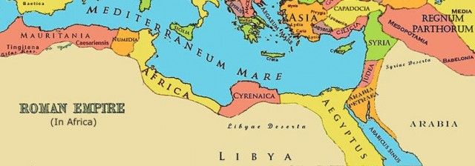
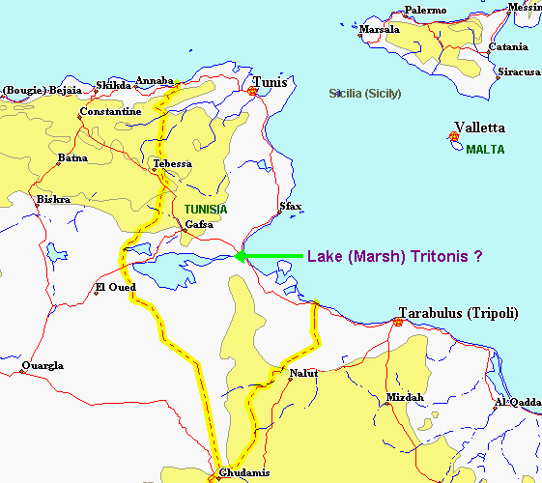
Kontakty
Viz také minulá hodina
Většinou mírové vztahy s Ptolemaiovci/Římem
Na jih od Sahary kontinent prakticky neznámý (nejistý pramen Nilu, geografie jihu obecně)
Občas nejasné umístění Aithiopů – na jihu i na východě (daleký jih/východ)
Na jih od Elefantíny, hl. město Meroé (Núbie)
Mnohem méně známé než Egypt či Kartágo
Odlišné klima oproti dnešku (úrodnější, lesy, Tritónské jezero)
Garamanté (Libye) – hl. město Garama
Gaetulové (Alžírsko) - Atlás

Slide 4
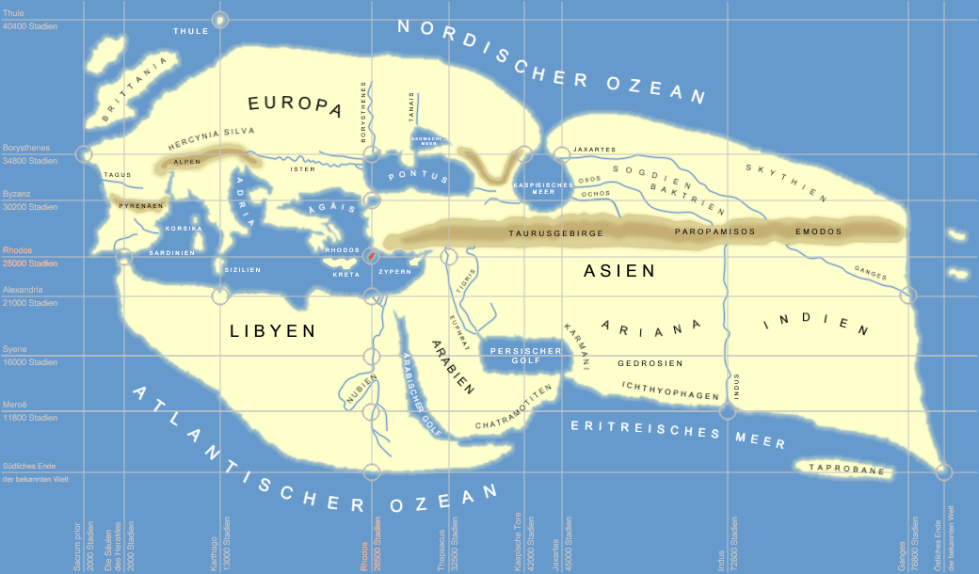
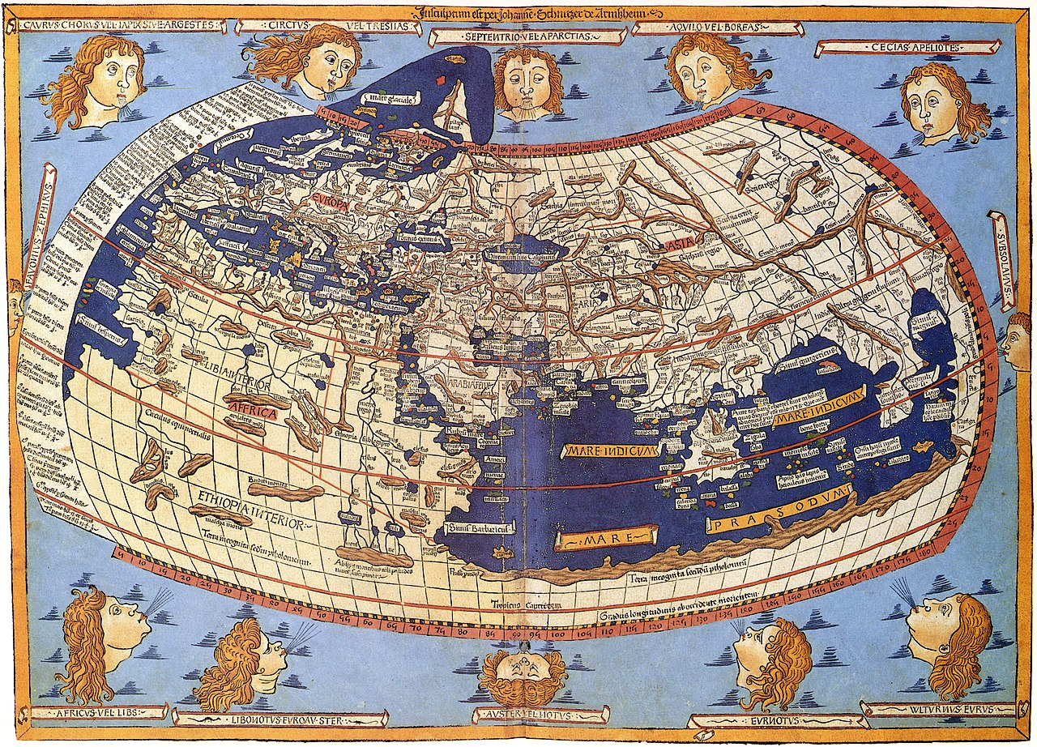
Kontakty
Znalost kontinentu – do oblasti dnešního Sahelu
Na jihu hraničí s Ókeánem
Po dnešní Somálsko/Senegal, dále na jih nikoli
Neznámé hranice na jihu
Rhapta – obchodní centrum
Azánia – JV pobřeží Afriky
Pramen Nilu – Atlás, Měsíční hory
Hic sunt leones

Slide 5
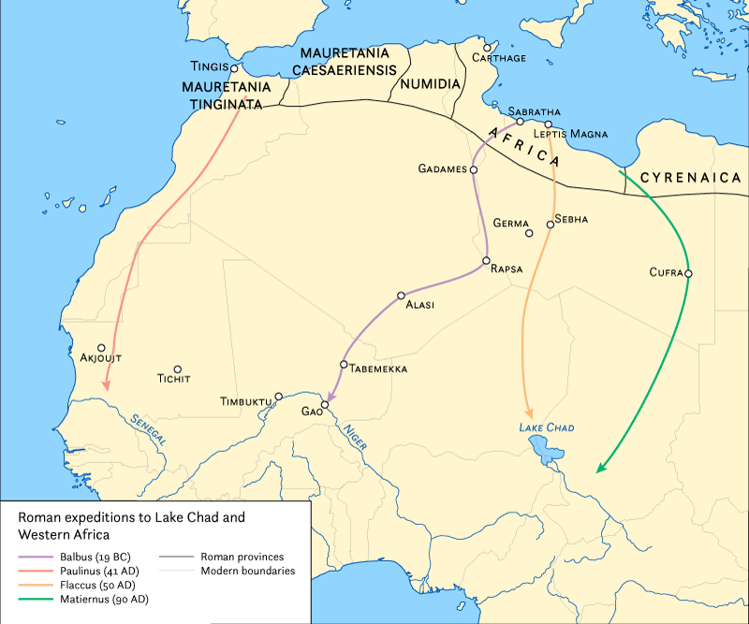
Kontakty
Římské expedice na jih
Cornelius Balbus – 19 pnl, k Nigeru
Suetonius Paulinus – 41 nl, přes Atlás, k Senegalu ?
Septimius Flaccus – 50 nl, k jezeru Čad
Julius Maternus – 90 nl, k jezeru Čad, Agisymba
Festus – 70 nl, k Nigeru
Nero – 60 nl, výprava k prameni Nilu, k bažinám (Jižní Súdán), Uganda ?

Slide 6
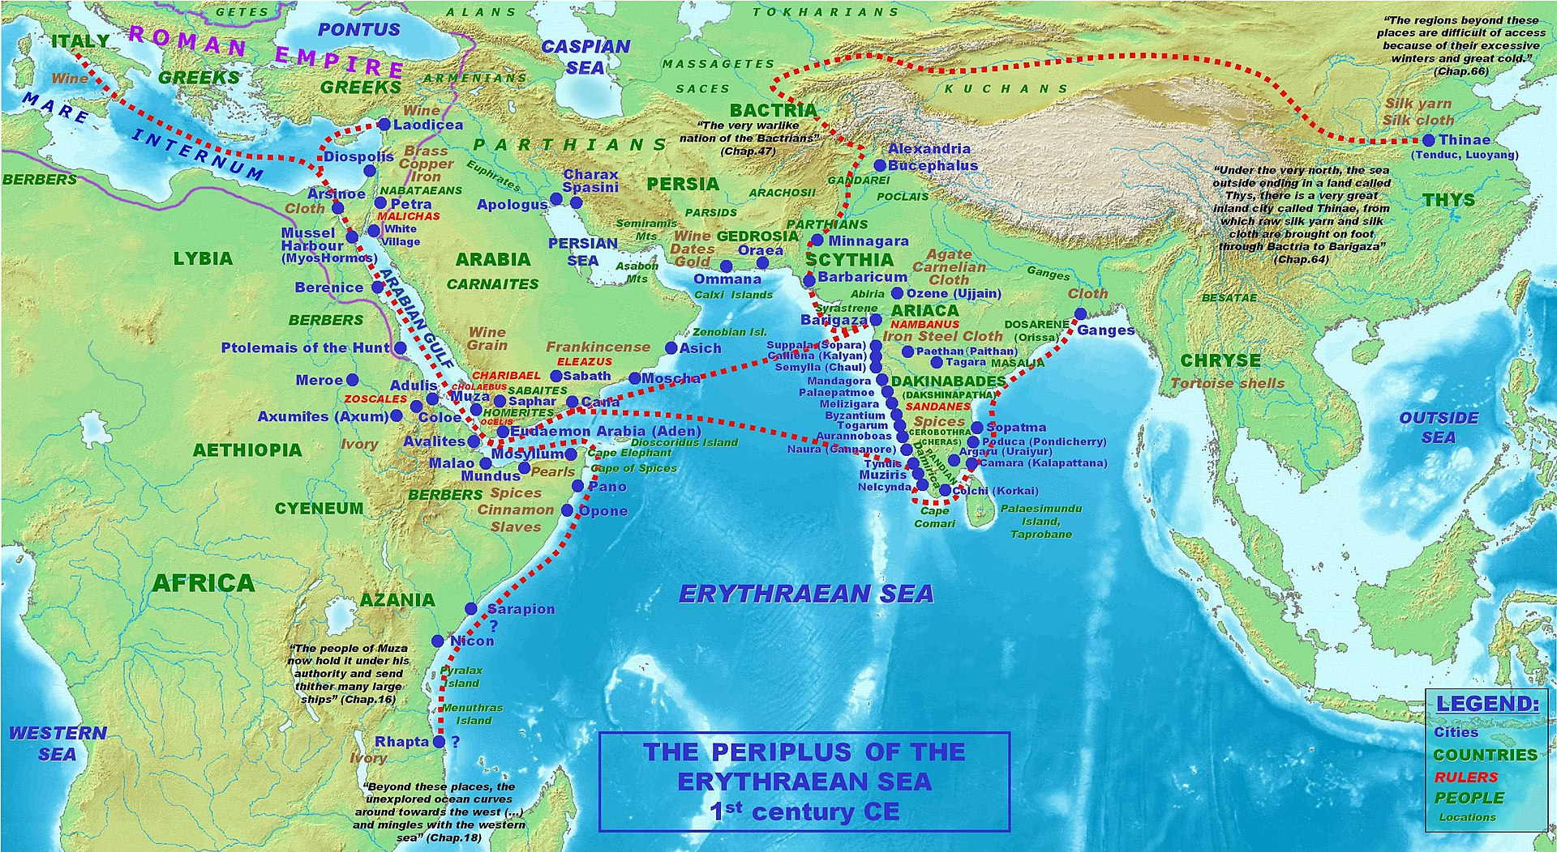
Prameny
Hérodotos, Diodóros, Strabón
Sallustius
Periplus Maris Erythraei
Héliodóros z Emesy – Aithiopika - román
Hiempsal – dějiny Numidie/Libye
Juba II. - Libyka

Slide 7
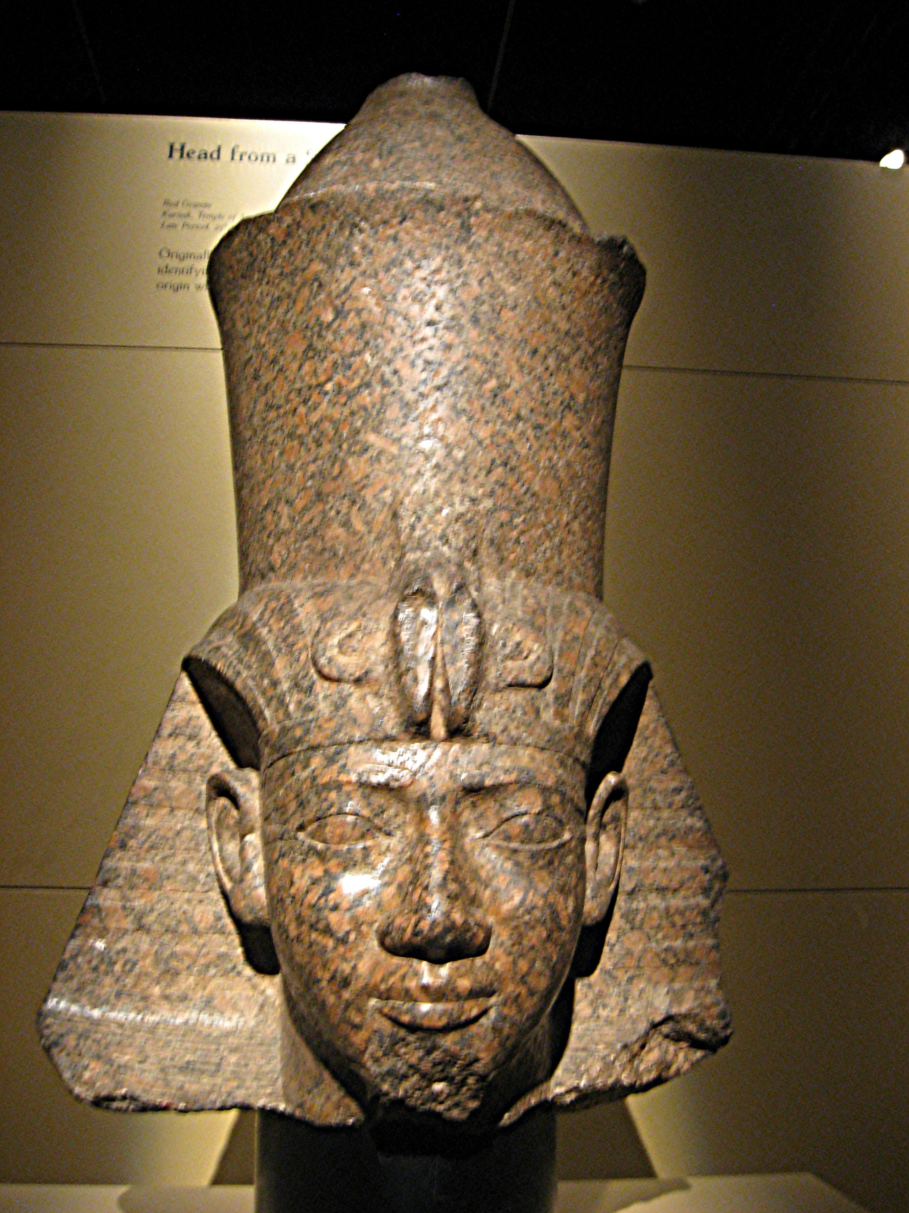
Egypt a Aithiopie
25. dynastie z Núbie
Šabako (Sabakos)
Šebitku (Sebithos/Sebichos)

Slide 8
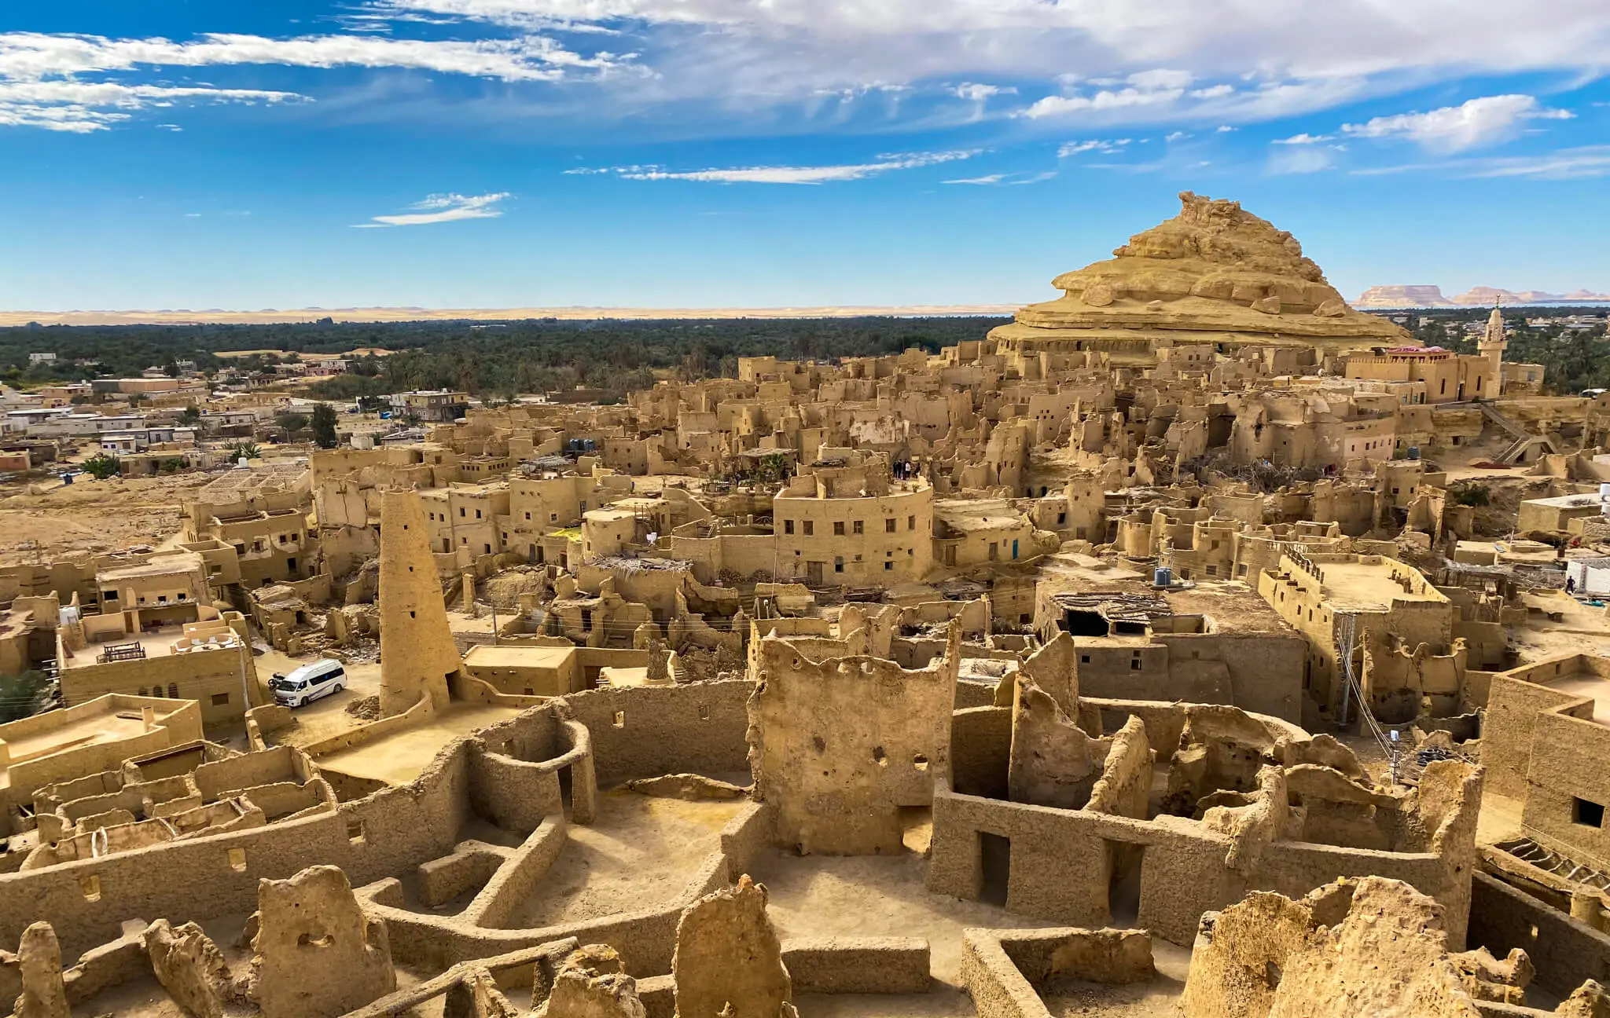
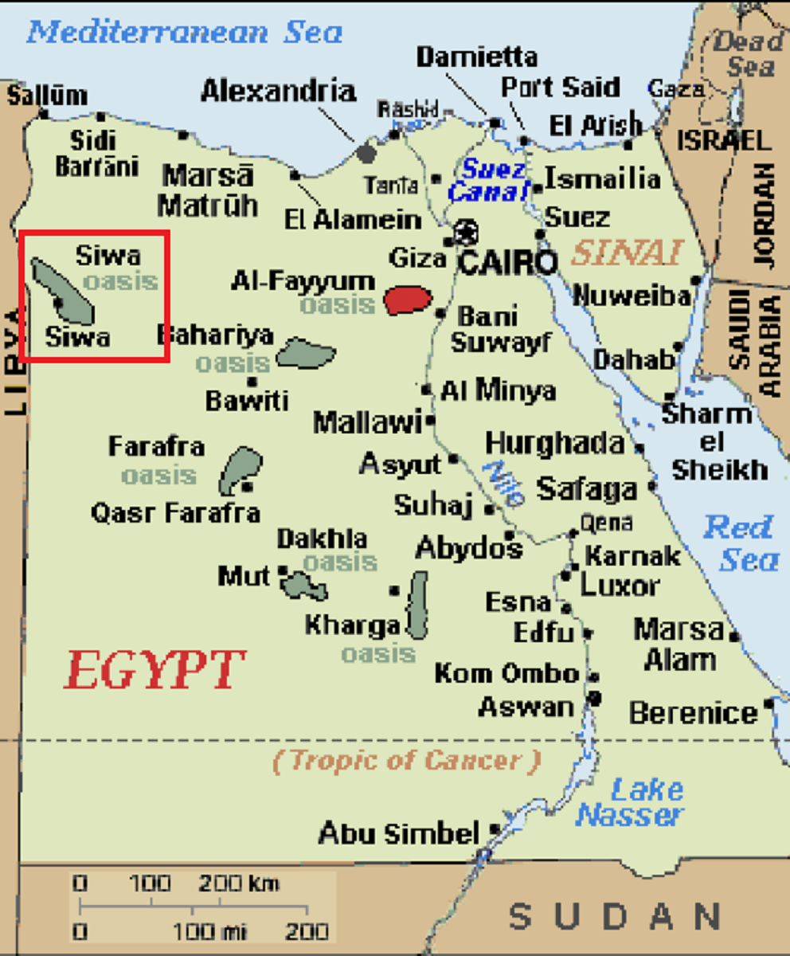
Siwa
Chrám (Dia) Ammóna
Věštírna
Alexandr Veliký, Héraklés, Hannibal, Cato, Kimón

Slide 9
Libyjci
Sal. Jug. 18
Africam initio habuere Gaetuli et Libyes, asperi incultique, quis cibus erat caro ferina atque humi pabulum uti pecoribus. Ii neque moribus neque lege aut imperio cuiusquam regebantur: uagi palantes quas nox coegerat sedes habebant.
Africa, then, was originally occupied by the Getulians and Libyans, rude and uncivilized tribes, who subsisted on the flesh of wild animals, or, like cattle, on the herbage of the soil. They were controlled neither by customs, laws, nor the authority of any ruler; they wandered about, without fixed habitations, and slept in the abodes to which night drove them.

Slide 10
Libyjci, původ Numiďanů, Maurů
Ii paulatim per conubia Gaetulos secum miscuere et, quia saepe temptantes agros alia, deinde alia loca petiuerant, semet ipsi Numidas appellauere.
Nomen eorum paulatim Libyes corrupere, barbara lingua Mauros pro Medis appellantes.
These, by degrees, formed intermarriages with the Getulians; and because, from constantly trying different soils, they were perpetually shifting their abodes, they called themselves Numidians.
The name of Medes the Libyans gradually corrupted, changing it, in their barbarous tongue, into Moors.

Slide 11
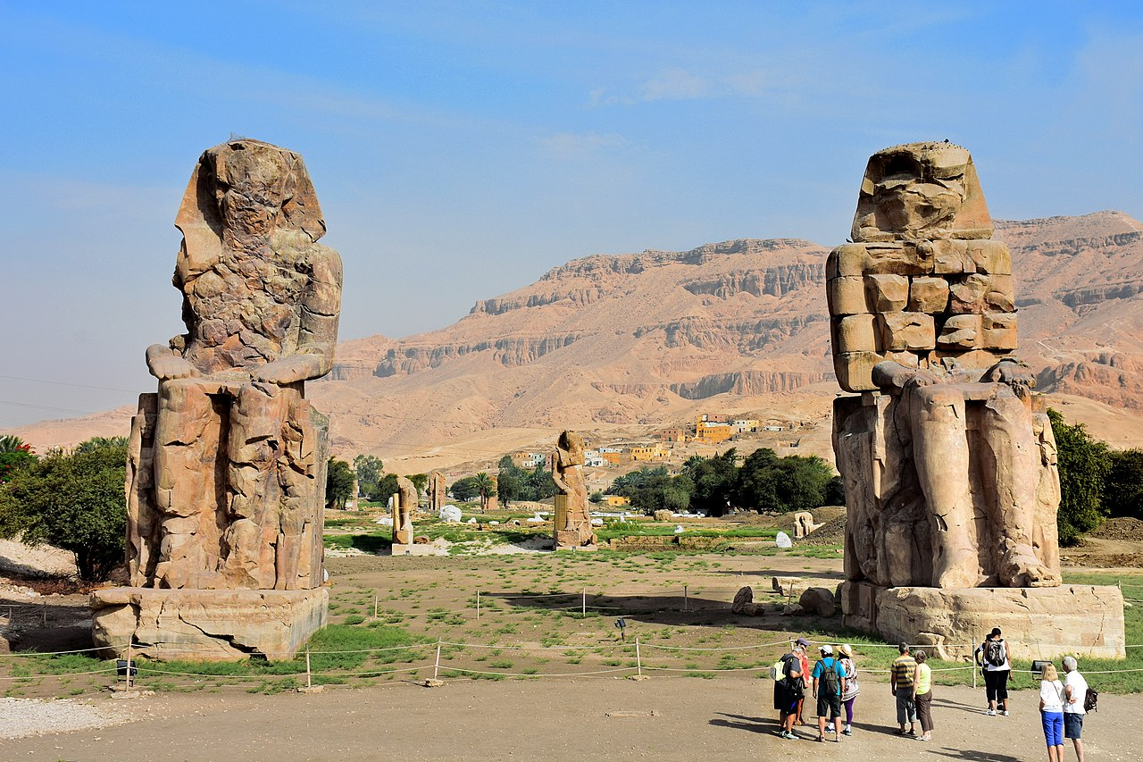
Mytologie – Memnón
Hes. Th. 984–985
Τιθωνῷ δ᾽ Ἠὼς τέκε Μέμνονα χαλκοκορυστήν, Αἰθιόπων βασιλῆα
Paus. 1.42.3
ἐμοὶ δὲ παρέσχε μὲν καὶ τοῦτο θαυμάσαι, παρέσχε δὲ πολλῷ μάλιστα Αἰγυπτίων ὁ κολοσσός. ἐν Θήβαις ταῖς Αἰγυπτίαις, διαβᾶσι τὸν Νεῖλον πρὸς τὰς Σύριγγας καλουμένας, εἶδον ἔτι καθήμενον ἄγαλμα ἠχοῦν—Μέμνονα ὀνομάζουσιν οἱ πολλοί, τοῦτον γάρ φασιν ἐξ Αἰθιοπίας ὁρμηθῆναι ἐς Αἴγυπτον καὶ τὴν ἄχρι Σούσων:
And Eos bore to Tithonus brazen-crested Memnon, king of the Ethiopians,
This made me marvel, but the colossus in Egypt made me marvel far more than anything else. In Egyptian Thebes, on crossing the Nile to the so called Pipes, I saw a statue, still sitting, which gave out a sound. The many call it Memnon, who they say from Aethiopia overran Egypt and as far as Susa.

Slide 12
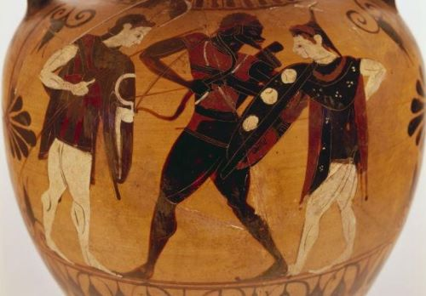
Mytologie – Memnón
Hdt. 5.54
μέχρι Σούσων（τοῦτο γὰρ Μεμνόνειον ἄστυ καλέεται)
D.S. 2.22
Manetho
Ἀμένωφις = Amenhotep
to Susa, which is the city called Memnonian,

Slide 13
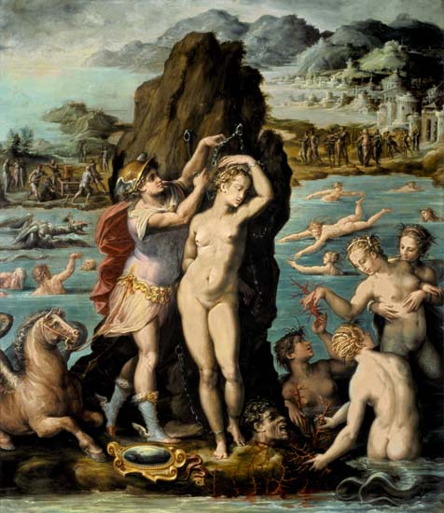
Mytologie - Andromeda
Dcera Kéfea a Kassiopeie
Pl. NH. 6.182
Aegyptiorum bellis attrita est Aethiopia vicissim imperitando serviendoque, clara et potens etiam usque ad Troiana bella Memnone regnante. et Syriae imperitasse eam nostroque litori aetate regis Cephei patet Andromedae fabulis.
Ethiopia was worn out by alternate periods of dominance and subjection in a series of wars with Egypt, having been a famous and powerful country even down to the Trojan Wars, when Memnon was king; and the stories about Andromeda show that it dominated Syria and the coasts of the Mediterranean in the time of King Cepheus.

Slide 14
Mytologie - Andromeda
Ov. Met. 4.668–671
Gentibus innumeris circumque infraque relictis Aethiopum populos Cepheaque conspicit arva. Illic inmeritam maternae pendere linguae Andromedan poenas iniustus iusserat Ammon.
Innumerous kingdoms far behind were left, till peoples Ethiopic and the lands of Cepheus were beneath his lofty view. There Ammon, the Unjust, had made decree Andromeda, the Innocent, should grieve her mother's tongue.

Slide 15
Aithiopové
Xenofanés fr. 16
Αἰθίοπές τε θεοὺς σφετέρους σιμοὺς μέλανάς τε …
Arr. Ind. 6.9
τῶν δὲ ἀνθρώπων αἱ ἰδέαι οὐ πάντη ἀπᾴδουσιν αἱ Ἰνδῶν τε καὶ Αἰθιόπων. οἱ μὲν γὰρ πρὸς νότου ἀνέμου Ἰνδοὶ τοῖσιν Αἰθίοψι μᾶλλόν τι ἐοίκασι, μέλανές τε ἰδέσθαι εἰσὶ, καὶ ἡ κόμη αὐτοῖσι μέλαινα, πλήν γε δὴ ὅτι σιμοὶ οὐκ ὡσαύτως οὐδὲ οὐλόκρανοι ὡς Αἰθίοπες: οἱ δὲ βορειότεροι αὐτῶν καὶ Αἰγυπτίους μάλιστα ἂν εἶεν τὰ σώματα.
The Ethiopians make their gods black and snub-nosed
The appearance of the inhabitants, too, is not so far different in India and Ethiopia; the southern Indians resemble the Ethiopians a good deal, and, are black of countenance, and their hair black also, only they are not as snub-nosed or so woolly-haired as the Ethiopians; but the northern Indians are most like the Egyptians in appearance.

Slide 16
Aithiopové
Str. 15.1.24
τοῦτο μὲν οὖν εὖ, οὐκέτι δὲ καὶ τὸ τοῦ μέλανας εἶναι καὶ οὐλότριχας τοὺς Αἰθίοπας ἐν ψιλοῖς τοῖς ὕδασι τὴν αἰτίαν τιθέναι, μέμφεσθαι δὲ τὸν Θεοδέκτην εἰς αὐτὸν τὸν ἥλιον ἀναφέροντα τὸ αἴτιον,
βελτίους δὲ οἱ τὸν ἥλιον αἰτιώμενοι καὶ τὴν ἐξ αὐτοῦ ἐπίκαυσιν κατ᾽ ἐπίλειψιν σφοδρὰν τῆς ἐπιπολῆς ἰκμάδος:
Now in this he is correct; but no longer so when he lays the black complexion and woolly hair of the Aethiopians on merely the waters and censures Theodectes,​ who refers the cause to the sun itself
But better is the opinion of those who lay the cause to the sun and its scorching, which causes a very great deficiency of moisture on the surface of the skin.

Slide 17
Aithiopové
Pl. NH. 2.189
Contexenda sunt his caelestibus nexa causis. namque et Aethiopas vicini sideris vapore torreri adustisque similes gigni, barba et capillo vibrato, non est dubium,
We must deal next with the results connected with these heavenly causes. For it is beyond question that the Ethiopians are burnt by the heat of the heavenly body near them, and are born with a scorched appearance, with curly beard and hair,

Slide 18
Aithiopové
De Physiognomonia, 79
Aristotelés, Problémata, 909b
Zbabělci – jsou tmaví

Slide 19
Aithiopové – „přátelé“ bohů
Hom. Il. 1.423–424
Ζεὺς γὰρ ἐς Ὠκεανὸν μετ᾽ ἀμύμονας Αἰθιοπῆας χθιζὸς ἔβη κατὰ δαῖτα, θεοὶ δ᾽ ἅμα πάντες ἕποντο:
Hom. Il. 23.205–207
οὐχ ἕδος: εἶμι γὰρ αὖτις ἐπ᾽ Ὠκεανοῖο ῥέεθρα Αἰθιόπων ἐς γαῖαν, ὅθι ῥέζουσ᾽ ἑκατόμβας ἀθανάτοις, ἵνα δὴ καὶ ἐγὼ μεταδαίσομαι ἱρῶν
Zeus went yesterday to Oceanus, to the blameless Ethiopians for a feast, and all the gods followed with him;
I may not sit, for I must go back unto the streams of Oceanus, unto the land of the Ethiopians, where they are sacrificing hecatombs to the immortals, that I too may share in the sacred feast.

Slide 20
Aithiopové – „přátelé“ bohů
Hom. Od. 1.22–24
ἀλλ᾽ ὁ μὲν Αἰθίοπας μετεκίαθε τηλόθ᾽ ἐόντας, Αἰθίοπας τοὶ διχθὰ δεδαίαται, ἔσχατοι ἀνδρῶν, οἱ μὲν δυσομένου Ὑπερίονος οἱ δ᾽ ἀνιόντος,
the Ethiopians who dwell sundered in twain, the farthermost of men, some where Hyperion sets and some where he rises,

Slide 21
Aithipové - zbožní
Luc. Sacr. 2
τοὺς δ᾽ αὖ Αἰθίοπας καὶ μακαρίους καὶ τρισευδαίμονας εἴποι τις ἄν, εἴ γε ἀπομνημονεύει τὴν χάριν αὐτοῖς ὁ Ζεὺς ἣν πρὸς αὐτὸν ἐπεδείξαντο δώδεκα ἑξῆς ἡμέρας ἑστιάσαντες
Luc. J.Tr. 37
ὑπὲρ τὸν Ὠκεανὸν ἴσως μετ᾽ ἀμύμονας Αἰθιοπῆας:
Luc. Astr. 3–5 - astrologie
Those Ethiopians, too; privileged, thrice-happy mortals! Zeus, one supposes, is not unmindful of the handsome manner in which they entertained him and all his family for twelve days running.
t’other side of Oceanus, possibly, on a visit to 'the blameless Ethiopians.'

Slide 22
Aithiopové – první z lidí
D.S. 3.2
Αἰθίοπας τοίνυν ἱστοροῦσι πρώτους ἀνθρώπων ἁπάντων γεγονέναι, καὶ τὰς ἀποδείξεις τούτων ἐμφανεῖς εἶναί φασιν. ὅτι μὲν γὰρ οὐκ ἐπήλυδες ἐλθόντες, ἀλλ’ ἐγγενεῖς ὄντες τῆς χώρας δικαίως αὐτόχθονες ὀνομάζονται
Now the Ethiopians, as historians relate, were the first of all men and the proofs of this statement, they say, are manifest. For that they did not come into their land as immigrants from abroad but were natives of it and so justly bear the name of autochthones

Slide 23
Aithiopové - zbožní
D.S. 3.2
φασὶ δὲ παρ’ αὐτοῖς πρώτοις καταδειχθῆναι θεοὺς τιμᾶν καὶ θυσίας ἐπιτελεῖν καὶ πομπὰς καὶ πανηγύρεις καὶ τἄλλα δι’ ὧν ἄνθρωποι τὸ θεῖον τιμῶσι· διὸ καὶ τὴν παρ’ αὐτοῖς εὐσεβίαν διαβεβοῆσθαι παρὰ πᾶσιν ἀνθρώποις
3.3
ἐπιόντας ἅπασαν τὴν οἰκουμένην μόνους τοὺς Αἰθίοπας τοὺς ὑπὲρ Αἰγύπτου μὴ καταπολεμῆσαι διά τε τὴν εὐσέβειαν τῶν ἀνδρῶν καὶ τὸ δυσκράτητον τῆς ἐπιβολῆς.
And they say that they were the first to be taught to honour the gods and to hold sacrifices and processions and festivals and the other rites by which men honour the deity; and that in consequence their piety has been published abroad among all men,
failed to subdue the Ethiopians alone who dwell above Egypt, both because of the piety of these men and because of the insurmountable difficulties involved in the attempt.

Slide 24
Aithipové - zbožní
D.S. 1.65
πολλοῖς δ᾽ ὕστερον χρόνοις ἐβασίλευσε τῆς Αἰγύπτου Σαβάκων, τὸ μὲν γένος ὢν Αἰθίοψ, εὐσεβείᾳ δὲ καὶ χρηστότητι πολὺ διαφέρων τῶν πρὸ αὐτοῦ.
Much later Egypt was ruled by Sabaco,​ who was by birth an Ethiopian and yet in piety and uprightness far surpassed his predecessors.

Slide 25
Aithiopové - božstva
D.S. 3.9
τήν τε γὰρ Ἶσιν καὶ τὸν Πᾶνα, πρὸς δὲ τούτοις Ἡρακλέα καὶ Δία σέβονται, μάλιστα νομίζοντες ὑπὸ τούτων εὐηργετῆσθαι τὸ τῶν ἀνθρώπων γένος. ὀλίγοι δὲ τῶν Αἰθιόπων καθόλου θεοὺς οὐ νομίζουσιν εἶναι·
for instance, they revere Isis and Pan, and also Heracles and Zeus, considering that these deities in particular have been benefactors of the race of men. But a few of the Ethiopians do not believe in the existence of any gods at all

Slide 26
Aithiopové – vlastnosti
Pl. NH. 7.6
in quibus prodigiosa aliqua et incredibilia multis visum iri haud dubito. quis enim Aethiopas ante quam cerneret credidit?
Hdt. 3.20
οἱ δὲ Αἰθίοπες οὗτοι, ἐς τοὺς ἀπέπεμπε ὁ Καμβύσης, λέγονται εἶναι μέγιστοι καὶ κάλλιστοι ἀνθρώπων πάντων.
some things among which I doubt not will appear portentous and incredible to many. For who ever believed in the Ethiopians before actually seeing them?
These Ethiopians, to whom Cambyses sent them, are said to be the tallest and most handsome of all men.

Slide 27
Aithiopové - divoši
D.S. 3.8
οἱ πλεῖστοι δὲ τούτων καὶ μάλισθ’ οἱ παρὰ τὸν ποταμὸν οἰκοῦντες ταῖς μὲν χρόαις εἰσὶ μέλανες, ταῖς δὲ ἰδέαις σιμοί, τοῖς δὲ τριχώμασιν οὖλοι. καὶ ταῖς μὲν ψυχαῖς παντελῶς ὑπάρχουσιν ἄγριοι καὶ τὸ θηριῶδες ἐμφαίνοντες, οὐχ οὕτω δὲ τοῖς θυμοῖς ὡς τοῖς ἐπιτηδεύμασιν· αὐχμηροὶ γὰρ ὄντες τοῖς ὅλοις σώμασι τοὺς μὲν ὄνυχας ἐπὶ πολὺ παρηγμένους ἔχουσι τοῖς θηρίοις παραπλησίως, τῆς δὲ πρὸς ἀλλήλους φιλανθρωπίας πλεῖστον ὅσον ἀφεστήκασι· 3 καὶ τὴν μὲν φωνὴν ὀξεῖαν προβάλλοντες, τῶν δὲ παρὰ τοῖς ἄλλοις ἐπιτηδευομένων εἰς βίον ἥμερον οὐδ’ ὁτιοῦν ἔχοντες, μεγάλην ποιοῦσι πρὸς τὰ καθ’ ἡμᾶς ἔθη τὴν διαφοράν.
The majority of them, and especially those who dwell along the river, are black in colour and have flat noses and woolly hair. As for their spirit they are entirely savage and display the nature of a wild beast, not so much, however, in their temper as in their ways of living; for they are squalid all over their bodies, they keep their nails very long like the wild beasts, and are as far removed as possible from human kindness to one another; 3 and speaking as they do with a shrill voice and cultivating none of the practices of civilized life as these are found among the rest of mankind, they present a striking contrast when considered in the light of our own customs.

Slide 28
Aithiopové - kanibalové
Orig. De Princ. 2.9.5
and then another among the Ethiopians, who are accustomed to feed on human flesh;

Slide 29
Aithiopové - satira
Petr. 102
Ita tanquam servi Aethiopes et praesto tibi erimus sine tormentorum iniuria hilares, et permutato colore imponemus inimicis.
Then we will stand by you with pleasure like Aethiopian slaves, without undergoing any tortures, and our change of colour will take in our enemies.

Slide 30
Aithiopové – satira
Mart. 6.39
Hic, qui retorto crine Maurus incedit, Subolem fatetur esse se coci Santrae. At ille sima nare, turgidis labris Ipsa est imago Pannychi palaestritae. Pistoris esse tertium quis ignorat, Quicumque lippum novit et videt Damam? Quartus cinaeda fronte, candido voltu Ex concubino natus est tibi Lygdo:
This, who runs towards us so like a Moor, with his crisped hair, avows himself the offspring of the cook Santra; while that other, with flattened nose and thick lips, is the very image of Pannicus, the wrestler. Who can be ignorant, that knows or has ever seen the blear-eyed Dama, that the third is that baker's son? The fourth, with his fair face and voluptuous air, evidently sprung from your favourite Lygdus.

Slide 31
Aithiopové - satira
Juv. 2.21–24
‘ego te ceventem, Sexte, verebor?’ infamis Varillus ait ‘quo deterior te?’ loripedem rectus derideat, Aethiopem albus; quis tulerit Gracchos de seditione querentes?
Am I to respect you, Sextus," quoth the ill-famed Varillus, "when you do as I do? How am I worse than yourself?" Let the straight-legged man laugh at the club-footed, the white man at the blackamoor: but who could endure the Gracchi railing at sedition?

Slide 32
Aithiopové - satira
Juv. 5.51–54
vos aliam potatis aquam, tibi pocula cursor Gaetulus dabit aut nigri manus ossea Mauri et cui per mediam nolis occurrere noctem, clivosae veheris dum per monumenta Latinae:
It will be handed to you by a Gaetulian groom, or by the bony hand of a blackamoor whom you would rather not meet at midnight when driving past the monuments on the hilly Latin Way.

Slide 33
Aithiopové - satira
Juv. 6.599–601
esses Aethiopis fortasse pater, mox decolor heres impleret tabulas numquam tibi mane videndus.
you might perhaps find yourself the father of an Ethiopian; and some day a coloured heir, whom you would rather not meet by daylight, would fill all the places in your will.

Slide 34
Aithiopové - satira
Juv. 13.161–165
quis tumidum guttur miratur in Alpibus, aut quis in Meroe crasso maiorem infante mamillam? caerula quis stupuit Germani lumina, flavam caesariem et madido torquentem cornua cirro?
Who marvels at a swollen throat in the Alps? or in Meroe at a woman's breast bigger than her sturdy babe? Who is amazed to see a German with blue eyes and yellow hair, twisting his greasy curls into a horn?

Slide 35
Aithiopové - satira
Luc. Ind. 28
οἶδα ὡς μάτην ταῦτά μοι λελήρηται καὶ κατὰ τὴν παροιμίαν Αἰθίοπα σμήχειν ἐπιχειρῶ:
All this advice is thrown away, I know that. Shall an Ethiopian change his skin?

Slide 36
Další kmeny
Pygmaioi
Na jižním okraji světa (nebo v Indii)
Při prameni Nilu
Trpaslíci
Nekonečná válka proti jeřábům
Pygmé (πυγμή) – loket (míra)
Hom. Il. 3.1–7
Ar. Hist. Anim. 8.14
Reálný kmen, jeskyně, malí koně
Setkání s Héraklem

Slide 37
Další kmeny
Tróglodyté
Hdt. 4.183
οἱ Γαράμαντες δὴ οὗτοι τοὺς τρωγλοδύτας Αἰθίοπας θηρεύουσι τοῖσι τεθρίπποισι: οἱ γὰρ τρωγλοδύται Αἰθίοπες πόδας τάχιστοι ἀνθρώπων πάντων εἰσὶ τῶν ἡμεῖς πέρι λόγους ἀποφερομένους ἀκούομεν. σιτέονται δὲ οἱ τρωγλοδύται ὄφις καὶ σαύρους καὶ τὰ τοιαῦτα τῶν ἑρπετῶν: γλῶσσαν δὲ οὐδεμιῇ ἄλλῃ παρομοίην νενομίκασι, ἀλλὰ τετρίγασι κατά περ αἱ νυκτερίδες.
These Garamantes go in their four-horse chariots chasing the cave-dwelling Ethiopians: for the Ethiopian cave-dwellers are swifter of foot than any men of whom tales are brought to us. They live on snakes and lizards and such-like creeping things. Their speech is like no other in the world: it is like the squeaking of bats.
Pomp. 1.44

Slide 38
Další kmeny
Tróglodyté
D.S. 3.32
οἱ τοίνυν Τρωγλοδύται προσαγορεύονται μὲν ὑπὸ τῶν Ἑλλήνων Νομάδες, βίον δ᾽ ἔχοντες ἀπὸ θρεμμάτων νομαδικὸν κατὰ συστήματα τυραννοῦνται, καὶ μετὰ τῶν τέκνων τὰς γυναῖκας ἔχουσι κοινὰς πλὴν μιᾶς τῆς τοῦ τυράννου: τὸν δὲ ταύτῃ πλησιάσαντα πρόστιμον ὁ δυνάστης πράττεται τεταγμένον ἀριθμὸν προβάτων.
The Trogodytes,​ we may state, are called Nomads by the Greeks, and living as they do a nomadic life off their flocks, each group of them has its tyrant, and their women, like their children, they hold in common, with the single exception of the wife of the tyrant; but if any man goes in to this woman the ruler exacts of him a fine of a specified number of sheep.

Slide 39
Další kmeny
Tróglodyté
καὶ γυμνοὶ μέν εἰσι πάντες τὰ σώματα πλὴν τῶν ἰσχίων, ἃ δέρμασι σκεπάζουσι: τὰ δ᾽ αἰδοῖα πάντες οἱ Τρωγλοδύται παραπλησίως τοῖς Αἰγυπτίοις περιτέμνονται
Str. 16.4.17
And they are all naked as to their bodies except for the loins, which they cover with skins; moreover, all the Trogodytes are circumcised like the Egyptians

Slide 40
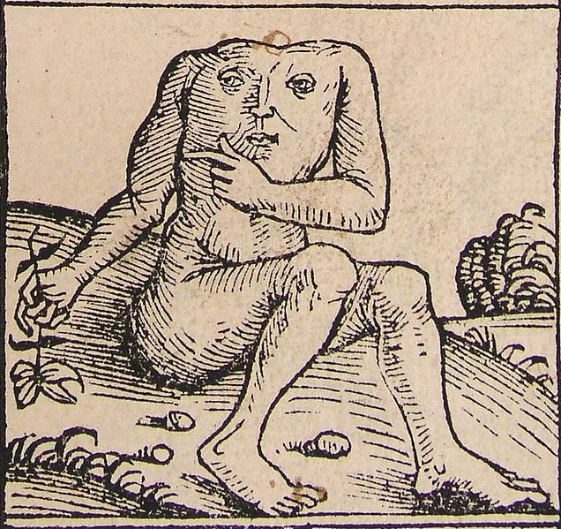
Další kmeny
Blemmyové
Jižně od Egypta, nomádi, Strabón
Pomp. 1.40
Blemyis capita absunt, vultus in pectore est.
Pl. NH. 5.8.46
Blemmyes traduntur capita abesse, ore et oculis pectore adfixis.
The Blemyes lack heads; their face is on their chest.
The Blemmyæ are said to have no heads, their mouths and eyes being seated in their breasts.

Slide 41
Další kmeny
Hdt. 4.191
καὶ οἱ κυνοκέφαλοι καὶ οἱ ἀκέφαλοι οἱ ἐν τοῖσι στήθεσι τοὺς ὀφθαλμοὺς ἔχοντες, ὡς δὴ λέγονταί γε ὑπὸ Λιβύων, καὶ οἱ ἄγριοι ἄνδρες καὶ γυναῖκες ἄγριαι, καὶ ἄλλα πλήθεϊ πολλὰ θηρία ἀκατάψευστα.
the dog-headed and the headless men that have their eyes in their chests, as the Libyans say, and the wild men and women, besides many other creatures not fabulous.

Slide 42
Další kmeny
Makrobioi
Hdt. 3.17
μετὰ δὲ ταῦτα ὁ Καμβύσης ἐβουλεύσατο τριφασίας στρατηίας, ἐπί τε Καρχηδονίους καὶ ἐπὶ Ἀμμωνίους καὶ ἐπὶ τοὺς μακροβίους Αἰθίοπας, οἰκημένους δὲ Λιβύης ἐπὶ τῇ νοτίῃ θαλάσσῃ. … ἐπὶ δὲ τοὺς Αἰθίοπας κατόπτας πρῶτον, ὀψομένους τε τὴν ἐν τούτοισι τοῖσι Αἰθίοψι λεγομένην εἶναι ἡλίου τράπεζαν εἰ ἔστι ἀληθέως,
After this Cambyses planned three expeditions, against the Carchedonians, against the Ammonians, and against the “long-lived” Ethiopians, who inhabit that part of Libya that is on the southern sea. … to Ethiopia he would first send spies, to see what truth there was in the story of a Table of the Sun in that country,

Slide 43
Další kmeny
Hdt. 3.18
Sluneční stůl
ἡ δὲ τράπεζα τοῦ ἡλίου τοιήδε τις λέγεται εἶναι, λειμὼν ἐστὶ ἐν τῷ προαστείῳ ἐπίπλεος κρεῶν ἑφθῶν πάντων τῶν τετραπόδων, ἐς τὸν τὰς μὲν νύκτας ἐπιτηδεύοντας τιθέναι τὰ κρέα τοὺς ἐν τέλεϊ ἑκάστοτε ἐόντας τῶν ἀστῶν, τὰς δὲ ἡμέρας δαίνυσθαι προσιόντα τὸν βουλόμενον. φάναι δὲ τοὺς ἐπιχωρίους ταῦτα τὴν γῆν αὐτὴν ἀναδιδόναι ἑκάστοτε.
Now the Table of the Sun is said to be something of this kind: there is a meadow outside the city, filled with the boiled flesh of all four-footed things; here during the night the men of authority among the townsmen are careful to set out the meat, and all day whoever wishes comes and feasts on it. These meats, say the people of the country, are ever produced by the earth of itself. Such is the story of the Sun's Table.

Slide 44
Další kmeny
Hdt. 3.23
ἀντειρομένων δὲ τὸν βασιλέα τῶν Ἰχθυοφάγων τῆς ζόης καὶ διαίτης πέρι, ἔτεα μὲν ἐς εἴκοσι καὶ ἑκατὸν τοὺς πολλοὺς αὐτῶν ἀπικνέεσθαι, ὑπερβάλλειν δὲ τινὰς καὶ ταῦτα, σίτησιν δὲ εἶναι κρέα τε ἑφθὰ καὶ πόμα γάλα.
The Fish-eaters then in turn asking of the Ethiopian length of life and diet, he said that most of them attained to a hundred and twenty years, and some even to more; their food was boiled meat and their drink milk.

Slide 45
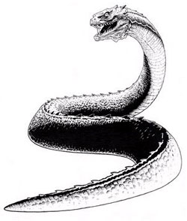
Různá stvoření
Bazilišek
Pl. NH. 8.33 (78)
Eadem et basilisci serpentis est vis. Cyrenaica hunc generat provincia, duodecim non amplius digitorum magnitudine, candida in capite macula ut quodam diademate insignem. sibilio omnes fugat serpentes nec flexu multiplici, ut reliquae, corpus inpellit, sed celsus et erectus in medio incedens. necat frutices, non contactos modo, verum et adflatos, exurit herbas, rumpit saxa: talis vis malo est. creditum quondam ex equo occisum hasta et per eam subeunte vi non equitem modo, sed equum quoque absumptum.
The basilisk serpent also has the same power. It is a native of the province of Cyrenaica, not more than 12 inches long, and adorned with a bright white marking on the head like a sort of diadem. It routs all snakes with its hiss, and does not move its body forward in manifold coils like the other snakes but advancing with its middle raised high. It kills bushes not only by its touch but also by its breath, scorches up grass and bursts rocks. Its effect on other animals is disastrous: it is believed that once one was killed with a spear by a man on horseback and the infection rising through the spear killed not only the rider but also the horse.

Slide 46
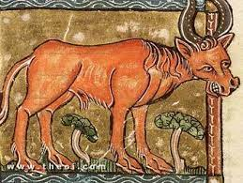
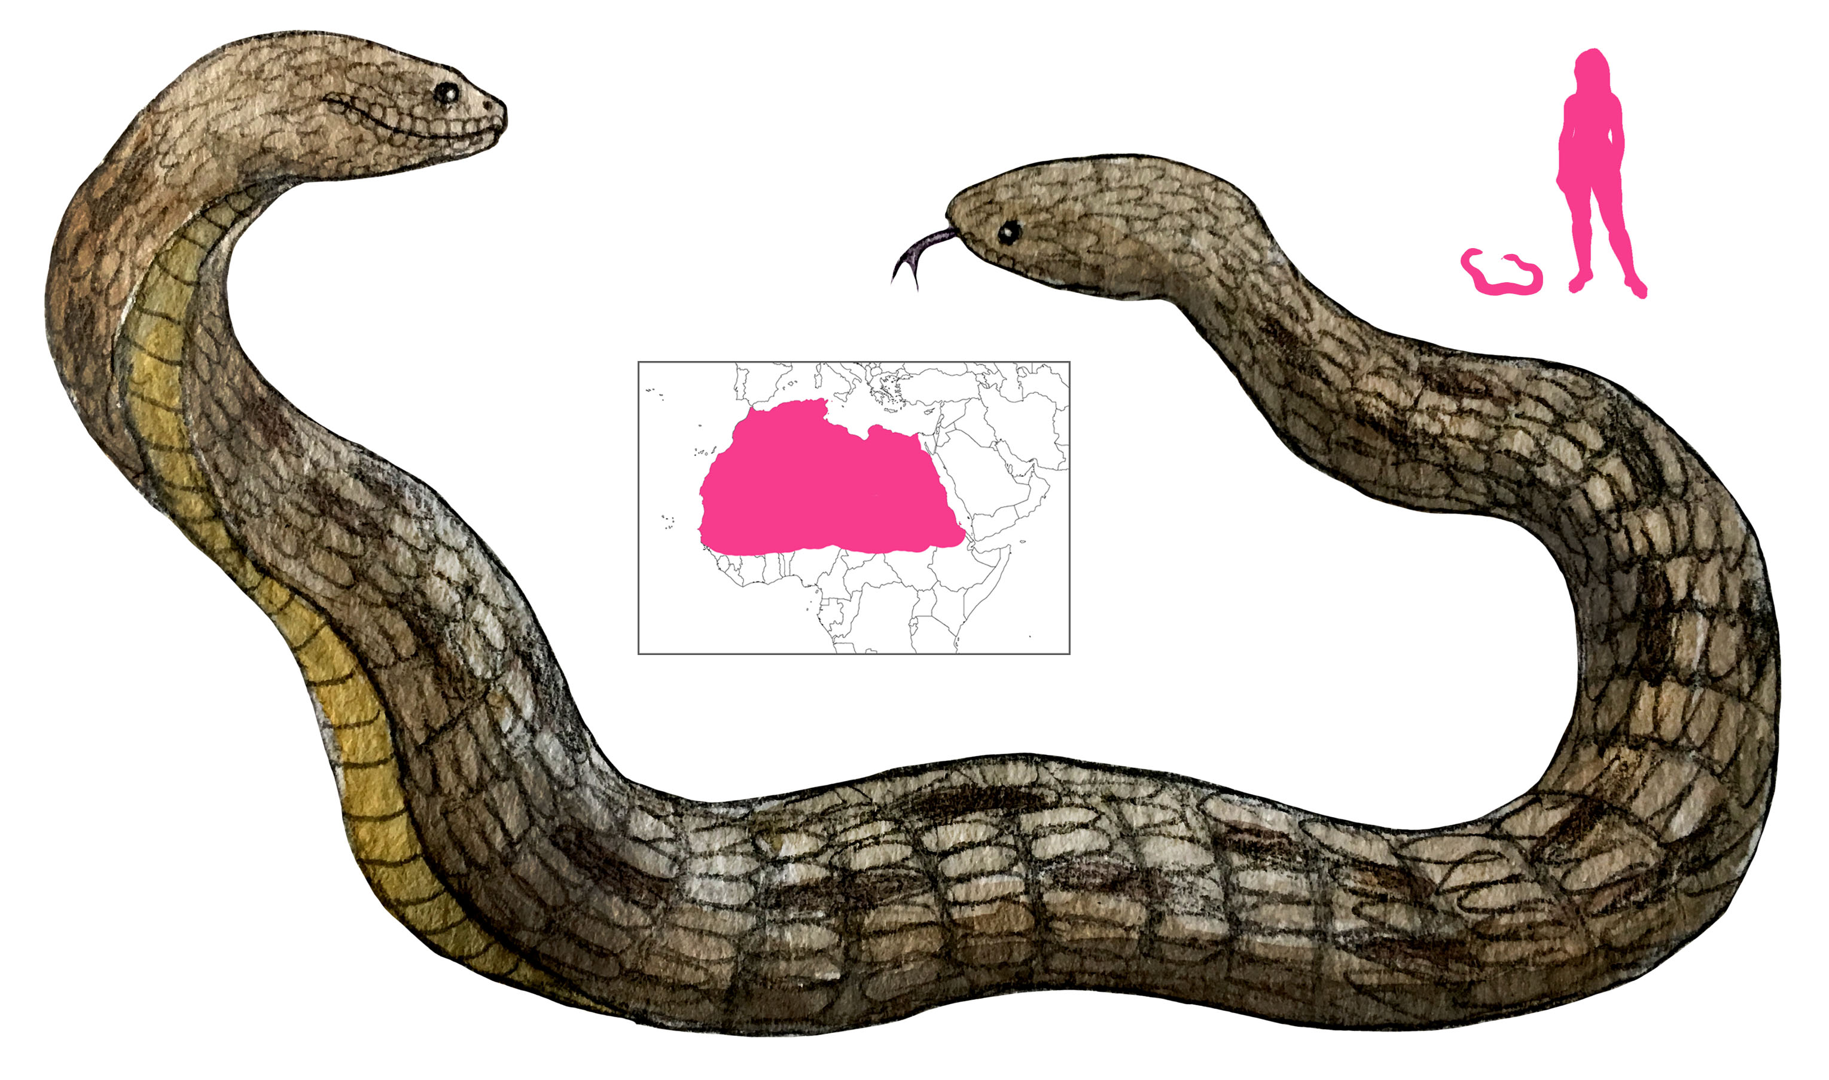
Amfisbaina - Pl. NH. 8.35 (85)
geminum caput amphisbaenae, hoc est et a cauda, tamquam parum esset uno ore fundi venenum.
Aithiopský býk – Pl. NH. 8.30 (74)
sed atrocissimos tauros silvestres, maiores agrestibus, velocitate ante omnes, colore fulvos, oculis caeruleis, pilo in contrarium verso, rictu ad aures dehiscente iuxta cornua mobilia. tergori duritia silicis, omne respuens vulnus. fera omnes venantur, ipsi non aliter quam foveis capti feritate semper intereunt.
that the amphisbaena has a twin head, that is one at the tail-end as well, as though it were not enough for poison to be poured out of one mouth
But its fiercest animals are forest bulls, larger than the bulls of the field, surpassing all in speed, of a tawny colour, with blue eyes, hair turned backward, mouth gaping open to the ears, along with mobile horns; the hide has the hardness of flint, rejecting every wound. They hunt all wild animals, but themselves can only be caught in pits, and when caught always die game

Slide 47
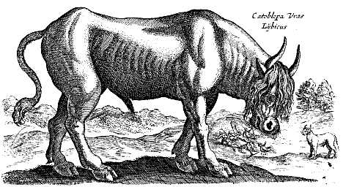
Katóbleps
Pl. NH. 8.32 (77)
Apud Hesperios Aethiopas fons est Nigris, ut plerique existimavere, Nili caput, ut argumenta quae diximus persuadent. iuxta hunc fera appellatur catoblepas, modica alioqui ceterisque membris iners, caput tantum praegrave aegre ferens — id deiectum semper in terram —, alias internicio humani generis, omnibus, qui oculos eius videre, confestim expirantibus.
In Western Ethiopia there is a spring, the Nigris, which most people have supposed to be the source of the Nile, as they try to prove by the arguments that we have stated. In its neighbourhood there is an animal called the catoblepas, in other respects of moderate size and inactive with the rest of its limbs, only with a very heavy head which it carries with difficulty - it is always hanging down to the ground; otherwise it is deadly to the human race, as all who see its eyes expire immediately.

Slide 48
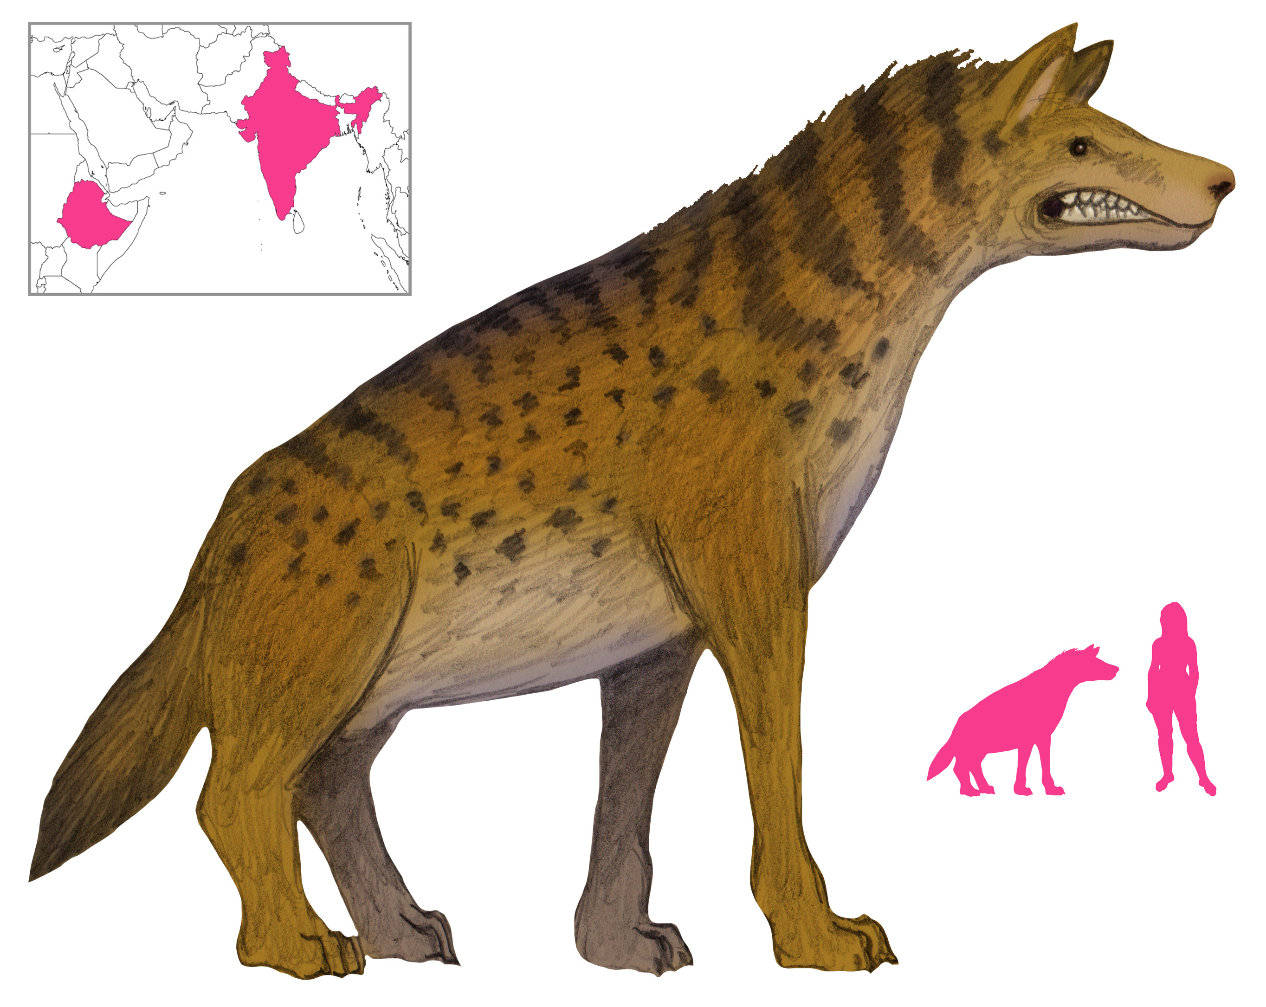
Leukokrottás
Pl. NH. 8.30 (72)
leucrocotam, pernicissimam asini feri magnitudine, clunibus cervinis, collo, cauda, pectore leonis, capite melium, bisulca ungula, ore ad aures usque recesso, dentium locis osse perpetuo
the leucrocota, swiftest of wild beasts, about the size of an ass, with a stag's haunches, a lion's neck, tail and breast, badger's head, cloven hoot mouth opening right back to the ears, and ridges of bone in place of rows of teeth - this animal is reported to imitate the voices of human beings.

Slide 49
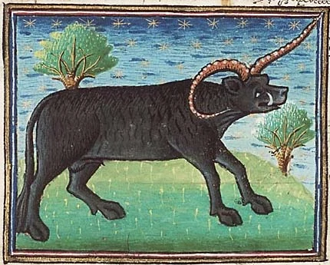
Pl. NH. 8.30 (72)
apud eosdem et quae vocatur eale, magnitudine equi fluviatilis, cauda elephanti, colore nigra vel fulva, maxillis apri, maiora cubitalibus cornua habens mobilia, quae alterna in pugna sistit variatque infesta aut obliqua, utcumque ratio monstravit
Among the same people is also found the animal called the Yale (mythical eale, the size of a hippopotamus, with an elephant's tail, of a black or tawny colour, with the jaws of a boar and movable horns more than a cubit in length which in a fight are erected alternately, and presented to the attack or sloped backward in turn as policy directs.

Slide 50
Literatura
Thompson, L. (1989). Romans and Blacks. London: Routledge.
Bourgeois, A. (1971). La Grèce antique devant la négritude. Paris: Présence africaine.
Snowden, F. (1970). Blacks in Antiquity: Ethiopians in the Greco-Roman Experience. Cambridge: Cambridge University Press.

