Slide 1
English for Museology Purpose
Mgr. Lenka Vargová, PhD.
lenka.vargova@uniba.sk
lenka.vargov6@gmail.com

Slide 2
Introduction
Conversation + theory, active engagement, presentation, test
Presentation: conference style, 10-15 min, topic of your thesis / if undecided, other topic of interest, during the semester
Test: vocabulary, definitions, end of semester
Reading?

Slide 3
Introducing ourselves (5-10 min)
  General introduction
  Why you decided to study Museology and what you like about it so far
  Topic of your thesis
  What type of museums do you like to visit and why

Slide 4
Discussion
What is a museum?
Why do they exist? What is their purpose?
Who is their audience? Whom do they serve?
Do we need them? Why?
What were some of the earliest museums?
Do all cultures have museums? Are they the same all over the world?

Slide 5
What all can be considered a museum? (A ZOO? Botanical garden? Planetarium? Science centre?)
What´s the difference between a museum and a library? An archive?
Do museums need collections? What type of artifacts can be found in museums?
What is the relationship of age to worth?
What is your opinion of virtual museums? Online exhibitions and digitisation?

Slide 6
Museum - definition
A museum is an institution dedicated to preserving and interpreting the primary tangible evidence of humankind and the environment.
What is the last museum you have visited? Where is it? What type of collections do they have? Exhibitions? Other activities? Discuss in pairs (10 min)
3 things you liked & 1 you´d change

Slide 7
ICOM (International Council of Museums):
  A museum is a not-for-profit, permanent institution in the service of society that researches, collects, conserves, interprets and exhibits tangible and intangible heritage. Open to the public, accessible and inclusive, museums foster diversity and sustainability. They operate and communicate ethically, professionally and with the participation of communities, offering varied experiences for education, enjoyment, reflection and knowledge sharing. (ICOM 2022)

Slide 8
Museums Association:
  „A museum is an institution which collects, documents, prepares, exhibits and interprets material evidence and associated information for the public benefit.“ (1992)
  „Museums enable people to explore collections for inspiration, learning and enjoyment. They are institutions that collect, safeguard and make accessible artefacts and specimens, which they hold in trust for society.“ (1998/2016)

Slide 9
Museums – typology / classification
Different criteria depending also on their ownership (founder), management and funding
Basic types (collection criteria):
  general,
  natural history and natural science,
  science and technology,
  history,
  art + virtual museum

Slide 10
ICOM classification – museums of:
  Art
  Natural history
  History
  Science and technology
  Social sciences and services
  Commerce and communication
  Ethnography and folklore
  Agriculture

Slide 11
Museums Association:
  National museums
  Local authority museums
  University museums
  Independent museums
  Historic properties and heritage sites
  Regimental museums and armouries

Slide 12
Classified by collections (Ambrose & Paine):
  general museums
  archaeology museums
  art museums
  history museums
  ethnography museums
  natural history museums
  science museums
  geology museums
  industrial museums
  military museums

Slide 13
Classified by who runs them:
  government museums
  municipal museums
  university museums
  independent (charitable trust) museums
  army museums
  commercial company museums
  private museums
Classified by the area they serve:
  national museums
  regional museums
  city museums
  local museums

Slide 14
Classified by the audience they serve:
  general public museums
  educational museums
  specialist museums
Classified by the way they exhibit their collections:
  traditional museums
  historic house museums
  open-air museums
  interactive museums

Slide 15
What is heritage?
What is cultural heritage? Why is it important?
How can it be exhibited in museums?
What is living heritage?
Can intangible heritage be exhibited in museums?
Have you visited any cultural heritage sites?

Slide 16
Cultural Heritage - definition
an expression of the ways of living developed by a community and passed on from generation to generation, including customs, practices, places, objects, artistic expressions and values
Tangible or Intangible

Slide 17
Tangible cultural heritage:
- movable cultural heritage (paintings, sculptures, coins, manuscripts...)
- immovable cultural heritage (monuments, archaeological sites...)
- underwater cultural heritage (shipwrecks, underwater ruins and cities)
(Natural Heritage, World Heritage in Danger)

Slide 18
Intangible cultural heritage
  practices, expressions, knowledge and skills that communities, groups and sometimes individuals recognise as part of their cultural heritage
  oral traditions; performing arts; social practices, rituals and festive events; knowledge and practices concerning nature and the universe; and traditional craftsmanship

Slide 19
UNESCO (1945)
„ to encourage the identification, protection and preservation of cultural and natural heritage around the world considered to be of outstanding value to humanity“
Convention concerning the Protection of the World Cultural and Natural Heritage (1972)
Convention for the Safeguarding of the Intangible Cultural Heritage (2003)

Slide 20
UNESCO lists:
World Heritage - 1154 World Heritage sites in 167 countries (897 cultural, 218 natural, 39 mixed), 52 in danger, 3 delisted
Intangible Cultural Heritage (631 elements in 140 countries)
Memory of the World Register (527)
UNESCO Global Geoparks ....

Slide 21
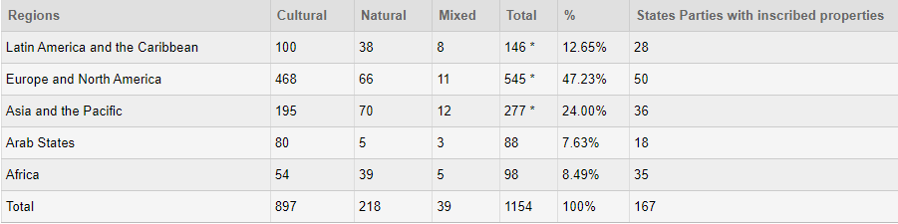
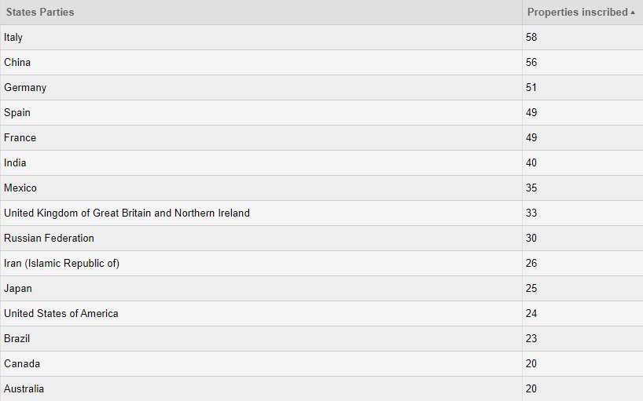
World Heritage List

Slide 22
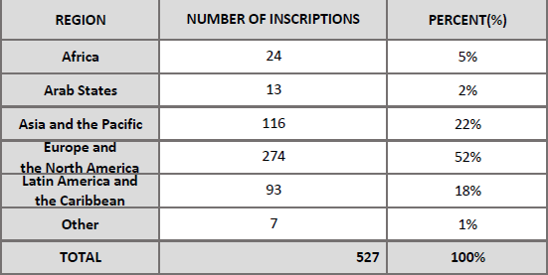
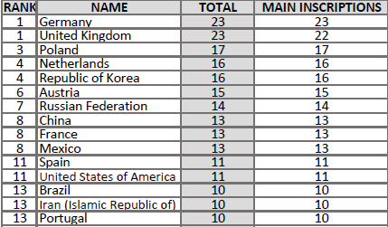
Memory of the World

Slide 23
Visiting museums
Why do people visit museums?
What are your expectations of a museum visit?
Have you ever been disappointed by a museum visit? Why?
Describe the process of visiting a museum
How can we evaluate the suitability of a museum building?

Slide 24
What role does ethics play in a museum?
Are there some regulations as to the proper conduct? Can you think of some negative examples?
Ethics – Case Study 4
A local collector has one of the finest private collections of material relating to your subject, even though he holds unorthodox views about it. You have fostered good relations with him in the hope that your museum might benefit from this. One day he offers to lend his collection for a temporary exhibition at the museum’s expense, subject to two conditions: that the exhibition only shows material from his collection and that he must be responsible for all label and publication content. Do you accept his offer?

Slide 25
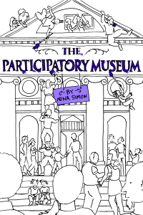
What is participation in museums?
Is it important?
What forms can it have?
Opening up the Museum -
Nina Simon:
https://www.youtube.com/watch?time_continue=12&v=aIcwIH1vZ9w&feature=emb_logo

