Slide 1
Climate Change Communication and the Role of Literature
Prof. Dr. Jens Martin Gurr
Brno, December 9, 2022

Slide 2
Overview
1 – 20 Years of Cli-Fi (Climate Fiction)
2 – The “Climate Change Literacy” Project: What Literature can(not) do
3 – Two model analyses: Ian McEwan, Solar (2010) and Kim Stanley Robinson, Ministry for the Future (2020)

Slide 3
Aims
Sketch a succession of phases in the development of climate fiction using a number of influential examples
Correlate these phases with key discursive events, developments in climate science (e.g., IPCC reports) and growing public awareness/sense of urgency
Notes:
- These are preliminary ideas from a project called „Climate Change Literacy“, which Julia Hoydis, Roman Bartosch and I will be really only be beginning in October, so this is very much a joint effort of the three of us.

Slide 4
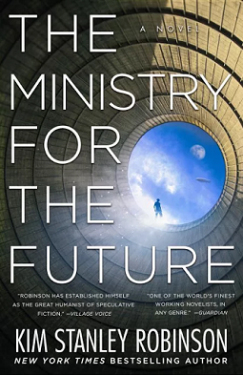
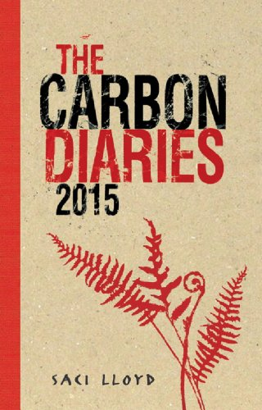
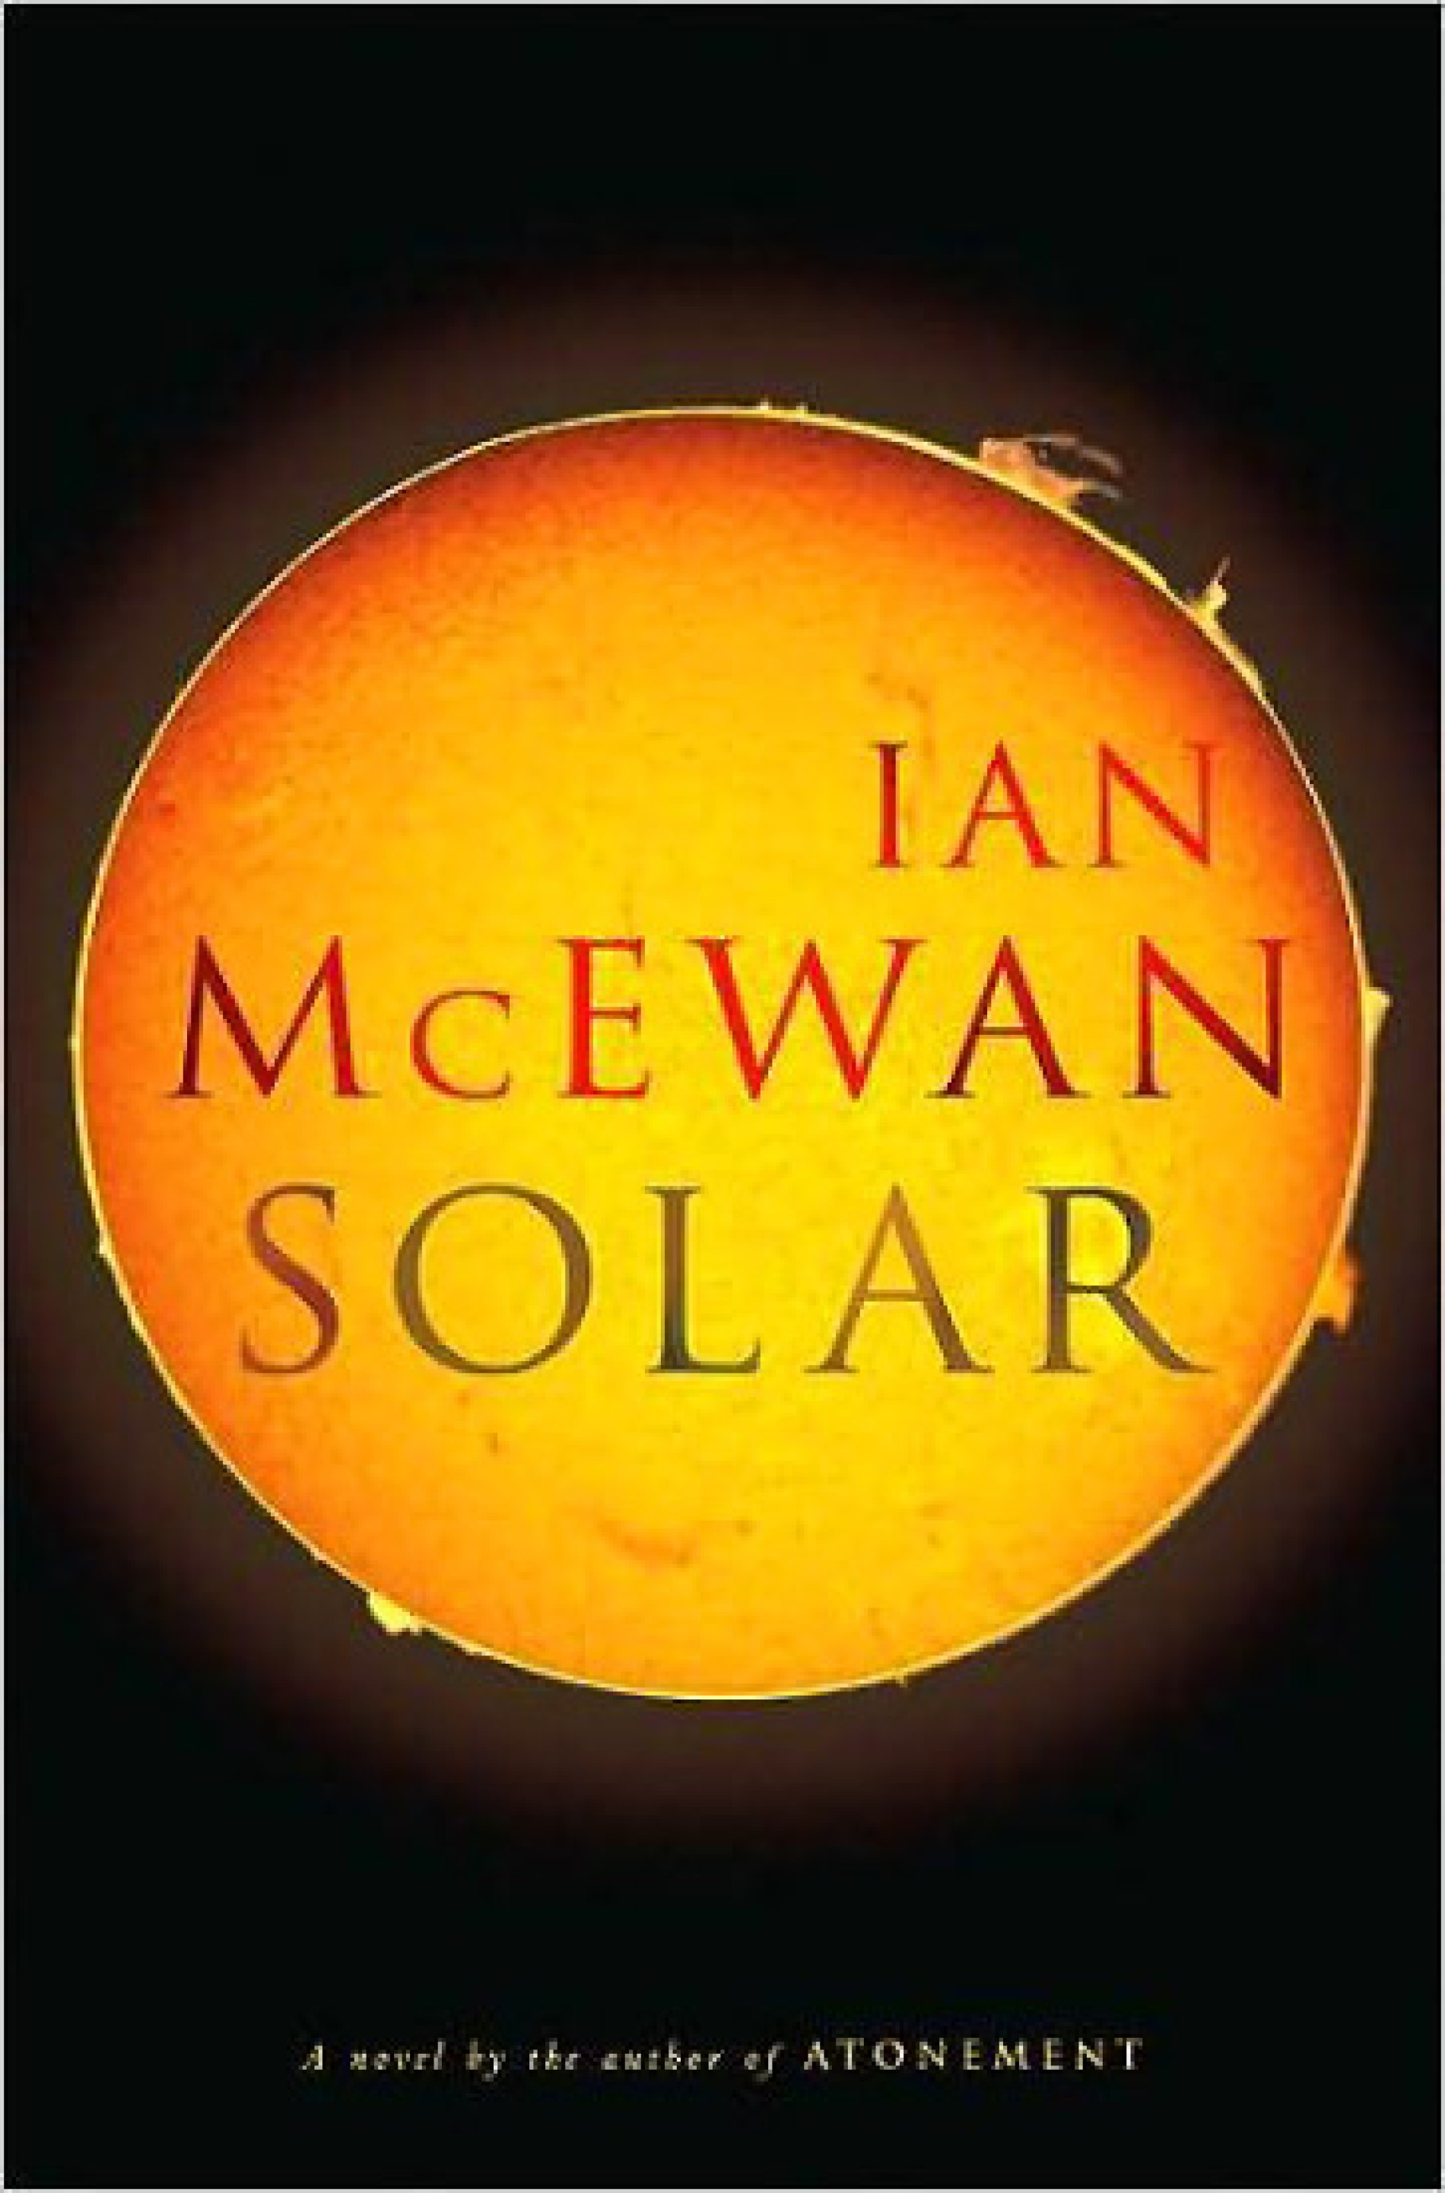
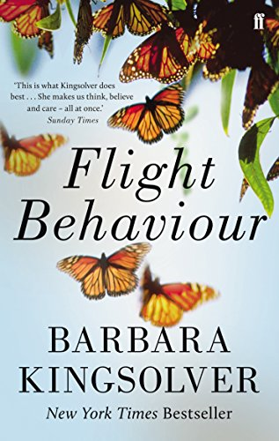
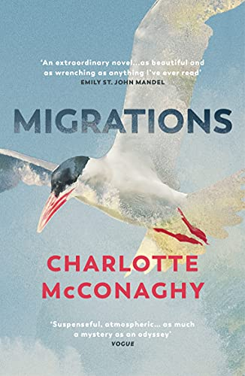
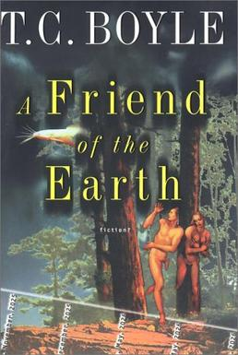
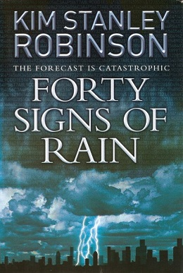
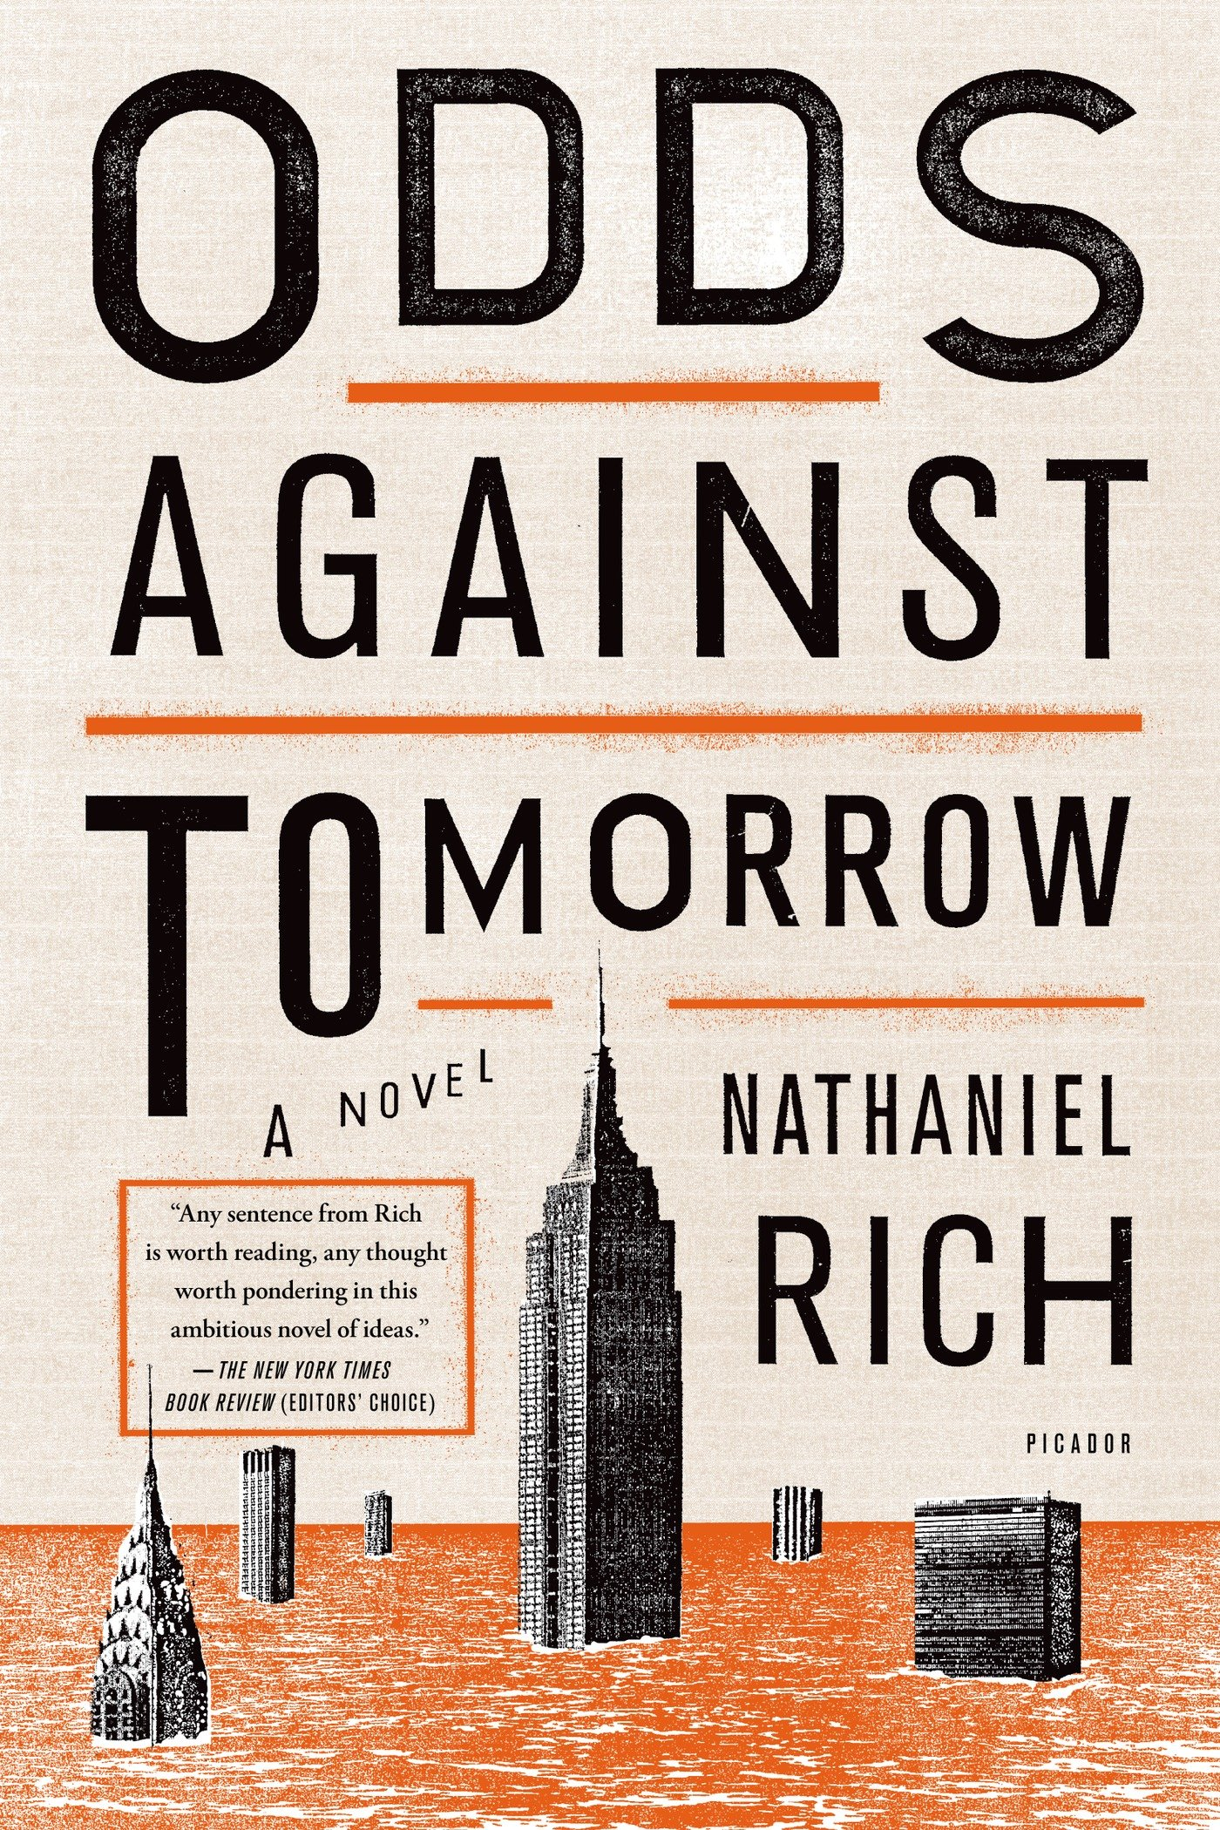
Timeline: Key Cli-Fi novels, milestones in climate science and selected discursive events
1997:
Kyoto Protocol
A Friend of the Earth |  |  |  | 40 Signs of Rain |  |  |  | Carbon Diaries 2015 | ng Year | Solar
IPCC Special Report "Emis-sions Scena-rios" | 3rd IPCC Report |  |  |  |  |  | 4th IPCC Report |  |  |  |  | IPCC Special Report "Extreme Events and Disasters" |  | 5th IPCC Report |  |  |  |  | IPCC Special Report "Ocean and Cryo-sphere in a Changing Climate" |  | 6th IPCC Report
 |  |  |  |  | Hurri-cane Katrina |  |  |  | Failure of Copen-hagen Summi |  |  | Hurri-cane Sandy |  |  | Paris Agree-ment |  |  | Fridays for Future begins | Greta Thunberg in Davos ("I want you to panic.“) |  | heat waves, droughts, floods
2000 | 2001 | 2002 | 2003 | 2004 | 2005 | 2006 | 2007 | 2008 | 2009 | 2010 | 2011 | 2012 | 2013 | 2014 | 2015 | 2016 | 2017 | 2018 | 2019 | 2020 | 2021

Slide 5
Aims
Sketch a succession of phases in the representation and “use” of fear in climate fiction, using a number of influential examples
Correlate these phases with key discursive events, developments in climate science (e.g., IPCC reports) and growing public awareness/sense of urgency
Discuss impact of growing sense of urgency on perception of earlier cli-fi novels (re-contextualization)

Slide 6
Aims
Sketch a succession of phases in the representation and “use” of fear in climate fiction, using a number of influential examples
Correlate these phases with key discursive events, developments in climate science (e.g., IPCC reports) and growing public awareness/sense of urgency
Discuss impact of growing sense of urgency on perception of earlier cli-fi novels (re-contextualization)
Critique still prevalent assumptions about the roles of fear and fiction
Climate change as a “hyperobject” (T. Morton) too large in time and space to be fully comprehended – fear of climate change therefore often unspatialized.
It is one of the functions of cli-fi to spatialize and “scale” climate change.

Slide 7
Phases in the Representation and “Use” of Fear in Climate Fiction (conceptual)
Early CliFi novels (until early 2000s): climate change as a rather diffuse issue among other issues of environmental degradation; not really an issue for “fear”
Second phase (early 2000s until ~ 2016): drastic representations of climate change, frequently with the rather obvious aim of shocking people into recognition and/or action by evoking fear, often with significant amounts of info-dumping [characters lecturing on climate science]
Since ~ 2008: rapid diversification of genres and modes (realist fiction, comic modes, sci-fi, genre fiction, midcult …)
Third phase (since ~ 2017): strong sense of urgency and an awareness that those who read climate fiction know the facts and need no wake-up calls – focus on solutions and generating hope or on recognition of inevitability (loss and mourning)

Slide 8
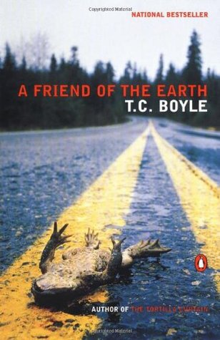
Dark humour (and ultimately optimism) in the face of climate change, environmental degradation, species loss …
“The woods – these woods, our woods – are coming back, the shoots of the new trees rising up out of the graveyard of the old, aspens shaking out their leaves with a sound like applause […] Then there comes a soft pale evening in the middle of the summer, wildflowers on fire in the fields […] and my wife and I strolling down the verge of the open street, arm in arm. […] That’s when the girl appears […] and there’s a chirp to her voice that brings me back thirty-seven years.” (274f. [last two pages])
… and pandemics
„Lori died in the mucosa epidemic that hit three years ago“ (3)
„Lori died in my arms, both of us wearing gauze masks, the mucosa so thick in her lungs and throat, she couldn‘t draw a breath“ (93)
„We all wore masks and kept strictly to ourselves …” (143)
1st ed., hardcover
2000
Goodreads, June 3, 2020: “I do not recommend reading this during a pandemic! I had to put it aside because it was too depressing. Mucosa virus and masks? Eek! I'm not even sure why I pressed on to get through this book […] Perhaps I did it for the animals. I certainly didn't find the humour people keep mentioning in reviews here. Maybe it's there and too close to home at the moment so I couldn't see it?”
1st paperback ed.
2000
Notes:
Ende: the frog (not climate change, but one flat frog)

Slide 9
Dates of publication and temporal setting of key examples
2000
(set 1989-2025)
2004
(near future)
2008
(set 2015)
2010
(set 2000-2009)
2012
(present/near future)
2013
(present/near future)
2020
(near future)
2009
(set 23rd century)
Dates of future projections have tended to move closer to the present (exceptions are genre-specific)

Slide 10
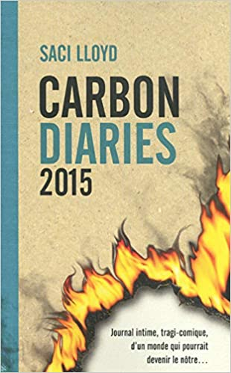
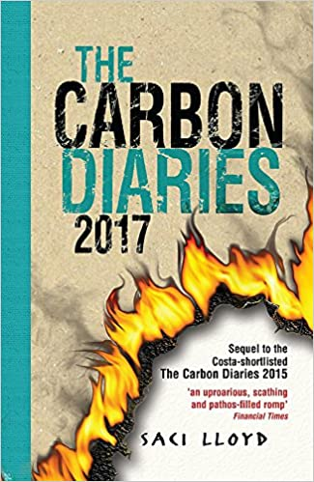
The Carbon Diaries: Changing Covers
Sequel: Carbon Diaries 2017 (2010)
1st. English ed.
9/2008
1st English paperback ed., 2/2009
French transl. 5/2012
Guardian 3/2012: “It had me rolling around in laughter at some points, and thoughtful at others.”
English 1st ed., 2/2010
English paperback ed., 7/2010
Notes:
There‘s lot to be said about this as a young adult novel on climate change, but today we only focus on the succession of covers. Clearly a shift in some four years from a teen novel that happens to be set in an England of carbon rationing to a really gloomy novel on climate apocalypse.

Slide 11
"A decrease in global biomass of marine animal communities, their production, and fisheries catch potential, and a shift in species composition […] over the 21st century in ocean ecosystems […] under all emission scenarios"
“The climate apocalypse is coming. To prepare for it, we need to admit that we can’t prevent it.” (J. Franzen, “What If We Stopped Pretending?”, 9/2019)
A Friend of the Earth |  |  |  | 40 Signs of Rain |  |  |  | Carbon Diaries 2015 | ng Year | Solar
IPCC Special Report "Emis-sions Scena-rios" | 3rd IPCC Report |  |  |  |  |  | 4th IPCC Report |  |  |  |  | IPCC Special Report "Extreme Events and Disasters" |  | 5th IPCC Report |  |  |  |  | IPCC Special Report "Ocean and Cryo-sphere in a Changing Climate" |  | 6th IPCC Report
 |  |  |  |  | Hurri-cane Katrina |  |  |  | Failure of Copen-hagen Summit |  |  | Hurri-cane Sandy |  |  | Paris Agree-ment |  |  | Fridays for Future begins | Greta Thunberg in Davos ("I want you to panic." |  | heat waves, droughts, floods
2000 | 2001 | 2002 | 2003 | 2004 | 2005 | 2006 | 2007 | 2008 | 2009 | 2010 | 2011 | 2012 | 2013 | 2014 | 2015 | 2016 | 2017 | 2018 | 2019 | 2020 | 2021
Notes:
Such correlations can be established for every text of cluster of texts here, but for reasons of time let‘s only look at one. => Clear sense that even in the relatively short span of twenty years, representations and „uses“ of fear in climate fiction have changed quite drastically and clearly in line with the growing sense of urgency and the general discursive climate around climate change, so in a sense, there is also an „ecology of fear“ in that sense. And here I hand over to Roman.

Slide 12
Loss and mourning in recent Climate Fiction
“In a future near enough you could almost mistake it for the present …” (Washington Post, August 11, 2020)
“A nameless sadness, the fading away of the birds. The fading away of the animals. How lonely it will be here, when it‘s just us.“ (62)
“There are no more monkeys in the wild, no chimps or apes or gorillas, nor indeed any animal that once lived in rain forests. The big cats of the savannas haven’t been seen in years … There are no bears in the once-frozen north, or reptiles in the too-hot south, and the last known wolf in the world died in captivity last winter.” (24)
Or: stories of successful transformation (“socio-ecological transition narratives”
(e.g., Kim Stanley Robinson, Ministry for the Future (2020)
Notes:
Instant classic – and one that takes place in a world after mass extinction and catastrophic climate change.

Slide 13
Overview
1 – 20 Years of Cli-Fi (Climate Fiction)
2 – The “Climate Change Literacy” Project: What Literature can(not) do
3 – Two model analyses: Ian McEwan, Solar (2010) and Kim Stanley Robinson, Ministry for the Future (2020)

Slide 14
Why Climate Change Literacy?
Climate Change Literacy ≠ knowing the scientific facts
“It’s not climate change – it’s everything change!“ (Margaret Atwood)
How to communicate climate change – and what can literature contribute?
How to achieve an understanding that translates into responsible individual and collective action?

Slide 15
Selection of Texts
Matthew Schneider-Mayerson: “The Inﬂuence of
Climate Fiction: An Empirical Survey of Readers” (2018)
T.C. Boyle, A Friend of the Earth (2000)
Kim Stanley Robinson, Forty Signs of Rain (2004)
Saci Lloyd, The Carbon Diaries 2015 (2008)
Paolo Bacigalupi, The Windup Girl (2009)
Ian McEwan, Solar (2010)
Barbara Kingsolver, Flight Behaviour (2012)
Nathaniel Rich, Odds Against Tomorrow (2013)

Slide 16
Two fallacies – what literature does not do (but is often expected to do)
cognitive fallacy
Literature does not primarily transport factual knowledge about climate change (“info-dumping”)
Factual knowledge does not translate into specific, foreseeable attitudes and behaviours.
sentimental fallacy
Sympathy for and empathy with attractive “climate heroes or heroines” or “cute animals” empirically does not lead to long-term behavior change
mind-behaviour gap -
gap between knowledge and action
Notes:
Noch schlimmer: Man muss den Leuten mit Dystopien Angst machen!

Slide 17
Climate change and the novel – more than facts
“The problem with writing about global warming may be that the truth is larger than usually makes for good fiction.” (McKibben 1)
"Hyperobjects"
"[issues or] things that are massively distributed in time and space relative to humans"
(Morton 1).
Notes:
McKibben: Umgekehrt wird ein Schuh draus – gerade das Skalieren ist die Leistung von Literatur!

Slide 18
Climate Change and “Scale”
Timothy Clark, “Derangements of Scale” (2012)
Progressive social and economic policies designed to disseminate Western levels of prosperity may even resemble, on another scale, an insane plan to destroy the biosphere. To live the hourly trivia of an affluent lifestyle in France is already to lurk as a destructive interloper in the living space of a farmer on the massive floodplains of Bangladesh. […] Yet, for any individual household, motorist, etc. a scale effect in their actions is invisible. […]
Human agency becomes, as it were, displaced […].
A sentence about the possible collapse of civilization can end, no less solemnly, with the injunction never to fill the kettle more than necessary when making tea. […] A motorist buying a slightly less destructive make of car is now ‘saving the planet’. (150f., 155)
[Timothy Clark (2012). “Derangements of Scale.” Telemorphosis: Theory in the Era of Climate Change. Ed. Tom Cohen. Ann Arbor: Open Humanities Press. 148-166.]
Notes:
Die Frage ist also, was Romane hier beitragen können. Mention: Flight Behaviour – individuell – local- national – global – und wieder zurück

Slide 19
One understanding – what literature can do
transformative potential of literature
Approaches from narratology and cognitive literary studies
More than facts
Scaling
Allowing readers to “experience” the effects of climate change
Climate Change + X (climate change as a “wicked problem”)
More than feeling and simple identification
critical empathy
Contradictory, counter-intuitive, complex processes of identification
Change of perspectives
Stories of successful transformation (“socio-ecological transition narratives”, e.g., Kim Stanley Robinson, Ministry for the Future, 2020)

Slide 20
Overview
1 – 20 Years of Cli-Fi (Climate Fiction)
2 – The “Climate Change Literacy” Project: What Literature can(not) do
3 – Two model analyses: Ian McEwan, Solar (2010) and Kim Stanley Robinson, Ministry for the Future (2020)

Slide 21
Solar and „Scaling“
“Four days ago, [the boot room on the arctic expedition] had started out in orderly condition, with all gear hanging on or stowed below the numbered pegs. Finite resources, equally shared, in the golden age of not so long ago. Now it was ruin. […] How were they to save the earth – assuming it needed saving, which he doubted – when it was so much larger than the boot room?” (109)
„Tragedy of the Commons“

Slide 22
The “Climate Lecture” in Solar
At the reception before his lecture, Beard eats nine salmon sandwiches …
“The planet, [he begins his lecture], is sick.” (204) [Then: eleven pages of dense lecture on climate change, energy transition, mind-behaviour gap etc., all accurate, but …]
“He released his grip on the lectern and turned to step […] through the gap in the curtain into a gloomy space […] To the sound of respectable applause, he bent double while his burden, well lubricated by fish oil, slid soundlessly from him. […] Then he went out onto the dais to stand, solemnly dabbing at his lips with a handkerchief, while Saleel gave a vote of thanks.” (204-216)
No neat identification with a “climate hero“

Slide 23
Michael Beard and identification
“He belonged to that class of men - […] bald, short, fat, clever – who were unaccountably attractive to certain beautiful women. Or he believed he was […] His fifth marriage was disintegrating.“(3)
“He was fifteen pounds overweight. Act now, or die early. He swore off all the usual things – dairy produce, red meat, fried food, cakes […]. During the last three days of his stay he kept to the new regime.” (100)
… but what kind of identification is that?

Slide 24
Michael Beard and identification (II)
Beard is seeing a doctor, who tells him he may have skin cancer and has to do something about it quickly, but he refuses to see the problem:
“Parks, in his engaging, neutral manner, told him he was being irrational. No time to lose, on the edge of no return, metastasis a possibility. “Don’t be a denier,” Doctor Parks had said, appearing to refer back to their climate-change chats. “This won’t go away just because you don’t want it or are not thinking about it.”
Beard‘s refusal to do what he rationally knows he should be doing and all of his irrational, irresponsible behaviour does not make him a likeable character inviting identification in any straightforward way. Rather, readers may recognize themselves in him, because in a sense, with his denial and complacency, he is “like us”.

Slide 25
Humor and perspective in climate novels
[Beard discusses the prospects of an investment in climate-friendly energy generation, which will only be profitable if climate change is real]:
“If the [earth] isn’t hotting up, we’re fucked […]”
“Here’s the good news. The UN estimates that already a third of a million people a year are dying from climate change. Bangladesh is going down because the oceans are warming and expanding and rising. […] There’s a meltdown under the Greenland ice sheet […] Now the eastern Antarctic is going. The future has arrived, Toby. […] It’s a catastrophe. Relax!” (298)
McEwan: “one approach to this subject was through a kind of forgiving humour.”

Slide 26
Kim Stanley Robinson, Ministry for the Future (2020)
Multi-perspectivity: chapters with “blockchain […] code” (177), “the market” (191), “a photon” (235f.), “a carbon atom” (327-329), or “history” itself (385) as narrators.
“[Robinson] does not employ the formal possibilities of literature, e.g., in dramatizing such individual conversions. Even his two round characters, Mary the United Nations bureaucrat and her initial antagonist Frank May, lack a realistic novel’s psychological interiority.” (Mackenthun 11)
Or: is it not perhaps the fact that the novel does not provide any internal view and does not invite identification with attractive climate heroes that makes it so interesting as a example of climate change communication?
Notes:
[Aus dem Kontext wird klar, dass sie das für ein großes Versäumnis hält].

Slide 27
Legitimizing eco-terrorism?, or: How does fiction work?
“Everyone alive knew that not enough was being done […] and the pressure kept building. So it was not really a surprise when a day came that sixty passenger jets crashed in a matter of hours. […] Clouds of small drones had been directed into the flight paths of the planes involved, fouling their engines. […] One message was fairly obvious: stop flying. And indeed many people stopped.” (228). [also: sinking of diesel-fuelled container ships, assassinations of oil executives …]
“violence towards petro-capitalist structures by agents from the Global South is portrayed as justified, even necessary, as a form of anti-imperial struggle for survival” (Frame and Flamm n.p.).
"A novel beginning in a very recognizable present and ending in a desirable future: Is this possibly not so much literature as activism? And ultimately one that propagates violence? It is not that simple. Science fiction writer Robinson … is too good a storyteller to make his novel the vehicle of a message. Ministry for the Future is not a how-to manual but a detached exploration of the dynamics that might turn a world driven by the forces of inertia into one of change. (Ahne 2021, my trans.)
Notes:
Wirklich?

Slide 28
So why Climate Change Literacy?
Climate Change Literacy ≠ understanding the facts of climate change
It takes more than the scientific facts.
“The cognitive capacity of distinguishing fact from fiction, as well as grasping the long-term and long-distance connections involved in the phenomenon of climate change, crucially depends on hermeneutic powers trained by literature” (Mackenthun 2021, 3).
The reading of literature alone does not automatically “train” these hermeneutic competencies – and does not automatically lead to ‘climate change literacy’
“Climate Change Literacy” also implies an understanding of how literature functions as a staging of conflicts around climate – role prose (speaking as another), different narrator figures, undercutting simple identification, climate change as a “wicked problem”

Slide 29
julia.hoydis@uni-koeln.de
jens.gurr@uni-due.de
roman.bartosch@uni-koeln.de
www.climate-change-literacy.de

