Slide 1
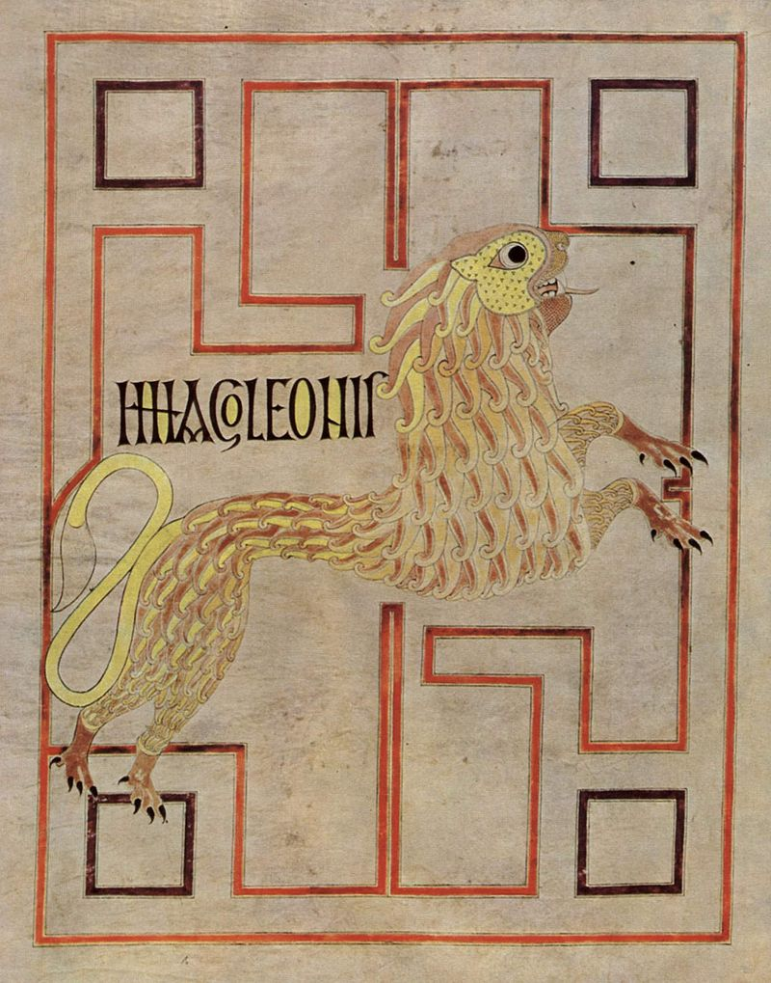
From Missionaries to
Powerholders: spreading the faith and perfecting Christian community (c. 500-900
AD)

Slide 2
Recap: Hermits, the First Monasteries and Late Antique Society
Some key points from the last lesson
Monasticism finds its most influential point of origin in Egypt in the 3rd-4th century AD, but was also found elsewhere in the Near East around the same time
Some men and women become eremitic recluses (i.e. hermits), separating themselves from society, and some even entering the barren desert of Egypt.
They set themselves a harsh ascetic (i.e. training) life of self-denial and constant prayer to avoid temptation, repent for sins, and develop virtues.
Coenobitic (i.e. communal) monasticism also takes root as monks and nuns begin to congregate together for mutual support. Not separate but define their society as different to society in the world: renouncing property and their own wills to the “common life” in obedience to a leader (an abbot or abbess)
Despite the desire to separate themselves in some ways, monks and nuns of all varieties frequently become well supported by outsiders, who offer them gifts and even estates to fund their efforts.

Slide 3
Recap: Hermits, the First Monasteries and Late Antique Society
Some key points from the last lesson
Monks looked back to the scriptural examples of Jesus in the wilderness (concerning separation), apostles giving away their property (concerning renunciation and charity) and the community of the apostles (concerning creating a more perfect community).
Some other potential influences had long traditions (e.g. Jewish semi-ascetic practices, Stoic philosophy, the influence of dualist religious culture in the Mediterranean).
Other potential influences were more specific to place - e.g. the physical and social geography of Egypt - and also time: at a point where Christianity was no longer so much of a “counter-culture”, monasticism offered this path
While some outsiders could be concerned by the difference they presented and also the accumulation of wealth, however, this culture was quickly found to be useful to society in the late Roman Empire: an “elite” serving it through prayer and example

Slide 4
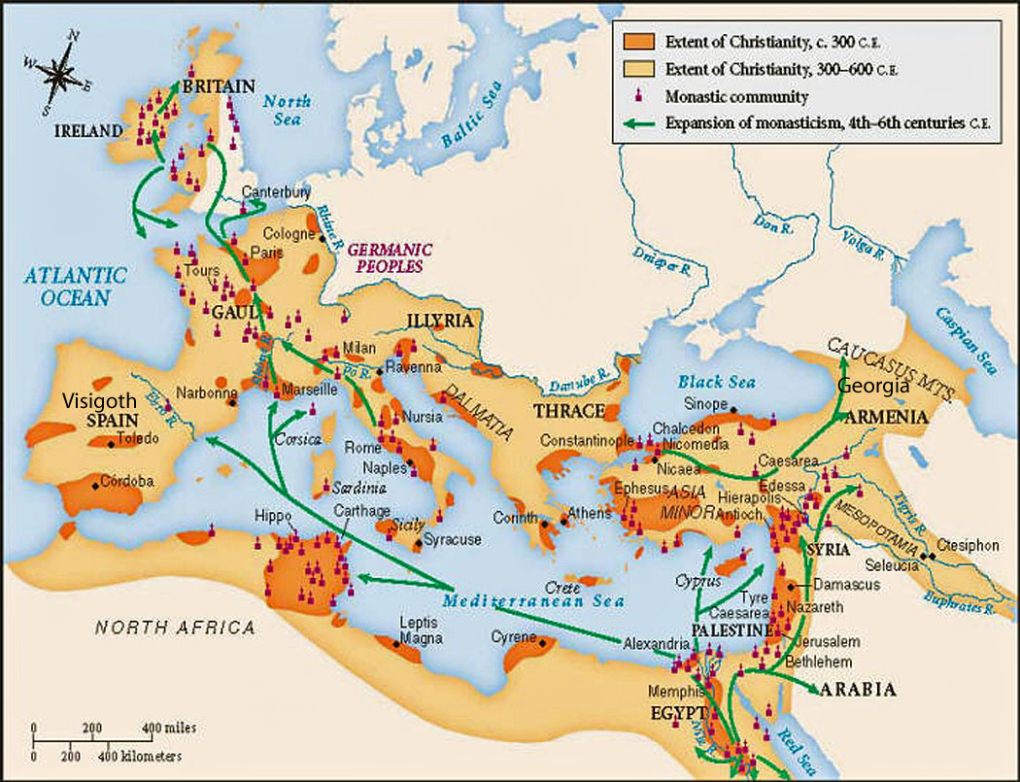
Christianity in the West at the dawn of the Middle Ages
Christianity became the Roman imperial religion from 324 onwards and was dominant in Egypt and the Near East
But many parts of Europe were weakly or not at all Christianized. Paganism was still widespread.
Pagan cults in fact gain new influence as the power of tribal groups (often Germanic) replaced that of the Western Roman Empire – which collapsed in 476 AD.

Slide 5
Christianity in the West at the dawn of the Middle Ages
Also still little in the way of a united Church organisation
The authority of the papacy – really just the bishops of Rome at this time – was not yet well-established.
Bishops elsewhere most often chosen locally and with no standard procedure.
Doctrinal variations added to the confusion. Arian Christianity – which did not believe in the Trinity – remained powerful, especially among some Germanic groups like the Goths and Vandals.
Roman imperial efforts (e.g. Council of Nicaea, 325 AD) to forge an orthodoxy often have limited initial reach

Slide 6
The spread of monasticism in the West
Monasticism enters Europe extremely rapidly
Arrives from Egypt and North Africa through the Mediterranean from the mid-fourth century onwards
Becomes most rapidly established in Italy, France, and – more surprisingly – Ireland (never part of the Roman Empire)
Key point: Monasticism may emphasise separation from society, but also plays a major role in the Christianization of Europe

Slide 7
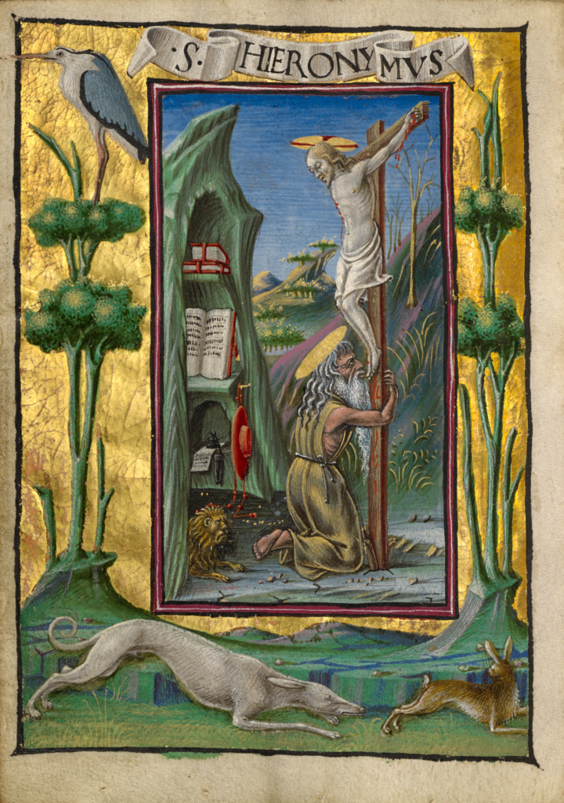
Monasticism and the “Church Fathers”
Monastic life and values exercise a powerful influence over some of those who would become the most prominent Christian thinkers
Saint Augustine of Hippo (354-430): arguably the most influential writer for Western Christianity (e.g. the Confessions, City of God)
Born in Thagaste (in modern day Algeria). In his early life he is a Manichaean (a dualist faith).
Becomes involved in the circle of Saint Ambrose in Italy, and converts to Christianity after hearing the life of Saint Anthony. Later founds a monastery in North Africa.
Saint Jerome (c.347-420): famed for his Latin translation of the Bible (the Vulgate), standard throughout the Middle Ages.
Born in Dalmatia (modern day Croatia) as a pagan, converts to Christianity in his youth, as a student in Rome (c. 360-6).
Journeys to the Middle East and lives as a hermit for two years. Returns to Rome and establishes a monastic community for widows and virgins.

Slide 8
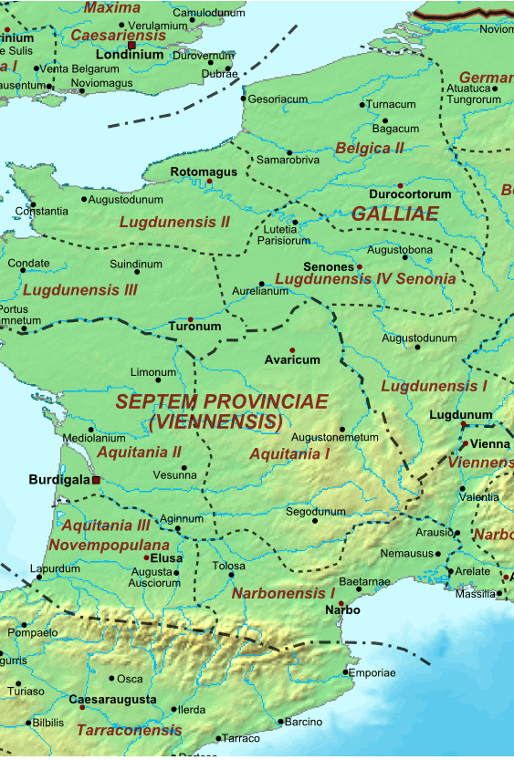
Early Monasticism in Gaul
In Mediterranean Gaul (the south of modern France) – in which Christianity was already very active c. 300 AD – monasticism takes root rapidly
Honoratus of Arles (d. 429 AD)
from a Gallo-Roman consular family, he converts to Christianity and journeys to the Holy Land and Egypt.
On his return to Gaul, he becomes a hermit on Lerins Islands (off the Mediterranean coast, near Cannes in modern day France): he gains followers and establishes a monastery there.
John Cassian (d. 435 AD)
born in Eastern Europe, he journeys to the Holy Land and then to Egypt with his friend Germanus.
He compiles a book of their conversations with hermits and monks (the Conferences). He goes to Rome, and then on to Marseilles, where he founds two monasteries.

Slide 9
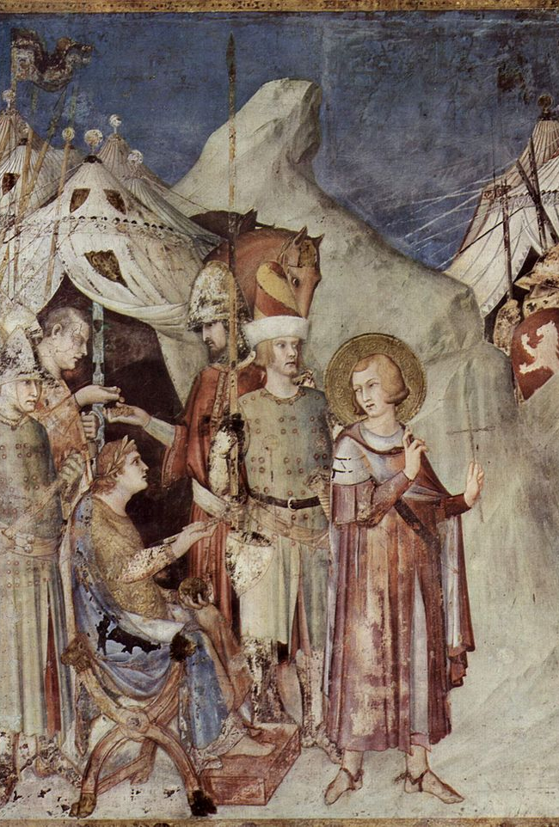
Early Monasticism in Gaul
In Northern Gaul, where paganism and Arian Christianity (non-trinitarian) are more common, monasticism is a vector for conversion to the official “Nicaean” Christianity of the late Roman Empire.
Martin of Tours (397 AD)
A Roman soldier from Pannonia (modern-day Hungary) who converts to Christianity in his youth. He comes to Gaul through military service.
Later converts many and leads groups of ascetics in the forests near Poitiers, before being acclaimed bishop of nearby Tours due to his popularity in the city.

Slide 10
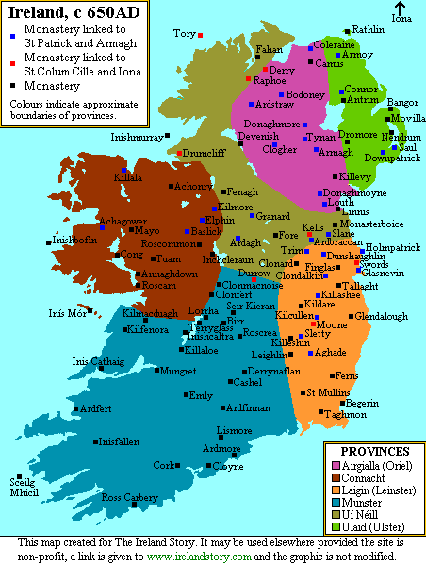
Irish Monasticism
In Ireland, the rise of Christianity is closely intertwined with the spread of monasticism
Saint Patrick (5th century AD) – a Celto-Roman Briton and somewhat mythic figure; said to have visited Marmoutier (the community of Saint Martin of Tours) and Lerins (monastery of Honoratus of Arles) before bringing Christianity to Ireland
Christian converts found monasteries from c. 500 for both men and women. Celebrated monastic leaders begin to appear
Saint Brigid of Kildare (late 5th to early 6th centuries) – said to have founded a monastery in Kildare, with two communties (one for women, one for men). Some debate as to whether she was a real person.
Saint Finian of Movilla (d. c. 589) – from the ruling clan of Ulaid; founds the monastery of Movilla after spending seven years in Rome
Saint Columba (a.k.a Colum Cille, d. 597) – from an Irish noble family, mentored by Saint Finian. Establishes the monastery of Iona, in the Outer Hebrides Islands

Slide 11
Irish Monasticism
Some key points:
Irish monasticism is particularly closely tied to local, rural powerholders from the very start.
The abbot is often a member of a leading family that supports the monastery.
In Ireland, monasteries (rather than existing towns) become the seats of bishops.
Such bishops are often chosen by the abbot from among the monks.

Slide 12
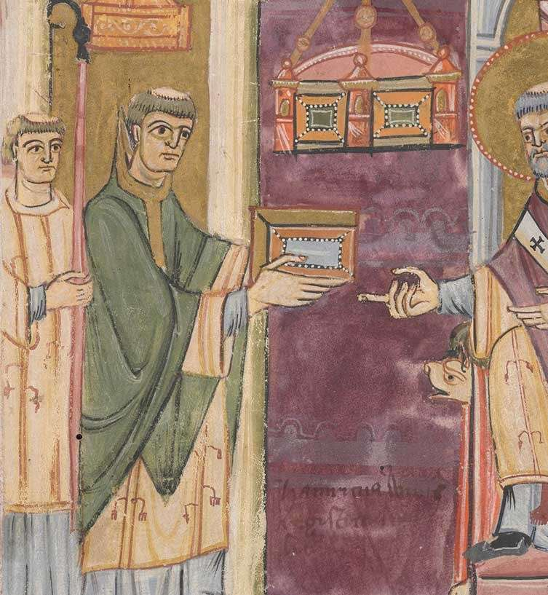
Monastic Missionaries
Monasticism does not just effect Christianisation through slow diffusion
Some monks become key proselytisers, despite their apparent commitment to the metaphorical “desert” (i.e. being outside of society).
Some taken out of monasteries by Church or lay authorities to take up such roles due to their virtues.
But some monks actively chose the missionary path for themselves: this is a particularly common choice for those from the Irish monastic tradition

Slide 13
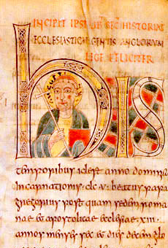
Monastic Missionaries
Some important monk-led missionary activities
Augustine of Canterbury’s mission to Anglo-Saxon England
Augustine (d. 604) – not the same as Augustine of Hippo! – was a Roman monk
Sent by Pope Gregory the Great (d. 604), who was keen to expand the influence of the (still quite weak) papacy
His mission has some success in Southern England especially, but also suffers some setbacks and retreats
Irish missions to Scotland and Anglo-Saxon England
Saint Columba (d. 597) founds the monastery of Iona in the Outer Hebrides – used as a base to preach to the Picts in Scotland
Saint Aidan (d. 651), a monk of Iona, travels to Northern England at the request of King Oswald of Northumbria, who had previously visited the Ireland and been converted to Christianity.
Aidan plays key role in conversion of Northern England and founds the powerful monastery of Lindisfarne.

Slide 14
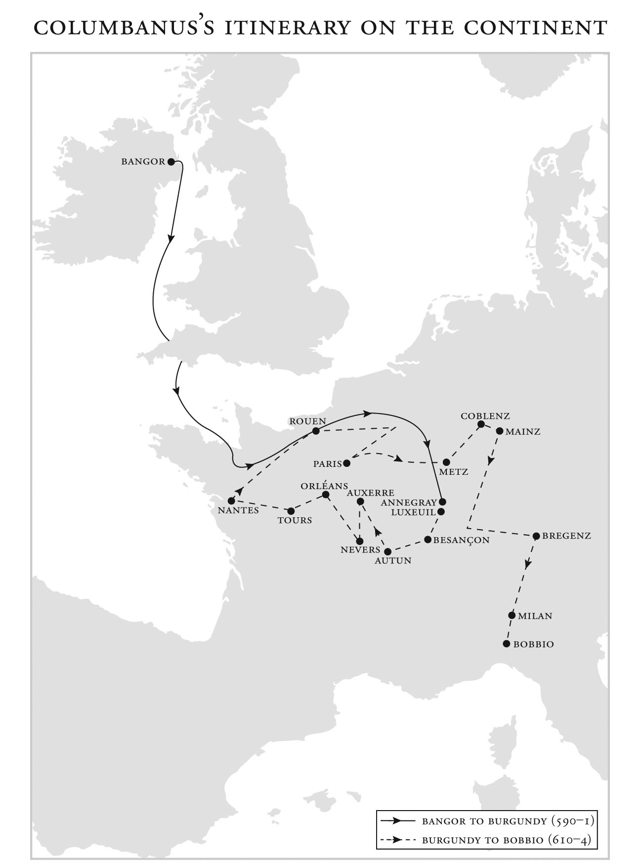
Monastic Missionaries
Irish and Anglo-Saxon missions to the Continent
Saint Columbanus (c. 540-615 AD)
Travels from Bangor in Ireland to Gaul and then to Italy.
He founds 12 monasteries in the Irish tradition. His form of monastic asceticism is particularly austere and physically demanding.
Nevertheless, he is frequently involved with laypeople and outside his monasteries.
While the areas he visits are usually quite Christianized, he plays a part in fighting Arianism and deepening the faith of Merovingian Frankish aristocrats.
Saint Willibrord (c. 658-739 AD)
An English monk of Lindesfarne, indebted to the Irish tradition.
Journeys to preach to the pagan Frisians (modern-day Netherlands), at the request of a Frankish aristocrat, Pepin of Herstal.
Saint Boniface (c. 675-754 AD)
Journeys to Frisia, and follows up the work of Willibrord.
Also goes deeper into Germany, preaching throughout the countryside to convert pagans and deepen the roots of Christianity in the region.
Becomes well-connected with Frankish aristocracy, but returns to Frisia later in life and is killed by pagans there.

Slide 15
Monasticism and the Active Life
Why would monks – people who “flee the world” to a contemplative life – be willing to take on such particularly active roles in ministry?
Biblical duty to proselytise and convert
If monks looked back to New Testament example (e.g. Christ in the wilderness, community of the apostles), they could not entirely ignore the preaching of Christ and his followers.
Another form of ascetic escape
Difficult missionary work could be seen as a form of ascesis (training), and even as a different form of isolation (e.g. from other Christians).
The renewed possibility of martyrdom
If many became a monk to be “dead to the world” and to live a life of “mourning”, the possibility of actual martyrdom could attract the most fervent.
Attempting to convert pagans provided this potentially appealing risk.

Slide 16
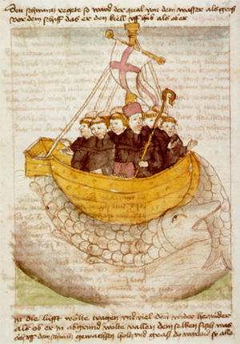
Monasticism and the active life
Irish socio-cultural factors
Missionary work had a strong association with the Irish monastic tradition. Why? Elva Johnson (see bibliography) offers some proposals:
Very rural, local society. Exile was thus a powerful punishment; conversely, ability to travel successfully was sign of status. For Irish monks, travel away from home similarly became a voluntary penitential and ascetic act but also elevated them
Irish monks inherited a classical intellectual culture that placed them at the wild edge of the world. Undertaking (often dangerous) sea journeys from their island home became a mark of trust in God.
The growing association of Irish monks with missionary work created a sense of identity: strong links between Ireland and mission sites were maintained, encouraging others to come
Irish monks equate their wandering and overseas journeys with religious pilgrimage (peregrinatio). But for them, it was the journey, not the destination that mattered.
A depiction of St Brendan the Navigator (d. 577) in a late medieval manuscript

Slide 17
The Appeal of Monastic Missionaries
Why were monks prove so capable at missionary work? [see Little, in course syllabus, and Brown]
Tenacity
If any committed Christian could be zealous in their faith, monks were particularly likely to be so.
Ascetic training prepared them well for the daunting task.
Otherworldliness
The most successful monastic missionaries have a level of self-denial that draws attention.
Their apparent humility and simplicity could make them appear less threatening.
Independence and Flexibility
Able to match the needs of local society in a way other church structures (i.e. bishops and their entourages) often failed to. The Irish tradition proved particularly adaptable in this respect.
Worked readily outside urban centres in largely rural societies.
Often bolstered existing local elites: houses remain strongly associated with elites and are often strongly devoted to providing prayer for them; elites retain influence over them.
As Christianisation progressed, such dynastic monasteries offered significant prestige to ruling families as seats of religion and education.

Slide 18
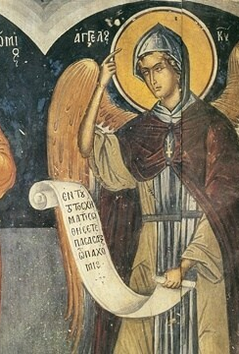
The Rise of “Rules”
As monasticism expanded and found new roles, so did its diversity. There were many experiments in the exact patterns of life.
But this constant experimentation also prompted questions:
How could monastic leaders and communities secure their particular brand of monastic vision and discipline beyond their deaths?
How could monasteries secure their place in society in a way that was sustainable?
Such questions lead to regularization – including the writing of “rules”.
But such initial efforts at regularization are also very diverse.

Slide 19
The Rise of “Rules”
Early Rules in Egypt
Rule of Pachomius (d. 348) – a summary of how his monasteries came to be, some practical instructions, comparisons of “bad monks” to different animals.
Rule of Shenoute (d. c. 465 AD) – contains the earliest known description of a monastic vow made publicly.
Early Rules in North Africa and the Near East:
Rule of Basil (330-379 AD) – an early monastic leader from the Near East, his rule later became the most common set of instructions for monks in the territories of the Eastern Roman/Byzantine Empire
Rule of Augustine (d. 430 AD) – wrote a set of instructions in Latin for both the male monks he led in later life at Hippo and for nuns. These were later compiled as a “Rule”. They had some influence in late antiquity, but become better known in the high Middle Ages (post 1000 AD).

Slide 20
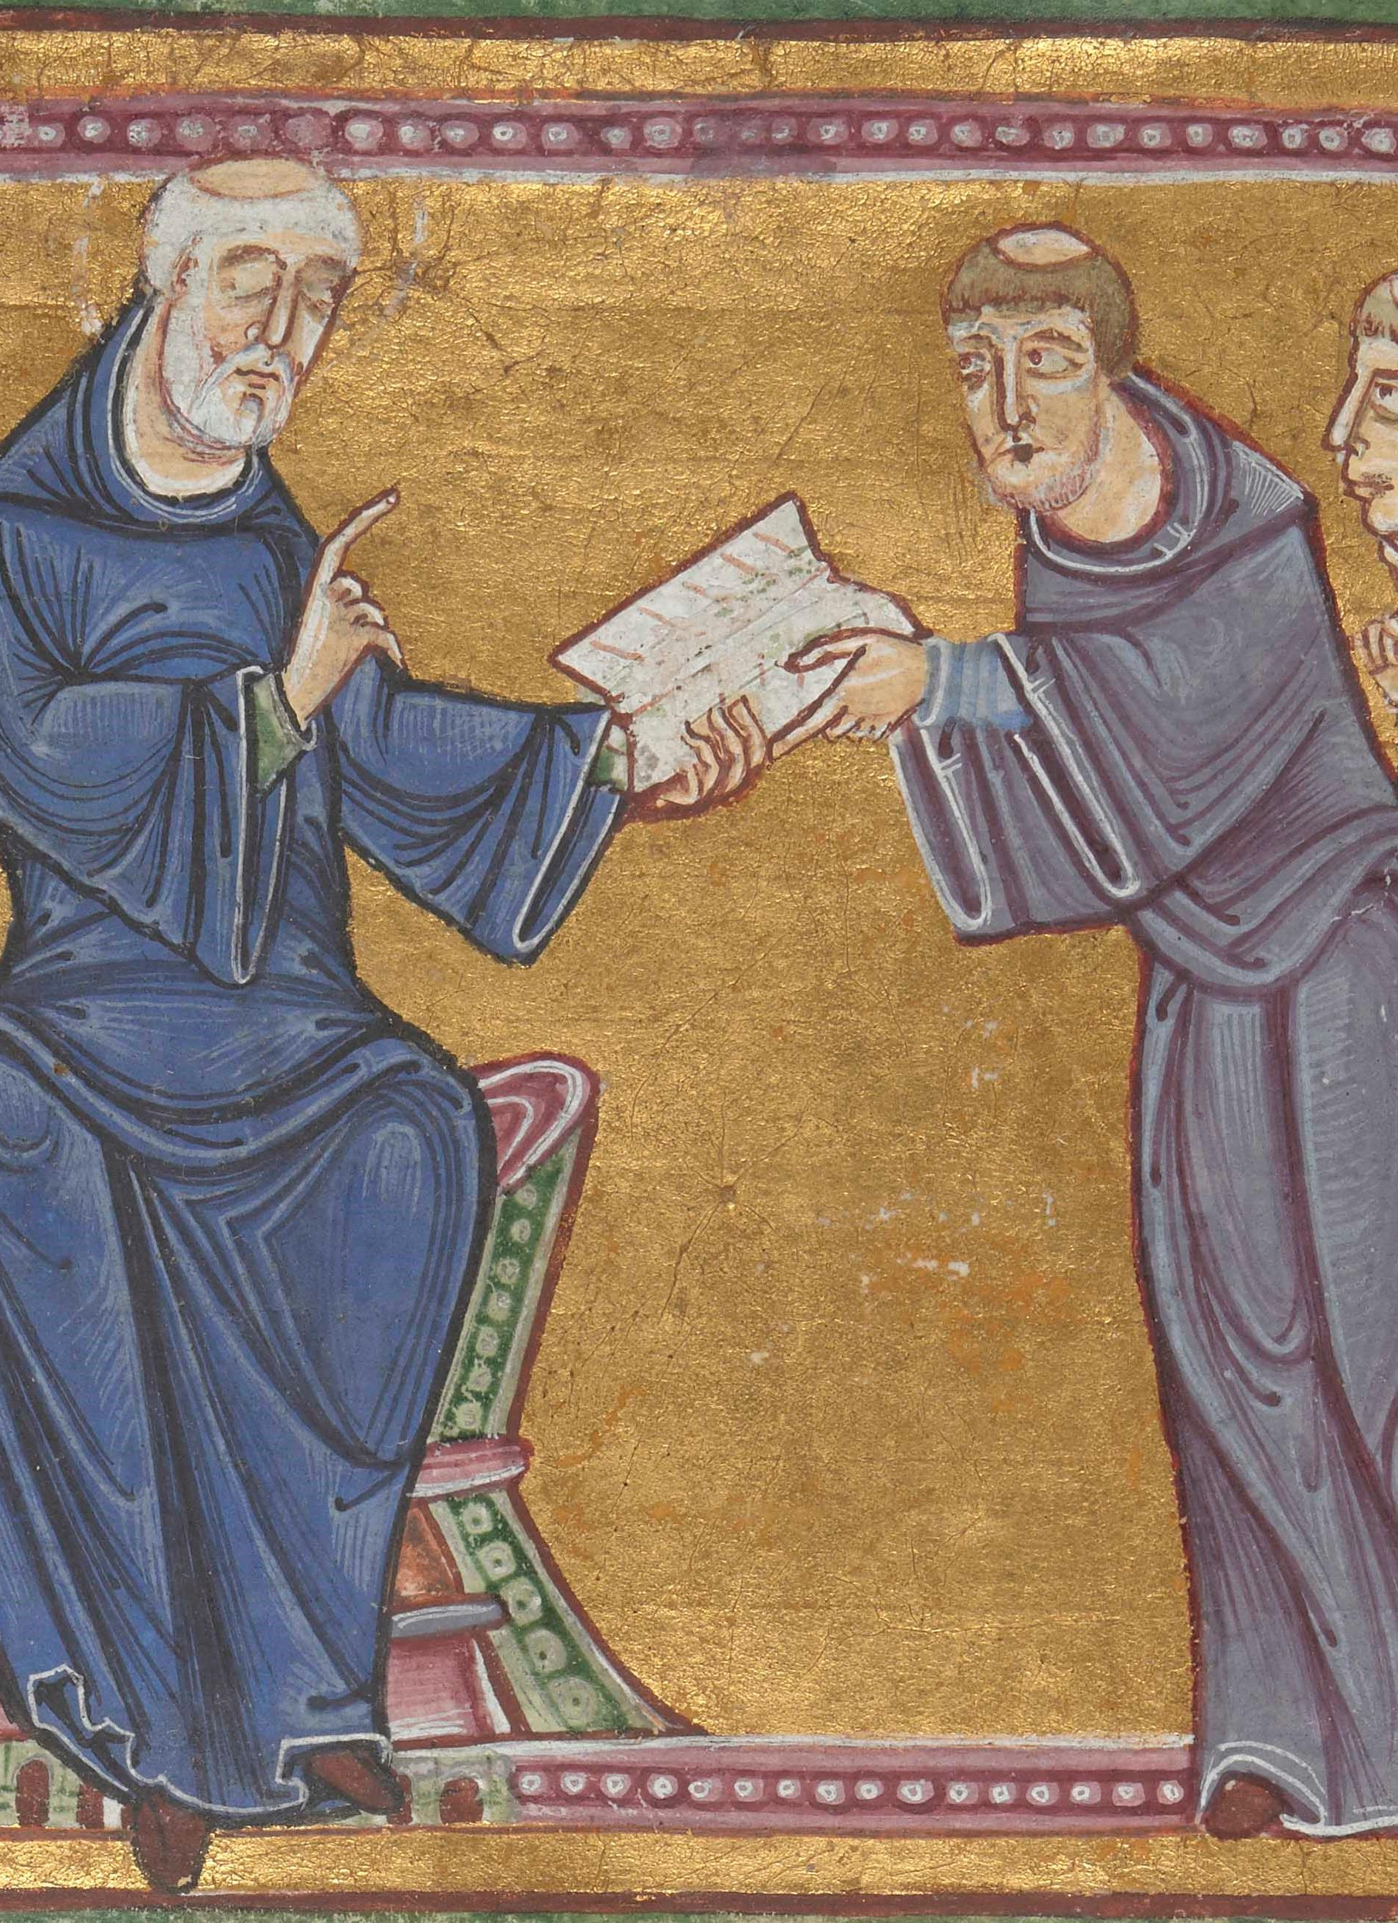
Rules in the Latin West
Diversity of rules grows further in Western Europe
Cassian’s Institutes – written by John Cassian (d. 435 AD) for his monasteries in Southern Gaul (modern day France).
Rule of the Master – anonymous, probably written in Europe c. 500 AD. Focuses on practical instructions, but, more innovatively, also provides very detailed spiritual reasons for everything commanded
Rule of Columbanus – Columbanus (d. 615 AD) offered very rigorous instructions to his monks : unlike most other Rules, his text lays down very precise – and quite harsh! - punishments for every form of monastic indiscipline
Rule of Saint Benedict (of Nursia) – written by Benedict (c. 480-550 AD), abbot of Monte Cassino monastery in Italy, this eventually becomes the most influential rule in the Latin West. Strongly influenced by the Rule of the Master.

Slide 21
Rules in the Latin West
These rules found notoriety and popularity beyond the communities of their writers.
But monasteries exercised broad independence in which, if any, prescriptions they chose to follow, and how closely
Some communities cited multiple rules, following what was called a regula mixta (a “mixed rule”).
In Frankish Gaul in the Merovingian and early Carolingian periods, common to use both Rule of Benedict of Nursia and the Rule of Columbanus.
Sometimes the “rule” of a monastery might not even be a written code [a key point of Albrecht Diem]:
Monks might simply say they followed the example of a founding saint (whose saint’s life might contain some advice or a model).
A “Rule” could even be understood as an oral tradition!

Slide 22
Rules in the Latin West
The traditional view: Rule of Benedict slowly but surely becomes dominant.
Monastic historians have praised this rule for its practicality, flexibility and clarity of spiritual explanation – it has been argued that its influence grows primarily from its superior usefulness.
The support of the papacy from Gregory the Great (d. 604) onward, and of Charlemagne, the first Carolingian Frankish emperor, and his successors seen as capping a more or less inevitable process.
Today, however, some historians (e.g. Albrech Diem) see the diversity of religious Rules and their use as more natural, only changed by outside imposition.
Although, this still leaves the question of why the Rule of Benedict was pushed rather than other “rules”

Slide 23
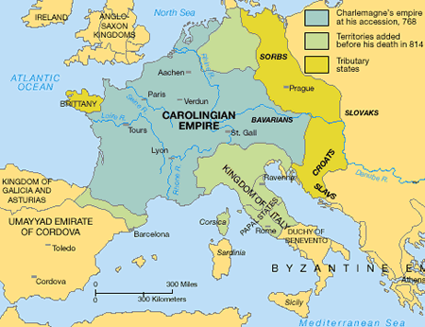
Carolingian Support for the Rule of Benedict
The spread of the Rule of Benedict certainly does require significant imposition from external authorities:
Louis the Pious, Charlemagne’s successor, prioritises the standardisation of religious practice in the Carolingian Empire
His chief religious advisor is another “Benedict” – Benedict of Aniane – who is a monk and a strong supporter of the Rule
Louis organises the Synods of Aachen (816-819 AD) to standardise monastic observance under the Rule of Benedict and a series of additional constitutions.
Other Rules are still copied, however. The manuscript evidence for the copying of the Benedictine Rule and the Aachen customs suggests that uptake of these regulations was more gradual

Slide 24
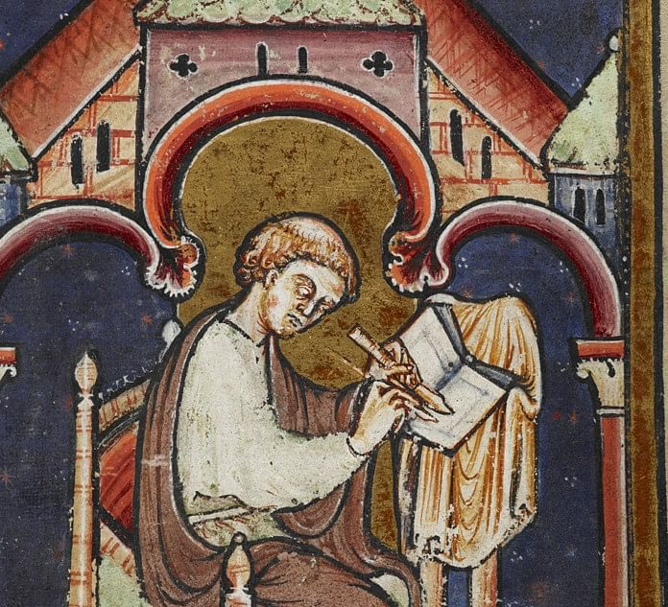
Education and Monasticism
Monasteries prove quite resistant to standardisation – it is only the insistence of the Carolingian Empire that gradually creates more uniformity
But, in other ways, they were still “normative” institutions in society, setting standards for the world around them.
This is most obvious in education: in the early Middle Ages monasteries become the most important seats of learning in the Latin West

Slide 25
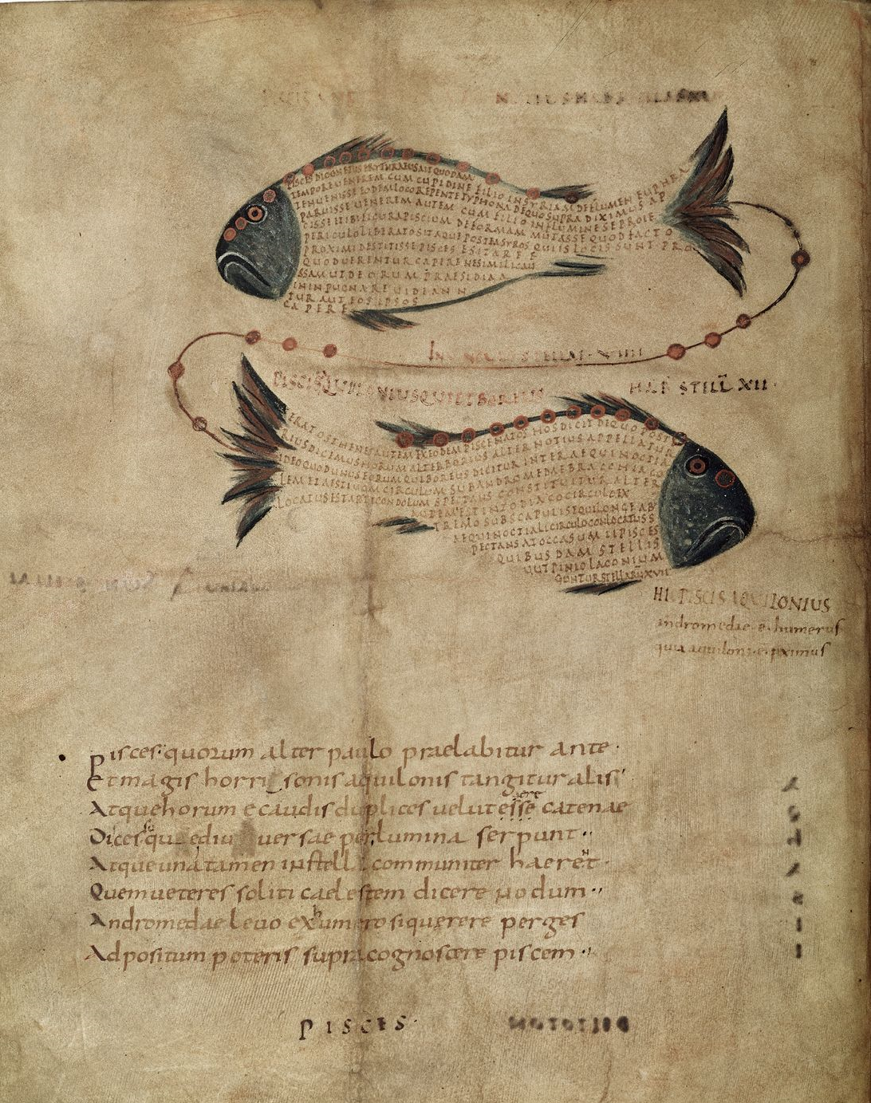
The Development of Monastic Schools
Decline of the Western Roman Empire (ended in 476 AD): education organised by urban authorities becomes rare.
Christian institutions become the only educational centres of any significance
Monasteries become particularly effective seats of learning:
Literacy is necessary for their contemplation of the Scriptures
The removal from a worldly life provides still greater time for their occupants to read, study and write.
But they do so in conversation with the world around them
Despite some tensions, keep and even copy many texts written by pagan authors – preserve cultural tradition
Can provide educational services to outsiders
A manuscript of Cicero’s Aratea
British Library, Harley MS 647, c. 820, France

Slide 26
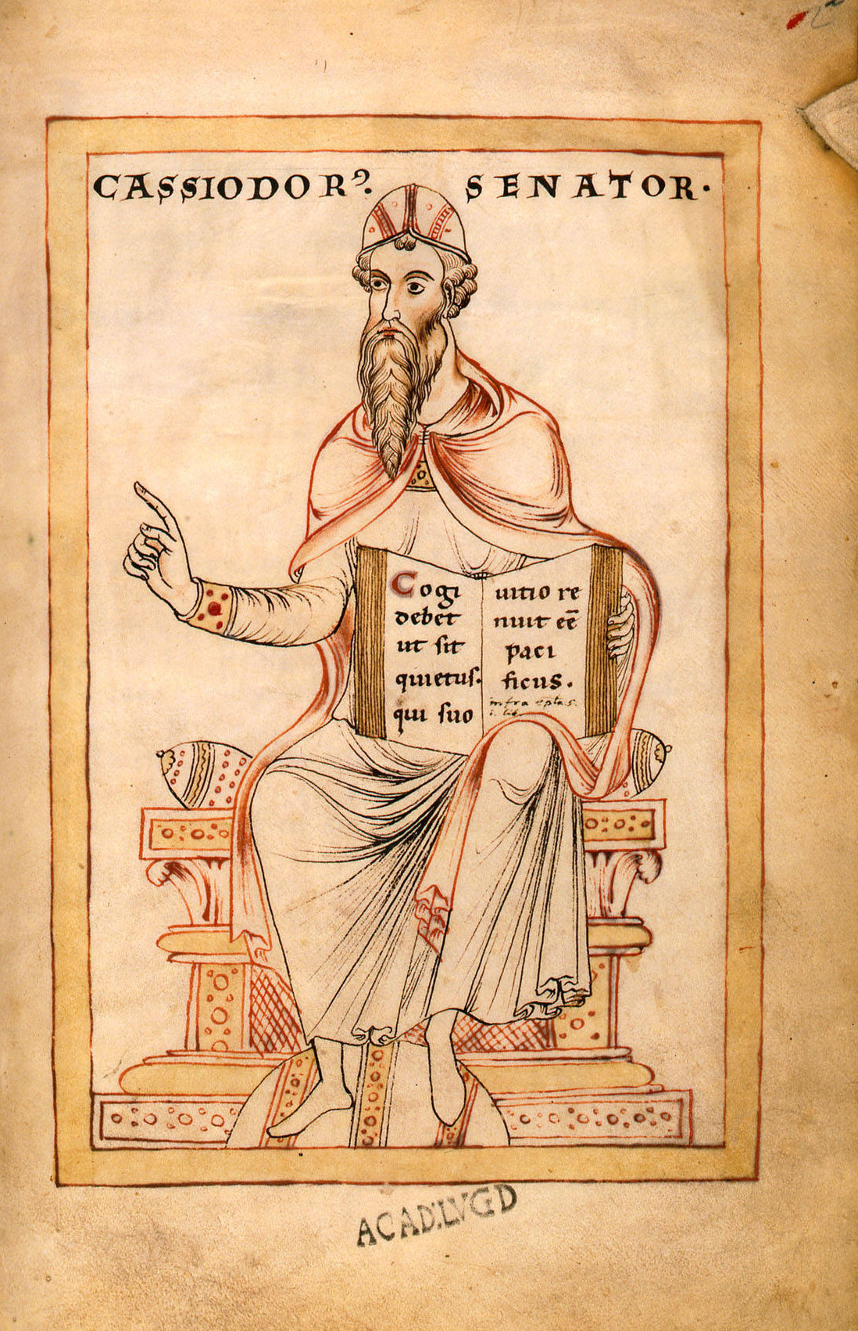
The Development of Monastic Schools
Cassiodorus (d. 585 AD)
A Roman noble who served the Ostrogothic king of Italy, Theodoric the Great
Founded a monastery at Vivarium in Southern Italy and became monk there
His Institutes are similar to a monastic rule in some respects, but focus primarily on educational curriculum.
Sees the need for a new Christian form of education to imitate the old Roman ones.
Justified the reading of pagan intellectual works – since pagans too were made in the image of God – although they remained subordinate to Christian religious texts
A depiction of Cassiodorus in a 12th century manuscript

Slide 27
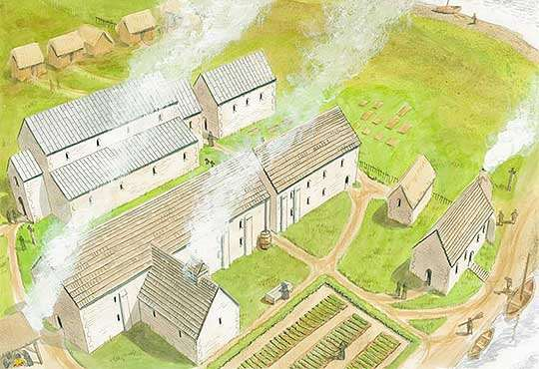
The Development of Monastic Schools
Monasteries perpetuate, enhance and also spread classical and Christian educational tradition.
Irish-influenced monasteries often bring advanced learning to new p.laces (e.g. Ireland, Northern England)
The monasteries of Monkwearmouth-Jarrow (in Northumbria) and Saint-Gall (founded by followers of Columbanus) become very prominent intellectual centres in the Early Middle Ages.
Cathedral schools also founded in the early Middle Ages.
But these were often under strong monastic influence.
E.g. Cathedral school of York, founded by Archbishop Ecgbert (d. 766), was inspired by Monkwearmouth-Jarrow.
Artist’s depiction of part of Monkwearmouth-Jarrow in the Early Middle Ages

Slide 28
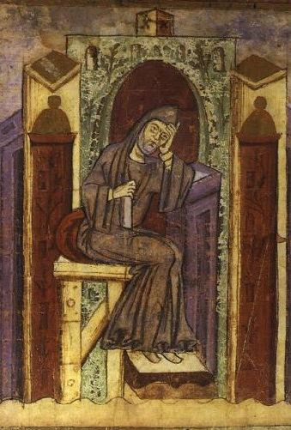
Monastic Education for the Laity
The quality of monastic education meant that it had an appeal for outsiders, even if they had no plans to become monks.
The aristocracy could use them to educate their children: e.g. the example of Oswald, future king of Northumbria.
In the Carolingian empire, such arrangements become frequent.
Notker the Stammerer (d. 912)
A monk of Saint-Gall, he describes how the monks of his monastery asked Charlemagne for young men to educate (in his book “Deeds of Charlemagne”), and how Charlemagne did so enthusiastically.
Alcuin of York (d. 804)
Not originally a monk, taught at the cathedral school of York.
Entering the service of Charlemagne, he is given the monastery of Marmoutier near Tours in 796 (he is made abbot)
The house expands to include a school that educates young aristocrats as well as monks.

Slide 29
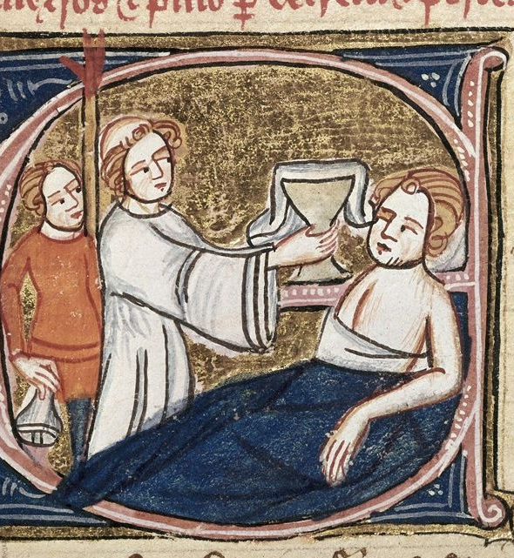
Monastic Hospitality and Charity
Monks and nuns commit to a wider range of social services at this time.
Religious justifications
Monastic flight from the ‘world’ did not remove Christian social responsibilities
Monks and nuns take up Christ’s recommendations of charity to the poor, the hospitality shown to him by others, and his example of healing the sick
Making oneself humble and poor etc. are seen as making one better able to care for others as well

Slide 30
Monastic Hospitality and Charity
Monks and nuns commit to a wider range of social services at this time.
Social aspects:
Practical support to monastic life within society: a social role, a tangible example of ‘giving back’
Hospitality and charity established as social expectations via “rules”: the Rule of Benedict sets guidelines for how guests should always be received and how poor should be relieved
Monastic communities come to run novel institutions: hospitals (to take care of the sick), and almshouses (to care for the poor)

Slide 31
The Carolingian Empire – a monastic realm?
Over the course of this presentation, the context of the rise of the Carolingian Empire has been referenced.
Overall, the creation of such a large polity (albeit one that soon splintered) significantly impacted Western monasticism
The Carolingian aristocracy valued and promoted monasticism – not least for the prayer and religious prestige it offered them.
Rulers also worked to standardise monasteries them under a more Benedictine form in support of wider religious unity.

Slide 32
The Carolingian Empire – a monastic realm?
On the other hand, monastic institutions become a huge influence on the powerholders of the Empire.
As seen, monastic schools were important in educating the aristocracy, providing both their religious and wider intellectual formation.
More broadly monastic institutions influenced the wider religious idealism of the emperors and their courts and even the running of the empire.
  E.g. Benedict of Aniane was a key advisor to Louis the Pious

Slide 33
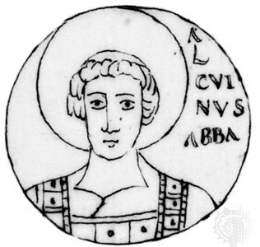
The Carolingian Empire – a monastic realm?
In the process, however, the dividing lines between monasticism and wider society were further blurred.
Monks did not just serve society through hospitality and charity – they also served the empire politically and intellectually.
Conversely, we find important men of the court becoming abbots - e.g. Alcuin of York –, contradicting the Rule of Saint Benedict, since abbots/abbesses were supposed to be elected by monks/nuns.
We also find the spread of monastic-style education outside the monastery (e.g. cathedral schools), and of monastic religious counsel offered to elite laymen.
If the Carolingian empire itself was “monasticized”, was there a risk to the prestige of monks and monasteries as a separate, spiritual elite?

Slide 34
Sources – Bede, Ecclesiastical History (completed c. 731)
Bede (672-735 AD)
An English monk, from the kingdom of Northumbria (Northern England); probably from a good, possibly noble, family.
Bede is given to the monastery of Monkwearmouth (in Northumbria) as a boy, and transfers to its nearby sister house at Jarrow. These monasteries were heavily influenced by Irish tradition and key intellectual centres.
A noted intellectual who writes work biblical commentaries, saint’s lives (e.g. the Life of Saint Cuthbert), scientific treatises (on nature and time), geographic works, but also history.
Ecclesiastical History of the English People
Completed c. 731, this popular Latin work focuses on the history of Christianity in Great Britain, but above all on its history among the Anglo-Saxon tribes and kingdoms: he sees them as one people, the “English”.
Bede’s narrative is clearly carefully researched from earlier histories and many contacts; but it is also a Christian history, written to show the progress of Christianity in England through God’s will.
Reference: Bede, The Ecclesiastical History of the English Nation, ed. V.D. Scudder (London/New York, 1910), [2.2, 3.3]. [I have simplified the translations somewhat]
https://sourcebooks.fordham.edu/basis/bede-book1.asp

Slide 35
Sources – Bede, Ecclesiastical History (on Saint Aidan and King Oswald in Northumbria)
“The same Oswald, as soon as he ascended the throne [of Northumbria], wanted that all his nation should receive the Christian faith […] and sent word to the elders of the Scots [the monastery of Iona]: among them, he and his followers, while banished, had received the sacrament of baptism. […] From the aforesaid island, and college of monks, Aidan was sent to instruct the English nation in Christ, having received the dignity of a bishop at the time when Segenius, abbot and priest, presided over that monastery. Among other instructions for life, he left the clergy [of Northumbria] a most healthy example of abstinence or continence; it was the highest commendation of his doctrine, with all men, that he taught no differently than he and his followers had lived. For he neither sought nor loved any thing of this world, but delighted in distributing immediately among the poor whatever he was given by the kings or rich men of the world. He liked to traverse both town and country on foot, never on horseback, unless compelled by some urgent necessity. And wherever he saw any infidel along his way, he invited them, whether rich or poor, to embrace the mystery of the faith. If he met believers, he sought to strengthen them in the faith, and to stir them up by words and actions to giving alms [charitable gifts] and good works.”

Slide 36
Sources – Willibald – Life of Saint Boniface (c. 760)
Willibald
An obscure English (i.e. Anglo-Saxon) monk who came to Mainz, in Germany, after the death of Boniface (754 AD)
Clearly well-educated: his literary style appears indebted to Aldhelm (d. 709), an English monk and intellectual educated by the Irish in Wessex (Western England)
Life of Saint Boniface
Written in c. 760, detailing the the life and missionary work of Boniface in Germany and Frisia.
While Willibald did not know him personally, he gained details from Boniface’s companion Lull
Perhaps the first Latin text composed in Germany
Known in over 40 manuscripts – reasonably popular. Very influential for other hagiographers (those who wrote saints’ lives) of the Anglo-Saxon missions to the continent.
Willibald, “Life of Saint Boniface”, in The Anglo-Saxon Missionaries in Germany, ed. and trans. C.H. Talbot (London/New York, 1954) [I have simplified the translation somewhat]
https://sourcebooks.fordham.edu/basis/willibald-boniface.asp

Slide 37
Sources – Willibald – Life of Saint Boniface (c. 760)
“When […] the faith had been planted strongly in Frisia and the glorious end of the saint's life drew near, he took with him a number of his personal followers and pitched a camp on the banks of the river Bordne [...] Here he fixed a day on which he would confirm by the laying-on of hands all the converts and those who had recently been baptized. […] But events turned out differently […] A vast number of enemies armed with spears and shields rushed into the camp brandishing their weapons. In the twinkling of an eye, the attendants [of Boniface] came out from the camp to meet them and took up arms wherever they could find them to defend the holy band of martyrs (for that is what they were to be) against the senseless fury of the mob. […] At once [Boniface] challenged the attendants and forbade them to continue the conflict, saying: "Sons, cease fighting. Lay down your arms, for we are told in Scripture not to render evil for good but to overcome evil by good. The hour to which we have long looked forward is near and the day of our release is at hand. Take comfort in the Lord and endure with gladness the suffering He has mercifully ordained. Put your trust in Him and He will grant deliverance to your souls." And addressing himself like a loving father to the priests, deacons, and other clerics, all trained in the service of God, who stood around him, he gave them courage, saying: "Brethren, be of stout heart, do not fear those who kill the body, for they cannot slay the soul, which continues to live for ever. […] Do not be slaves to the transitory pleasures of this world. Do not be seduced by the vain flattery of the pagans, but endure with steadfast mind the sudden onslaught of death, so that you can reign forever with Christ.“

Slide 38
Sources – Eligius, Foundation Charter of Solignac Abbey, 631 AD
Eligius (d. 660)
From a Gallo-Roman aristocratic background, born in Aquitaine in Western Gaul (modern day France)
Becomes “master of the mint” (i.e. coinmaking) under Clotaire II, king of the Neustrian (i.e. Western) Franks. Clotaire’s successor, Dagobert, appoints him chief counsellor
Lived a religious life inspired by the Irish monastic rule of Columbanus with his friend Dado at the court. Also founds monasteries to live in this Irish style.
Foundation Charter of Solignac Abbey (631 AD)
Issued in 631 AD by Eligius, giving a large estate at Solignac, near Limoges, in Aquitaine to a group of monks led by Remaculus, a monk of noble origin from Aquitaine
The monks are to live under the “Rule of the most blessed fathers Benedict and Columbanus”. Thus, it recognised the increasingly popular Italian rule of Saint Benedict (from Monte Cassino), but also the Irish Rule of Columbanus.
The monastery is thus strongly indebted to the Irish monastic tradition that Eligius had become attached to in his own life
Reference: Monumenta Germaniae Historica: scriptores rerum Merovingicarum 4, 746-9 [My own translation from the Latin]
https://www.dmgh.de/mgh_ss_rer_merov_4/index.htm#page/746/mode/1up

Slide 39
Sources – Eligius, Foundation Charter of Solignac Abbey, 631 AD
“Considering the great weight of my sins, and so that I might deserve to be set free from this and lifted up by God, I, your kneeling follower, grant to you [the monks of Solignac] small things in exchange for great things, earthly things in exchange for heavenly things, temporal things in exchange for eternal things. And I want to give […] the aforesaid field of Solignac, which came to me from the generosity of the most glorious and pious lord King Dagobert, along with the buildings which are known to be in this field […]
Neither the bishop nor any other person should have any power within the aforesaid monastery, whether over its things or its people – except the most glorious Prince [Dagobert]. Although I do not believe this will happen, if anyone, whether by their own will or by the command of any people should deceitfully attack the small gift I have granted – which I offer to omnipotent God for the good fortune of kings, for the remedy of my soul, for prayers for the peace of the people, and for peace for the servants of God – or in any way oppose it, […] they should fall victim to the the anger of Omnipotent God.”

Slide 40
Sources – Rule of Saint Benedict of Nursia, 516 AD
Benedict of Nursia (c. 480-550 AD)
An Italian monk and abbot of Monte Cassino monastery
Wrote a rule in Latin that would eventually become the most famous and influential rule in the Latin West.
The Rule of Saint Benedict (516 AD) would be heavily promoted by the Carolingian Emperors from the early 9th century
Despite some long-standing resistance, would become increasingly recognised as the standard rule for monasteries in the Carolingian empire

Slide 41
Sources – Rule of Saint Benedict of Nursia, 516 AD
All guests who present themselves are to be welcomed as Christ, for he himself will say: “I was a stranger and you welcomed me” (Matt 25:35). Proper honour must be shown to all, especially to those who share our faith (Gal 6:10) and to pilgrims. Once a guest has been announced, the superior and the brothers are to meet him with all the courtesy of love. First of all, they are to pray together and thus be united in peace; prayer must always precede the kiss of peace because of the temptations of the devil. All humility should be shown in addressing a guest on arrival or departure. By a bow of the head or by a complete prostration of the body, they are to be adored like Christ, because He is indeed welcomed in them. After the guests have been received, they should be invited to pray; then the superior or an appointed brother will sit with them. The divine law is read to the guest for his instruction, and after that every kindness is shown to him. The superior may break his fast for the sake of a guest, unless it is a day of special fast which cannot be broken. The brothers, however, observe the usual fast. The abbot shall pour water on the hands of the guests, and the abbot with the entire community should wash their feet. After the washing they will recite this verse: “God, we have received your mercy in the midst of your temple” (Ps 47[48]:10). Great care and concern are to be shown in receiving poor people and pilgrims, because in them more particularly Christ is received; our very awe of the rich guarantees them special respect. […] No one is to speak or associate with guests unless he is asked; however, if a brother meets or sees a guest, he is to greet him humbly, as we have said. He should ask for a blessing and continue on his way, explaining that he is not allowed to speak with a guest.

Slide 42
Sources – Ermoldus - In Honour of Emperor Louis (c. 826-8)
Ermoldus Nigellus/Niger (Ermoldus the Black – active between 824-30)
A poet, who lived at the court of Pepin of Aquitaine (d. 838). Clearly educated, but it is not known where
Pepin had been made King of Aquitaine by his father, the Carolingian emperor Louis the Pious.
He was exiled for some crime to Strasbourg c. 826-8, but returns to Pepin’s court afterwards
In Honour of Emperor Louis (c. 826-8)
A poem written in Latin, Ermoldus tells us that he composed it hduring his exile
Its purpose is pretty clear: to win Louis’s favour, so his exile could be ended and he could return to Pepin’s court.
Not a reliable history; rather reveals much about the culture – and, above all the cultural aspirations - of Carolingian aristocratic society.
The following extract describes Louis the Pious’s foundation of the Benedictine Monastery of Inde (near Aachen, Western Germany), at the instigation of his religious advisor, the Benedictine monk Benedict of Aniane.
Reference: Patrologia Latin 105, 569- 640 [My translation from Latin]

Slide 43
Sources – Ermoldus - In honour of Emperor Louis
This monastery, built by these men [Louis the Pious and Benedict of Aniane], was called Inde
and took the name from the river which ran before its gates.
Three miles separated the monastery from the royal Palace,
in the town of Aachen, whose renown has carried far.
This most agreeable place was previously home to long-horned deer,
bears, buffalo and wild goats.
But the pro-active Louis chased off these wild animals,
and skillfully built a place that was pleasing to God.
He hurried to found it, and enriched it with the best things.
There, Saint Benedict, your pious rule flourishes.
The same Benedict was the father of this house.
And Louis was both Caesar and abbot there.

Slide 44
Sources – Alcuin - Book of the Virtues and Vices, c. 801-4 AD
Alcuin of York (d. 804)
An Anglo-Saxon (i.e. English). Born in Northumbria, probably in the 730s.
Perhaps from an aristocratic background: he is educated at the prestigious cathedral school of York, established by Archbishop Ecgbert (d. 766)
Becomes a deacon (not a priest) at York Cathedral, and a leading teacher of the school.
Meets Charlemagne on a trip to Rome and is invited to join his court in 761; he leads a school at Charlemagne’s palace and becomes a key advisor
Despite not being a monk, he is made abbot of Marmoutier abbey outside Tours in 796; the house expands to include a school that educates young aristocrats
Book of Virtues and Vices
Written in Latin by Alcuin at Marmoutier for Wido, count of the Breton March in c.801-4
It is intended for his spiritual instruction but became a very popular work – present in over 140 manuscripts
Reference: Patrologia Latina 101, 613-38 [My own translation from the Latin]

Slide 45
Sources – Alcuin - Book of the Virtues and Vices, c. 801-4 AD
I have composed this for you, dearest son Wido, in brief words, just as you asked, so that through this little book you may have a manual in your sight every day. Reading it, you will be able to consider what you ought to avoid or what to do. And through the individual adversities or prosperities of this life, you may be encouraged to find how you should ascend to the highest perfection.
Do not be frightened by your lay condition and secular way of life, as if this condition might bar you from entering the doors of heaven. For just as the blessings of the kingdom of God are preached in the same way to all, so the doors of His kingdom open equally to every sex, age, and person according to their merits. There is no distinction there, between those who were lay or cleric in the world, rich or poor, junior or senior, unfree or lord. Rather, each, according to the merits of their good work, will be crowned with perpetual glory.

Slide 46
Select Bibliography
Peter Brown, The rise of Western Christendom: triumph and diversity, A.D. 200-1000 (Malden, 2013). [Available in library]
Elva Johnson, “Exiles from the Edge? The Irish Contexts of Peregrinato “, in Roy Flechner and Sven Meeder (eds.), The Irish in early medieval Europe, (London, 2016), 38-52. https://researchrepository.ucd.ie/bitstream/10197/8299/1/Exiles_from_the_edge_The_Irish_contexts.pdf
Albrecht Diem and Philippe Rousseau, “Monastic Rules (Fourth to Ninth Century),” in in Medieval Monasticism in the Latin West, vol. 1, ed. A.I. Beech and I. Cochelin (Cambridge, 2020). On IS filestore.
R. Kramer, “Teaching Emperors: Transcending the Boundaries of Carolingian Monastic Communities”, in Meanings of Community across Medieval Eurasia: Comparative Approaches, ed. E. Hovden, C. Lutter, and W. Pohl(Leiden, 2016), 309-337.
https://www.jstor.org/stable/10.1163/j.ctt1w76w6c.18

