Slide 1
Korean class
Week 1

Slide 2
Index
Introduce
About Korea
About Hangeul
Vowels / Consonants
Today’s K-pop

Slide 3
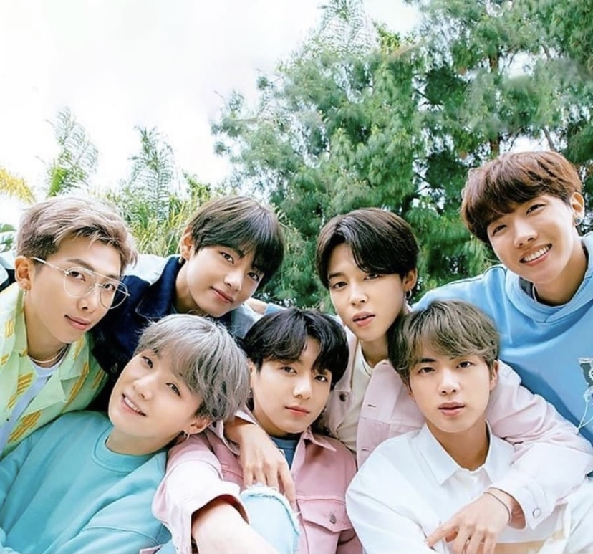
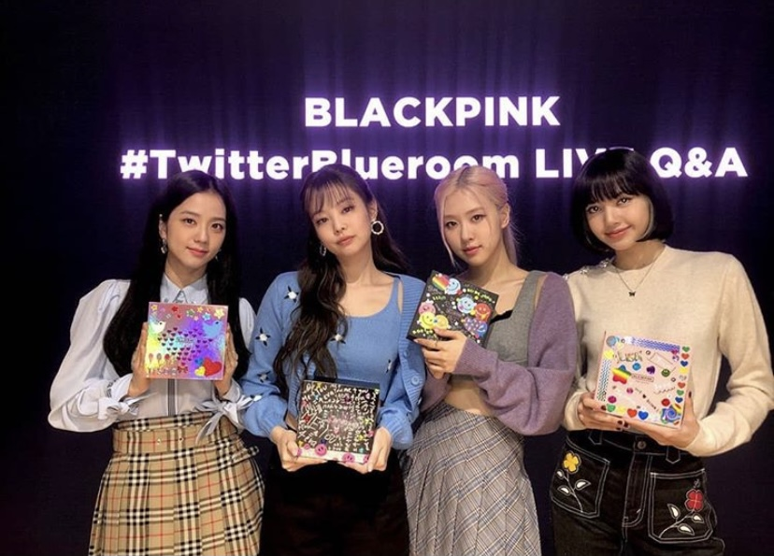
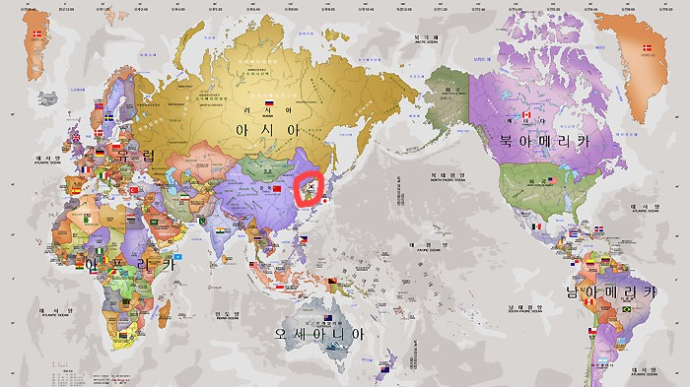
About korea

Slide 4


About korea
Watch video!
https://youtu.be/i0VJq55pIJU

Slide 5
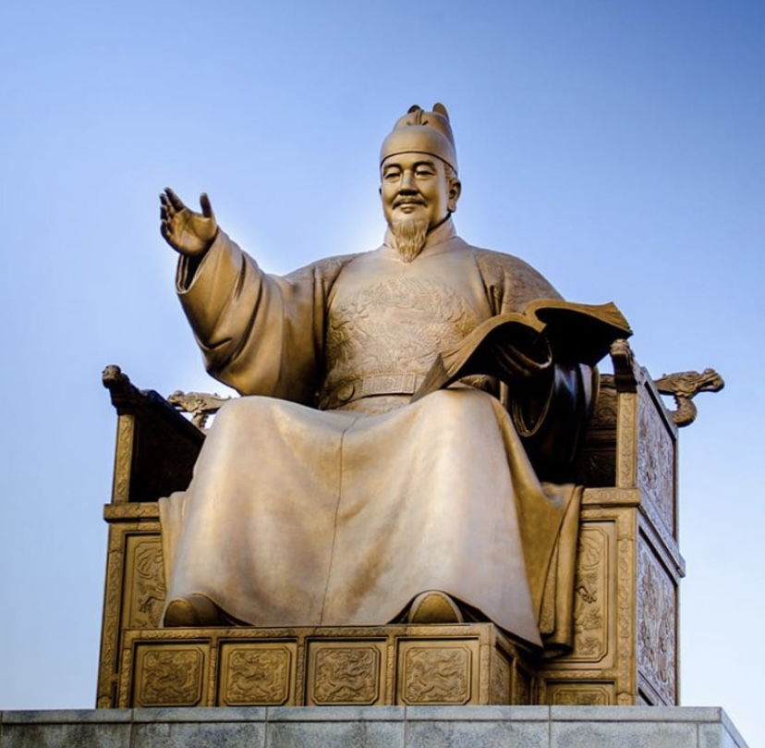
About hangeul
King Sejong created with many scholars
He made it for the whole nation
Cultural heritage

Slide 6
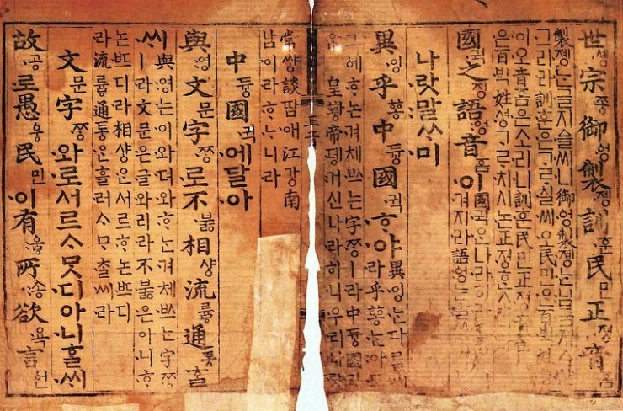
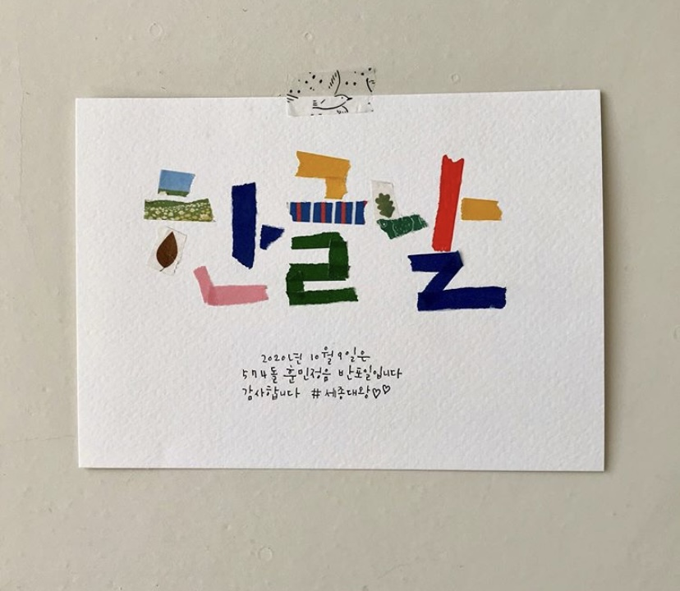
About Hangeul
  훈민정음(Hunminjeongeum)
  -A book containing the principles of Hangeul
  한글날(Hangeul Proclamation Day)
  -October 9 every year

Slide 7
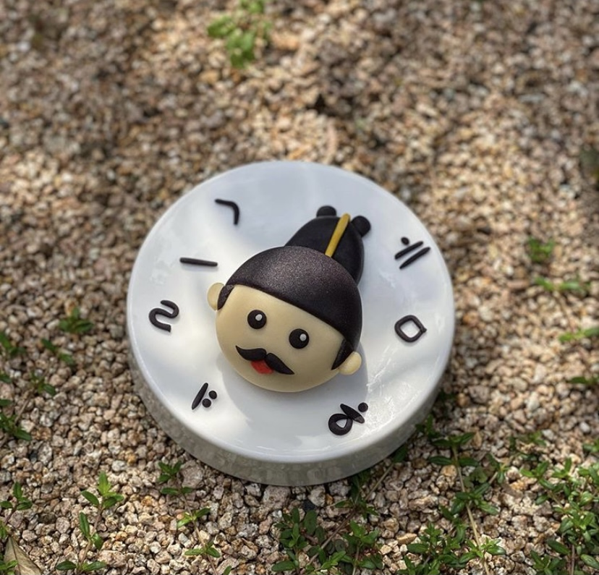
About hangeul
Watch video!
https://youtu.be/2aDPpssj0h0

Slide 8
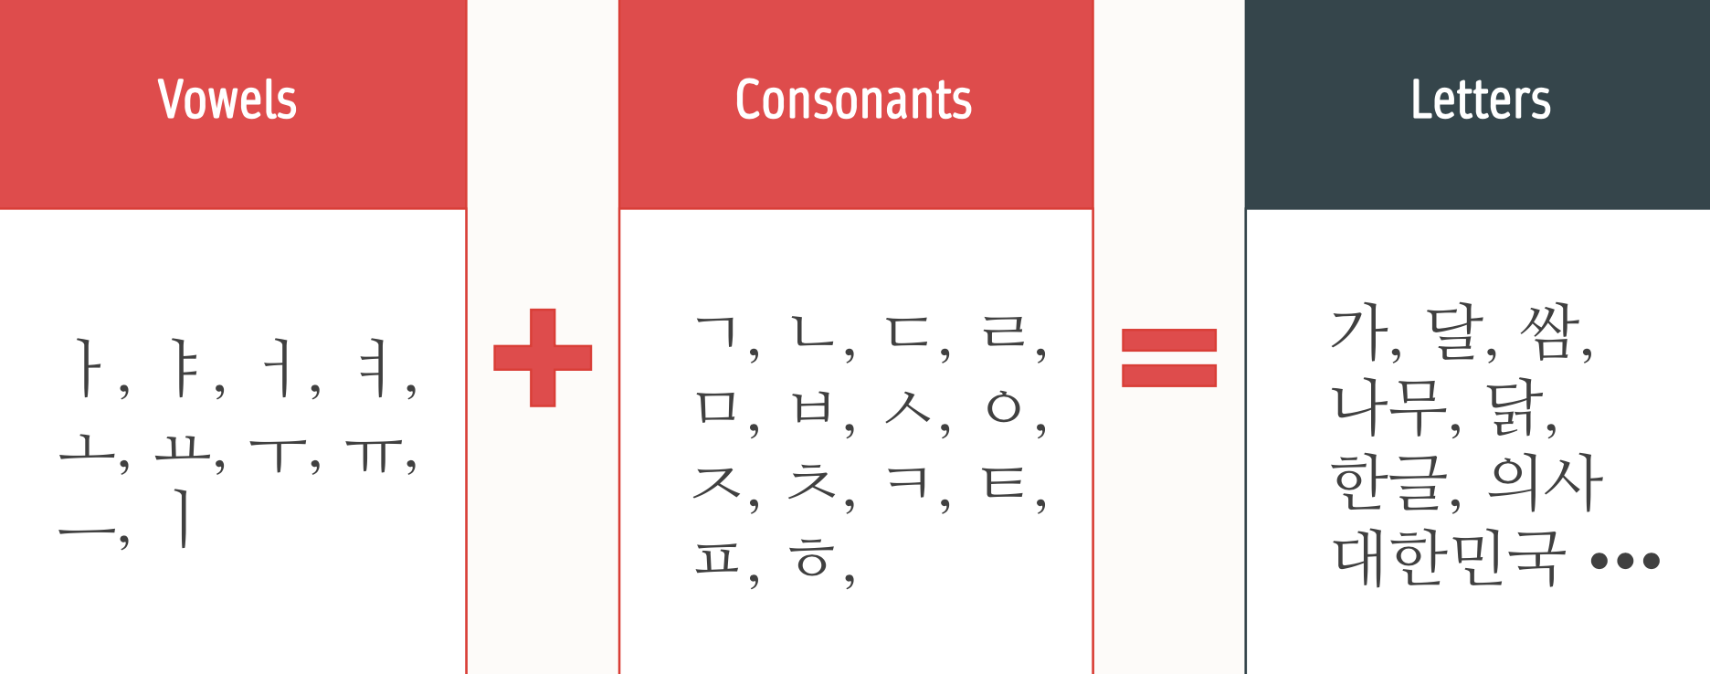
About hangeul

Slide 9
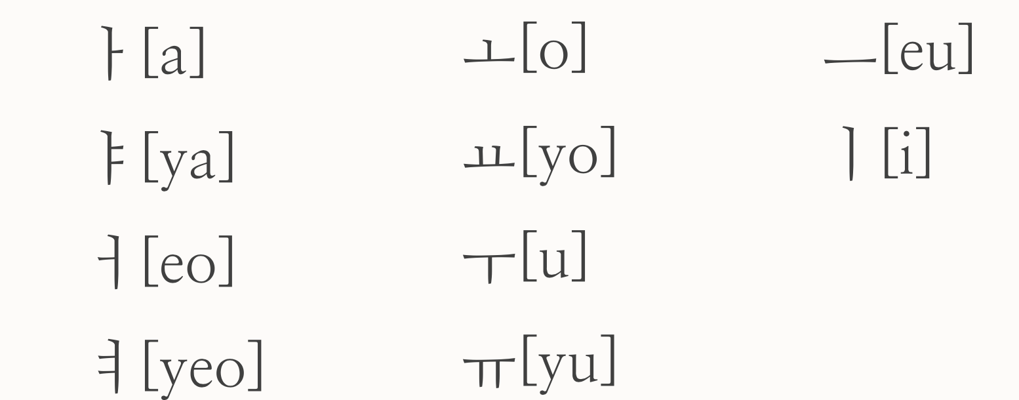
Vowels [모음:mo eum]
Basic vowels

Slide 10
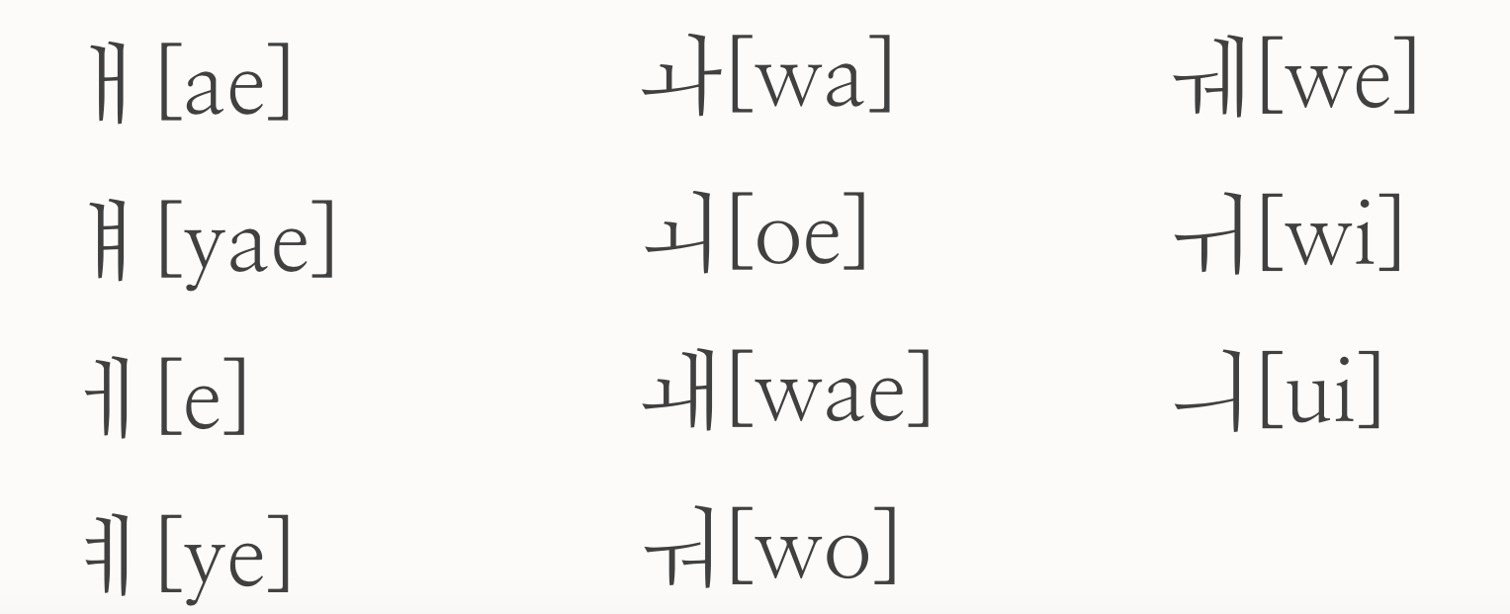
Vowels [모음:mo eum]
Combined Vowels

Slide 11
Combined vowels
ㅐ [ae] =ㅏ+ㅣ ㅘ [wa] =ㅗ+ㅏ ㅞ [we] =ㅜ+ㅔ
ㅒ [yae] =ㅑ+ㅣ ㅚ [oe] =ㅗ+ㅣ ㅟ [wi] =ㅜ+ㅣ
ㅔ [e] = ㅓ+ㅣ ㅙ [wae] =ㅗ+ㅐ ㅢ [ui] =ㅡ+ㅣ
ㅖ [ye] =ㅕ+ㅣ ㅝ [wo] =ㅜ+ㅓ

Slide 12
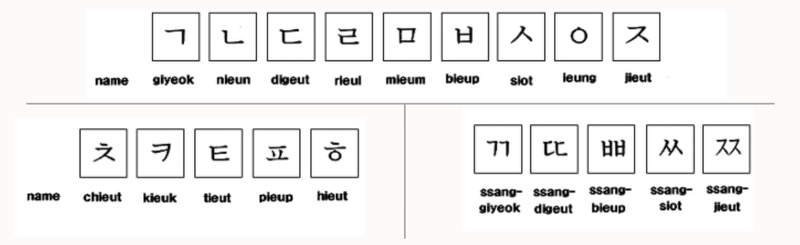
Consonants [자음:ja eum]

Slide 13
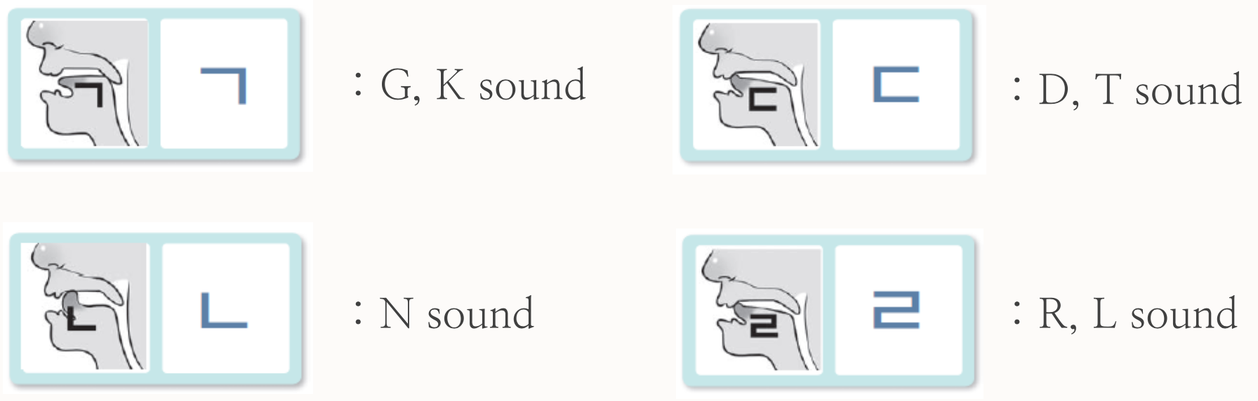
Consonants [자음:ja eum]
Let’s learn how to write and make sounds of consonants

Slide 14
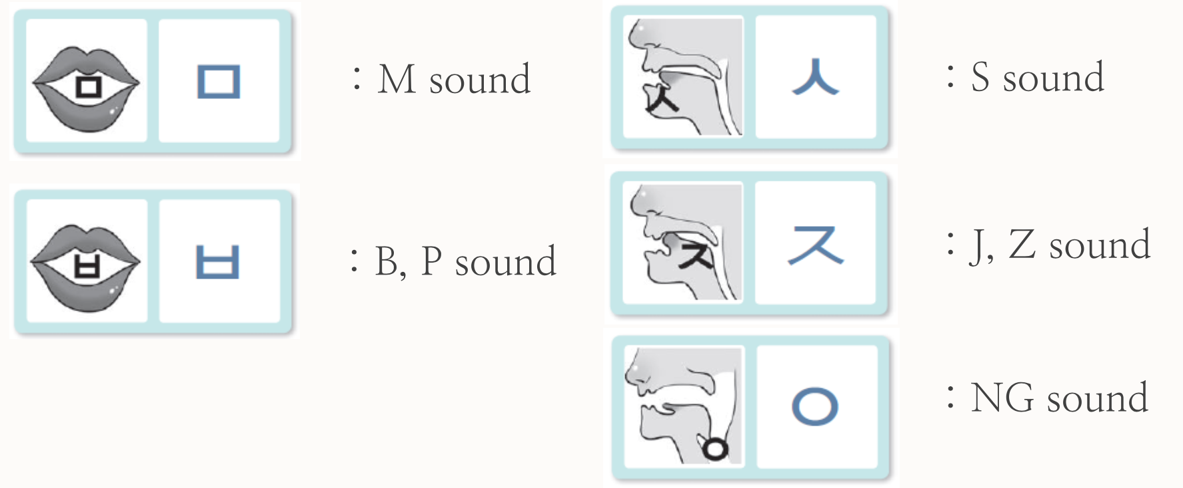
Consonants [자음:ja eum]
Let’s learn how to write and make sounds of consonants

Slide 15
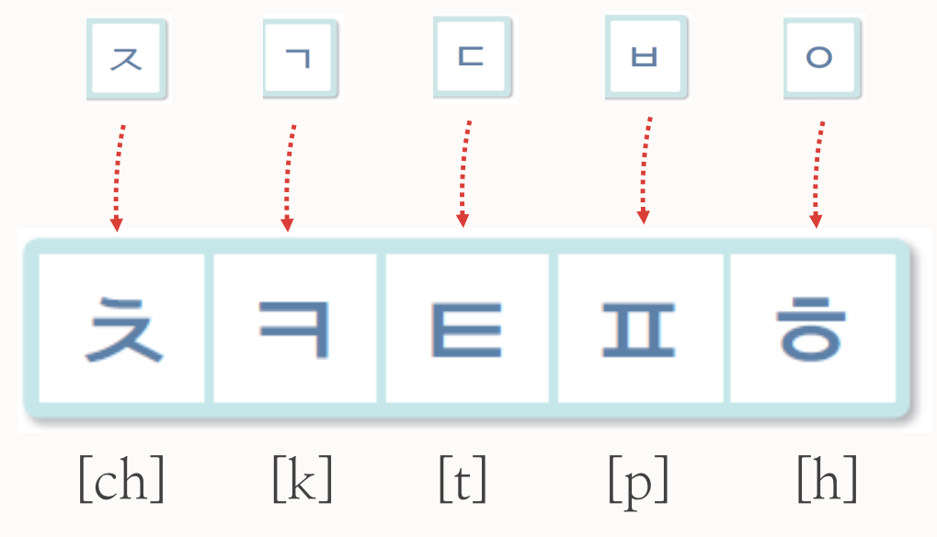
Consonants [자음:ja eum]
Let’s learn how to write and make sounds of consonants
These consonants let out a lor of air when pronounced

Slide 16
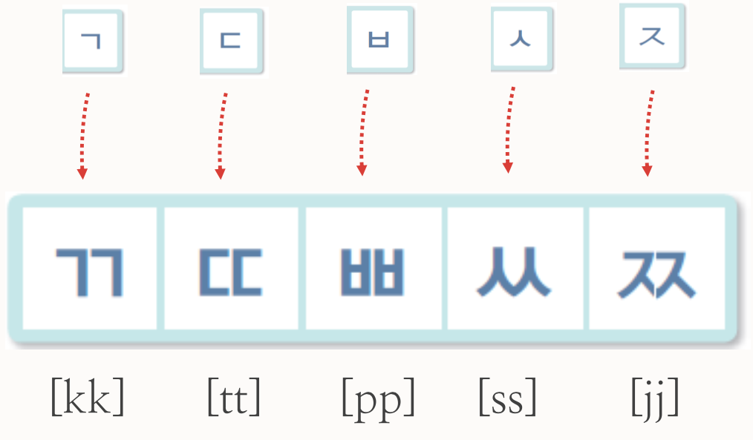
Consonants [자음:ja eum]
Let’s learn how to write and make sounds of 쌍자음 [ssang:jaeum]
These consonants let out no air when pronounced

Slide 17


Today’s k-pop
Let’s watch video!
https://youtu.be/nM0xDI5R50E
BBIBBI - IU

Slide 18

Thank you

