Slide 1
Korean class
Week 5

Slide 2
index
Postpositional Particles
Future expression
Review
Korea’s Culture

Slide 3
Postpositional particles – object marking
을[eul] / 를[leul]
Words ending with a consonant + -을
Words ending with a vowel + -를

Slide 4
Example
거울[geo-ul] + 을[eul]
=mirror
나무[na-mu] + 를[leul]
=tree
나[na] + 를[leul]
=me
기차를 봐요 ! [gi-cha-leul bwo-yo] = Look at the train !
=train

Slide 5
rEVIEW - Postpositional particles
은 [eun] / 는 [neun]
이[i] / 가[ga]
-----> Subject marker
을[eul] / 를[leul]
-----> Object marker

Slide 6
practice - Postpositional particles
1. 나 / 피자 / 좋아해요
I like pizza
---> 나는 피자를 좋아해요

Slide 7
practice - Postpositional particles
2. 저 / 한국어 / 공부해요
I study korean
---> 저는 한국어를 공부해요

Slide 8
practice - Postpositional particles
3. 저 / 사과 / 먹어요
I eat apple
---> 저는 사과를 먹어요

Slide 9
Future expression
If you want to make a future expression,
add –ㄹ 거야/거다 to verb’s ending
[geo-ya / geo-da]
= will

Slide 10
Future expression
가다[ga-da]= go
Verb stem
+
=
Future
tense
-ㄹ거다
[geo-da]
가
[ga]
갈 거다
[gal-geo-da]

Slide 17
Future expression dialogue
Jeonghyeon : 너 내일 뭐해?
[neo-nae-il mwo-hae?]
=What will you do tomorrow?
Seryeong : 나 내일 프라하 갈 거야.
[na nae-il peu-ra-ha gal-geo-ya]
=I will go Prague tomorrow.

Slide 18
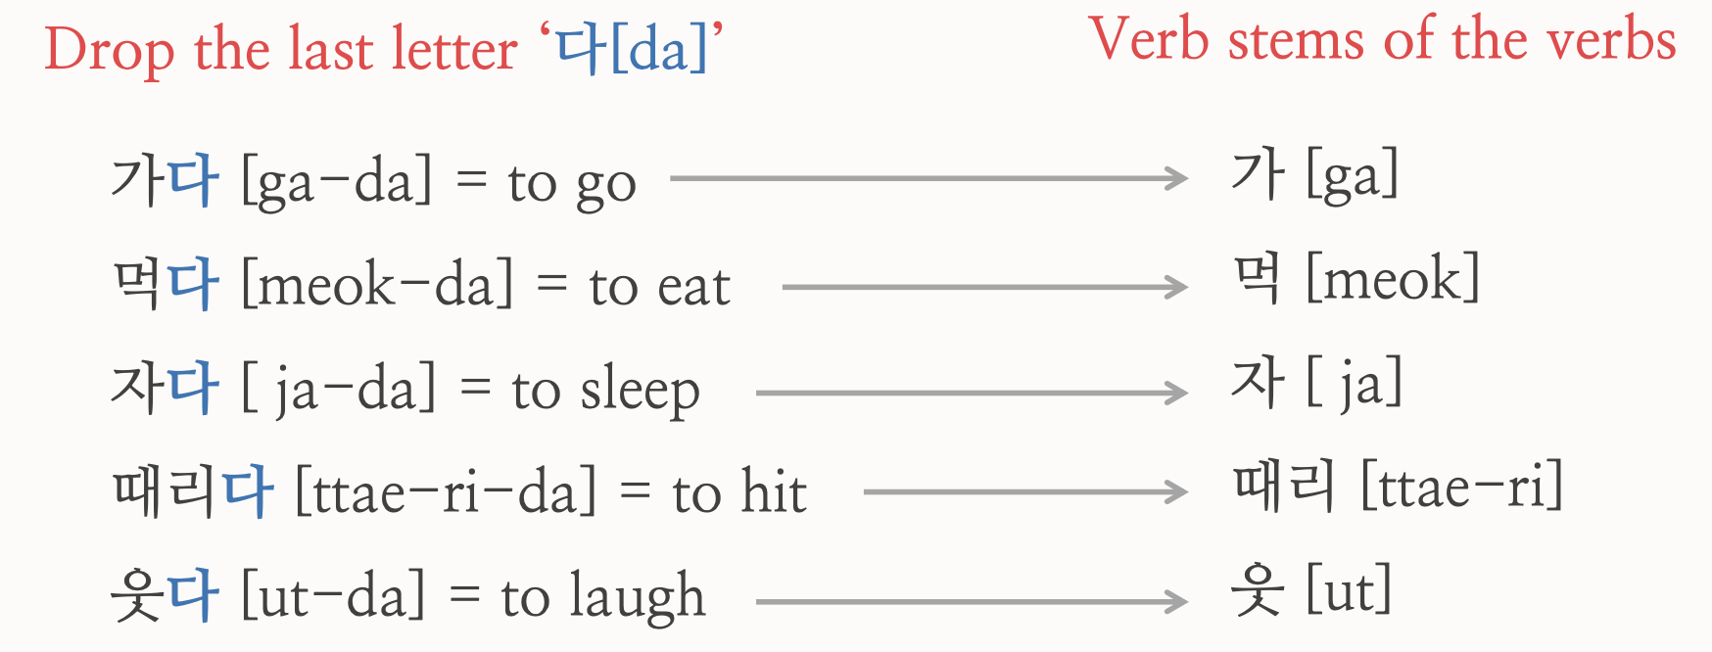
rEVIEW - past expression
.
Present sentence

Slide 19
Past expression
1. Verb stems ending with vowels ᅩ [o] or ᅡ [a] + 았어요 [ass-eo-yo]
2. Verb stems ending with vowels OTHER THAN ᅩ or ᅡ + 었어요 [eoss-eo-yo]
3. Verb stem 하 + 였어요 [yeoss-eo-yo]

Slide 20
sentence practice

Slide 21
Thank you

