Slide 1
Korean class
WEEK 9

Slide 2
Index
The sentence final ending
Numbers
Vocabulary
Korean culture

Slide 3
The sentence final ending
Four speech level: the speaker’s interpersonal relationship with addresses or attitude toward them
  ex) social meaning such as intimacy ad formality of the situation

Slide 4
The sentence final ending
정현이는 피자를 먹어요 ( Jeonghyeon eats pizza )
어제 점심에는 케밥을 먹었어! ( I ate kebab for yesterday lunch!)
오늘 저녁은 뭘 먹습니까? ( What will we gonna eat for dinner? )
오늘 저녁은 비빔밥을 먹자 ( Let's eat bibimbap for dinner tonight)

Slide 5
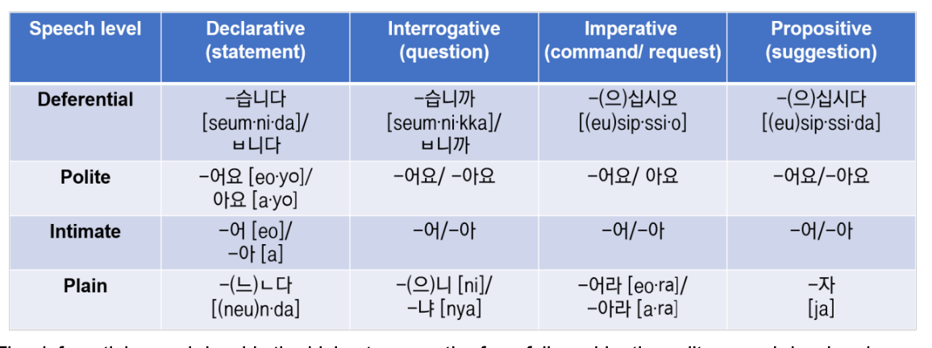
The sentence final ending

Slide 6
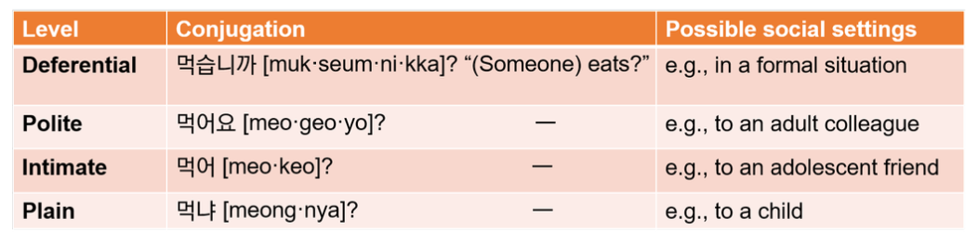
The sentence final ending

Slide 7
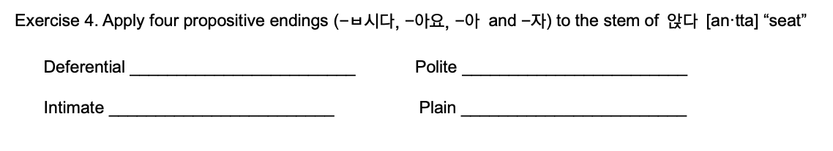
The sentence final ending

Slide 8
The sentence final ending
먹다 (eat) {meok-da}
읽다 (read) {ik-da}
마시다 (drink) {ma-si-da}
가지다 (have, get) {ga-ji-da}
쓰다 (use, write) {sseu-da}

Slide 9
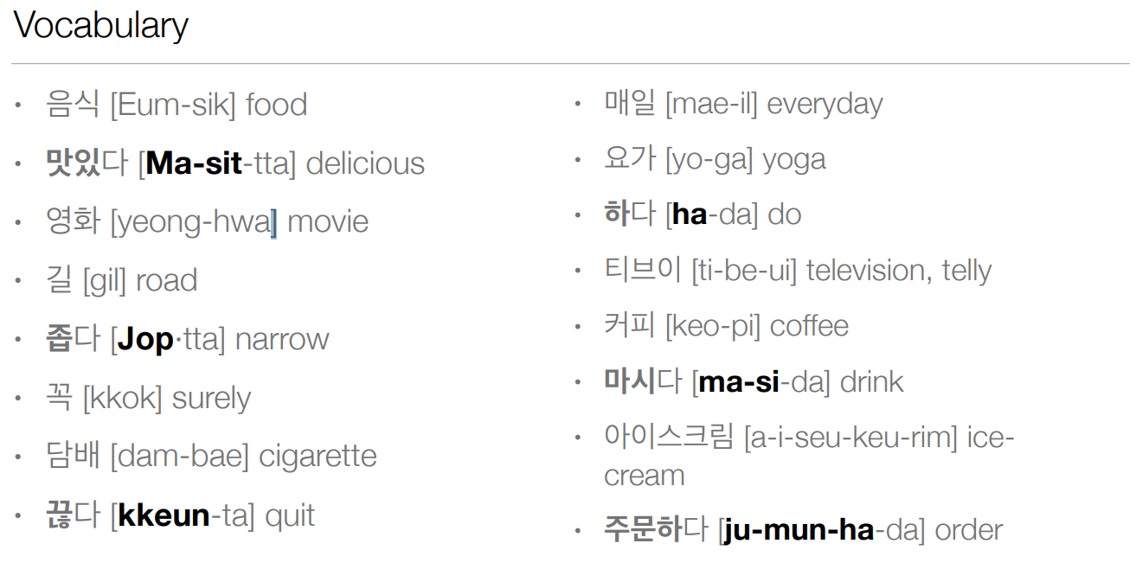

Slide 10
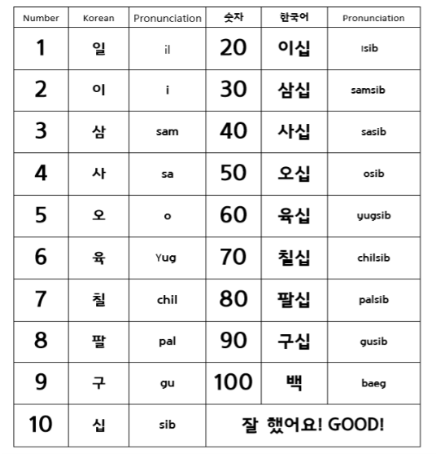
Chinese number
0 : 영 [yeong] / 공 [gong]
22
78
141
300
이십이 [i-sib-i]
칠십팔 [chil-sib-pal]
백사십일 [baek-sa-sib-il]
삼백 [sam-baek]

Slide 11
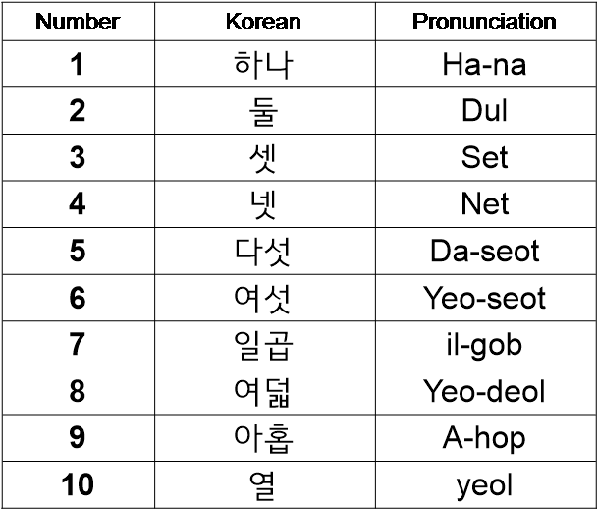
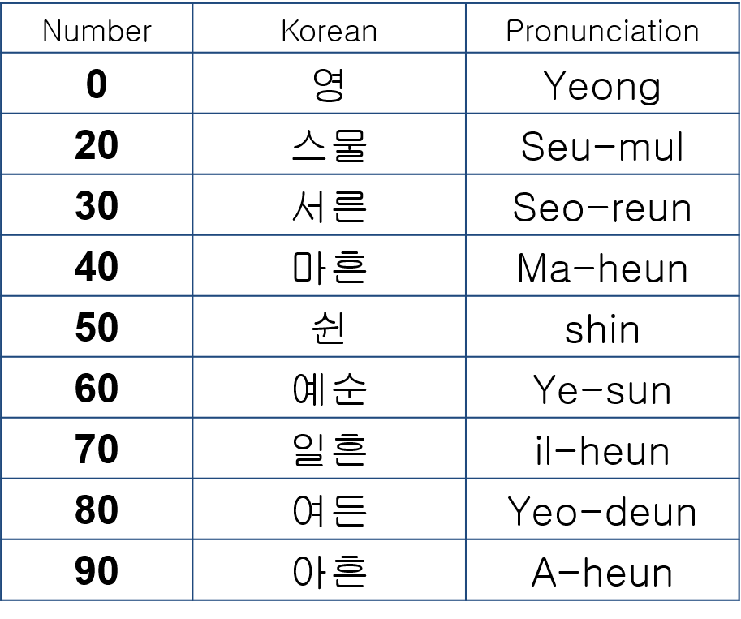
2. Korean number

Slide 12
Chinese number
Counting number
Date : day (일 [il]) , month (월 [wol]) , year (년[nyeon])
  ex) 4th : 사일[sa-il], 12nd : 십이일[sib-i-il]
Phone number
  ex) 010-6372-0819 / 776-079-455
2. Korean number
Counting number
Counting age
Counting materials (paper, piece, things, etc)
-Time

Slide 13
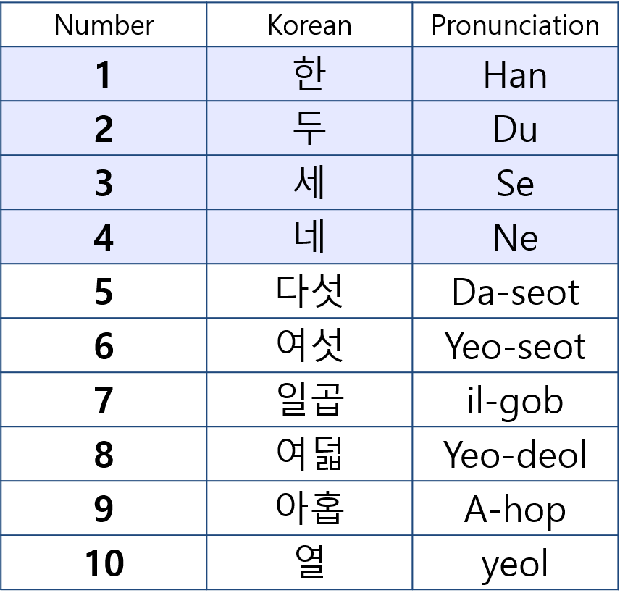
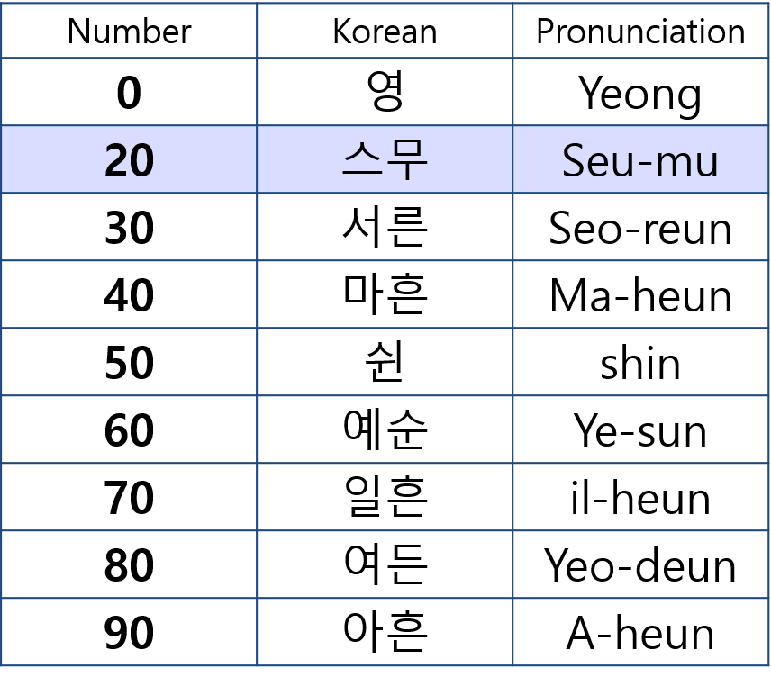
2. Korean number (when counting materials)

Slide 14
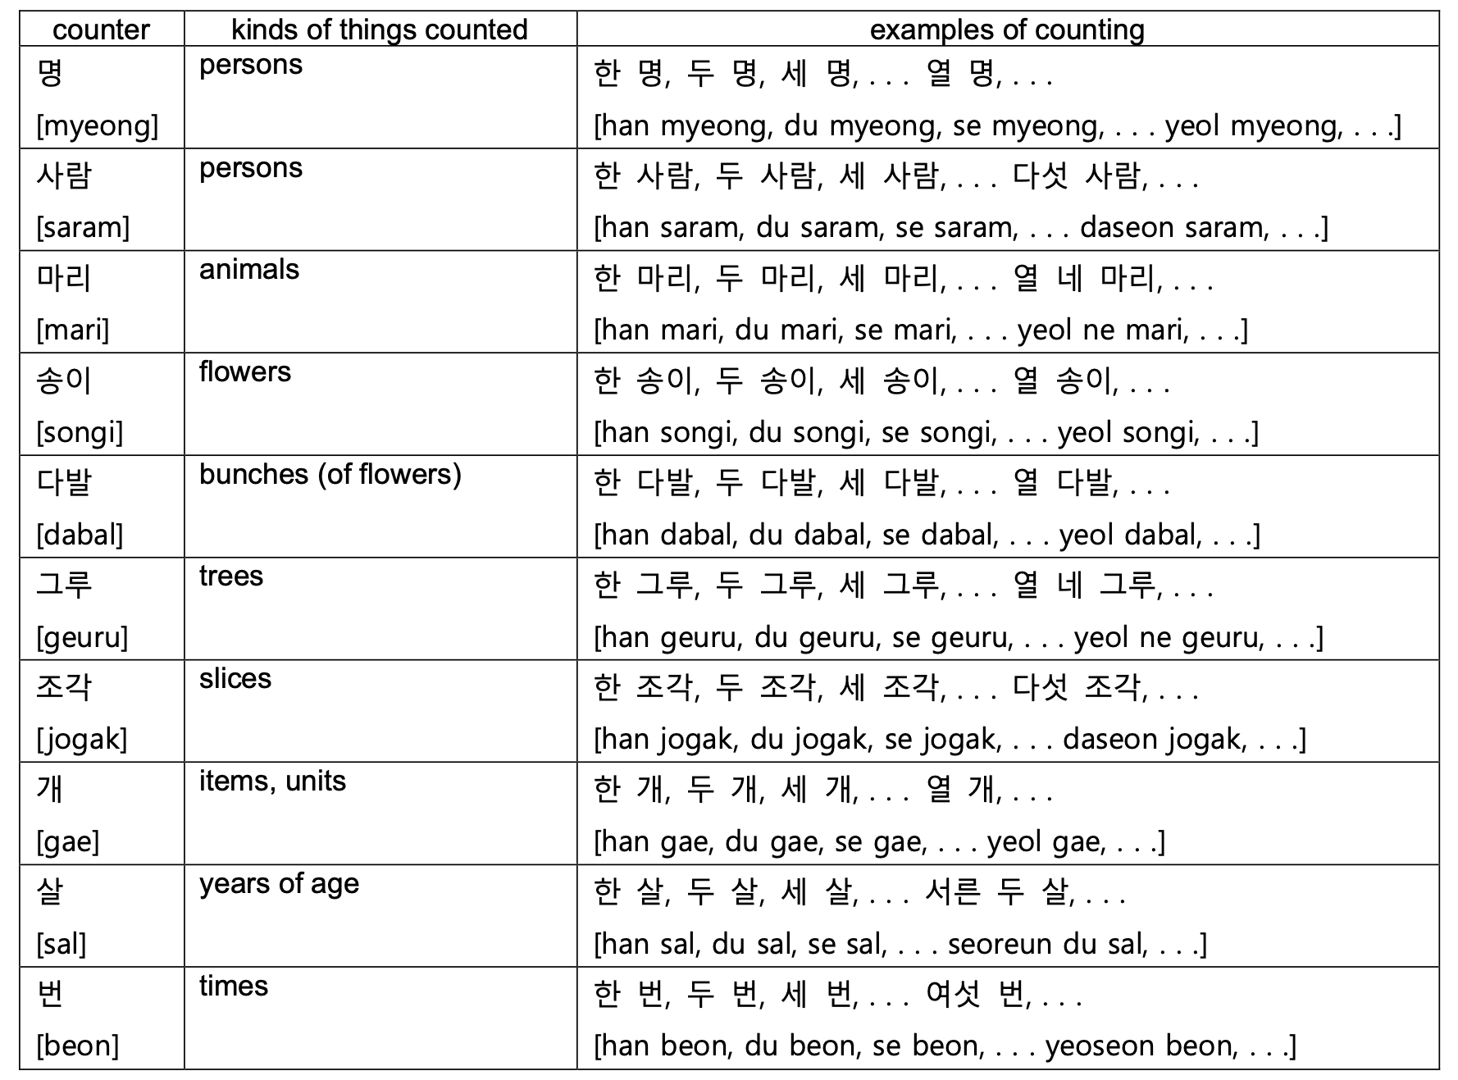

Slide 15
1 years old : 한 살 [han-sal]
2 years old : 두 살 [du-sal]
3 years old : 세 살 [se-sal]
4 years old : 네 살 [ne-sal]
20 years old : 스무 살 [seu-mu-sal]
Q. How old are you? 너 몇 살이야? [neo myeot-sal-i-ya?]
A. I’m 22 years old. 나는 스물 두살이야. [na-neun seu-mul-du-sal-i-ya.]

Slide 16
1 thing : 한 개 [han-gae]
2 things : 두 개 [du-gae]
3 things : 세 개 [se-gae]
4 things : 네 개 [ne-gae]
20 things : 스무 개 [seu-mu-gae]
Two apples please : 사과 두 개 주세요. [sa-gwa du-gae ju-se-yo.]
How much is four chocolates? : 초콜릿 네 개 얼마예요? [cho-kol-lit ne-gae eol-ma-ye-yo?]

Slide 17
Koreans use native Korean numbers for
시[si] “o’clock”
분[bun] “minutes”
초[Cho] “seconds”
For A.M
오전[ojeon] “before noon”
아침[achim] “morning”
For P.M
오후[ohu] “afternoon,”
저녁[jeonyeok] “evening,”
밤[bam] “night”
To say half past, you can either say
1) “삼십 분[samsip bun]”
2)반[ban], meaning “a half”

Slide 18
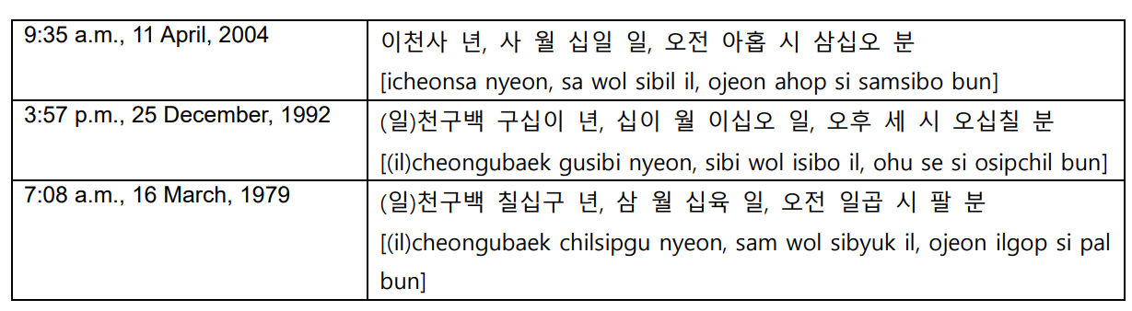

Order of Korean number
Koreans give dates starting from the largest unit to the smallest
This is the opposite of the English expression
Ex) “2:19 p.m., 18 May, 1970”
“(일)천구백 칠십년 오월 십팔일,오후 두 시 십구 분”
[(il)cheongubaek chilsimnyeon owol sipparil, ohu du si sip gu bun]

Slide 19
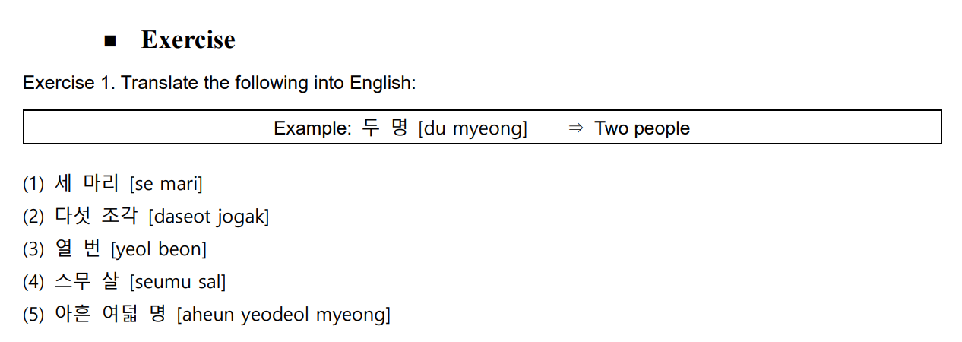
Practice

Slide 20
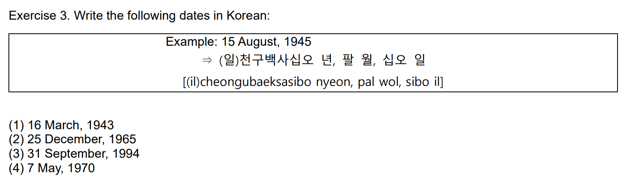
Practice

Slide 21
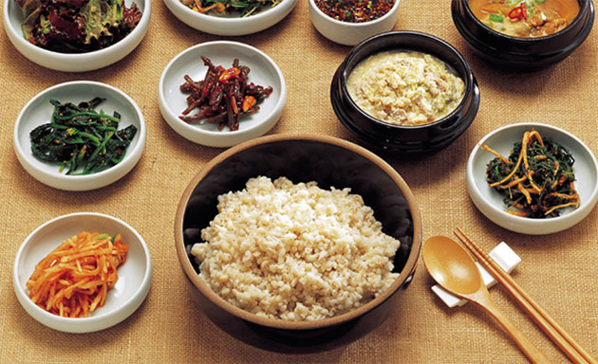
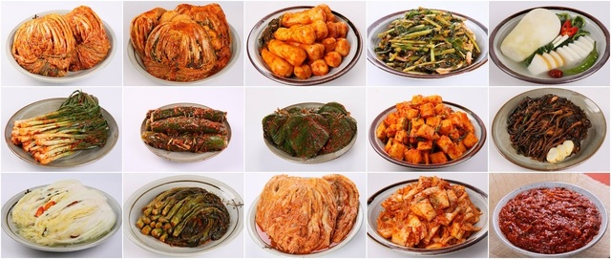
Korean culture - food

Slide 22
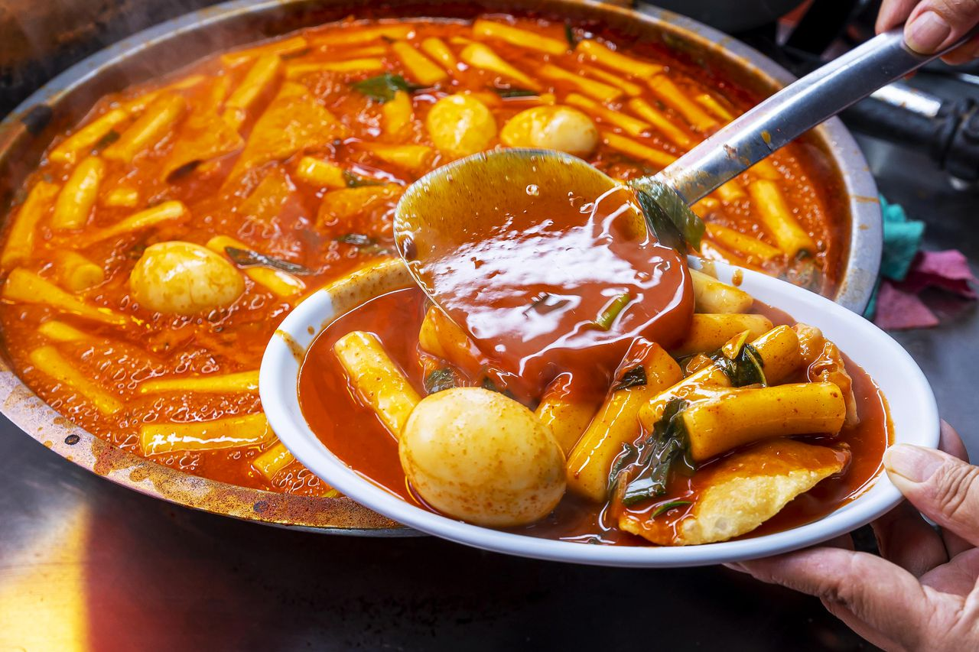
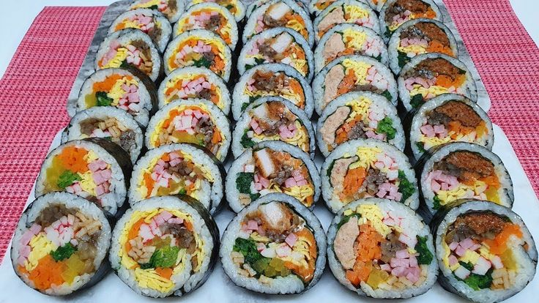
Korean culture - food
떡볶이 (tteok-boki) 김밥(gim-bap)

Slide 23
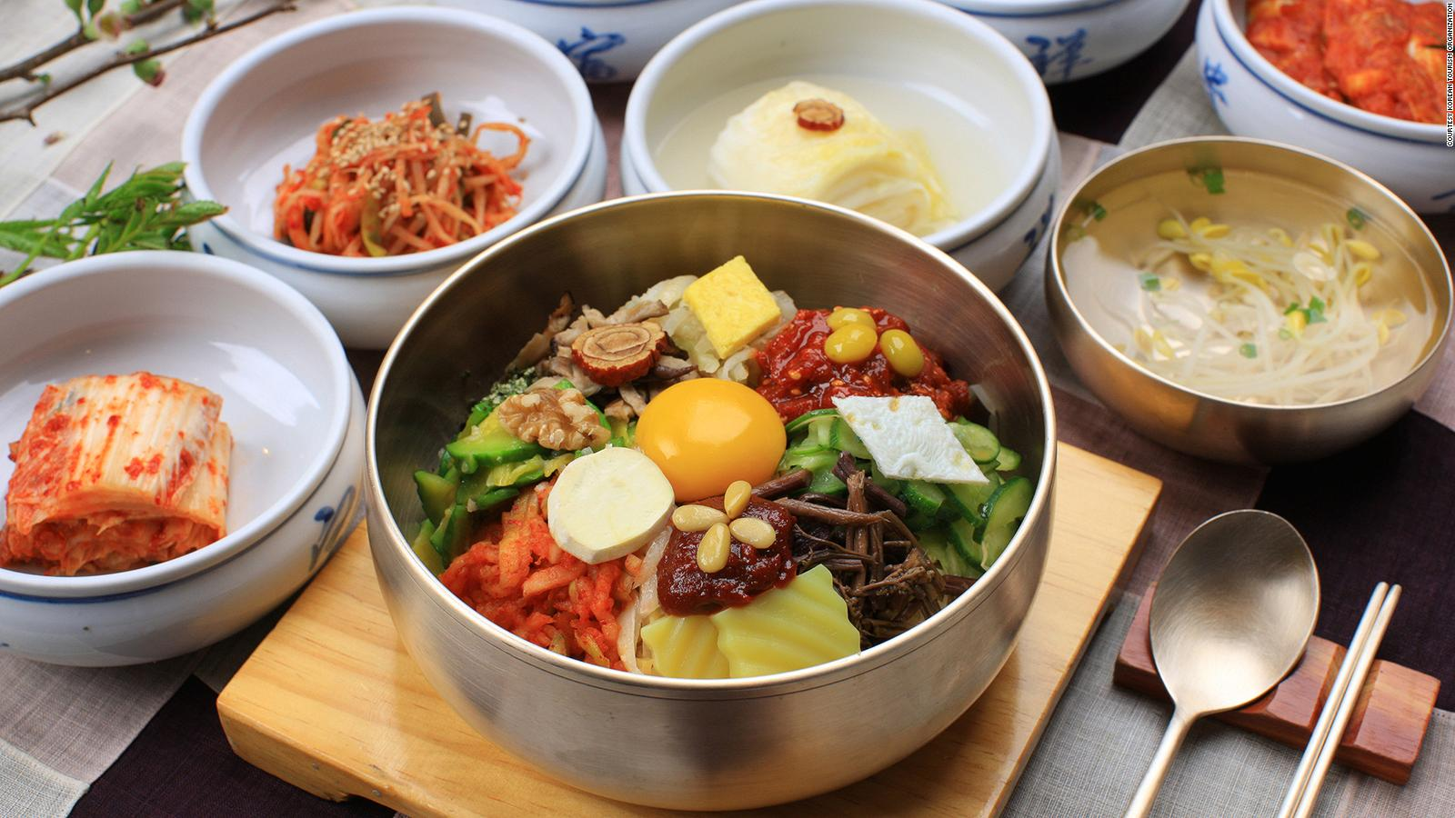
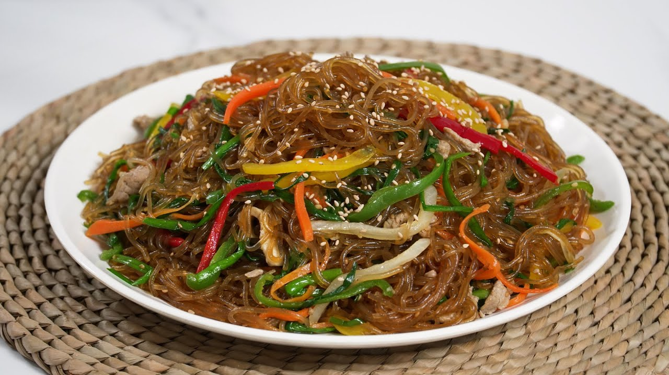
Korean culture - food
비빔밥 (bibimbap) 잡채 (japchae)

Slide 24

Thank you

