Slide 1
SOME FEATURES OF MONTREALIAN ACCENT
Annamária Zemanová & Catherine Girard
AJL22093

Slide 2
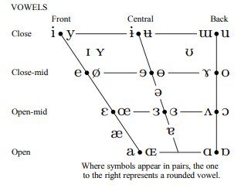

CANADIAN RAISING AND CANADIAN SHIFT
Centralization of /aɪ/ or /aʊ/ before voiceless consonants, raising the open a sound to /ɐ/, /ʌ/, or /ə/
  Example: „price“ and „clout“ but not „prize“ or „cloud“ or typical „out and about“
Merger of /ɑ/ (cot) with /ɔ/ (caught) in low back position as /ɒ/ (on)
Lowering of the tongue in the front short vowels /æ/ (trap), /ɛ/ (dress), and /ɪ/ (kit)
Notes:
IPA Chart, http://www.internationalphoneticassociation.org/content/ipa-chart, available under a Creative Commons Attribution-Sharealike 3.0 Unported License. Copyright © 2018 International Phonetic Association.

Slide 3
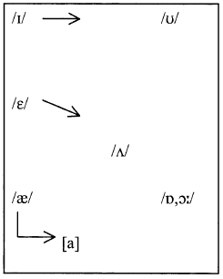
CANADIAN SHIFT IN MONTREAL
According to Boberg‘s 2005 study
  The Canadian Shift, or something very similar to it, is active in Montreal, but its phonetic character is not identical with the version of the Shift reported for Ontario English
  The retraction of /ɛ/ is the most active part of the Canadian Shift in Montreal
  The Shift is somewhat influenced by gender and age of the speakers

Slide 4
DISTINCTIVE MONTREALIAN FEATURES
Among young Canadian women in particular, the pronunciation of /ɛ/ is sometimes low enough to produce potential confusion with /æ/, at least when taken out of context
  left, bet → laughed, bat
Vowel sounds before intervocalic /r/
  Resistance to „merry-marry“ merger
  Mary vs merry vs marry

Slide 5
CULTURAL INFLUENCES
Communities (Italian, Jewish, British)
Surrounded by French
Local vs. Global prestige

Slide 6
RESOURCES
Boberg, C. (2005). The Canadian shift in Montreal. Language Variation and Change, 17(2), 133-154. https://doi.org/10.1017/S0954394505050064
Kelly, J. (2014, February 22). The quest for the Montreal English accent [Radio broadcast]. CBC, https://www.cbc.ca/player/play/2442617322?fbclid=IwAR05Iy6oPC7EjmT6lGr3jopMjEIdYjaCisPGFAFJ0-dR-cuAEeokOps-IOc
Labov, W., Ash, S., & Boberg, C. (2006). The Atlas of North American English. Berlin: Mouton-de Gruyter.

Slide 7
Q&A

