Slide 1
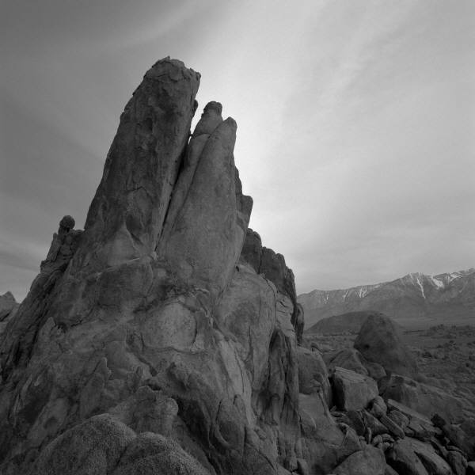
November lights
The torchlight and candlelight season in 13 slides.

Slide 2
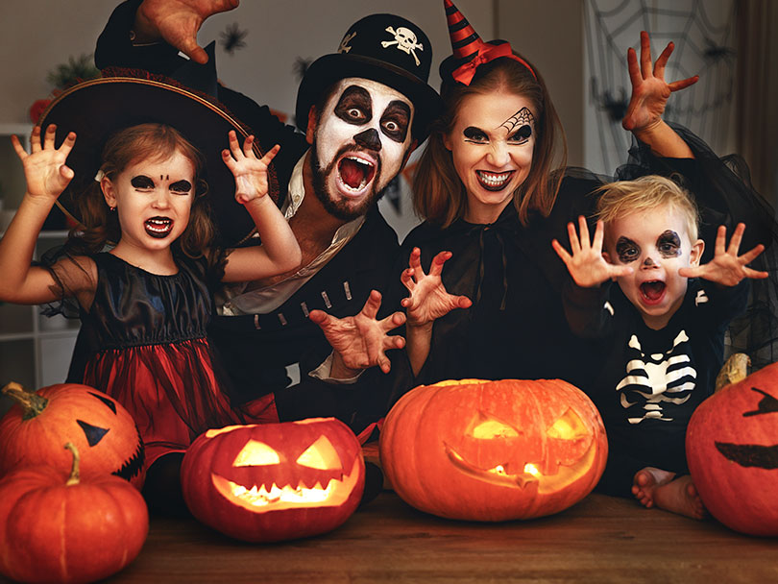
Halloween

Slide 3
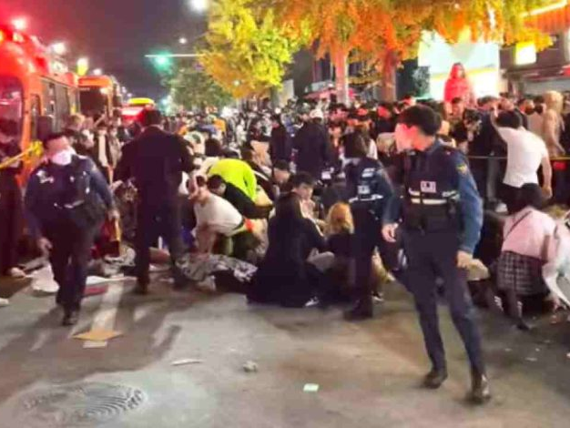
… can also turn out like this.

Slide 4
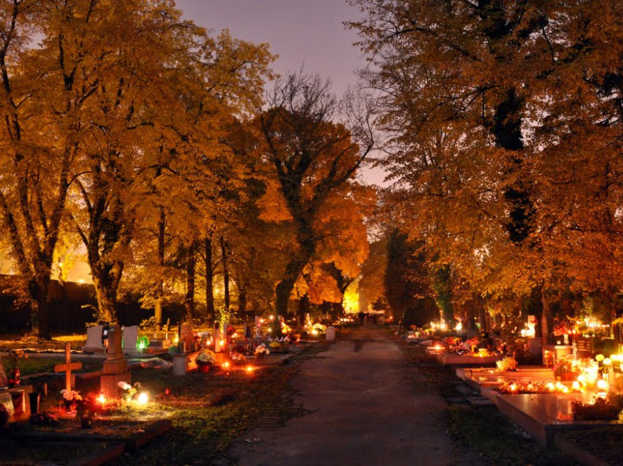
Nov. 1+2: All Saints and All Souls Day

Slide 5
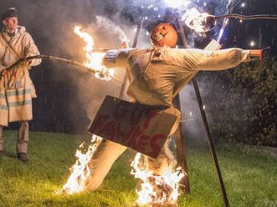
Guy Fawkes Night

Slide 6
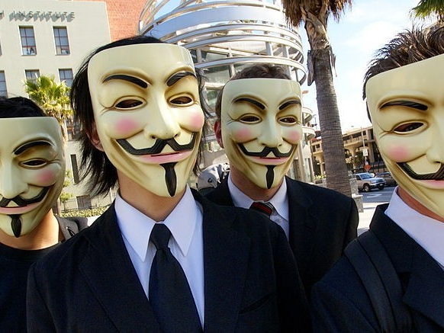
the Anonymous (V for Vendetta)

Slide 7

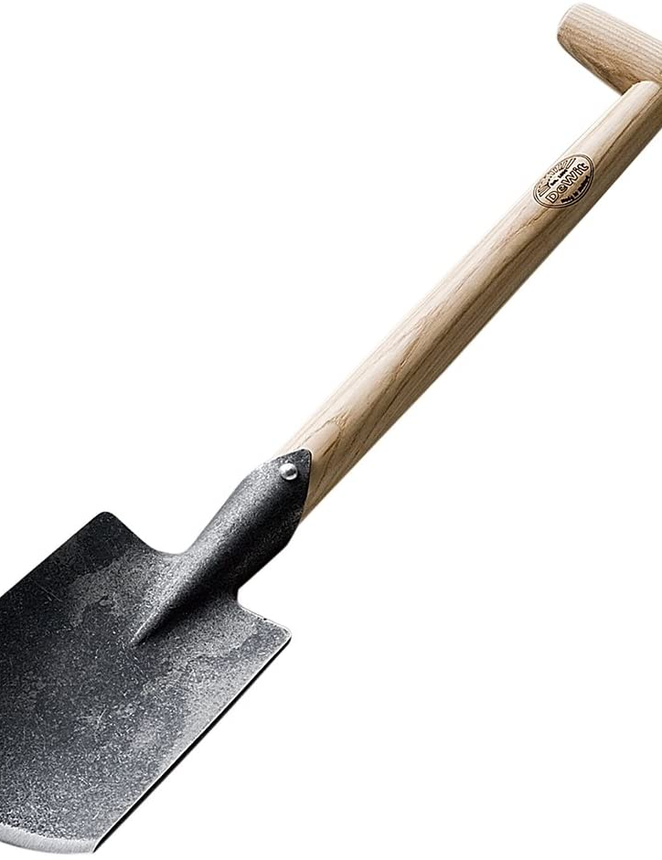
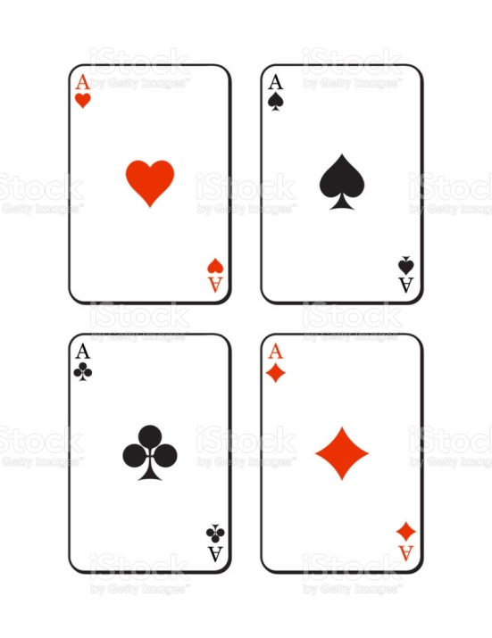
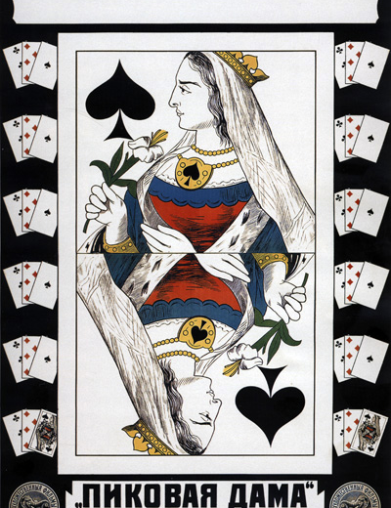
SHOVEL
SPADE
HEARTS, SPADES, CLUBS AND DIAMONDS
QUEEN OF SPADES

Slide 8
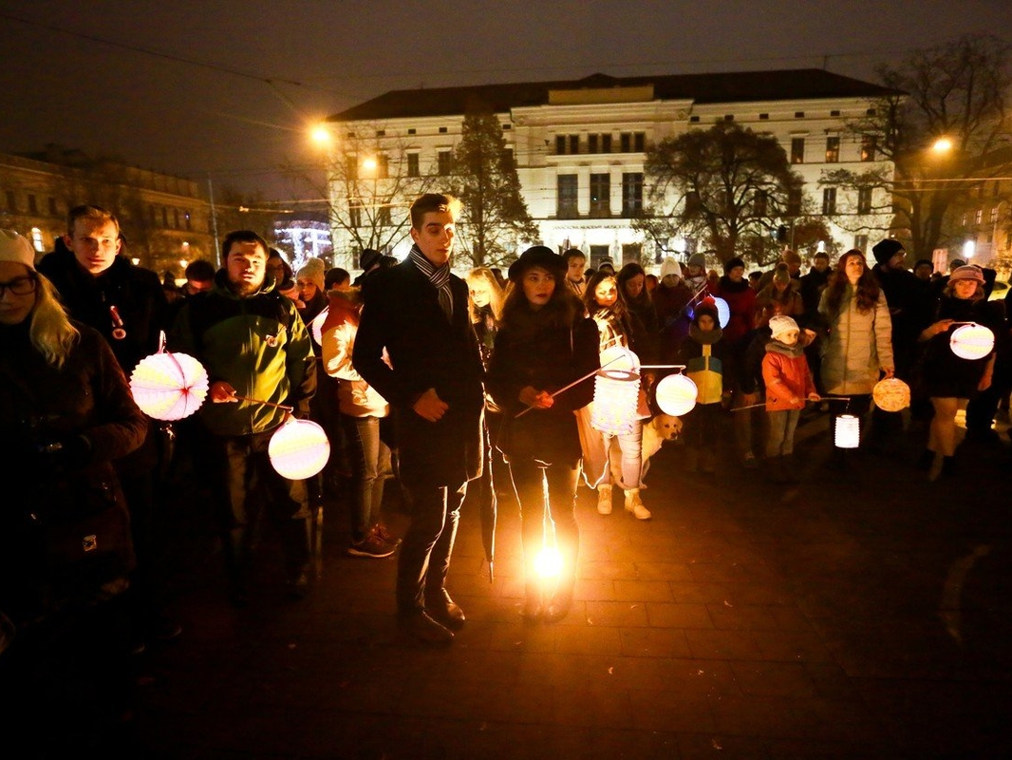
The October Revolution torchlight parade

Slide 9

Why Is Veterans Day Important? - YouTube

Slide 10
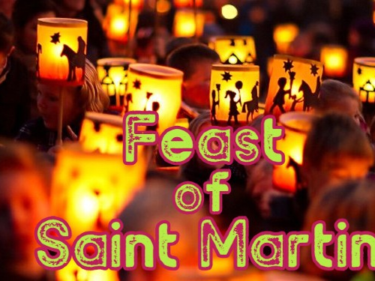
Ich geh mit meiner Laterne - Laternenlieder | Kinderlieder deutsch - Sankt Martin Lied - YouTube

Slide 11
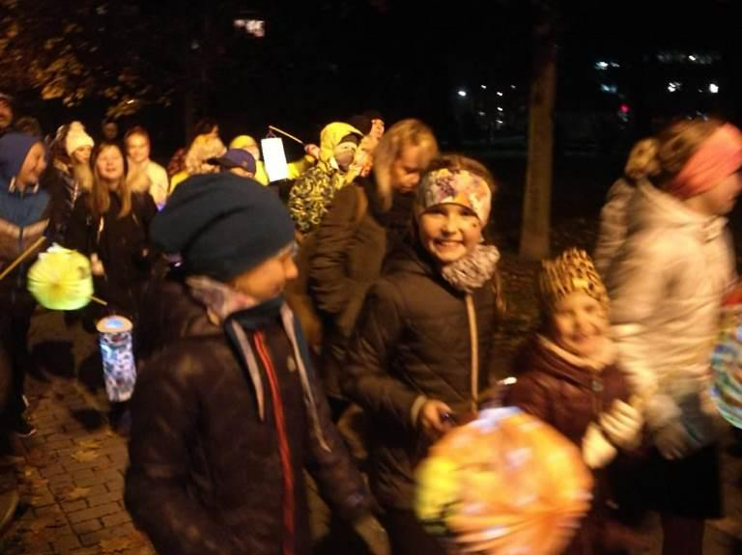
The Velvet Revolution, 1989

Slide 12
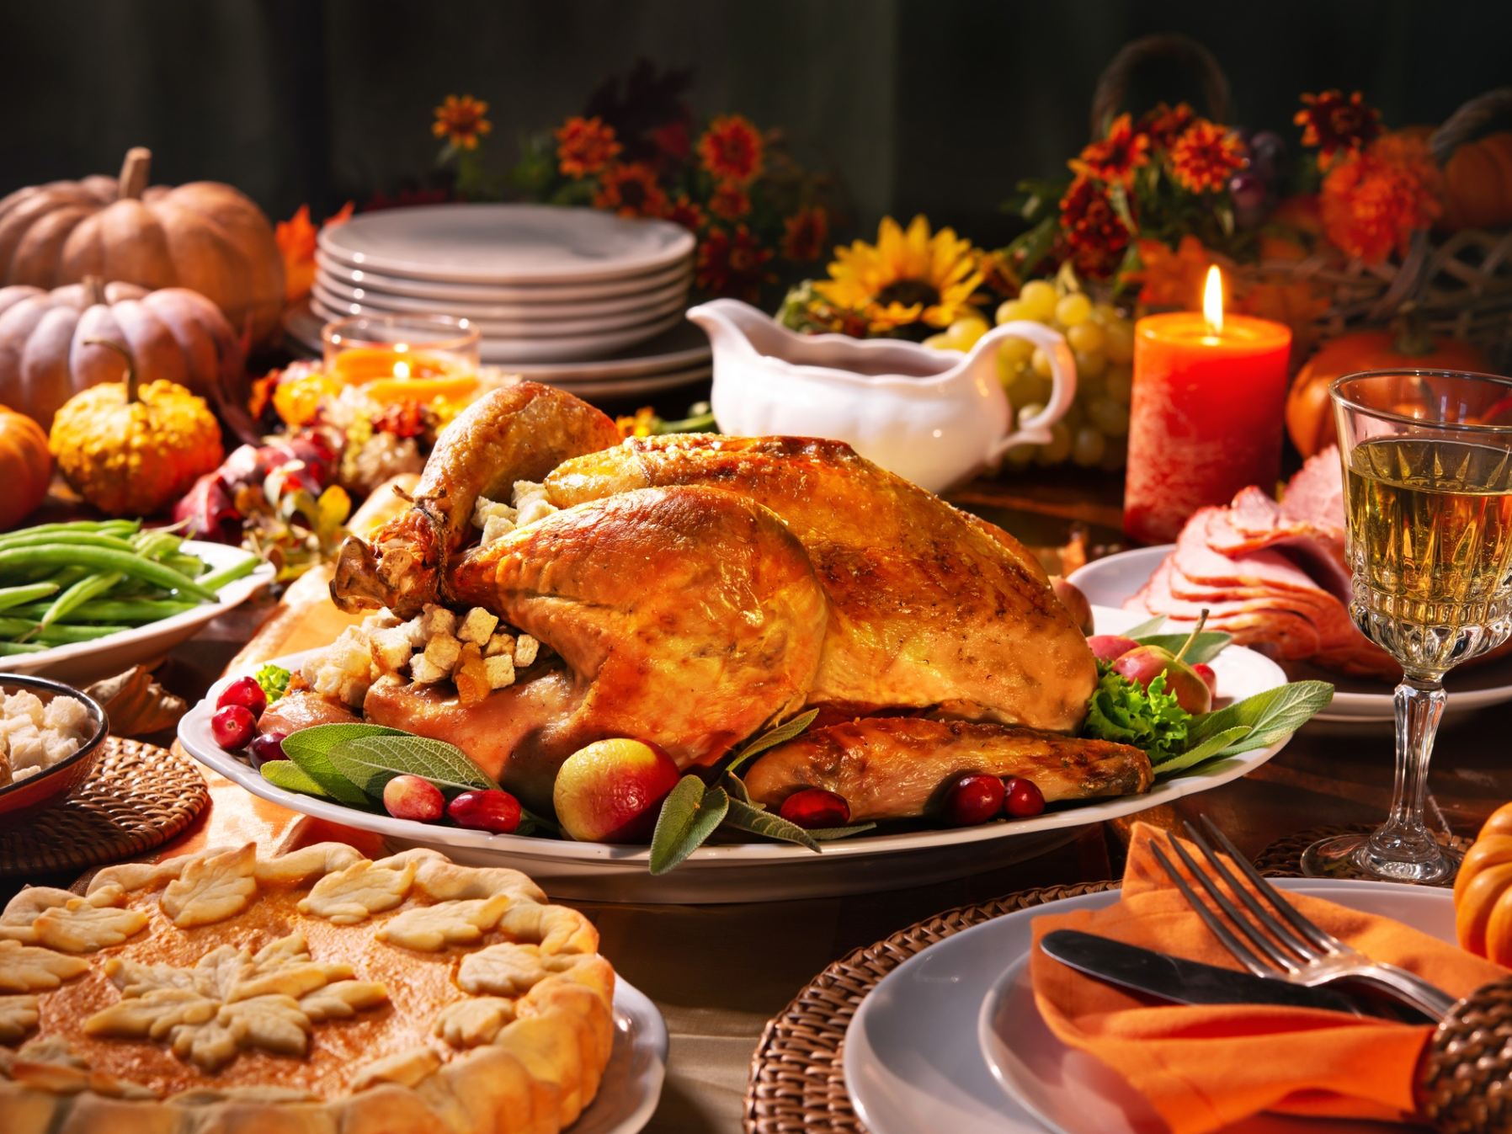
Thanksgiving Day A Thanksgiving Miracle - SNL - YouTube

Slide 13
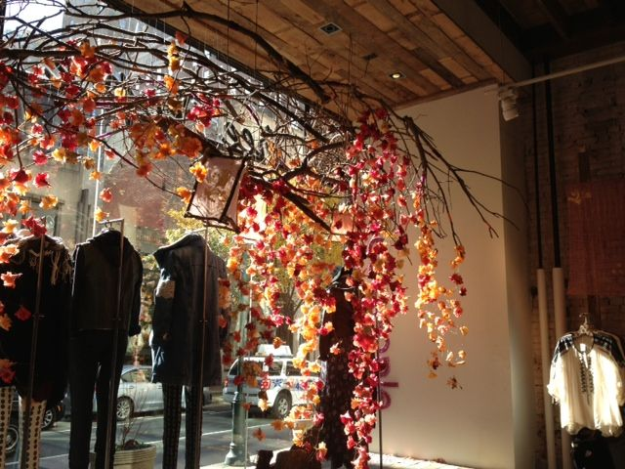
Be thankful! *** Thank you.

